Slide 1
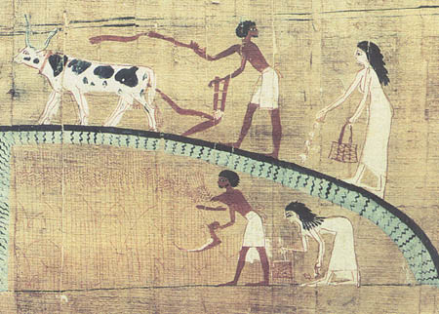
Creativity Begins to Flow
Civilization

Slide 2
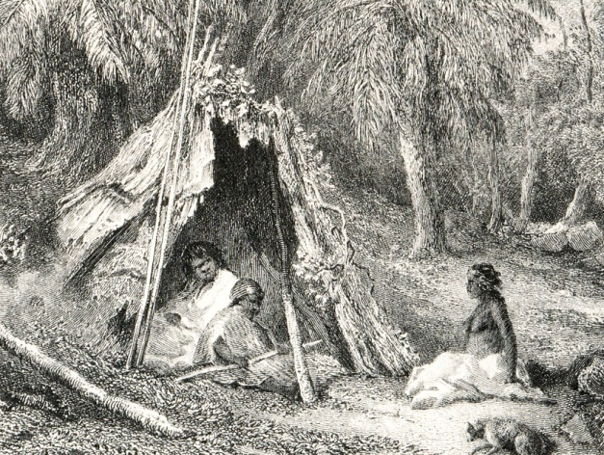
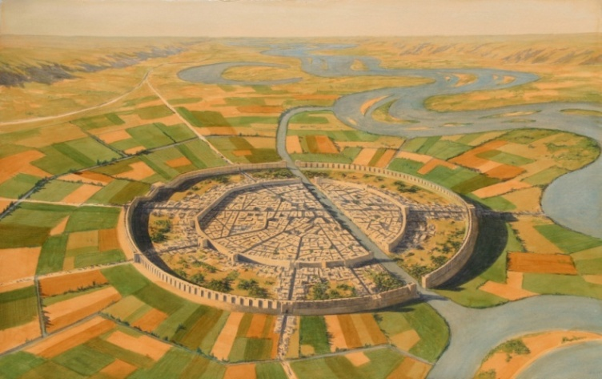
Basic changes Hunter-Gatherers to Civilization
Hunter-Gatherers
Civilization
Small units (family or expanded families)
Little contact with other groups (little trade)
Advancements for personal or family use
Cities as the focus of progress
Both local and long-distance trade
Advancements for society as well as personal use

Slide 3
Hunter-Gatherer to Farmer
“Hunting and gathering is a matter of taking what nature
offers….When improved methods are applied to hunting,
the result is often just depletion of the prey…
“Agriculture consistently rewarded the creative tinkering
with high returns in the form of increased yields or
improved crops and livestock.
“Moreover, agricultural endeavors lent themselves
to creative interactions with other industries.”

Slide 4
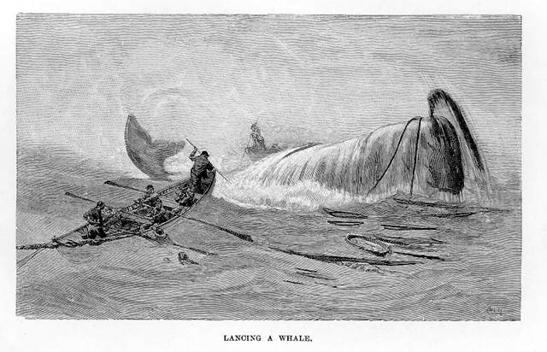
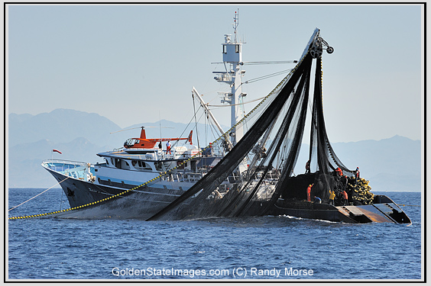
Hunter-Gatherer to Farmer
Example of modern hunter-gathering: Fishing

Slide 5
Why Man Creates The Edifice of Civilization

Slide 6
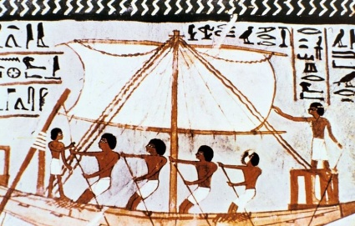
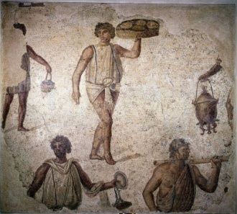
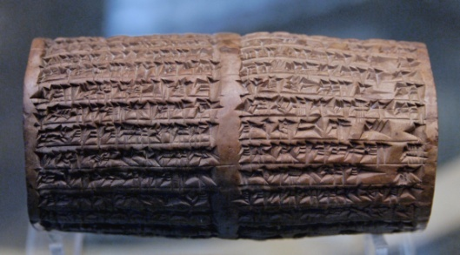
The FLOW of Civilization Essential Elements for Civilization
F
ood in abundance
from fixed location
abor specialization
rder and organization
of society
riting system
L
O
W

Slide 7
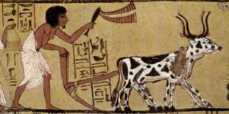
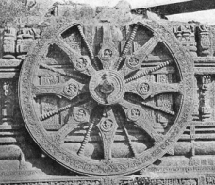
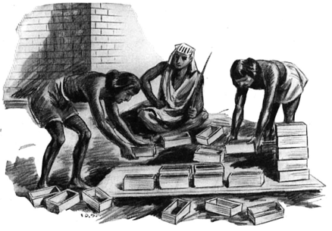
Domesticated Food
Allowed localization of population into cities
Allowed increased population density
Led to focused technological developments:
Agriculture
Plow
Wheel
Materials
development

Slide 8
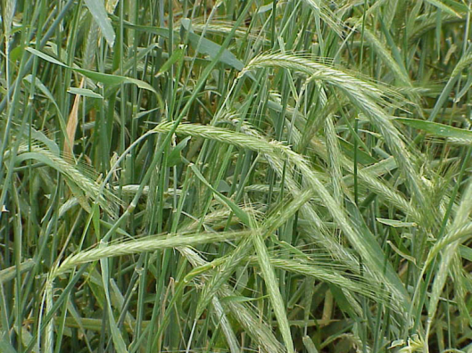
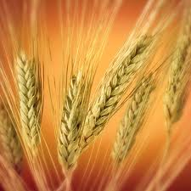
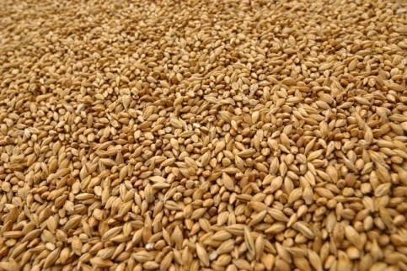
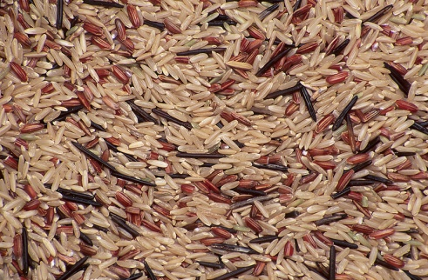
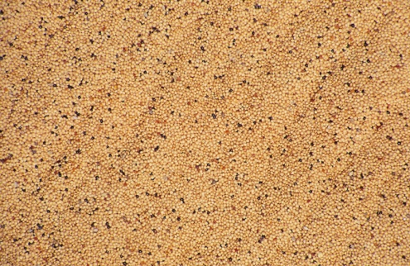
Domesticated Food
The key step was grain domestication.
56 wild grasses possible (seed size, seed retention, nutrition, storage, etc.)
32 varieties in Mediterranean Eurasia (versus 11 max elsewhere)
Hence, civilization began in the areas where grain domestication was easiest.

Slide 9
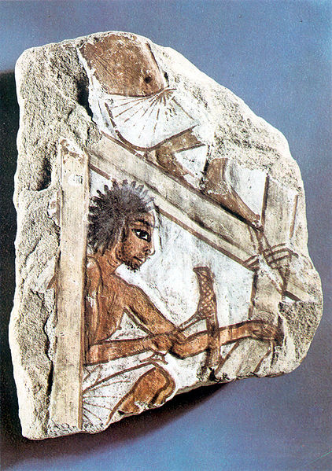
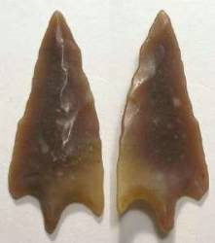
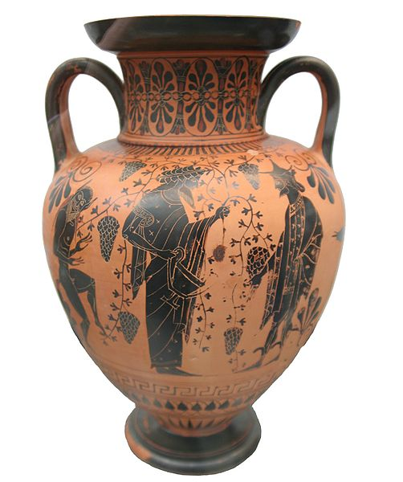
Labor Specialization
Brought Technology
Labor specialization in science, art, and business was tied to technology.
Technology and . . .
Science
Art
Business
Technology was intuitive and rarely needed science.
(Except since the 20th C.)
Techné means technology and also art in ancient Greek.
Technology helped artisans make improved products.

Slide 10
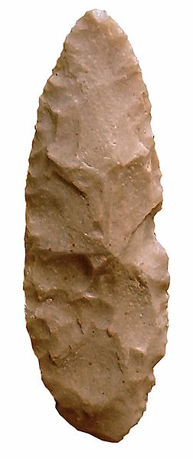
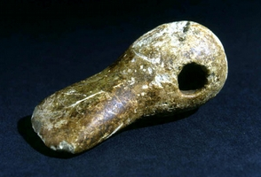
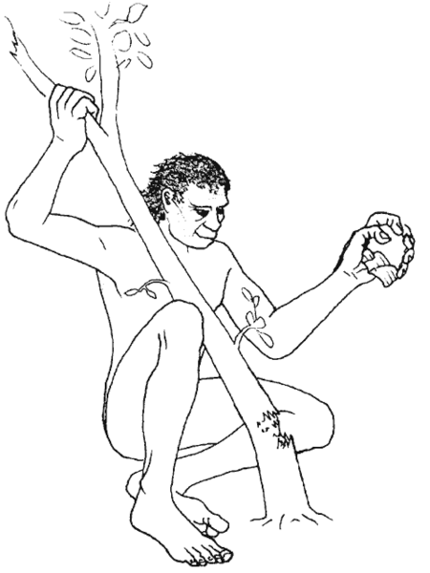
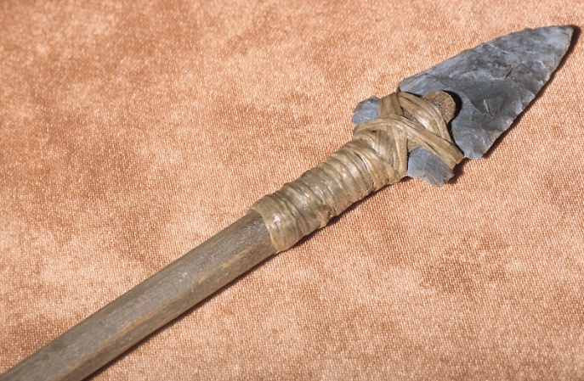
Labor Specialization
Tools
Stone Age

Slide 11
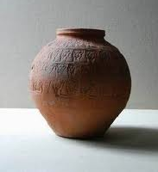
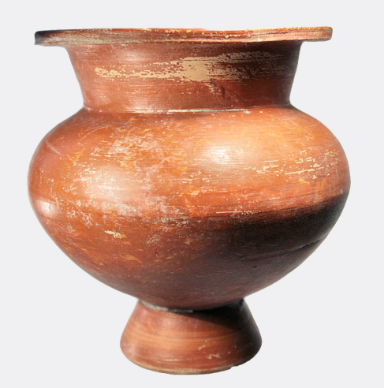
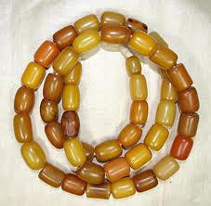
Labor Specialization
Products
Stone Age

Slide 12
Labor Specialization
Technology

Slide 13
Materials Development
Bronze: A mixture of copper and tin
How would you discover bronze?
Would you have expected bronze to be harder than copper or tin?
How would you identify tin ore?
Where would you find tin ore?
78
Hardness
48
35
Metal

Slide 14
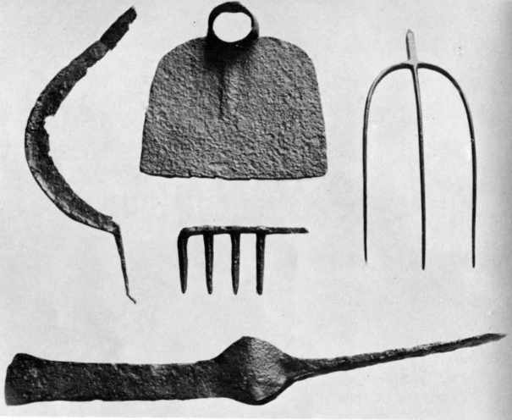
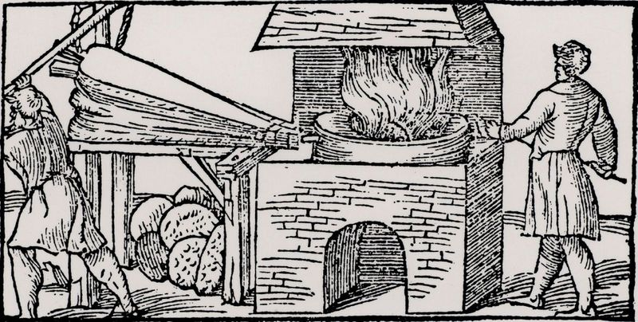
Iron Technology
Iron smelting more difficult than bronze
78
2800°F
Iron
48
35
1980°F
Copper
1900°F
Bronze
Melting points
450°F
Tin
Bellows and charcoal or coke needed to reach the temperature

Slide 15
Iron Technology
And the children of Israel cried unto the Lord: for he [Jabin, King of Canaan] had nine hundred chariots of iron; and twenty years he mightily oppressed the children of Israel.
78
48
35
Judges 4:3

Slide 16
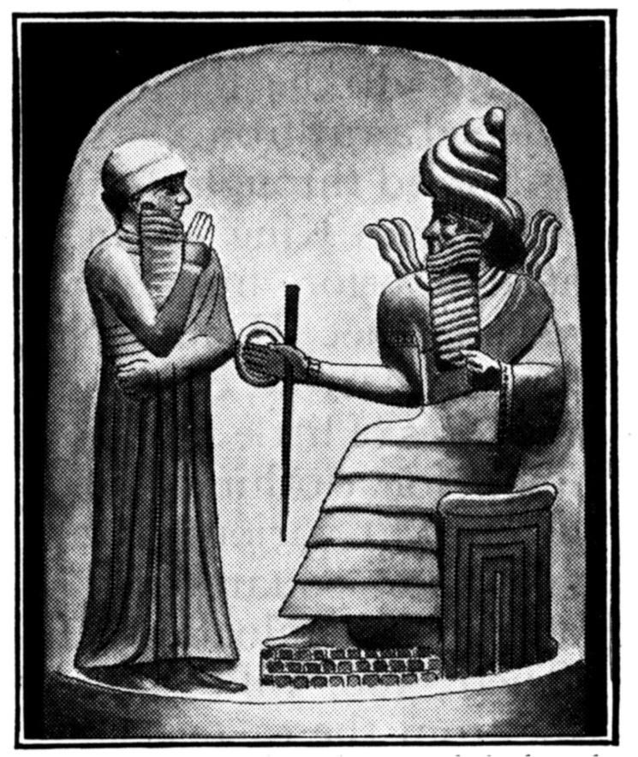
Order and Organization
Written Law: The Code of Hammurabi
Developed by King Hammurabi (~1700 BC)
78
Great leader, ruled during the cultural pinnacle of the Early Babylonian Period
Personally supervised navigation, construction of temples, agriculture, and tax collection
48
35

Slide 17
Order and Organization
Written Law: The Code of Hammurabi
78
Engraved on 8-foot stela (pillar)
Early set of written laws (predates Moses by 200 years)
48
35

Slide 18
ORDER & ORGANIZATION
Code of Hammurabi: Trial by Ordeal
If a man has accused another of laying a death spell upon him,
but has not proved it,
the accused shall go to the
sacred river,
he shall plunge in the sacred
river,
and if the sacred river shall
conquer him,
he that accused him shall take
possession of his house.
78
48
35

Slide 19
ORDER & ORGANIZATION
Code of Hammurabi: Trial by Ordeal
If the sacred river shall show his innocence and he is saved,
his accuser shall be put to death.
He that plunged in the sacred river shall appropriate the house of him that accused him.
78
48
35

Slide 20
ORDER & ORGANIZATION
Hammurabi Code
The Bible
Source:
Religious:
Capital crimes:
Justice:
Equality:
Responsibility:
Existing laws
Little
False accusation or witness
Stolen temple goods
Stolen child
Assisted fleeing slave
Adultery
Eye for eye or compensation
Changes by rank
Surgeon, home builder
God
Strong
Murder
Smite or curse parents
Steal man and sell him
Killed fetus
Adultery
Eye for eye or compensation
No differences
Repeated ox goring
78
48
35

Slide 21
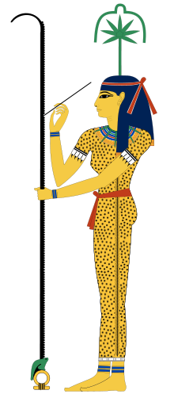
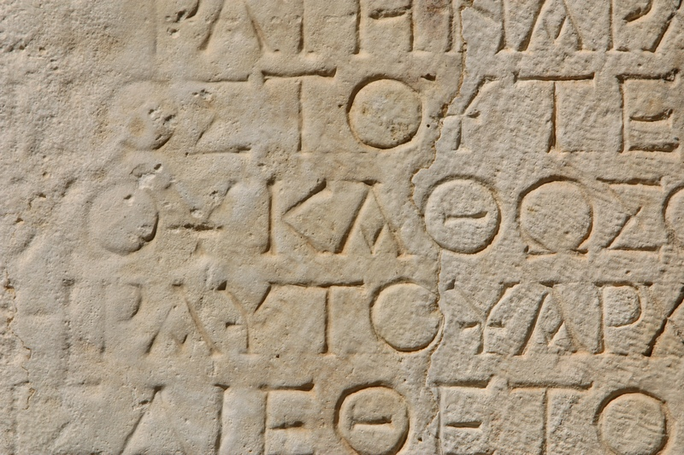
Writing
Writing was the "lubricant" that let all the other elements of society work together.
78
48

Slide 22
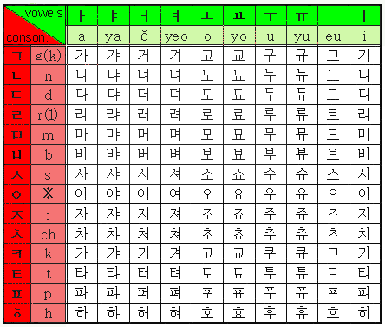
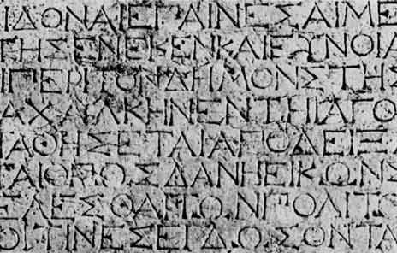
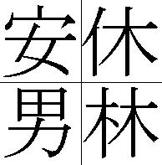
Types of Writing Systems
Syllabaries
Symbol
represents a syllable
Shorthand
Text for blind readers
Korean script
Alphabet
Symbol
represents a
sound
• Roman, Greek, Cyrillic ..alphabets
Logograms
Symbol
represents a
whole word
Chinese characters
Egyptian hieroglyphs
Sumerian cuneiform
Symbols: %, $, +

Slide 23
Writing Systems and Languages
Scripts
Languages
(using Roman script)
Roman alphabet
Aa Bb Cc
Greek alphabet
Γ γ Δ δ Θ θ Ω ω
Cyrillic alphabet
Б Д Ж З И Л
Hebrew alphabet
ד ה צ פ ש
English
Dog, house,
woman, man
Spanish
Perro, casa,
mujer, hombre
German
Hund, haus,
frau, mann

Slide 24
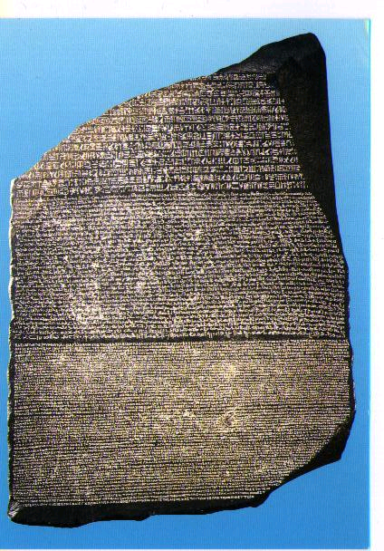
WRITING
Deciphering Hieroglyphs
Rosetta Stone
Discovered in a small village in the Nile Delta in 1799 by Napoleon’s troops

Slide 25
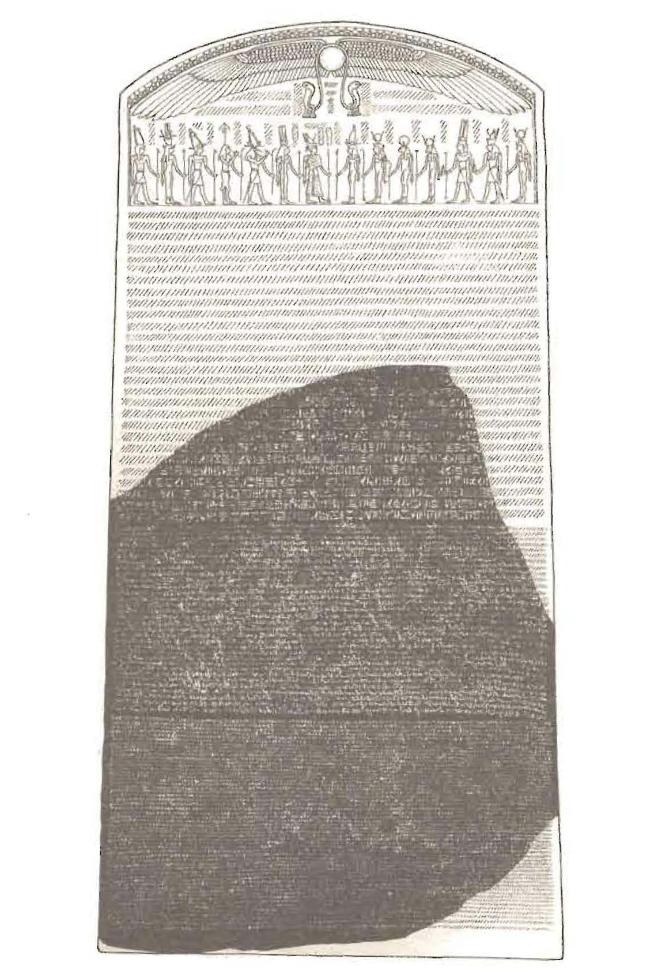
WRITING
Deciphering Hieroglyphs
Simulation of the Original stela
(stone pillar)
Rosetta Stone

Slide 26
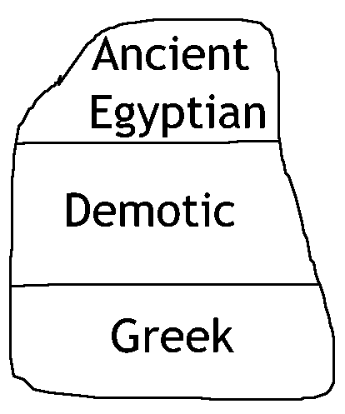
WRITING
Deciphering Hieroglyphs

Slide 27
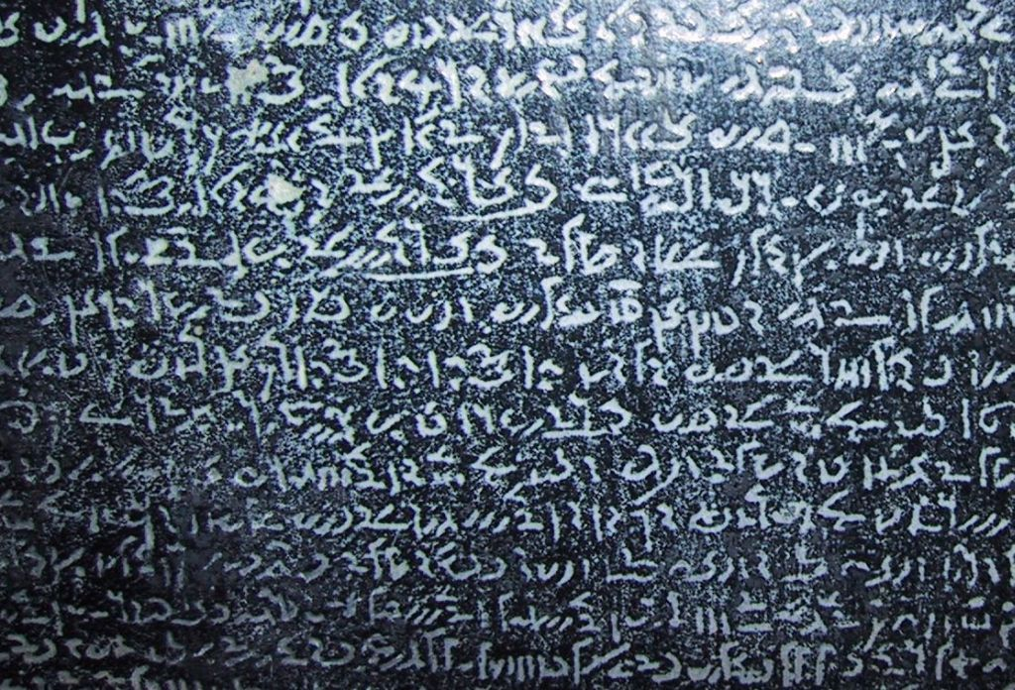
WRITING
Deciphering Hieroglyphs
Hieroglyphs is sacred script of the ancient Egyptian language
Ordinary writing of the ancient Egyptian language
Realization of the three texts
3 scripts
2 languages
1 message

Slide 28
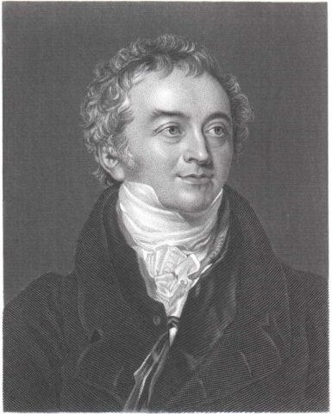
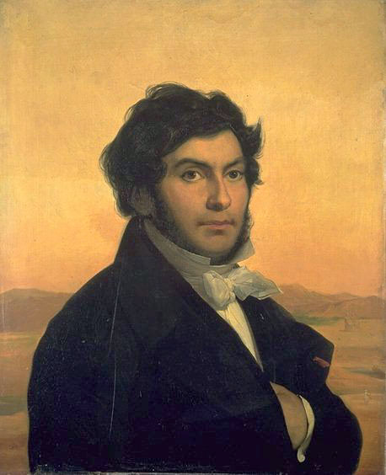
WRITING
Deciphering Hieroglyphs
Thomas Young
Jean Francoise
Champollion
English
Left brain thinking
Many contributions to physical sciences
Logical thinker
French
Right brain thinker
Humanist (spoke several languages including Coptic)
Loved tricks and puzzles

Slide 29
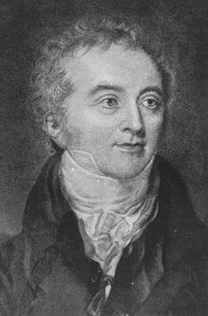
WRITING
Deciphering Hieroglyphs
Thomas Young
Three contributions to reading hieroglyphs:
Translation of the demotic script from Greek
Demotic portion more complete than hieroglyphs
Demotic, a rational language with rational script (like modern western languages)

Slide 30
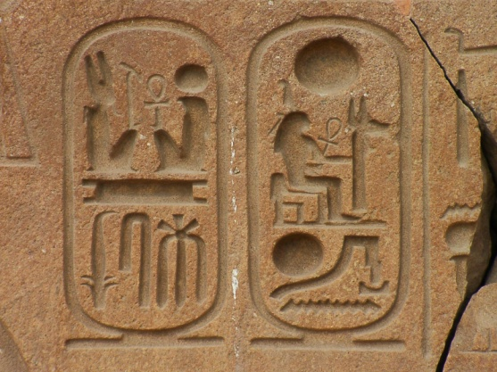
WRITING
Deciphering Hieroglyphs
Thomas Young
Three contributions to reading hieroglyphs:
2. Greek names could not be represented by pictures
Therefore, these names must be phonetic and, therefore, alphabetic
Royal names are given in cartouches (ovals)

Slide 31
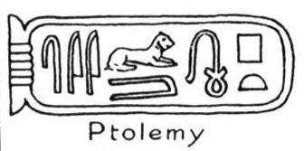
WRITING
Deciphering Hieroglyphs
Thomas Young
Three contributions to reading hieroglyphs:
(cont.) Name for Ptolemy (Ptolemaios) and for Cleopatra (Kleopatra) had several symbols that were the same

Slide 32
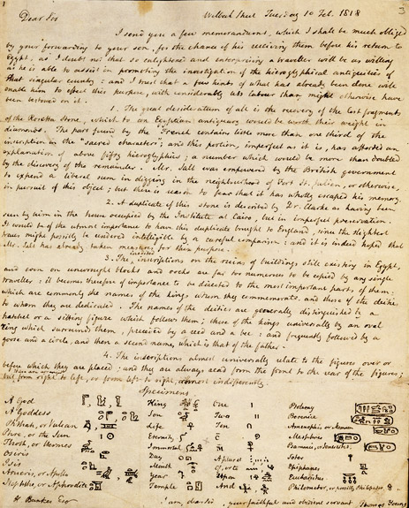
WRITING
Deciphering Hieroglyphs
Thomas Young
Three contributions to reading hieroglyphs:
Published an incomplete hieroglyph alphabet
A letter from Thomas Young wherein he copied some of glyphs he deciphered.

Slide 33
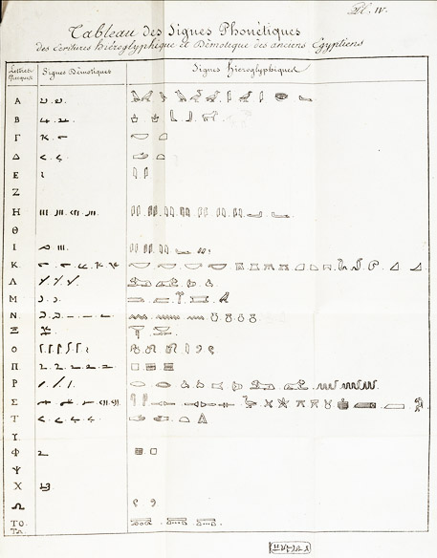
WRITING
Deciphering Hieroglyphs
Six contributions to reading hieroglyphs:
Independently developed an alphabet for the hieroglyphs
Published a paper in which the alphabet was given–30 letters (more letters than Young)
Gave no credit to Young
Courtesy British Museum
Actual document by Champollion

Slide 34
WRITING
Deciphering Hieroglyphs
Jean Francois Champollion
Six contributions to reading hieroglyphs:
2. Using Coptic, he worked out several words in the hieroglyphic text.
•
In Coptic the word for “boat” is said “depet.”
•
There are no vowels in Ancient Egyptian.
•
Using his alphabet, he worked out this word (and many others).
= boat
D
P
T

Slide 35
WRITING
Deciphering Hieroglyphs
Jean Francois Champollion
Six contributions to reading hieroglyphs:
3. Recognized a major problem ….still existed
The alphabet was 30 characters but the total number of hiero-glyphs was hundreds or maybe thousands.

Slide 36
WRITING
Deciphering Hieroglyphs
Jean Francois Champollion
Six contributions to reading hieroglyphs:
4. Recognized that some of the ….hieroglyphs were ideograms
horizon

Slide 37
WRITING
Deciphering Hieroglyphs
Jean Francois Champollion
Six contributions to reading hieroglyphs:
5. Recognized that some of the ….letters made rebuses (symbols …..that used pictures to represent sounds).
This required knowledge of Coptic (as it sounds).
Example: Using English to illustrate the word “belief.”

Slide 38
WRITING
Deciphering Hieroglyphs
Jean Francois Champollion
Six contributions to reading hieroglyphs:
6. Recognized that some hiero-glyphs were used as determiners to reduce confusion caused by lack of vowels.
Example: In Egyptian tax, horse, and twin all have the same letters.
For clarity, a picture was added.
Tax added roll of papyrus
Horse added an animal
Twin added a person

Slide 39
WRITING
Deciphering Hieroglyphs
What does the Rosetta Stone say?
Ptolemy V granted the priests certain favors in taxation and debt relief.
The priests were thankful and they praised Ptolemy and cited his accomplishments.

Slide 40
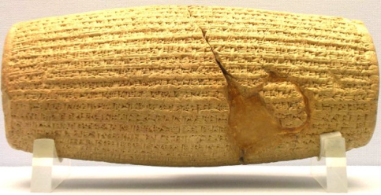
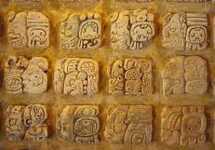
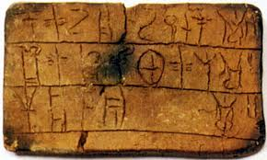
WRITING
Deciphering Hieroglyphs
Significance of the deciphering of the Rosetta stone.
•
First translation of an ancient language
•
The beginning of interpretation of the ancient world’s texts
•
The key to ancient archeology and history

Slide 41
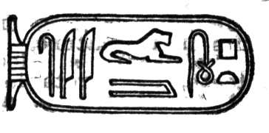
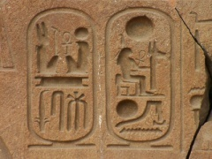
WRITING
Deciphering Hieroglyphs
What have you learned about creativity from the deciphering of the Rosetta stone?

Slide 42
WRITING
Cuneiform
Creative Contribution: Writing (cuneiform)
Sumerian language not connected to any other (Adamic?)
Sumerians used cuneiform
Recorded business and laws
Adopted by later empires because it could apply to any language
1200 known characters

Slide 43
WRITING
Cuneiform—Assyrian Gate

Slide 44
WRITING
Cuneiform
Began with tokens (money)
Drawings of tokens
Symbols (complex)
Symbols (simple)

Slide 45
WRITING
Chinese
Same writing system used for Mandarin, Cantonese, Japanese
Pictographs (evolution to symbols)
Sun
Moon
Mountain
Water
Bird

Slide 46
WRITING
Chinese (evolution)
Carving on Oracular Bone
Inscription on bronze work
Small seal style
Administrative style
Exemplar style
Cursive style

Slide 47
The FLOW of Civilization Essential Elements for Civilization
F
ood
Freedom to join into cities
L
abor specialization
Working together and using technology
O
rder and hierarchy
Everyone in place
W
ritten communication
Share information

Slide 48
Be Civilized
Thank You

