Slide 1
Introduction
MFG 355
Plastics

Slide 2
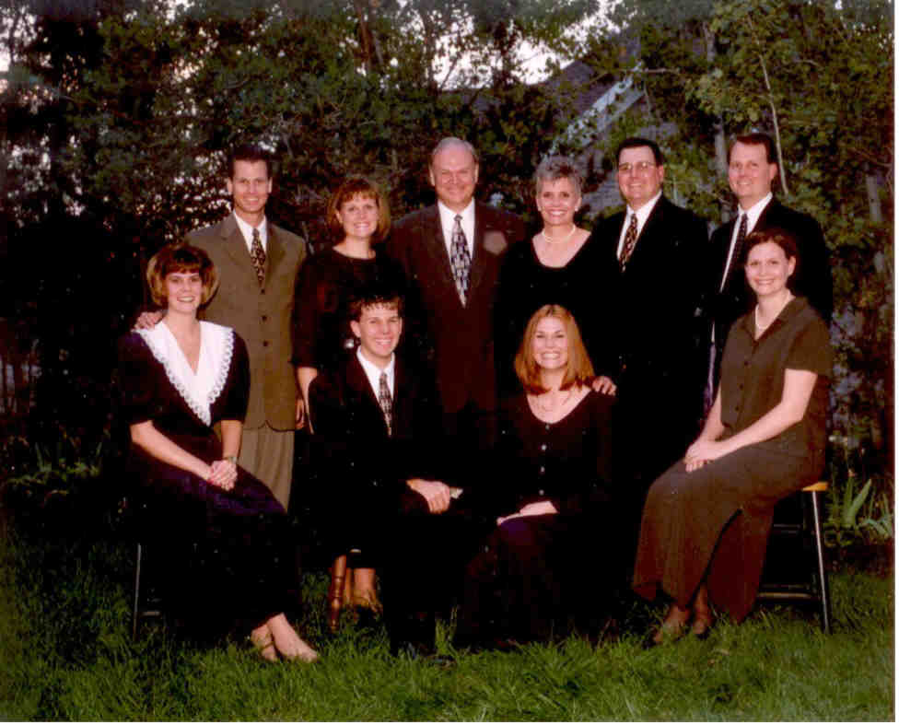
Dr. Strong
Married for 46 years
8 children

Slide 3
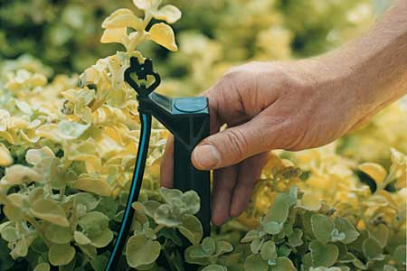
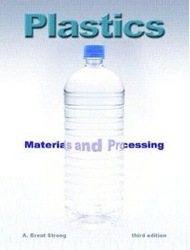
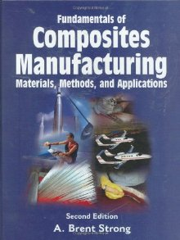
Brent Strong – Background
PhD in Chemistry
Worked for DuPont
Worked for Hardie Irrigation
BYU (1986)

Slide 4
Class Website
You can access many valuable things at the my website:
http://mfg355.groups.et.byu.net/
Lectures and outline are available on Blackboard

Slide 5
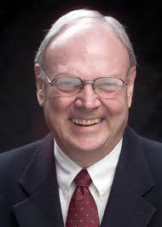
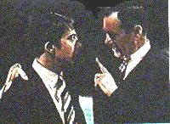
I just want to say one word to you —just one word— ‘plastics.’
Advice to Dustin Hoffman’s character in The Graduate

Slide 6
Resin Rules
Resin Rule: This will be a simple-to-remember rule that will help with general principles of plastics.
These subheadings will be explanatory details
Sometimes these subheadings will have application details

Slide 7
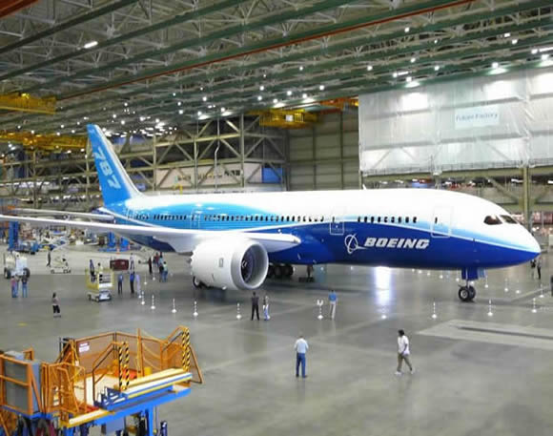
Plastics: Materials and Processing
2 midterms
Usually 4 questions of an essay type
Class project
What ever you would like that is made of plastics
Get to know a process
Talk to TA about materials (some free, some not)
Final group project
Boeing project

Slide 8
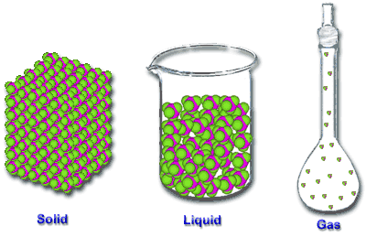
Basic Materials
Three states of matter
Solid
Liquid
Gas
For most practical purposes, solids are the state most materials are used in

Slide 9
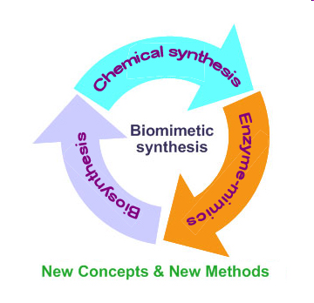
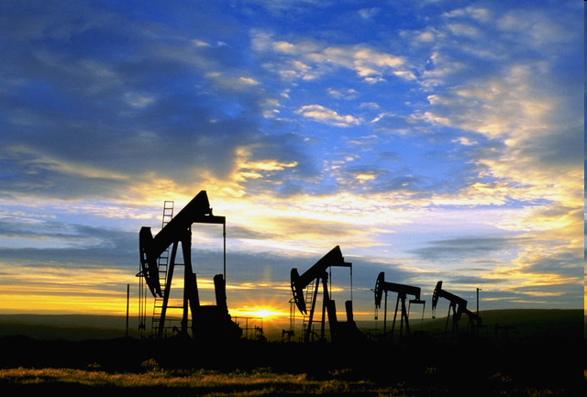
What is a plastic?
Materials composed of large molecules (called polymers) which are synthetically made or modified
Most are made from oil
DuPont has a non-petroleum source for all its plastics

Slide 10
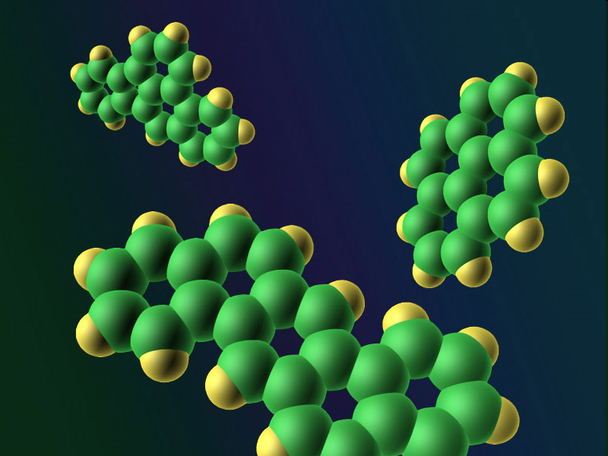
What is a molecule?
A collection of atoms having a particular property
Molecules are made of units of atoms that are bonded together

Slide 11
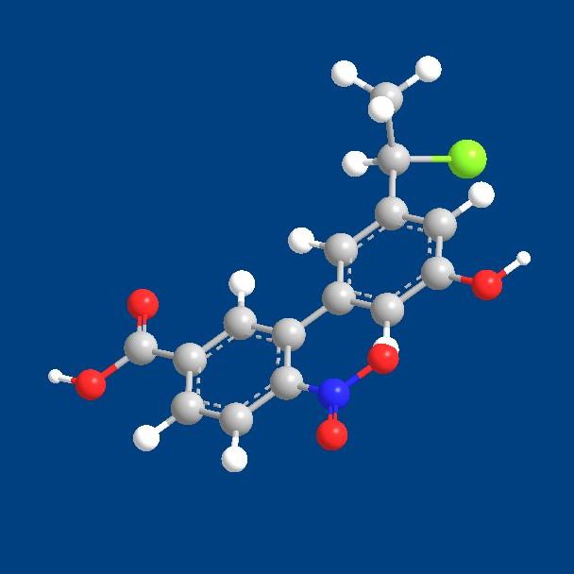
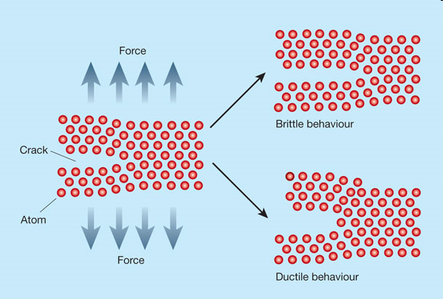
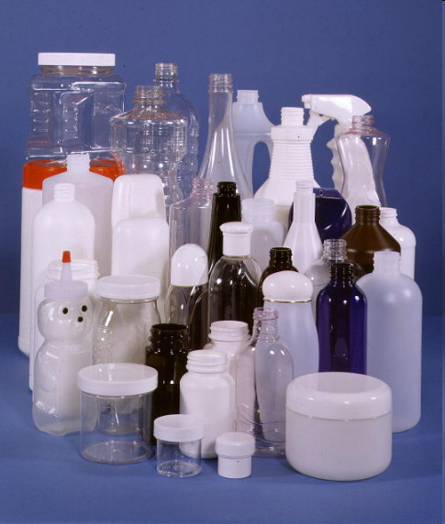
Levels of Focus
Molecular (each atom’s effect)
Micro (crystals and interactions of several molecules)
Macro (bulk)

Slide 12
What are plastics used for?
Plastics are usually solids at room temperature
The bonding in plastics distinguishes them from metals and ceramics
Raise your hand and identify a plastic in this room
Metals
Ceramics

Slide 13
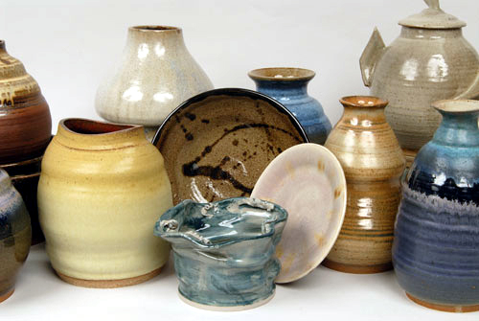
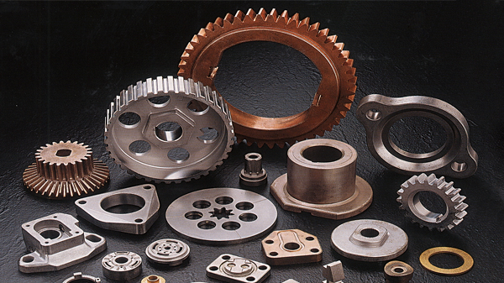
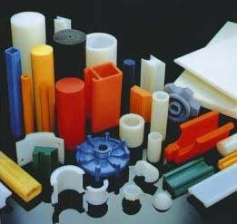
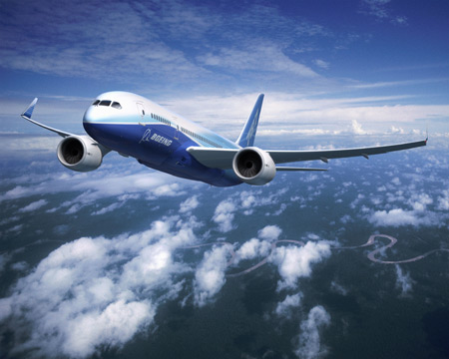
Solid Materials – 3 Types
Ceramics
Metals
Polymers
These differ, at the most fundamental level,
in the types of bonds between the atoms

Slide 14
Plastics Compared to Metals and Ceramics
Characteristic
Low melting point
High elongation
Low density
Low thermal conductivity
Electrical resistance
Optical clarity (some)
Easily colored
Solvent sensitivity
Flammable
Advantage
Ease of processing
Low brittleness
Lightweight products
Good thermal insulation
Good electric insulation
Utility as clear material
Use without painting
Can be dissolved (some)
Waste can be burned
Disadvantage
Lower useful thermal range
High creep
Low structural strength
Low heat dissipation
Poor conductivity
UV degradation
Hard to color match
Affected by solvents
May cause fumes/fire hazard

Slide 15
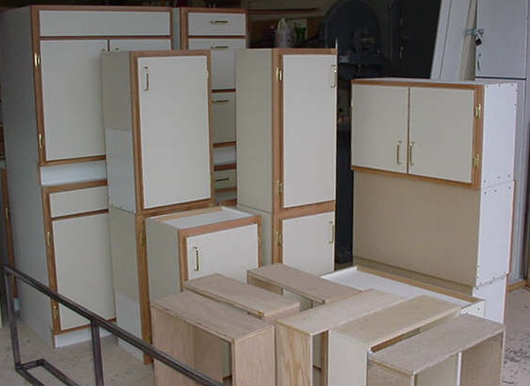
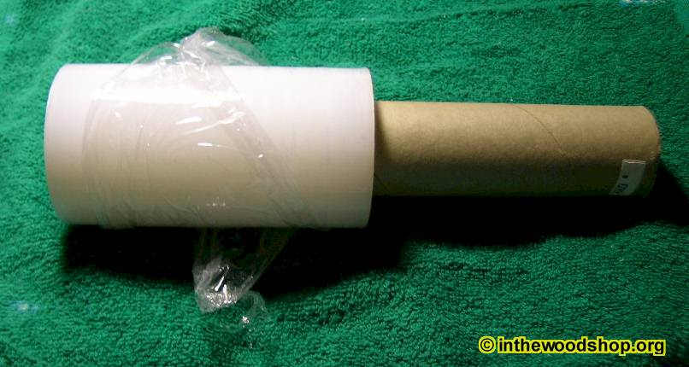
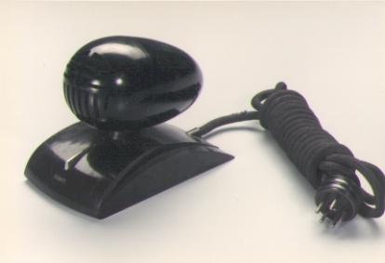
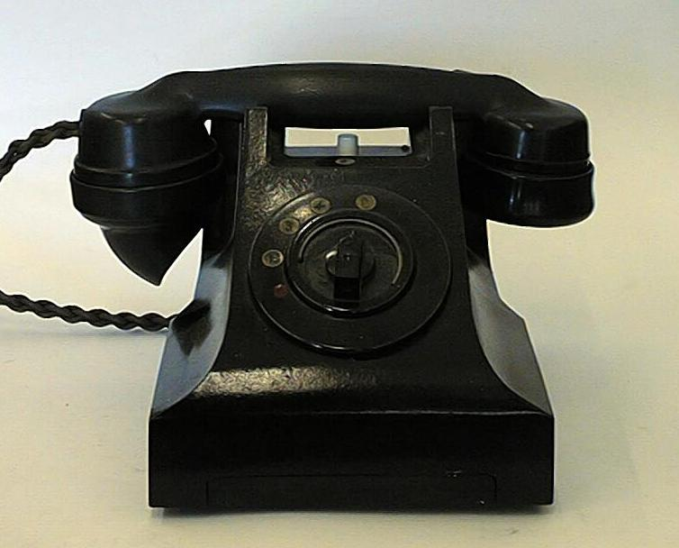
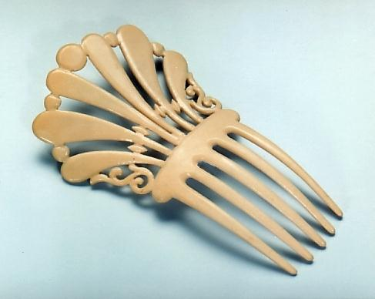
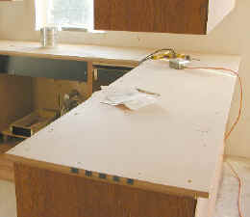
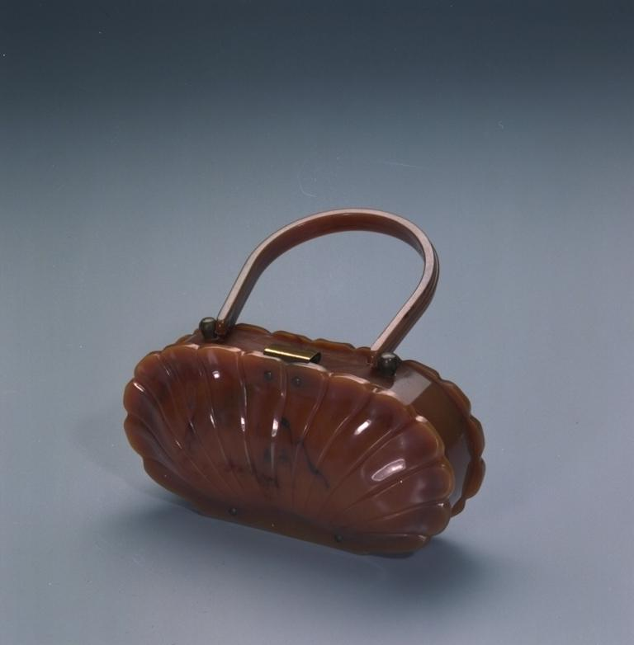
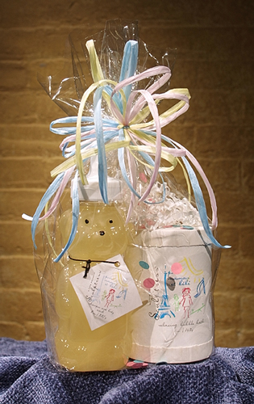
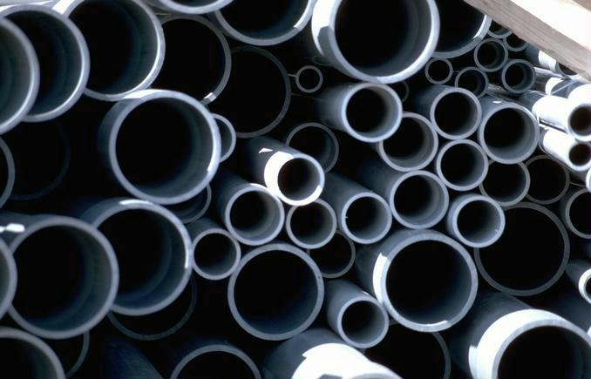
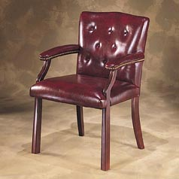
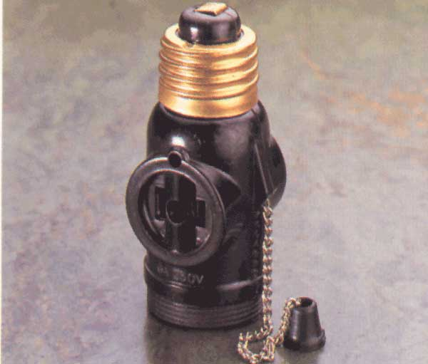
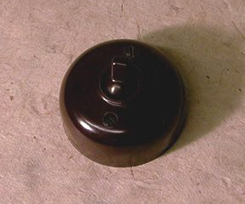
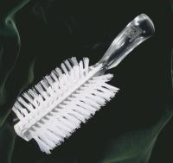
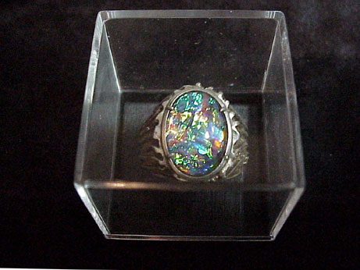
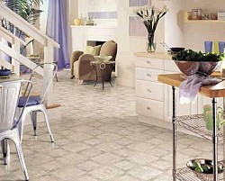
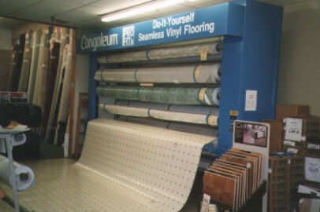
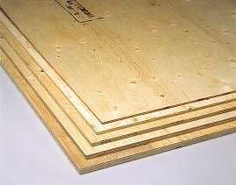
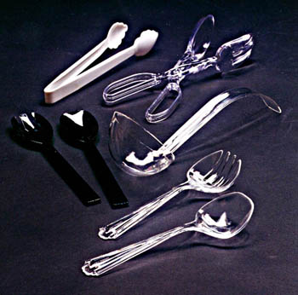
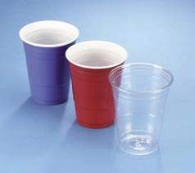
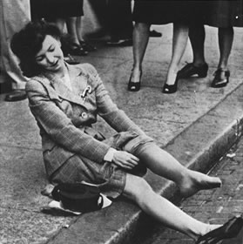
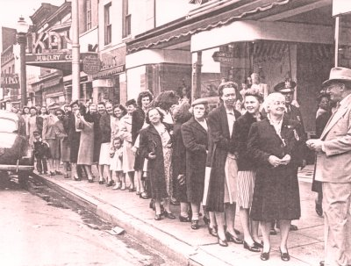
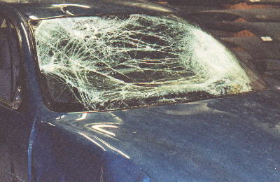
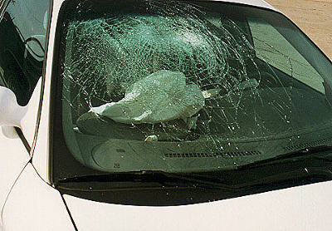
History of Polymers
Date
1868
1909
1919
1927
1927
1929
1936
1936
1938
1938
1938
1939
1939
Material
Cellulose Nitrate
Phenol-Formaldehyde
Casein
Cellulose Acetate
Polyvinyl Chloride
Urea-Formaldehyde
Acrylic
Polyvinyl Acetate
Polystyrene or Styrene
Nylon (Polyamide)
Polyvinyl Butyrate
Polyvinylidene Chloride
Melamine-Formaldehyde
Example Use
Figurines
Electrical equipment
Beauty accessories
Cellophane package wrapping
Pipe, Synthetic Leather
Lighting fixtures, Plywood glue
Brush backs, displays
Synthetic flooring
Disposable utensils
Hosiery
Safety glass interlayer
Saran wrap
Countertops, Cabinets

Slide 16
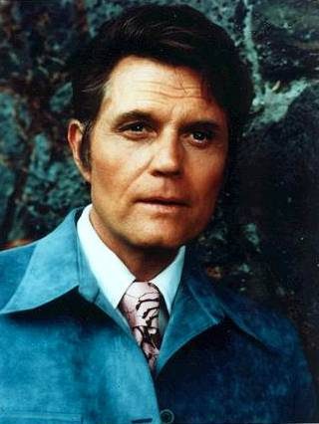
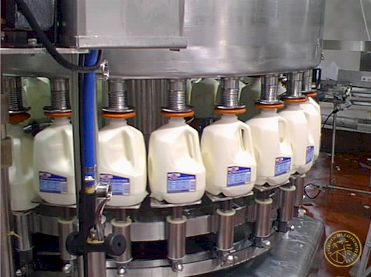
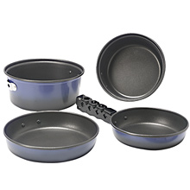
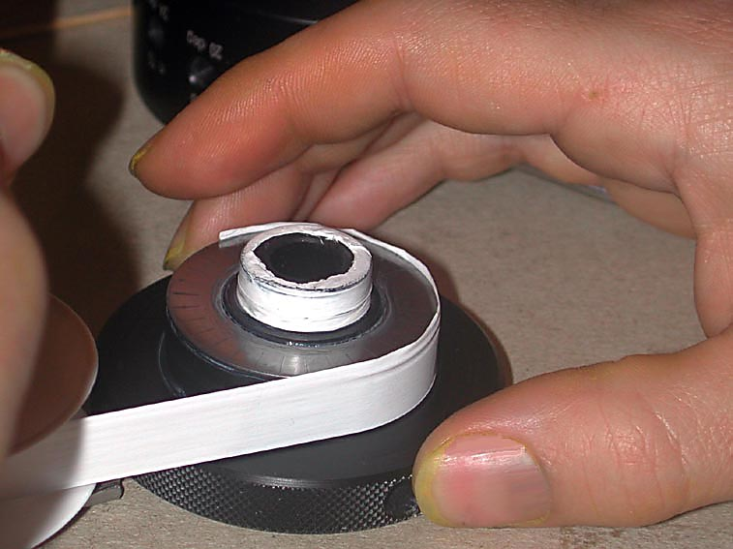
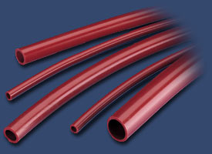
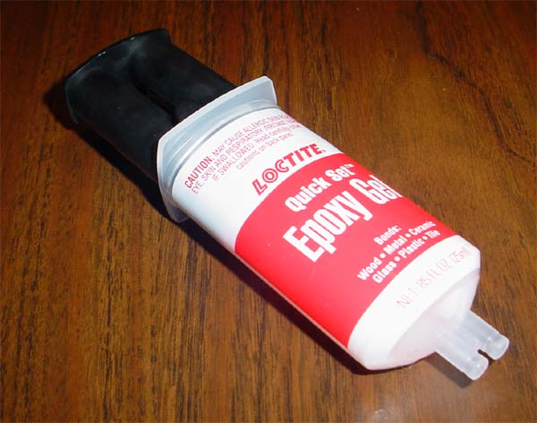
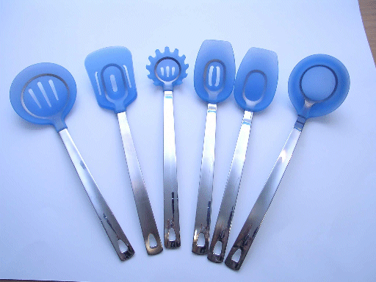
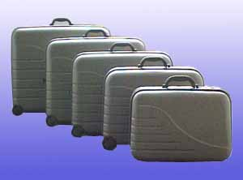
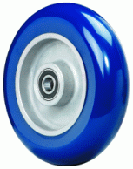
History of Polymers
Date
1942
1942
1943
1943
1947
1948
1954
1956
1957
1957
1964
1964
Material
Polyester
Polyethylene
Fluorocarbon
Silicone
Epoxy
Acrylonitrile-Butadiene-Styrene
Polyurethane or Urethane
Acetal
Polypropylene
Polycarbonate
Ionomer
Polyimide
Example Use
Clothing, Boat hulls
Milk Jugs
Industrial gaskets, Non-stick liners
Gaskets, Tubing, Utensils
Glues
Luggage
Foam cushions, Shoe soles, Wheels
Automotive parts, Toilet parts
Living hinges, Safety helmets
Water bottles, Eye protection
Golf balls, Skin packages
Gears

Slide 17
Plastics Industry

Slide 18
Definitions
Resins: Unshaped polymers and the polymer component of composites
Plastics: Shaped polymers

Slide 19
Resin Forms
Powder (flake)
Pellets
Liquid

Slide 20
Resin Delivery
Tank car
Hopper car
Gaylord/Pillar pack
Resin drum

Slide 21
Developments in Polymers
New types
Electrically conductive
Light sensitive
Bio-degradable
Bio-compatible

Slide 22
Uses
Automobile
Weight (mileage)
Aviation
767, 787
Voyager, Space Ship One
Everywhere

Slide 23
Salaries in the plastics industry

Slide 24
Thank You

