Slide 1
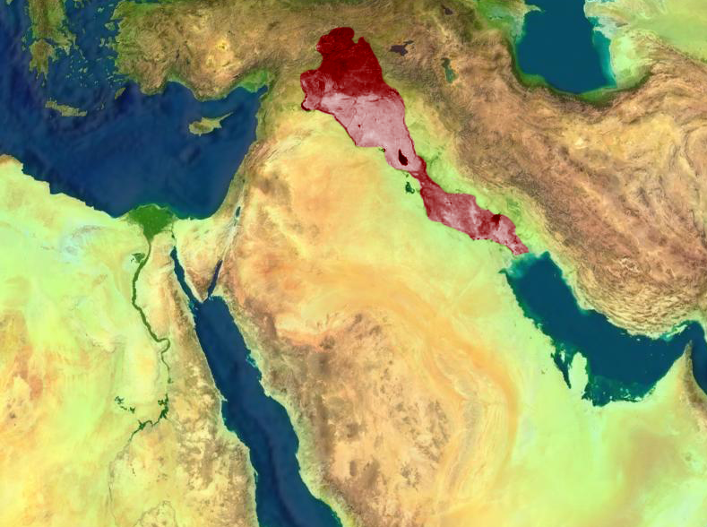
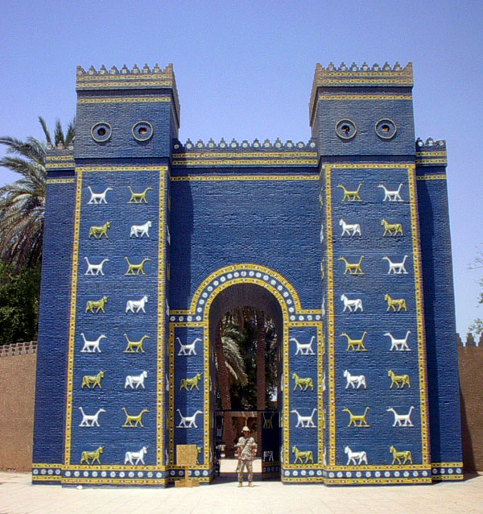
Mesopotamia
The Seeds of
Creativity

Slide 2
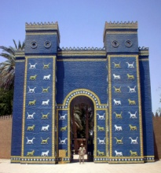
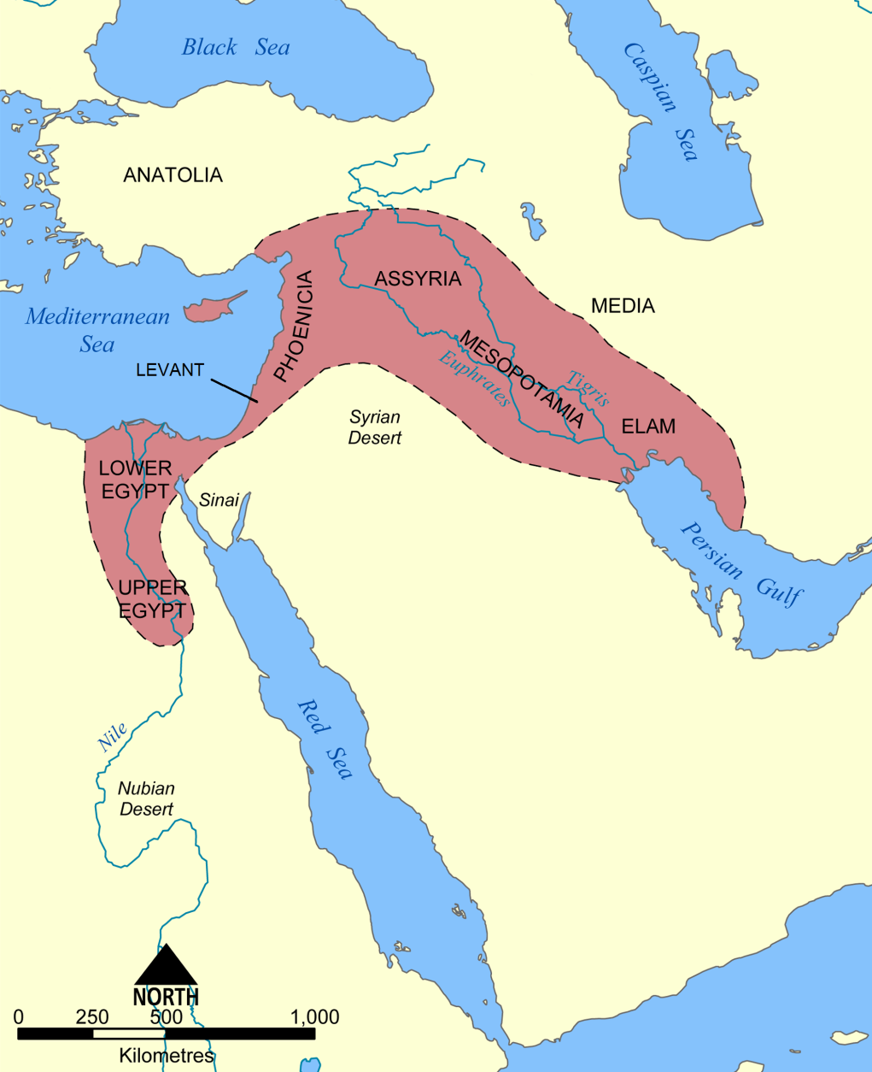
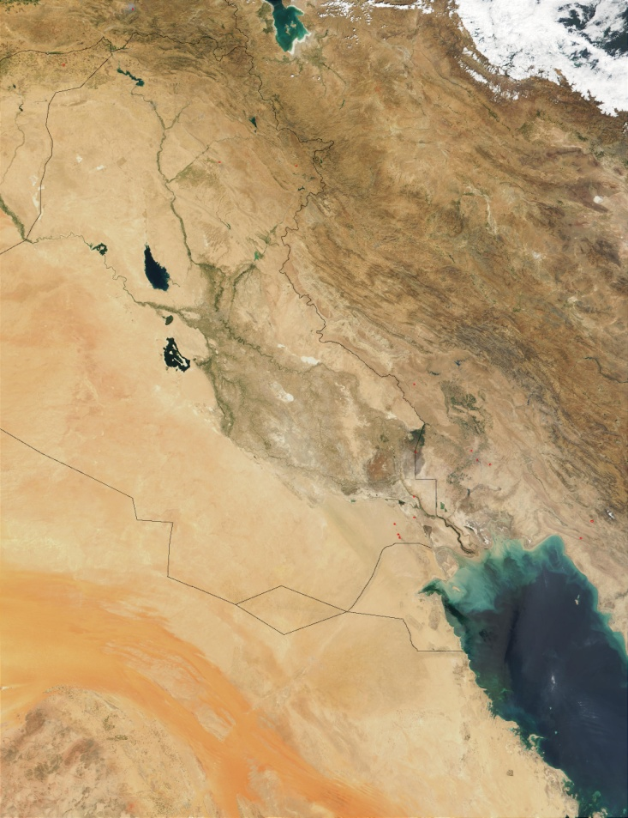
Mesopotamia
The Fertile Crescent
Fertile Crescent
PALESTINE
Jerusalem
Babylon
NASA Satellite View 2006

Slide 3
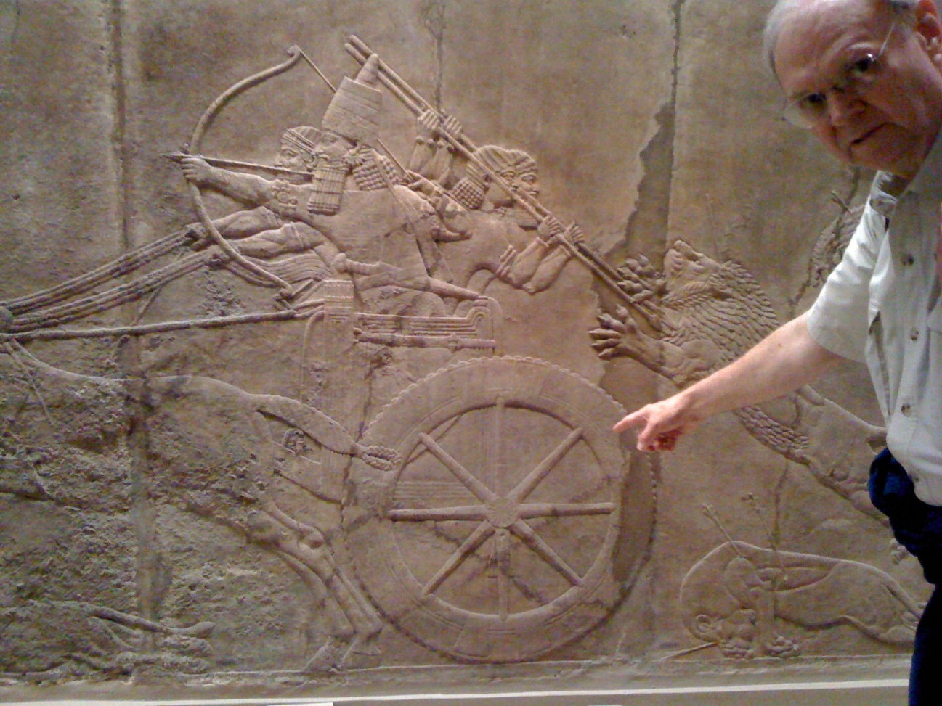
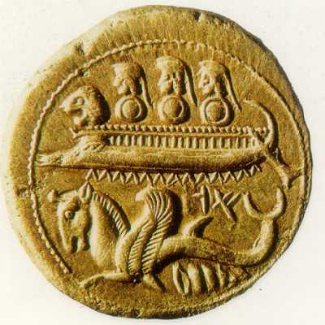
Mesopotamia
Civilizations
Sumerians
Akkadians/Babylonians
Hittites
Phoenicians
Israelites
Assyrians
Babylonians/Medes/Persians
Non-Semetic, ziggurats
Law Code, chariots
Iron
Trade
Religion
Walls, ruthless
Empire, riches

Slide 4
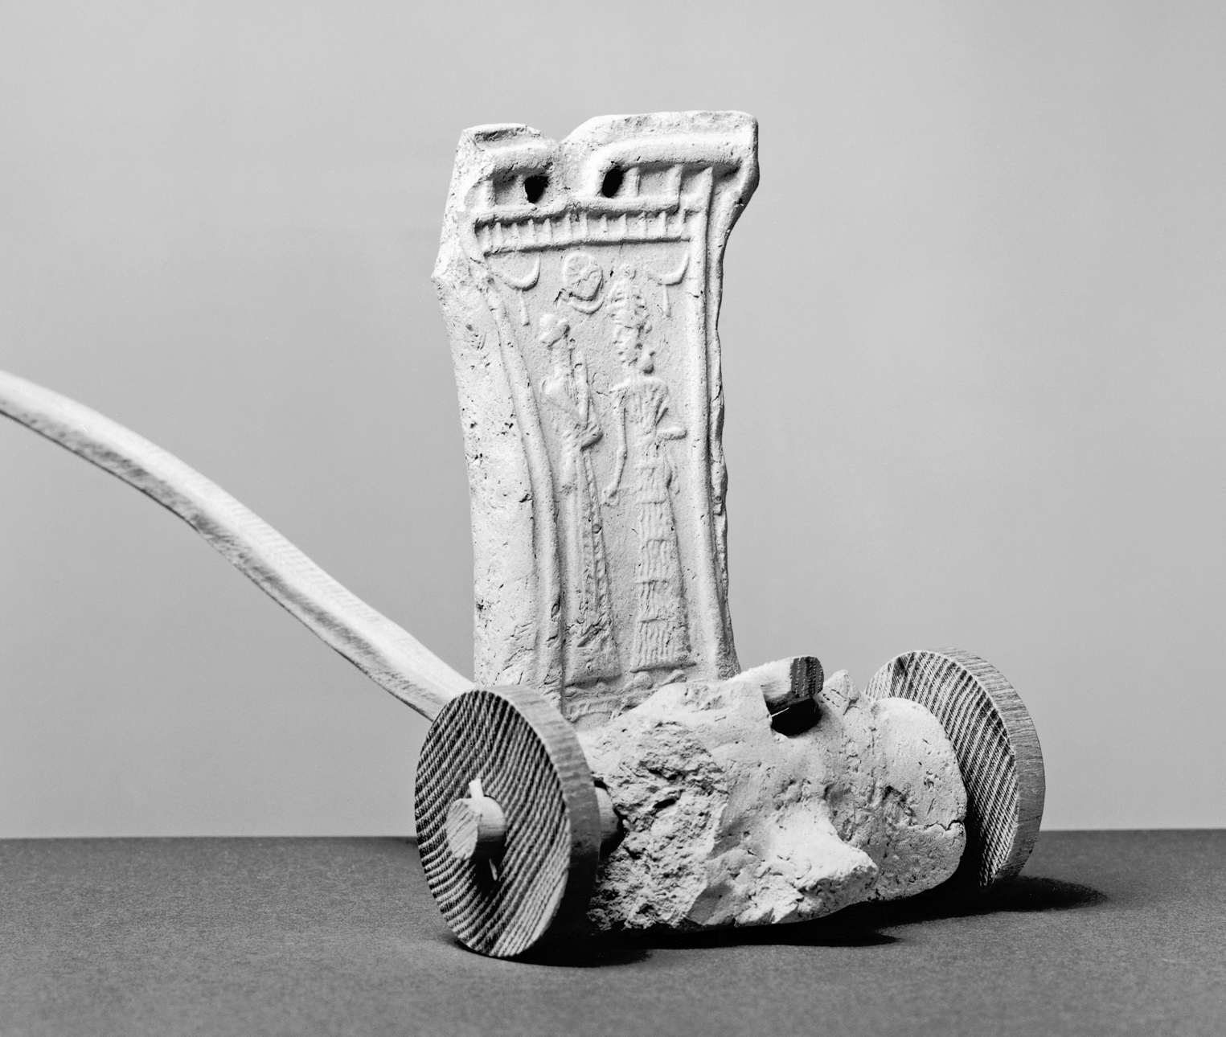
Babylonians
Chariot expertise

Slide 5
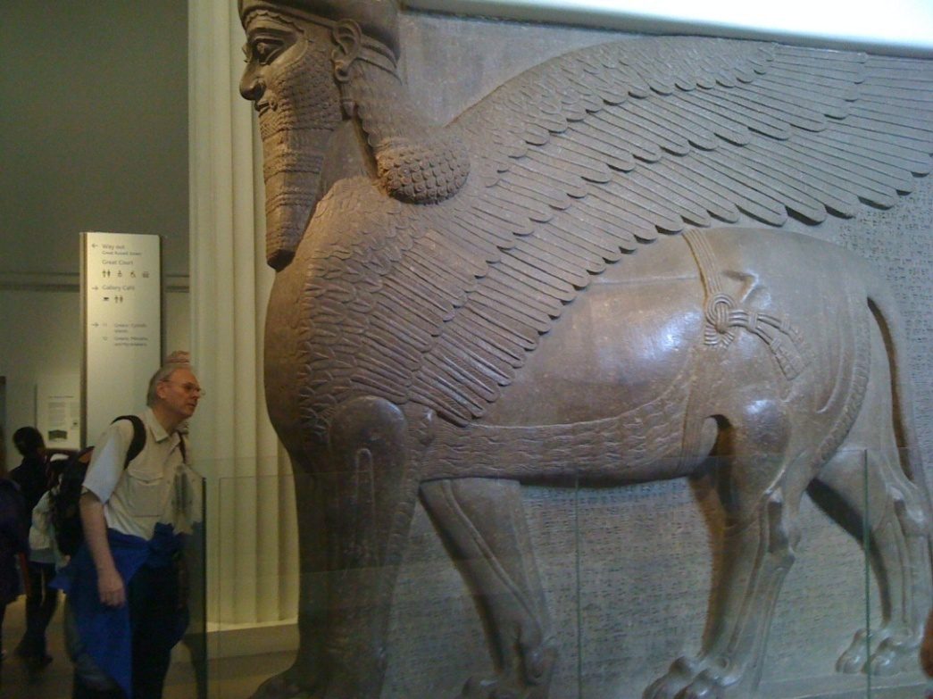
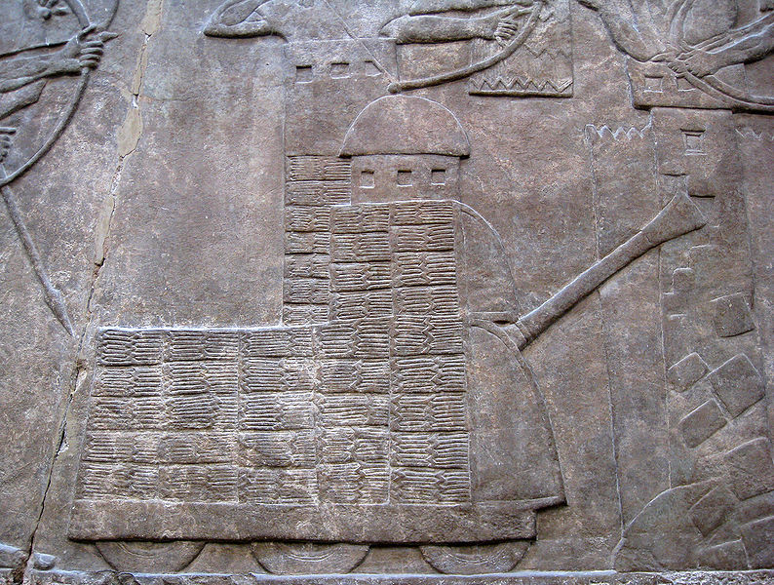
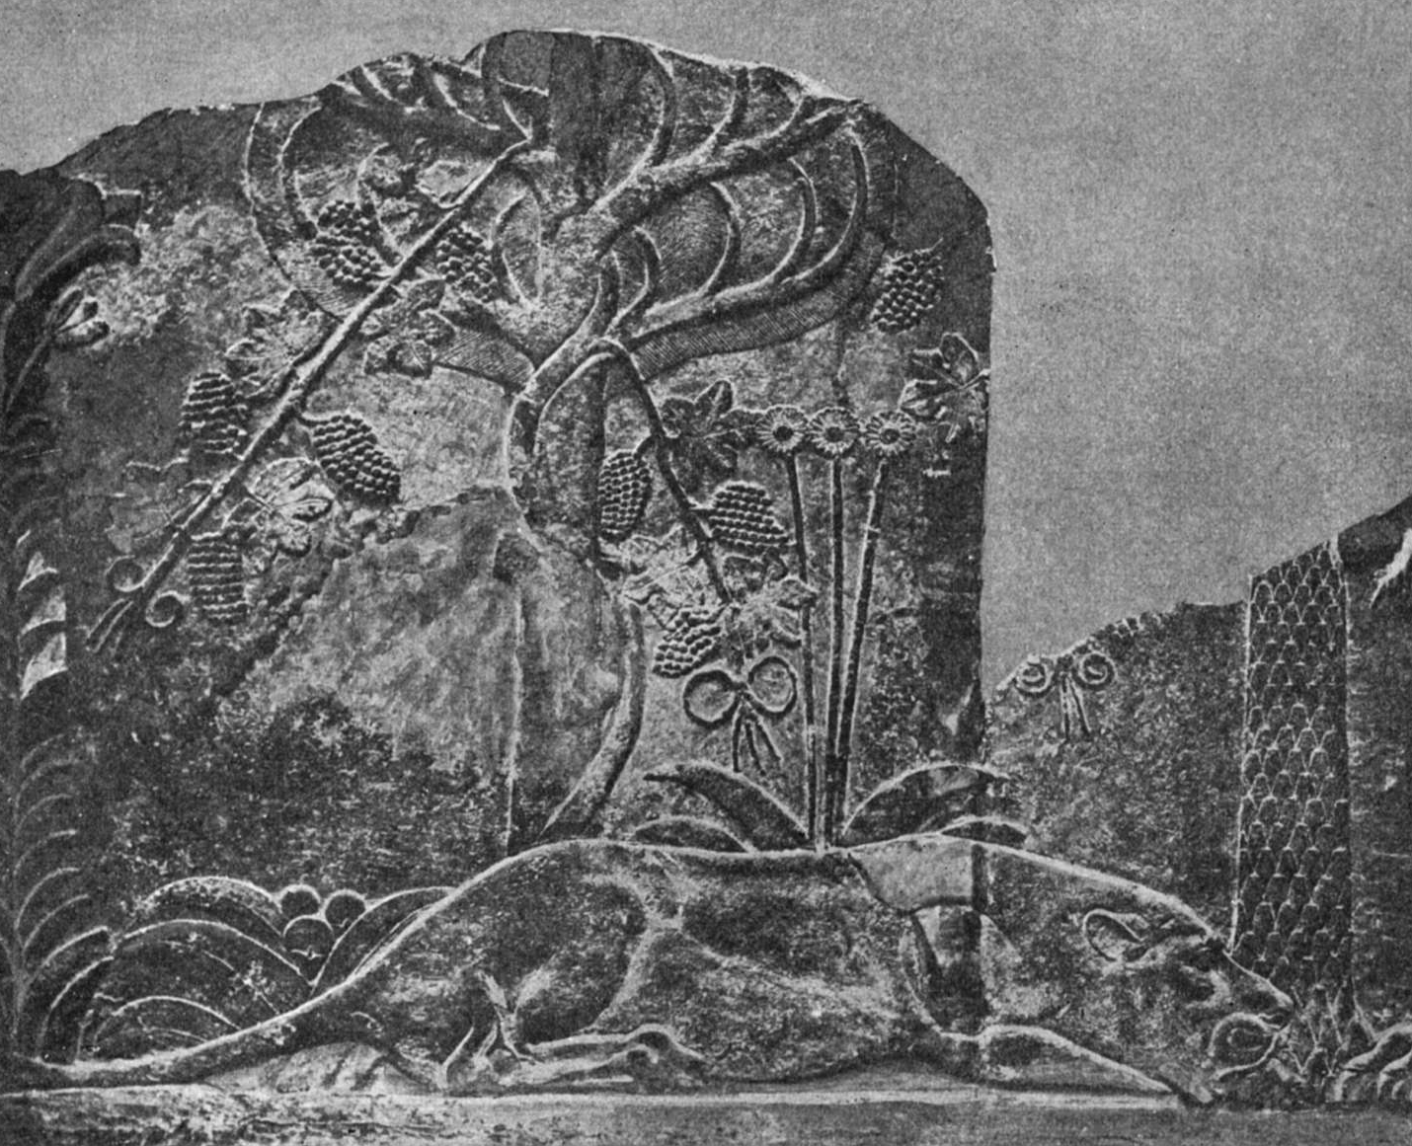
Assyrians
Gates and walls indicated strong military presence.

Slide 6
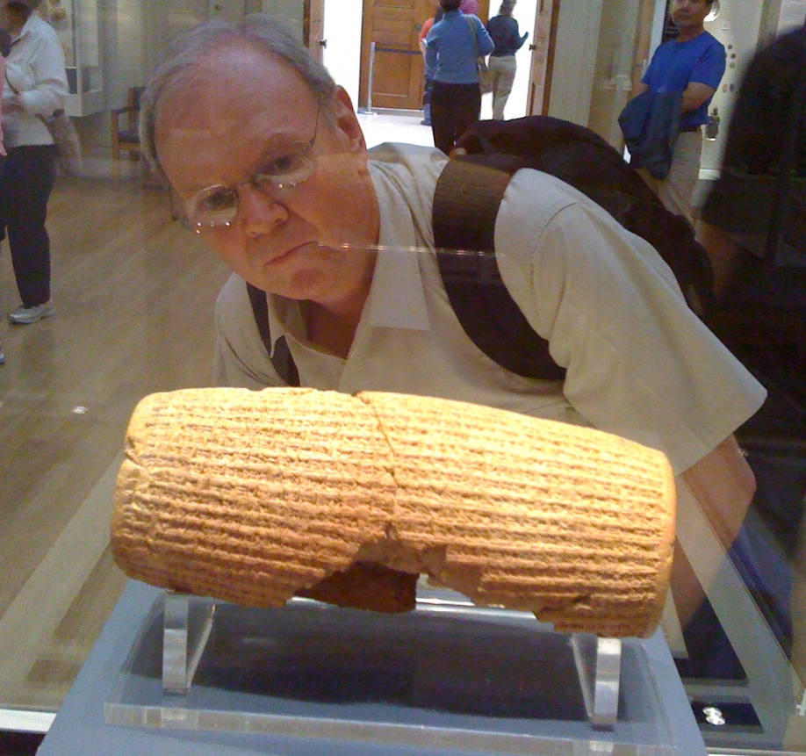
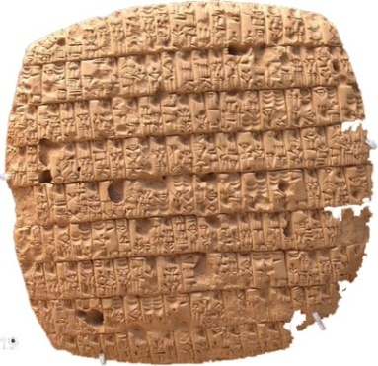
Cuneiform
Cyrus the Great Cylinder
Commemorates the victory of the Persians, under Cyrus, over the Medes/Babylonians.

Slide 7
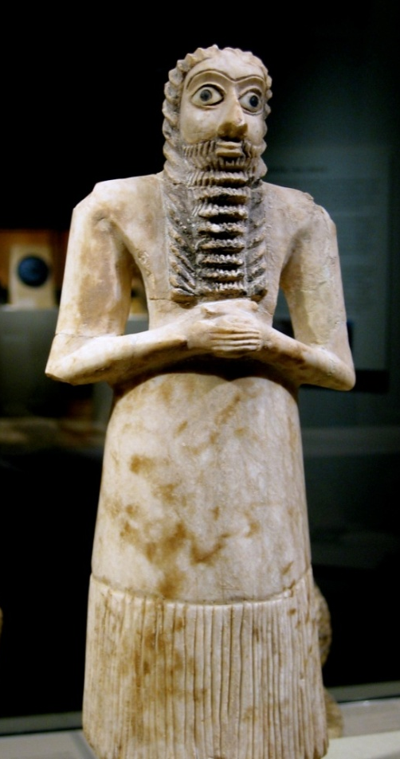
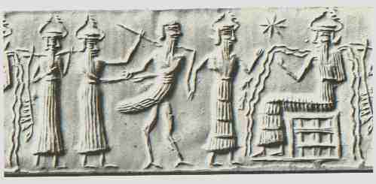
Religion
The Critical Element of Mesopotamian Life
Gods for natural phenomena
• Rain, wind, fertility, light
• Seeking favors from these gods

Slide 8
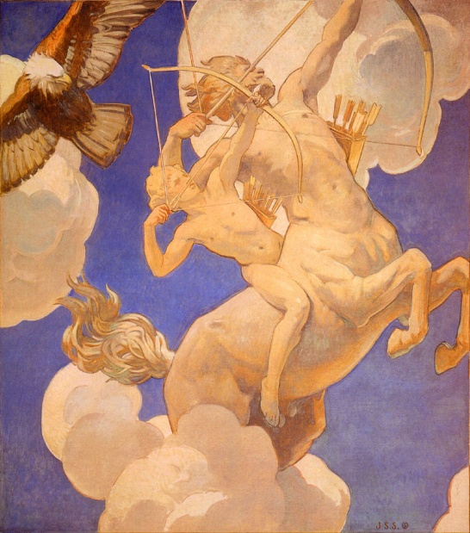
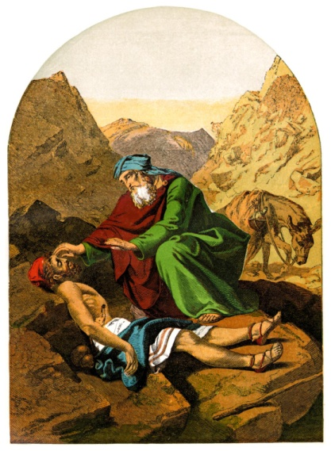
Religion and Myth
What is the difference between myth and religion?
Myth
teaches a principle but . . .
Religion
teaches a principle but . . .
is not to be taken as true.
is to be believed as a matter of faith.
Religion sometimes uses stories that teach principles but are not, necessarily, to be taken as true, (but might be an actual event) such as a parable.

Slide 9
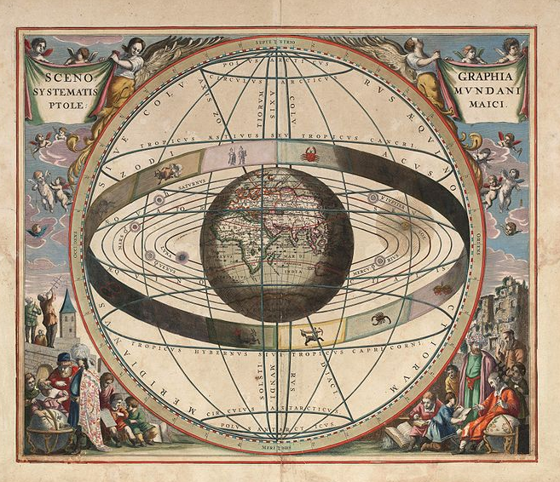
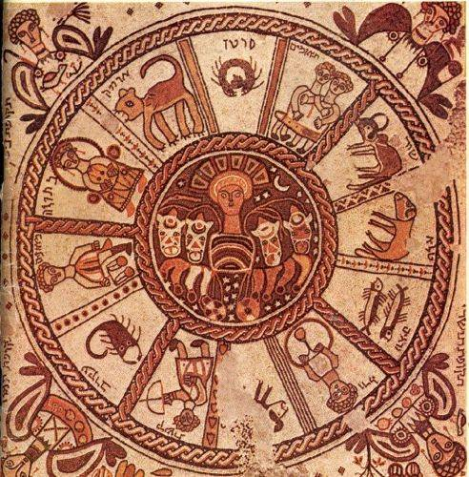
Religion
An Astral religion
Logical extension of the basic gods because our lives are largely governed by heavenly events.
Gave birth to the Zodiac.

Slide 10
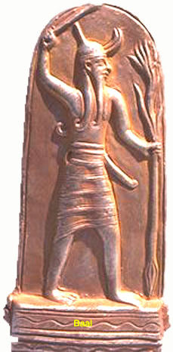
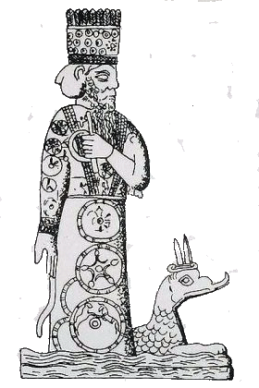
Religion
Gods associated with particular cities or regions
• Protection for the cities.
Marduk (Babylon)
Baal (Phoenecia)
Linked to the king
• The Hebrew word bayit means both temple and dynasty.
Baal
Marduk

Slide 11
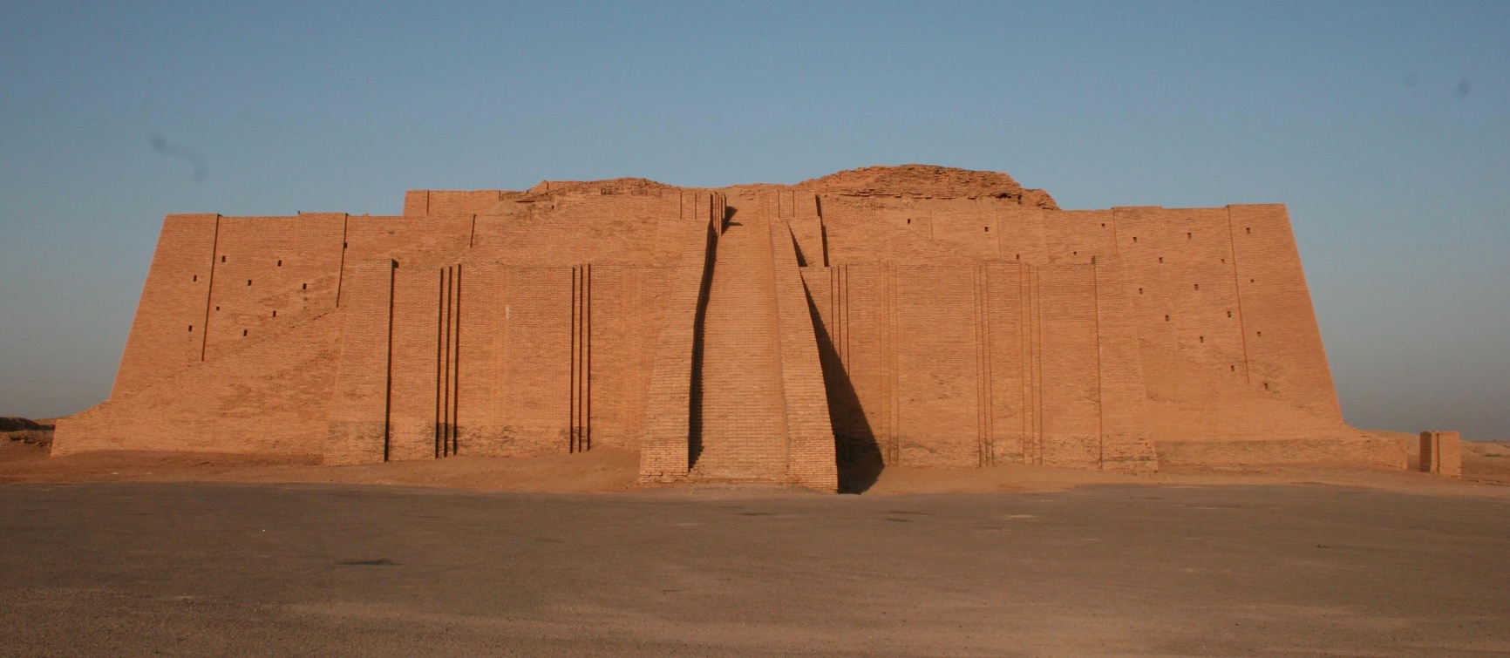
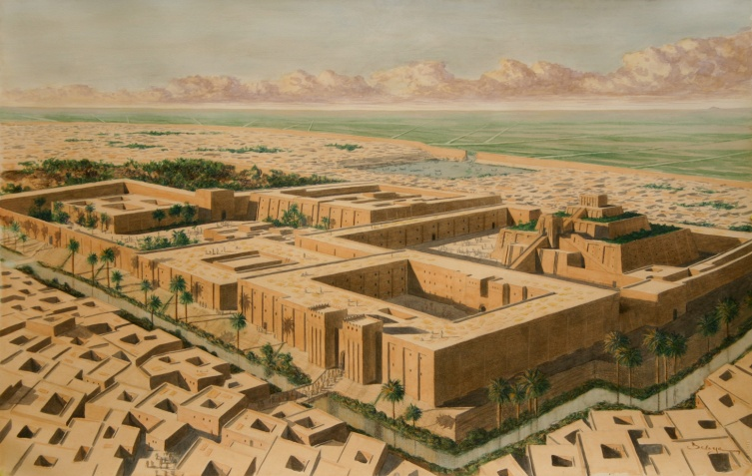
Religion
Ziggurat = Temple and Civil combined
Tower of Babel?

Slide 12
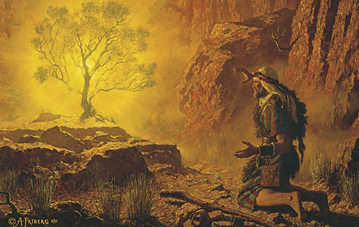
Religion
Purposes of a temple
A place to meet or honor the god
Early temples were mountains
A place to perform ordinances

Slide 13
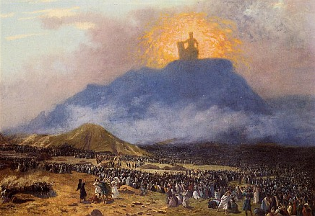
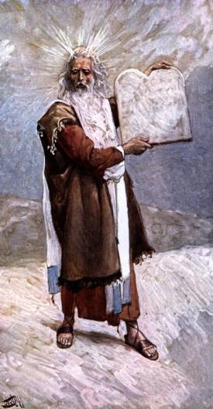
Moses on Mount Sinai
Moses on the mount for 40 days and nights
Thunder and lightning signify God’s presence
Moses came down and invited the people to make a covenant with God
People refused the covenant because of
• Fear
• Unrighteousness
A lesser covenant was given

Slide 14
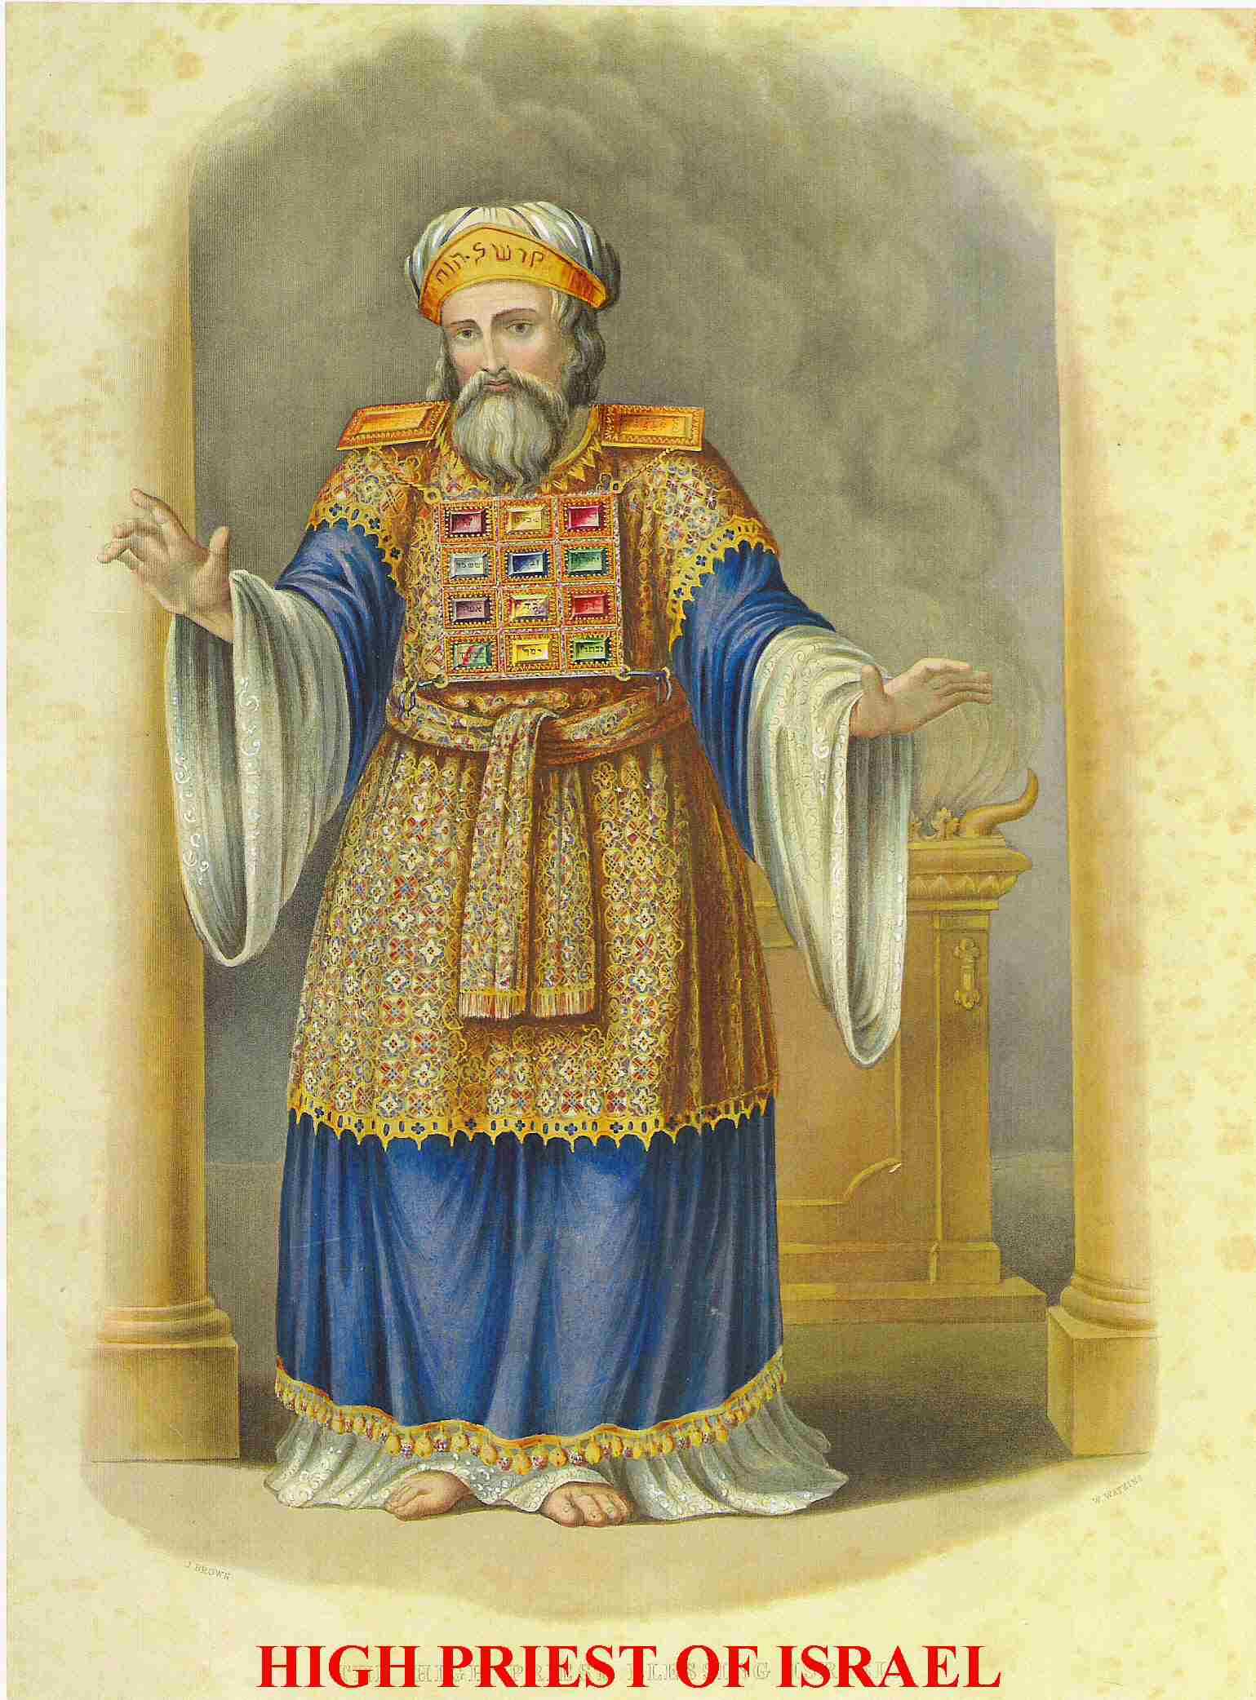
New Order of the Priesthood
All men were no longer entitled to the priesthood.
Only the tribe of Levi.
The direct descendents of Aaron would be the leaders (high priests of the Aaronic Priesthood).
The new priesthood tribe would serve all other tribes.

Slide 15
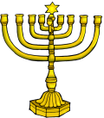
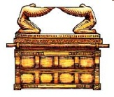
Tabernacle of Moses
Built with three distinct areas
3
Holy of Holies
2
Holy Place
1
Outer Court
Entrance
Veil
Incense
(prayers)
Menorah (Holy Spirit)
Brazen altar (sacrifices)
Laver (clean)
Ark of the Covenant
Showbread–12 loaves
(commune with God)

Slide 16
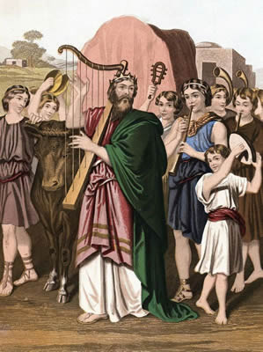
The Promised Land
During the conquest and during the time of the judges, the tabernacle (ark of the covenant) moved from tribe to tribe.

Slide 17
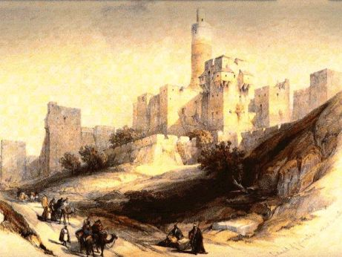
Fixed Location for Temple
David . . .
conquered Jerusalem and made it his capital.
permanently located the ark there.
asked God to allow a permanent temple to be built.
was allowed, by God, to collect the materials but was not permitted to build the temple.

Slide 18
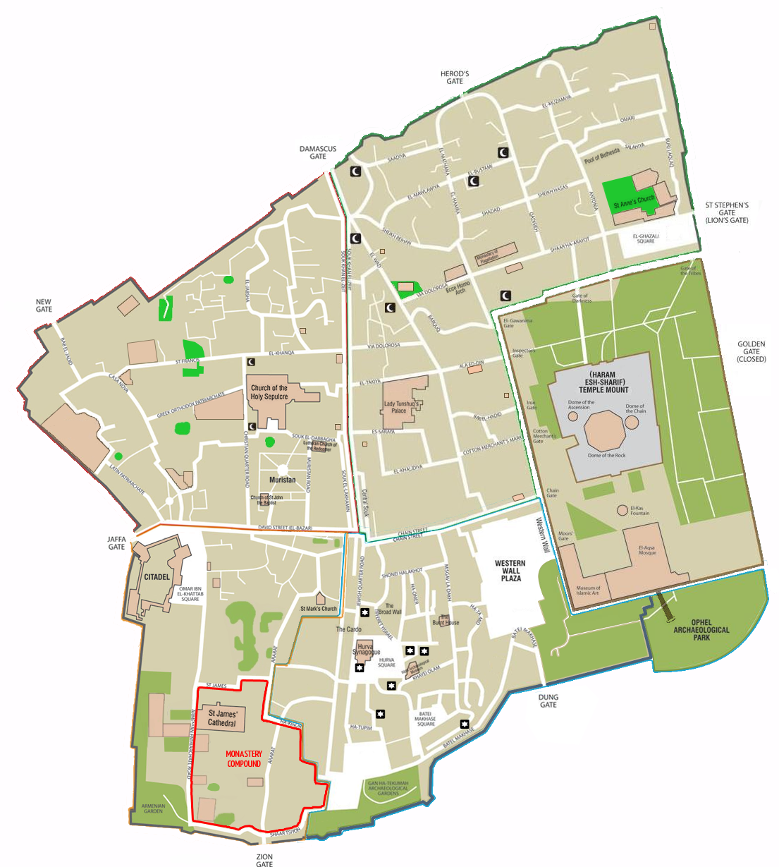
Jerusalem Four Quarters
Muslim Quarter
Temple Mount
Christian Quarter
Jewish Quarter
Armenian Quarter

Slide 19
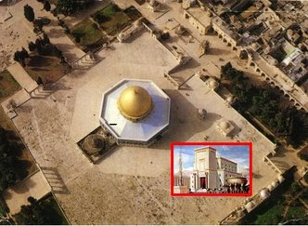
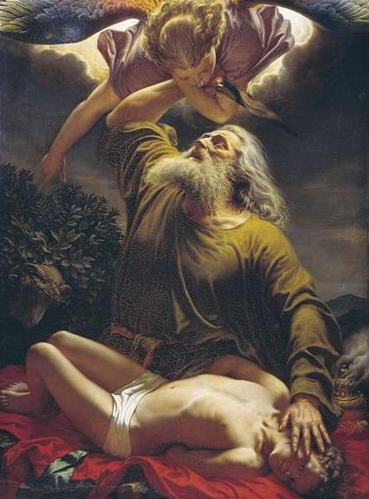
Solomon’s Temple
Temple Site
(Noble Sanctuary)
Mount Moriah
(Abraham)

Slide 20
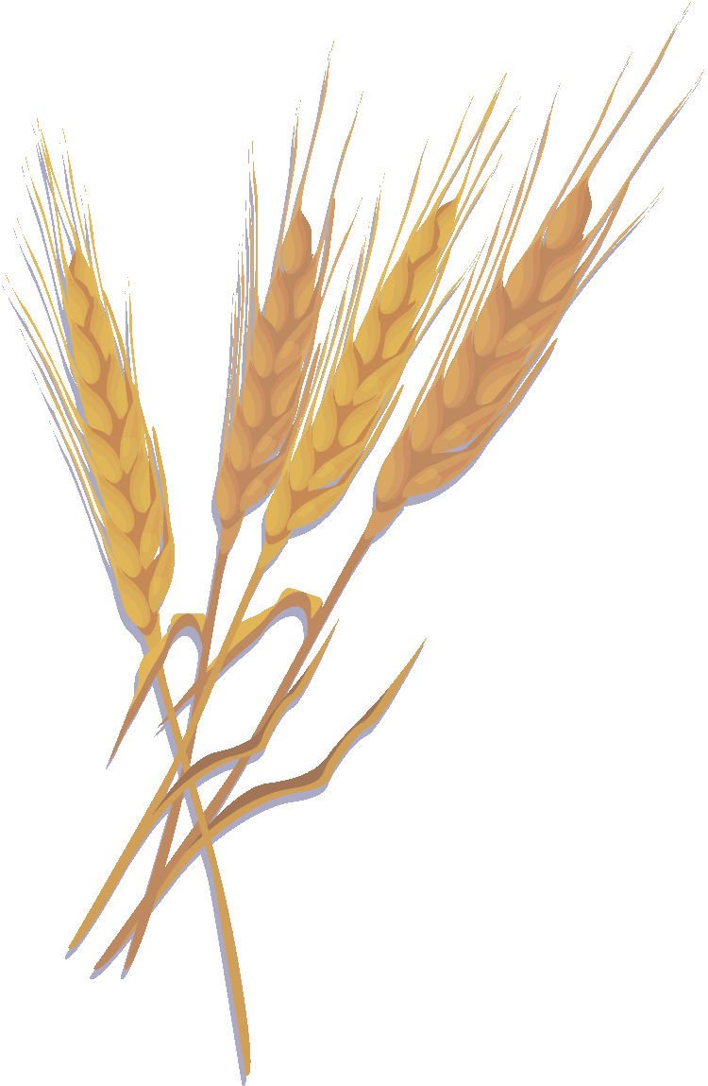
Solomon’s Temple
Temple site
Selection by Solomon
Jewish tradition (Midrash) has Solomon picking the site because of the piety of two brothers who grew grain on the site.
The poor bachelor brother took grain to his married rich brother because of the rich brother’s large family.
The rich married brother took grain to the poor brother because of his poverty.

Slide 21
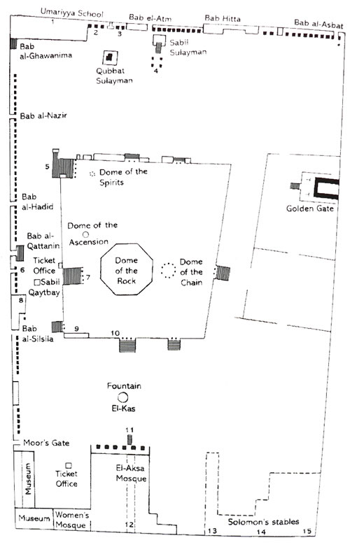
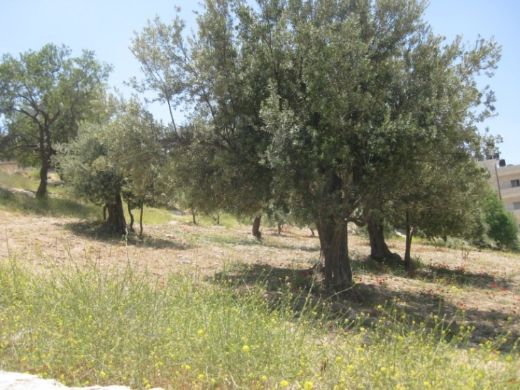
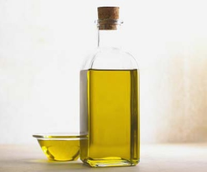
Solomon’s Temple
Present temple mount (noble sanctuary) is aligned with Mecca.
Temple was aligned eastward
Possible alignment to Garden of Gethsemane.
East

Slide 22
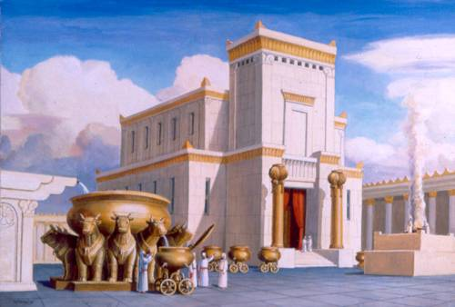
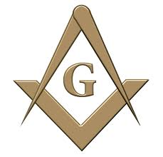
Solomon’s Temple
Built by Solomon
20,000 workers just to cut wood
80,000 masons
Finest materials
May have been the most beautiful building in the world at that time
Masonic claims

Slide 23
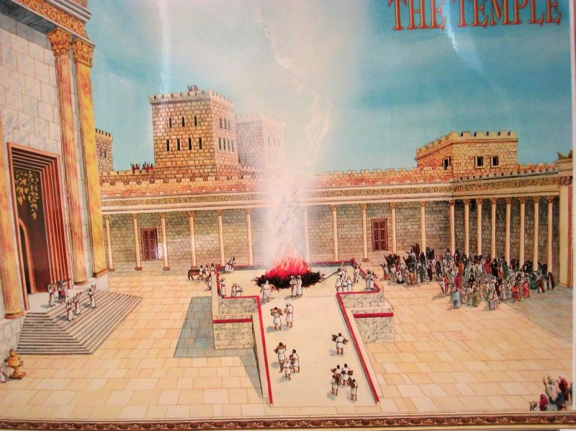
Solomon’s Temple
Sacrifice controlled by the priests.
Take the breath and blood together.

Slide 24
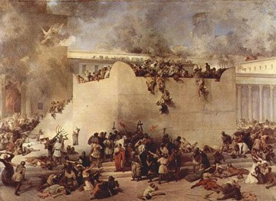
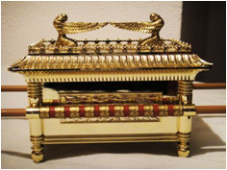
Babylonian Invasion
Solomon’s temple destroyed by Babylonian invasion in about 600BC.
By Jewish tradition the ark was buried beneath the temple.

Slide 25
Babylonian Punishment

Slide 26
Second Temple
Some Jews allowed to return to Jerusalem.
Many stayed behind in Babylon and
gave up the temple part of their religion.
Temple re-built about 500-400 BC.
Ezra and Nehemiah
Zerubabel was governor of Jerusalem
Second temple not as luxurious as the temple of Solomon.

Slide 27
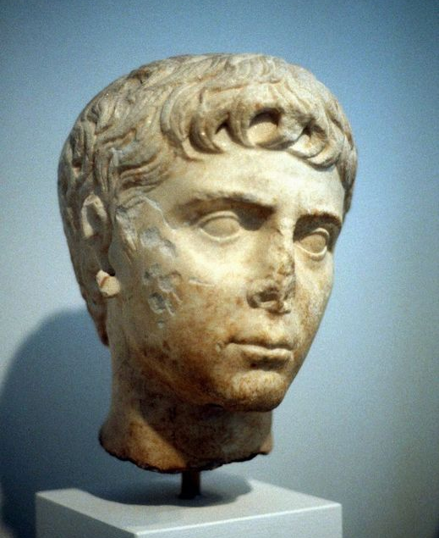
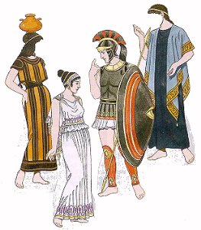
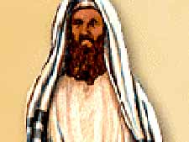
Jews in a Hellenistic World
Greeks (under Alexander) conquered the Middle East.
Greek culture became dominant.
Some Jews resisted adopting Greek culture and tried to stay apart.
Pharisees

Slide 28
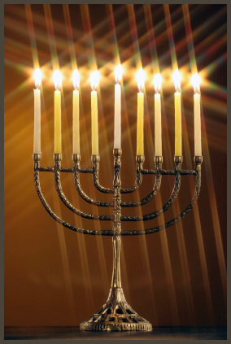
Defilement of the Temple
by the Greeks
About 167 BC.
Greek ruler (Selucus) demanded that all people in his territory worship him.
Maccabees refused and began a successful revolt.
They cleansed and rededicated the temple.
Miracle of Hanukkah.

Slide 29
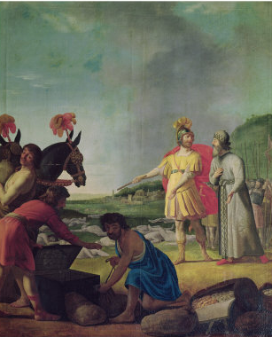
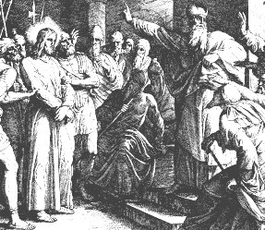
Maccabean Period
Self-rule by Jews for about 150 years.
Maccabean rulers made themselves the high priests and appointed other priests.
Linkage of kings and temple.
These priests became the Sadducees.

Slide 30
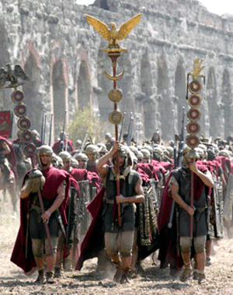
Maccabean Period
Corruption of the Maccabean house and internal revolts.
Romans intervened to impose order and named Herod as the king.

Slide 31
Second (Herod’s) Temple
Refurbished by Herod
Gain favor with the Jews
Very large and luxurious
Used a unique rock style
Model City

Slide 32
Second (Herod’s) Temple
Linkage of priests and king perpetuated with Herod naming the high priest.

Slide 33
Second Temple
Temple at the time of Christ
Destroyed by the Romans, 66-70 AD.
Arch of Titus

Slide 34
Judaism After the Temple
Jews physically removed and prevented from living in Jerusalem or near vicinity.
Temple to be rebuilt before the coming of the Messiah.

Slide 35
Judaism After the Temple
Jews adopt a new religion.
Old religion only had temple worship.
Without the temple, Judaism lacked critical elements.
No means for expiation of sins.
Ancient synagogue

Slide 36
New View of Scripture

Slide 37
Jews After the Temple
Jews adopt a new religion.
Step 1 in the new religion:
New view of scripture
Step 2 in the new religion:
Rise of rabbis
Renewed use of the synagogue
Awakening of the use of prayer

Slide 38
Rabbis, Synagogue, Prayer

Slide 39
Jews in the Middle Ages
Jews needed to reduce their oral traditions to writing in order to preserve them.
Babylonian and Palestinian Talmuds created.
Written in 2nd Century
Discussion and arguments

Slide 40
Western (Wailing) Wall
Holiest place in world for Jews
Prayers
(individual and group)
Prayer scrolls
Separate men and women
Bar Mitzvah
Men
Men
Women
Women

Slide 41
Rabbinic Judaism
Vestiges of the temple

Slide 42
Thank You
Thank You
Religion has been critical to civilization from the beginning.

