Slide 1
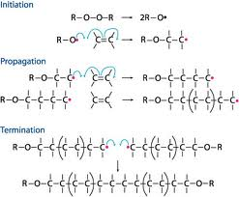
Polymeric Materials Molecular View
MFG 355

Slide 2
Level of focus – Molecular View
Molecular features at the atomic level
Bonding
Chemistry
What is a polymer
Polymerization reactions
Addition polymerization
Condensation polymerization

Slide 3
Fundamentals of Matter
Metals
Non-Metals
(Give up electrons)
(Take on electrons)
3

Slide 4
Bonding (attractions)
Ionic – Metal with Non-metal
-
+
Na
Cl
Transfer of electron

Slide 5
+
-
+
-
Ionic Bonds
Negatively Charged Non-Metal Ion
Positively Charged Metal Ion
Part
-
+
-
+
+
-
+
-
-
+
-
+
Crystal structure showing charged metal and non-metal ions and the ionic bonds between them

Slide 6
Bonding (attractions)
Metallic – Metal with Metal
+
+
Fe
Cr
Sea of electrons

Slide 7
+
+
-
+
+
-
Sea of electrons
Positively Charged Metal Ion
-
-
Part
-
-
+
+
+
+
-
-
-
-
-
+
-
+
+
+
-
-
-
-
-
-
+
+
+
+
-
Crystal structure showing charged metal ions and the sea of electrons between them

Slide 8
Bonding (attractions)
Covalent – Non-metal with Non-metal
Cl
Cl
Shared electrons

Slide 9
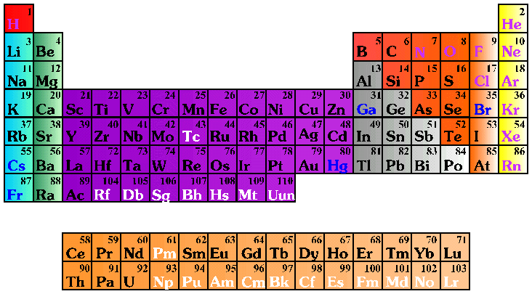
Periodic Table of the Elements
Metals
Non-Metals
Ceramics
(Ionic Bonds)
Polymers
(Covalent Bonds)
Metals
(Metallic Bonds)

Slide 10
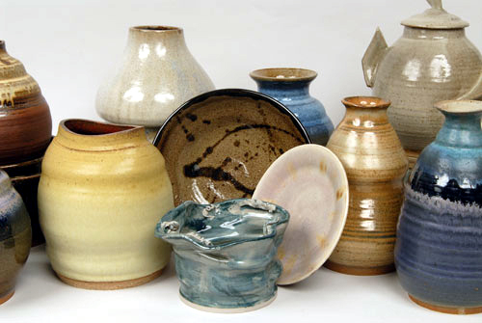
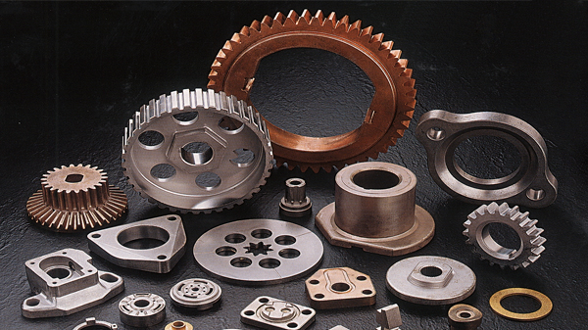
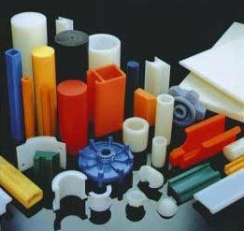
Solid Materials – 3 Types
Ceramics
Metals
Polymers
These differ, at the most fundamental level,
in the types of bonds between the atoms

Slide 11
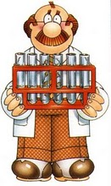
Now, a little more chemistry
Don’t be afraid!

Slide 12
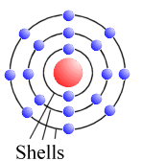
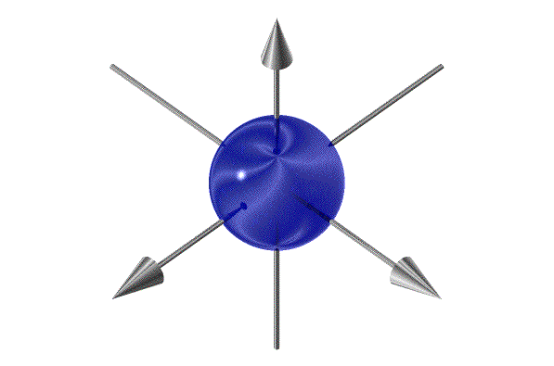
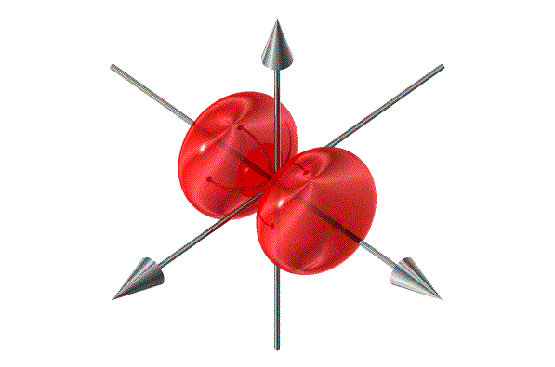
Atomic Orbitals
Electrons
Shells (n=1,2,3,4,5)= rows on periodic table
Orbitals (s,p,d,f) = columns on periodic table
s
p

Slide 13
Basic Organic Chemistry
Atomic Carbon has 4 electrons in its outer shell
All organic molecules contain Carbon
Valence bonds (number of bonds formed)
Carbon=4, Nitrogen=3, Oxygen=2, Chlorine=1, Hydrogen=1

Slide 14
Basic Rule
In molecules, the atomic bonds change to allow bonding with the approaching atoms
If 4 atoms approach, all 4 atomic orbitals change to equivalent molecular orbitals and spread apart
C
These are called sp³ molecular orbitals and they form σ molecular orbitals (cylindrical)

Slide 15
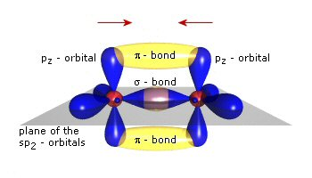
Basic Rule
If 3 atoms approach, 3 atomic orbitals change to equivalent molecular orbitals (called sp²) and one atomic orbital does not change (p_{z})
When carbon only bonds with three other atoms, the unchanged atomic orbital (p_{z}) overlaps above and below to make one molecular bond (a π-bond)

Slide 16
Bonding (attractions)
Function of
distance between atoms
Energy neutral line
System energy
Bond energy
Ι
Distance between atoms
Bond Length (average)

Slide 17
Resin Rules
Resin Rule: Polarity occurs when certain highly electro-negative atoms are present in the molecule
Electronegative atoms withdraw electrons from their neighboring atoms
Highly electronegative atoms are: F, O, N, and Cl
Attractions between polar areas on molecules or atoms result in secondary bonds
These bonds are much weaker than the three types of primary bonds (ionic, metallic, covalent)

Slide 18
Bonding (attractions)
Secondary bonds
Polar bond/Hydrogen bond
One atom in a covalent bond is more negative than the other
Atoms that cause polar bonding = F, O, N, Cl
Electrons spend more time around the more polar atom
Partial charges
δ-
δ+
C
O
Unequal sharing

Slide 19
Polarity – Magnet Analogy
N S
S N
S N
S N
δ+
δ-
δ+
δ-

Slide 20
Secondary Bonds
Attractions between polar areas on molecules or atoms result in secondary bonds
These bonds are much weaker than the three types of primary bonds (ionic, metallic, covalent)
Primary bond
Secondary bond
Energy neutral line
System energy
Secondary bond energy
Primary bond energy
Distance between atoms

Slide 21
Bonding in polymers by polarity
Polar areas on the polymers attract oppositely charged polar areas on other molecules
δ+
δ-
Secondary bond
δ+
Polyester
δ-
Attacked by water molecules

Slide 22
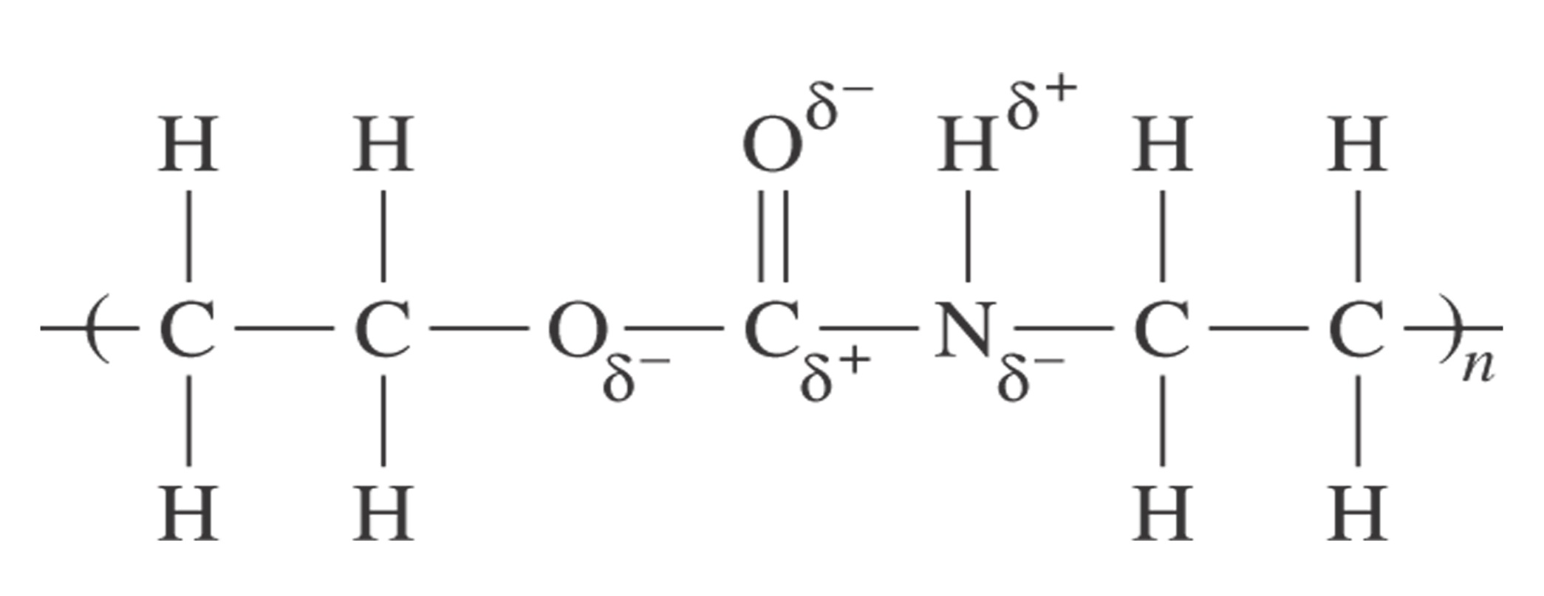
Polymers
Polarity in polymers

Slide 23
Weight gain in water of polyester and vinyl ester resins because polyester is more polar than vinyl ester
6
―
5
―
Polyester resin
4
―
●
●
●
Weight gain (%)
3
―
2
―
●
Vinyl ester resin
1
―
□
□
□
□
●
│
│
│
│
│
0
□
0
50
100
150
200
250
Exposure time (hours)

Slide 24
Bonding
Non-polar areas also attract each other
Hence areas within molecules attract other areas that are similar
Non-polar attractions are even weaker than polar attractions
Like-attracts-like rule

Slide 25
Bonding – Coupling Agents
δ+
Fiberglass
− A highly polar molecule
δ-
Sizing or coupling agent
− Mixed polar/non-polar
Polar
regions
attract
Non-polar
δ+
Nonpolar regions (weak attraction)
δ-
δ+
Polyester
− Largely non-polar with a polar end

Slide 26
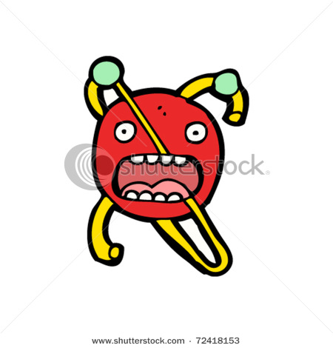
Now, since you know about atoms and molecules, it is time for a little story
Two atoms were walking along the street and the first atom said to the other:
“I’ve lost an electron.”
The other said, “Are you sure?”
The first answered, “Yes, I’m positive!”

Slide 27
Functional Groups – Determining Properties

Slide 28
Resin Rules
Resin Rule: Aromatic groups change the mechanical, thermal, flammability and weathering properties of a polymer.
Aromatic (benzene) rings are hard, flat entities
Aromatic rings increase stiffness and strength of the polymer, especially as they are integrated into the backbone or into a network
Aromatic rings increase thermal stability
Aromatic rings decrease flammability and smoke
Aromatic rings decrease UV stability

Slide 29
Polymers − Molecular shape
Aromatic − Contains the benzene group (sometimes called phenyl group)
Increases stiffness
Increases strength
Increases non-flammability
Aliphatic −Does not contain the benzene group
Increases flexibility
Increases toughness
Increases weatherability

Slide 30
H
H
H
H
H
H
a) Aromatic group (benzene)
b) Polystyrene (pendant
aromatic)
c) Epoxy (aromatic backbone)
Aromatic molecules
d) Phenolic (aromatic network)

Slide 31
Flammability
Flame Spread Index
Specific Optical Density
Vinyl Ester
Vinyl Ester
Epoxy
Epoxy
FR Polyester
FR Polyester
Phenolic
Phenolic
10
20
30
40
100
200
300
400
500
600
(ASTM E-162 for thermoset
composites)
(ASTM E-662 for thermoset
composites)

Slide 32
Resin Rules
Resin Rule: Materials containing halogen atoms (F, Cl, Br, I) have good flame retardance properties.
Smoke evolution is increased with halogens

Slide 33
Halogenated polymers
Polyvinyl chloride (PVC)
Polytetrafluoroethylene (PTFE)
Brominated Epoxy

Slide 34
Polymers
Polymers can be natural (like wood, cotton, wool, leather)
Polymers can be man-made (plastics)
Polymers can be easily shaped (molded)
Polymers have other advantages over ceramics and metals

Slide 35
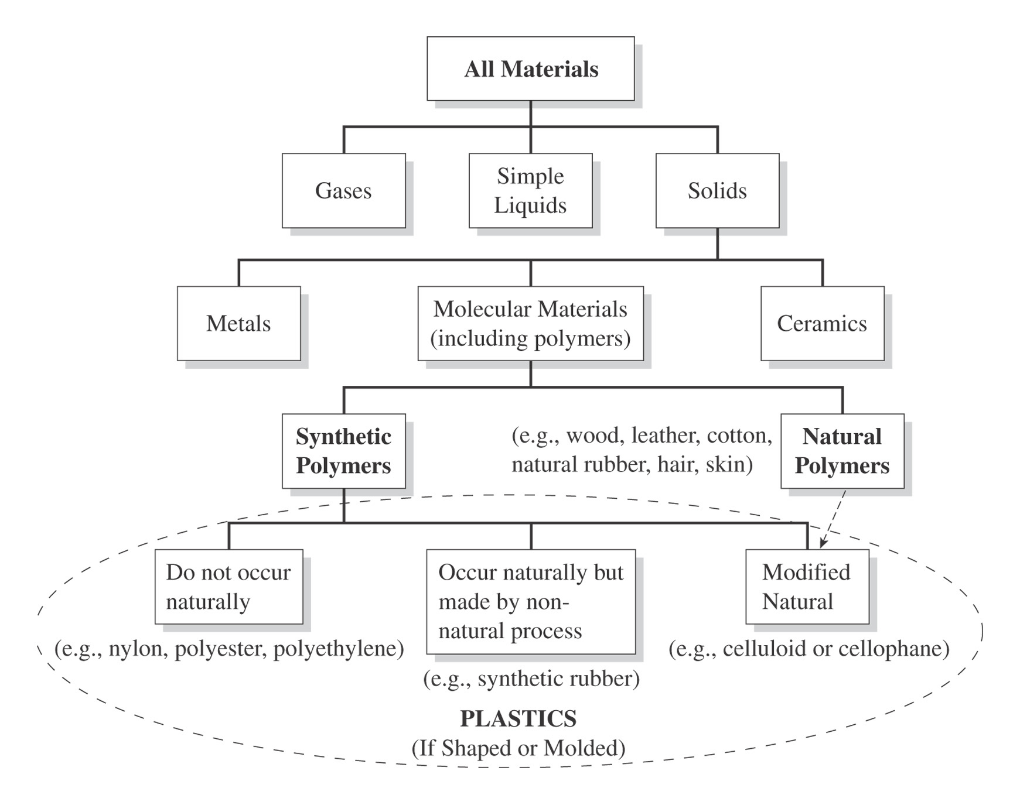
Materials Taxonomy

Slide 36
Polymers
Made from small molecules (monomers) which are linked together
“mono” means one
“mer” means unit
The linked monomers form a chain-like structure called a polymer
“poly” means many

Slide 37
Polymers
M
Monomers
M
M
M
M
M
M
M
M
M
M
M
Covalent
Bonds
M
M
M
Polymer
M
M
The links are the covalent bonds between the atoms

Slide 38
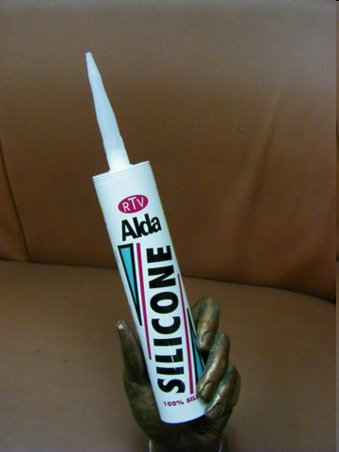
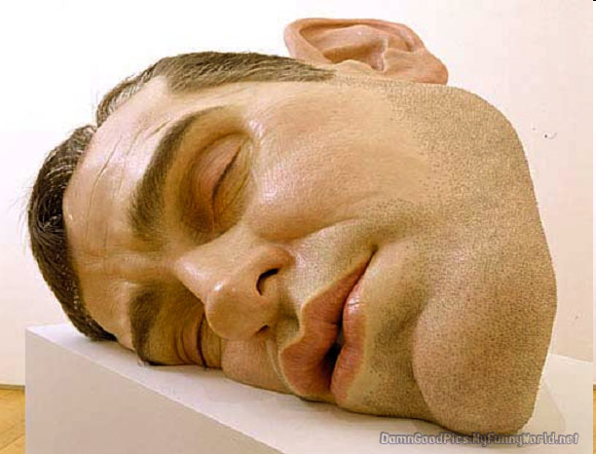
Polymers
Carbon based and silicon based
Almost all polymers are based on carbon
Silicones and related polymers are the only silicone based polymers

Slide 39
Addition Polymerization
Mechanism
Monomer in vessels (temperature and pressure)
Initiator—free radicals
Attack C=C (π bond)
Bond and make new free radical
New π bond reaction
New free radical created
Continuation
Termination

Slide 40
Addition Polymerization

Slide 41
Addition Polymerization
Initiation and growth

Slide 42
Addition Polymerization
Chain Termination—Unreacted end, another chain

Slide 43
Addition Polymerization
Chain Termination—Unreacted Peroxide

Slide 44
Addition Polymerization
Chain Termination—Ozone Quench

Slide 45
Addition Polymerization -- Variables
Catalysts (not the same as initiators)
Usually metal or metal oxides
Give a place for the growing molecule to be located
Increase effectiveness of collisions (reactions)
Concentrations (pressure)
Temperature (high)
Contaminants
Other monomers

Slide 46
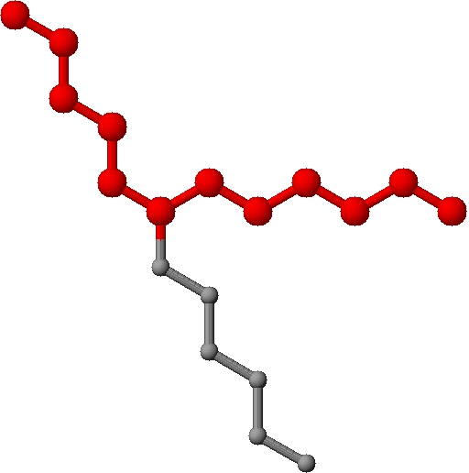
Addition Polymerization
Copolymers from Addition Polymerization
Block Copolymer
Random Copolymer
Regular Copolymer
Graft Copolymer

Slide 47
Condensation Polymerization
Mechanism
Monomers (2)
Each has two reactive sites
Monomer ends react
Condensation
Removal of condensate
Chain termination ends reaction

Slide 48
Polyester polymerization
Monomers
Acids A
(di-acids)
A
G
Glycols G
(di-alcohols)
A
G
A
G
A
Polyester polymer
G
A

Slide 49
Polyester polymerizationn
One end of the di-acid (the OH group) reacts with one end of the glycol (the H group) to form water (H−OH)
The water separates from the polymer and condenses out as a liquid
These type of polymerization reactions are called condensation reactions

Slide 50
Condensation Polymerization of a typical polyester
Step 1: Monomers react
O
O
O
O
HO―G―OH
+
H
O
C
A
C
O
H
HO―G―O―C―A―C―OH
+ H₂O
Glycol
Di-acid
Ester
Step 2: New molecule reacts with new monomers
New bond
O
O
O
O
H
O
C
A
C
O
H
+
HO―G―O―C―A―C―OH
+
HO―G―OH
Di-acid
Glycol
O
O
O
O
HO―C―A―C―O―G―O―C―A―C―O―G―OH
+ 2 H₂O
Ester
Ester
Ester

Slide 51
Condensation Polymerization
Monomers/Polymers

Slide 52
Addition vs. Condensation
Addition polymerization
Condensation polymerization
Polymer Growth Mechanism
Dependence on previous step
Initiator needed
Type of monomer
Number of active sites (functional groups) per monomer
Number of different types of monomers needed to form polymer
By-product formed
Basic (polymer repeat unit) representation
Polymer chain characteristics
Branching
Chain reaction
Yes—dependent sequential events
Yes
Contains carbon-carbon double bond
1
1
No
Monomer without the double bond and with bonds on either side
A few, long chains
Possible
Step-by-step reactions
No—independent events
No
Has reacting bifunctional groups on the ends
2
2 (usually)
Yes (usually)
Two monomers joined (without condensate)
Many not very long chains
Unlikely

Slide 53
Thank You
Remember the molecules

