Slide 1
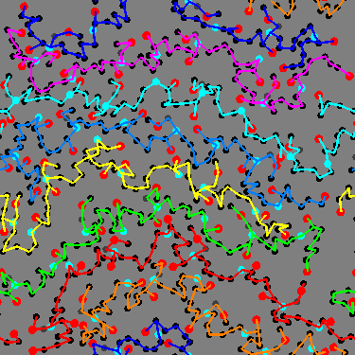
Microstructures
MFG 355

Slide 2
Level of focus – Microstructures
Gross molecular features
  Molecular length
  Molecular shape
  Molecular interactions
    Crystallinity
    Intermolecular bonding
Effects of heating and cooling

Slide 3
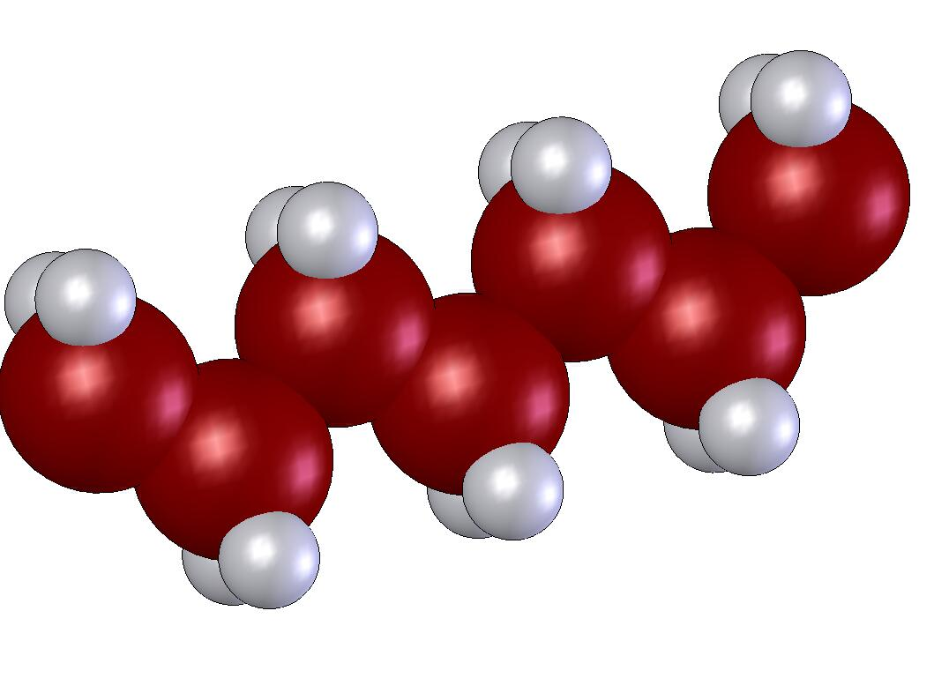
Molecular Weight
Monomer
Polymer
Molecular weight = length/weight of the polymer chain

Slide 4
Thermal Effects –
Solids, Liquids Gases
Why polymers are solids at room temperature
  n = 2 (ethylene – gas)
  n = 4 (butane – gas)
  n = 6 (hexane – liquid)
  n = 8 (octane – liquid)
  n = 10 to 20 (cooking oils – liquids)
  n = 20 to 30 (cooking greases – solids)
  n = >100,000 (typical polyethylene – solid)
H
( )_{n}
–C–
General molecular formula
H

Slide 5
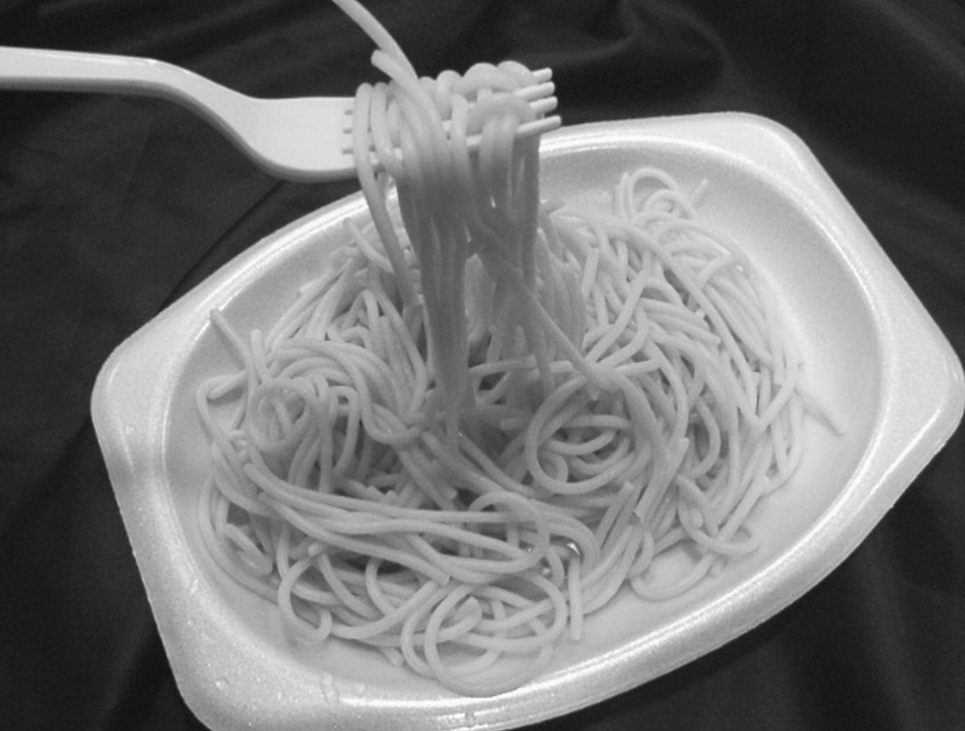
Resin Rules
Resin Rule: Increases in molecular weight (length of the polymer chain) result in increases in most mechanical and thermal properties.
  Many millions of chains exist in a typical polymeric part
  Entanglement inhibits molecular motion
  Longer chains are more entangled
  Analogy: spaghetti

Slide 6
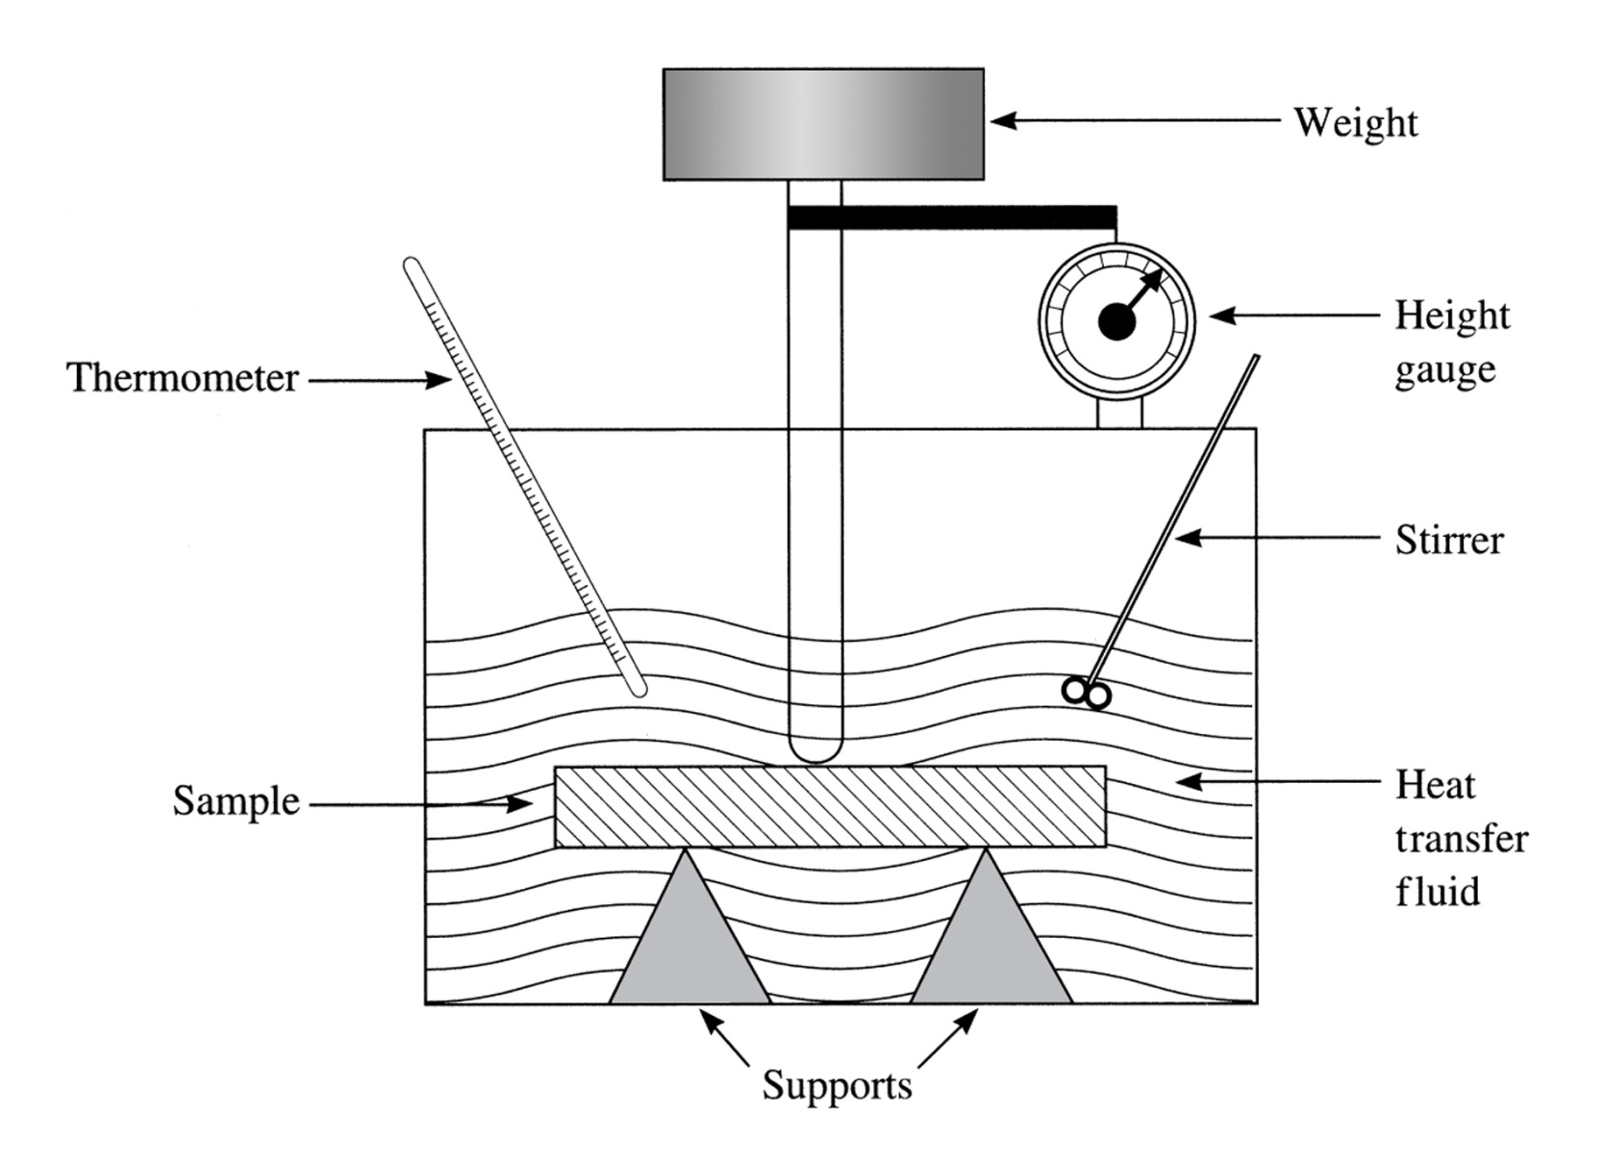
Resin Thermal and Mechanical Properties
Heat Deflection Test (HDT)
Typical Polymer
{
Heat Deflection
Glass Transition (T_{g})
Decomposition (T_{d})
Melting (T_{m})
Temperature

Slide 7
Resin Thermal and Mechanical Properties
Flexibility
T_{g}
Typical Polymer
Temperature
Heat Deflection
Glass Transition (T_{g})
Temperature

Slide 8
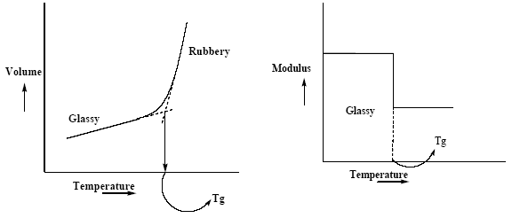
Glass Transition Temperature (T_{g})
T_{g} is the transition from rigid to flexible in the solid state
  Example: rubber that is cooled by liquid nitrogen

Slide 9
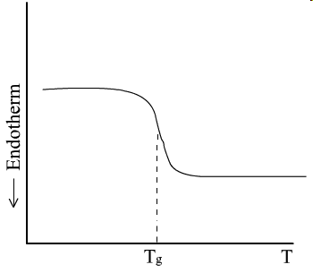
Glass Transition Temperature (T_{g})
T_{g} is usually measured with sophisticated equipment
  Differential Scanning Calorimeter (DSC)
  Thermogravimetric Analyzer (TMA)
  Dynamic Mechanical Analyzer (DMA)
DSC

Slide 10
Resin Thermal and Mechanical Properties
ΔG=ΔH-T_{m}ΔS = 0
T_{d}
Flexibility
T_{m}
T_{g}
Typical Polymer
Temperature
{
Heat Deflection
Glass Transition (T_{g})
Decomposition (T_{d})
Melting (T_{m})
Temperature

Slide 11
Temperature transitions
Small polymer (low molecular weight)
Solid
Liquid
Char and gases
│
│
Melting-Freezing point
Decomposition point
Large polymer (high molecular weight)
Solid
Liquid
│
Char and gases
│
Melting-Freezing point
Decomposition point
Temperature

Slide 12

Resin Rules
Resin Rule: Increases in molecular weight (length of the polymer chain) result in increases in viscosity and decreases in ease of processing.
  Ease of processing is associated with:
    Lower processing temperature
    Lower resin viscosity (easier flow)
Low viscosity fluid
High viscosity fluid

Slide 13
Molecular Structure
Chain Length – A measure of polymerization
  Difficult to measure
    How do you count atoms?
Too many to count

Slide 14

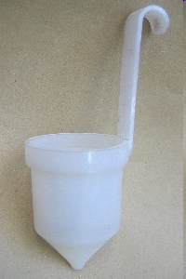
Measuring factors related to chain length
Viscosity can be related to molecular weight
  Measure the viscosity [η]
  Calculate the Molecular Weight (M)
    [η] = KMª
Capillary pipette
Viscosity cup

Slide 15
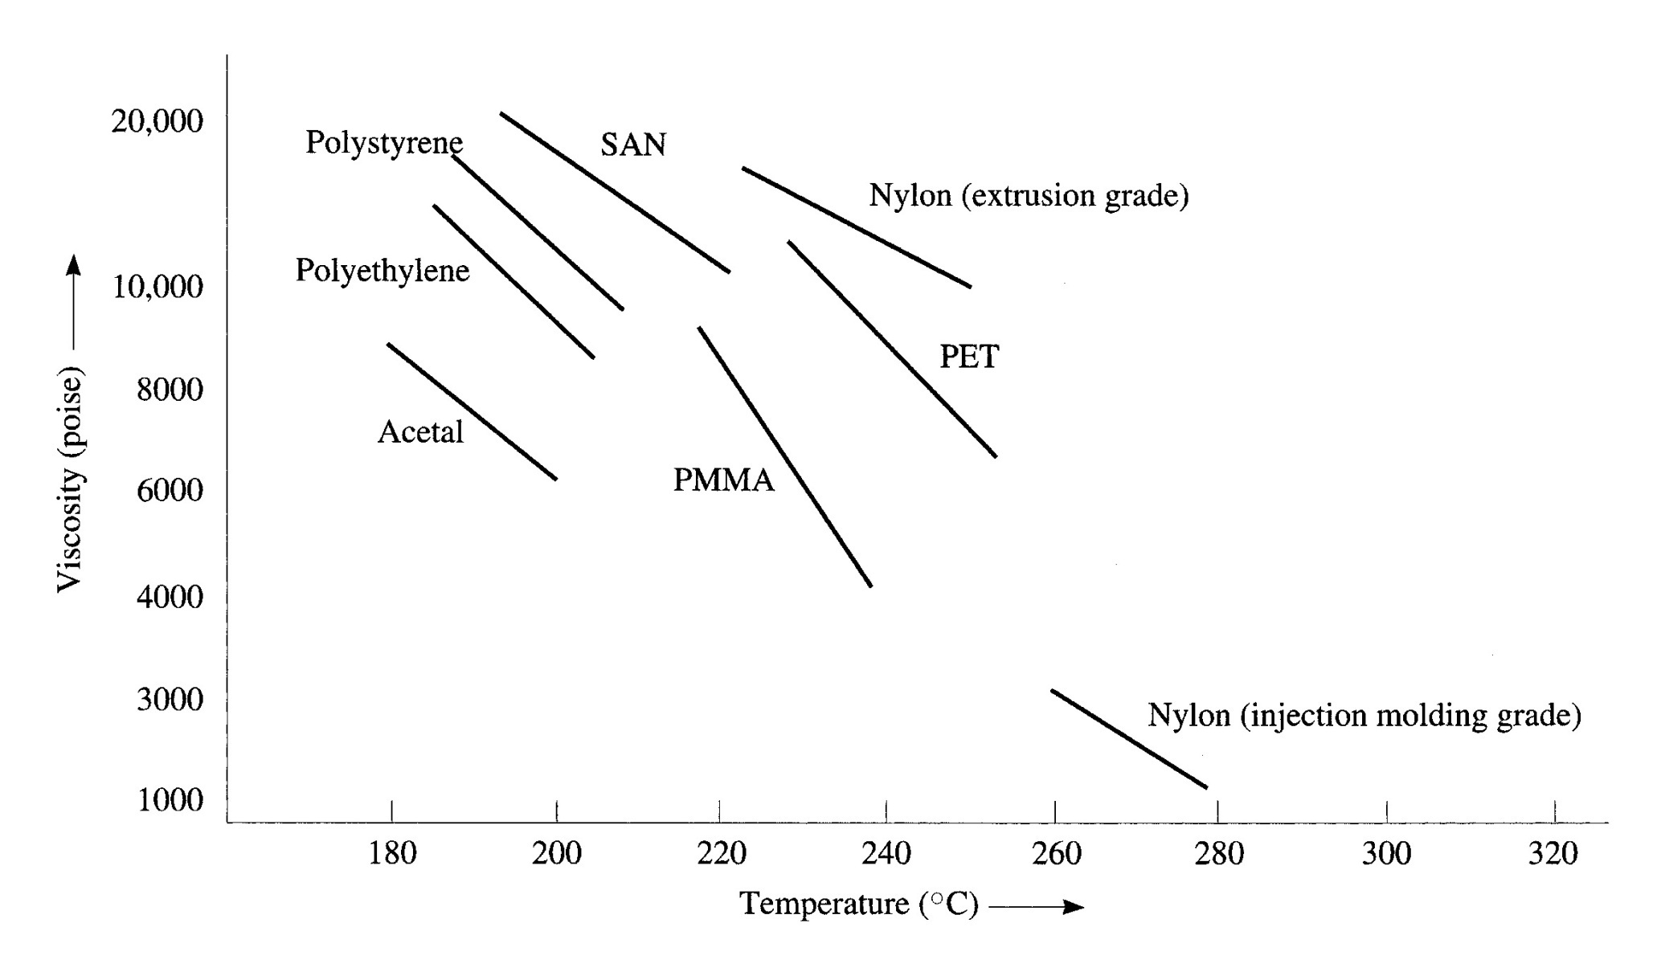
Viscosity Thermal Effects

Slide 16
Molecular Weight
Statistical measurement (approximation)
Two important parameters
-Average Molecular Weight
-Molecular Weight Distribution

Slide 17
Molecular Weight Distributions
(Statistical Measure)
Broad Distribution
Narrow Distribution
Skewed Distribution
Bimodal Distribution
Weight (g)

Slide 18
Degree of polymerization
Generic representation of a polymer = –A–
( )_{n}
DP = n (number of repeat units in the chain)
n = M_{n}/M_{o}
where
M_{n} = Ave Molecular weight
M_{o} = Weight of a repeat unit
Notes:
What are typical degrees of polymerization i.e. min and maximum??

Slide 19
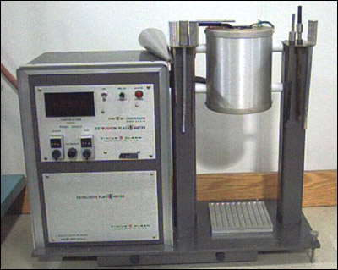
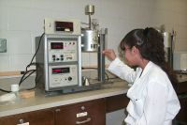
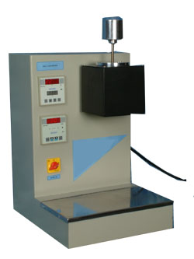
Effect of molecular weight
Measuring the effect of molecular weight on processing
  Melt Index
    Melting the polymer and timing the flow through an orifice
    Essentially measures viscosity
    Reports the values as weight of polymer per time

Slide 20
Molecular Weight and Melt Index
Low melt index
High
Molecular Weight
Melt Index (typical values)
  HDPE 0.1 - 33 g/10 min
  LDPE 0.2 - 70 g/10 min
  LLDPE 0.2 - 20 g/10 min
  PP 2.0 - 36 g/10 min
Low
High melt index

Slide 21
The Great Dilemma in Polymers
Polymers must have good properties
  Good properties are favored by high molecular weight
Polymers must have good processing
  Good processing is favored by low molecular weight

Slide 22
The Great Dilemma In Polymers
Thermoplastics meet the dilemma by compromise
  High enough molecular weight to get adequate properties
  Low enough molecular weight to process OK
Thermosets meet the dilemma by crosslinking
  Low molecular weight initially (for wetout and processing) followed by curing to increase molecular weight
  No compromise is required

Slide 23
Atom in a polymeric molecule
Covalent bond (shared electrons)
Crosslink bonds
(shared electrons)

Slide 24
Polymers − melting, molecular weight, crosslinking
Polymers are classified into two groups depending on whether they are crosslinked
  Thermoplastics (not crosslinked)
  Thermosets (crosslinked)
Crosslinks are covalent bonds that link between the polymer chains
  The crosslinks are about the same strength as bonds along the chain
When crosslinking occurs, the polymers will no longer melt
  When heated to a high temperature, they burn or char

Slide 25
Thermal Properties
Typical Thermoplastic
{
Heat Deflection
Glass Transition
Decomposition
Melting
Typical Thermoset
Heat Deflection
Glass Transition
X
Decomposition
Melt
Temperature

Slide 26
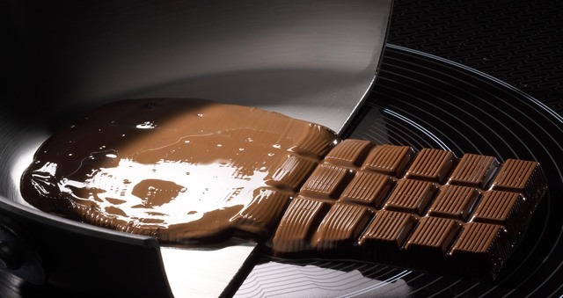
Thermoplastics (Summary)
Thermoplastics are not crosslinked and so they will melt
Thermoplastics are processed (molded) as molten liquids
Thermoplastics are cooled to solidify
Thermoplastics can be re-melted repeatedly
Kitchen example:
candy
Examples of thermoplastics: polyethylene, polystyrene, nylon, polycarbonate, acrylic, Teflon®, PET (thermoplastic polyester)

Slide 27

Thermosets (Summary)
Thermosets are crosslinked and do not melt
Crosslinking is sometimes called curing
Thermosets are loaded into the mold (processed) as room temperature liquids or low-melting solids
Thermosets are heated to solidify (harden)
Kitchen example:
cake
Examples of thermosets: unsaturated polyesters, vinyl esters, epoxies, phenolics, polyimides, silicones

Slide 28
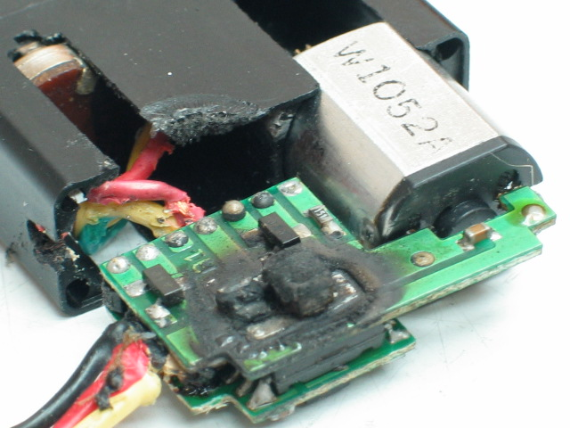
Thermoplastics and Thermosets
Melting vs. decomposition
Melted
Decomposed

Slide 29
Resin Rules
Resin Rule: The presence of crosslinks changes dramatically the mechanical, thermal, and viscosity properties of polymers.
  Mechanical properties increase with crosslinking
  Thermal transitions increase with crosslinking
  Viscosity increases with crosslinking
  Thermoset polymers all have crosslinks
  Ionic crosslinks (rare) can be broken with heat and, therefore, occur in thermoplastics

Slide 30
Viscosity curves for typical thermoplastic and thermoset
Gel Point
Solids
Liquid-Solid Line
Viscosity
Liquids
Thermoset
thinning due to
temperature
Thermoset
crosslinking
Thermoplastic
(Reversible)
Time/Temperature
Thermoset
combination
(What is seen)
(Non-Reversible)

Slide 31
Resin Rules
Resin Rule: When portions of polymers pack together, a crystalline-like internal structure is formed.

Slide 32
Non-Metal Atoms
Crystalline Region
Part
Amorphous Region
Covalent Bond (shared electrons)

Slide 33
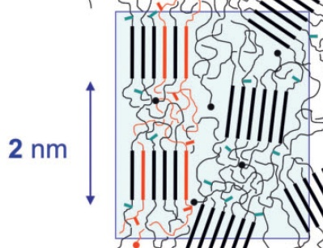
Crystallinity

Slide 34
Polymers − Physical structure
Amorphous − Polymers that have no regular internal structure (just like the spaghetti)
Semi-crystalline − Polymers that have some internal structure (regular packing)
  Semi-crystalline polymers vary in the amount of packing (crystallinity)
  Semi-crystalline polymers with high percentage of packing are sometimes called crystalline
  No polymers are 100% crystalline
  Crystallinity increases strength and stiffness
  Crystallinity decreases permeation

Slide 35
Amorphous and Crystalline
Crystalline
Regions
Amorphous
(random entanglement)
Semi-Crystalline or Crystalline
(regular packing)

Slide 36
Three-dimensional representation
of a crystalline polymer
Amorphous region
Crystalline region

Slide 37
Liquid Crystal Polymer
Crystalline areas in both solid and liquid states
Solid state
Liquid state

Slide 38
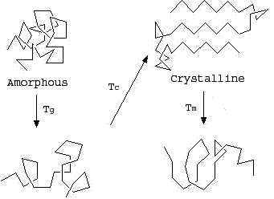
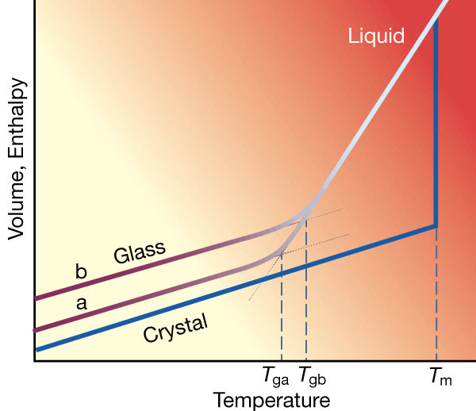
Transition Temperatures
Pure crystalline polymers have no transition from rigid to flexible except at melting
  No polymers are 100% crystalline and therefore almost all polymers have a T_{g}
Pure amorphous polymers have no sharp melting point
  The melting point listed is the point where the polymer flows easily

Slide 39
Resin Rules
Resin Rule: The presence of large molecular groups pendant to the chain or in the chain increases mechanical properties.
  “Barbed wire effect”
  Pendant groups can reduce (or prevent) crystallization
  Pendant groups and crystallization may work counter to each other in strength
  Flexible branching, rather than act like pendant groups, acts to facilitate flexibility

Slide 40
Pendant Groups
―CH₂―CH―CH₂–CH–
(
)_{n}
│
│
X
Y
Pendant groups

Slide 41
Molecular Structure
Pendant Groups
  Large groups increase mechanical and thermal properties

Slide 42
Molecular Structure (Steric)
Backbone
  Stiffness increases mechanical and thermal properties

Slide 43
Molecular Structure
Branching
  Decreases mechanical (stiffness and strength) and thermal properties

Slide 44
Other Thermal Effects
Aging
Oxidation
  Thermal protective additives
Thermal conductivity
Thermal expansion
Thermal stresses
Rates of reaction (Arrhenius equation)
  Rate = Ae^{-E/RT}

Slide 45
Thank You
Micro understanding is good

