Slide 1
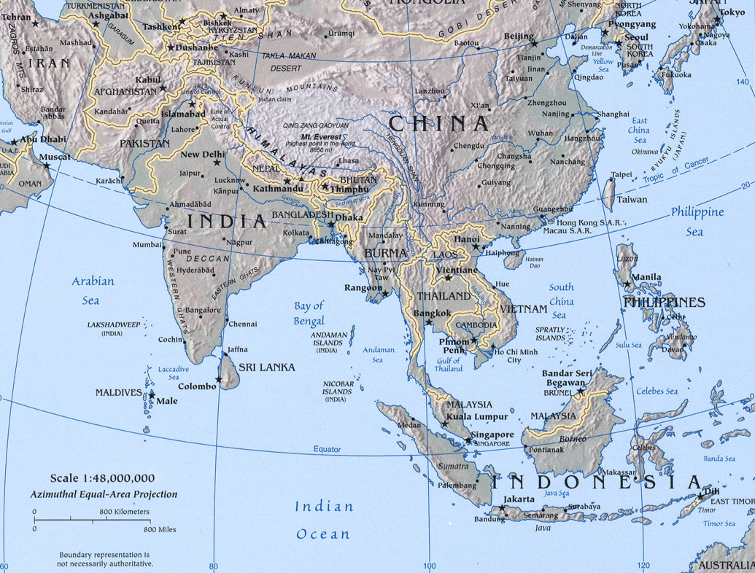
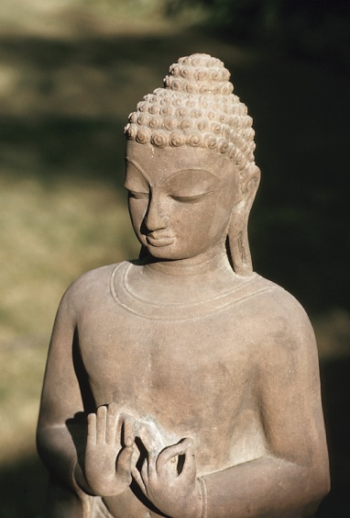
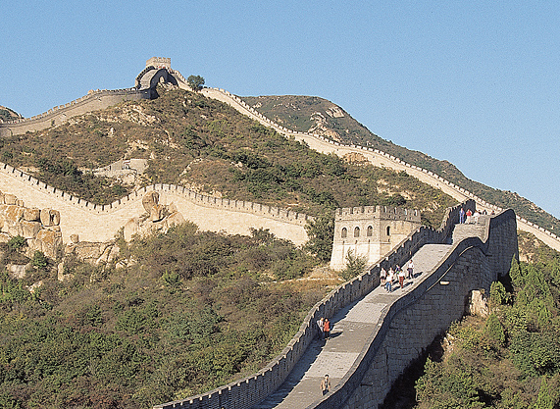
India and China Creativity Continues to Flow
CHINA
INDIA
India & China
Creativity
Continues to Flow

Slide 2
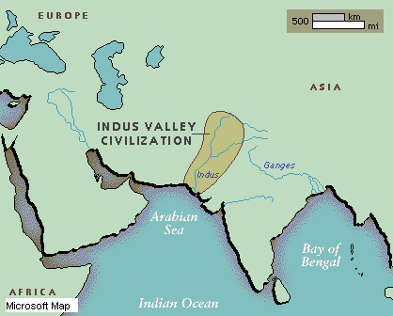
Indus River Valley Civilization
Dravidian society
About 2500 BC

Slide 3
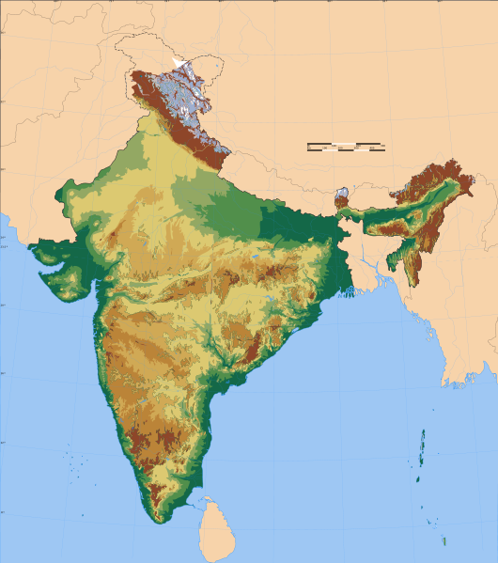
Aryans (1750 BC)
Indo-Aryan Migration
Into India, c. 1750 BC
Invasion by Indo-European tribes (Aryans)
War-like
Changed from urban to village society
Preservation of culture?
Hindu Kush
Plateau
of Iran
Himalayas
Vindhya Mts.
Arabian Sea
Deccan Plateau
Bay of
Bengal
INDIAN OCEAN

Slide 4
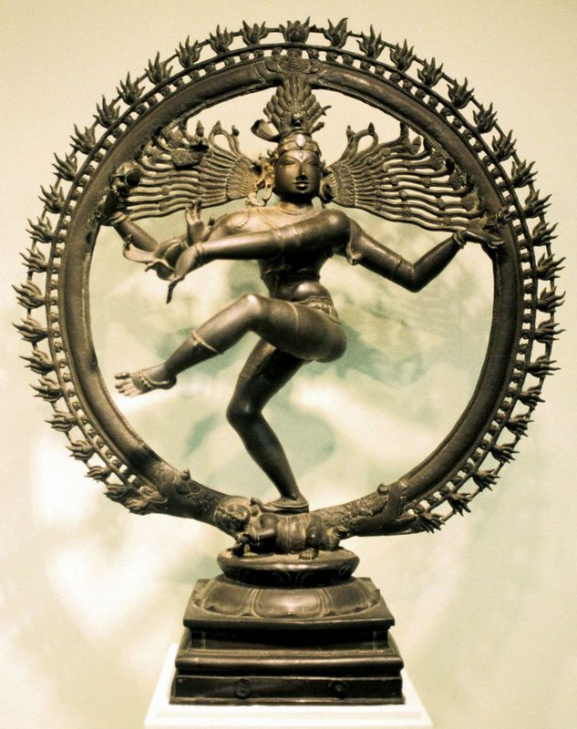
Aryan Contribution
Writing
Sanskrit (Aryan language)
Ruler called raja (compare to rey or rex in other Indo-European.languages)
Vedas (holy books)
Epic poems
Mahabharata (contains Bhagavad-Gita)

Slide 5
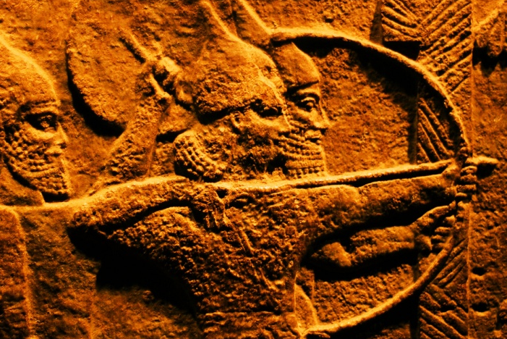
Aryans
Development of caste system
“Caste” = “color”
4 main castes:
1. Brahmans (priests)
2. Aristocrats and warriors
3. Peasants and craftsmen
4. Untouchables, outcasts
Aryan
Aryan
Drav.
Drav.
Reincarnation kept all in their place
Incorporated into Hinduism

Slide 6
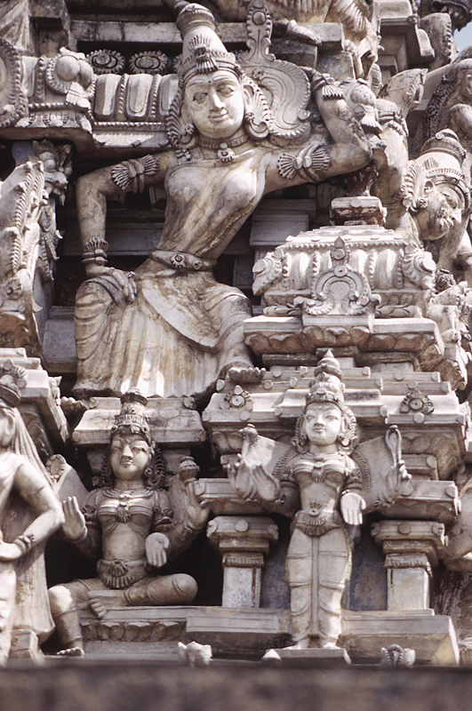
Hinduism
Its origin is in the Aryan faith and, therefore, it claims to be the oldest major religion.
Aryans had similar religion before their invasion in 1750 BC
Moses lived about 1300 BC
Third largest religion
96% of Hindus live in India
An umbrella term for many religions that are related in beliefs and origin
“Truth is one, although the sages (gurus) know it as many.”

Slide 7
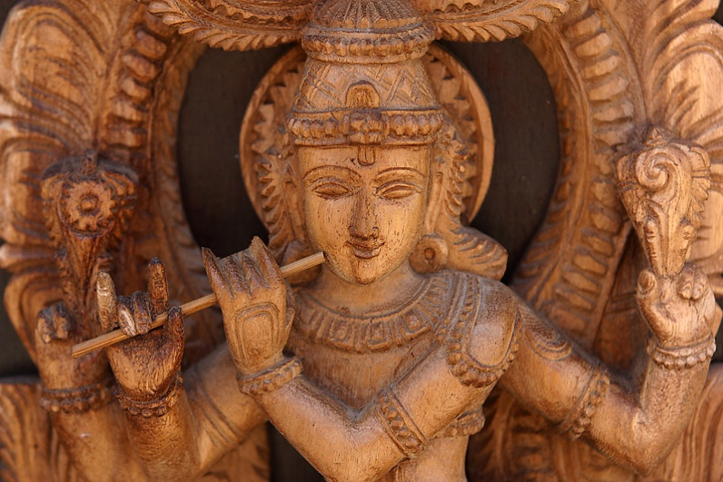
Hinduism
Essentially, any kind of spiritual practice followed with faith, love and persistence will lead to the same ultimate state of self-realization. Thus, Hindu thought distinguishes itself by strongly encouraging tolerance for different beliefs since temporal systems cannot claim sole understanding of the one transcendental Truth.
―Theology Professor (website)

Slide 8
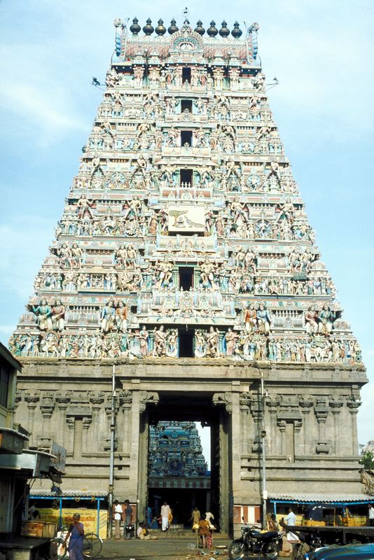
Hinduism
Four essential basic beliefs for any Hindu.
Karma
The totality of actions in this and future lives.
Reincarnation
Living again in another body. Life’s goal is to gain enlightenment and overcome reincarnation.
All-pervasive divinity
God is not manifest but is a father-mother god.
Dharma
There was order given by God when the world was created. The divine law includes respect for all life (often leading to vegetarianism).

Slide 9
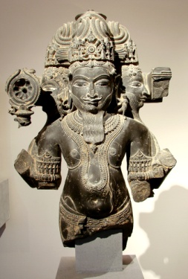
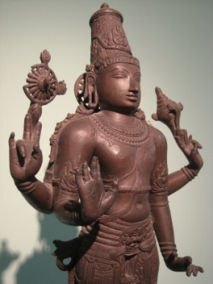
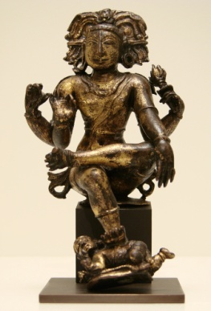
Hinduism
God has three principal aspects:
Bhadavan―personal aspect
Ishvara―controller of the universe aspect
Ishwar―formless, all powerful, abstract, but has taken forms to operate in the world
Forms that have been taken:
Lord Brahma―creator
Lord Vishnu―preserver
Lord Shiva―destroyer
God has many forms and avatars (taking a human body) which are often depicted in Hindu temples.
Brahma
Vishnu
Shiva

Slide 10
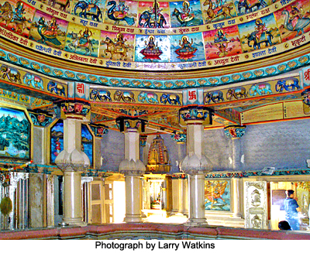
Hinduism—Practices
Daily devotional (usually at home)
Offering food to the god
Prayer
Reading scriptures
Attendance at temple (especially on holy days)
Temples are usually dedicated to one or two gods
Gurus–Give direction and interpretation
Cremation (quickly releases the soul)
Jain temple (related to Hinduism)

Slide 11
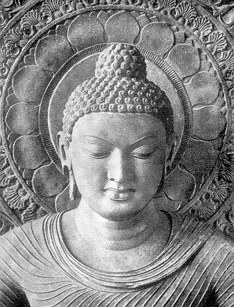
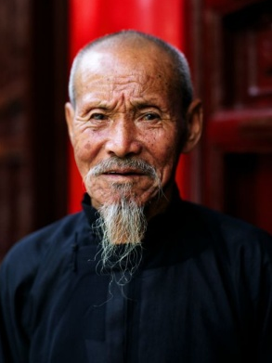
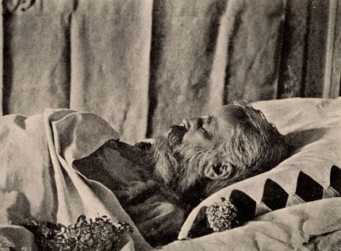
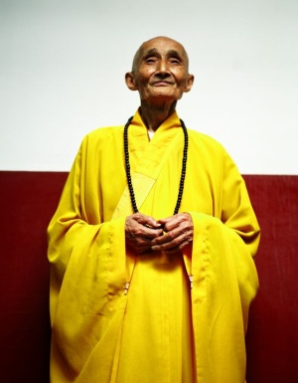
Religion
Buddhism
Gautama Siddhartha (563-483 BC)
4 new things made him meditate
An old man
A sick man
A corpse
A monk

Slide 12
Religion
Buddhism
At age 29 Siddhartha left his wife and joined 5 monks
Siddhartha leaving his palace.

Slide 13
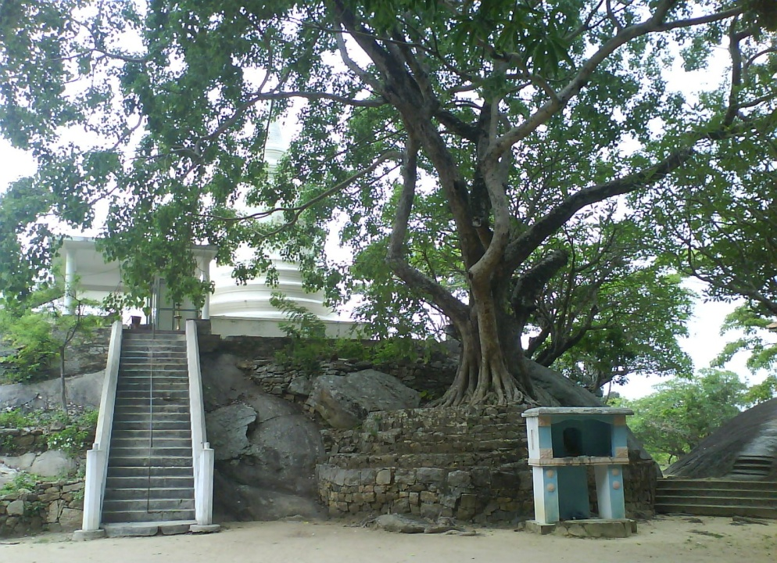
Religion
Buddhism
A woman suggested he wasn’t reaching his full potential.
He sat beneath a Bo tree for 49 days and contemplated the meaning of life.
Formulated Buddhism and began preaching
Buddha=enlightened one
The Middle Way (avoid extremes)

Slide 14
Religion
Buddhism
Four Noble Truths
1. Suffering is with us
throughout life
2. Suffering and conflict originate from craving for pleasure
3. Cessation of suffering (Nirvana) comes from rooting out these desires
4. Suffering ceases by observing the Eight Fold Path

Slide 15
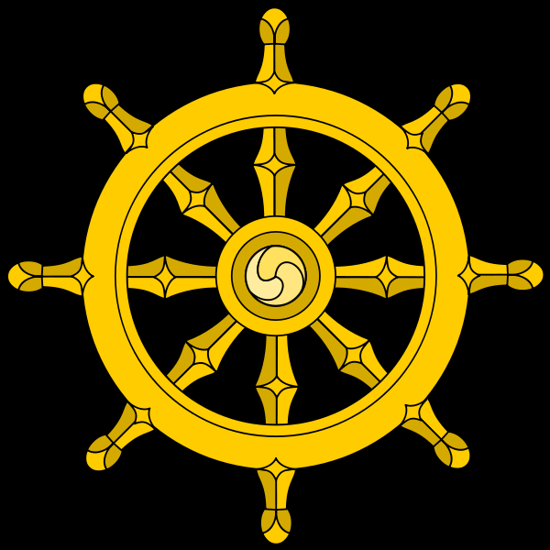
Religion
Buddhism
The Eight Fold Path
Right understanding or views
Right intention (aim) and thought
Right speech
Right conduct or action
Right means of livelihood
Right endeavor or effort
Right mindfulness
Right meditation or concentration

Slide 16
Religion
Buddhism
Led to a focus on self improvement and an avoidance of suffering (or risk or creativity).
Led to a focus on nature and human place in the overall scheme of life.

Slide 17
India’s Great Technical Gifts
0
Zero
Single digit numbers
(rather than counting)

Slide 18
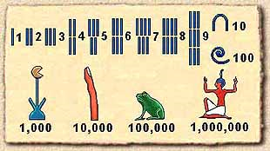
Egyptian Numbers
Counting
Measuring land and volumes
Measuring time

Slide 19
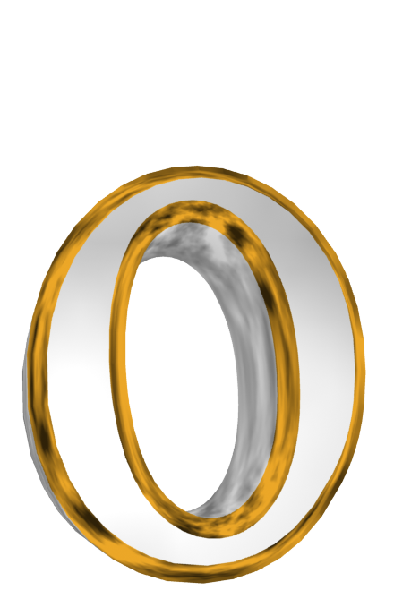
Numbers
Zero as a number was a concept thought to be evil
What is zero time?
What is zero area?

Slide 20
Numbers
The math of zero
How can a number plus itself not change value?
How can a number times any other number also equal the first number alone?
What is meant by a number divided by zero?

Slide 21
Indian Numbers
Hinduism understood concepts of zero.
In Hinduism, the world was created out of a void, so nothing (vacuum) was an acceptable concept.
In Hinduism, the soul of god fills all space, so infinity is acceptable.
Indian thinking was able to divorce arithmetic from counting and geometry.
This also allowed negative numbers

Slide 22
Indian Numbers
Conceptualizing a different number for each numeral from 0 to 9.
This saved using “tick marks.”
This facilitated arithmetic.
Example: Multiply these Roman numerals.
IX by XLII
9 by 42 = 378
We get our “Arabic” numbers from India
1234567890

Slide 23
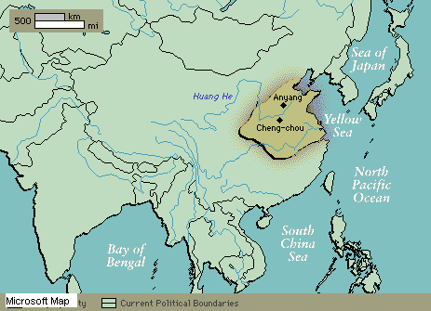
Chinese Civilizations

Slide 24
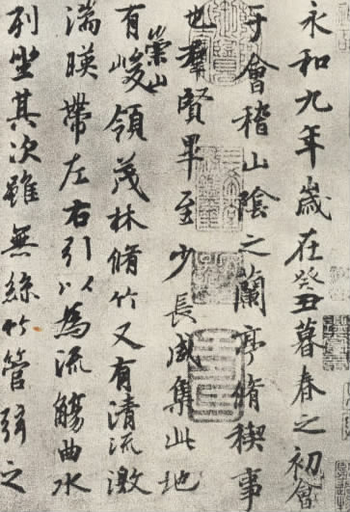
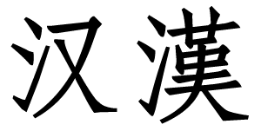
Writing
Shang Dynasty
Chinese Writing System developed
Over 50,000 characters, but good literacy requires only 5,000
Used in much of Asia
Discussion
How would such a writing system affect creativity?

Slide 25
China Writing
Building thoughts into new words
To create
To make or build
Strength
Creativity
Ingenuity

Slide 26
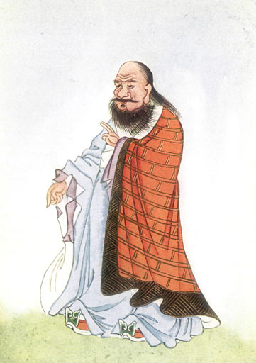
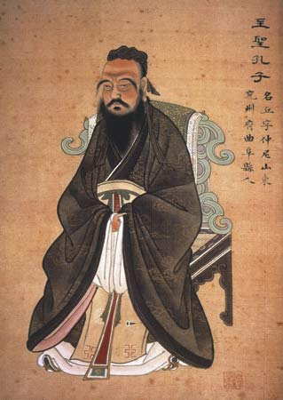
Way of Living
Zhou Dynasty
Mandate of Heaven
A perfect plan that,
if followed by the ruler and the people,
brings blessings
Lao Tzu
Confucius

Slide 27
Way of Living
Confucius (551-479 BC)
Kung Fu-Tzu (Master Kung)
Developed a system of good government, which was based on
Honesty
Dependability
Hard work
Loyalty
Bureaucrats became more powerful than generals.

Slide 28
Confucism
Relationships
Father and son
Kindness from father to son
Filial devotion from son to father
Siblings
Gentleness in older brother
Humility in younger brother
Husband and wife
Righteous behavior in the husband
Obedience in the wife
Elder and junior
Consideration among elders
Deference among juniors
Ruler and subject
Benevolence in rulers
Loyalty among subjects

Slide 29
Way of Living
Lao-Tzu: Taoism
Lived about the same time as Confucius.
Teachings known as
Tao Te Ching or The Way.
Nature is the great teacher.
By observing nature we can find the correct path in life.

Slide 30
Way of Living
Taoism
wu wei = non-action
Abstaining from activity that is out of harmony with the ongoing cosmic process
"By non-action everything can be done."

Slide 31
Way of Living
The world is ruled by letting things take their course.
It cannot be ruled by interfering.

Slide 32
Taoism
When the effective leader is finished with his work, the people say it happened naturally.
Lao Tzu, quoted in Thorpe, Scott, How to Think Like Einstein, Barnes & Noble Books, Inc., 2000, p.172.

Slide 33
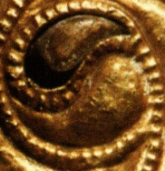
Way of Living
Yin
Feminine
Earth
Moon
Night
Winter
Moisture
Coolness
Interior
Intuition
Contractive
Conservative
Responsive
Cooperative
Synthesizing
Yang
Male
Heaven
Sun
Day
Summer
Dryness
Warmth
Surface
Rational
Expansive
Demanding
Aggressive
Competitive
Analytical

Slide 34
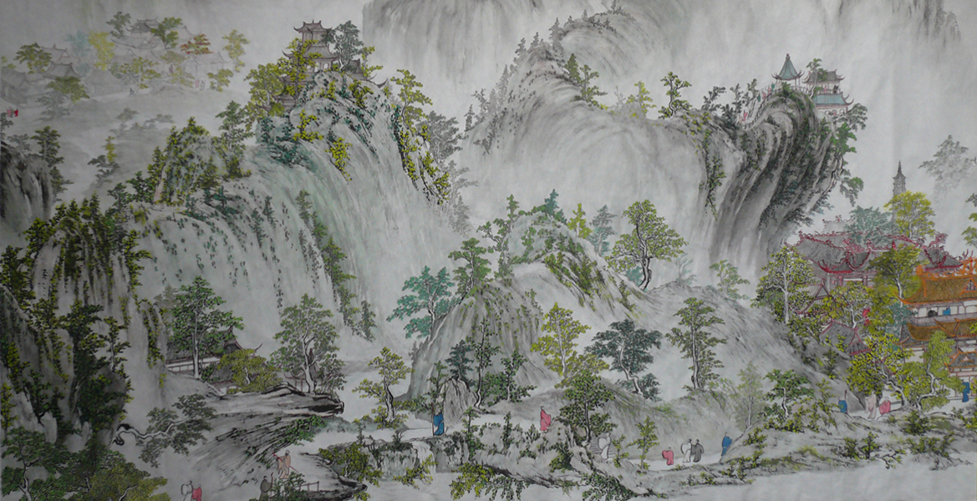
China
Wen
Human way.
People adjust nature.
Government tries to adjust the world to better people's lives.
Li
Nature's way.
Minimal human intervention.
Government creates environment where nature's way can succeed.

Slide 35
Way of Living
Comparison
Taoism
Confucianism
Government—do more by doing nothing
Man’s relationship to nature
Government─do more, but do it better
Man’s relationship to man
Both groups were relatively pacifist.

Slide 36
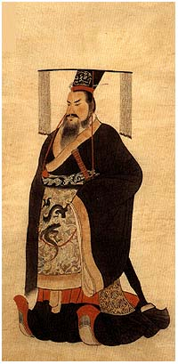
Forming an Empire
Qin emperor (221-210 BC) ruthlessly united all China.
The name “China” derives from Qin

Slide 37
Qin Dynasty

Slide 38
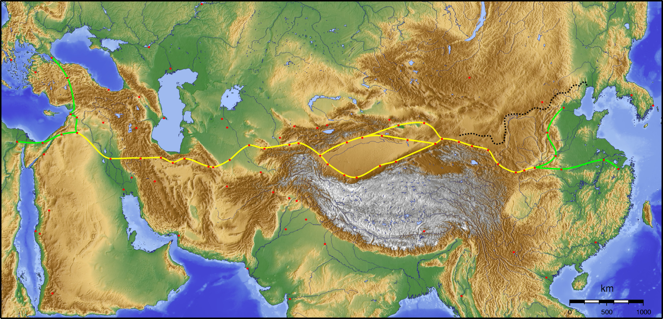
Qin Dynasty
Silk Road
Byzantium
China
Persia
Arabia
India

Slide 39
Building the Great Wall

Slide 40
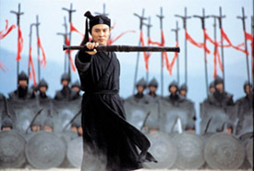
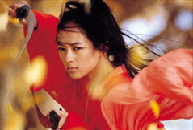
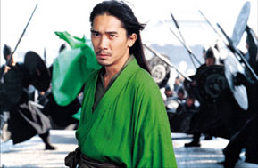
Qin Dynasty
Traditions
Movie:
Hero

Slide 41
Qin Dynasty
Traditions

Slide 42
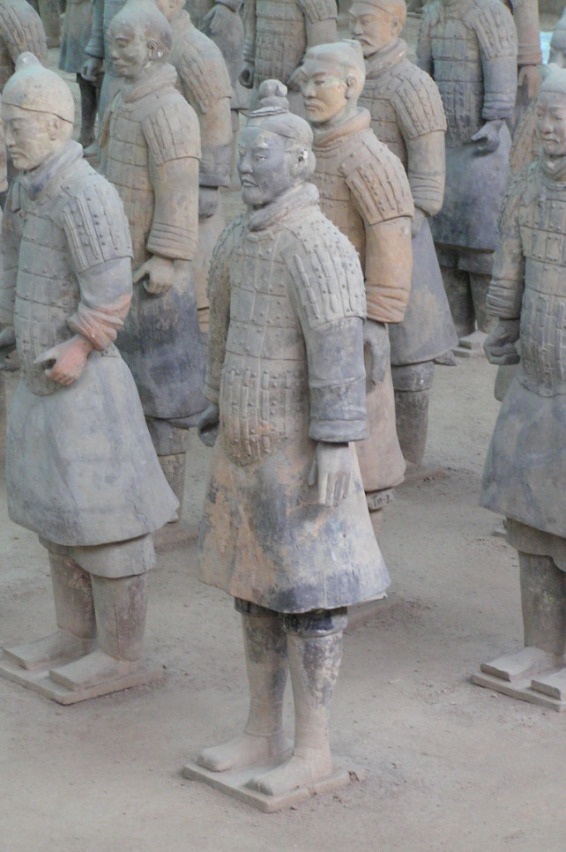
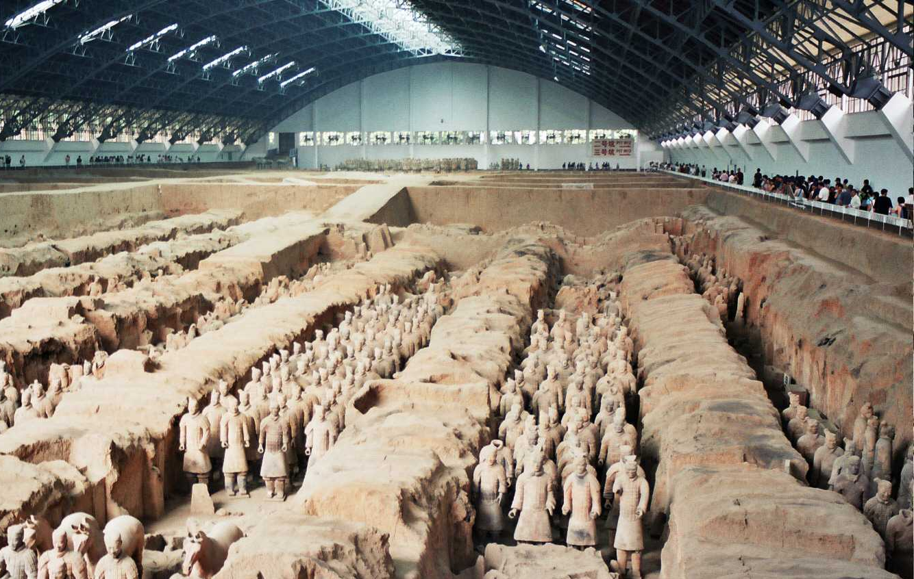
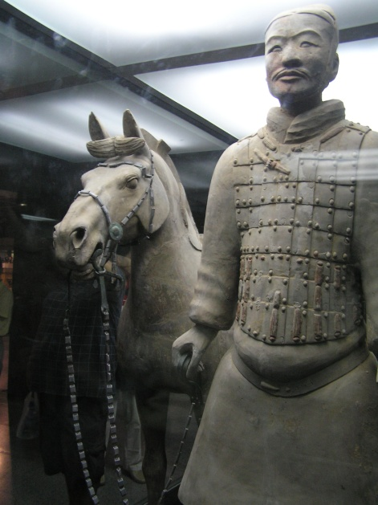
Qin Dynasty
Traditions
Built terracotta warriors in the capital Xi’an to perpetuate his exalted status

Slide 43
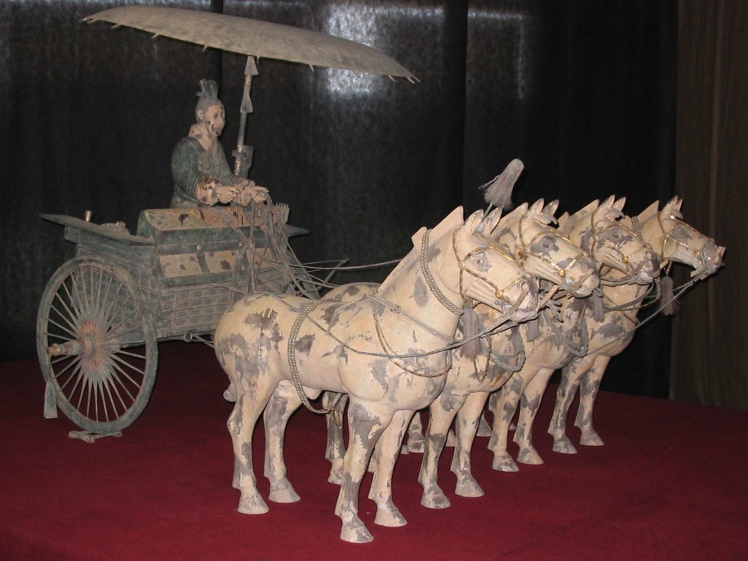
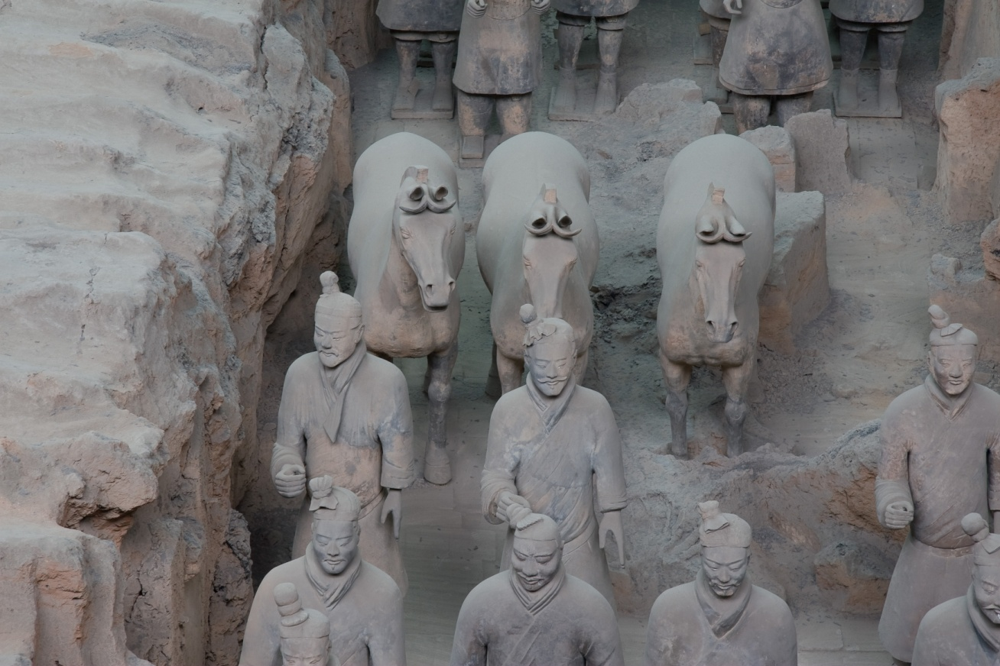
Qin Dynasty
Traditions
Built terracotta warriors in the capital Xi’an to perpetuate his exalted status

Slide 44
Qin Dynasty
Terracotta Warriors

Slide 45
Expanding the Great Wall

Slide 46
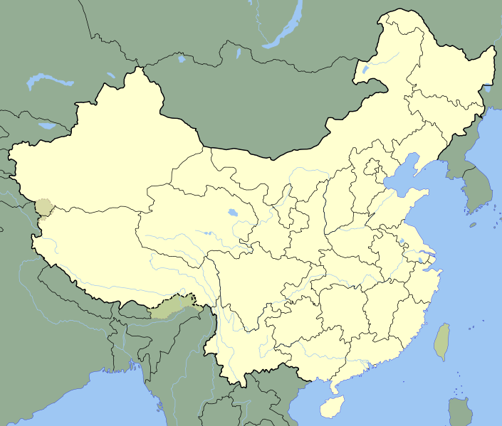
Geography
Geographic connectedness and only modest internal barriers gave China an initial advantage [by developing civilization over a wide area].

Slide 47
Geography
But China's connectedness eventually became a disadvantage, because a decision by one despot could and repeatedly did halt innovation. In contrast, Europe's geographic balkanization resulted in dozens or hundreds of independent, competing statelets and centers of innovation.
–Jared Diamond, Guns, Germs, and Steel, 1999, 414-416.

Slide 48
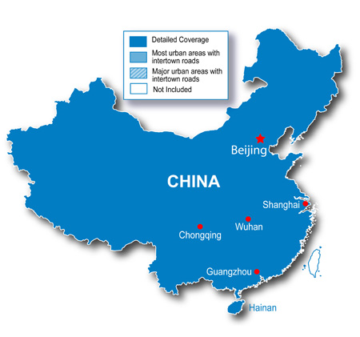
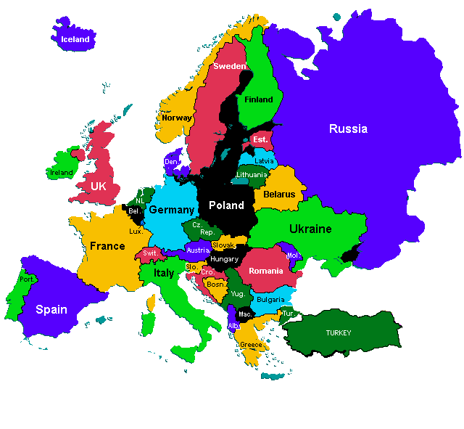
China and Europe
Connectedness → Stagnation
Diversity → Progression

Slide 49
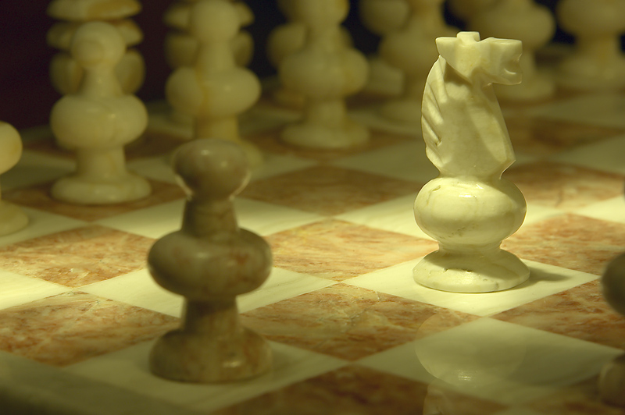
Creativity
Discuss how creativity is improved by competitiveness.

Slide 50
Thank You
Unity and diversity are both good and bad.

