Slide 1
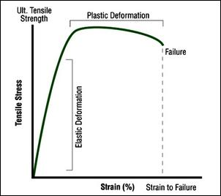
Mechanical Properties
MFG 355

Slide 2
Level of focus – Macrostructures
Mechanical forces
Viscoelasticity
Fillers
Reinforcements
Tougheners

Slide 3
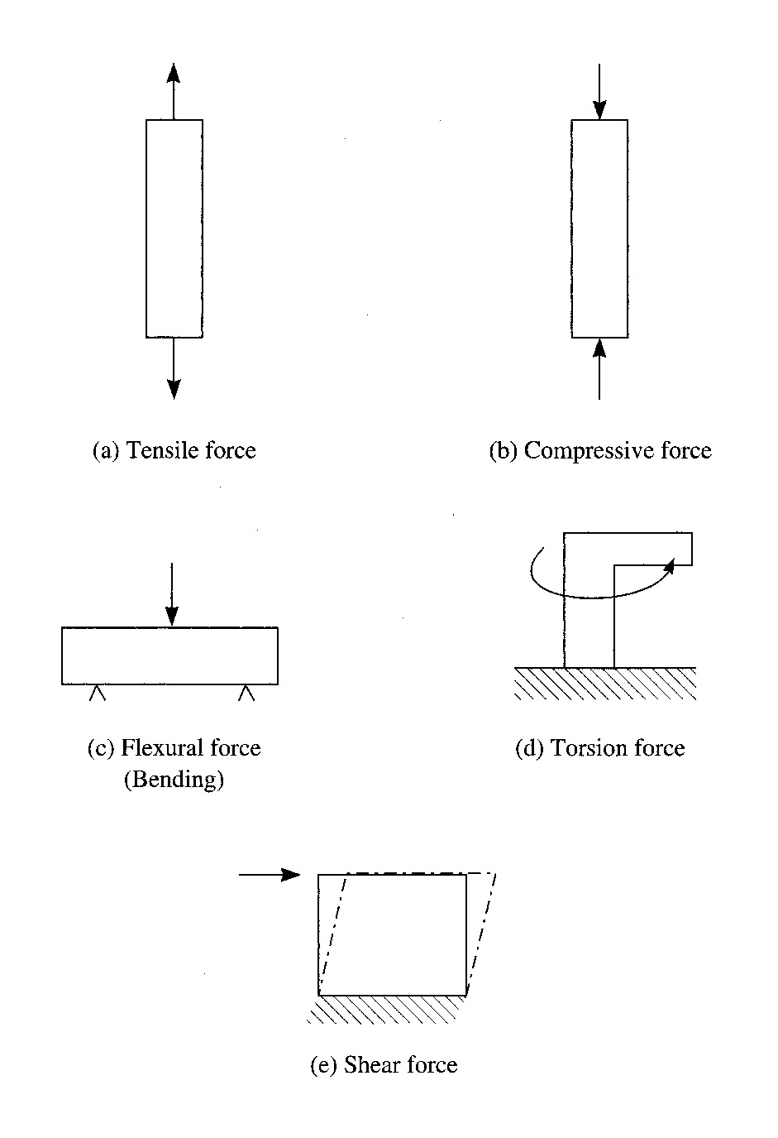
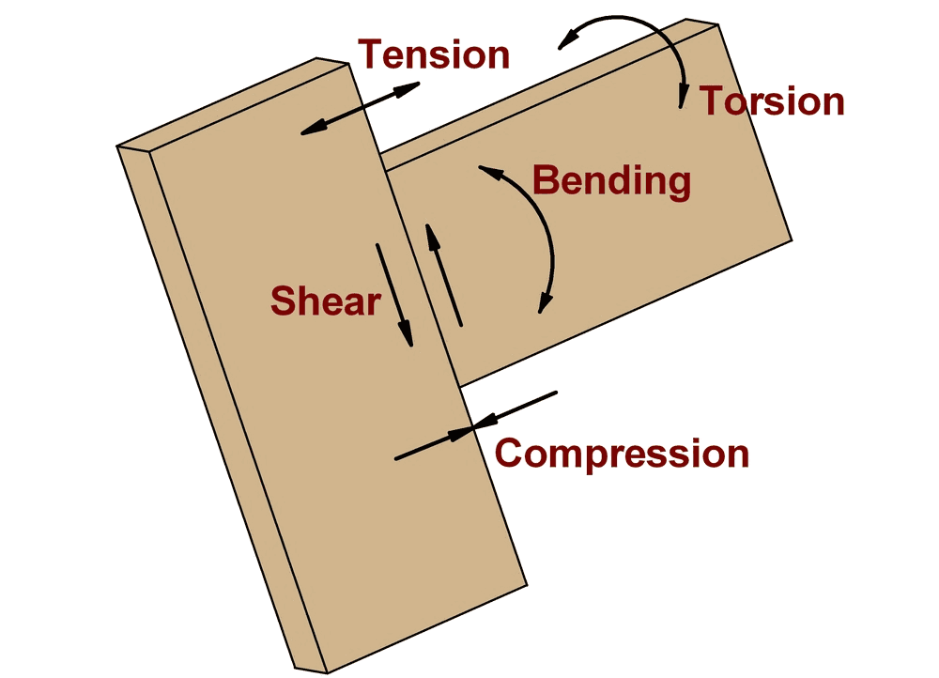
Types of Forces

Slide 4
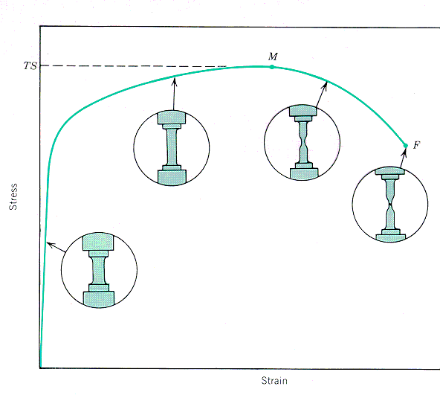
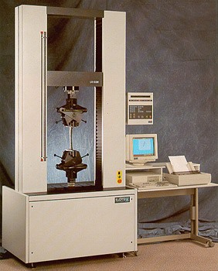
Forces and Responses
Tensile – applied loads “pull” the sample
ΔL
L_{o}

Slide 5

TensileTest

Slide 6
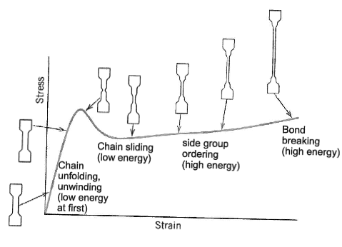
Tensile Testing

Slide 7
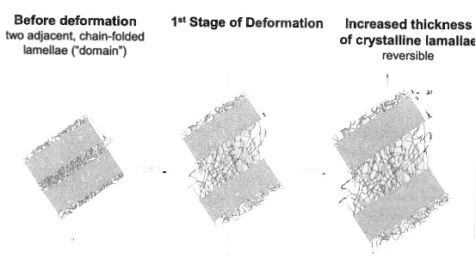
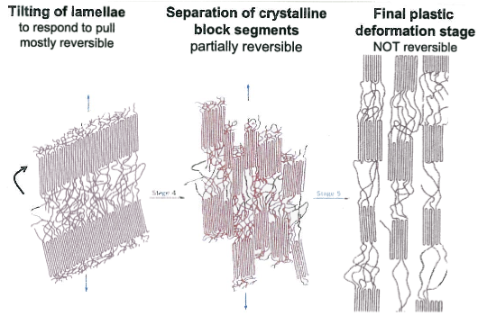
Tensile Testing

Slide 8
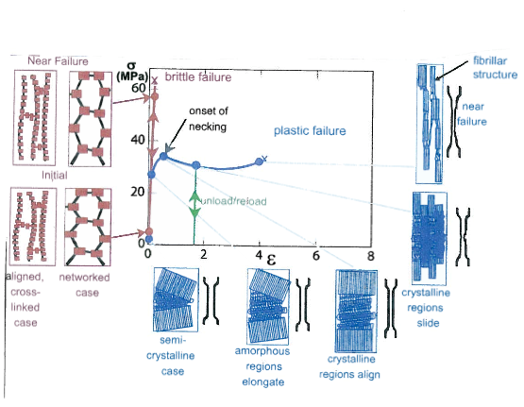
Tensile Response Plastic/Brittle

Slide 9
Tensile Forces
Gripping Zone
Gripping Zone
Failure Zone
¾ inch
½ inch
8 ½ inches

Slide 10
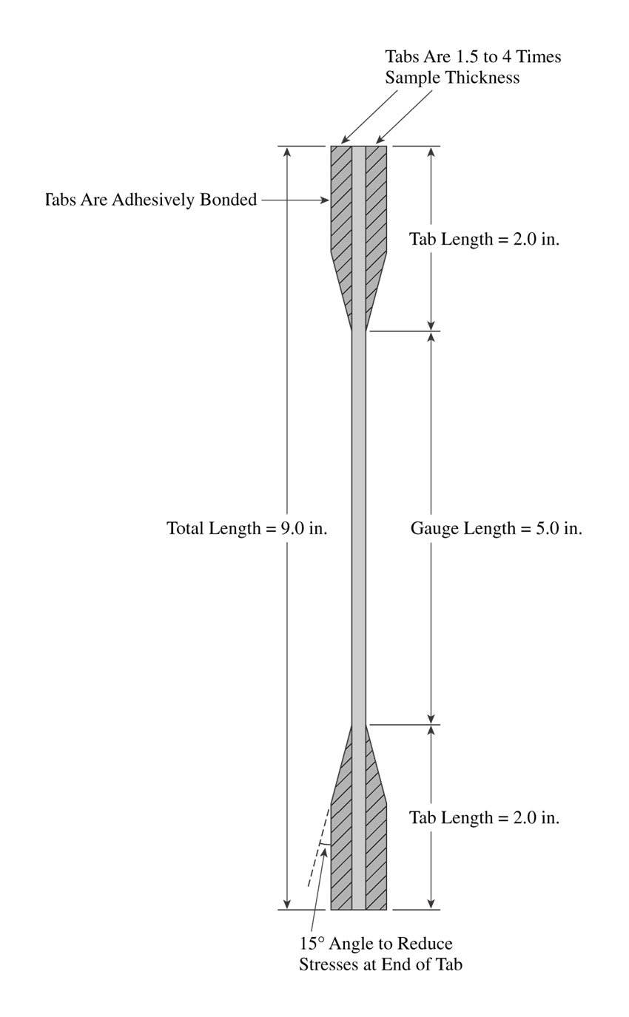
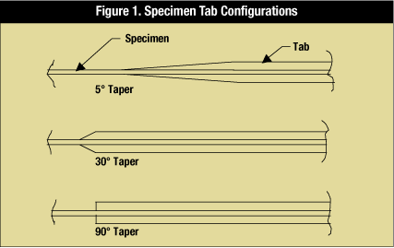
Tensile Forces
For specimens in cases where the wider grip is not effective
  Composites

Slide 11
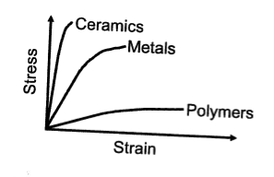
Polymer Stress/Strain Curve
Very strong, not tough or ductile
Strong, tough and ductile
Not so strong, tough and very ductile

Slide 12
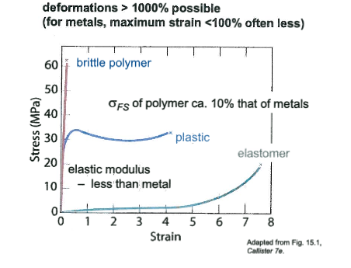
Polymer Mechanical Variation

Slide 13
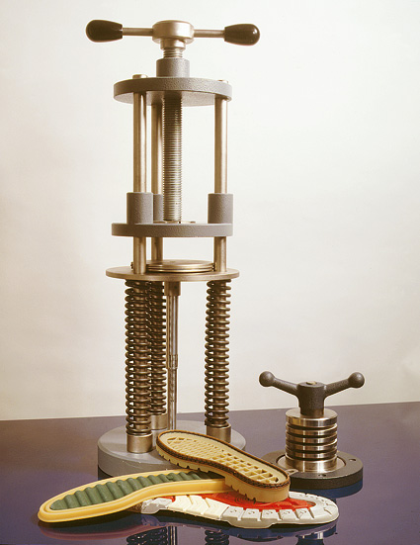
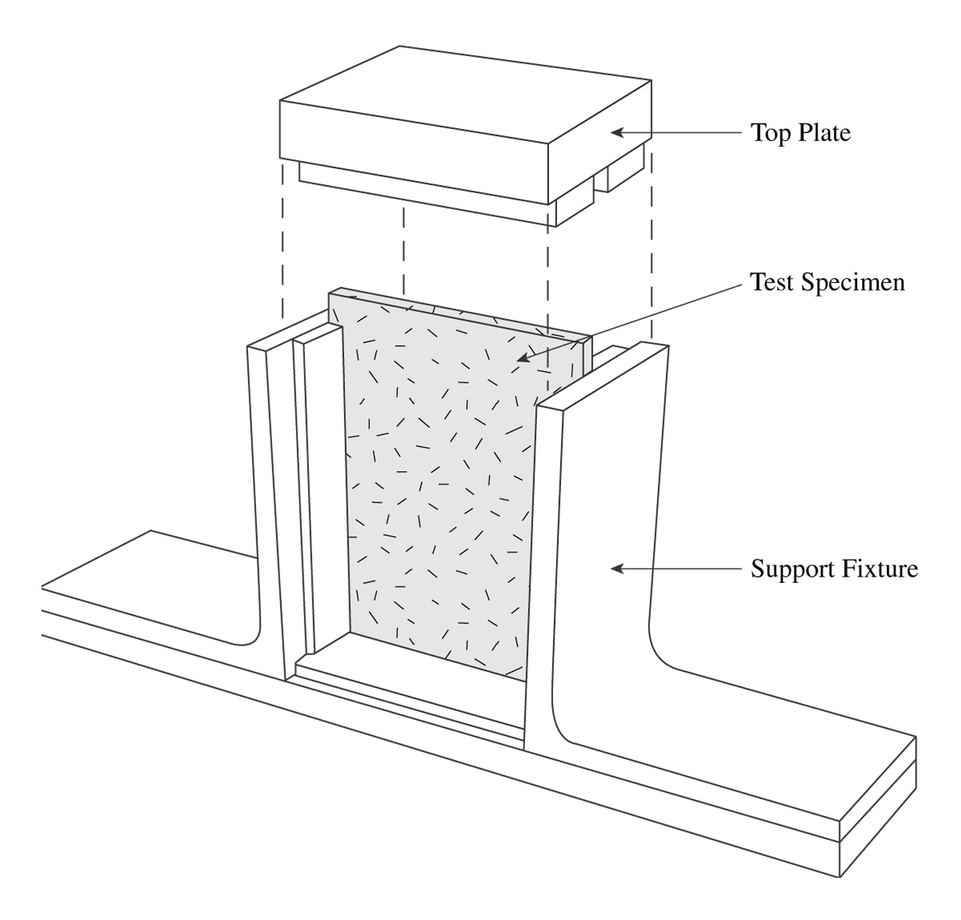
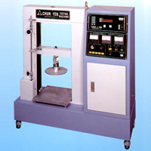
Forces and Responses
  Compression – applied loads “squeeze” the sample longitudinally/vertically
ΔL
L_{o}

Slide 14
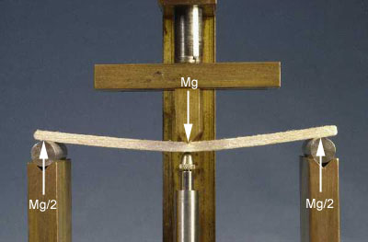
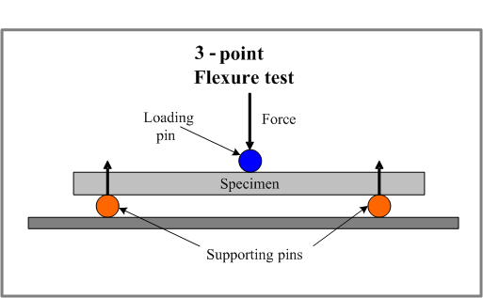
Forces and Responses
Flexural – applied load “bends” the sample

Slide 15
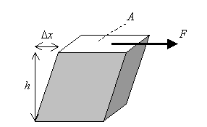
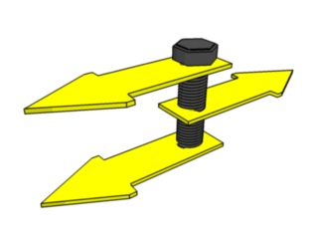
Forces and Responses
Shear – applied loads are offset

Slide 16
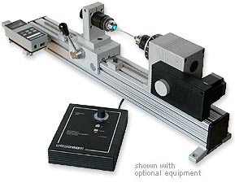
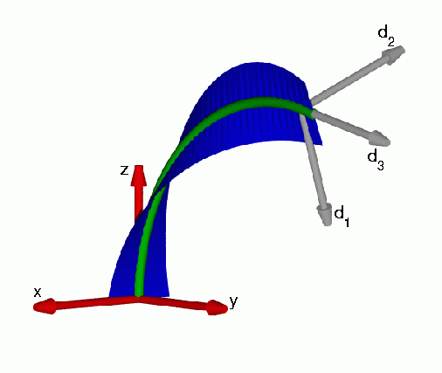
Forces and Responses
Torsion – applied loads “twist” the sample

Slide 17

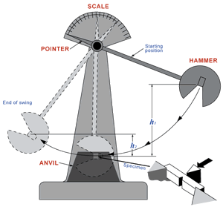
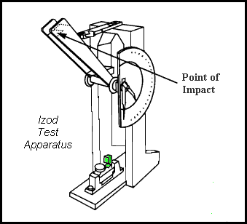
Mechanical Behavior
Impact (toughness) – Izod
  applied loads “hit” the sample
Impact (charpy)
Impact (dart)

Slide 18
Toughness
Backbone Structure
  Aliphatic increases elongation and toughness
  Aromatic increases strength and toughness
    Usually, elongation is more important than strength
Pendant Groups
  Decrease toughness (restrict movement)
Crystallinity
  Decreases toughness (restrict movement)
Plasticizers
  Increase toughness (facilitate movement)

Slide 19
Impact Toughness Guide
Resin | Izod (ft-lb) | Reasoning
Polyurethane (x-link) | 25 | High elongation and strength
Polycarbonate | 16 | High strength
SMC | 7 | Reinforced and toughened
ABS | 6 | Toughened with rubber
HDPE | 3 | High elongation, flexible
Acetal | 2 | Can be toughened
Nylon 6/6 | 2 | Can be toughened
PET | 1 | Can be alloyed
PP | 1 | Some crystallinity
LDPE | 1 | Low strength
Polystyrene | 0.3 | Pendent group
Acrylic | 0.3 | Short link, large pendent group
Phenolic, w/fiberglass | 0.3 | Crosslinked
Epoxy, unreinforced | 0.2 | Crosslinked
Crosslinked polyester | 0.2 | Crosslinked
Increasing Toughness

Slide 20
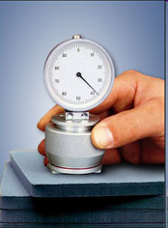
Hardness
Hardness is related to tensile/flexural strength
Several hardness scales are used
  Barcol
  Shore (A, D, O, H scales)

Slide 21
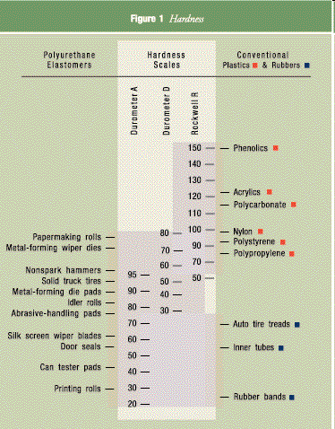
Hardness
Scales

Slide 22
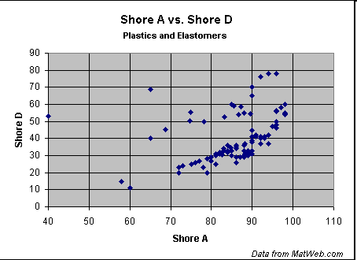
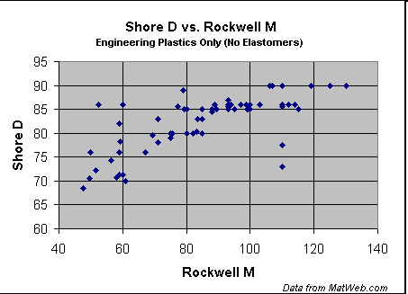
Hardness

Slide 23
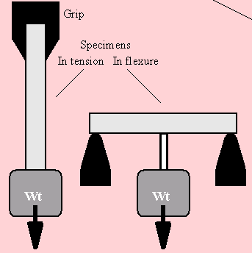
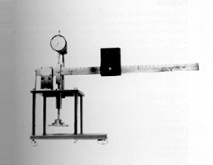
Mechanical Behavior
Creep

Slide 24
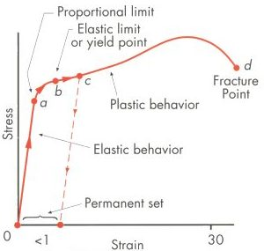
Elastic Solid
Stress-strain
What happens when force is removed?

Slide 25
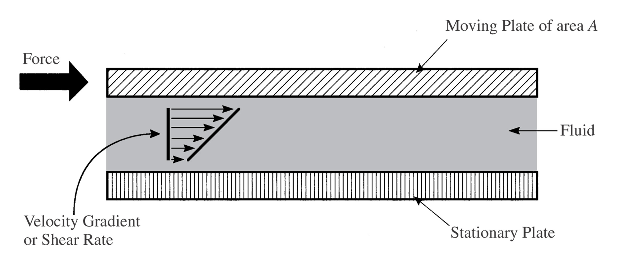
Viscous liquid
Tensile forces in a liquid?
  Depends on the viscosity (pulling water versus honey)
Shear forces
What happens when force stops?

Slide 26
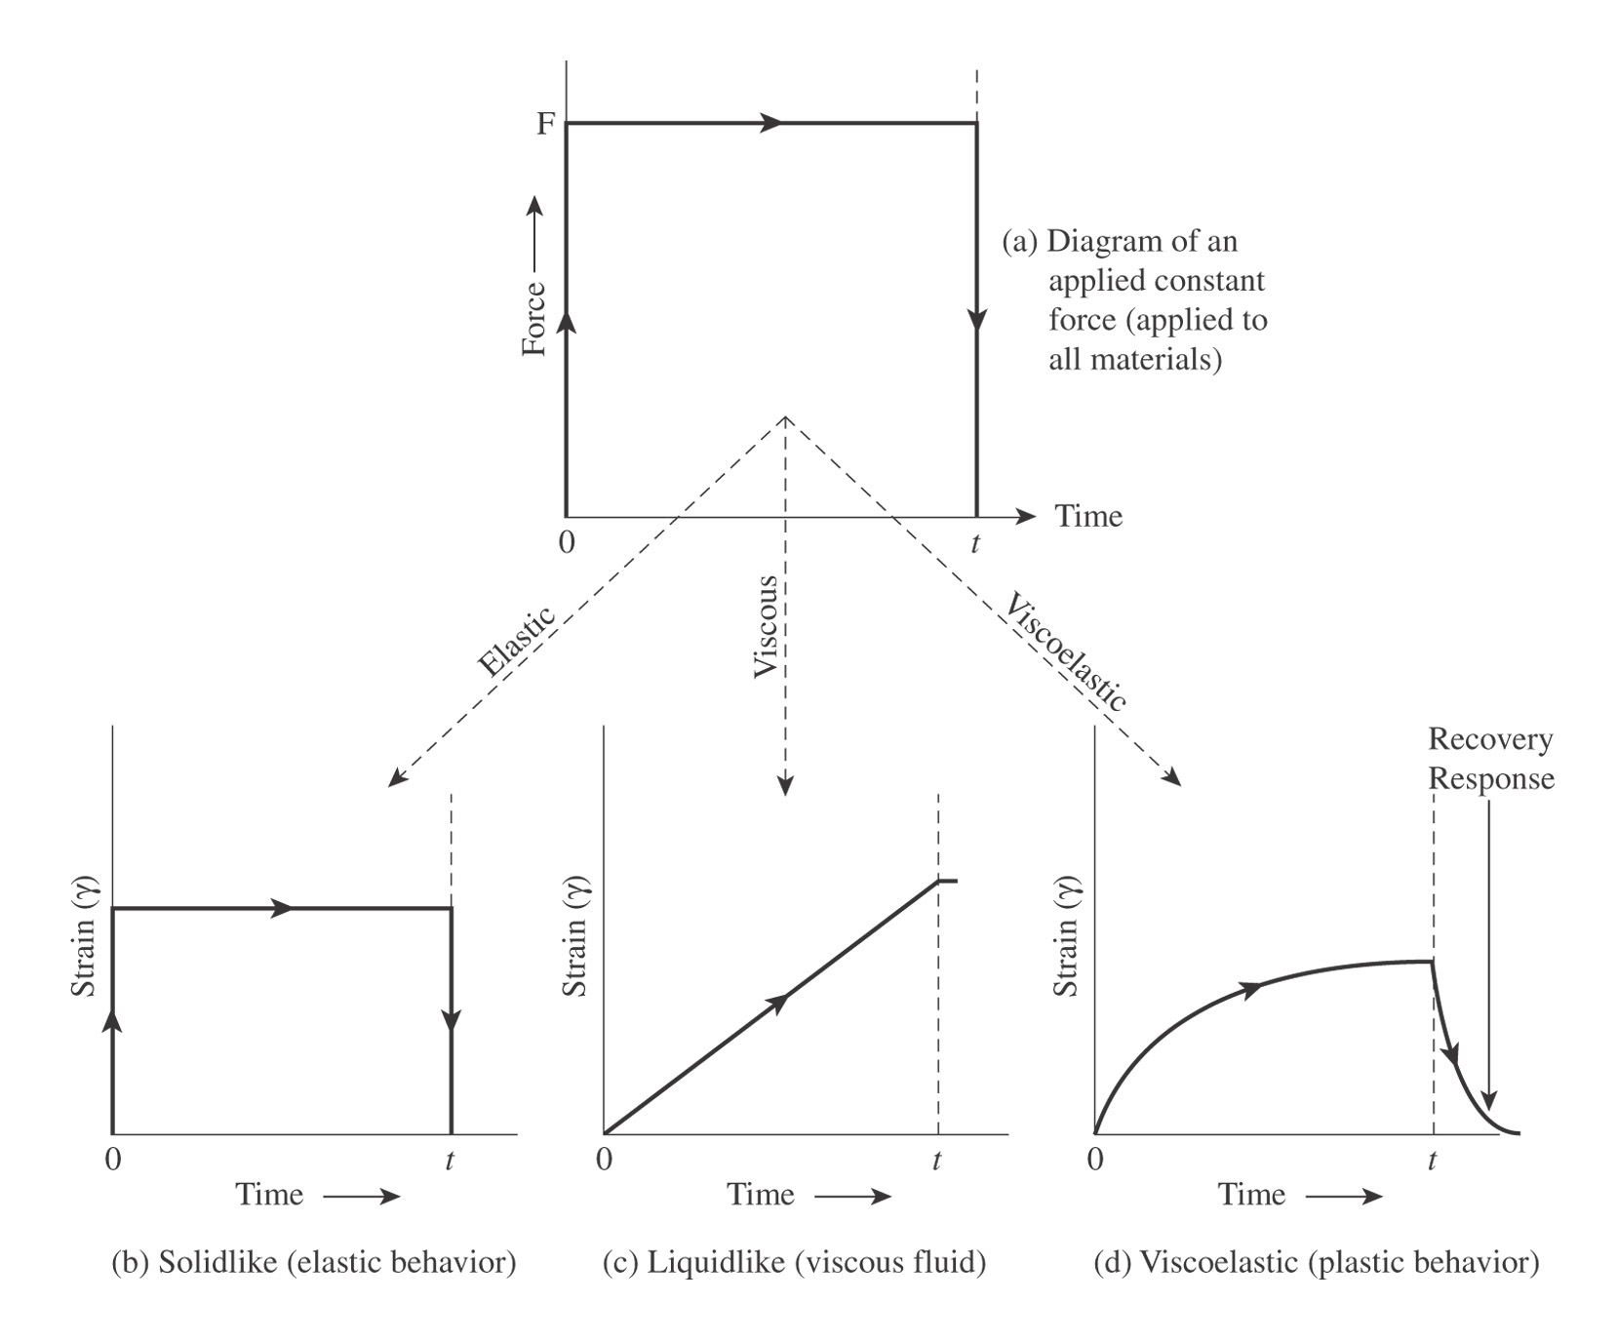
Viscoelasticity

Slide 27
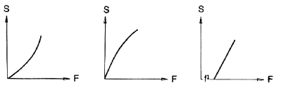
Viscous liquid
Newtonian and non-Newtonian
Newtonian
F/A = η dv/dx = ηγ
Shear Thickening
Shear Thinning
Newtonian

Slide 28
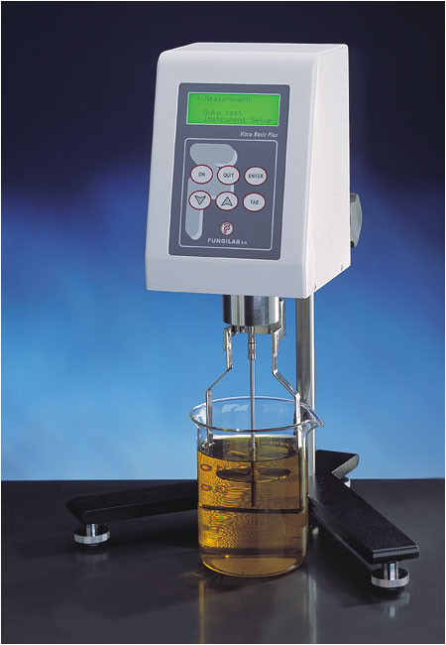
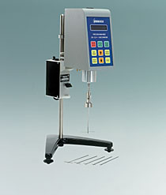
Measures of Viscosity
Equation
  F/A = τ = η (dv/dx)
Viscometer

Slide 29
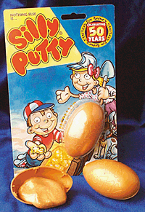
Viscoelasticity
Time/temperature dependant

Slide 30
Time Dependence of Plastics
Increasing shear rate
Stress
Strain

Slide 31
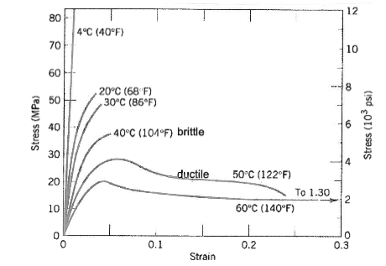
Temperature Dependence

Slide 32
Mechanical Model of Plastic Behavior
Dashpot
Permanent Deformation (sandpaper)
Spring

Slide 33
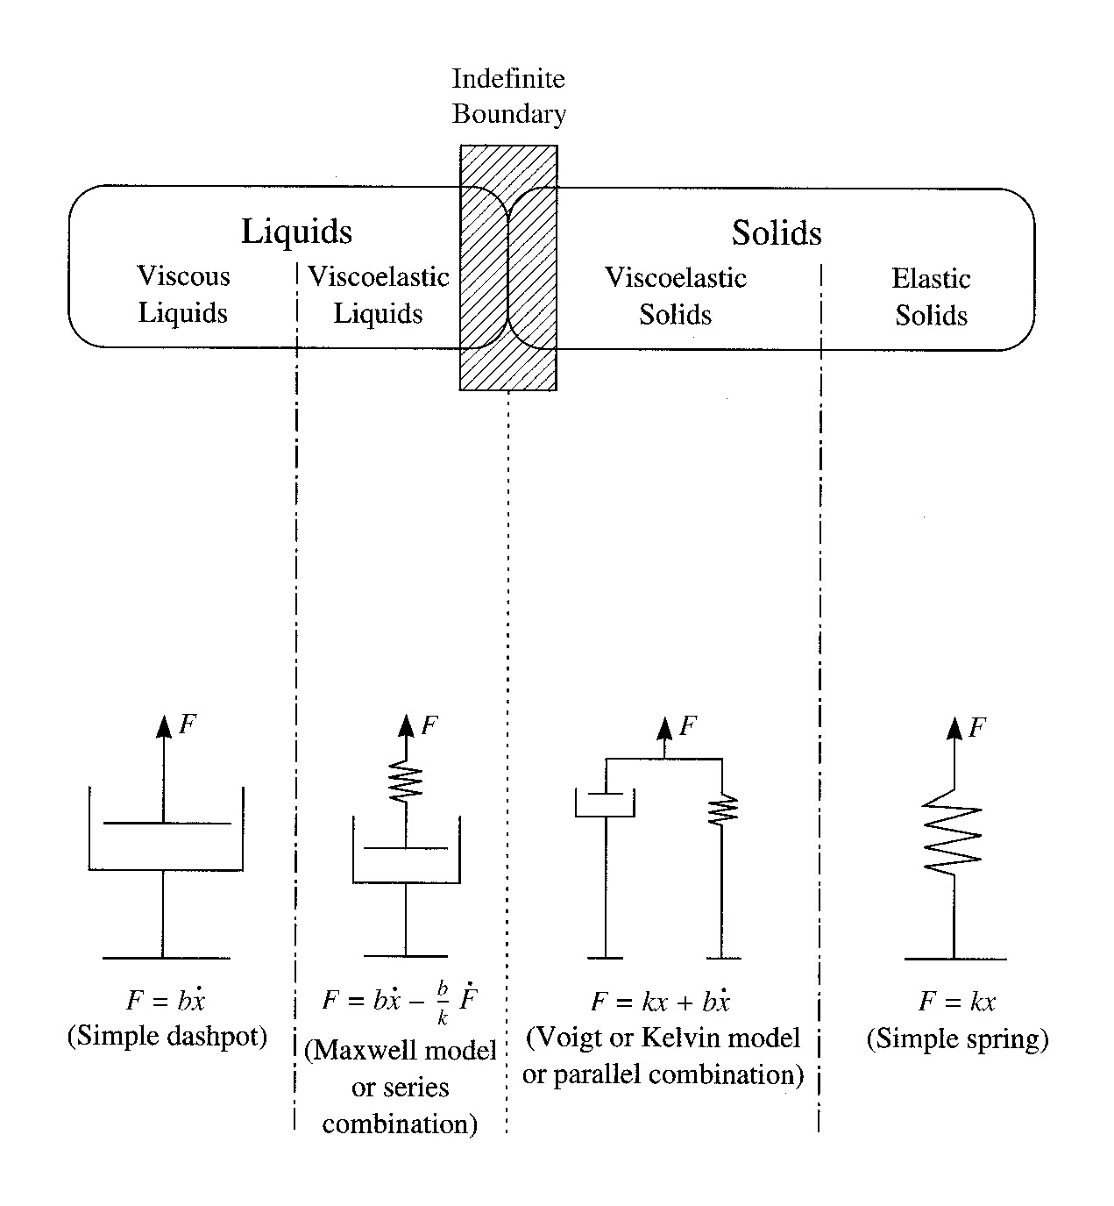
Viscoelasticity

Slide 34
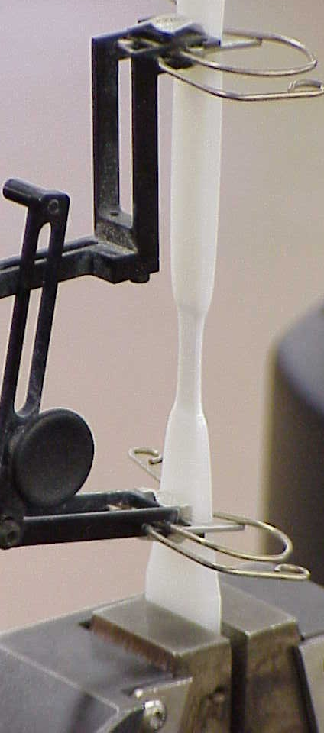
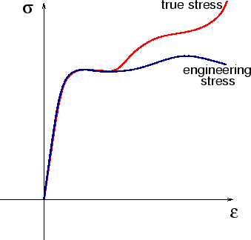
Interpretation of Plastic Behavior
Intermolecular relationship
Intermolecular relationship

Slide 35
Resin Rules
Resin Rules: Resin properties can be altered significantly with the addition of fillers, reinforcements, and other additives.

Slide 36
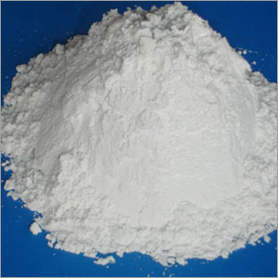
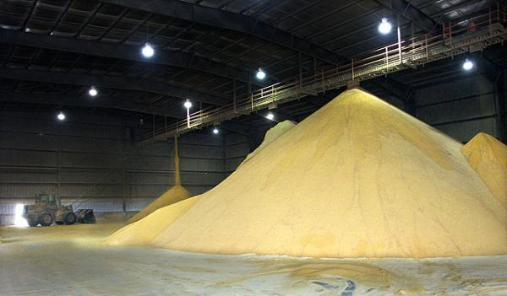
Fillers
Reduce cost
Can improve
  Mechanical properties
  UV stability
  Thermal stability
  Wear resistance
  Electrical conductivity
  Flame resistance
  CTE

Slide 37
Reinforcements
Increase mechanical properties
Generally fibers
Composites
  Carry the load (most mechanical properties)
  Give directionality of some properties (optional)

Slide 38
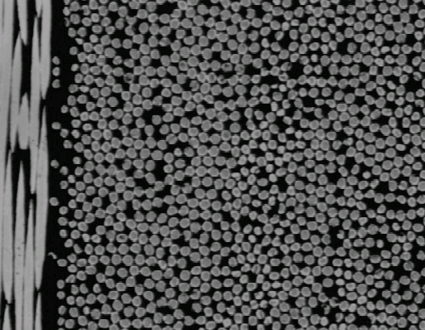
Polymer/Fiber Composite
Fibers
Polymer Matrix
The phases can be thought of as
a group of islands (discontinuous) in a sea (continuous)

Slide 39
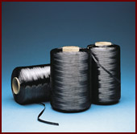

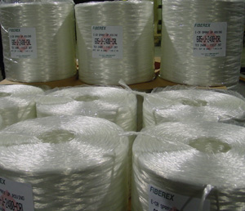
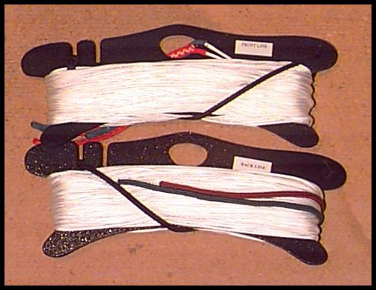
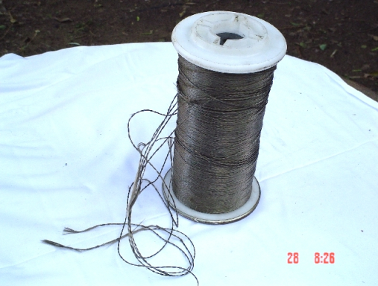
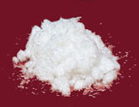
Reinforcements
Fiberglass
Carbon/Graphite
Aramid
Basalt
Ceramic whiskers
UHMWPE

Slide 40
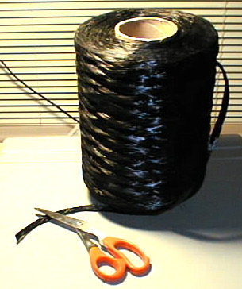




Reinforcement Forms
Tow
(or roving if
fiberglass)
Mat
Prepreg
Cloth fabric
Preform

Slide 41
Toughness Modifiers
Increase impact strength
Increases the potential for movement within the plastic on impact (creep)

Slide 42


What is Core-Shell Rubber (CSR) ?
2-Layer CSR
100nm
Nano-particle

Slide 43

Appearance of MX and CTBN (in DGEBA Epoxy)
No toughener
Nanoparticle tougheners 7.5 phr
Conventional toughers 7.5 phr

Slide 44

Fracture Toughness of DGEBA Epoxy/MX 120
Curing Agent DDS

Slide 45
Lap-shear Strength of DGEBA Epoxy/MX 120

Slide 46
Thank You

