Slide 1
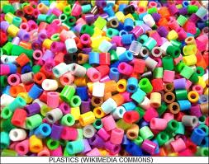
Chemical and Physical Properties
MFG 355

Slide 2
Level of focus – Macrostructures
Chemical and Physical properties
  UV stability
  Oxidation stability
  Plasticization
  Adhesive bondability
  Diffusion
  Flammability
  Optical properties
  Conductivity

Slide 3
What Determines Chemical and Physical Properties?
Polarity of atoms within the polymer molecules
Size of the crystal structures within resin
Space between the polymer molecules
Presence of additives
Ability of the electrons to move freely within the molecules
Chemical reactivity of atoms within the polymer molecules

Slide 4
Resin Rules
Resin Rules: UV and oxidation combine in degradation of plastics.
  UV and oxidative degradation are also called weathering
  Unsaturation and aromatic have poor UV and oxidative resistance
  Coatings can protect from weathering but they also are attacked eventually

Slide 5
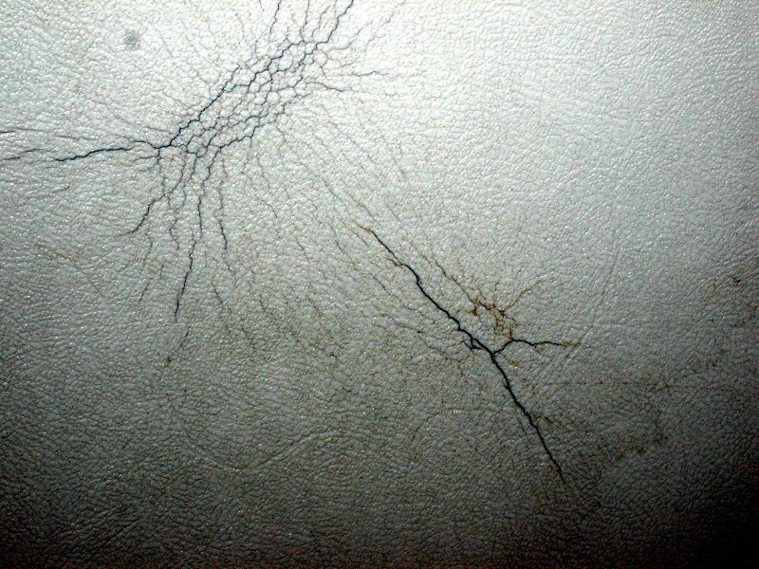
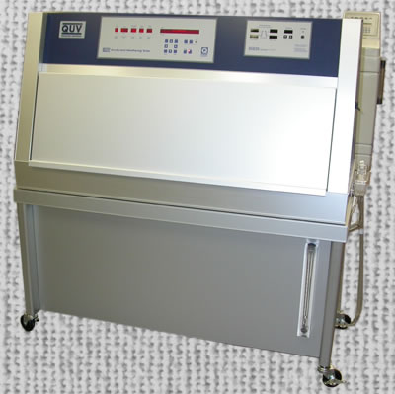
Ultraviolet (UV) Light Degradation

Slide 6
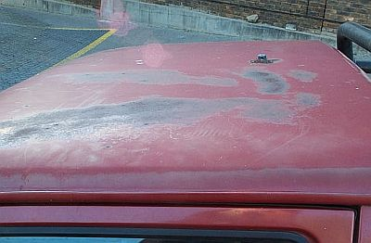
Oxidation
Plastic paint

Slide 7
Weathering
Prevention or reduction of weathering
  UV absorbers
    Complex organic molecules
    Carbon black
  UV blockers
    Pigments (especially titanium dioxide) (paint)
  Anti-oxidants
    Typical concentrations = 1-2%

Slide 8
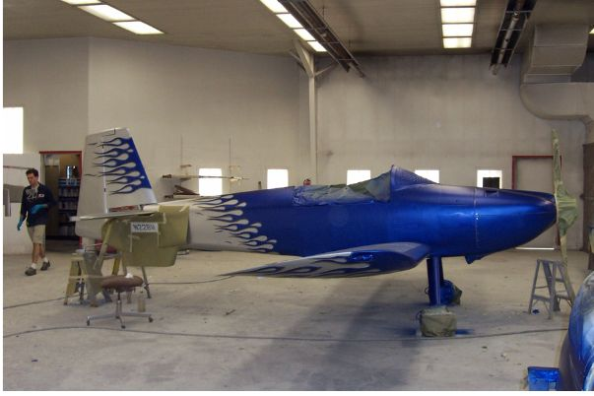
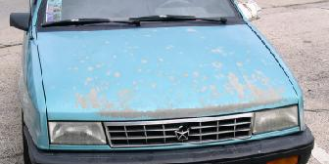
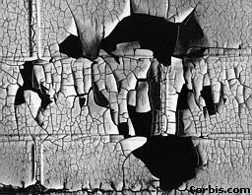
Coatings
Decorative and protective
  Adhesion
  Weatherability

Slide 9
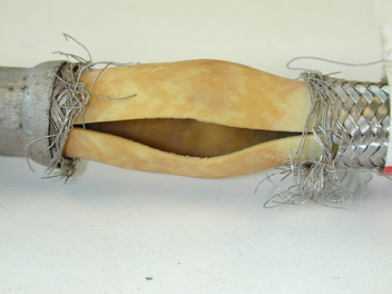
Environmental Resistance and Weathering

Slide 10
Resin Rules
Resin Rules: Many polymers will form cracks when under stress.
  Stress cracks are accelerated by environmental conditions
  Stress cracks are accelerated by temperature
  Stress cracks are accelerated by crystallinity
  Stress cracks are accelerated by internal stress areas
  Stress cracks are accelerated by molecular alignment

Slide 11

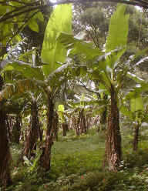
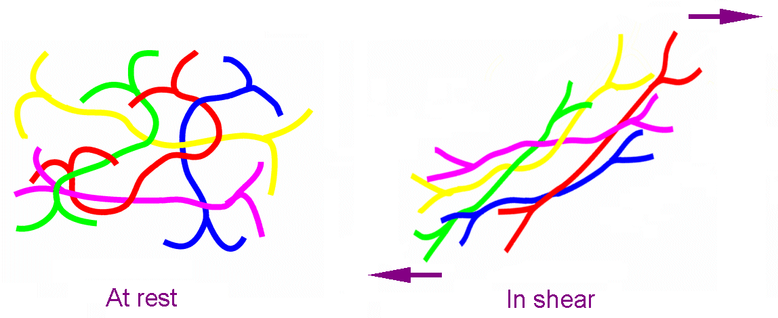
Environmental Stress Cracking
Hawaii Story
  Crosslinked, LLDPE
Banana Plantation
  Drawdown

Slide 12
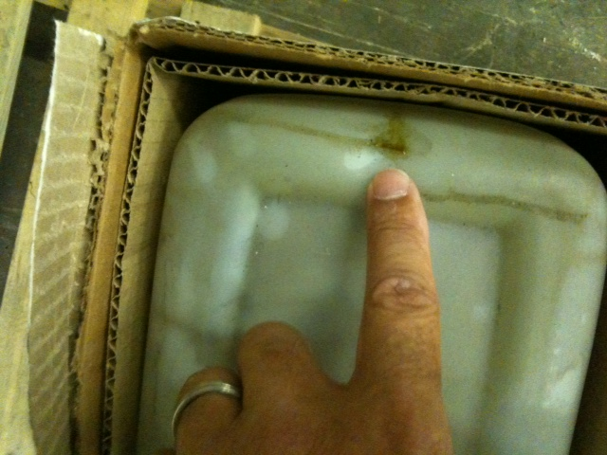
ESCR
Bottles in Utah
  Fertilizer
  Thickest part of the bottle

Slide 13
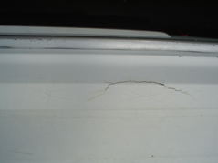
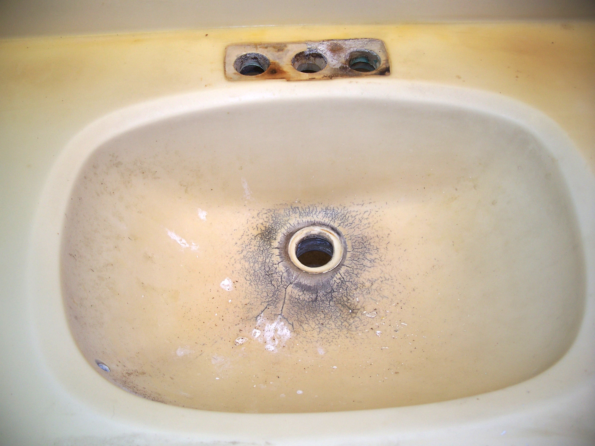

Crazing
Cracks at stress areas

Slide 14
Resin Rules
Resin Rules: Solvent attack on plastics depends on polarity, shape, openness and chemical reactivity.
  Polarity effect follows like-with-like
  Shape effect follows size interference
  Openness effect follows crystallinity and size interference
  Chemical reactivity depends on chemical groups

Slide 15
Chemical resistivity and solubility
None
Swelling/softening
Dissolving
Reacting
PE and H₂O
Nylon and H₂O
PVC and ketone
PVOH and water
Cellulosics
and acids
Increasing Chemical Reactivity to Plastic

Slide 16
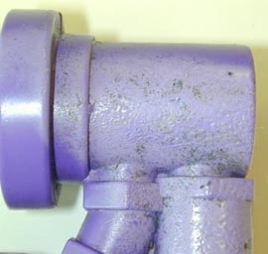
Chemical Resistivity and Solubility
PS exposed to gasoline
  Chemical reactivity

Slide 17
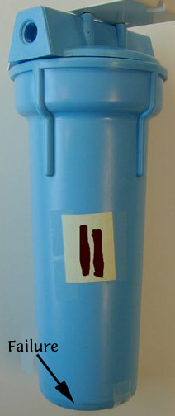
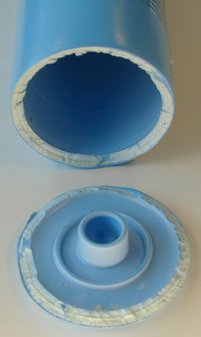
Chemical Nature and
Solvent-Solute Interactions
Nylon water heater
  Polar
  Internal stresses
  Thermal
Nylon in hot water

Slide 18
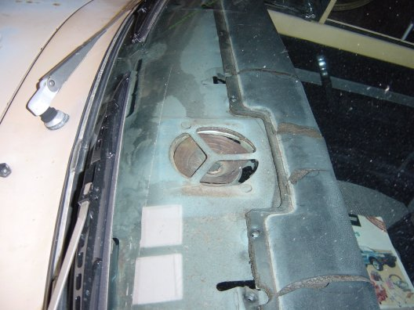
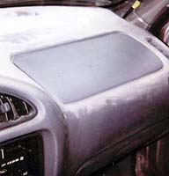
Plasticizers (Solvents)
Increase swelling
  Randomness
Plasticizers can migrate out

Slide 19
Thermodynamics of Solvent Interactions
ΔG = ΔH – TΔS (Free Energy Equation)
    ΔG is free energy and the reaction (solvation) will occur when ΔG is negative
    ΔH is enthalpy (energy content of bonds) and gets negative when bonds are formed (more stable)
    ΔS is entropy and is positive when randomness increases
  When does each variable contribute to a negative ΔG (thermodynamically favoring solvation)?
    When ΔH is highly negative (formation of many bonds)
    When ΔS increases greatly (increasing randomness)
    When T becomes large (high temperature)

Slide 20
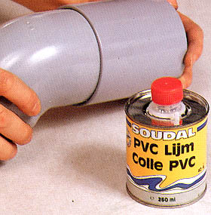
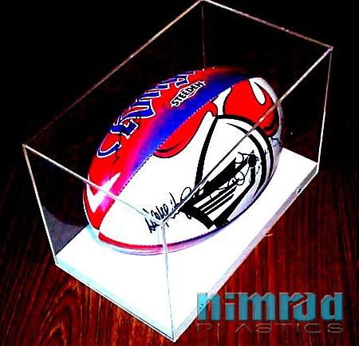
Adhesive and Solvent Welding
PVC adhesive
  Adhesive solvent reacts with the surface
  Solvent dries leaving polymer layer in the interphase
Solvent welding
  Softens the surface and then evaporates as the surfaces are pressed together (creating an entangled interphase)

Slide 21
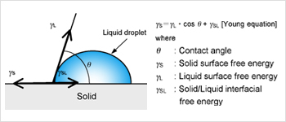
Water Repellent
Surface energy must be LOW
  PTFE = 20 mN/m (lowest plastic)
  PE = 35 mN/m (moderate)
  PVC = 41.5 mN/m (fairly high)
  Nylon = 46.5 mN/m (high)
  Copper = 165 mN/m (very high – typical metal)

Slide 22
Corrosion-Resistant
Availability of electrons
Polymers are better than metals
Fluoropolymers—tightly attached
Solvent effects are much more important in plastics than are corrosion effects

Slide 23
Resin Rules
Resin Rules: While all plastics are more permeable that most metals and ceramics, permeability depends on the plastic.
  Thickness decreases permeability
  Crystallinity decreases permeability
  Branching and large pendant groups open the structure and increase permeability
  Polar attractions between the polymer and the gas increase permeability

Slide 24
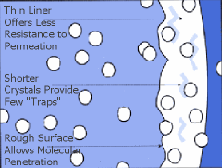
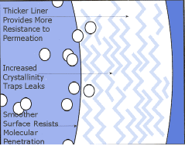
Gas (vapor) Permeation
Polar groups (solubility) to solvent or gas
Intermolecular size (distance)
Crosslinking and crystallinity

Slide 25
Permeability
Wide range of values
  16 orders of magnitude at a single temperature
Diffusion Coefficient
  D = D_{o}e^{-A/RT}
Fick’s Laws of diffusion
  J = -D dc/dx
Barrier Properties
  dc/dt = D d²c/dx²

Slide 26
Resin Rules
Resin Rules: Electrical activity depends on the ability of the electrons to move within the polymer.
  Polymers generally have poor conductivity because the electrons are locked (shared) between atoms
  Recent advances in polymer chemistry have developed de-localized electrons

Slide 27
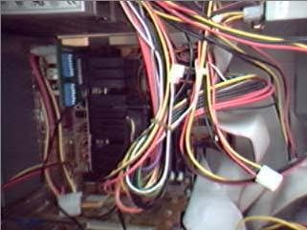
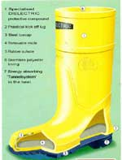
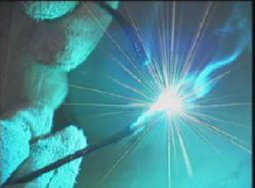
Electrical Properties
Resistivity (10¹⁸ – 10⁻⁶)
Dielectric Strength
Arc Resistance
Dielectric Constant
Dissipation Factor (heat up)

Slide 28
Conductive Polymers

Slide 29
Conductive Polymers
Material | Conductivity (Ohm-cm)⁻¹
Silver | 6.25 x 10⁵
Copper | 5.85 x 10⁵
Gold | 4.44 x 10⁵
Polyacetylene (doped) | 6.0 x 10⁴ - 1.5 x 10⁵
Steel | 6.0 x 10⁴
Silicon | 1.56 x 10⁻³
Carbon, graphite | 1.0 x 10⁻³
Polyacetylene (unmodified) | 1.0 x 10⁻¹¹ to .1.0 x 10⁻¹⁵
Carbon, diamond | 1.0 x 10⁻¹⁴
Alumina ceramic | 1.0 x 10⁻¹⁵
Epoxy | 1.0 x 10⁻¹⁵
Polyethylene, medium density | 1.0 x 10⁻¹⁶
Teflon | 1.0 x 10⁻¹⁸

Slide 30
Resin Rules
Resin Rules: Optical properties depend upon the ability of light to pass through the polymer.
  Crystallinity decreases clarity
  Multiple phases decrease clarity
  Light refraction decreases clarity

Slide 31
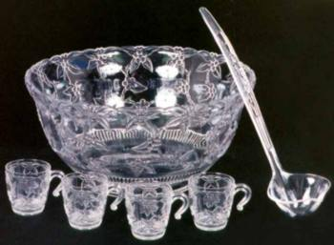

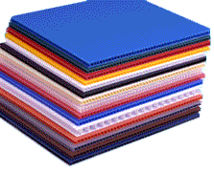
Optical Properties
Light Transmission
  Clear
  Translucent
  Opaque

Slide 32
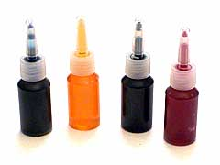
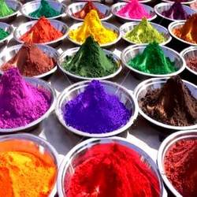
Optical Properties
Colorants
  Dyes
  Pigments

Slide 33
Transparency
Non-crystalline
  PET is exception because of size of the crystals
Index of refraction – low
Total luminous transmittance – high

Slide 34
Resin Rules
Resin Rules: Polymer flammability depends on the basic thermal stability and the ability to char or smother the flame.
  High aromatic raises thermal stability
  High aromatic content increases char
  Halogen content smothers flames but increases smoke toxicity
  Water vapors (usually in fillers) smother flame

Slide 35
Flammability
Self-extinguishing
  Halogen effects (oxygen)
  Fillers (Al₂O₃·3H₂O) (heat)
  Aromatics (fuel)
  Silicones (fuel)
Heat
Fuel
Oxygen

Slide 36
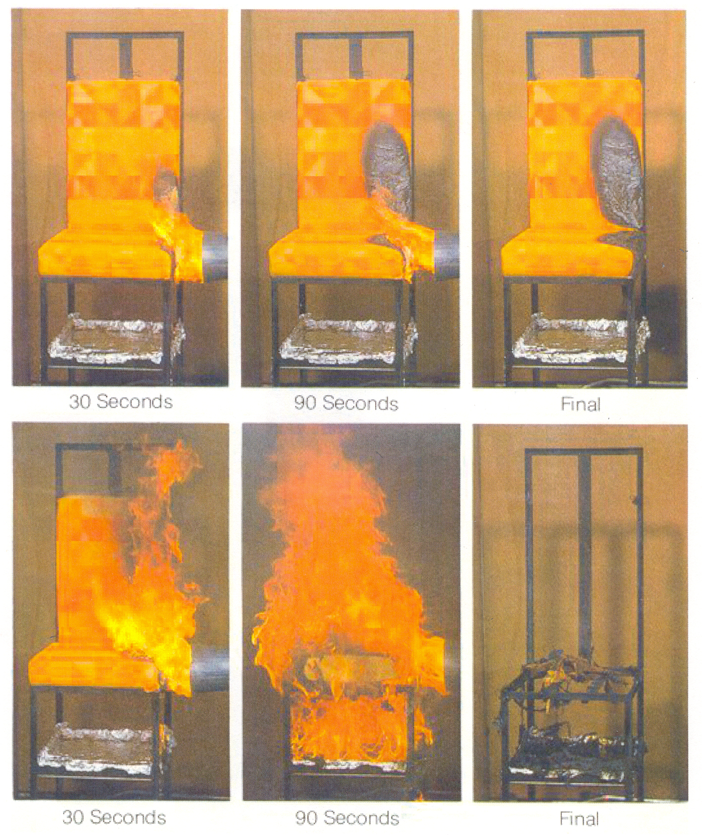
Flammability of aircraft seats with PBI foam
PBI foam
Conventional foam

Slide 37
Resin Rules
Resin Rule: The charring property of some resins can be used to produce a material that has extremely high thermal stability.
  The charring step is usually done in a oxygen-free (or low oxygen) environment.
  These resins require multiple charring/infusion steps to minimize the void content.
  When reinforced with carbon fibers, the material is both thermally stable and strong.

Slide 38
Rocket exit nozzle with phenolic as the ablative material
Nose
Cone
Rocket
Propellant
Rocket
Motor
Exit Nozzle
(Ablative
Material)
Rocket Exit Throat
10 ºF
500 ºF
4000 ºF

Slide 39
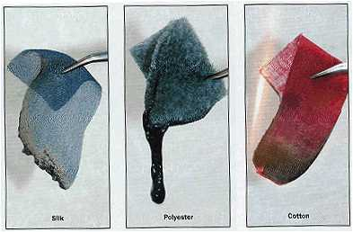
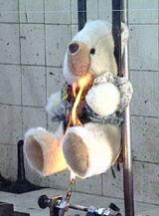
Flammability Tests
Vertical and horizontal burn tests

Slide 40

Limiting Oxygen Index
Chamber
Sample
Sample holder
Gas manifold
O₂
N₂

Slide 41
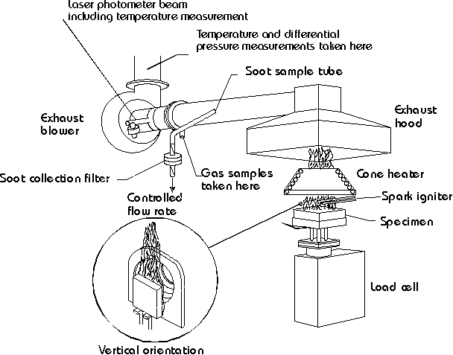
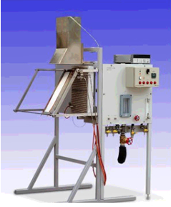
Flammability Tests
Radiant panel
Cone calorimeter

Slide 42
Heat Resistance
Stiffening groups along the chain
  Tg goes up since it takes more heat to move molecules
  Phenyl groups
Strong intermolecular H-bonding increases heat resistance
Crystallinity increases heat resistance

Slide 43
Insulating Polymers
Non-polar is better
  Movement of molecules absorbs energy
Foams
  Air is an insulator

Slide 44
Resin Rules
Resin Rules: Plastics are identified by their chemical and physical properties.
  Chemical groups are detected by FTIR
  Physical properties include: smoke, light transmission, melting point, solvent sentivity

Slide 45
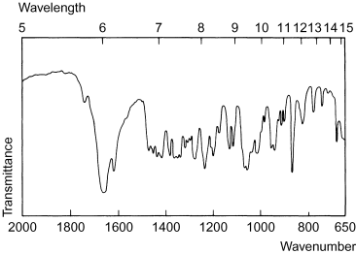
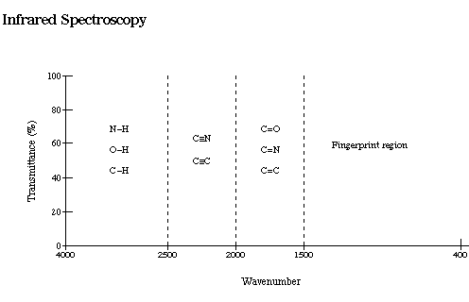
Plastic Identification
Spectroscopy (FTIR)

Slide 46
Thank You

