Slide 1
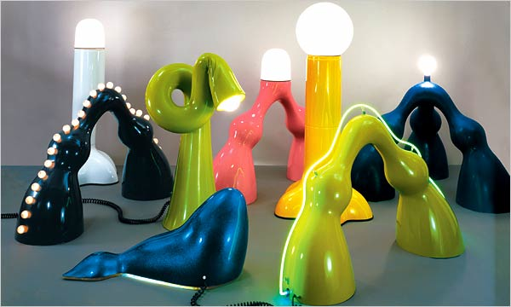
Designing with Plastics
MFG 355

Slide 2
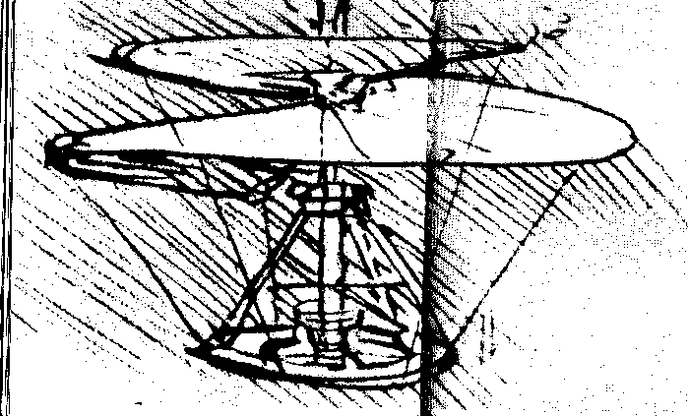
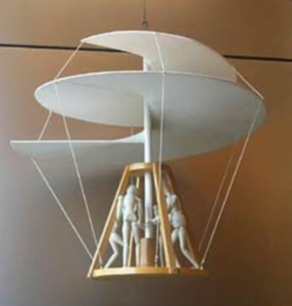
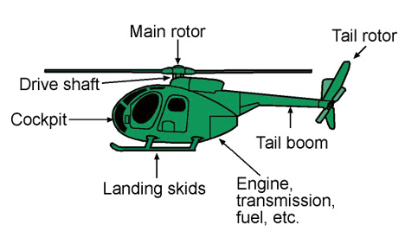
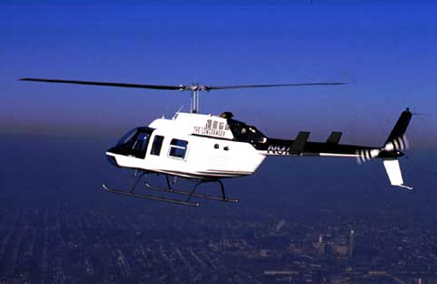
Design Methodology
Inspiration
Concept
Prototype
Development
Final product

Slide 3
How to get Inspiration
It’s all in how you think

Slide 4
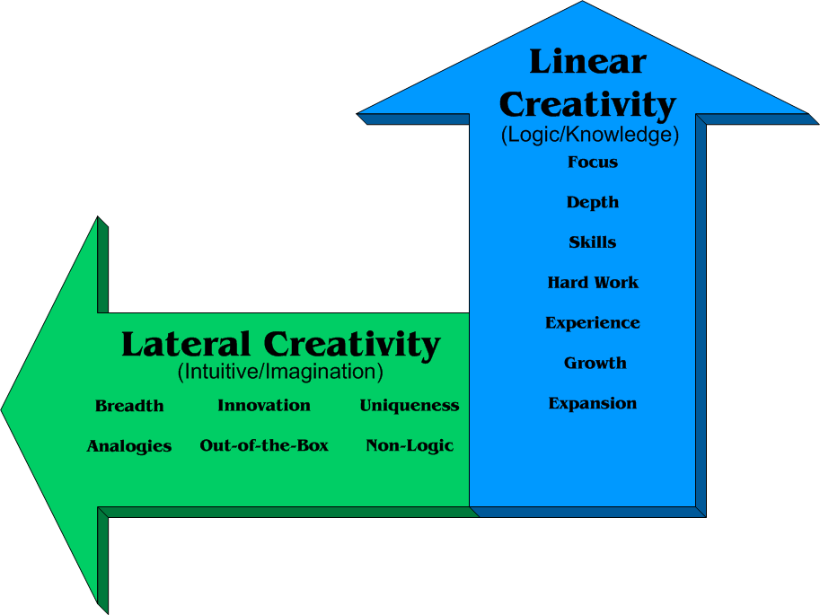
How to get inspiration
Logical thinking
Intuitive thinking

Slide 5
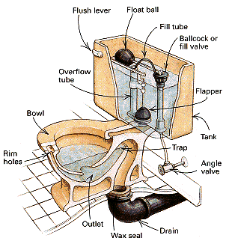
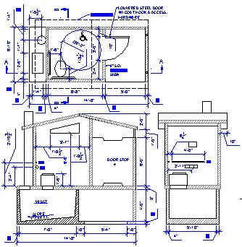
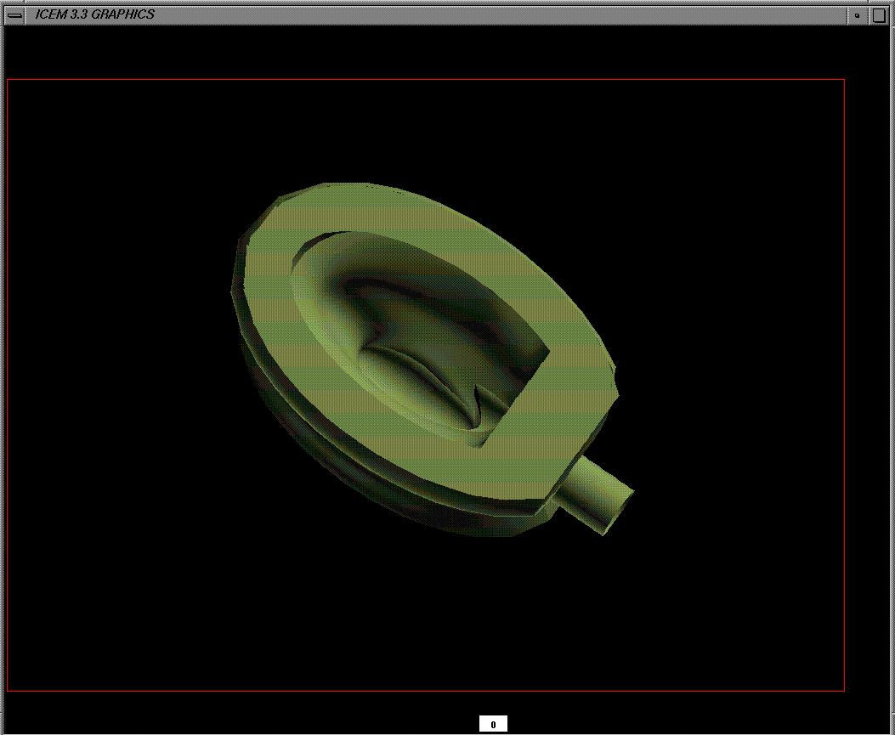
First Step in Concept: Layout or Drawing
Sketch
Drawing
CAD
Advantages and disadvantages to each
Detail
Complexity
Time
Communication of idea
Visualization of problems

Slide 6
Second Step in Concept: Constraints
Appearance
Mechanical
Environmental
Safety, Codes and Standards
Manufacturing Method/Design Rules
Economics

Slide 7
Third Step in Concept: Material Choice
Database – IDES (like in lab) or others
Multiple grades
Multiple additives
Multiple blends

Slide 8
Material Choice
Selection methodology
Define the criteria for material selection
Determine the advantages and disadvantages of each polymer type
Select polymers for special properties
Rank the resins and make a preliminary selection
Computer-aided selection

Slide 9
Material Selection Matrix
Resins | Properties
 | Property 1: |  | Property 2: |  | Property 3: |  | Property 4:
 | Value/Rank | WF= | Value/Rank | WF= | Value/Rank | WF= | Value/Rank | WF= | Total Score
 |  | Score |  | Score |  | Score |  | Score

Slide 10
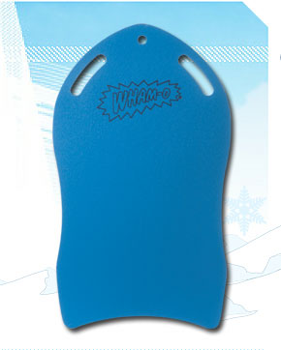
Material Selection
Choosing material for a snow sled

Slide 11
PLASTICS HAVE FOLLOWED A CONSISTENT PATTERN OF APPLICATION GROWTH
Enabler applications
Platform application
Widespread substitution
Description
Simple, new applications in which the plastic allows people to do things they couldn’t do before
Single major application in which the plastic replaces incumbent material based on superior properties
Material competes with incumbent materials in many applications based on performance and cost
Purpose
Build credibility, capability, knowledge, and awareness around material
Establish commercial viability of material
Generate first profits
Generate long term volume and profits for material
Typical timeframe
First 2-3 years after commercialization (full scale production)
2-6 years after commercialization
6+ years after commercialization
Source: Modern Plastics, team analysis

Slide 12
Material Choice ― Cost/Performance
ABS-acrylonitrile butadiene styrene
FP-fluoropolymers
HDPE-high density polyethylene
LCP-liquid crystal polymers
LDPE-low density polyethylene
PA 4,6-polyamide 4,6
PA 6/6,6-polyamide 6/6,6
PAI-polyamide imide
PAR-polyarylate
PBT-polybutylene terephthalate
PC-polycarbonate
PE UHMW-ultrahigh mol. weight PE
PEEK-polyetheretherketone
PEI-polyether imide
PES-polyethersulfome
PET-polyethylene terephthalate
PI-polyimide
PMMA-polymethyl methacrylate
POM-polyoxymethylene
PP-polypropylene
PPA-polyphtalamide
PPC-polyphthalate carbonate
PPO-polyphenylene oxide
PPS-polyphenylene sulfide
PPSU-polyphenylsulfone
PS-polystyrene
PSF-polysulfone
PVC-polyvinyl chloride
PVDF-polyvinylidene fluoride
SAN styrene acrylonitrile
SMA-styrene maleic anhydride
TPI-thermoplastic polyimide
PI
PEEK
High
Performance
Polymers
PAI
TPI
FP
PPSU
PVDF
PEI
LCP
PES
PPS
PSF
PPA
PAR
PA-4,6
PPC
PET
Cost/Performance
PBT
PC
PA-6/6,6
Mid-Range
Polymers
POM
PPO
PE-UHMW
SMA
ABS
PMMA
PP
PS
SAN
HDPE
Common
Polymers
PVC
LDPE
Amorphous
Semi-crystalline

Slide 13
Material Selection Matrix
Choosing material for a snow sled
Resins | Properties
 | Property 1: |  | Property 2: |  | Property 3: |  | Property 4:
 | Value/Rank | WF= | Value/Rank | WF= | Value/Rank | WF= | Value/Rank | WF= | Total Score
 |  | Score |  | Score |  | Score |  | Score
HDPE
LDPE
ABS
PC
PS
PP
Possible resins

Slide 14
Material Selection Matrix
Choosing material for a snow sled
Resins | Properties
 | Property1: Toughness |  | Property 2: Abrasion Resist |  | Property 3: Surface Finish |  | Property 4: Cost
 | Value/Rank | WF= | Value/Rank | WF= | Value/Rank | WF= | Value/Rank | WF= | Total Score
 |  | Score |  | Score |  | Score |  | Score
HDPE
LDPE
ABS
PC
PS
PP
Desired properties

Slide 15
Material Selection

Slide 16
Material Selection Matrix
Choosing material for a snow sled
Resins | Properties
 | Property1: Toughness |  | Property 2: Abrasion Resist |  | Property 3: Surface Finish |  | Property 4: Cost
 | Value/Rank | WF= 5 | Value/Rank | WF= 5 | Value/Rank | WF= 3 | Value/Rank | WF= 4 | Total Score
 |  | Score |  | Score |  | Score |  | Score
HDPE | 4 |  | 3 |  | 1 |  | 5
LDPE | 2 |  | 6 |  | 1 |  | 6
ABS | 5 |  | 4 |  | 1 |  | 2
PC | 6 |  | 2 |  | 1 |  | 1
PS | 1 |  | 1 |  | 1 |  | 3
PP | 3 |  | 5 |  | 1 |  | 4
Values rank
from properties
(Higher is better)

Slide 17
Material Selection Matrix
Choosing material for a snow sled
Resins | Properties
 | Property1: Toughness |  | Property 2: Abrasion Resist |  | Property 3: Surface Finish |  | Property 4: Cost
 | Value/Rank | WF= 5 | Value/Rank | WF= 5 | Value/Rank | WF= 3 | Value/Rank | WF= 4 | Total Score
 |  | Score |  | Score |  | Score |  | Score
HDPE | 4 | 20 | 2 | 10 | 1 | 3 | 5 | 20
LDPE | 2 | 10 | 6 | 30 | 1 | 3 | 6 | 24
ABS | 5 | 25 | 4 | 20 | 1 | 3 | 2 | 8
PC | 6 | 30 | 3 | 15 | 1 | 3 | 1 | 4
PS | 1 | 5 | 1 | 5 | 1 | 3 | 3 | 12
PP | 3 | 15 | 5 | 25 | 1 | 3 | 4 | 16
Score = value x WF

Slide 18
Material Selection Matrix
Choosing material for a snow sled
Resins | Properties
 | Property 1:Toughness |  | Property 2: Abrasion Resist |  | Property 3: Surface Finish |  | Property 4: Cost
 | Value/Rank | WF= 5 | Value/Rank | WF= 5 | Value/Rank | WF= 3 | Value/Rank | WF= 4 | Total Score
 |  | Score |  | Score |  | Score |  | Score
HDPE | 4 | 20 | 2 | 10 | 1 | 3 | 5 | 20 | 53
LDPE | 2 | 10 | 6 | 30 | 1 | 3 | 6 | 24 | 67
ABS | 5 | 25 | 4 | 20 | 1 | 3 | 2 | 8 | 56
PC | 6 | 30 | 3 | 15 | 1 | 3 | 1 | 4 | 52
PS | 1 | 5 | 1 | 5 | 1 | 3 | 3 | 12 | 25
PP | 3 | 15 | 5 | 25 | 1 | 3 | 4 | 16 | 59
Total Score

Slide 19
Material Selection Matrix
Choosing material for a snow sled
Resins | Properties
 | Property 1:Toughness |  | Property 2: Abrasion Resist |  | Property 3: Surface Finish |  | Property 4: Cost
 | Value/Rank | WF= 5 | Value/Rank | WF= 5 | Value/Rank | WF= 3 | Value/Rank | WF= 4 | Total Score
 |  | Score |  | Score |  | Score |  | Score
HDPE | 4 | 20 | 2 | 10 | 1 | 3 | 5 | 20 | 53
LDPE | 5 | 25 | 6 | 30 | 1 | 3 | 6 | 24 | 67
ABS | 2 | 10 | 4 | 20 | 1 | 3 | 2 | 8 | 56
PC | 1 | 5 | 3 | 15 | 1 | 3 | 1 | 4 | 52
PS | 6 | 30 | 1 | 5 | 1 | 3 | 3 | 12 | 25
PP | 3 | 15 | 5 | 25 | 1 | 3 | 4 | 16 | 59
Selecting the best

Slide 20
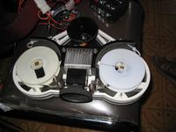
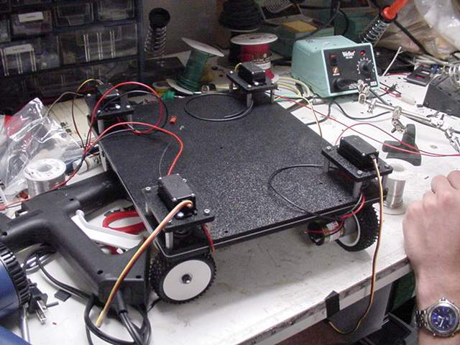
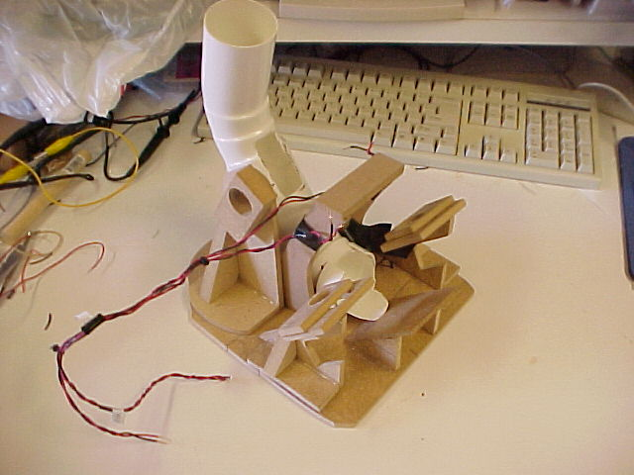
Prototyping
Traditional

Slide 21
Rapid Prototyping

Slide 22
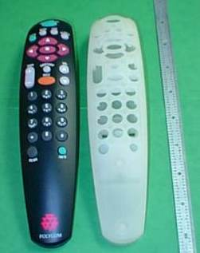
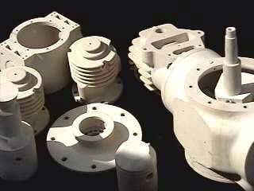
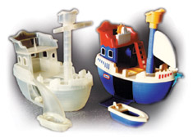
Prototyping
Rapid prototyping
Stereolithography

Slide 23
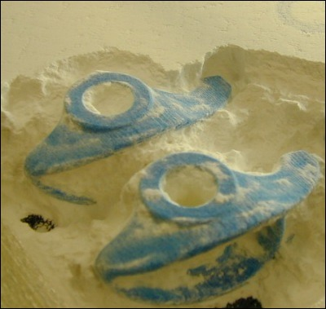
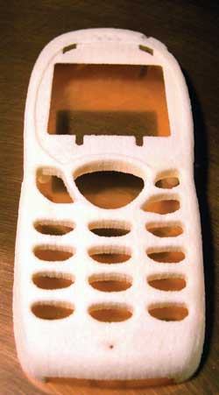
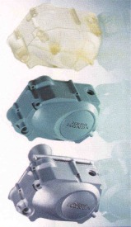
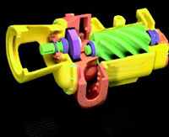
Prototyping
Rapid prototyping
3D printing

Slide 24
3-D Printing

Slide 25
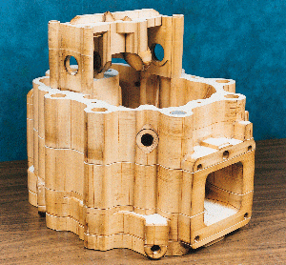
Prototyping
Rapid prototyping
Laminated object manufacturing (LOM)

Slide 26
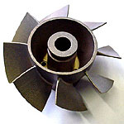
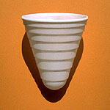
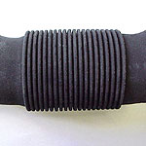
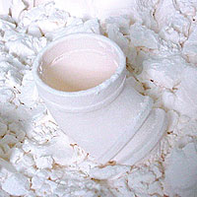
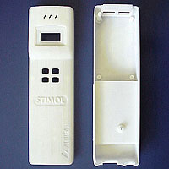
Prototyping
Rapid prototyping
Selective Laser Sintering (SLS)

Slide 27
Laser Sintering

Slide 28
Prototyping
Rapid prototyping
Fused deposition modeling (FDM)

Slide 29
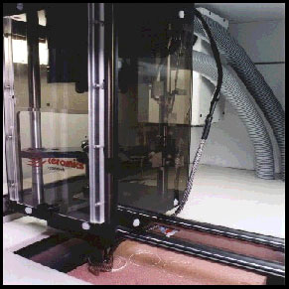
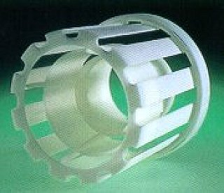
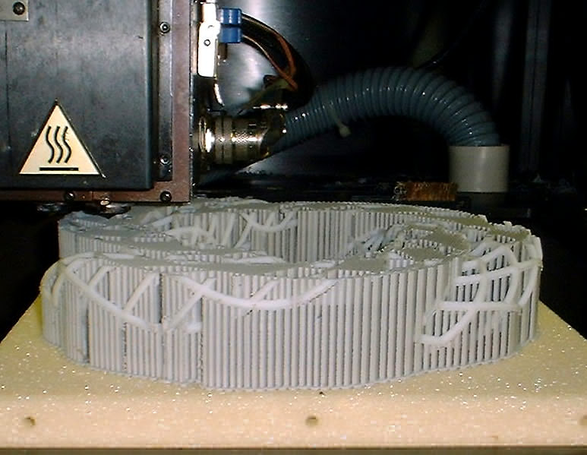
Prototyping
Rapid prototyping
Fused deposition modeling (FDM)

Slide 30
Process Selection
Some parts are more suited for a particular process
Many parts can be modified and processed through different methods
Some processes are incapable of producing certain features
Injection molding—hollow features
Roto-molding—deep ribs

Slide 31
Process Selection Matrix
Processes | Features
 | Feature 1: |  | Feature 2: |  | Feature 3: |  | Feature 4:
 | Value/ Rank | WF= | Value/Rank | WF= | Value/Rank | WF= | Value/ Rank | WF= | Total Score
 |  | Score |  | Score |  | Score |  | Score

Slide 32
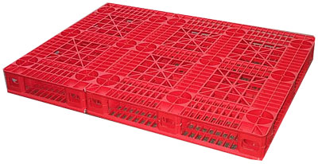
Process Selection Matrix
Process selection for a plastic pallet

Slide 33
Process Selection Matrix
Process selection for a plastic pallet
Processes | Features
 | Feature 1: |  | Feature 2: |  | Feature 3: |  | Feature 4:
 | Value/Rank | WF= | Value/Rank | WF= | Value/ Rank | WF= | Value/Rank | WF= | Total Score
 |  | Score |  | Score |  | Score |  | Score
Injection molding
Thermo-forming
Roto-molding
Casting/ Foaming
Extrusion
Possible
processes

Slide 34
Process Selection Matrix
Process selection for a plastic pallet
Processes | Features
 | Feature 1: Ribs |  | Feature 2: Net shape/no assembly |  | Feature 3: Short Cycle Time |  | Feature 4: Size
 | Value/Rank | WF= | Value/Rank | WF= | Value/Rank | WF= | Value/Rank | WF= | Total Score
 |  | Score |  | Score |  | Score |  | Score
Injection molding
Thermo-forming
Roto-molding
Casting/ Foaming
Extrusion
Features

Slide 35
Process Selection Matrix
Process selection for a plastic pallet
Processes | Features
 | Feature 1: Ribs |  | Feature 2: Net shape/no assembly |  | Feature 3: Short Cycle Time |  | Feature 4: Size
 | Value/Rank | WF= 4 | Value/Rank | WF= 3 | Value/Rank | WF= 5 | Value/Rank | WF= 6 | Total Score
 |  | Score |  | Score |  | Score |  | Score
Injection molding
Thermo-forming
Roto-molding
Casting/ Foaming
Extrusion
Weighting Factor
(higher is more
Important)

Slide 36
Process Selection Matrix
Process selection for a plastic pallet
Processes | Features
 | Feature 1: Ribs |  | Feature 2: Net shape/no assembly |  | Feature 3: Short Cycle Time |  | Feature 4: Size
 | Value/Rank | WF= 4 | Value/Rank | WF= 3 | Value/Rank | WF= 5 | Value/Rank | WF= 6 | Total Score
 |  | Score |  | Score |  | Score |  | Score
Injection molding | 5 | 20 | 3 | 9 | 5 | 25 | 2 | 12
Thermo-forming | 1 | 4 | 2 | 6 | 2 | 10 | 4 | 24
Roto-molding | 2 | 8 | 5 | 15 | 1 | 5 | 5 | 30
Casting/ Foaming | 4 | 16 | 4 | 12 | 3 | 15 | 3 | 18
Extrusion | 3 | 12 | 1 | 3 | 4 | 20 | 1 | 6
Score–assessment
(higher is better)

Slide 37
Process Selection Matrix
Process selection for a plastic pallet
Processes | Features
 | Feature 1: Ribs |  | Feature 2: Net shape/no assembly |  | Feature 3: Short Cycle Time |  | Feature 4: Size
 | Value/Rank | WF= 4 | Value/Rank | WF= 3 | Value/Rank | WF= 5 | Value/Rank | WF= 6 | Total Score
 |  | Score |  | Score |  | Score |  | Score
Injection molding | 5 | 20 | 3 | 9 | 5 | 25 | 2 | 12 | 66
Thermo-forming | 1 | 4 | 2 | 6 | 2 | 10 | 4 | 24 | 44
Roto-molding | 2 | 8 | 5 | 15 | 1 | 5 | 5 | 30 | 58
Casting/ Foaming | 4 | 16 | 4 | 12 | 3 | 15 | 3 | 18 | 61
Extrusion | 3 | 12 | 1 | 3 | 4 | 20 | 1 | 6 | 41
Total score
(higher is better)

Slide 38
Process Selection Matrix
Process selection for a plastic pallet
Processes | Features
 | Feature 1: Ribs |  | Feature 2: Net shape/no assembly |  | Feature 3: Short Cycle Time |  | Feature 4: Size
 | Value/Rank | WF= 4 | Value/Rank | WF= 3 | Value/Rank | WF= 5 | Value/Rank | WF= 6 | Total Score
 |  | Score |  | Score |  | Score |  | Score
Injection molding | 5 | 20 | 3 | 9 | 5 | 25 | 2 | 12 | 66
Thermo-forming | 1 | 4 | 2 | 6 | 2 | 10 | 4 | 24 | 44
Roto-molding | 2 | 8 | 5 | 15 | 1 | 5 | 5 | 30 | 58
Casting/ Foaming | 4 | 16 | 4 | 12 | 3 | 15 | 3 | 18 | 61
Extrusion | 3 | 12 | 1 | 3 | 4 | 20 | 1 | 6 | 41
The best

Slide 39
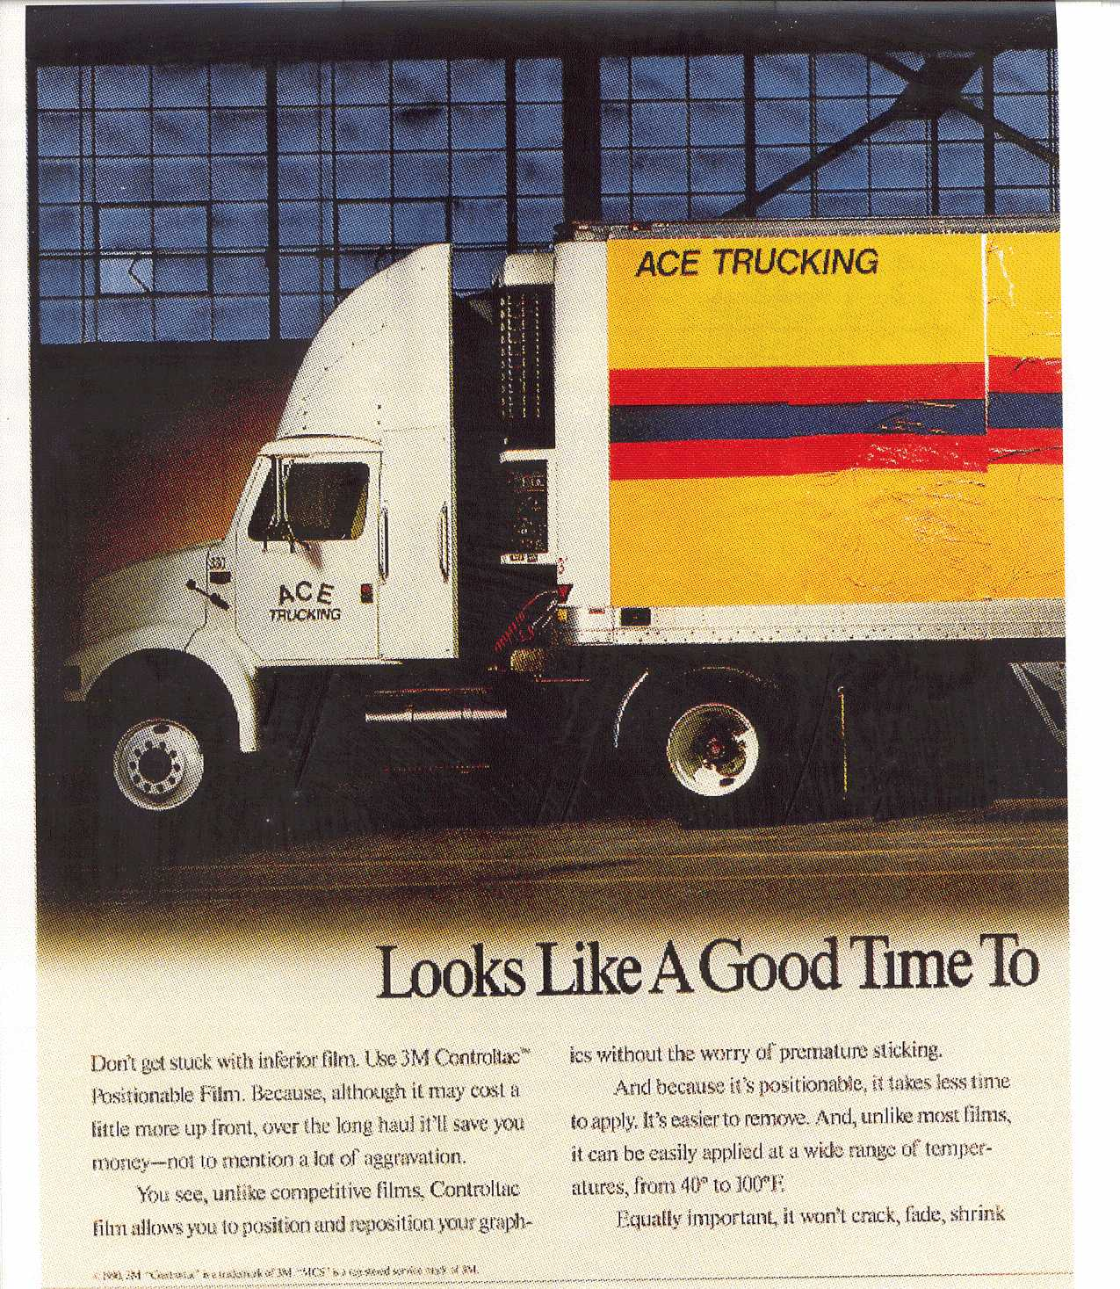
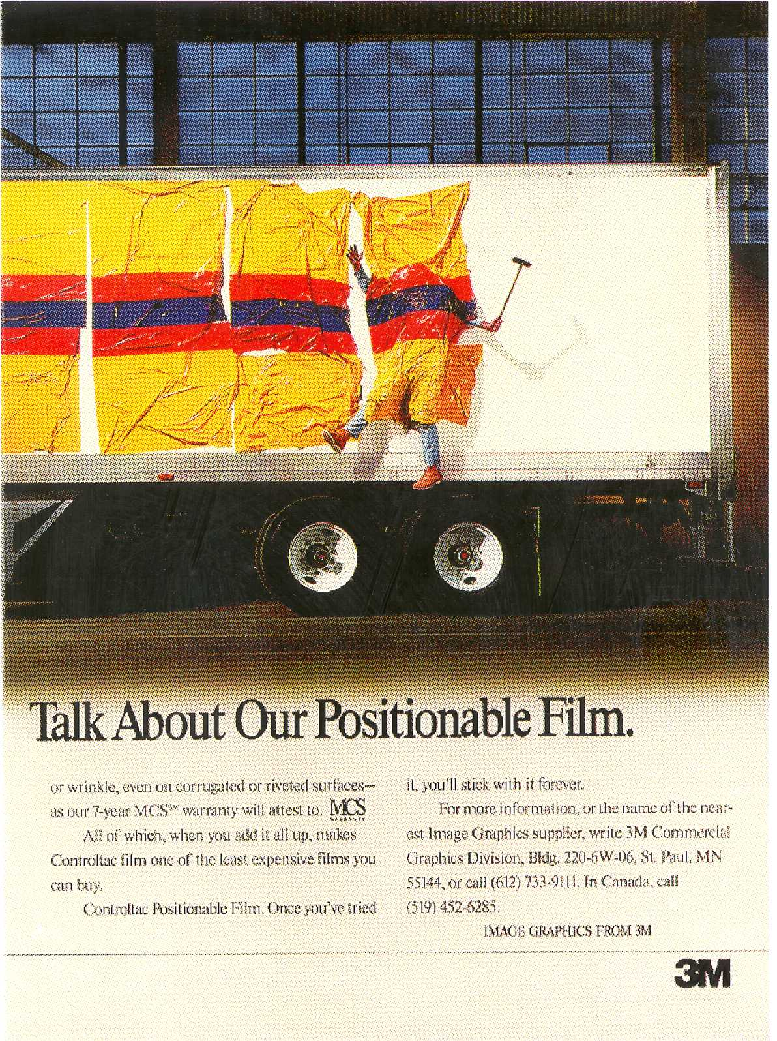
Unique Product
Design example

Slide 40
3M Comply Product
Covered with adhesive
Plastic Sheet (PE)
Embossed Sheet (ribs connecting to edges)
Graphic film applied
Depressions filled with glass spheres
Separated graphic product
Multiply embossed sheet creating ridges and lands
Separated plastic sheet

Slide 41
Avery-Dennison EZ Film
Adhesive added
Plastic Sheet (PE)
Polyurethane printed cured forms (array)
Graphic film applied
Polyurethane forms pressed into the PE sheet
(thereby forming depressions and embossing the sheet)
Separated graphic product
PE sheet embossed with ridges and lands
Separated embossed PE sheet

Slide 42
3M v. Avery-Denison
Separated graphic product
Separated graphic product
Separated plastic sheet
Separated embossed PE sheet

Slide 43
Patent Case Decision
Avery-Dennison EZ Film
Question: Do the dots form a “regular array”
as required in the 3M patent?

Slide 44
Thank You

