Slide 1
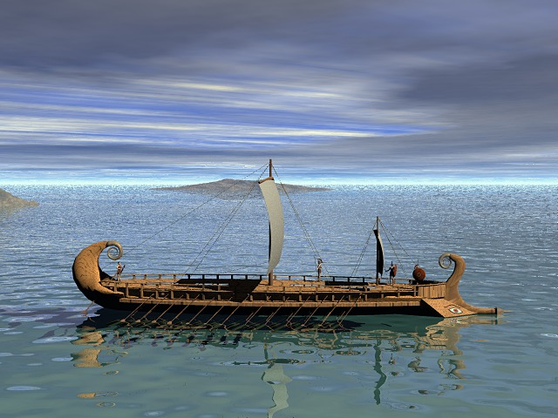
Greek Language and Religion

Slide 2
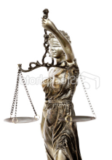
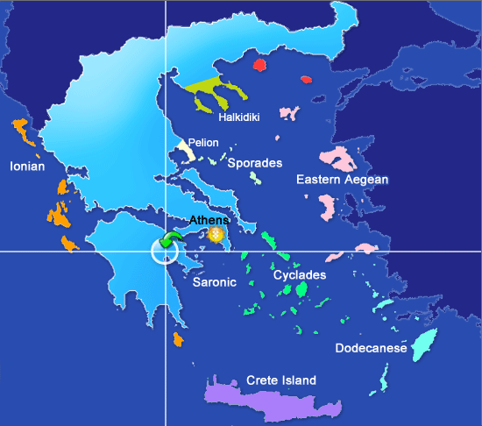
The “Dark Age” of Greece 1000–800 BC
Dorian
invasion
After the return of the heroes from the Trojan War
Dorian invasion defeated Mycenaeans
Culture was stagnant during the “Dark Age”

Slide 3
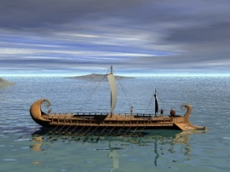
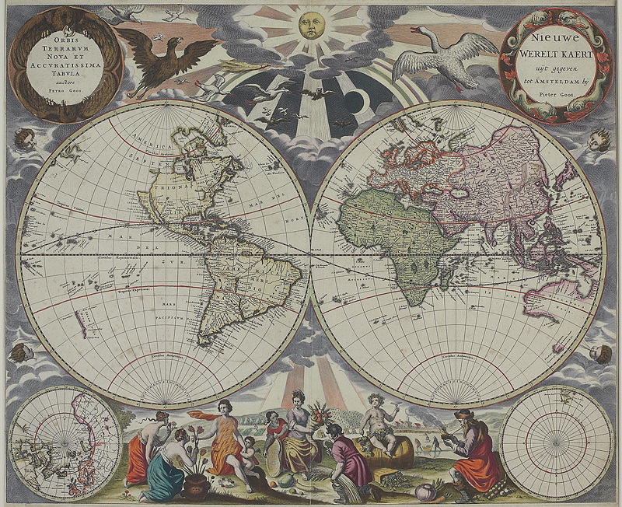
Greek Language and Religion
What is the most important event in the Ancient World?

Slide 4
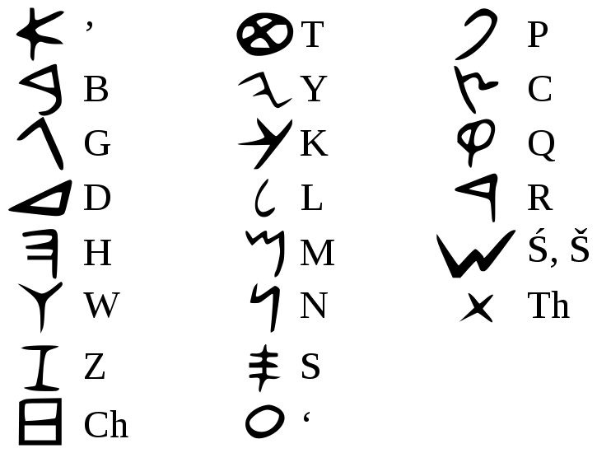
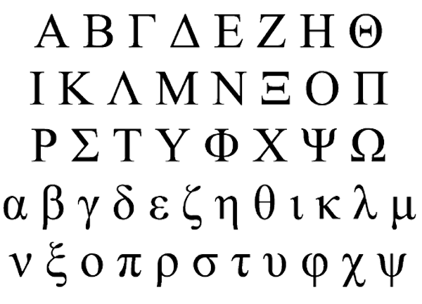
What is the most important event in the ancient world?
Answer by a UCLA professor:
Development of the Greek Alphabet
Phoenician Alphabet
Greek Alphabet
Greek: First alphabet with the ability to
write in full phonetic detail

Slide 5
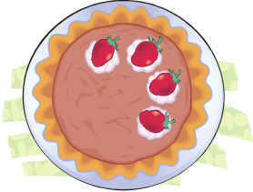
What is the most important event in the ancient world?
Why was the Greek alphabet better?
α
Less ambiguity
History, laws, business (all improved)
More democratic
Empowered many classes of people (intuitive and easy to learn)
Easy recording of details
Scientific thinking (more precise)
Subtleties can be expressed
Philosophy
More creative
Literature (more expressive)
V
∆
∑
ß
K
∏
Ω

Slide 6
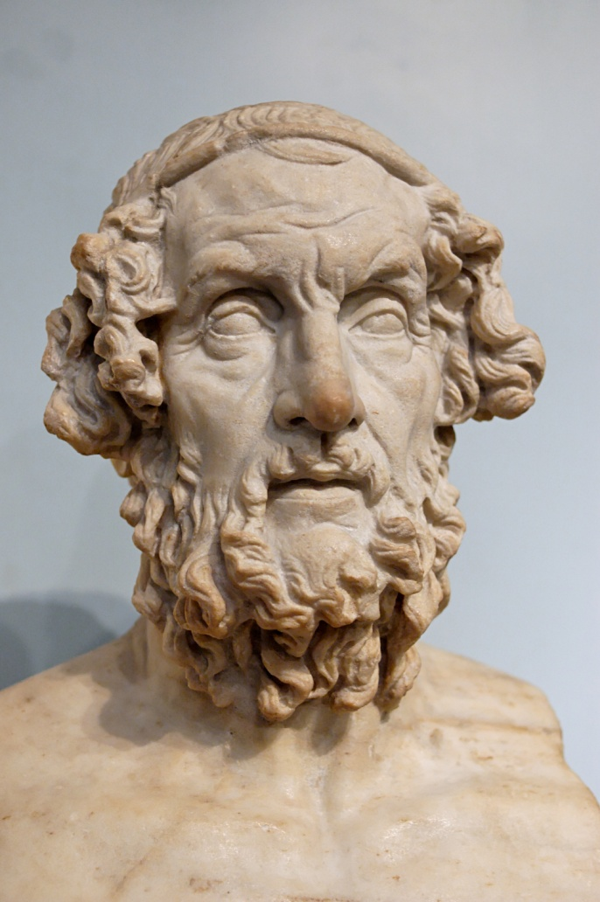
Homer
Blind
Recited and it was recorded
Created the Illiad and the Odyssey
Began the western literary tradition
Mythical beginnings for Greek history
A unifying force for the Greek people
Became a “religious” document
Quest for areté (aristocracy, excellence, virtue, fulfillment of purpose)
Solidified the Epic genre

Slide 7
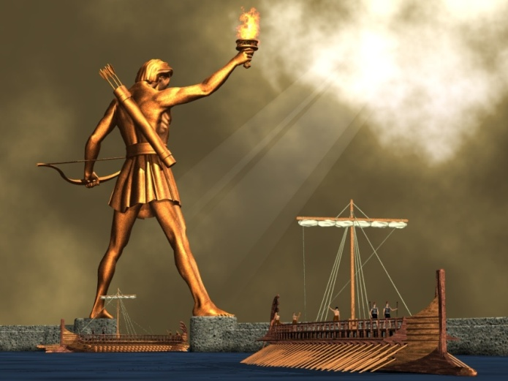
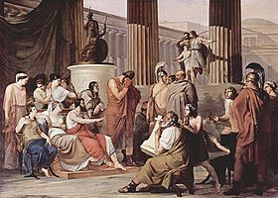
Epics
Larger than life in scope and meaning
Long story with many events over many years
Heroes and often gods
Wrestle with problems and also with life
Lessons that can apply to everyone in many periods of time

Slide 8
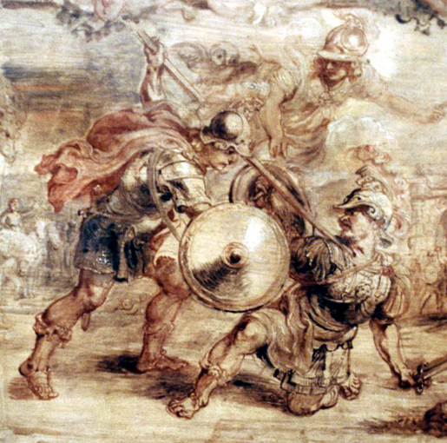
Illiad
Hector pleads with Achilles
“I beg you, Achilles, by your own soul and by your parents, do not allow the dogs to mutilate my body. . .”
And Achilles, fixing him with a stare,
“Don’t whine to me about my parents, you dog! I wish my stomach would let me cut off your flesh in strips and eat it raw for what you’ve done to me. There is no one and no way to keep the dogs off your head.”

Slide 9
Achilles and Priam

Slide 10
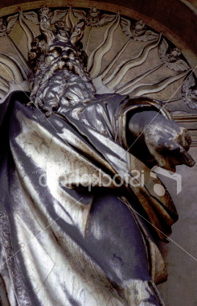
Illiad
Quote from Zeus
“How foolish men are! It is their lot to suffer, but because of their own folly they bring upon themselves sufferings over and above what is fated for them. And then they blame the gods.”

Slide 11
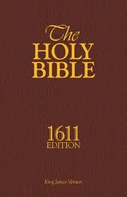
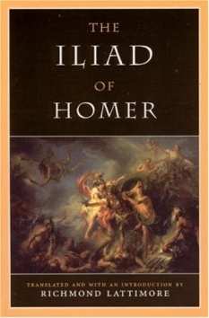
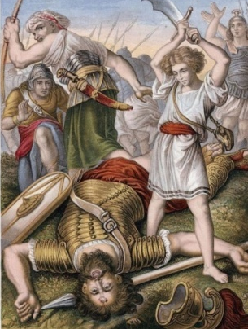
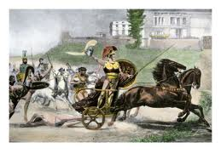
Illiad & The Bible
Many gods involved
Challenge by Achilles
Trojan fear and shame
Acceptance by Hector
Achilles’ ridicule of Hector
Spears and swords
Armor of Achilles
Post fight sacrilege
One God
Challenge by Goliath
Israelite fear
Acceptance by David
Goliath’s ridicule of David
Slings/stones and sword
Armor of Goliath
Post fight beheading

Slide 12
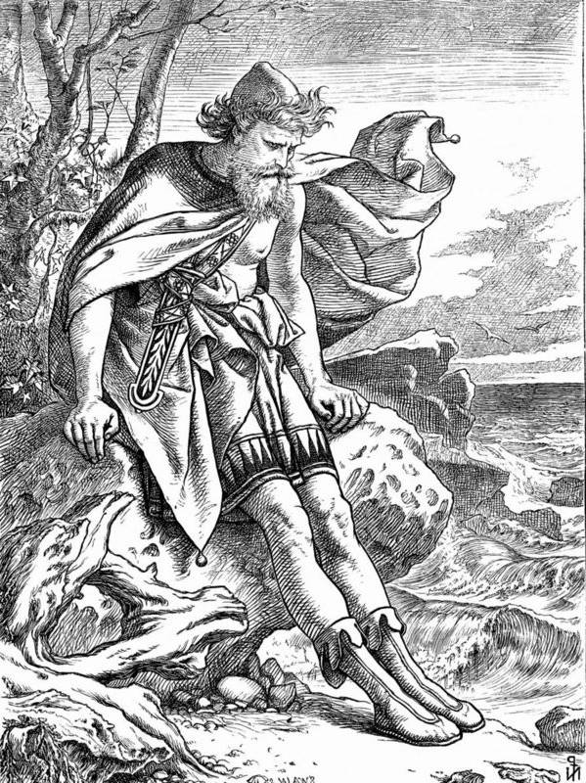
The Odyssey
Travels of Odysseus trying to get home
Tone is lighter than the Illiad
10 year journey
Growth and maturing
From experiencing troubles

Slide 13
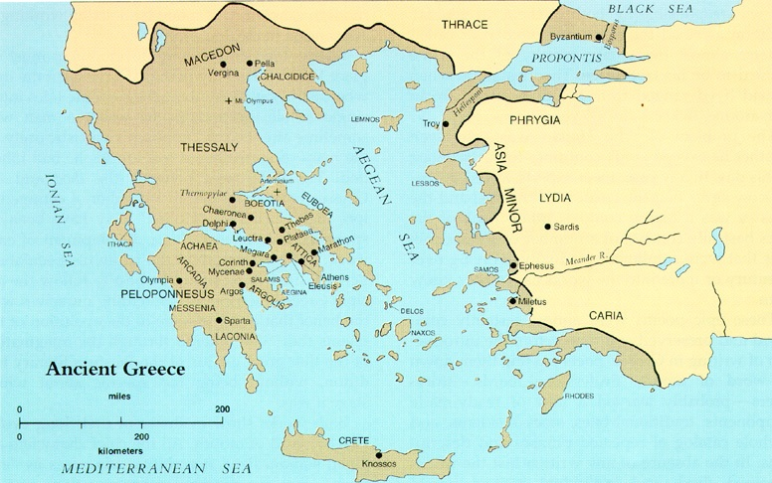
Trojan War Historic

Slide 14
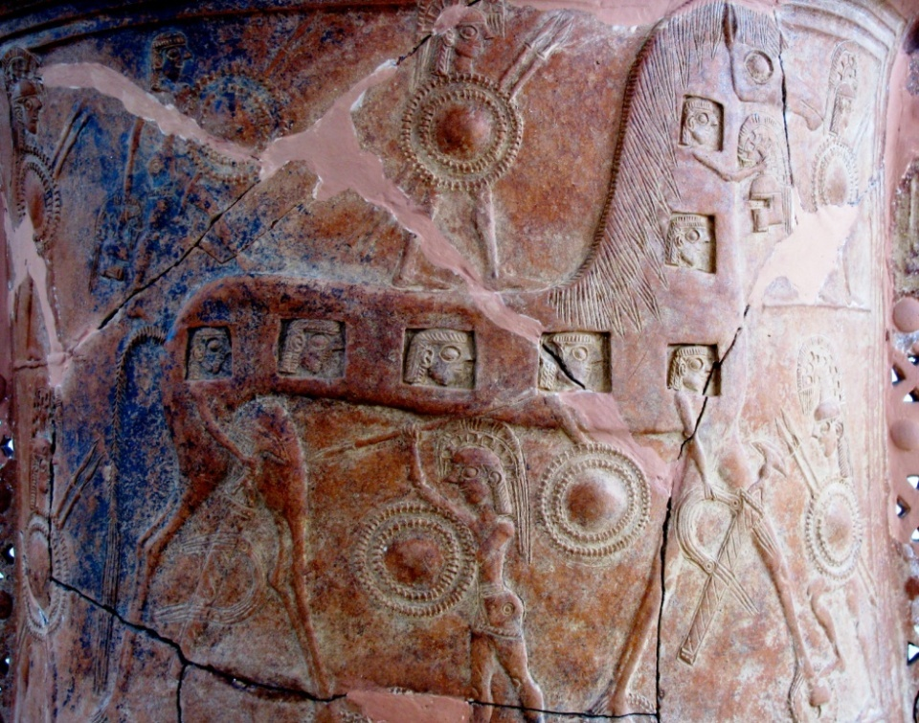
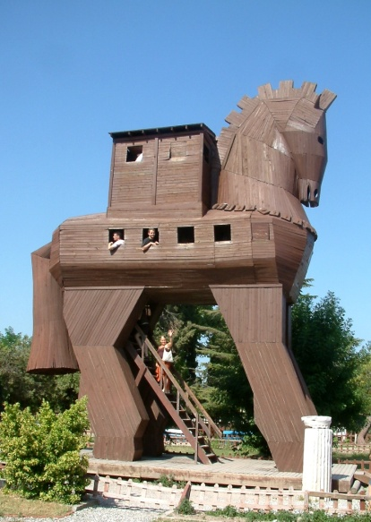
Trojan War Historic?
Trojan War (1200 BC)
It did happen.
Archeological evidence is
quite strong.
Discussion:
Why did Homer say that the war was fought over love and trade was ignored?
Decorated vase depicting one of the earliest known renditions of the Trojan Horse.

Slide 15
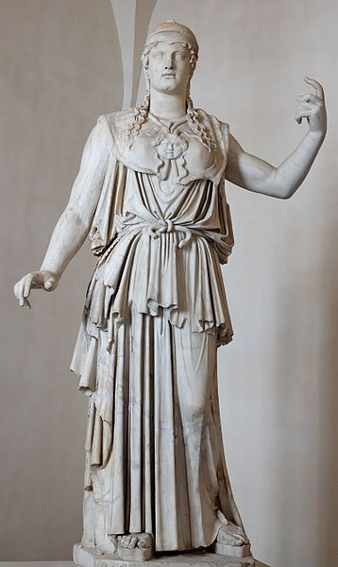
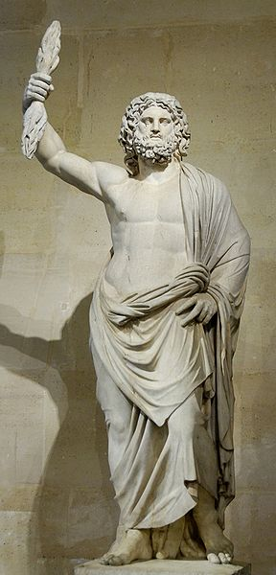
Another way of determining
proper behavior: Religion
Theogony
by Hesiod (700 BC)
Traces the descent of the gods (myths)
6
Greek Gods
Separate race from humans
Immortal characteristics
Did not give patterns for moral behavior
Art and literature—method of finding purpose of life

Slide 16
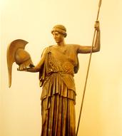
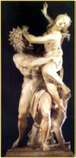
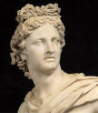
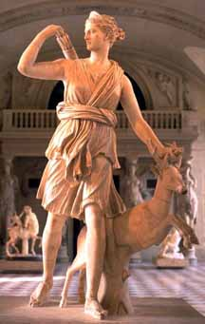
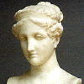
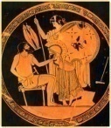
The Gods
Chaos
Gaea
Tartarus
Eros
Erebus
Uranus +
Gaea
Mountains
Pontus
Cyclope
Hecatonchires
Cronus
(Saturn)
+ Rhea
Coeus +
Phoebe
Oceanus +
Tethys
Hestia
Hades
(Pluto)
Poseidon
(Neptune)
Zeus
(Jupiter) +
Hera
(Juno)
Demeter
(Ceres) +
Zeus
Leto
+
Zeus
Iapetus
Athena
(Minerva)
(no mother)
Persephone
(Proserpina)
Apollo
Artemis
(Diana)
Atlas
Prometheus
Epimetheus
Ares
Hebe
Hephaistos
(Vulcan)
Maia
+
Zeus
Dione +
Zeus
Hermes
(Mercury)
Aphrodite
(Venus)

Slide 17
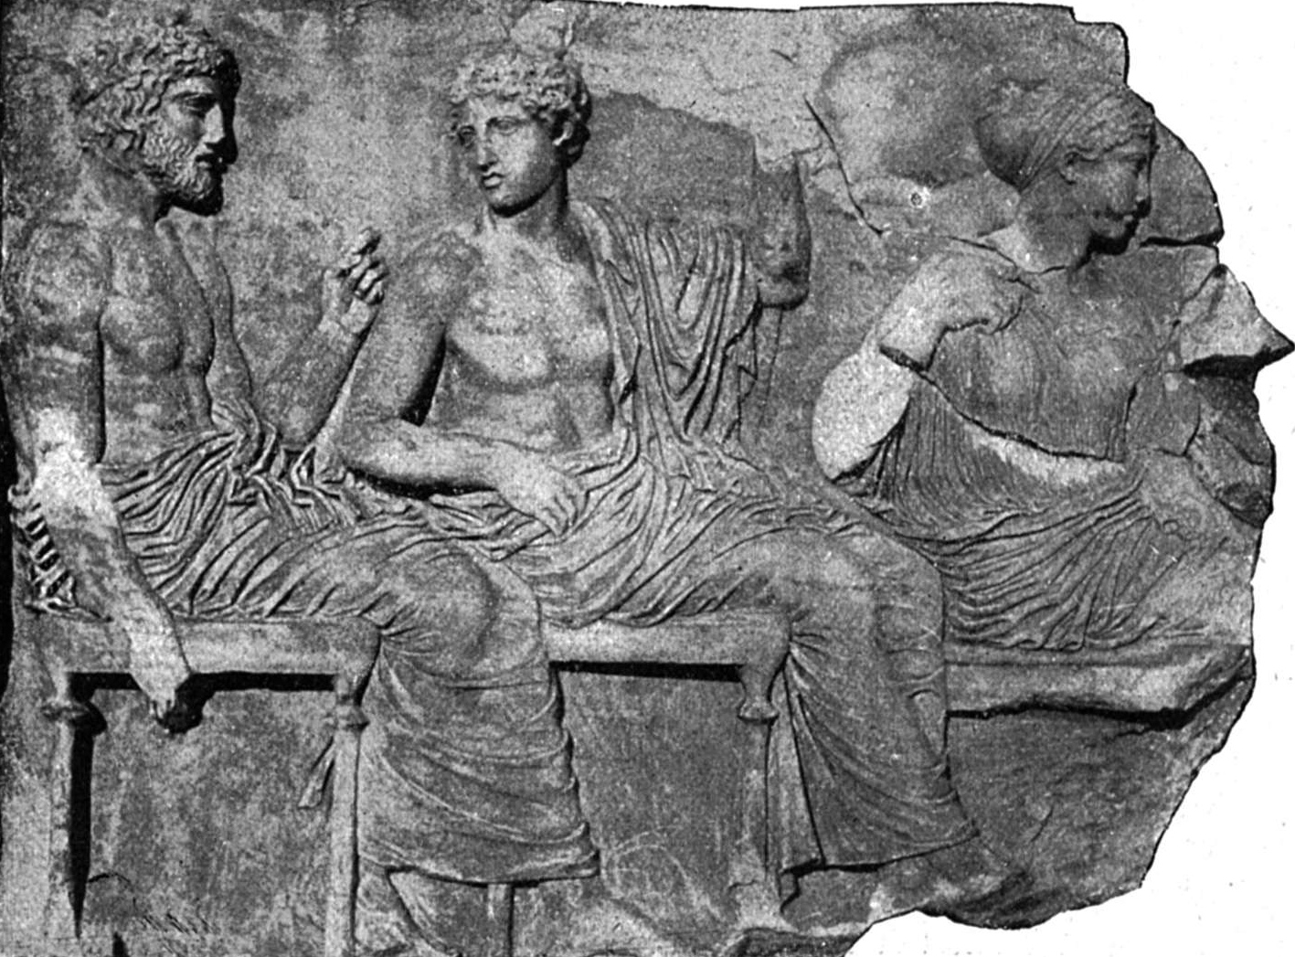
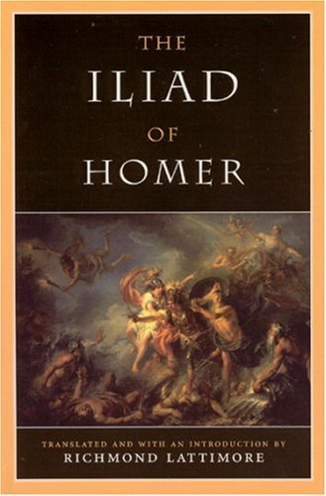
Greek Religion versus Literature
Greek religion did not have a god that acted in the “true” method of living.
Greeks adopted the lifestyle of the Homeric heroes as their standard.
Homer’s works became the “scriptures” of the Greeks.

Slide 18
Greek Religion versus Literature
Discussion
Do we have non-religious books today that are “scriptural” for some people?

Slide 19
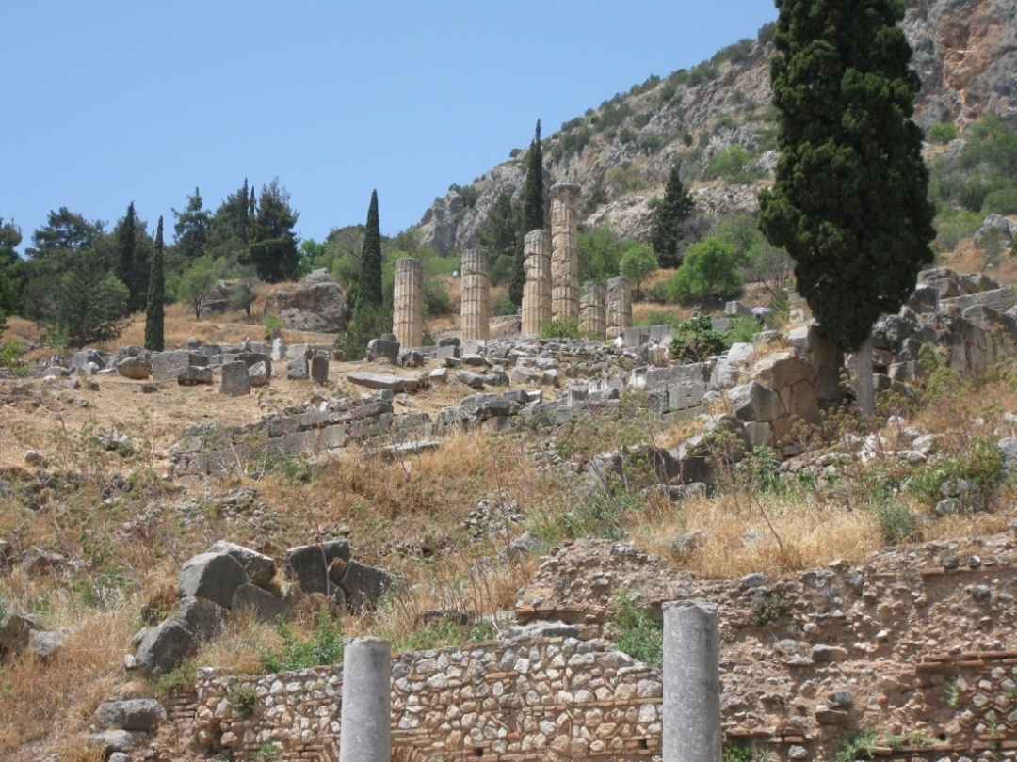
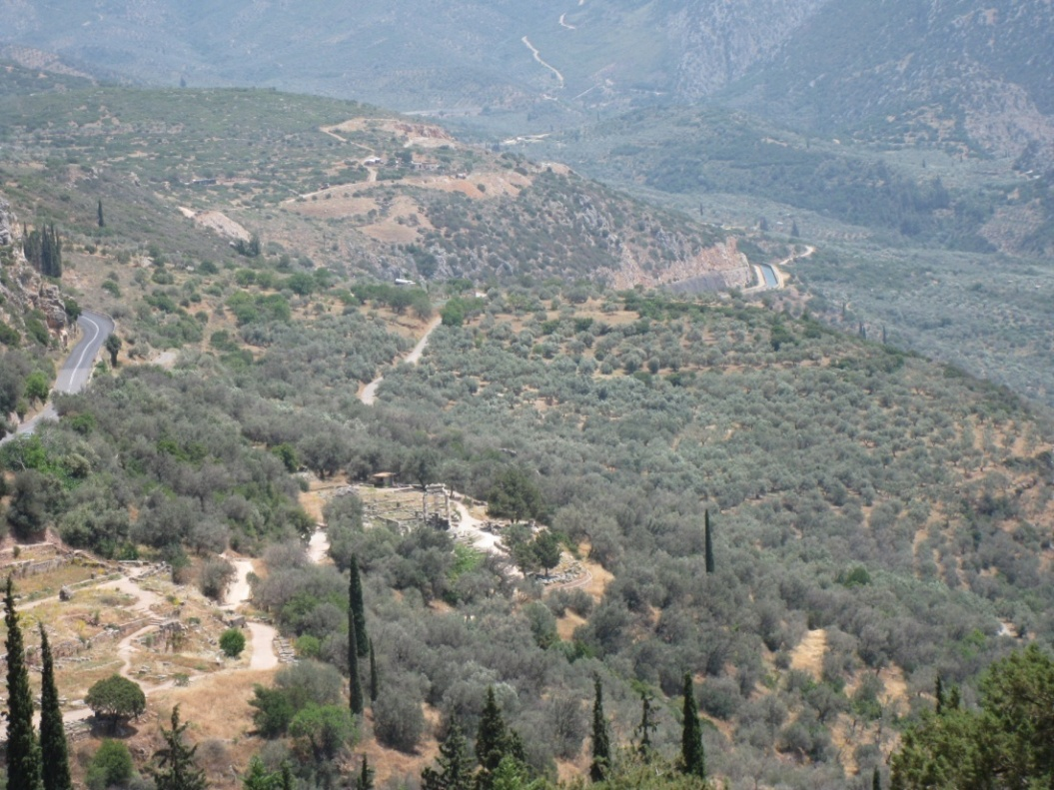
Religion—Delphi
Seeking advice from an oracle:
Another way of determining proper behavior.
Looking down across the valley.
Looking up at the temple of Apollo.

Slide 20
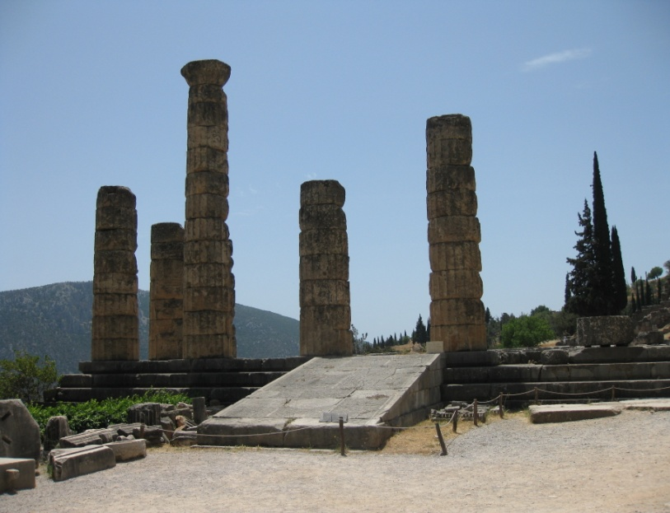
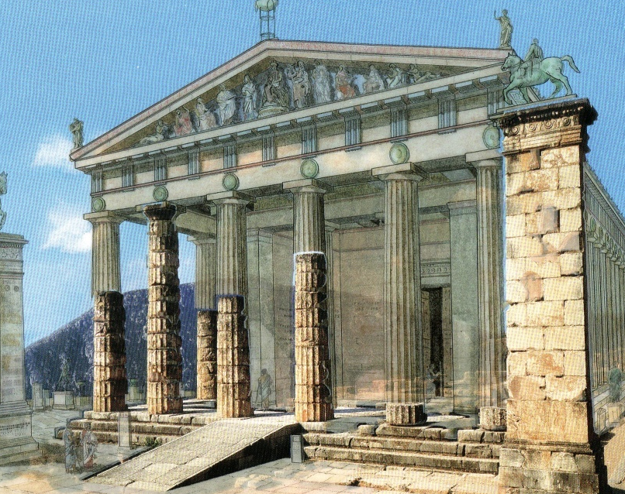
Delphi
•
5th century onwards–a priestess was abducted to serve in Apollo’s temple.
Priestess purified herself in a spring.
Priestess entered sanctuary of Apollo.
Priestess inhaled vapors that caused her to fall into a trance and she muttered.
Priest interpreted her unintelligible words.
•
•
•
•

Slide 21
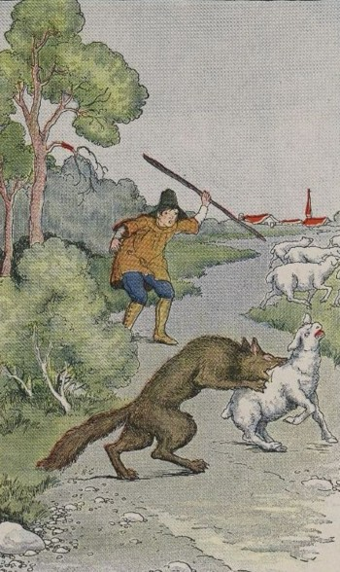
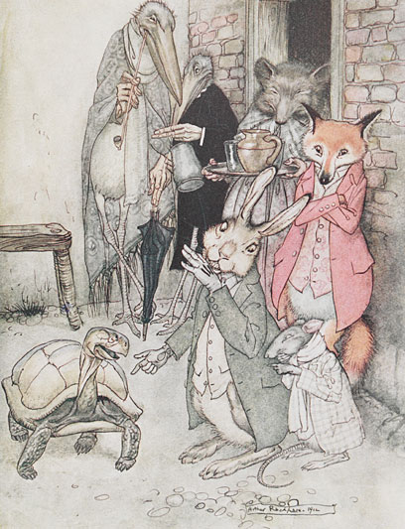
Another way of determining proper behavior: Moral stories
Aesop
Slave in 550 BC
Wrote short stories
Attention to ethics
Used fables and morals . to make his points
Boy and Wolf
Tortoise and Hare

Slide 22
Boy and Wolf

Slide 23
Tortoise and Hare

Slide 24
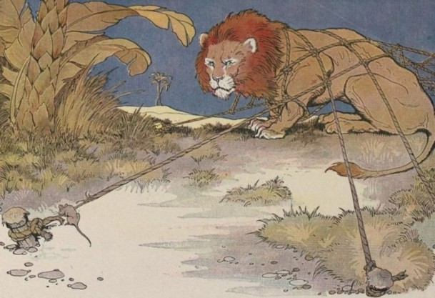
Aesop’s
The Lion and the Mouse
or The Mion and the Louse

Slide 25
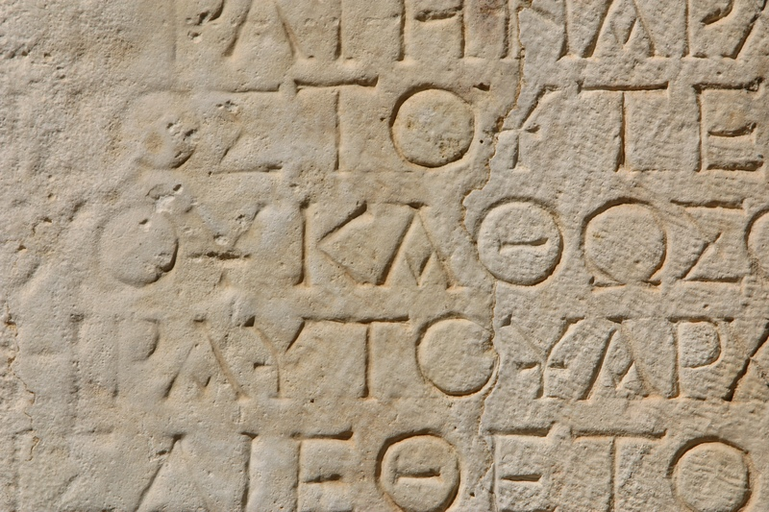
Language and Creativity
Language is a set of rules that allow people to communicate.
People that the Greeks did not understand were called barbarians because their language sounded like “bar-bar-bar” to the Greeks.
If we don’t follow the rules, we can’t communicate.
Words and Rules
Question:
Do the rules of language limit creativity?

Slide 26
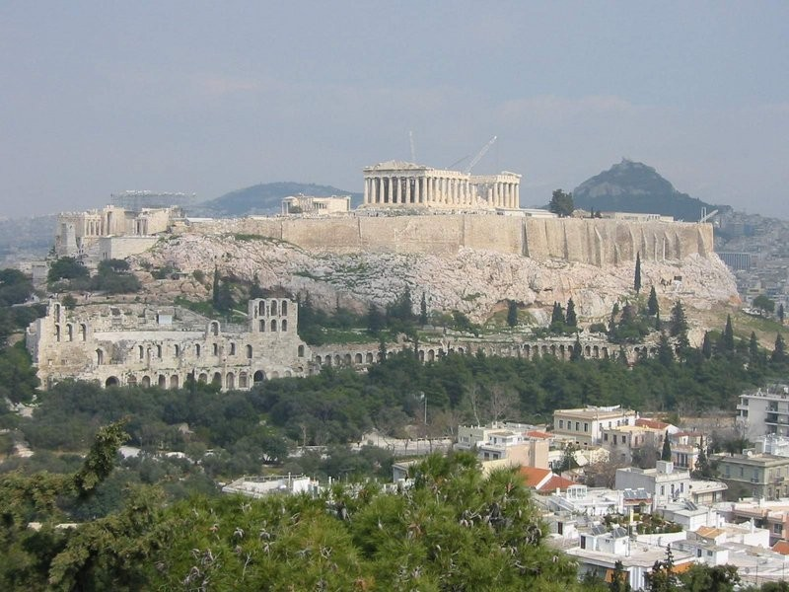
Thank You
Thank You
It's Greek to me.
It's Greek to me.

