Slide 1
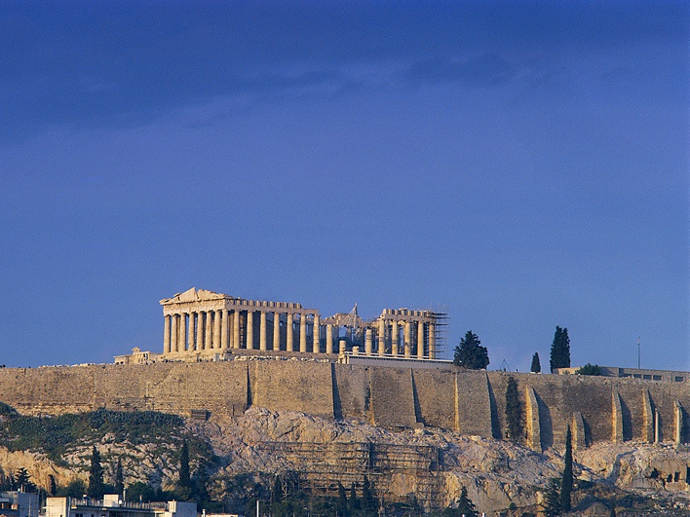
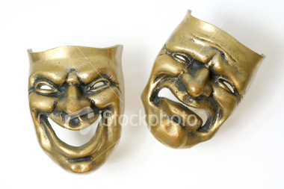
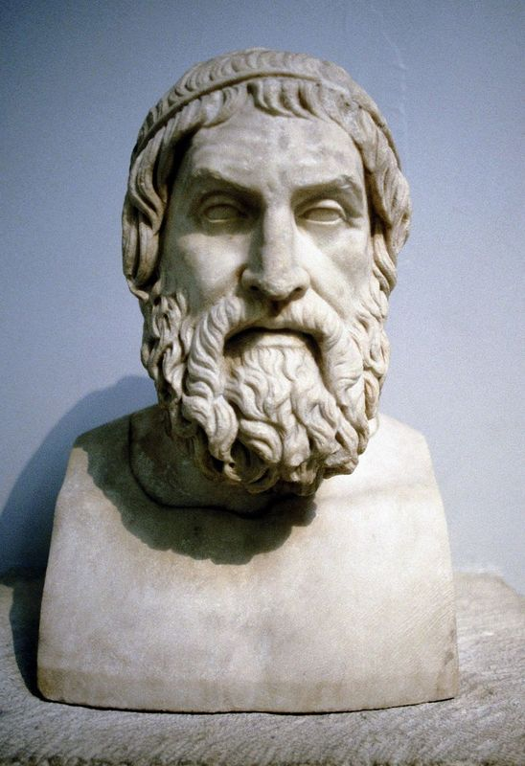
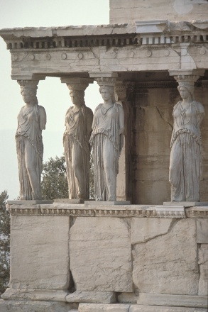
Classical Greece
Living Creatively

Slide 2
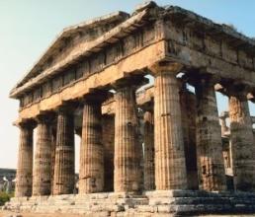
Drama
Festivals of Dionysus
Playwrights submit 4 plays for competition
3 were tragedies
1 was a satyr
Competition was fierce, the winner had a nice income for the ensuing year and funding for the next play.
Acoustics are amazingly good

Slide 3
Drama

Slide 4
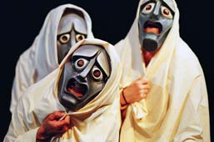
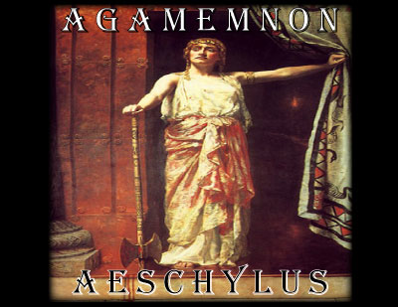
Drama
Method of presentation
Actors with masks
Chorus
Themes
Trojan war characters and their descendents
Ethics from Heroic period

Slide 5
Drama
Tragedy
Genre invented by Thespis (543 BC)
Where the word “thespian” originated
The most common of the Greek dramatic genrés
About 1000 written, only 31 remain–
all by Aeschylus, Sophocles, and Euripides
Tragedy = the change that occurs due to difficulty
Not about a person dying

Slide 6
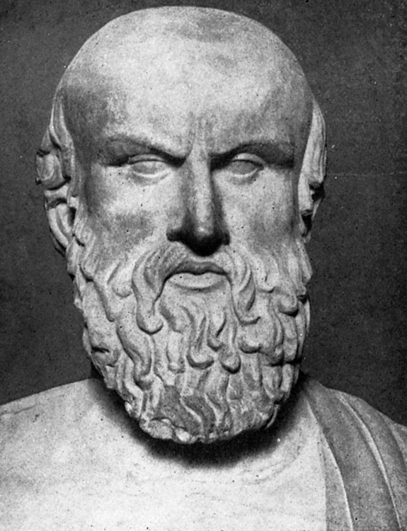
Drama
Aeschylus (525–456 BC)
Aware of human weakness
Discusses pain and suffering
In the end, justice triumphs
Oresteia trilogy about the House of Atria
Agamemnon (Lesson=revenge)
The Libation Bearers
The Eumenides (The Furies)

Slide 7
Drama
Sophocles (496–406 BC)
Friend of Pericles
Great prestige and wealth
Wrote 123 plays, but only 7 exist
Sophoclean tragic heroes
Have tragic defects
Are likeable and we feel sorry for them
Introduced the use of multiple actors

Slide 8
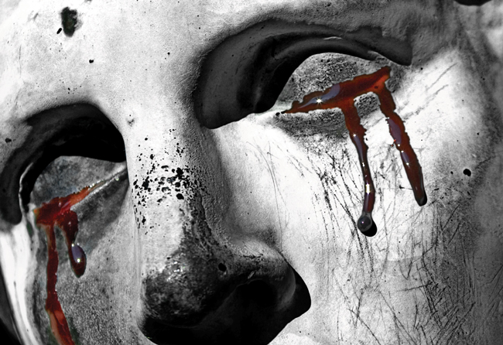
Drama
Sophocles (continued)
Oedipus the King (Oedipus Rex) (Lesson = fate stronger than effort)
Epitome of Greek tragedy.
Fate has powerful hold on humans.
Tragic Flaw?

Slide 9
Drama

Slide 10
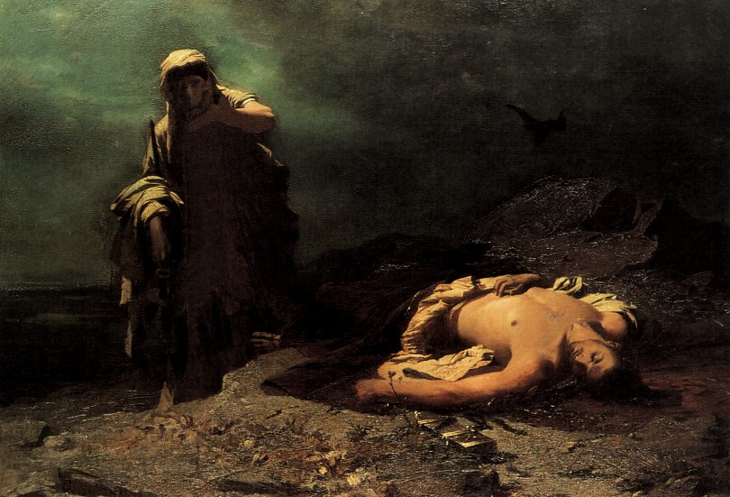
Drama
Sophocles (continued)
Antigone
Oedipus’ sons fight over ruling the city . . .
One is loyal to King Creon and the other is a rebel. Both are killed.
King Creon decrees that the loyal
brother will be buried with honor but
the other will be left in the field to rot.
Oedipus’ daughter, Antigone, decides
to bury her rebel brother.

Slide 11
Sophocles: Antigone and Creon

Slide 12
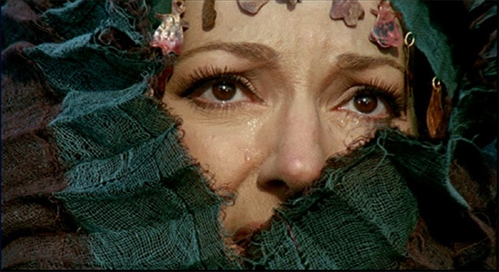
Drama
Euripedes
Medea
Lesson=love and revenge
Medea helps Jason
find the Golden Fleece
but sacrifices all for him
Jason and Medea have
2 boys but Jason decides
to divorce

Slide 13
Euripedes: Medea and Jason

Slide 14
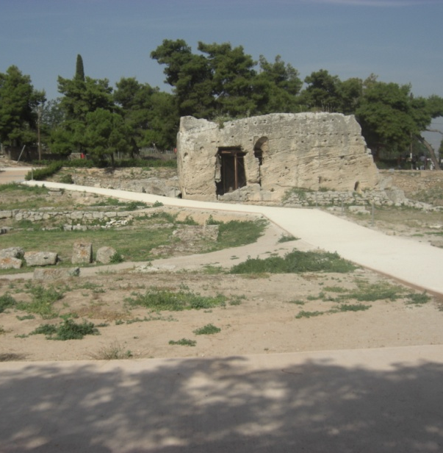
Medea
Fountain/well in Corinth
where the bride tried
to wash off the poison
from the golden dress.

Slide 15
Euripedes: Medea—end

Slide 16
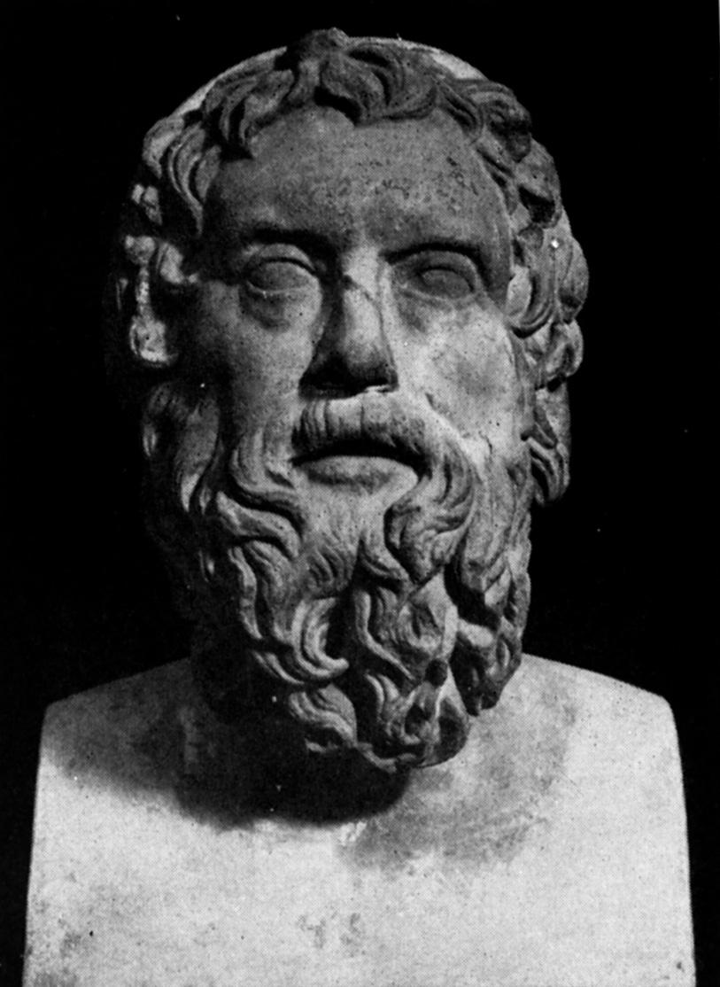
Drama—Comedy
Aristophanes
Sarcastic in humor
Dealt with current events (war, marriage, etc)
Poked fun at tragedians (especially Euripedes)

Slide 17
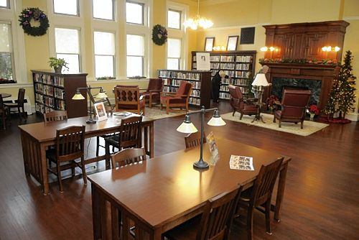
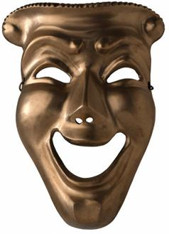
Drama—Comedy
Creative project
Aristophanes visits a student in the library and complains about not being featured in the lectures
Aristophanes gives the student a play proving why he is as good as the dramatists

Slide 18
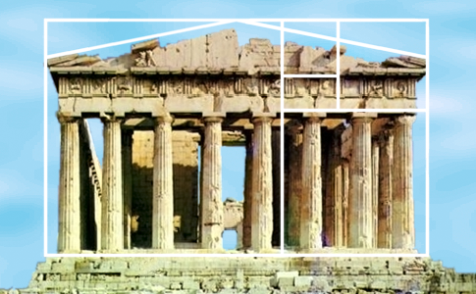
Architecture
Elements of Greek architecture
Rectangles based on the Golden Mean
Pillars, bases, capitals
Capital
Pillar
Base

Slide 19
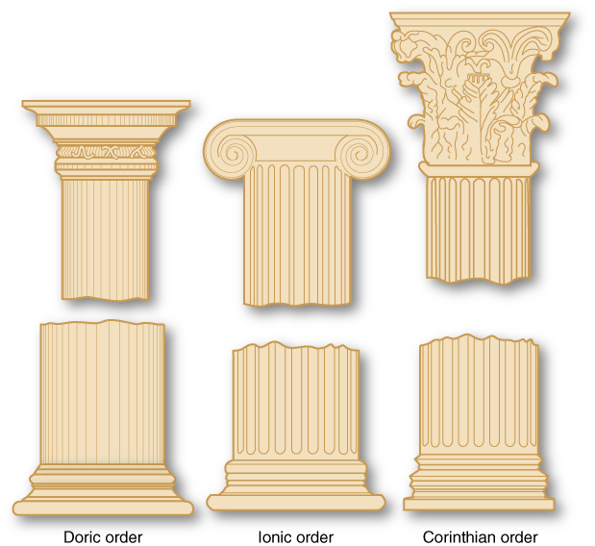
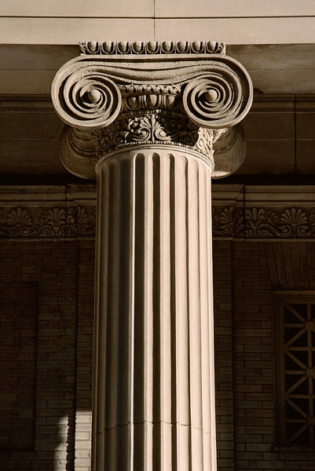
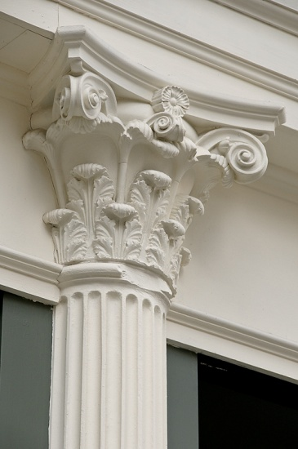
Architecture
Ionic
Doric
Corinthian

Slide 20
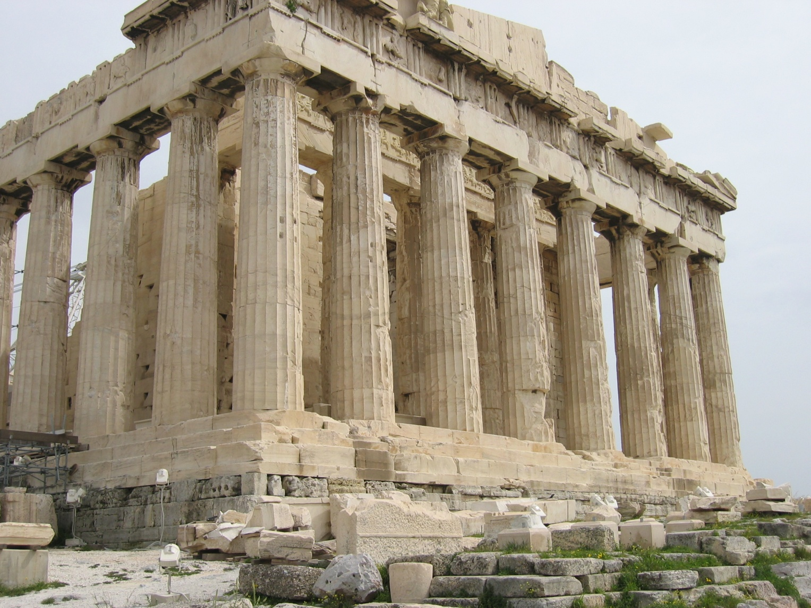
Architecture
The Acropolis:
Parthenon

Slide 21
Architecture
The Acropolis:
Parthenon

Slide 22
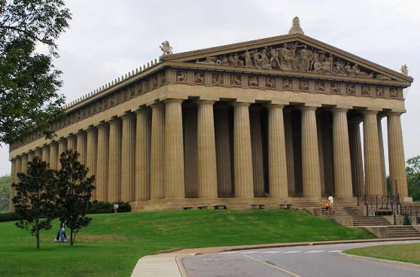
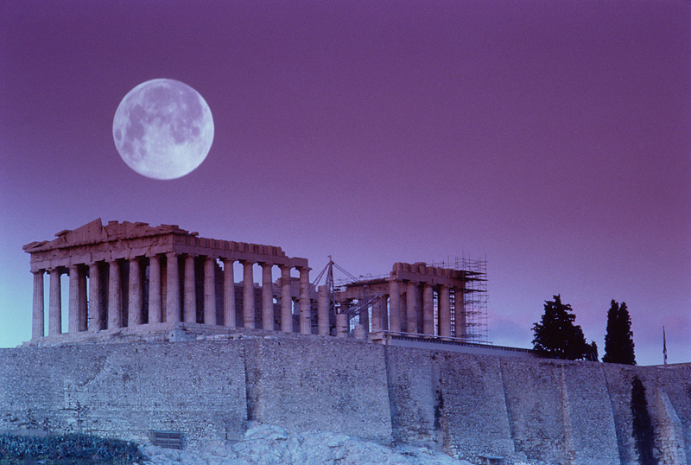
Parthenon
Discuss:
Why is the Greek style copied so often?
Restoration Project on the original Parthenon

Slide 23
Parthenon Restoration

Slide 24
Parthenon
Analysis:
Why are the lines not straight?

Slide 25
Parthenon

Slide 26
Parthenon
Discussion:
Which is more perfect–a square?
or
something that looks like a square?

Slide 27
Parthenon

Slide 28
Parthenon―Columns

Slide 29
Parthenon
The cost of construction
Done during a time of war.
Democratic government needs cost accounting.
Cost of culture versus the cost of war (or anything else).

Slide 30
Parthenon―Cost

Slide 31
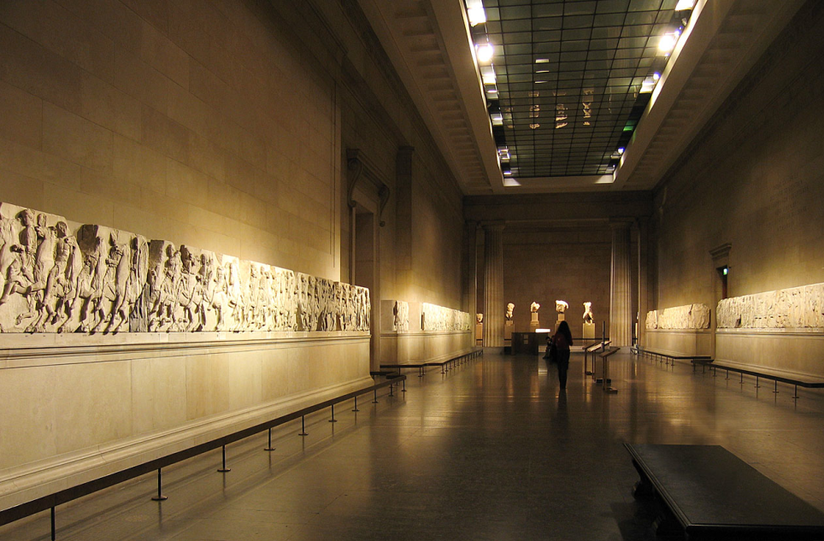
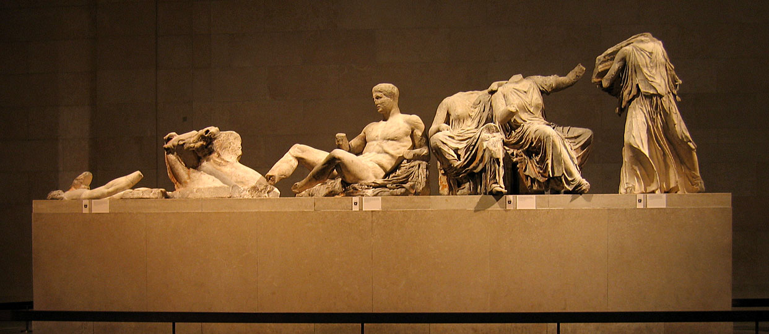
Parthenon
Elgin Marbles – British Museum
The Elgin Marbles
(British Museum)

Slide 32
Parthenon
Elgin Marbles

Slide 33
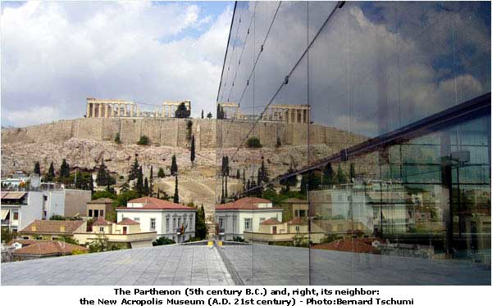
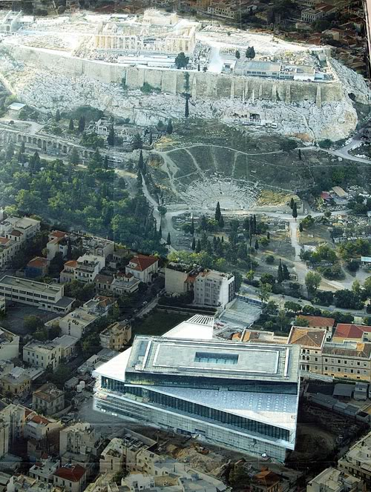
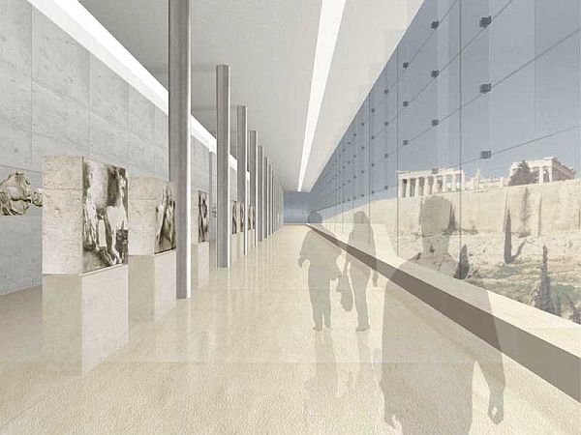
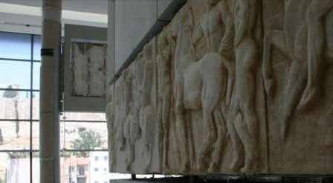
Parthenon
Elgin Marbles
The Acropolis
Museum
(Athens)

Slide 34
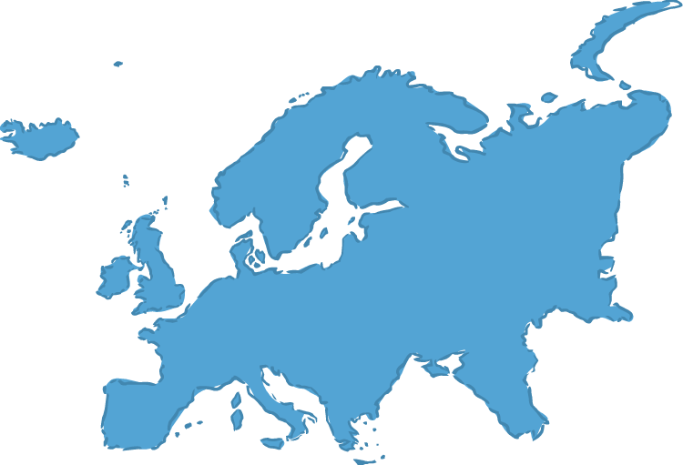
Parthenon
Elgin Marbles
Discussion
Who (what country) should have possession of the Parthenon (Elgin) Marbles?

Slide 35
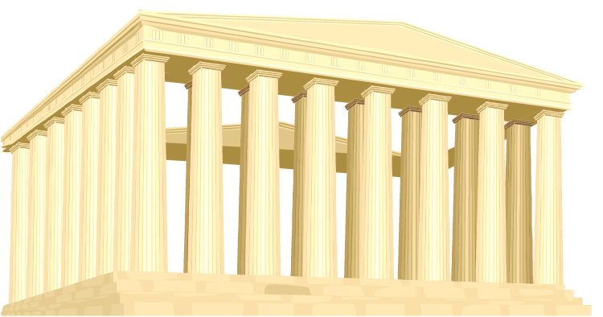
Creativity in the Classical Era
Discussion
What must be the characteristics of architecture for it to be great?
Do those characteristics
include creativity?

Slide 36
Thank You
Greece’s Legacy of Creativity

