Slide 1
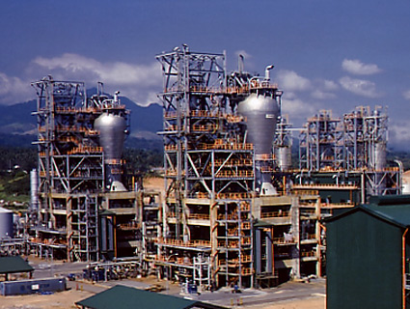
Commodity Resins
MFG 355

Slide 2
Commodity Plastics
Followed a consistent price-volume curve
After maturity, price tracks the crude oil price
Products are purchased based on price or service rather than properties

Slide 3
Polyethylene (PE)
Mer unit
Polymer chain

Slide 4
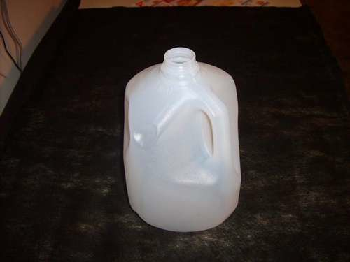
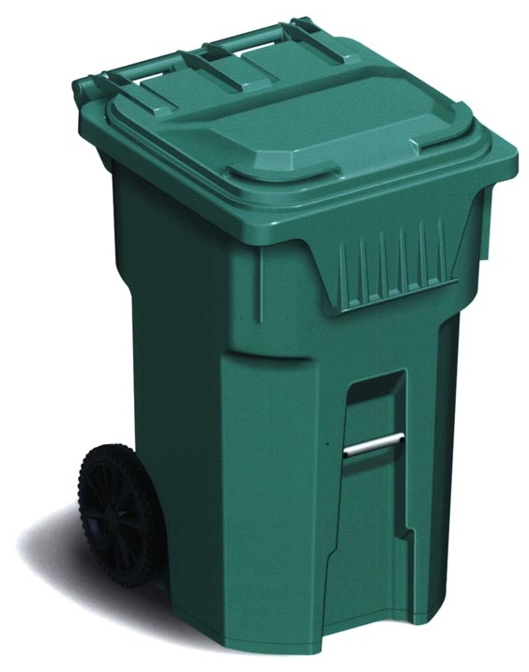
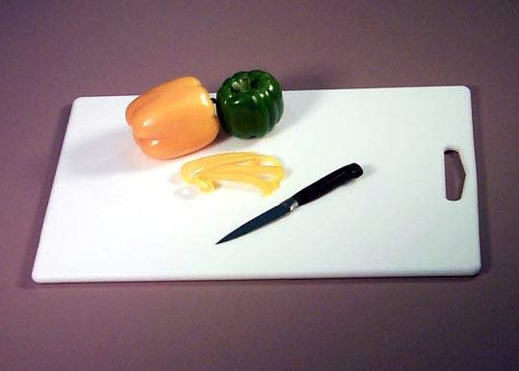
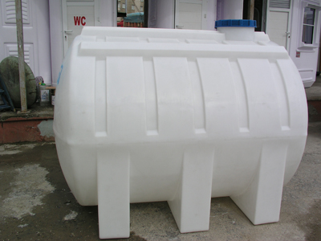
Polyethylene
LDPE
High Pressure/High Temperature processing
Branching, flexibility
HDPE
Ziegler-Natta catalyst
Little branching
Highly crystalline
LLDPE
“Copolymer”—side chains prevent crystalization
Improved toughness, strength, ESCR
UHMWPE
Not melt processable
Crosslinked PE

Slide 5
Polyethylene processes
High Pressure Process (LDPE)
Pressures around 350 MPa
Temp. 300^{ס} C
Long construction lead time
Mammoth space requirements
Huge capital outlay
High energy demands
Limited to low density polyethylene
Costly and complex maintenance
Production rates vary with PE grade
Meets environmental requirements with difficulty
Rapidly inflating operating costs
Limited catalyst system choice
Catalyst removal required
Acceptable resin properties
Low Pressure Process (LLDPE)
Pressures around 3 MPa
Temp. 100^{ס} C
Reduced const. lead time by 8-12 months
Occupies 1/10 the space
Capital outlay reduced by 50%
Reduced energy demands by 75%
Produces both HDPE and LLDPE
Easy to maintain
Same production rate for all resin grades
Environmental pollution minimal
Operating costs reduced
Several available catalysts
Catalyst removal not needed
Superior resin properties

Slide 6
Polyethylene Properties
Relatively soft, flexible and waxy like
Relatively low strength and stiffness
High elongation (but not elastomeric)
Easy to mold/extrude
Easy to recycle
Low surface energy (difficult to bond to)
Excellent insulation properties
Excellent solvent resistance
Low cost

Slide 7
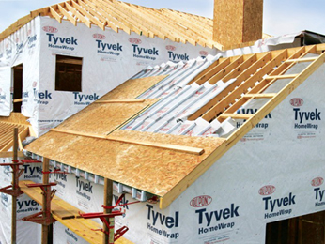
Polyethylene Non-woven
Different molecular weights of PE
Different melting points
Lay down in a mat
Calendar at temperature between the melting points of the two materials

Slide 8
Polyethylene Copolymer
Types of Copolymers
Random
Regular
Segment/
block
Graft

Slide 9
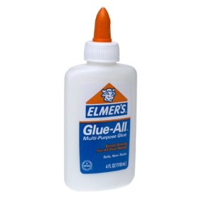
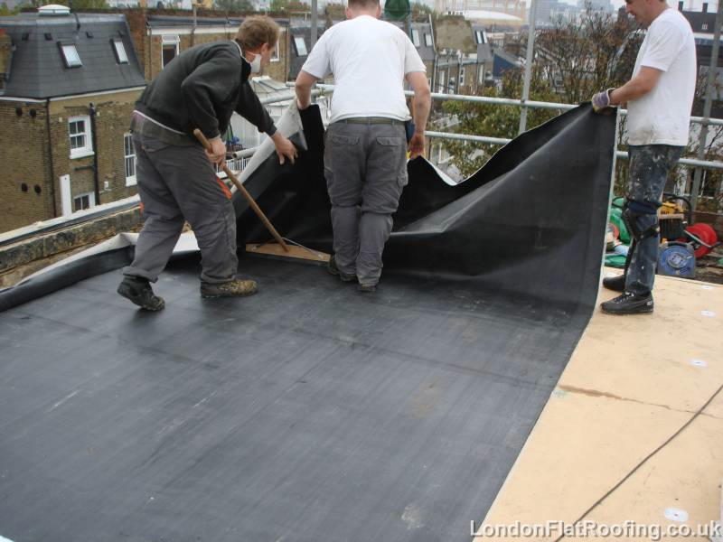
Polyethylene Copolymers
Ethylene/Vinyl Acetate (EVA)
Glue, soft
EVA allows water softening
Ethylene/Acrylic Acid (EAA)
Ionic crosslinks (broken with heat)
Tougher, stronger
Ionomer (Surlyn)
EPM (EPDM with butadiene)
Rubbery
Crosslinked lightly

Slide 10
Forms of other polyolefins

Slide 11
Polypropylene (PP)
Mer unit
Polymer chain

Slide 12
Polypropylene
Analogy
I need 6 volunteers to come up front

Slide 13
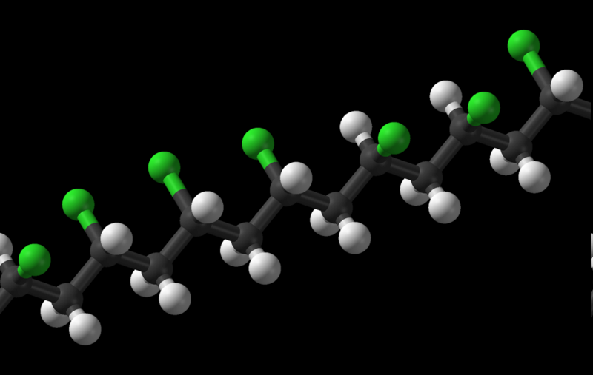
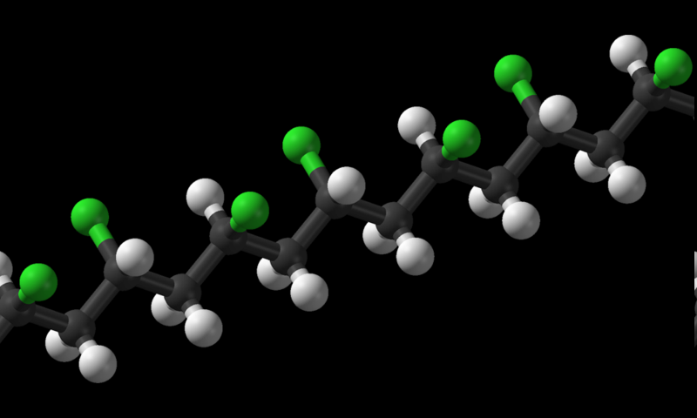
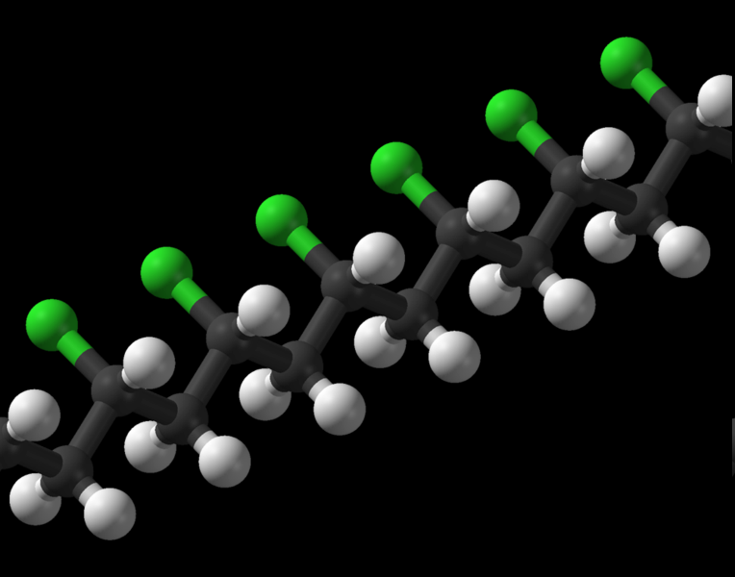
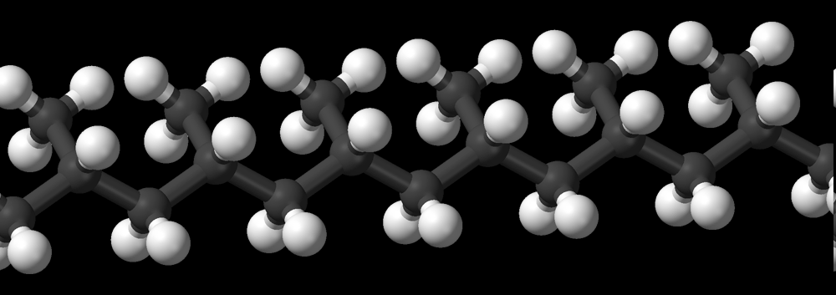
Stereoisomers of Polypropylene
Atactic (no order)
Syndiotactic (alternating order)
Isotactic (same order) showing methyl groups
Isotactic (same order)

Slide 14
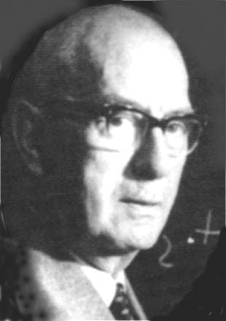
Polypropylene
Zigler-Natta catalyst
Isotactic
Only commercial type of polypropylene
Karl Ziegler
Guilio Natta

Slide 15
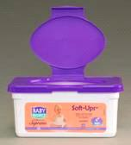
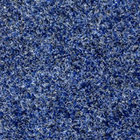
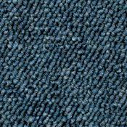
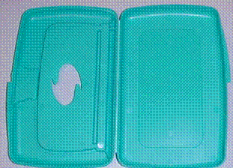
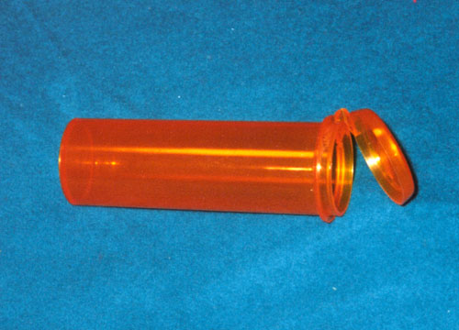
Polypropylene Properties
Properties (compared to polyethylene)
Similar in electrical, bonding, solvent resistance
Stiffer
Improved Environmental Stress Crack Resistance
Worse UV sensitivity
Higher T_{g}
Better resistance to mechanical stress cracking
Carpets
Living hinges

Slide 16
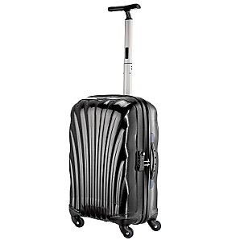
Polypropylene
Curv – Self-reinforcing composite
Make fibers and draw to crystallize
Crystalline areas have higher melting point
Calendar at a temperature between the amorphous and crystalline temperatures
Amorphous becomes the matrix for the fibers

Slide 17
Polyvinylchloride (PVC)
Mer unit
Polymer chain

Slide 18
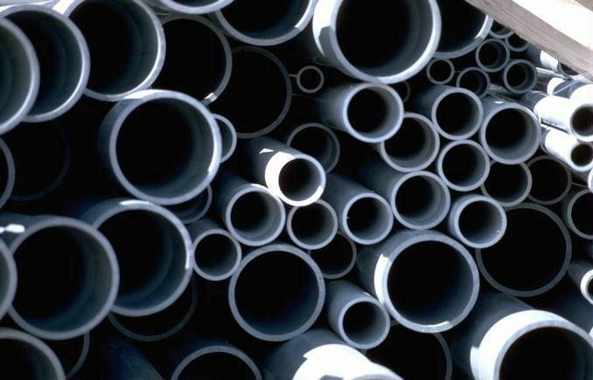
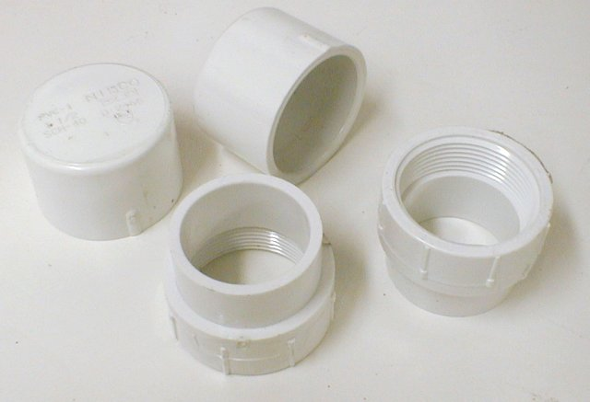
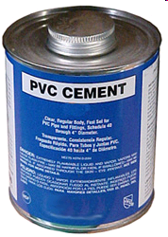
PVC
Rigid
Amorphous
Heat sensitive (yellow)
Often highly filled (cost)
Solvent sensitive
Gluing

Slide 19
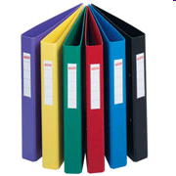
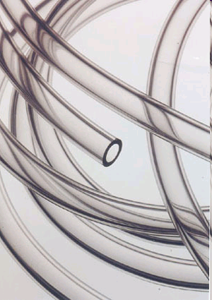
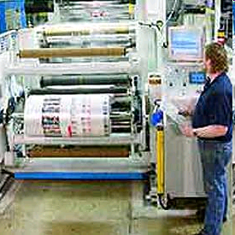
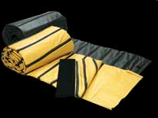
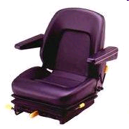
PVC
Plasticized PVC (called vinyl)
Processed w/o heat when possible

Slide 20
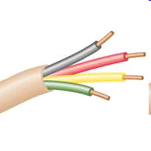
PVC
Properties
UV sensitive
Non-flammable (except plasticized)
Self extinguishing
LDPE
PVC

Slide 21
Polystyrene (PS)
Mer unit
Polymer chain

Slide 22
Polystyrene
Non-crystalline (pendant group interference)
So what is “crystalline polystyrene”?

Slide 23
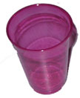
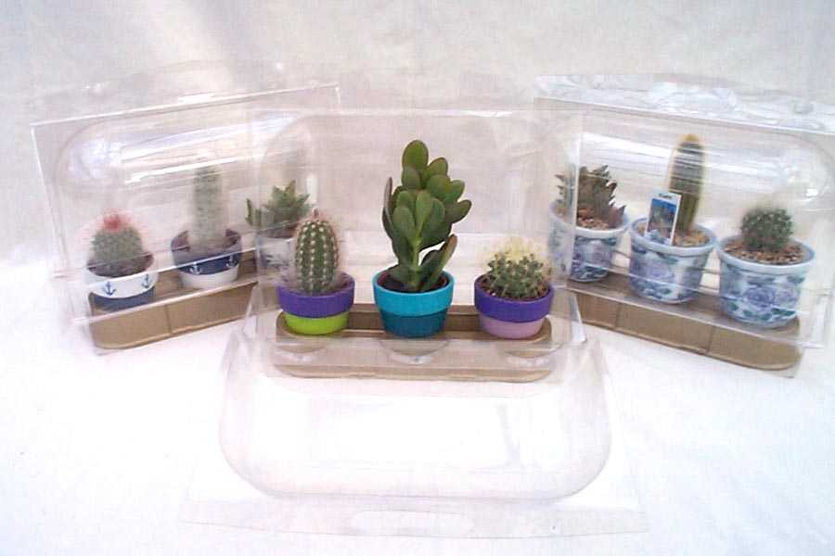
Polystyrene Properties
Brittle and Hard
Fair scratch resistance
Very low price
Very easy to mold

Slide 24
Properties
Clear but yellows and embrittles

Slide 25
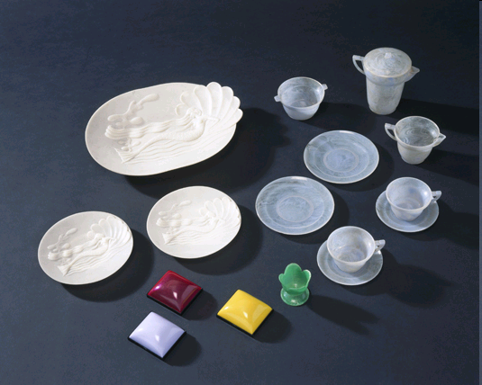
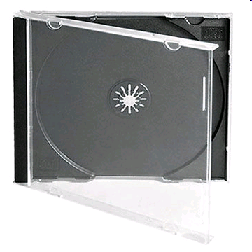
Properties
Modified for toughness
Impact polystyrene contains rubber

Slide 26
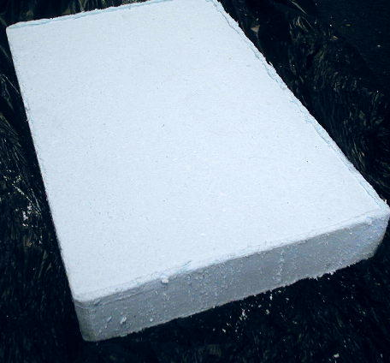
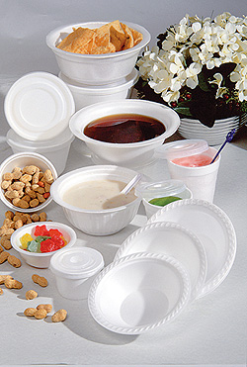
PS
Foam
expanded

Slide 27
Copolymers, Alloys and Blends
Mixing monomers = copolymer
Mixing polymers or a polymer with a monomer (one phase) = alloy
Mixing polymers (multi-phase) = blend
Can be copolymers, alloys or blends
HIPS (rubber added)
SAN
ABS

Slide 28
ABS
PolyButadiene Rubber
B
Properties of the ABS dependant on the mix ratio
Alloys can acquire the properties of their component parts
PolyAcrylonitrile
PolyStyrene
A
S

Slide 29
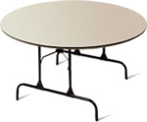
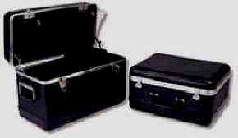
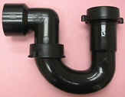
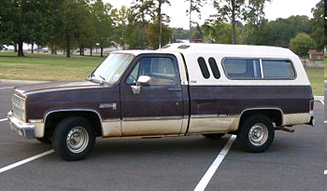
ABS

Slide 30
Thank You

