Slide 1
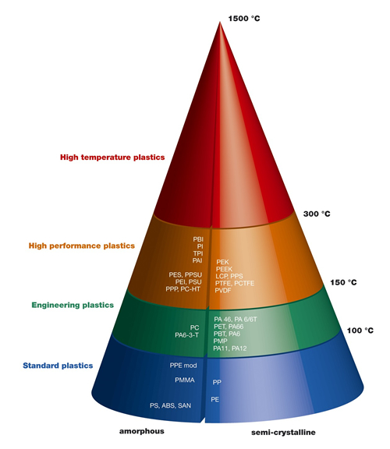
Engineering and High Performance Thermoplastics
MFG 355

Slide 2
Engineering/High Performance Thermoplastics
Replace metallic parts
Strength and stiffness
Retention of properties over range of temperatures
Toughness to withstand incidental damage
Dimensional stability
Low creep
Low CTE
Withstand environmental factors (UV, O₂, chemicals)
Shaped easily compared to metals

Slide 3
Engineering Thermoplastics
Compared to commodity plastics
More expensive
The commodity resins are all lacking some critical property
Some Engineering/High Performance Thermoplastics are formed through the condensation polymerization process

Slide 4
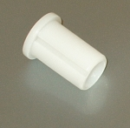
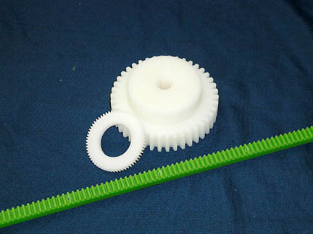
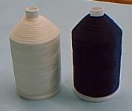
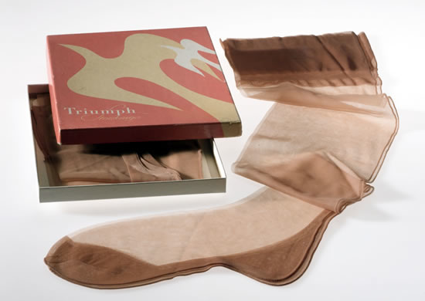
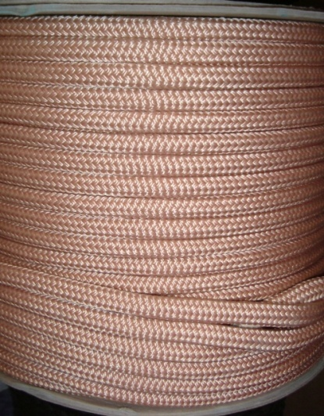
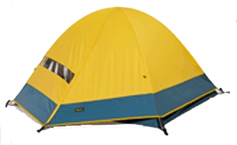
Polyamides or Nylons (PA)

Slide 5
Polyamides or Nylons (PA)
( )_{n}
[ ]_{a}
[ ]_{b}
Amide group
Types of nylons
[ ]_{a}
[ ]_{b}

Slide 6
Types of nylons
Used to designate different a and b values which came from different monomers
Nylon a/(b+2)
To account for the carbons in the acid groups
Example: Nylon 6/6
Example: Nylon 6/12
( )_{n}
[ ]_{a}
[ ]_{b}

Slide 7
Types of nylons
What happens as a and b increase?
More CH₂ groups give greater flexibility
More CH₂ groups give more “oil-like” properties
Fewer CH₂ groups (more amide groups) gives more polarity and more strength
( )_{n}
[ ]_{a}
[ ]_{b}

Slide 8
PA General Family Characteristics
Polarity
Crystallinity
Sharp melting point
Strength
Some water absorption (depends on a/b number)

Slide 9
PA General Family Characteristics
Highly crystalline
Sharp melting point
Strength (polar bonding and crystallinity)
Transparent (barely)—cook-in-bag (turkey)
Anti-friction—not like PTFE but good
Toughness—excellent
Fatigue resistance—excellent
Water absorption—0.2-2.5% (must be dried for injection molding)

Slide 10
Nylon 6/6 Monomer
Hexamethylenediamine
(6 carbons)

Slide 11
Nylon 6/6 Monomer
Adipic Acid
(6 carbons)

Slide 12
Nylon 6/6 Polymer
Water
Amide group

Slide 13
Nylon 6 Monomer
Amine
Group
Acid
Group

Slide 14
Nylon 6 Polymer
Amide group

Slide 15
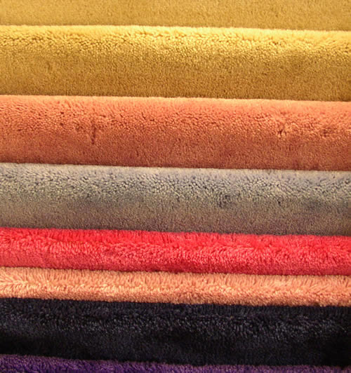
Properties of Specific Nylon Types
Nylon 6,6 – General
Nylon 6 – Copycat
Nylon 6,10 – Less water absorption
Nylon 6,12 – Flexibility and less water (silky)
Nylon 2,2 – Strength

Slide 16
Processing Nylon
Injection molding
Shrinkage (crystallinity)
.018 in/in
Dry it first
Extrusion
Low melt viscosity (process at temp just high enough to melt)
Be careful of decomposition (especially if not dried)
Fibers
Drawing
Crystallization
Orientation

Slide 17
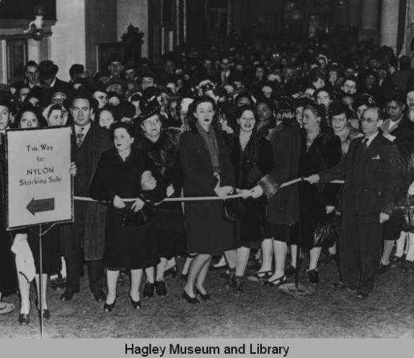
Nylon History
Nature of polymer bonding not understood
Carothers
Di-functional monomers
Polymers—1000 units long
Larger units—molecular still to eliminate water
Control of melting point and length
Many combinations of polyesters
Trying polyamides
Settling on 6,6
Carothers death
3 weeks after patents
Tremendous success

Slide 18
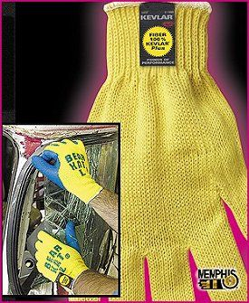
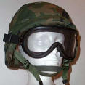
Aramids

Slide 19
Aramids
Amide group
All else is aromatic

Slide 20
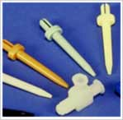
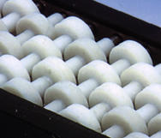
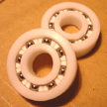
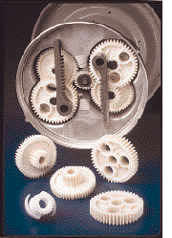
Acetals or Polyoxymethylenes (POM)

Slide 21
Acetals or Polyoxymethylenes (POM)
(
)_{n}

Slide 22
Acetal Family Characteristics (compared to nylon 6/6)
Mechanical—do not embrittle, good impact strength
Moisture—very little (shower heads)
Chemical resistance—very high, resists stains, sensitive to strong acids and bases
Weathering—fair
Thermal—200º F
Electrical—good
Machining—like cutting brass
Adhesion—not very good (epoxy glues needed)

Slide 23
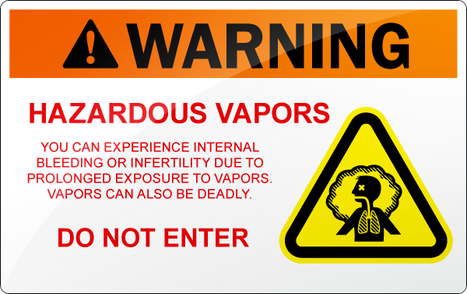
Processing Acetals
Do not heat above 440º F
Melt viscosity is not too dependant on temperature
Do not leave in barrel overnight
Startup heating

Slide 24
Acetal Copolymer
(
Prevents unzipping
(
n

Slide 25
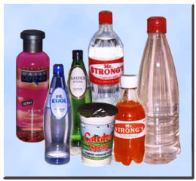
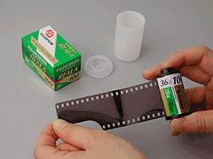
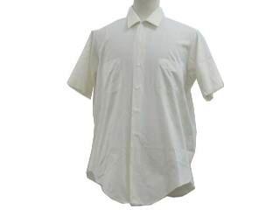
Thermoplastic Polyesters (PET/PBT)
Third largest polymer in production
(behind PE and PP)

Slide 26
Thermoplastic Polyester General Family Characteristics
PET (compared to nylon 6/6)
Higher mechanical stiffness
Strength by orienting chains not by H-bonding
Get 50% crystallinity
Forced by mechanical stretching
Clear because crystalline structures are <500nm
PBT
Crystallizes rapidly
Processes faster
Lower overall properties

Slide 27
Thermoplastic Polyesters (PET/PBT)
(
[
]_{m}
PET/PBT
m = 2 or 4
)_{n}

Slide 28
Processing PET
Shape it (film, tape, fiber, extrude, etc)
Amorphous structure
Reheat and stretch in strength direction(s)
Cool to below T_{g}

Slide 29
Specific TP Polyester Types
Dacron fiber—mix with cotton or wool-gives permanent creases
Kodel – photo film
Mylar—transparencies, tapes, balloons
PETG—large glycol modified, amorphous

Slide 30
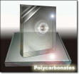
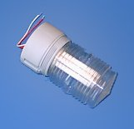
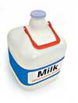
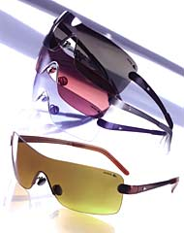
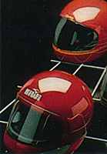
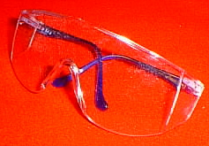
Polycarbonate

Slide 31
Polycarbonate
(
)_{n}

Slide 32
History
Poor solvent resistance (DuPont)
GE-Lexan (now Sabic)
Properties
Polar
Stiffness of backbone
Long repeat unit
Bis-Phenol-A (BPA) problems
Stress-crack problems

Slide 33
Properties
Solvent sensitivity—poor but nice for joining
Clear—except for UV yellowing, slight crystallinity
Hard
Ductile—nailed, sawed, drawn, punched, sheared, drilled
Tough—helmets, light covers, windows, roadside signs, bullet proof shields
Dimensional stability—low creep
Electrical resistance—good but not fantastic
Machining—good

Slide 34
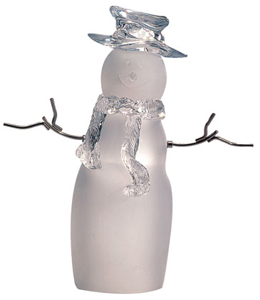
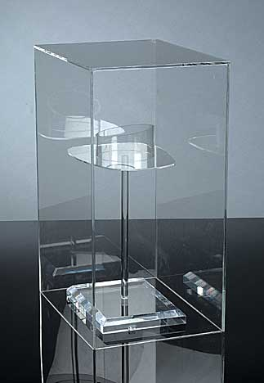
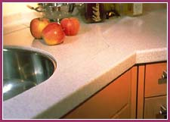
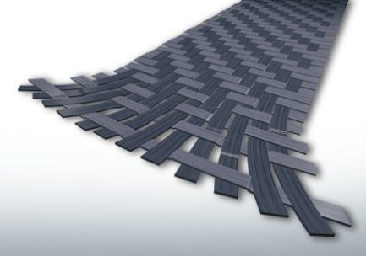
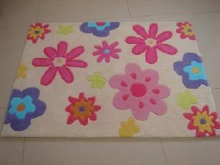
Acrylics (PMMA and PAN)

Slide 35
Acrylics (PMMA also PAN)
(
)_{n}
)_{n}
(

Slide 36
Properties
Weathering—best
Color (transparency)—20 years w/ <10% change
Color compatibility (pigments, dyes)
Mechanical properties—average except for impact (brittle) and flex (carpets)
Chemical—chlorinated solvents attack it, acetone gives it cracks
Electrical—good (especially arc resistance)

Slide 37
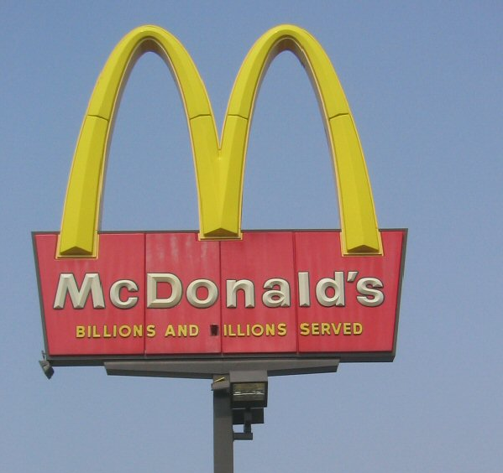
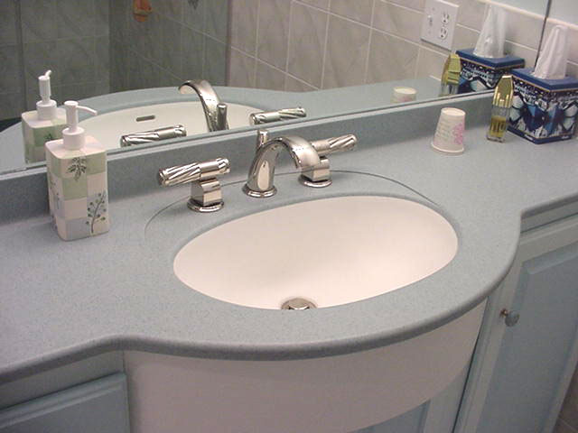
Uses
Signs
Counter tops—Corian
Decorative pieces
Floor waxes
Paint, fingernail polishes
Contact lenses, glasses
Fibers (PAN)
Carbon fibers

Slide 38
Processing
Casting (sheets)—syrup
Injection molding—good
Thermoforming—ok but brittle
Machining—similar to wood

Slide 39
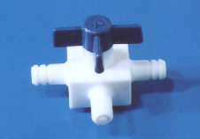
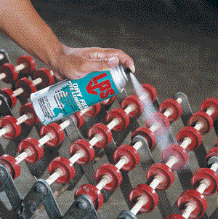
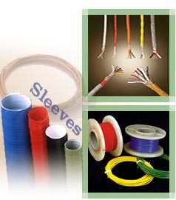
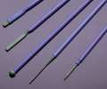
Fluoropolymers

Slide 40
Fluoropolymers (PTFE)
(
)_{n}
)_{n}
(

Slide 41
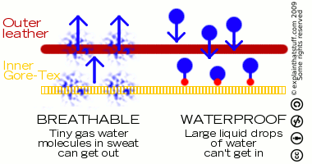
History of Discovery
Chambers plant
Making Freon
Gas cylinder
Problems with sticking
Problems with processing
Goretex®

Slide 42
Properties
Most are strengthened by the tight bond between the Fluorine and the Carbon atoms
Slippery (anti-stick surfaces)
Chemical inertness
High temperature melting
Non-flammable
High electrical resistance
Very dense—2.13-2.2 (high melt viscosity)

Slide 43
Fluoropolymers
F
F
―C―C―
a) Perfluoroalkoxy (Teflon-PFA)
(
)_{n}
F
OCF₃
F
F
―C―C―
b) Polyhexafluoropropylene (PHFP)
(
)_{n}
F
CF₃
F
F
F
F
―C―C―
―C―C―
(
(
)_{m}
)_{n}
c) Fluorinated ethylene propylene (FEP)
F
F
F
CF₃

Slide 44
Fluoropolymers
H
F
a) Polyvinylidenefluoride (PVDF or PVF₂ ― Tedlar)
―C―C―
(
)_{n}
H
F
H
Cl
―C―C―
b) Polyvinylidenechloride (PVCl₂ ― Saran wrap)
(
)_{n}
H
Cl
F
F
―C―C―
(
)_{n}
F
SO₃Na
c) Nafion

Slide 45
Fluroroelastomers
Viton (copolymers)
F
F
H
F
F
F
―
―
―
―C―C―
+
―C―C―
+
―C―C―
F
CF₃
H
F
F
F
(PHFP)
(PVDF)
PTFE

Slide 46
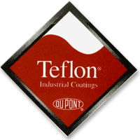
Uses
O-rings
Non-stick surfaces
Insulation-electrical
Lubricant
Coatings
Gears

Slide 47
Processing
PTFE not processible by extrusion or injection molding
Sintering
Put in approx shape and heat to about 650ºF (melt = 664°F)
Similar to processing powdered metals
Fusion of particles
Ram extrusion
Compaction
Rods and tubes
Calendaring
Very poor adhesion

Slide 48
High Performance Thermoplastics

Slide 49
Polyphenylenes (PPE, PPO, PPS)
PPO

Slide 50
Polyphenylene Oxide (PPO) Properties
CH₃
CH₃
(
O
O
)_{n}
CH₃
CH₃
Thermal stability—excellent (650º F)
High HDT = 375º F
Good cold properties (-275º F)
Low water absorption
Low heat expansion
Good solvent resistance, but can be solvent welded

Slide 51
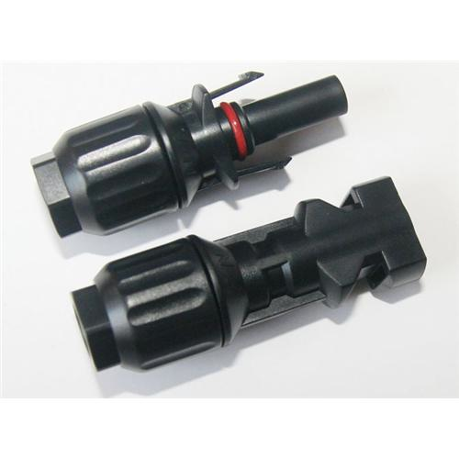
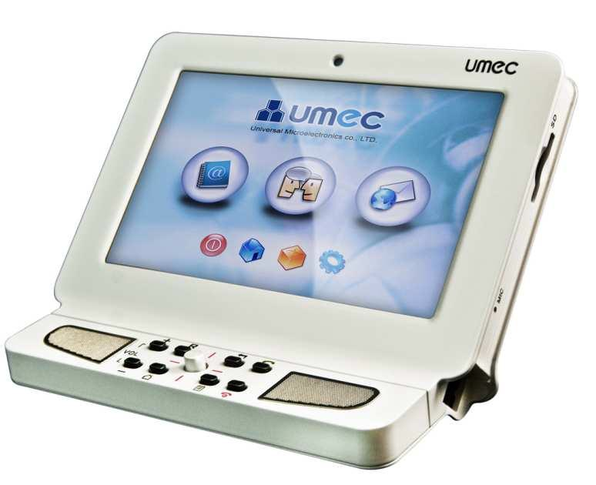
PPO uses
Used to replace stainless steel for surgical equipment
Replace thermosets
Pump housings
Valve components
Video terminal housings

Slide 52
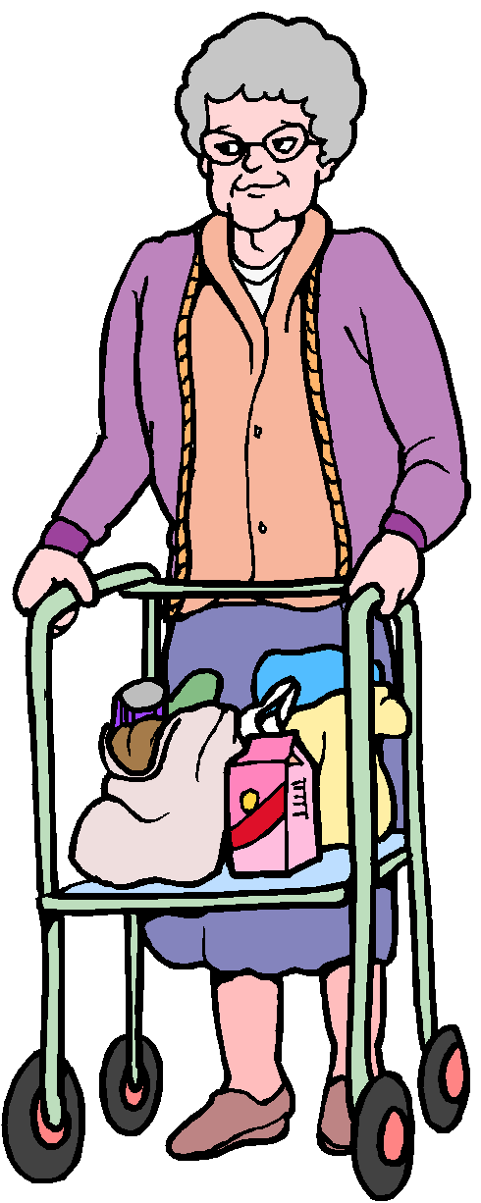
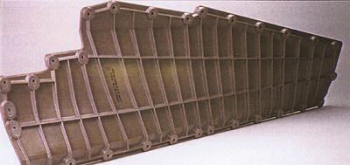
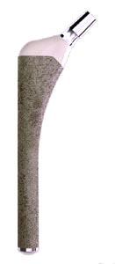
Polyaryletherketones (PEEK, PEK, and Others)
+
Inside of hip replacement
is PEK

Slide 53
Polyaryletherketones (PEEK, PEK, and Others)
Ether Linkage
Ketone Linkage

Slide 54
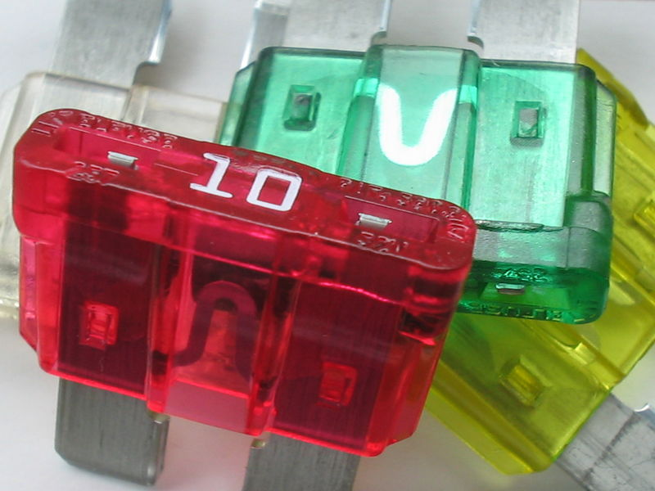
Polysulfones (PSU and PES)

Slide 55
Polysulfones (PSU and PES)

Slide 56
PSU and PES Properties
Resistant to oils
Heat stability (300º F)
Creep resistance
SO₂ group adds stiffness
More dimensionally stable than PPO
Toughness—good

Slide 57
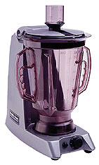
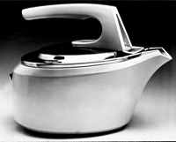
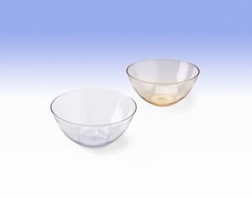
PSU and PES Uses
Hot water pipes
Coffee pots
Dishwasher components
Automobile applications near engines
Compete with thermosets, but can be injection molded

Slide 58
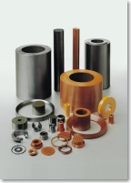
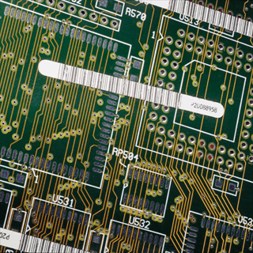
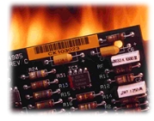
Thermoplastic Polyimides (PI and PAI)

Slide 59
Thermoplastic Polyimides (PI and PAI)
(
(
)_{n}
)_{n}
Imide

Slide 60
Thermoplastic PI and PAI Properties
Very stiff
Highest thermal stability
PI cannot be melted or melt processed
PAI can be (Torlon)
PI is sintered (Vespel)
PI film is cast as monomers and heated to polymerize (Kapton)

Slide 61
Thermoplastic PI and PAI Uses
PI is used in circuit boards (Kapton film)
High temperature parts (Vespel – sintered)
Low friction bearings, sliding parts, gears
Filled Vespel (Mo, carbides)

Slide 62
Flammability of aircraft seats with PBI foam
PBI foam
Conventional foam

Slide 63
Cellulosics

Slide 64
Cellulosics
Nitrocellulose
Gun cotton
Explosive billiard balls (past product)
Movie films
Cellulose nitrate
Lacquers and plastics

Slide 65
Types of Cellulosics
Rayon
Viscose process
Cellophane
Methyl cellulose
Filler
Edible (hydroxypropyl methyl cellulose)

Slide 66
Thank You
Brent Strong

