Slide 1
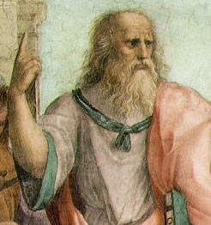
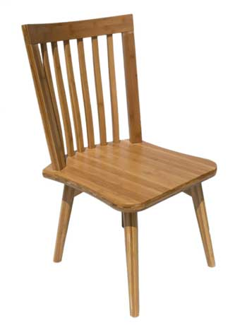
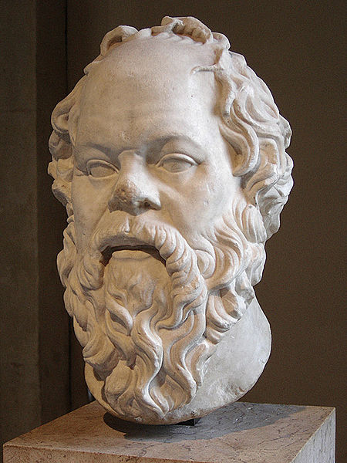
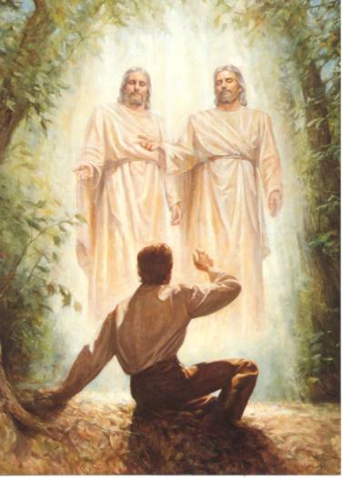
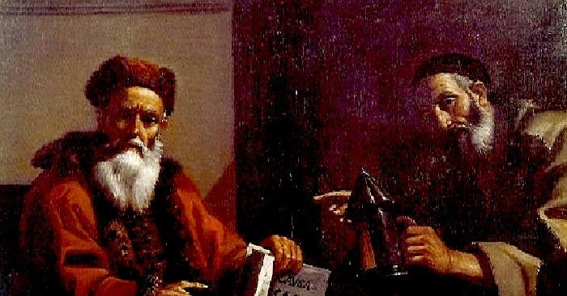
Classical Greek Philosophy
Plato

Slide 2
Classical Greek Philosophy
Greek Philosophy
Plato

Slide 3
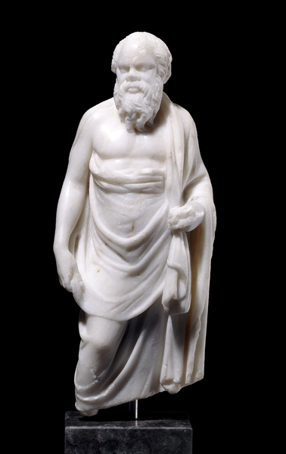
My Mentor
Socrates
The heart of Socrates' teaching:
The unexamined life is not worth living.

Slide 4
Socrates
Socratic Method
Posed questions and then questioned the answers
Searched for the ultimate nature of qualities
What is Duty?
What is Truth?
What is Evil?
What is Ethical?

Slide 5
Socrates
Discussion
Illustration of the Socratic Method
Would someone volunteer?

Slide 6
Socrates
Knowledge is intuitive and is merely revealed by learning
Example using the Pythagorean Theorem
Demonstration: Would someone who is not familiar with the theory behind the Pythagorean Theorem volunteer to help?
A non-science, non-engineering, non-math major

Slide 7
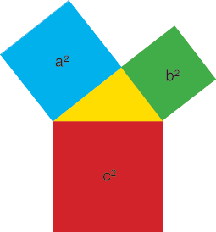
Socrates
b
a
a
b
c
c
The Pythagorean Theorem states that
the square area defined by length a
plus the square area defined by length b
equals the square area defined by length c.
a² + b² = c²

Slide 8
Socrates
b
Using the hollow squares, rearrange the small squares and fit them together
inside the largest square.
a
a
b
c
c

Slide 9
Socrates
Therefore: a² + b² = c²

Slide 10
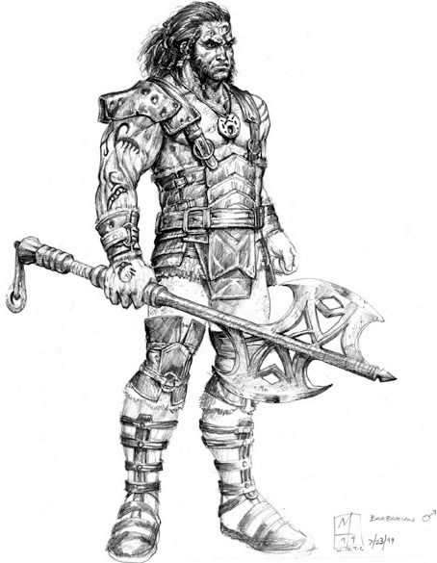
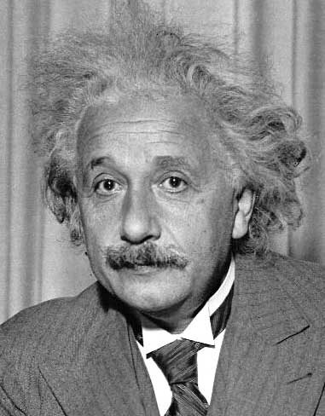
Socrates
What have we learned from this example?
+
=
Conclusion: Everyone can learn everything

Slide 11
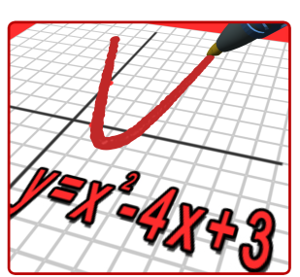
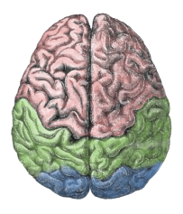
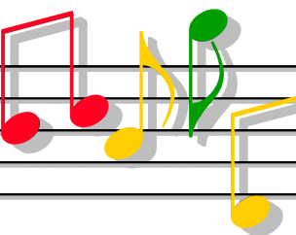
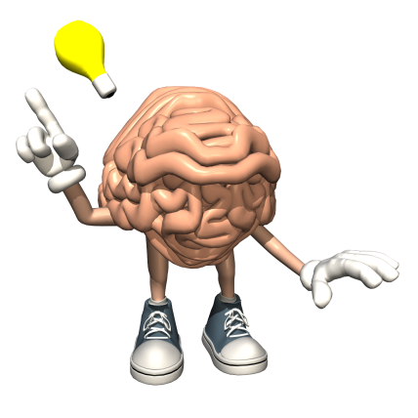
Socrates
Discussion
Why are some subjects harder than others for us?
Right brain/left brain?
(Similar to right handed/left handed?)
What are the implications of Socrates’ idea for being creative?

Slide 12
Who, Truly is the Wisest?
I am called wise, for my hearers always imagine that I myself possess the wisdom which I find wanting in others: but the truth is, O men of Athens, that God only is wise; and by his answer he intends to show that the wisdom of men is worth little or nothing; he is not speaking of Socrates, he is only using my name by way of illustration, as if he said, O men, he is the wisest, who, like Socrates, knows that his wisdom is in truth worth nothing.
Socrates quoted by Plato in The Apology

Slide 13
Socrates
Convicted of “corrupting the youth” by the townspeople
Described by students as “the best and wisest” and “most noble” man.

Slide 14
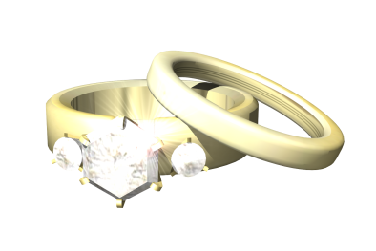
Socrates
Deep philosophy about marriage
My advice is to get married:
if you find a good wife you’ll be happy;
if not you’ll become a philosopher.

Slide 15
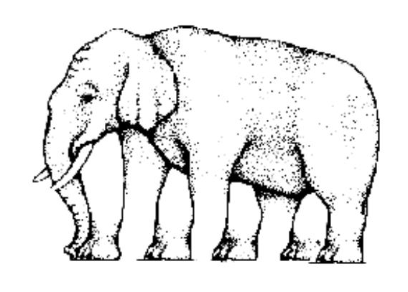
Plato
Our senses sometimes deceive us.
Are the horizontal lines parallel?
How many legs does the
elephant have?

Slide 16
Plato
Because our senses occasionally deceive us, they lead to opinions.
But, there is an underlying truth that exists (even thought it may occasionally be hidden from our senses).
The heart of Platonic philosophy is:
What is the real nature of things (that is, the fundamental or the truth)?

Slide 17
Plato
What is this?
Is the right angle perfectly 90º?
Conclusion: Only the Form of the angle is perfect.

Slide 18
Plato
The Pythagorean theorem is only true when the angle is 90º.
Therefore, the Pythagorean theorem is only true in theory and not in actuality.

Slide 19
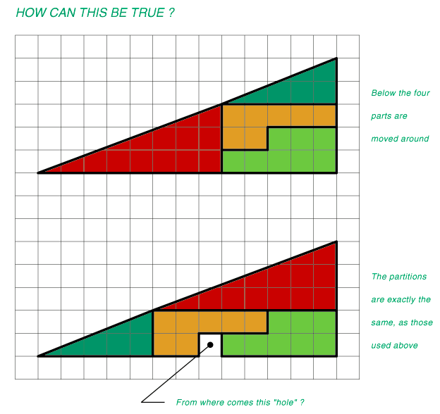
Form in Language
How can this be true?

Slide 20
Plato
Would a volunteer please read the following paragraph.
Aoccdrnig to rscheearch at Cmabrigde Uinervtisy, it deosn’t mttaer in waht oredr the ltteers in a wrod are, the olny iprmoetnt tihng is taht the frist and lsat ltteer be at the rghit pclae. The rset can be a total mses and you can sitll raed it wouthit a porbelm. Tihs is bcuseae the huamn mnid deos not raed ervey lteterby istlef, but the wrod as a wlohe.
Amzanig huh?
Conclusion: We are accustomed to approximate truths in this world

Slide 21
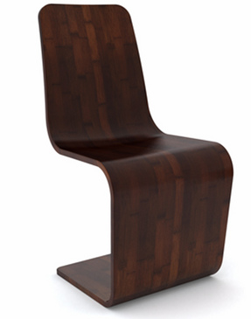
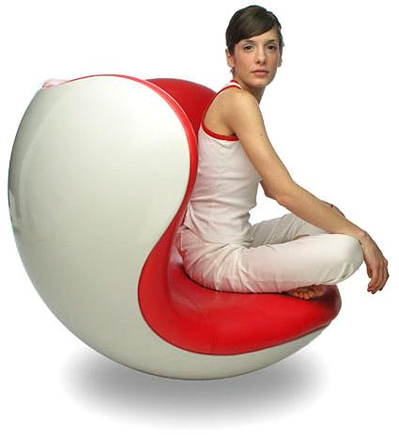
Plato
What makes this a Chair?
Chairness

Slide 22
Plato
What makes this a Chair?
The word “chair” represents all chairs (so the Form for chair is similar to the idea we get from the word).
Note: Form, information and DNA

Slide 23
Plato
Allegory of the Cave

Slide 24
Plato
Allegory of the Cave

Slide 25
Plato
Allegory of the Cave
What are the shadows?
What are the real things?

Slide 26
Plato
Hierarchy of Value
Form
Highest, unchanging, remote
Contemplative, theory
Mental/Mathematical
Physical
Changing, our world
Lowest, least valuable
Memory

Slide 27
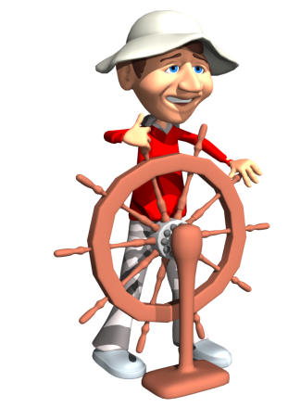
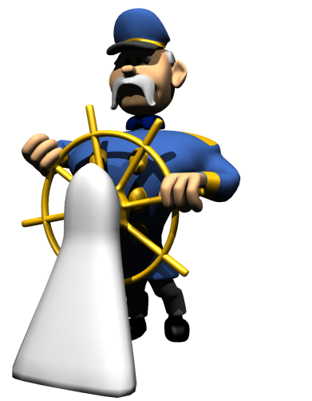
Government
Who should be the leaders?
Analogy: Ship of State
Should we let the common people take turns as the captain?
Even worse, should we make decisions on how to steer the ship by voting? (Think of an airplane instead of a ship)
Should we not, rather, choose as captain someone who has studied navigation and sailing and has knowledge (ie, a meritocracy)?

Slide 28
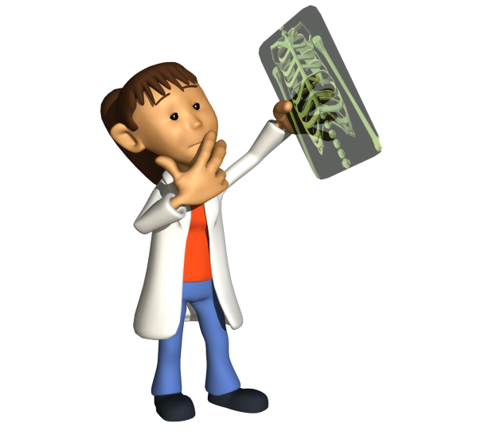
Government
Who should be the leaders?
Analogy: Physician
Should we treat someone by voting?
Should we find someone who has knowledge?

Slide 29
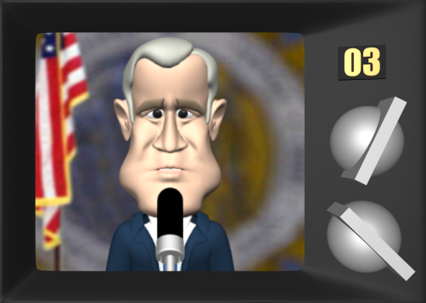
Government
Who should be the leaders?
State
We should have a meritocracy.
Those with knowledge in politics (government) should lead and they are the philosophers (that is, the well educated).

Slide 30
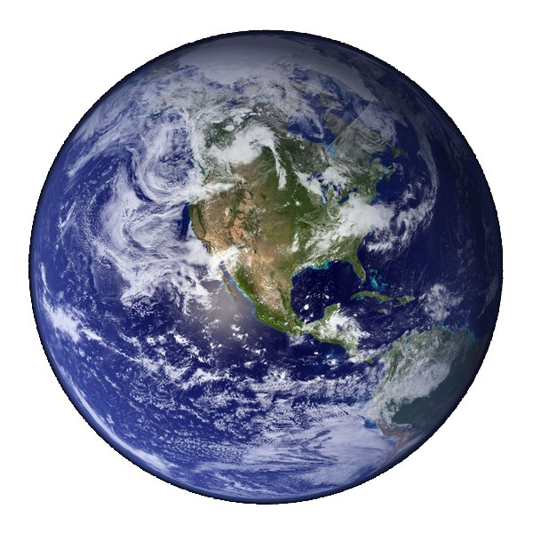
Creation of the World
Done by the Demiurge (God).
Used Forms as designs (blueprints).
Used existing matter.
Physical and, therefore, imperfect.
Demiurge created the spirit of man.
Lesser gods, created the body of man.
Hierarchy = soul > body

Slide 31
Plato
What is perfection?
Is it true that a perfect thing cannot change?
Perfection
Imperfection
Imperfection

Slide 32
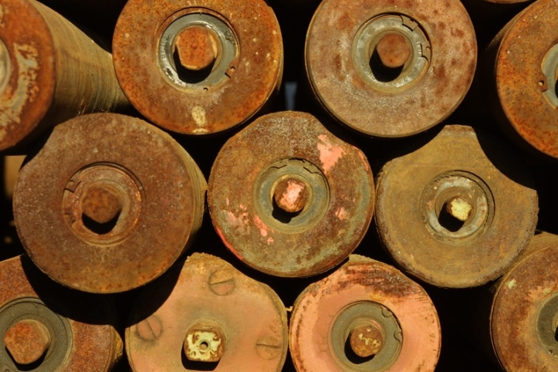
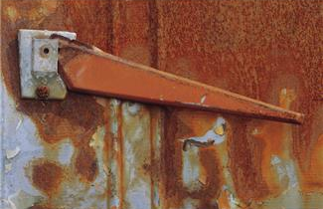
Plato
Discussion
Does something physical change?

Slide 33
Plato
Discussion
Is a passion always the same and does it last forever?

Slide 34
Plato
Therefore
Nothing that is perfect can be
made of physical matter.
And
Nothing that is perfect can
have emotions (passions).

Slide 35
Plato
Therefore,
God, who is perfect,
cannot have a physical body or emotions.
"God is without body, parts, or passions."
God is a Form (perhaps he is the keeper of all Forms)

Slide 36
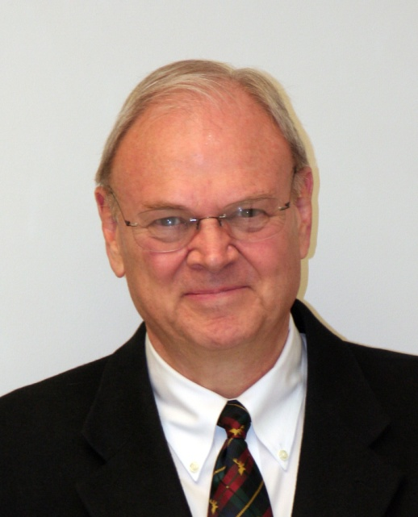
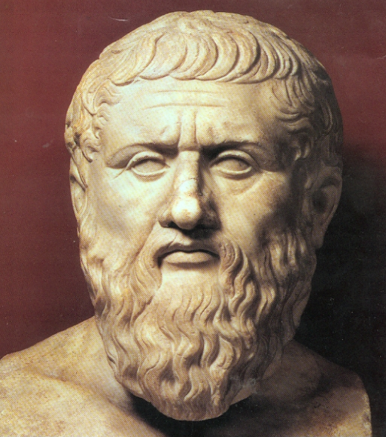
Classical Greek Philosophy
Dr. Strong
Plato

Slide 37
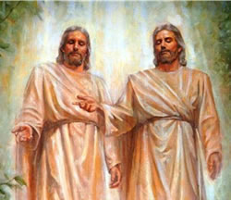
Discussion
Classical Greek Philosophy
How can God be perfect and be consistent with LDS views?

Slide 38
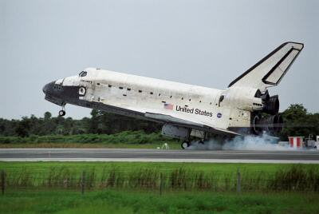
Classical Greek Philosophy
Discussion
Perfection
What is the meaning of perfection?
A plateau of stability
Completeness of mission
This is the meaning of “Be ye therefore perfect” when translated correctly.
Note that Christ did not include himself in this phrase in the Bible sermon but did in the Book of Mormon.
Progression

Slide 39
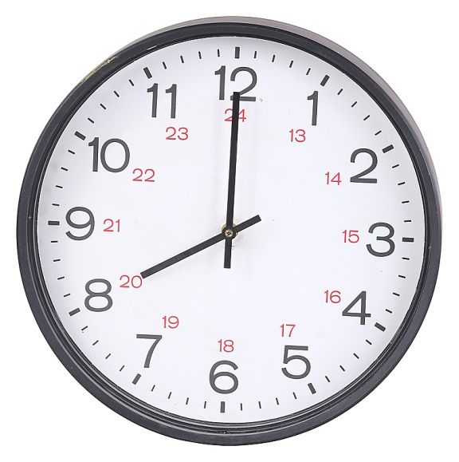
The Nature of God
What is the mission of a clock?
To tell the correct time
Does a “perfect clock” change?

Slide 40
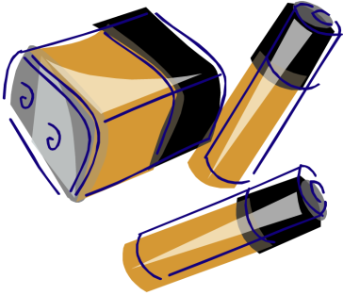
Perfection
What is our mission?
Learn (but not everything)
Experience with a body (but not everything)
Obey (realizing we may not always do it)
Repent (to fix when we don’t obey)
Putting a battery in a clock is like repentance.

Slide 41
Perfection
Some Latter-day saints seem to have different definitions of perfection when applied to God and when applied to people.
For God they do not accept Plato’s definition.
For people (especially themselves) they use Plato’s definition.
This conflict in thinking leads to frustrations and self-depreciation.
They should use a new definition for both
Perfection
Imperfection
Imperfection
Perfection
Progression

Slide 42
Perfection
In 325 Constantine summoned the Christian leaders from all over the empire to a council at Nicaea (modern Iznik), on the shores of the Sea of Marmara. These leaders believed in widely differing interpretations of the Scriptures, but Constantine brow-beat them into accepting an official line on such matters as the divinity of Christ, and his equality with God. This was essentially a political move, enabling Constantine to strengthen his hold on the empire by merging the power of the Church with that of the state.
Strathern, Paul, Mendeleyev's Dream, New York: Berkley Books, 2000, p.38.

Slide 43
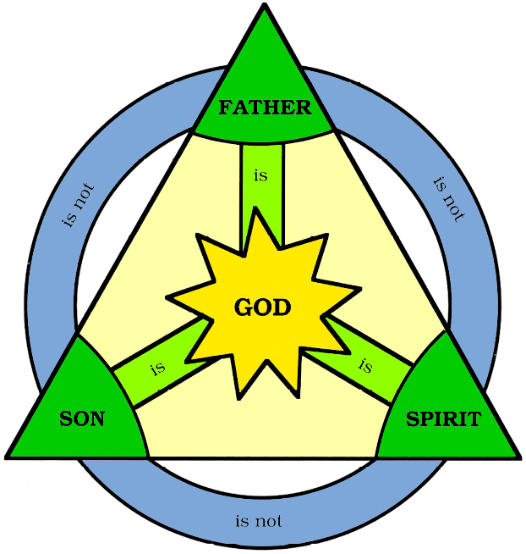
Christians Over the Centuries
God is a trinity.
God is without body, parts, or passion.

Slide 44
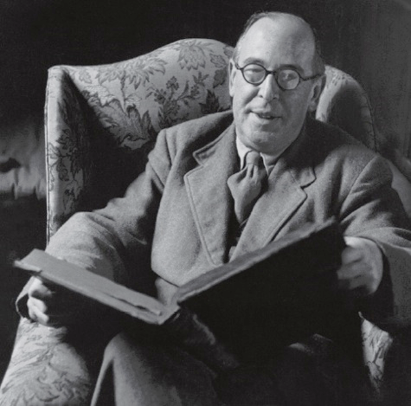
Does God Have a Body?
What soul ever perished from believing that God the Father really has a beard?
C.S. Lewis, Letters to Malcolm

Slide 45
Some Modern Christians
The God Who Risks, Sanders
The Openness of God, Pinnock, et al
BYU Studies, Number 48, No. 2, 2009
Who God is does not change, but what God experiences does change. So, too, God is not impassible [without emotions], as the tradition has mostly insisted.

Slide 46
Some Modern Christians
The God Who Risks, Sanders
The Openness of God, Pinnock, et al
BYU Studies, Number 48, No. 2, 2009
Maybe corporeality is a funny idea to many Christians and not one that we can easily entertain, but why rule it out when it has scriptural backing?
Latter-day Saints are entitled to a bit of ‘we told you so’ to more traditional Christians.

Slide 47
Joseph Smith
God the Father has a body.
The Father has a body of flesh and bones as tangible as man’s; the Son also; but the Holy Ghost has not a body of flesh and bones, but is a personage of Spirit. Were it not so, the Holy Ghost could not dwell in us.
D&C 130:22

Slide 48
LDS
God’s body is not like our earthly body.
Pass through walls
Does not decay
Therefore, we should not give others the impression that we believe God has a body like ours.
When stated thusly, the gap between LDS and Open God beliefs narrows significantly.

Slide 49
Joseph Smith
If the veil were rent today, and the great God who holds this world in its orbit, and who upholds all worlds and all things by His power, was to make Himself visible—I say, if you were to see Him today, you would see Him like a man in form—like yourselves in all the person, image, and very form as a man.
King Follett discourse (1843)

Slide 50
Joseph Smith
God Himself was once as we are now, and is an exalted man, and sits enthroned in yonder heavens! That is the great secret. . . .
King Follett discourse (1843)

Slide 51
Some Modern Christians
The God Who Risks, Sanders
The Openness of God, Pinnock, et al
BYU Studies, Number 48, No. 2, 2009
We have not felt comfortable saying that humans ‘become gods,’ as Latter-day Saints have, even though we know that early Christians did speak of our human destiny in such terms. . .

Slide 52
Some Modern Christians
The God Who Risks, Sanders
The Openness of God, Pinnock, et al
BYU Studies, Number 48, No. 2, 2009
Sacred scripture affirms that God is both able and willing to transform us into his likeness. Why then should we call such transformation impossible or even qualify God’s promises in ways he does not?

Slide 53
Thank You
Greek philosophy permeates the world

