Slide 1
Thermoset Materials
MFG 355

Slide 2
Introduction
Thermoplastics vs Thermosets
Thermal properties
Strength
Uses
Processing

Slide 3
Resin Rules
Resin Rule: Thermoset resins depend upon two chemical reactions for their properties:
Polymerization
Crosslinking (curing)

Slide 4
Thermal Effects During Reactions
Molecular collisions are required for reactions
Heat increases molecular movement and collisions
The rate (speed) of chemical reactions increases as the temperature is increased
Arrhenius equation: exponential relationship between rate and temperature
Rate roughly doubles for each 10°C rise
Some reactions create heat (exotherm)

Slide 5
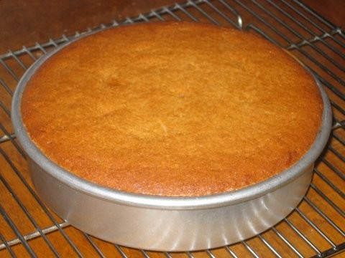
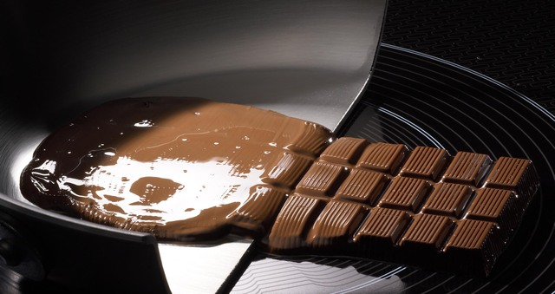
Viscosity curves for typical
thermoplastics and thermosets
Gel Point
Solids
Liquid-Solid Line
Viscosity
Liquids
Thermoset
thinning due to
temperature
Thermoset
crosslinking
Thermoplastic
Time/Temperature
Thermoset
combination
(What is seen)
Processing Window

Slide 6
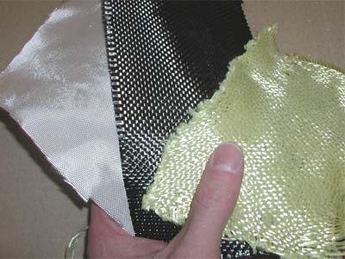
General Properties of Thermosets
Crosslinking (always)
Strength (good)
Flexibility (poor)
Thermal (good)
Creep (low)
Ability to wet-out reinforcements (good)
Ability to cure at room temperature (some)

Slide 7
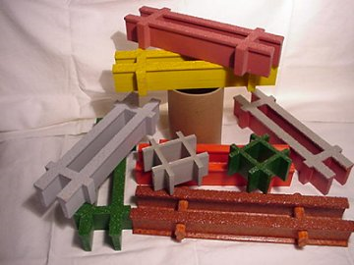
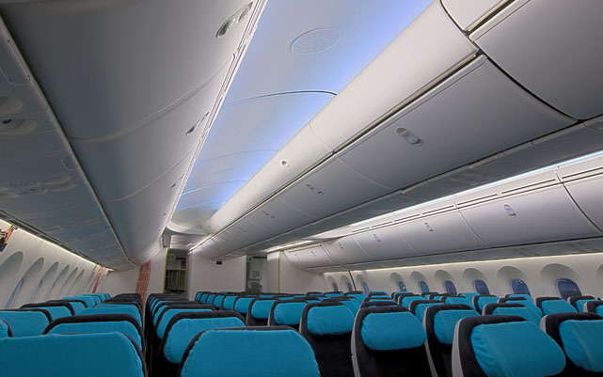
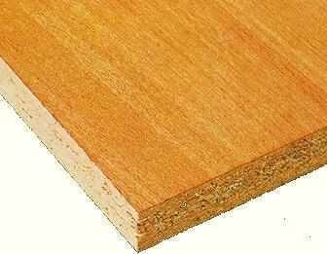
Formaldehyde Resins

Slide 8
Resin Rules
Resin Rule: For some polymers both polymerizing and crosslinking reactions can occur simultaneously.
The reactions can often be stopped before completion to allow easier handling and forming of the polymer
When this is done, the intermediate material is called the B-stage and the processing is called B-staging.

Slide 9
Phenolic polymerization and crosslinking
O
O
H
C
+
*
*
H
H
Loss of
Water
*
Formaldehyde
Phenol
(* = Active site)
3-D Phenolic
Crosslinked Network

Slide 10
Phenolics − Processing
Problem | Solution
Toxic monomer (formaldehyde) | B-staging to novolac (solid, 2-step with hexa) or resole (liquid,1-step)
Condensation of water | Slow cures and venting of mold (compression molding)
High shrinkage | Fillers (minerals, sawdust, wood flour, ground nut shells, etc.)
Brittleness | Fillers (selected) and thickness of parts
Inconsistent color | Black pigment

Slide 11
Phenolics
Aromatic content determines most of the applications of phenolics
Very low flammability and low smoke
Very stiff and hard
Very low heat transfer
High thermal stability
Good electrical properties
Excellent adhesion
Resistance to chlorinated solvents
Moderately low price (10-15% above polyesters)

Slide 12
Phenolics
Applications
Interiors of public transportation
Glue for laminates (such as plywood)
Electrical switches and other equipment
Molded parts in moderately hot environments (such as near the motor of an automobile)
Billiard balls
Conversion to epoxy or vinyl ester resins
Rocket exit nozzles and carbon-carbon composites (ablation)

Slide 13
Phenolic flammability
Flame Spread Index
Specific Optical Density
Vinyl Ester
Vinyl Ester
Epoxy
Epoxy
FR Polyester
FR Polyester
Phenolic
Phenolic
10
20
30
40
100
200
300
400
500
600
(ASTM E-162 for thermoset
composites)
(ASTM E-662 for thermoset
composites)

Slide 14
NBS Smoke Chamber (Smoldering)
700-
600-
500-
400-
300-
200-
100-
Epoxy
Polyester
Optical
Density
Phenolic
0 2 4 6 8 10 12 14 16 18 20 22
Time (min)

Slide 15
Rocket exit nozzle with phenolic as the ablative material
Nose
Cone
Rocket
Propellant
Rocket
Motor
Exit Nozzle
(Ablative
Material)
Rocket Exit Throat
10 ºF
500 ºF
4000 ºF

Slide 16
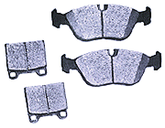
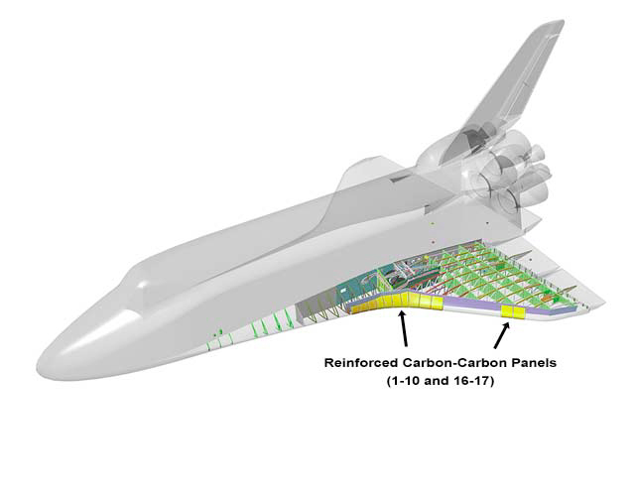
Carbon-Carbon
Brake Pads

Slide 17
Carbon-Carbon Composites
Carbon matrix and carbon fibers
Carbon matrix is made from phenolic resins that have been repeatedly charred and infused (infiltrated) with new resin
Very long process (up to 6 months for a part)
Very costly
Extremely high thermal stability
Needs flammability coating (ceramic) at very high temperatures

Slide 18
Production flow chart for carbon-carbon composites
Polymer or Pitch
Binder
Carbon Fiber
Cured Carbon/Resin Part
Pyrolize
1000-1500ºC
Impregnation by
Gas or Liquid
Heat Treatment
2000-2800ºC
Carbon/Carbon
Composite

Slide 19
Retention of properties of various composites with time and temperature
10⁶-
10⁵-
10⁴-
10³-
10²-
10-
1-
Experimental
Advanced
Metalics
Polyimides
Exposure
Time
(sec)
Carbon-Carbon
Epoxy Composites
Ablative Materials
(such as phenolics)
ºF
ºC
0 1000 2000 3000 4000
-18 538 1093 1650 2204
Temperature

Slide 20
Amino Plastics
Plus
Amine
Formaldehyde

Slide 21
Amine plastics – clear adhesive
Chipboard

Slide 22
Melamines
Three
active
sites
Formaldehyde
Plus
Melamine
Melamine
Formaldehyde

Slide 23
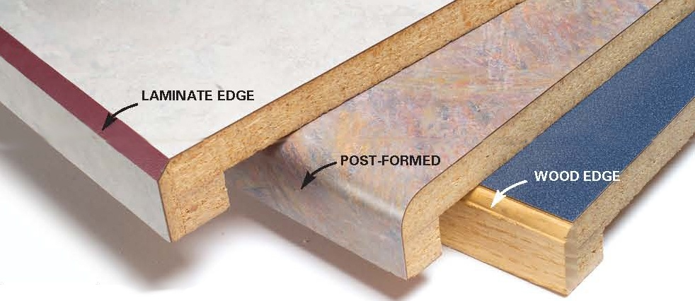
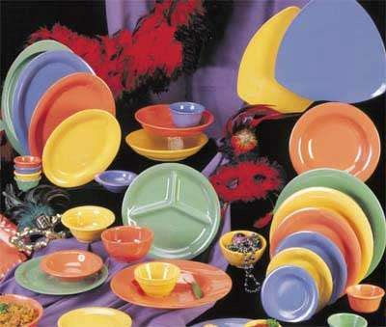
Melamines

Slide 24
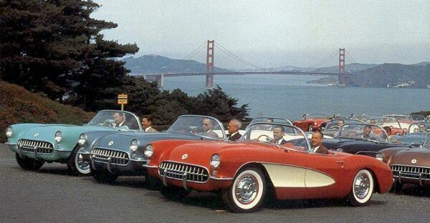
Unsaturated Polyesters

Slide 25
Resin Rules
Resin Rule: Polymerization of unsaturated polyesters occurs by the condensation method.
Polyester = a polymer in which ester groups are the repeating units
Unsaturated = contains carbon-carbon double bonds after polymerization (but before crosslinking)
Polyesters are made from two types of monomers:
Di-acids
Glycols (di-alcohols)

Slide 26
Polyester polymerization
Monomers
Acids A
(di-acids)
A
G
Glycols G
(di-alcohols)
A
G
A
G
A
Polyester polymer
G
A

Slide 27
Polyester polymerizationn
One end of the di-acid (the OH group) reacts with one end of the glycol (the H group) to form water (H−OH)
The water separates from the polymer and condenses out as a liquid
These type of polymerization reactions are called condensation reactions
A new bond is formed where the water left

Slide 28
Polymerization of a typical polyester
Step 1: Monomers react
O
O
O
O
HO―G―OH
+
H
O
C
A
C
O
H
HO―G―O―C―A―C―OH
+ H₂O
Glycol
Di-acid
Ester
Step 2: New molecule reacts with new monomers
New bond
O
O
O
O
H
O
C
A
C
O
H
+
HO―G―O―C―A―C―OH
+
HO―G―OH
Di-acid
Glycol
O
O
O
O
HO―C―A―C―O―G―O―C―A―C―O―G―OH
+ 2 H₂O
Ester
Ester
Ester

Slide 29
Resin Rules
Resin Rule: The types of di-acids and glycols and their percentages determine the properties of the unsaturated polyester.
The amount of unsaturated di-acid controls the amount of crosslinking (crosslink density)
Several types of di-acids and glycols can be mixed to form polymers with specific properties
Aromatic/aliphatic, halogenated, polar, etc.

Slide 30
Unsaturated di-acid monomers
Name
Structure
Comments
HOOC
H
Trans isomer,
highly reactive,
crosslinkable
│
│
Fumaric acid
―
C C
―
│
│
H
COOH
Cis isomer,
converts to fumaric acid,
crosslinkable
H
H
Maleic acid
│
│
―
C C
―
│
│
HOOC
COOH
H
H
│
│
Readily converts to
maleic acid and
fumaric acid
in presence of water,
crosslinkable
―
C C
Maleic anhydride
―
│
│
O=C
C=O
O

Slide 31
Saturated di-acid monomers
Name
Structure
Comments
O
│
│
Orthophthalic acid (ortho)
―C―OH
Low cost,
styrene compatible
―C―OH
│
│
O
O
│
│
―C
Orthophthalic anhydride
O
Converts to ortho
―C
│
│
O
O
│
│
―C―OH
Isophthalic acid (iso)
Strength, thermal,
water/chemical resistance
―C―OH
│
│
O

Slide 32
Saturated di-acids
Name
Structure
Comments
O
│
│
Thermal stability
Terephthalic acid (tere)
―C―OH
HO―C―
│
│
O
O
O
Tough,
weatherable
│
│
│
│
Adipic acid
HO―C―CH₂―CH₂―CH₂―CH₂―C―OH
Br
O
Br
│
│
│
Tetrabromophthalic
anhydride
―C
O
Flame retardance
―C
Br
│
│
│
Br
O
Cl
Cl
C
O
│
│
Cl―CH₂―CH―CH―C―OH
Flame retardance,
chemical resistance
Chlorendic acid
Cl―CH₂―CH―CH―C―OH
│
│
O

Slide 33
Glycol monomers
Name
Structure
Comments
Ethylene glycol
HO―CH₂―CH₂―OH
Low cost
Propylene glycol
HO―CH₂―CH―OH
Styrene compatibility
│
CH₃
Diethylene glycol
HO―CH₂―CH₂―O―CH₂―CH₂―OH
Flexibility, toughness
CH₃
│
Weathering,
water/chemical resistance
Neopentyl glycol
HO―CH₂―C―CH₂―OH
│
CH₃
CH₃
│
Strength, toughness,
water/chemical
resistance
Bisphenol A
HO―
―C―
―OH
│
CH₃

Slide 34
Polyesters − specific molecules
Acid
Glycol
Acid
Glycol
Acid
Acid
Glycol
Acid
Glycol
Acid
Glycol
Acid
Crosslinking occurs at the carbon-carbon double bonds
the number of which can be increased during polymerization

Slide 35
Resin Rules
Resin Rules: Unsaturated polyesters cure by a chain reaction mechanism that is started by an initiator molecule reacting with a carbon-carbon double bond.

Slide 36
Crosslinking Reaction
Called addition or free radical crosslinking reaction
Proceeds as a chain reaction
Once started, it will keep going unless specifically terminated
Doesn’t need more initiator
Makes its own reactive sites

Slide 37
Initiators
Initiators are sometimes called catalysts.
The most common initiators are peroxides.
The peroxides are effective initiators because they split into free radicals which react easily with the double bonds.
Free radicals have unshared electrons.
I–I ➔ I• + I•
Reaction can be heat or chemical induced
Free radical
Peroxide Initiator

Slide 38
Polyesters − crosslinking (curing)
C
C
C
C
Carbon-carbon double bond
(Unsaturated portion)
Polyesters must have unsaturated portions to crosslink

Slide 39
Polyesters − crosslinking (curing)
Initiator
I
●
C
C
C
C
Initiation

Slide 40
Polyesters − crosslinking (curing)
I
C
●
C
●
●
C
C
Reacting with the carbon-carbon double bond

Slide 41
Polyesters − crosslinking (curing)
Bond (2 electrons)
I
C
C
C
C
●
Unshared electron or
free radical (reacts readily)
Formation of a bond and a new free radical
To react and form a crosslink, the free radical on the polymer needs to encounter (collide with) a double bond on another polymer
The polymers are long and entangled (highly viscous), thus they don’t move very quickly
The chances of lining up just right are not good

Slide 42
Polyesters − Solution to the problem
Dissolve (dilute) the polymer in a solvent
Ideally, the solvent will react during crosslinking
These types of solvents are called “reactive solvents” or “reactive diluents” or “co-reactants”
Styrene is the most common diluent
Added benefit: The solvent will also reduce the viscosity so that the polymer will wet the fibers more easily if used in a composite
or

Slide 43
Polyesters − crosslinking (curing)
Bond (2 electrons)
I
C
C
C
C
●
Styrene molecule
is attacked at
double bond site
C
C
C
C
C
C
C
C

Slide 44
Polyesters − crosslinking (curing)
Bond (2 electrons)
I
C
C
C
C
Formation of a new bond
and a new free radical
C
C
C
C
C
●
C
C
C
Can link to another unsaturation site
(usually on another styrene molecule or another polymer)

Slide 45
Polyester − forming the crosslink
I
C
C
C
C
New bonds
(crosslink)
Styrene
C
C
C
C
●
New free radical
The new free radical is available to react with another styrene

Slide 46
Continuing/Terminating
Once started, the free radical-based reactions will continue until one of the following conditions is met:
Reactive diluent (styrene) is not available
Stops encountering other polymers’ double bonds
Post-curing can improve crosslinking
The free radical site meets another free radical site on another polymer
The free radical site meets another initiator free radical
Danger of adding too much initiator
The free radical reacts with a terminator molecule
Ozone is commonly used

Slide 47
Inhibitors
Inhibitors are added to increase storage time, usually by the resin manufacturer
Inhibitors typically absorb free radicals
Inhibitors protect the polymer during storage because sunlight, heat, contaminants, etc. can start the curing reaction
Molders must add sufficient initiator to overcome the inhibitors and to cause the crosslinking to occur

Slide 48
Promotors (accelerators)
Added to the polymer to make the initiator work more efficiently or at a lower temperature
Each type of peroxide has a temperature at which it will break apart into free radicals
These temperatures are usually above room temperature
For room temperature curing, a chemical method for breaking apart peroxides is needed
The most common promoters (accelerators) are cobalt compounds and analines (DMA)
Never add a promoter directly into an initiator

Slide 49
Additives
Additives are components (usually minor) that have various functions that are not related to the curing reaction
The most common types of additives are:
Fillers (to lower cost and/or give stiffness)
Thixotropes (to control viscosity)
Pigments
Fire retardants
Surfactants (to promote surface wetting)
UV inhibitors/Anti-oxidants

Slide 50
The cure reaction is followed by
measuring gel time and exotherm
280
Exotherm temperature
138
Time to exotherm
240
Gel time
115
ºC
Gelation point
Temperature, °F
180
82
0
5
10
15
Time, min

Slide 51
Heat buildup as a function of thickness of the curing part
340
―
320
―
300
―
Peak exotherm, °F
280
―
260
│
│
│
│
│
1.25
1.5
1.75
2.00
2.25
2.50
Thickness, inches

Slide 52
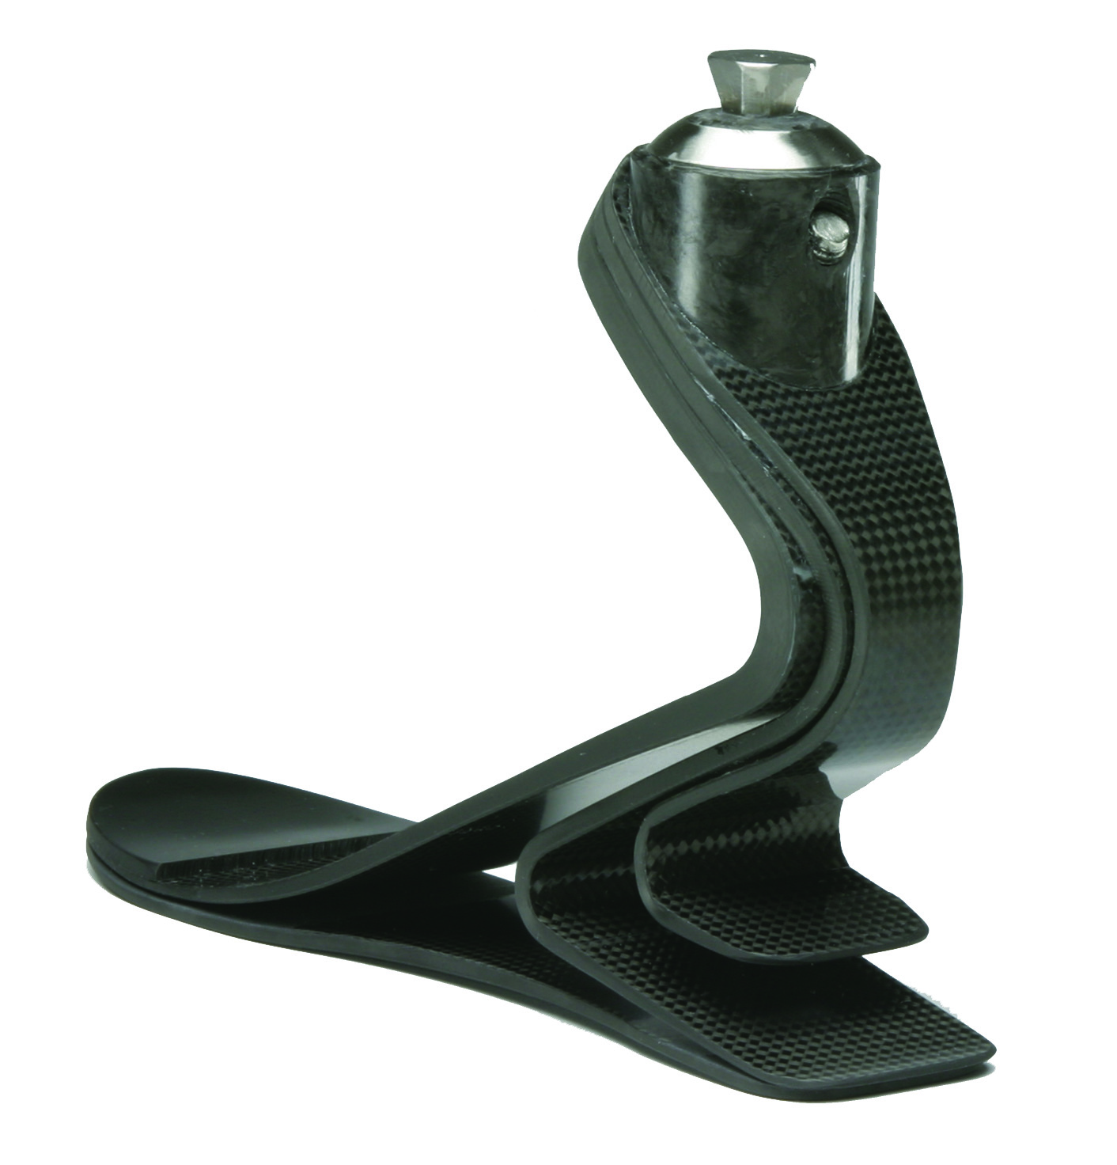
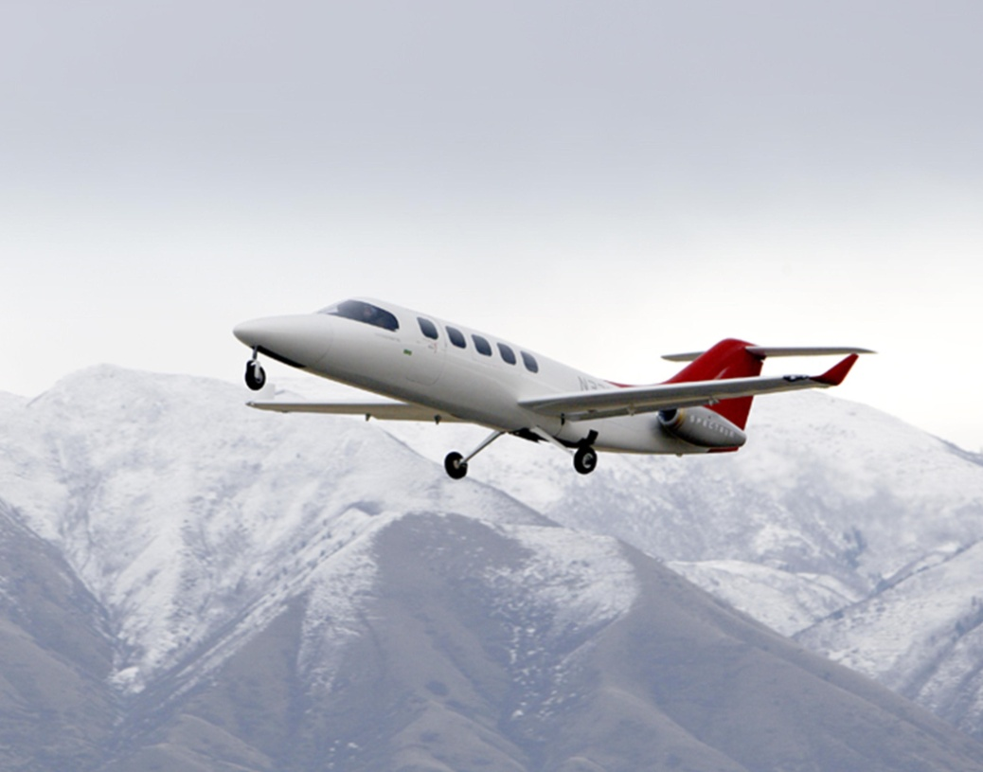
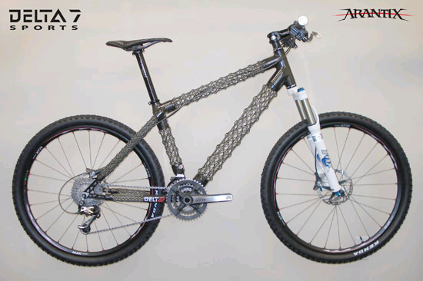
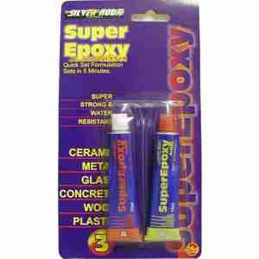
Epoxies

Slide 53
Epoxies
Second most widely used family of thermosets (after polyesters)
Large portion of uses are non-reinforced (adhesives, paints, etc.)
Circuit boards are the largest reinforced application (low conductivity, low volatiles)
Advanced composites use epoxies because of:
Thermal stability
Adhesion
Mechanical properties

Slide 54
Epoxy and glycidyl groups
a) Epoxy group
H
H
│
│
H―C―C―R
O
Generalized organic group
H
H
H
│
│
│
H―C―C―C―R
O
│
H
b) Glycidyl group

Slide 55
Generalized epoxy polymer
Epoxy ring (or glycidyl group)
C
(
C
C
)_{n}
C
O
O
Polymer portion
Number of repeat units

Slide 56
A common epoxy synthesis reaction
CH₃
│
+
HO―
―C―
―OH
Cl―CH₂―CH―CH₂
│
CH₃
O
Epichlorohydrin
Bisphenol A
n reactions
Glycidyl
OH
CH₃
(
│
)_{n}
│
CH₂―CH―CH₂
―OCH₂CHCH₂O―
―C―
―O―
CH₂―CH―CH₂
+ nHCl
│
O
CH₃
O
Diglycidyl Ether of Bisphenol A (DGEBPA)

Slide 57
Resin Rules
Resin Rule: The number of epoxy groups determines the amount of crosslinking.
Epoxy groups are at the end of a chain
Chains containing epoxy groups can be repeated so that a molecule can have several epoxy groups
High crosslinking gives thermal stability but requires high curing temperatures

Slide 58
Tri-functional epoxy
O―CH₂―CH―CH₂
│
O
CH₂―CH―CH₂―O―
―O―CH₂―CH―CH₂
O
O
Multiple epoxy groups increases crosslinking
High temp applications OK but requires high temp cure and post cure.

Slide 59
Tetra-functional epoxy
H₂C―CH―CH₂―CH₂
CH₃
│
CH₂―CH₂―CH―CH₂
O
N―
―CH₂―C―CH₂―
―N
O
│
CH₂―CH₂―CH―CH₂
H₂C―CH―CH₂―CH₂
CH₃
O
O
Tetraglycidylmethylenedianiline (TGMDA)
Tetraglycidyldiaminodiphenylmethane (TGDDM)
Standard of high performance resins for 40 years
Exotherm can be very high (depending on curing agent).
-Control: thickness, heat-up rate, number of temperature holds.
Thermal stability, high degree of crosslinking

Slide 60
Novolac-based epoxy resin (Epoxydized phenolic resin)
(
―CH₂―
―CH₂―
)_{n}
│
│
│
CH₂
CH₂
CH₂
│
│
│
O
O
O
│
│
│
CH
CH
CH
O
│
O
│
O
│
CH₂
CH₂
CH₂
The central chain is a repeat unit (n repeats)
High density of crosslink sites can give high T_{g}. High temp cure is usual.

Slide 61
A flame retardant epoxy (TBBA)
Br
Br
CH₃
│
H₂C― CH―O―
―C―
―O―
CH₂―CH―CH₂
│
O
CH₃
O
Br
Br
Low flame spread but high smoke and choking fumes.

Slide 62
Resin Rules
Resin Rule: Epoxies use hardeners instead of initiators for curing.
Hardeners open the epoxy ring and link to the main epoxy chain
Hardeners have active groups at both ends so that they can crosslink two molecules together

Slide 63
Curing
Epoxy ring
Epoxy ring
C
(
C
C
)_{n}
C
O
O
H
H
N
H
N
H
Hardener molecules have two
reactive ends, so they can each
react with two epoxy molecules.
N
N
H
H
H
H

Slide 64
Epoxy Crosslink Mechanism
C
C
Epoxy
H
H
Cured Polymer
Hardener
The other ends can also react (usually with other molecules).

Slide 65
Resin Rules
Resin Rule: Many different hardeners are available to cure epoxies.
Very active ends on the hardener molecule allows crosslinking at lower temperatures
Hydrogens attached to highly electronegative atoms are very active
Nearby aromatic groups decrease activity
Nearby large groups of atoms hinder access and therefore decrease activity

Slide 66
Effects of various hardeners
Hardeners | Advantages | Disadvantages
Aliphatic amines | Convenience, low cost, room temp cure, low viscosity | Skin irritant, critical mix ratios, blushes
Aromatic amines | Moderate heat resistance, chemical resistance | Solids at room temp, long and elevated cures
Polyamides | Room temp cure, flexibility, toughness, low toxicity | High cost, high viscosity, low HDT
Amidoamines | Toughness | Poor HDT
Dicyandiamide | Good HDT, good electrical | Long, elevated cures
Anhydrides | Heat and chem resistance | Long, elevated cures
Polysulfide | Moisture insensitive, quick set | Odor, poor HDT
Catalytic | Long pot life, high HDT | Long, elevated cures, poor moisture
Melamine/form. | Hardness, flexibility | Elevated temp cure
Urea/form. | Adhesion, stability, color | Elevated temp cure
Phenol/form. | HDT, chem resistance, hardness | Solid, weatherability

Slide 67
Curing Profile
355±10
400
120 minutes
300
Temperature (°F)
200
130
100
1-5°F/minute (critical for precipitate)
Begin heat after full pressurization of autoclave
0
Time
Vacuum
Autoclave

Slide 68
Curing Profile
Why 2-stage?
To minimize exotherm
To allow time for gas escape before hardening completely
Not required in parts less than 0.5 inches thick
Danger of curing too quickly (ramp rate, etc)
Exotherm
Why such long time at highest temperature?
Molecular mobility gives full cure (crosslinking)

Slide 69
Epoxy and Polyester Comparison
Comparisons | Polyester | Epoxy
Active site | C=C
Crosslinking reaction | Addition/free radical | Ring opening
Crosslinking agent | Initiator (peroxide) | Hardener
Amount of x-link agent | 1-2% of resin | 1:1 with resin
Solvent/viscosity | Styrene (active)/low | Infrequent/high
Volatiles | High | Low
Inhibitors, accelerators | Frequent | Infrequent
Reactant toxicity | Low | Moderate
Cure conditions | Room temp or heated | Heated (some room)
Shrinkage | High | Low
Post cure | Rare | Common

Slide 70
Polyester and Epoxy − Properties
Property | Polyester | Epoxy
Adhesion | Good | Excellent
Shear strength | Good | Excellent
Fatigue resistance | Moderate | Excellent
Strength/stiffness | Good | Excellent
Creep resistance | Moderate | Moderate to good
Toughness | Poor | Poor to good
Thermal stability | Moderate | Good
Electrical resistance | Moderate | Excellent
Water absorption resist | Poor to moderate | Moderate
Solvent resistance | Poor to moderate | Good
UV resistance | Poor to moderate | Poor to moderate
Flammability resistance | Poor to moderate | Poor to moderate
Smoke | Moderately dense | Moderately dense
Cost | Low | Moderate

Slide 71
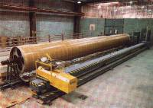
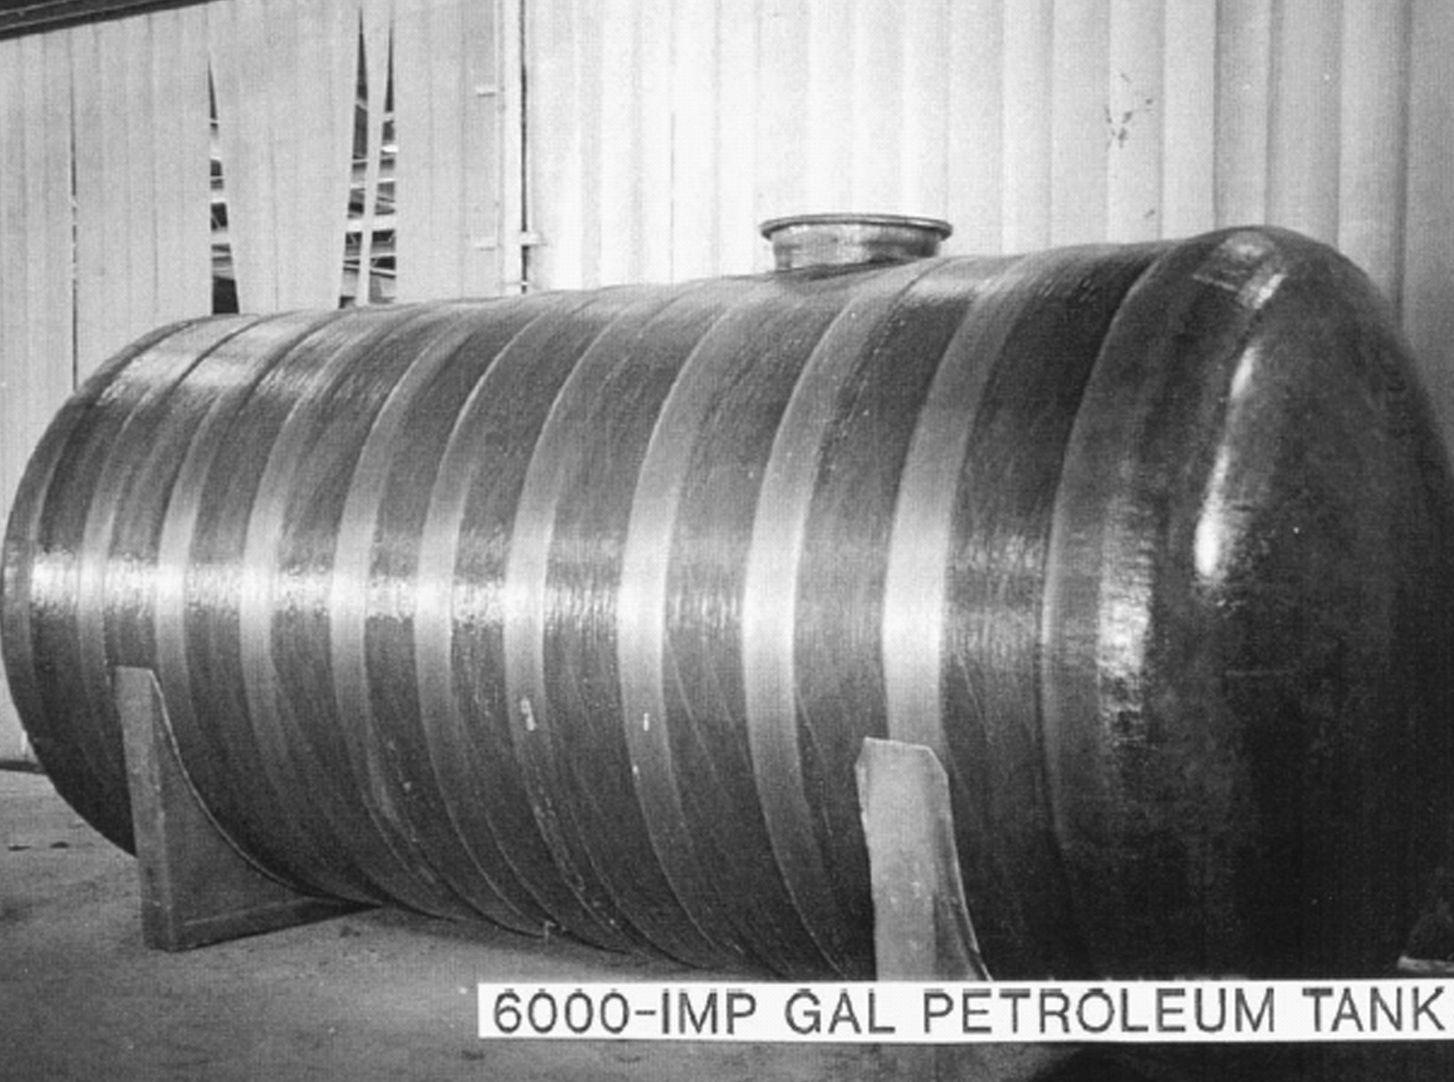
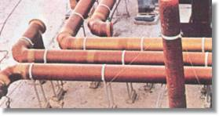
Vinyl Esters

Slide 72
Resin Rules
Resin Rule: Curing properties of a polymer can be modified by appropriate chemical substitution.

Slide 73
Vinyl Esters
Epoxy resins that have been modified so that they can be cured like a polyester
The modification is usually a reaction with an acrylic (acrylic modified epoxy)
The modification must substitute a carbon-carbon double bond for the epoxy ring
The name, vinyl ester, comes from old chemistry

Slide 74
Typical vinyl ester polymer
Often an epoxy backbone
C
C
(
C
C
)_{n}
Unsaturated end group
Unsaturated end group

Slide 75
Synthesis of a vinyl ester from an epoxy
O
Attack and bond
Broken bond
│
―
│
…
CH₂―CH―C―O―H
+
CH₂―CH―CH₂
―O―
O
Acrylic acid
Bonding
Epoxy (typical)
Note: The carbon at which the
molecules link is bolded
O
│
―
│
…
CH₂―CH―C―O―
CH₂―CH―CH₂
―O―
O–H
Vinyl ester (typical)

Slide 76
Typical Vinyl Esters
(
)_{n}
Epoxy Novolac Vinyl Ester Resin
Bisphenol-A Epichlorohydrin-based vinyl ester

Slide 77
Vinyl esters − Properties
Almost all properties of vinyl esters (and cost) are intermediate between polyesters and epoxies
Some of the most important properties include:
Water and chemical resistance
Electrical stability
Thermal stability
Toughness
Low volatiles during manufacture
Low shrinkage

Slide 78
Weight gain in water of polyester and vinyl ester resins
6
―
5
―
Polyester resin
4
―
●
●
●
Weight gain (%)
3
―
2
―
●
Vinyl ester resin (fewer polar groups)
1
―
□
□
□
□
●
│
│
│
│
│
0
□
0
50
100
150
200
250
Exposure time (hours)

Slide 79
Resin Rules
Resin Rule: Aromatic-like properties can be obtained from inclusion of groups other than benzene rings.
The object of such substitution is usually for thermal stability.
These resins are usually very difficult to process.
The resins usually also contain many benzene rings to further enhance aromaticity.

Slide 80
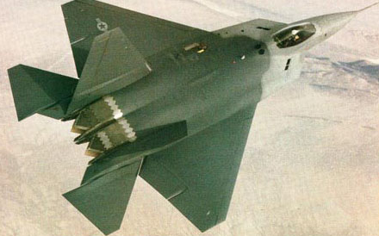
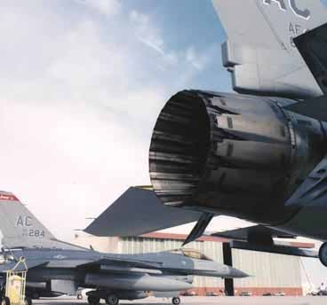
Polyimides

Slide 81
Resin Rules
Resin Rule: Aromatic-like properties can be obtained from inclusion of groups other than benzene rings.
The object of such substitution is usually for thermal stability.
These resins are usually very difficult to process.
The resins usually also contain many benzene rings to further enhance aromaticity.

Slide 82
Imide group and its inclusion in a polymer
O
│
R
│
C―C
R―N
│
R = other atoms or groups
C―C
│
R
│
O
a) Imide group
O
O
│
│
│
│
C
C
(
―N
N―R―
)_{n}
C
C
│
│
│
│
O
O
b) Imide group in polymer

Slide 83
Bismaleimide (BMI)
Crosslink sites
Crosslinks using the unsaturated polyester reaction
Has very good thermal stability compared to epoxies

Slide 84
Thermal stability of a PMR-15 composite
10
―
800°F (427°C)
700°F (371°C)
8
―
6
―
Weight loss (%)
4
―
600°F (315°C)
2
―
0
│
│
│
│
│
0
100
200
300
400
500
Hours

Slide 85
Mechanism of self-healing of a polymer
Microspheres filled with DCPD
Catalyst
•
•
•
•
Polymer
•
•
•
•
Crack
•
•
•
•
•
•
•
•
•
•
Propagation
of crack
through
microsphere
•
•
•
•
•
•
•
•
•
•
Cracks filled
with DCPD
which cures
when it
encounters
catalyst in the
body of the polymer
•
•
•
•
•
•
•
•
•
•
•
•
•
•

Slide 86
Thank You
Thermosets

