Slide 1
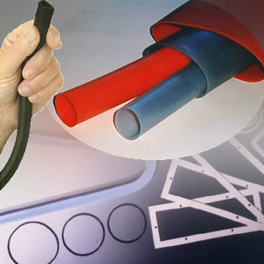
Elastomers
MFG 355

Slide 2
Elastomeric Materials
Highly amorphous
Highly random orientation
High elongation

Slide 3
Elastomeric Materials
Metals
Stress
Conventional Plastics
Elastomers
Strain

Slide 4
Elastomeric Materials
No Stress
Recovery
from Entropy
Stressed
In tension

Slide 5
Elastomeric Materials
Crosslinks
No Stress
Recovery
from Entropy
and Crosslinks
Stressed
In tension
Crosslinks
(stretched)

Slide 6
Aliphatic Thermoset Elastomers
These are the most common elastomers
These have a double bond after polymerization has occurred
These are noncrystalline
These are highly flexible

Slide 7
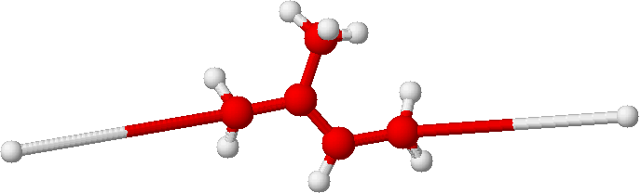

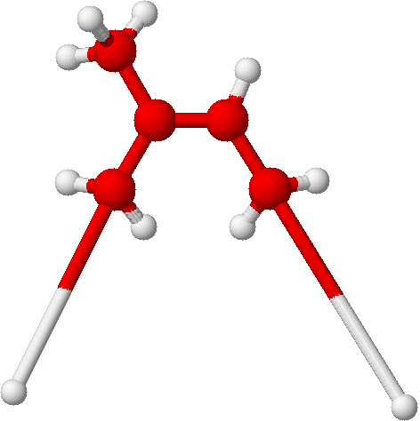
Natural Rubber
Gutta percha or Balatta
(trans-polyisoprene)
Hevea Rubber
(cis-polyisoprenene)

Slide 8
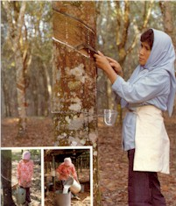
Natural Rubber
Raw material extracted from trees

Slide 9
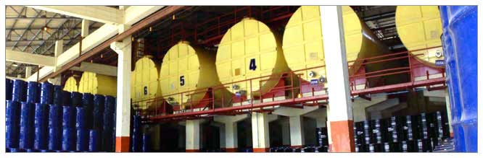
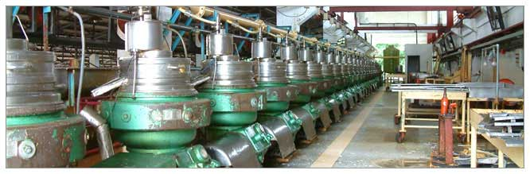
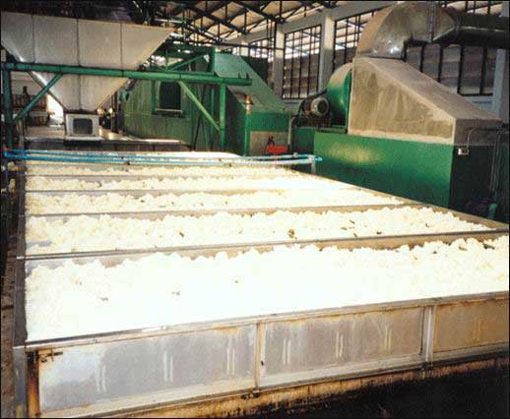
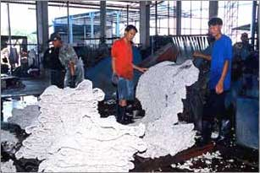
Natural Rubber
Material is processed

Slide 10
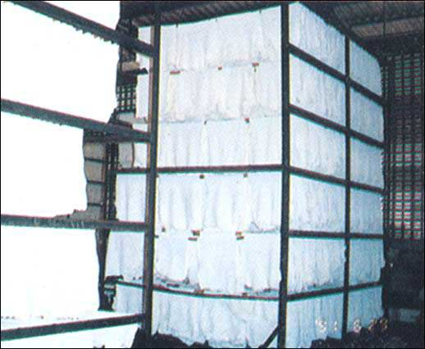
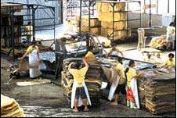
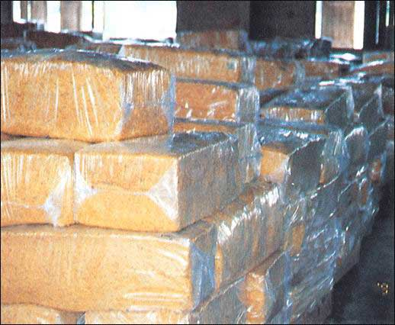
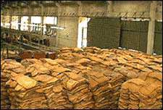
Natural Rubber
Latex is then dried, sorted and smoked

Slide 11
Natural Rubber
The difficulties with natural rubber
  Strength
  Availability
  Bacterial breakdown
  Creep

Slide 12
Natural Rubber
Creep
  Solved by Goodyear in the 1800's
  Discovered that the polymer could be crosslinked (cured or vulcanized) by heating with sulphur
Sulphur attacks this double bond
- As many as 2-8 sulphur atoms might
be in the bridge between molecules

Slide 13
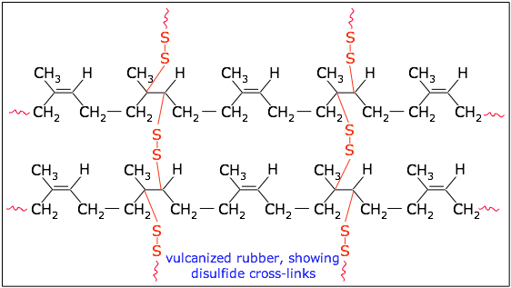
Vulcanization

Slide 14
Synthetic Polyisoprene or Isoprene Rubber
Need
  Supply of natural rubber disrupted during WWI and WWII
  Used in tires for bicycles and early cars
  Used the Ziegler-Natta catalyst system to improve properties
    The trans- or cis- nature of the rubber could be controlled up to 90% in either direction

Slide 15
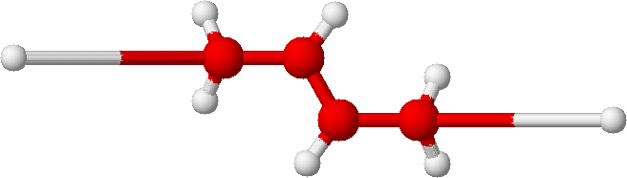
Butadiene Rubber (BR)
How is this polymer different from natural rubber?

Slide 16
Butadiene Rubber (BR)
No cis or trans isomers
Lower mechanical strength because of no of pendant methyl group but also more flexibility
Lower cost (all synthetic from cheap monomer)
Improvement of low-temp flexibility
Compatibility with other polymer materials

Slide 17
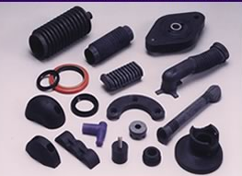
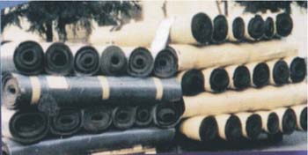
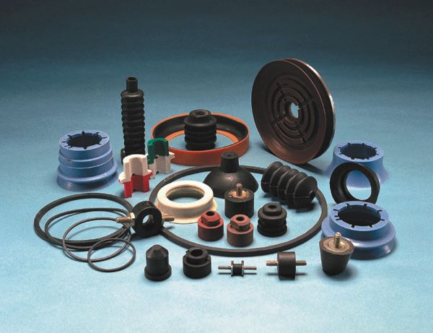
Styrene Butadiene Rubber (SBR)

Slide 18

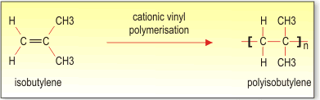
Butyl rubber
Also known as polyisobutylene
Butyl bullets for less lethal control

Slide 19
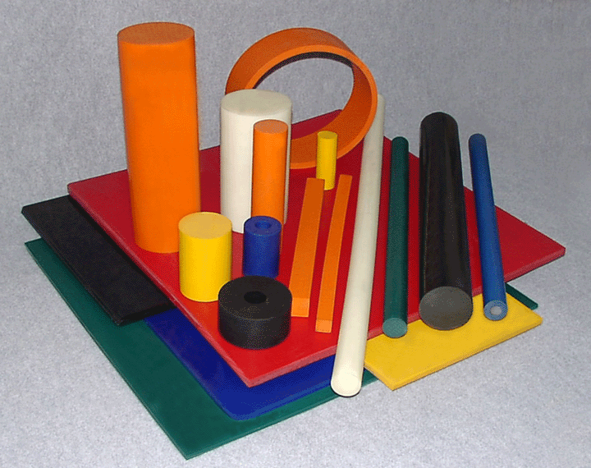
Oil-Resistant Elastomers
NBR—Nitrile Butadiene Rubber
  Copolymerization of butadiene and acrylonitrile
  More expensive than SBR or BR
CR—Chloroprene rubber (neoprene)
  Thermal stability
  Non-flammable

Slide 20
Ethylene-Propylene-Butadiene Monomer (EPDM)
H
H
H
H
C
C
C
C
H
H
H
[
C
H
H
E monomer
H
[
[
P monomer
Butadiene monomer

Slide 21
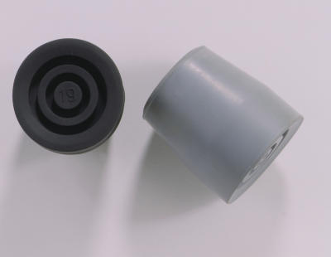
Thermoplastic Elastomers (EPM and EPDM)
Many of the properties of thermoset elastomers
  Resiliency
  Elasticity
More easily processed
  Injection molding, extrusion and other standard thermoplastic processes
  Highly compatible with polyolefins
  EPDM is crosslinked very lightly and may not be capable of being melted

Slide 22
Thermoplastic Olefin Elastomers (TPO)
Poor compatibility with other rubbers
Melt processible

Slide 23
Flouroelastomers
+
Vinylidene fluoride monomer
Tetrafluoroethylene monomer
Copolymer = Viton®

Slide 24
Flouroelastomers
Many of the desirable properties of flouropolymers
  Low solvent effects
    Excellent for chemical and petroleum handling applications
  High thermal stability
    Good for gaskets and seals

Slide 25
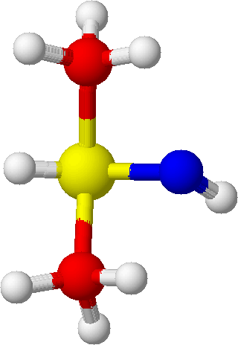
Silicones
(
i
)_{n}
(
)_{n}

Slide 26
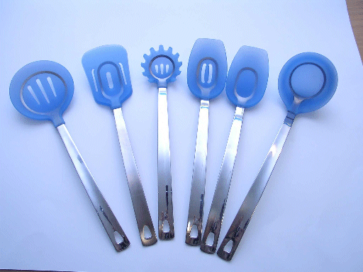
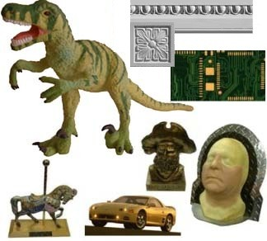
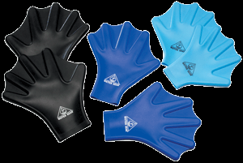
Silicones

Slide 27
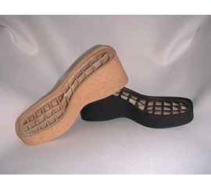
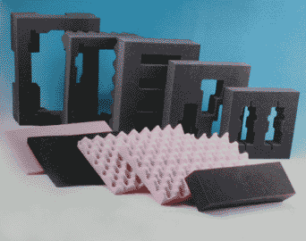
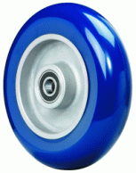
TPE – Polyurethanes

Slide 28
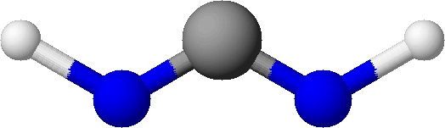
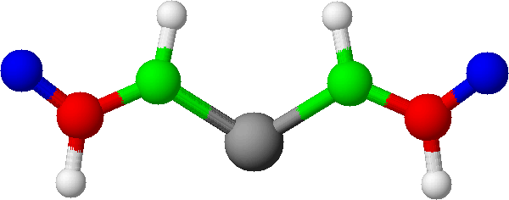
Polyurethanes
Plus
Diisocyanates
Polyols

Slide 29
Urethane linkage formation
O
O
=
=
HO
OH
+
C=N
N=C
Polyol
Di-isocyanate
O
H
O
=
=
HO
O
C
N
N=C
Urethane
linkage
Note: This is a rearrangement reaction (like condensation but no condensate)

Slide 30
TPU Chemistry: A+B
Chain Extender
Polyol
A: Hard Segment
B: Soft Segment
Isocyanate
Long chain polyol
Diisocyanate (aromatic or aliphatic)
Short chain polyol (chain extender)

Slide 31
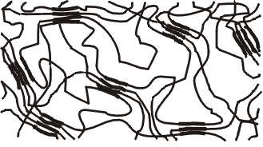
Hard Segment Properties
Diisocyanate + Chain Extender
  Polymer Strength
  Crystallinity
  Melting Temperature
  Modulus (Stiffness)
  Hardness
  Heat Resistance
  Biocompatibility
  Aromatic or Aliphatic Isocyanates

Slide 32
Hard Segment
Diisocyanates and Chain Extenders
Aromatic Isocyanates
MDI (Methylenediphenylisocyanate)
TODI (Tolidine Diisocyanate)
PPDI (Paraphenylenediisocyanate)
NDI (Napthalenediisocyanate)
Aliphatic Isocyanates
HMDI (Methylenediphenylisocyanate)
TMXDI (ETA-Tetramethylxylenediisocyanate)
CHDI (Cyclohexanediisocyanate)
HDI (Hexamethylenediisocyanate)
Chain Extenders
BDO (1,4 Butanediol) – Di-functional
HQEE (Hydroquinonedi-B-Hydroxyethylether) – Di-functional
TMP (Trimethylolpropane) – Tri-functional
DG (Di-Ethylene glycol)
Many others

Slide 33
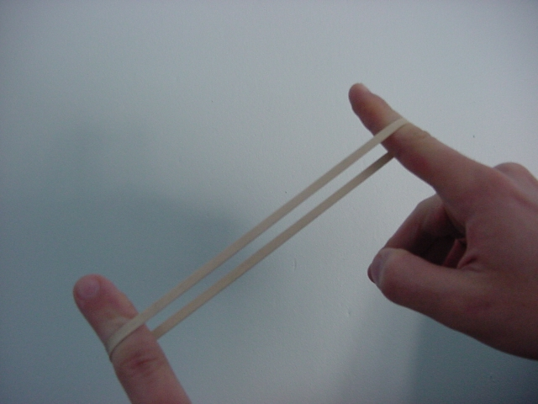
Soft Segment Properties
Long Chain Diol
  Polymer Elasticity
  Resilience
  Solvent Resistance (Solubility Parameter)
  Biocompatibility
  Low Temperature Properties
  Glass Transition Temperature
  Phase Separation
  Mechanism to introduce alternative chemistries to the polymer backbone for compatibility and reactivity

Slide 34
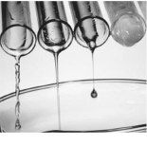
Soft Segment Polyols
Ester Based
  PBA (Polyester Butylene Adipate)
  PEA (Polyester Ethylene Adipate)
  Polycaprolactone Ester
  Polycarbonate Ester
Ether Based
  PTMO (polytetramethyleneoxide)
  PSX (polydimethylsiloxane) + PTMO
  PTMEG (polytetramethyleneglycol)
  PPO (Polypropylene oxide)
  PEG (Polyoxyethylene glycols)
  Perfluorinated Polyethers
Various Modifications
Various Molecular Weight/Distribution

Slide 35
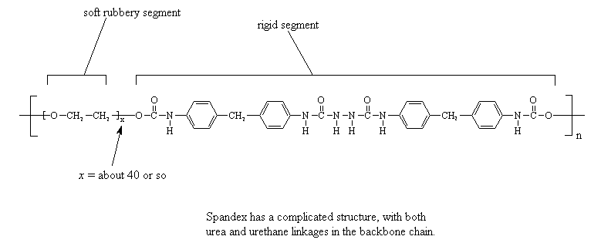
Thermoplastic Polyurethane (TPU)

Slide 36
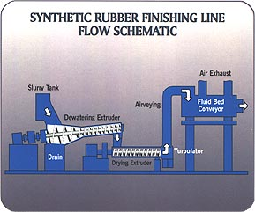

Slide 37
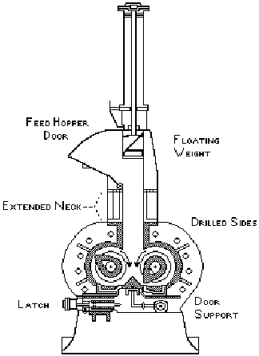
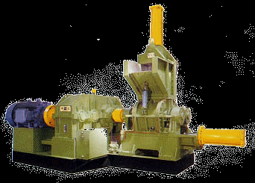
Elastomer Processing
Compounding
  Banbury mixer

Slide 38
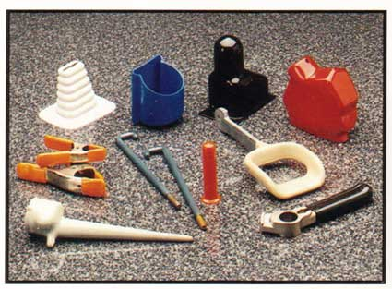
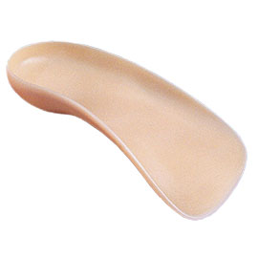
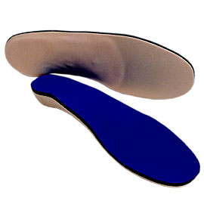
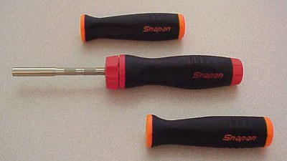
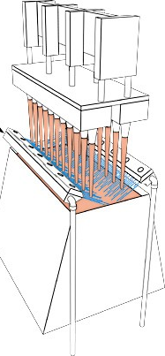
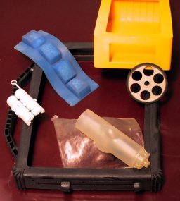
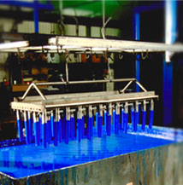
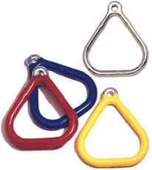
Elastomer Processing
Preforming
Molding
Dipping

Slide 39
Impact Toughness Guide
Resin | Izod (ft-lb) | Reasoning
Polyurethane (x-link) | 25 | High elongation and strength
Polycarbonate | 16 | High strength
SMC | 7 | Reinforced and toughened
ABS | 6 | Toughened with rubber
HDPE | 3 | High elongation, flexible
Acetal | 2 | Can be toughened
Nylon 6/6 | 2 | Can be toughened
PET | 1 | Can be alloyed
PP | 1 | Some crystallinity
LDPE | 1 | Low strength
Polystyrene | 0.3 | Pendent group
Acrylic | 0.3 | Short link, large pendent group
Phenolic, w/fiberglass | 0.3 | Crosslinked
Epoxy, unreinforced | 0.2 | Crosslinked
Crosslinked polyester | 0.2 | Crosslinked
Increasing Toughness

Slide 40
Thank You

