Slide 1
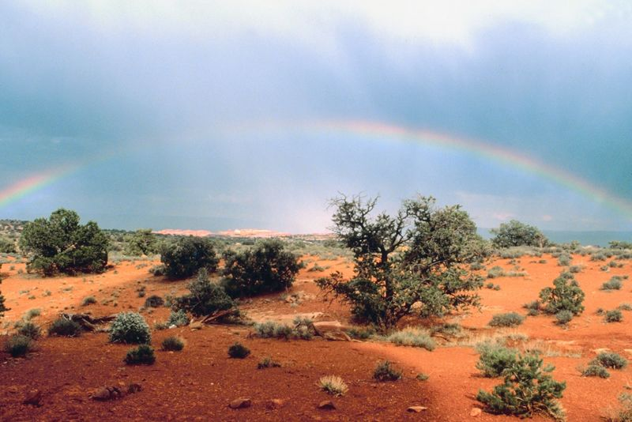
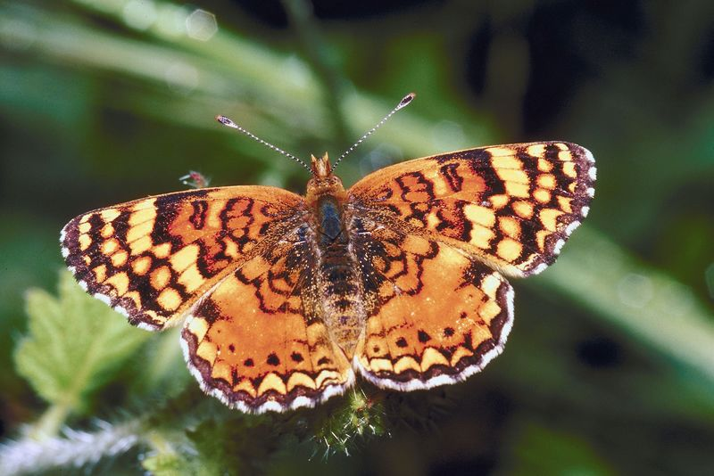
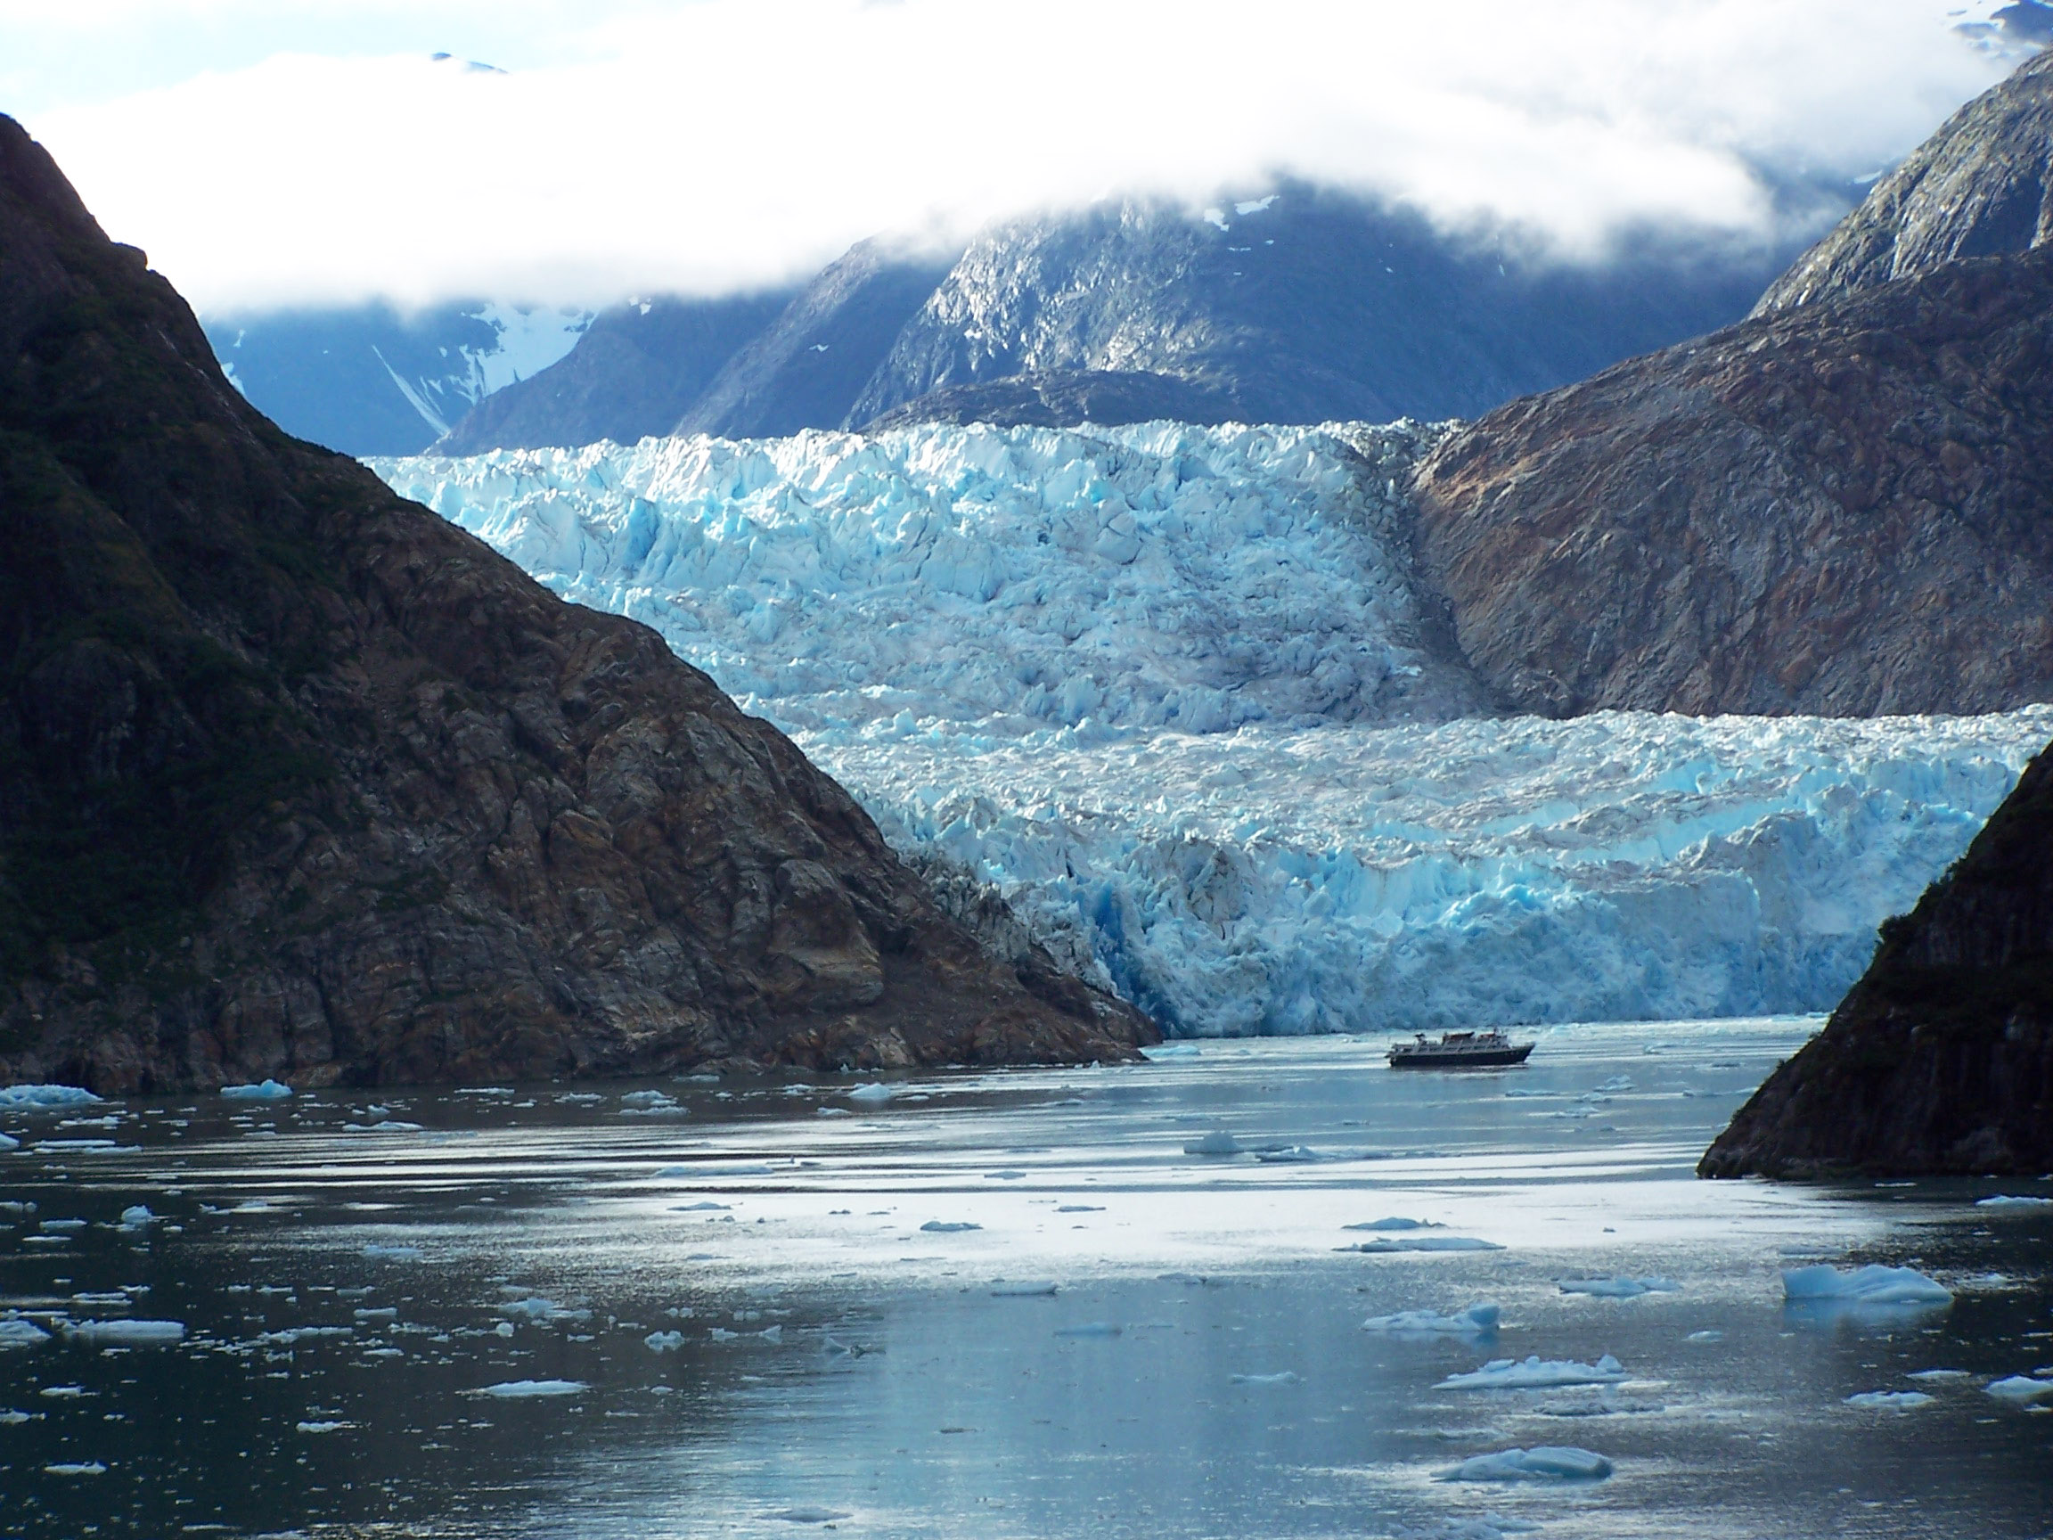
What is Beauty, Ethics, and Truth?
Hellenistic Philosophy and Religion

Slide 2
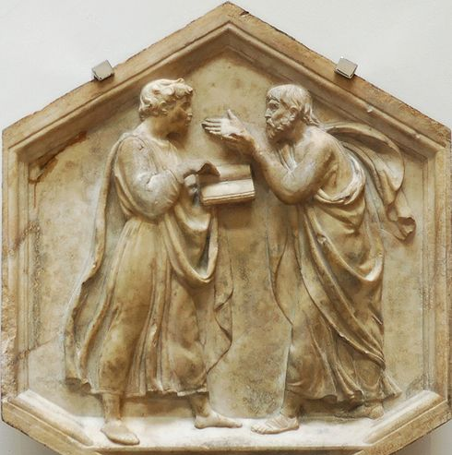
Beauty
The role of the nude in art
Objections because of potential pornographic or erotic content.
Greek/Roman and later Western Civilization opinions of the nude in art.
Difficulty in discussing art without using nudes.
The approach of this class
Use nudes when appropriate.
Don’t focus on the nudity but, rather, on the other factors that are to be learned.
Carefully select pieces to be used.

Slide 3
Art
Pre-classical
Sculpture-generalized to be symbolic of all humans
Relation to Forms
Generic
Without dramatic expression
Lacked realism
Kouros

Slide 4
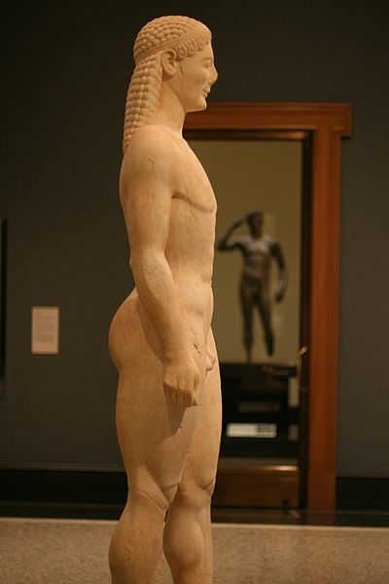
Art
Story: Getty Museum purchasing a Kouros
Price = $7M
What was different about the fake Kouros bought by the Getty?
The “feeling”
Museum’s label reads:
Greek, about 530 BC,
or modern forgery.

Slide 5
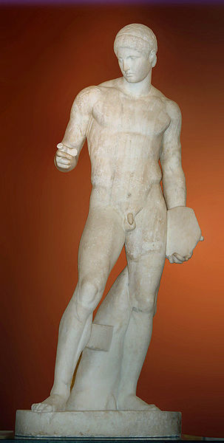
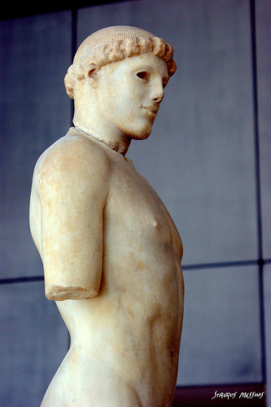
Art
Classical Greek Sculpture
Great advances
Technical ability
Reality (life-like)
Perfection of dimensions
But, is this the end of sculptural evolution?
Discophoros
Kritios Boy

Slide 6
Beauty: Sculptural Perfection

Slide 7
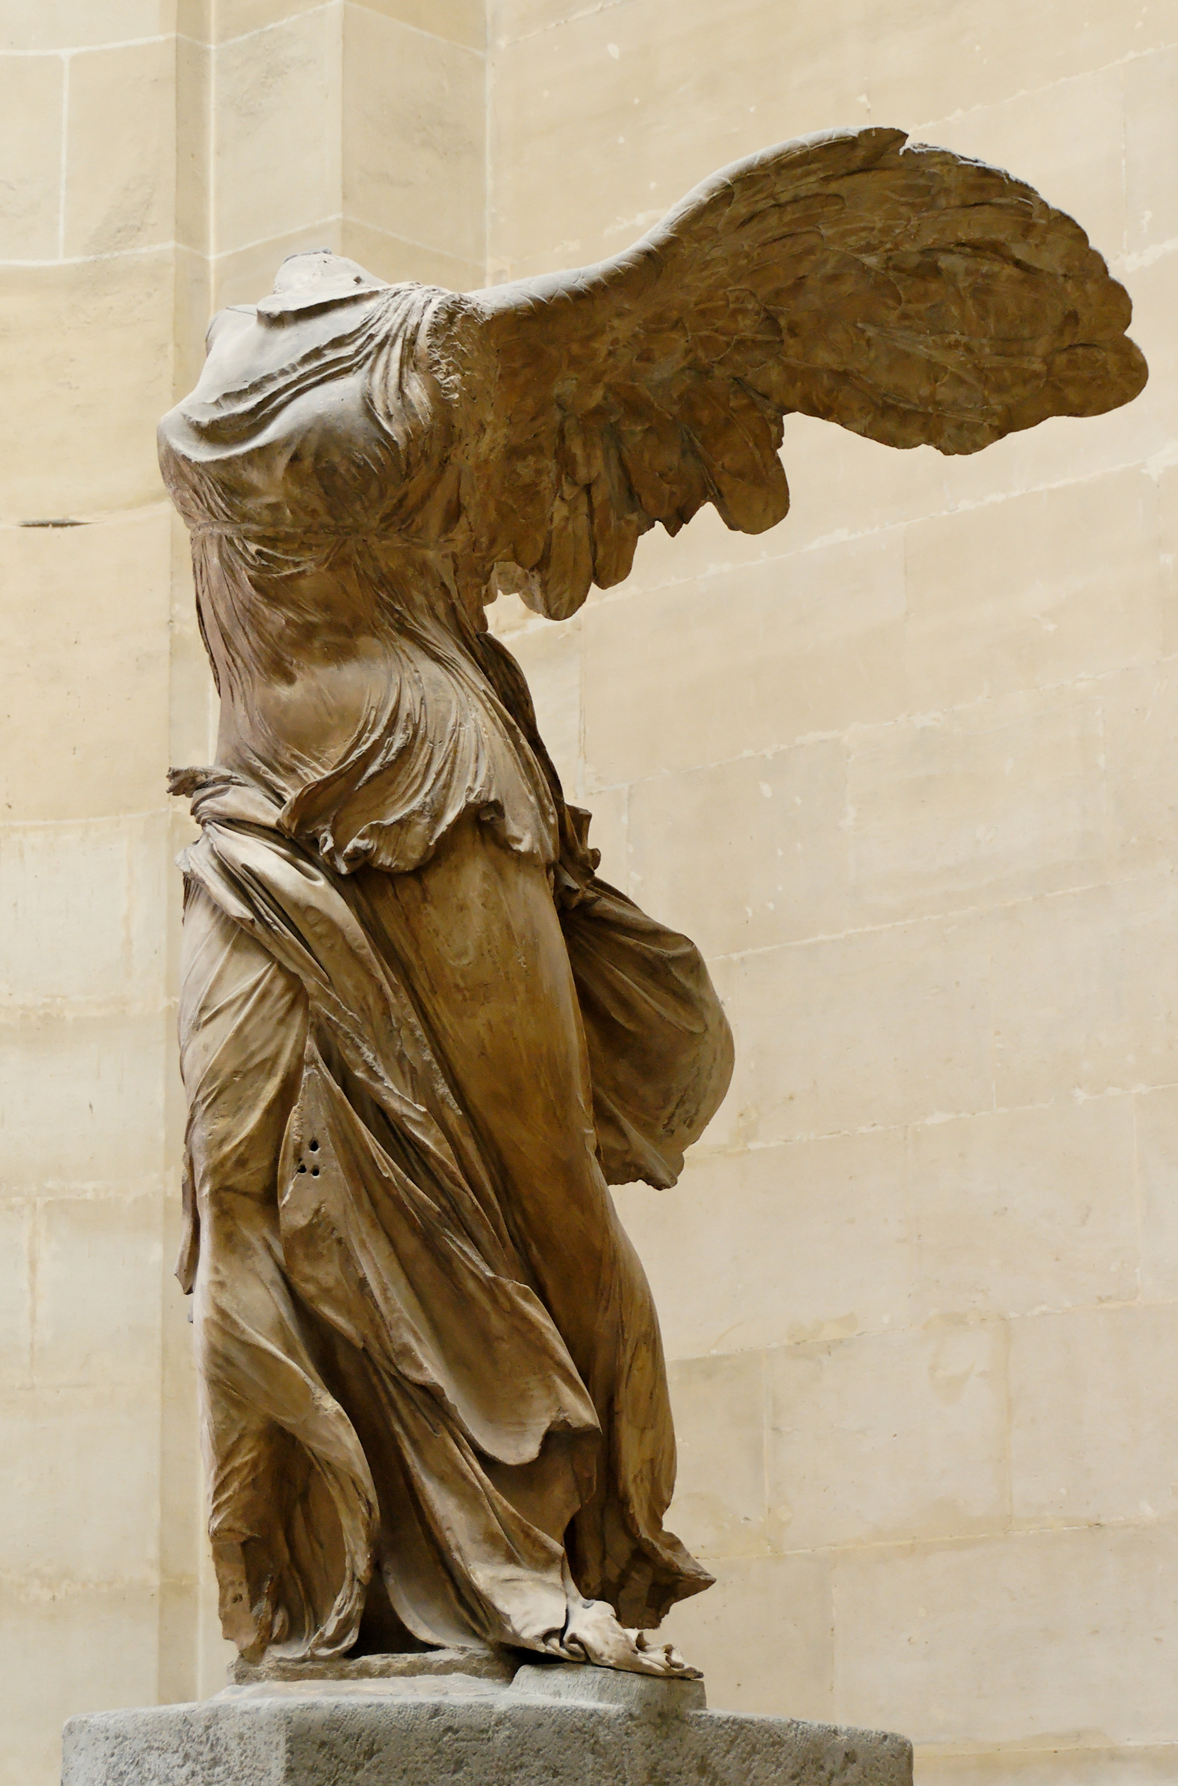
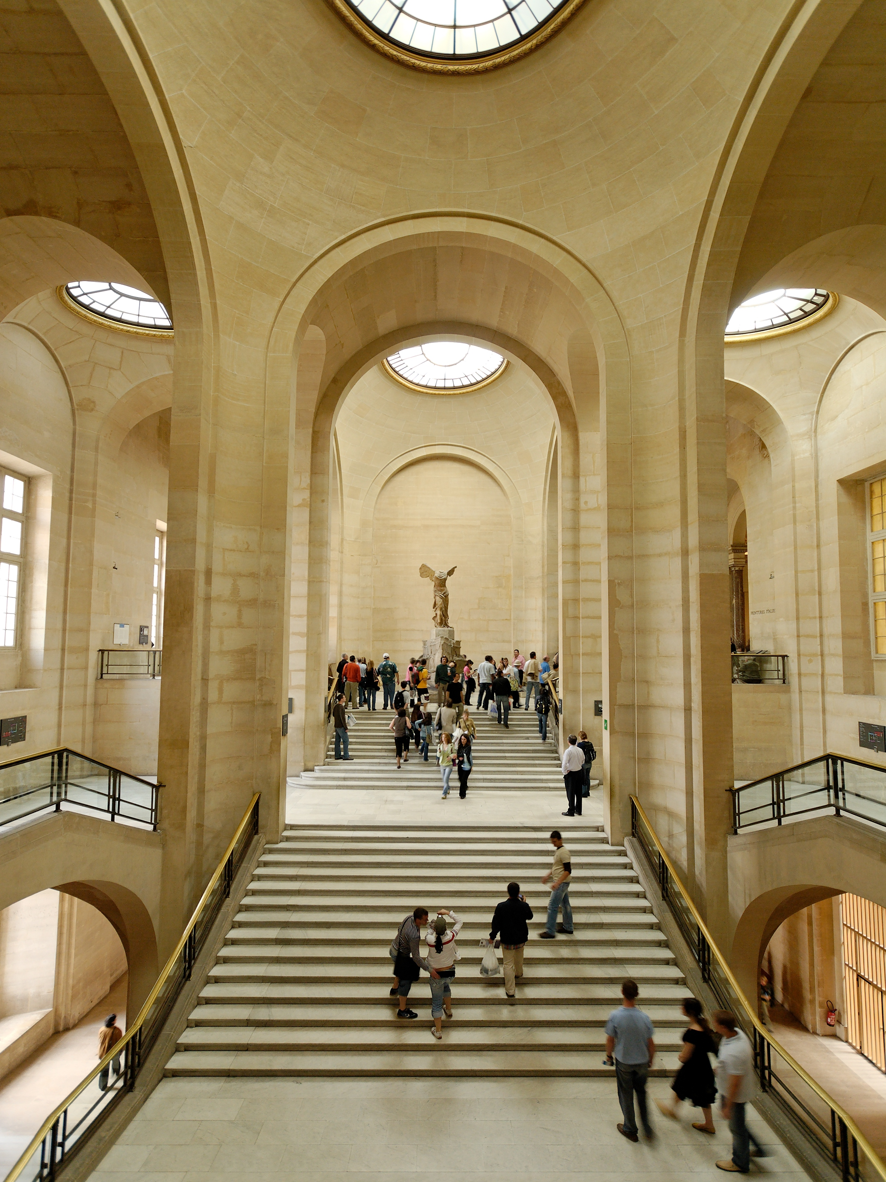
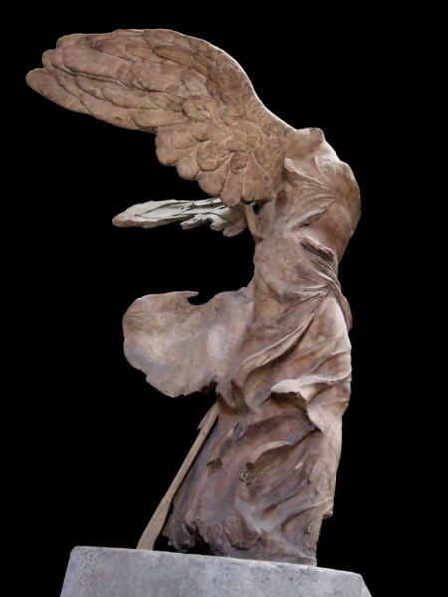
Hellentistic Art
Often showed movement
Victory at Samothrace

Slide 8
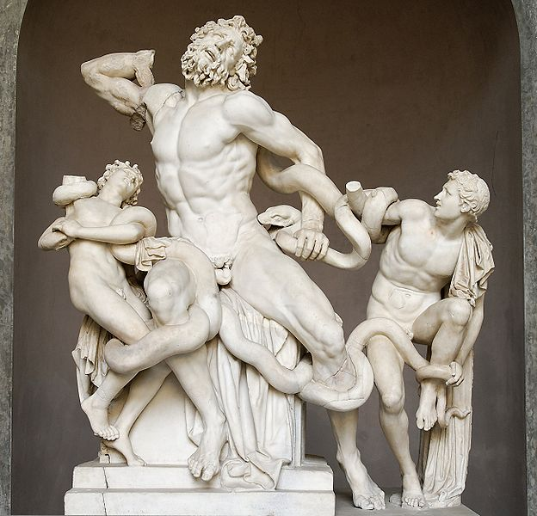
Hellenistic Art
Usually very dramatic
Laocoön and His Sons
Story of a man who tried to convince the Trojans not to accept the Trojan horse (killed by Athena with a snake).

Slide 9
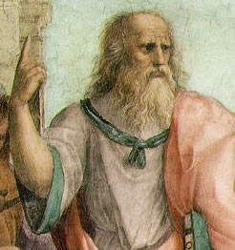
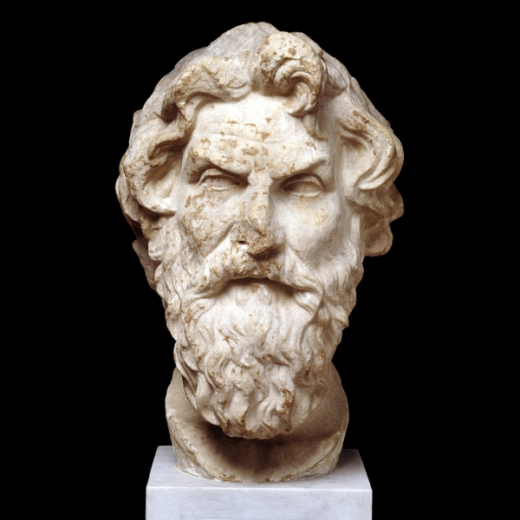
Philosophy Descended from Plato
Cynics/Skeptics
Ultimately not satisfying as a way of life.
Plato
Antisthenes the Cynic

Slide 10
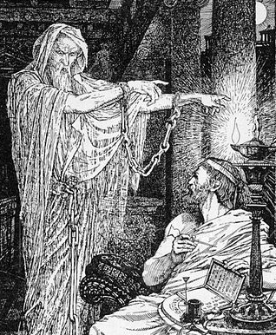
Philosophy Descended from Plato
Stoics (alternate to Skepticism)
Searched for ultimate truth in their lives.
Truth can be discovered by the senses and passed to the brain but is subject to error from emotions.
The greatest good is surrender to the Divine Will (Logos).
Plato
Athenodorus

Slide 11
Stoicism
The Logos—
A “ratio of small whole numbers” (Pythagoras)
The Form of Forms (Platonic)
A divine force that pervades all reality

Slide 12
The Force

Slide 13
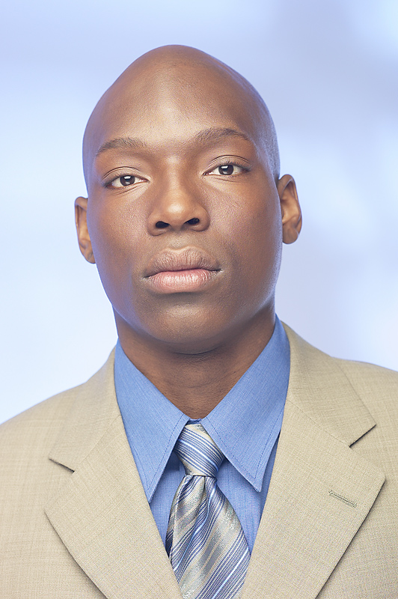
Stoicism
Apathea— the active control of emotions
Emotions are the opposite of a rational approach to life.
The “stoical approach” is without emotions.
Virtue is its own reward
Happiness is derived from conformance with nature or Logos.
Fate
Accept fate and try to find hidden benefits.

Slide 14
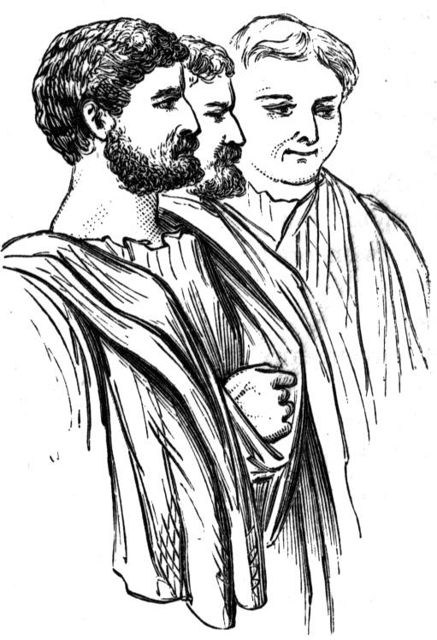
Influence of Stoicism
Strong influence on the later Greeks, Romans, and Christians
Roman belief in supremacy of law and basic virtues
Logos came to be identified with deity
"Logos" = "Word" (John 1:1)

Slide 15
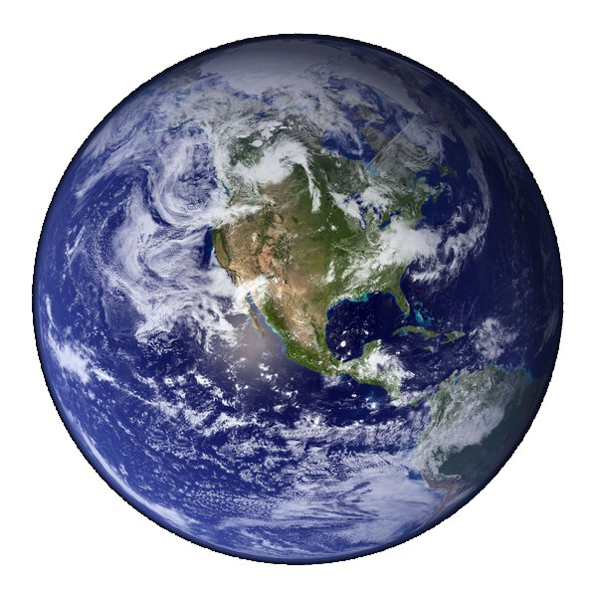
Influence of Stoicism
“By the Logos, the whole world is now become Athens and Greece.”
—Clement of Alexandria
(Bishop of the Catholic Church in the 3rd Century)

Slide 16
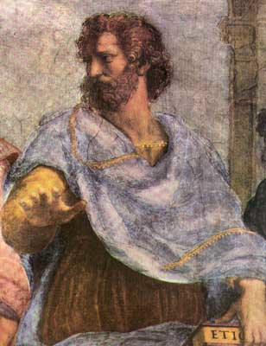
Philosophy/Science Descended from Aristotle
Peripatetics
Knowledge from science = ultimate truth
Senses were a valid source of knowledge.
Emotion was a way of evaluating knowledge.
Aristotle
Center of science moved to Alexandria
Alexandrian scientists strongly supported Aristotle.
Athens was left a second-rate center of learning.

Slide 17
Philosophy Descended from Aristotle
Epicureans
Founded by Epicurus (340-270 BC)
Rejected religion
Religion based on ignorance
Religion ignores sensory knowledge (empiricism)
Life began by spontaneous generation
There is no life after death
Aristotle
Atomic theory is the law of nature.

Slide 18
Epicureanism
Live according to the most pleasure/happiness
Happiness is achieved through conformance with the
(balance)
Long-term view is best
Hedonism is a corruption of Epicureanism
The Golden Mean

Slide 19
Philosophical Descent
PLATO
Cynics
Stoics
Christians
ARISTOTLE
Peripatetics/Scientists
Epicureans
Hedonists/Atheists

Slide 20
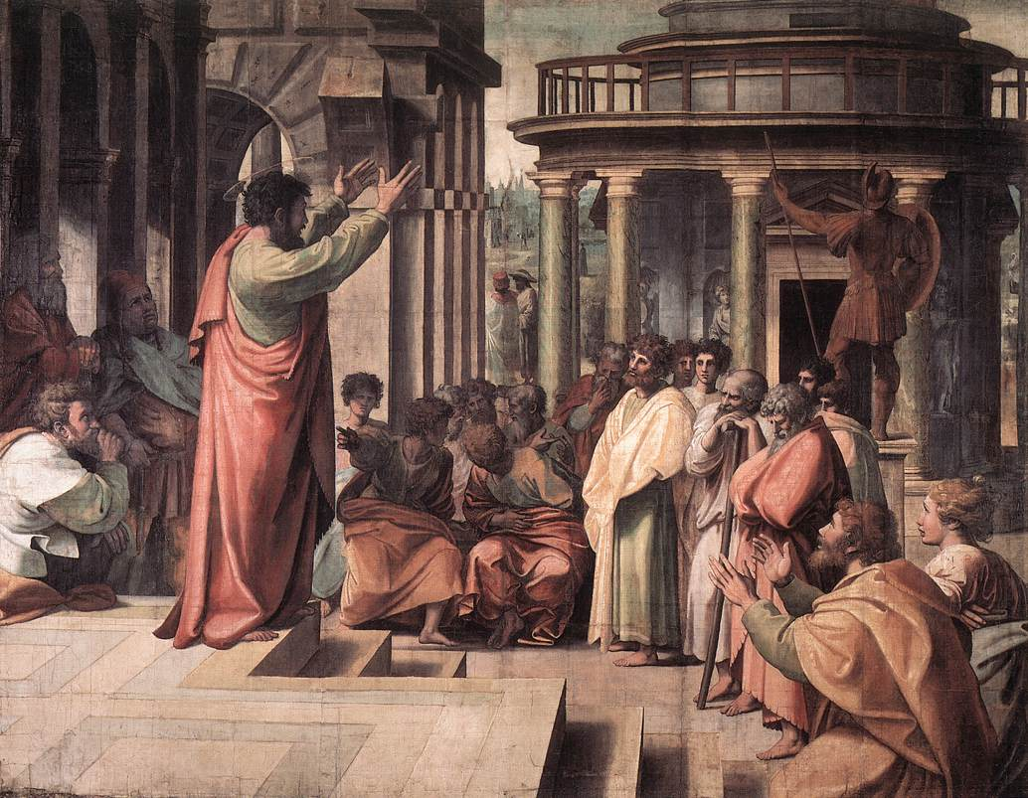
Philosophical Descent
Now while Paul waited for them in Athens, his spirit was stirred in him, when he saw the city wholly given to idolatry.
Therefore disputed he in the synagogue with the Jews, and with the devout persons, and in the market daily with them that met with him.
Acts 17:16-17

Slide 21
Philosophical Descent
Then certain philosophers of the Epicureans, and of the Stoicks, encountered him. And some said, What will this babbler say? Other some, He seemeth to be a setter forth of strange gods: because he preached unto them Jesus, and the resurrection.
Acts 17:18

Slide 22
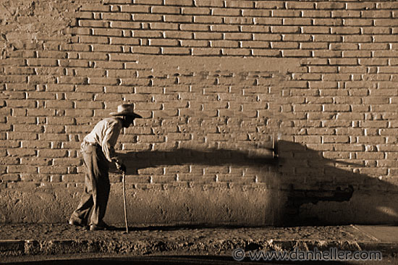
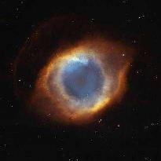
What is Truth?
Jew/Christians
Truth is absolute
God knows all truth
Perceiving truth (example)
Man—blind man
(learns linearly in time)
God—different dimension so
he sees all at one time

Slide 23
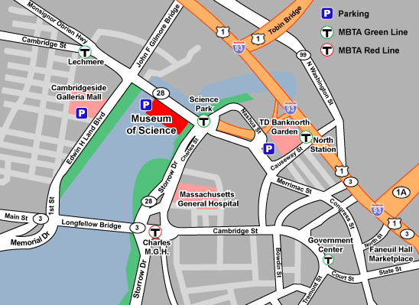
New Ways of Thinking about Knowledge
Analogy:
A person’s knowledge is not like a picture of reality
Instead, it is like a map
What are some differences between maps and pictures?

Slide 24
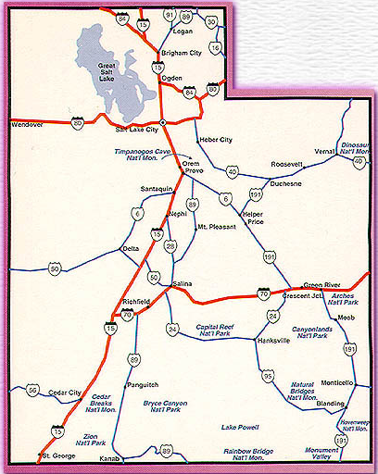
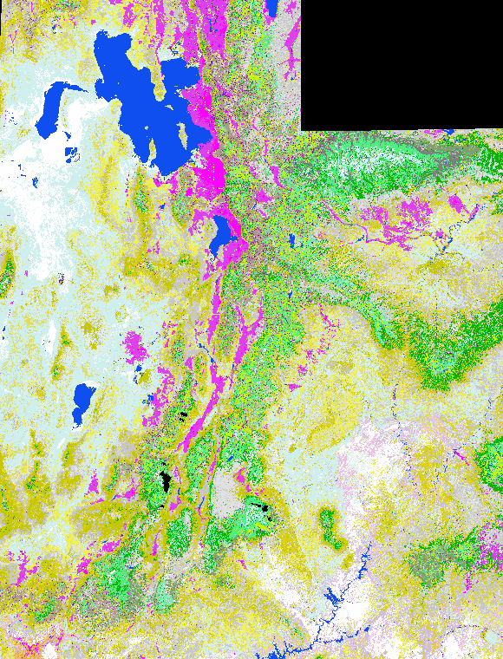
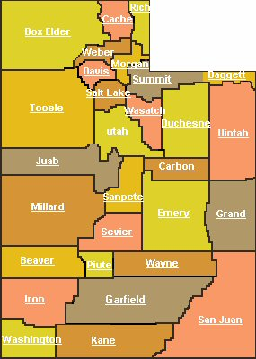
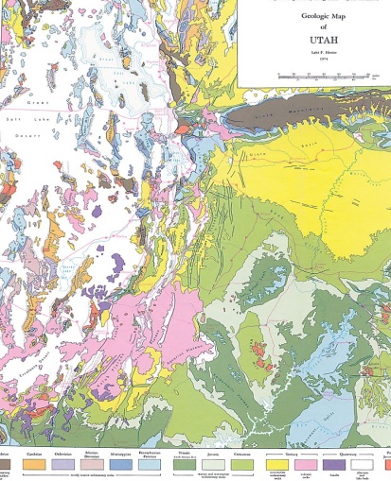
Types of Maps
Many different types of maps can represent a given area.
Elevation
Highway
Political
Vegetation
Geology

Slide 25
Types of Maps
No map has all aspects of reality.
To really be effective, a map must leave out things and focus on just a few aspects of the area being studied.
Likewise, our knowledge cannot be complete

Slide 26
Maps and Knowledge
Our maps or systems of knowledge are often skewed (not totally real) and may be influenced by:
Parents and other family members
Teachers
Independent study
Our interactions with society
Our own personality
People from the same environment can have very different maps.

Slide 27
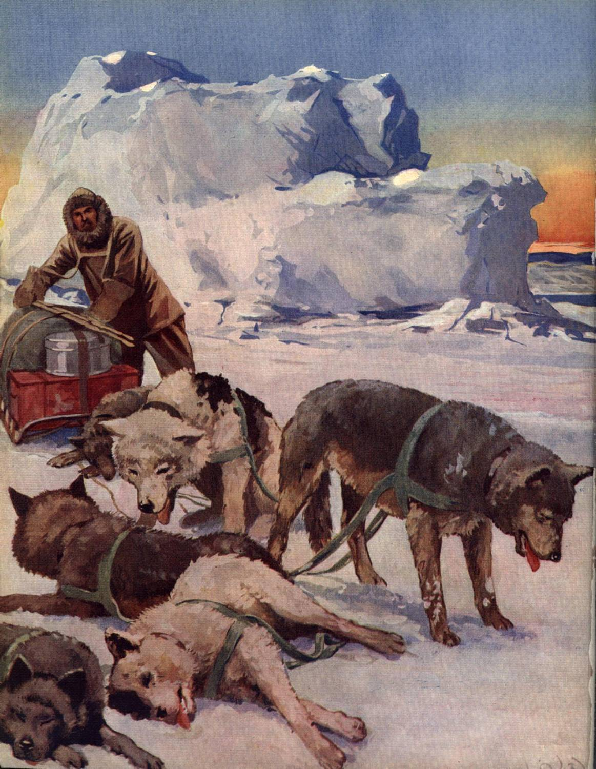
Maps and Knowledge
Examples of specialized knowledge:
Eskimos can distinguish
9 types of snow.
Chinese understand tone inflections that I can barely discern.
Meteorologists can look at clouds and predict short term weather, but I just see clouds.
“Rigor” for a mechanical engineer and for a chemist are very different.

Slide 28
Paradigms and Objectivity
What a man sees depends both upon what he looks at and also upon what his previous visual-conceptual experience has taught him to see.
―Thomas Kuhn, The Structure of Scientific Revolutions

Slide 29
Knowledge
Our knowledge is, therefore, incomplete and possibly skewed
Knowledge is like a map
Therefore, we must act on a knowledge base that is not informed by all possible facts.
Acting when all the facts are not known is called:
Faith

Slide 30
Western versus Eastern Summary
Learning and perceiving
Political
Cultural
Views of mankind

Slide 31
Learning and Perceiving
Western
Education comes through experience and reasoning
Facts are absolute
Facts are discovered through research and experimentation
Open discussions help
mankind find truth
Typical writing is logical and philosophical
Eastern
Education comes by
rote learning
Facts begin and end
Facts are subject to divine will and come only from God
Mankind apprehends facts rather than investigates
Typical writing is poetical and abstract (like Isaiah)

Slide 32
Political Differences
Western
Freedom is institutional—
it should be guaranteed
by society.
Loyalty to the state.
Eastern
Freedom is individual, existing even if the society is not free.
Loyalty to the leader.

Slide 33
Cultural Differences
Western
The body is most glorious creation
Body should be a focus of life in art
Health care, exercise, leisure, and pleasure
Eastern
People should be covered modestly
No statues or art to depict the body
Little effort at personal comfort

Slide 34
Views of Mankind
Western
Mankind is the ultimate being in the universe and lord of the earth by right of reason.
Religion is logical and scientific.
Eastern
Man is the subject of God and should focus on carrying out His will.
Religion is mystical and emotional.
Discussion:
Is the LDS Church principally Eastern or Western in orientation?

Slide 35
Our Greek & Hebrew Heritage
Greek
Heritage
Reason
Individualism
The
Golden
Mean
Hebrew Heritage
Faith
Authoritarianism
The area of overlap, where the individualistic and authoritarian principles co-exist, is where we live most productively. Here authoritarianism acts as a check against unbridled individualism, and individualism acts as a check against unbridled authoritarianism.
—Bruce C. Hafen, “Reason, Faith, and Things of Eternity”

Slide 36
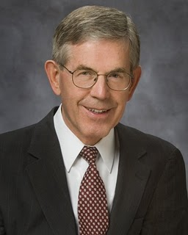
Two Cultures
We must all be truly bilingual, speaking fluently both the language of our disciplines and the language of the scriptures, yet our priorities are clear: our professional credentials may have earned us passports to Athens, but our citizenship must always remain in Jerusalem.
—Bruce Hafen

Slide 37
Discussion:
How do the answers to
“What is ethics, beauty, and truth?”
shape an individual’s or
a society’s creativity?

Slide 38
Creativity involves truth, beauty, and ethics.
Thank You

