Slide 1
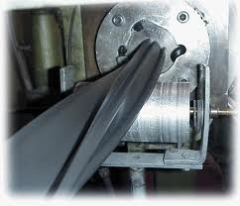
Extrusion
MFG 355

Slide 2
Extrusion

Slide 3
Extrusion System
Cutter/
Winder
Extruder
Water Bath
Puller

Slide 4
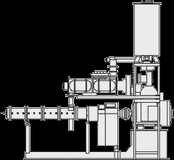
Extruder
Feed
Hopper
Feed throat
Heating zones
Motor
Barrel
Die
Linkage
Thrust bearing

Slide 5
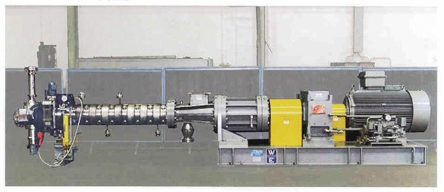
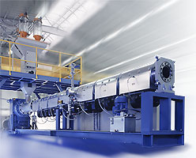
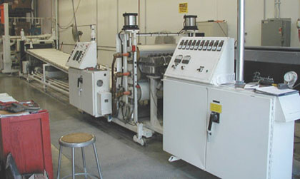
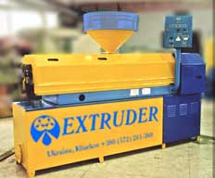
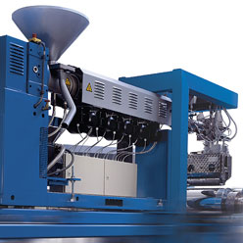
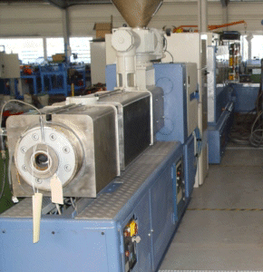
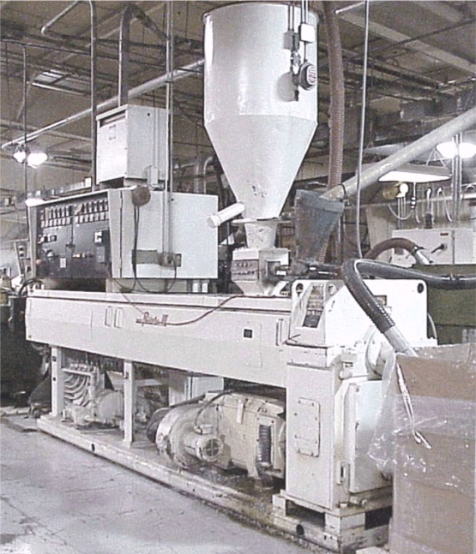
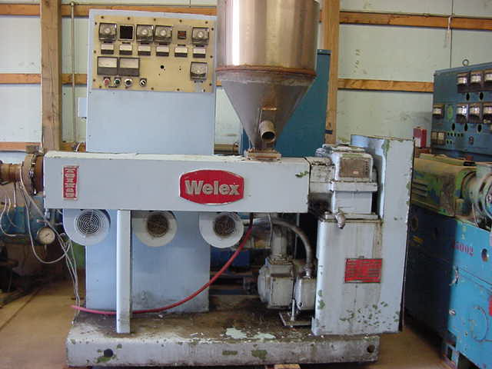
Extruder

Slide 6
Drive Motor
Turns the Screw
Provides power for the process

Slide 7
Thrust Bearing
Prevents the screw from moving backward
Seals off the end of the barrel

Slide 8
Extruder Screw
Connected to drive linkage
Inside barrel
Squeezes the plastic
Moves the plastic

Slide 9
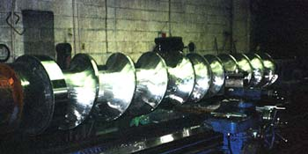
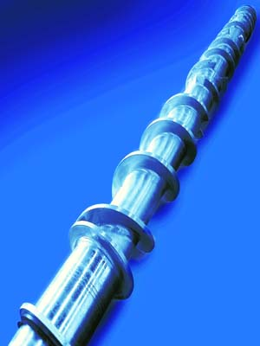
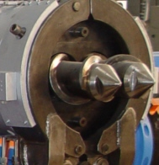
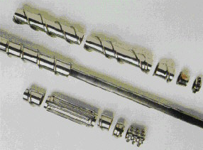
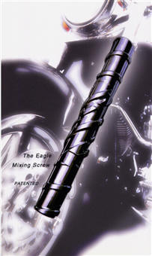
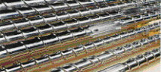
Extrusion Screws

Slide 10
Extrusion Screws

Slide 11
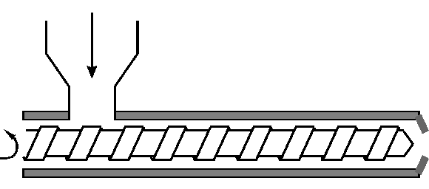
Extrusion Screws
L/D ratio
Relates directly to the extruder’s ability to mix
Typical L/D ratio is 16:1 up to 32:1
Newer machines tend to have higher ratios
Diameter (D)
Length (L)

Slide 12
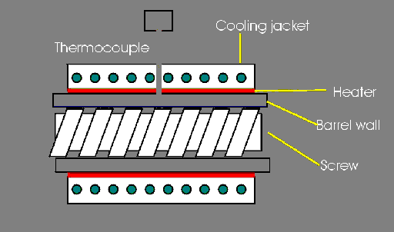
Extrusion Screws

Slide 13
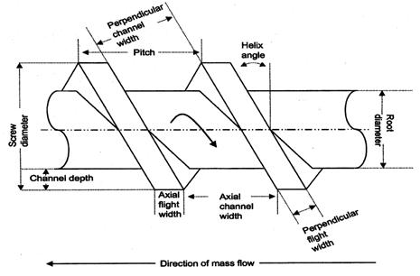
Extrusion Screws
Pitch Angle

Slide 14
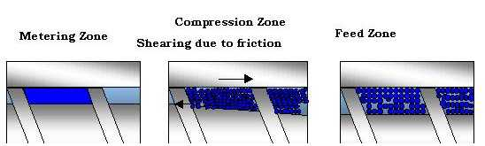
Extrusion Screws
Zones
Shows gaps between barrel and screw root
Material Flow Direction

Slide 15
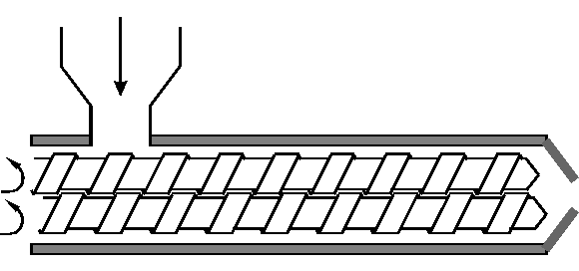
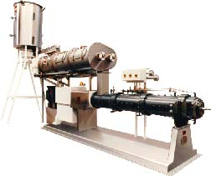
Multi-Screw and Multi-Barrel
Valuable in heat sensitive material processing (PVC)
Increases efficiency in moving material
More positive pumping action

Slide 16
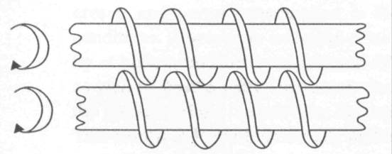
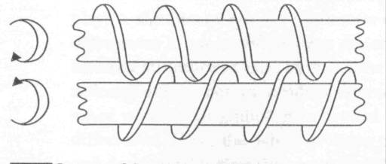
Multi-Screw and Multi-Barrel
Co-Rotating Screws
Counter-Rotating Screws
Advantages and Disadvantages
Co-Rotating Screws
Counter-Rotating Screws

Slide 17
Head Zone
The portion of the machine at the end of the barrel
Holds/contains the die

Slide 18
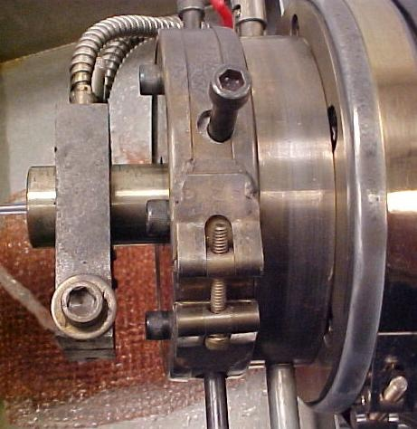
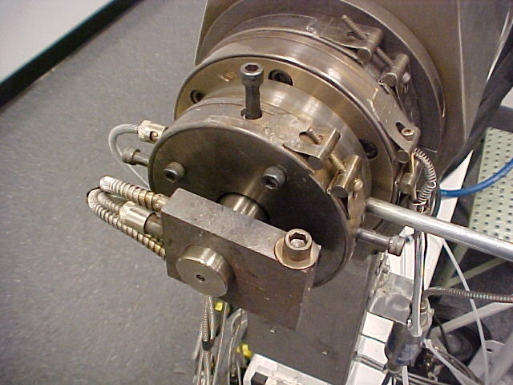
Head Zone

Slide 19
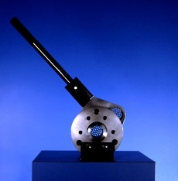
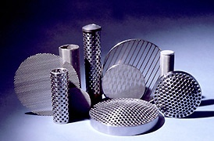
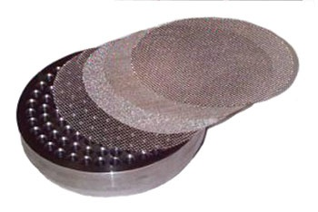
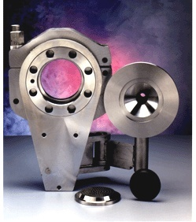
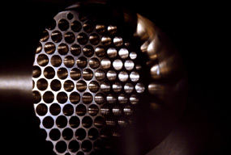
Head Zone
Breaker plate
Screens
Filters
Adaptor
Die mount

Slide 20
Die
The “mold” for the extrusion process

Slide 21
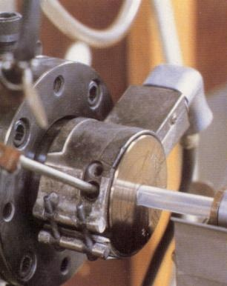
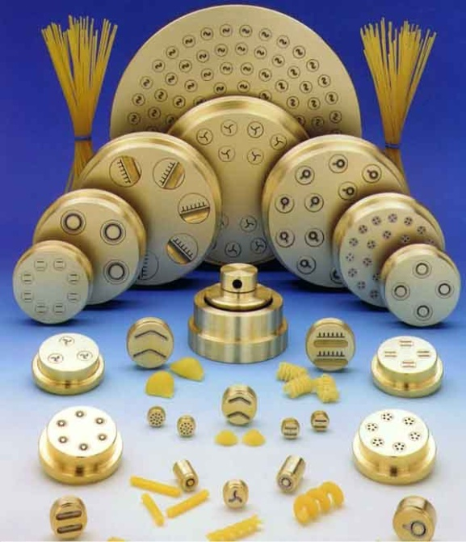
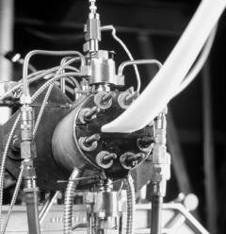
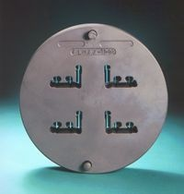
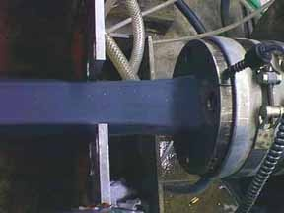
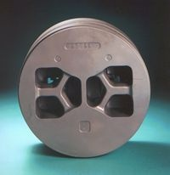
Die
Input (machine) side
Output side

Slide 22
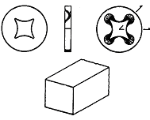
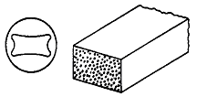
Die
Dies are cut to produce a certain profile
Cutout will probably not match the finished product
Die
Die
Die
Part
Part

Slide 23
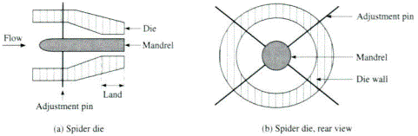
Spider Die
Material Flow

Slide 24
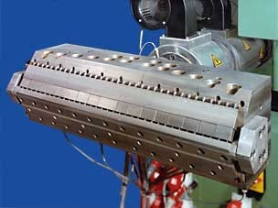
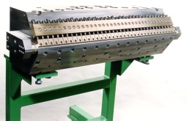
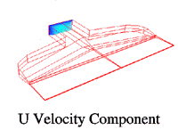
Coat Hanger Dies
Correct flow
Velocity
Distribution

Slide 25
Sheet Extrusion

Slide 26
Wire Coating Dies

Slide 27
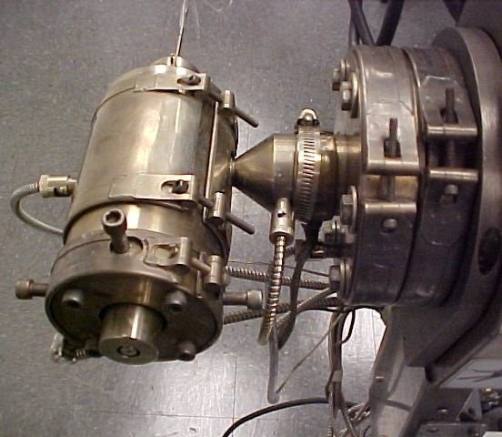
Wire Coating Dies
Bare Wire
Input
Heat Unit
Extruder
Insulated Wire
Output

Slide 28
Dimensional Control
Sizing Plates

Slide 29
Part Dimension Control
Die
Gap/Extrudate swell/Draw down
Sizing plate
Air pressure/Vacuum pressure
Cooling (shrinkage)
Speed of pull
OD
ID
Wall Thickness

Slide 30
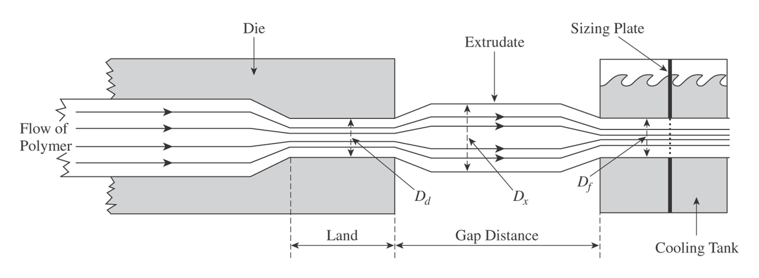
Part Dimension Control
Gap/Extrudate swell/Draw down

Slide 31
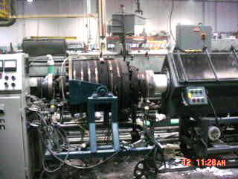
Gap

Slide 32
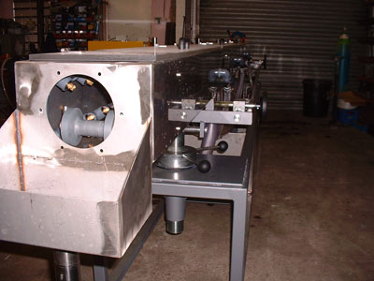
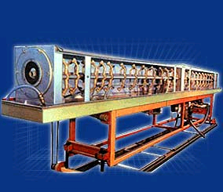
Part Dimension Control
Sizing plate
Air pressure
Cooling (shrinkage)

Slide 33
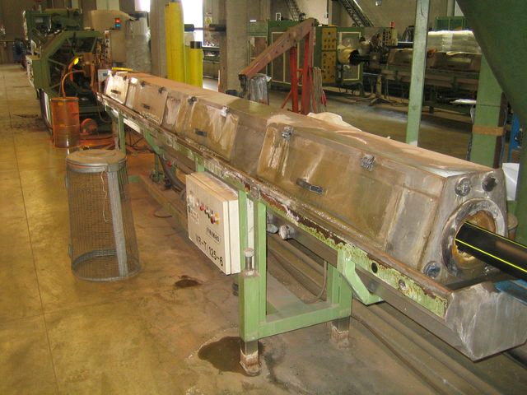
Cooling Tank

Slide 34
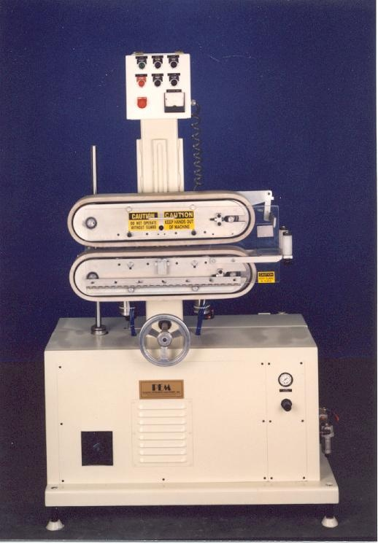
Pullers
Pullers are in contact with cooled material
Pulling quicker will decrease the cross-sectional area of the extrudate

Slide 35
Puller and Printing

Slide 36
Extrusion Plant

Slide 37
Extrusion Plant

Slide 38
Film Blowing
Extrude a “tube” upwards through vertical die
Inflate “tube” till it becomes a film
Collect film and process as needed

Slide 39
Film Blowing

Slide 40
Film Blowing

Slide 41
Film Blowing
Nip Rollers
Sizing Basket
Frost Line
Windup
Extruder
Die/Blower
Assembly

Slide 42
Film Blowing
Film Blowing Systems

Slide 43
Film Blowing
Extruder and Blower

Slide 44
Fiber Extrusion
Extrusion through an extruder
Spun and stretched as filaments exit the die
Twisted/wound and/or taken up on a roll

Slide 45
Fiber Extrusion

Slide 46
Coating of Paper and Fabric
Extrude a film
System of rollers to apply extruded film to paper/fabric
Windup rollers take up coated paper/fabric

Slide 47
Extrusion Cast Coating
Extrude (blow) a film
Feed film into a machine that has other films that are pressed together (heated)

Slide 48
Post Extrusion Forming
Corrugated pipe
Perforated pipe
Bell ended pipe

Slide 49
Coextrusion
Join two streams of molten plastic into one
Separate extruder for each stream (typically)
Allows for multiple layers from different materials

Slide 50
Extrusion Problems
Melt fracture
Sharkskin or alligator hide
Uneven flow and surging
Degradation
Poor mixing
Contamination
Bubbles in extrudate

Slide 51
Melt Fracture
Laminar flow or turbulent flow
Die
Material
Material
Material Flow

Slide 52
Sharkskin or Alligator Hide
Uneven or poor surface finish

Slide 53
Poor Mixing
Streaks of coloration
Particles

Slide 54
Bubbles in the Extrudate
Excessive moisture
Absorbed volatiles
Severe degradation in the presence of moisture
PET, PC, Nylon
Air entrapment

Slide 55
Thank You

