Slide 1
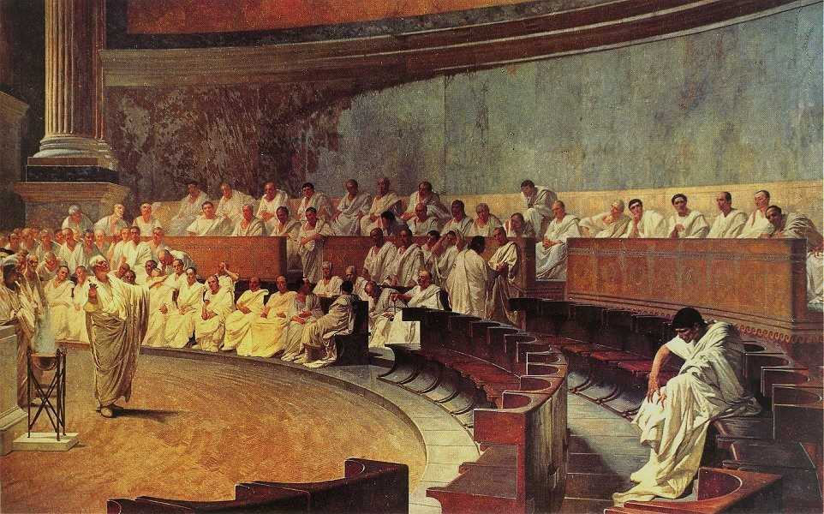
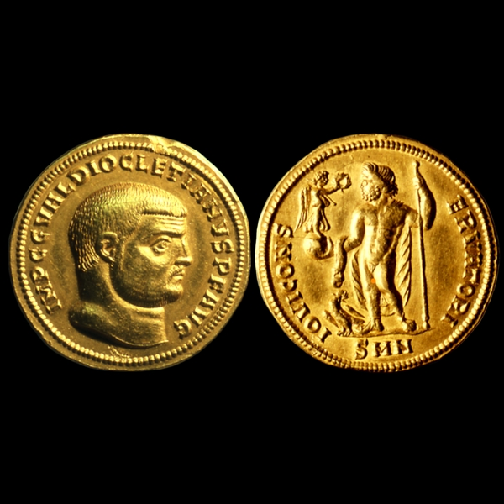
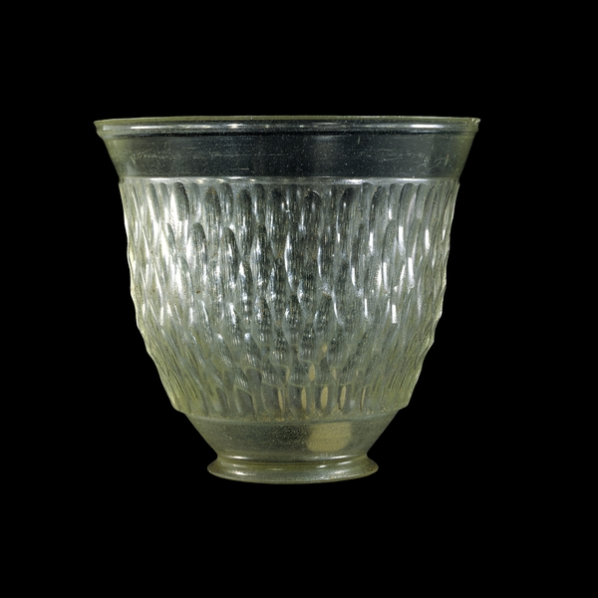
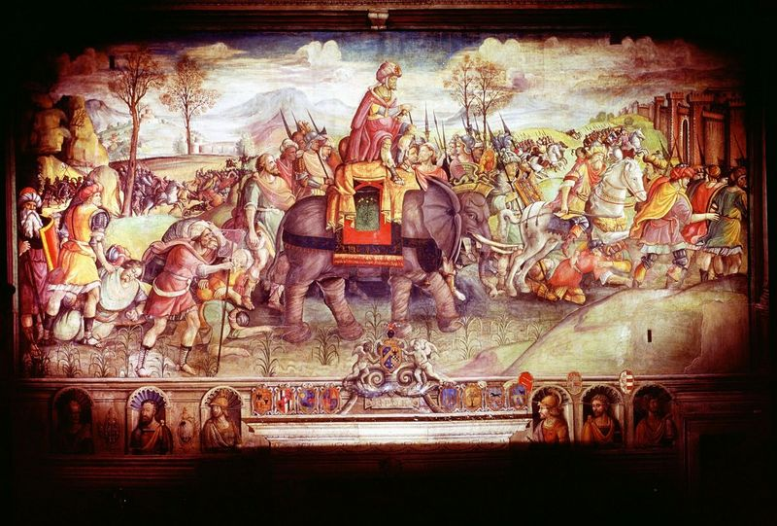
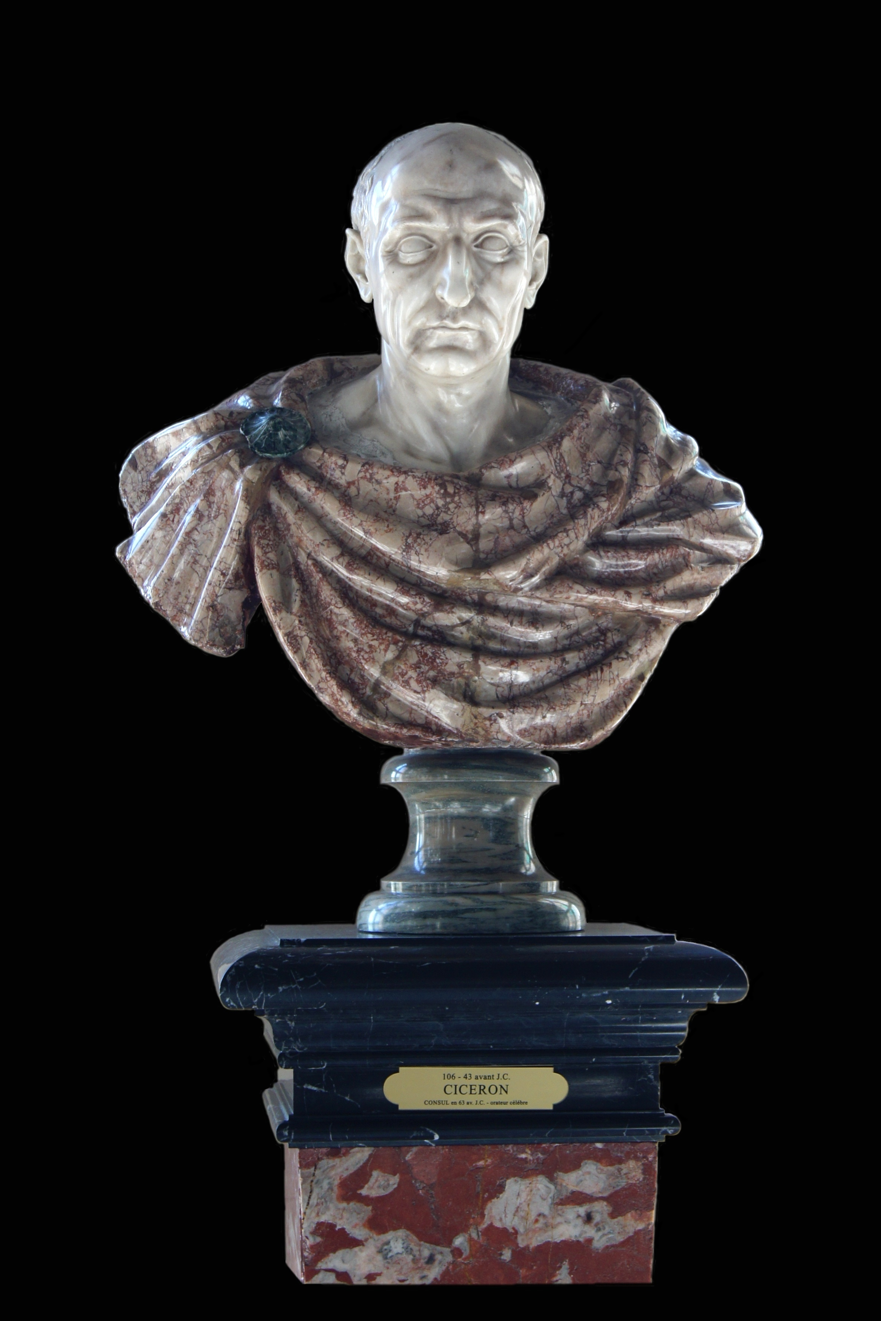
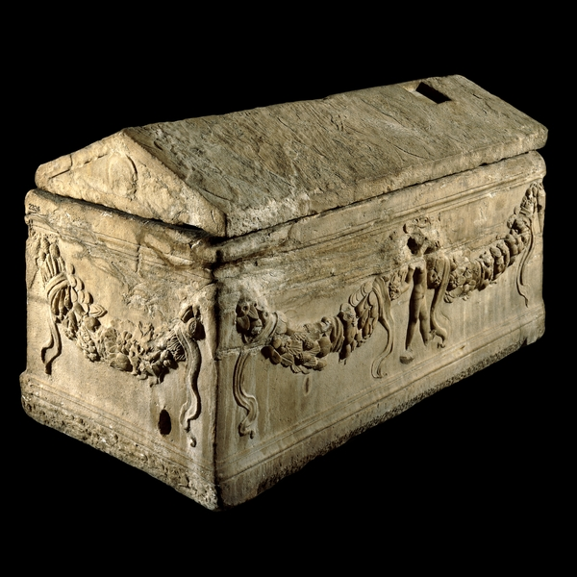
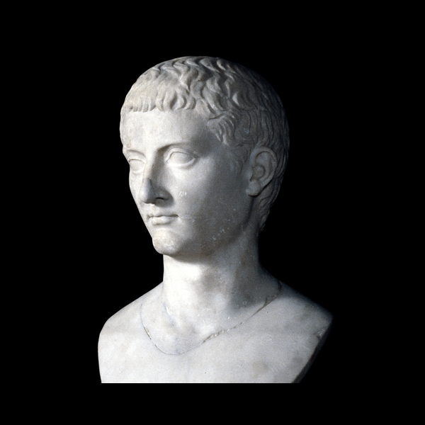
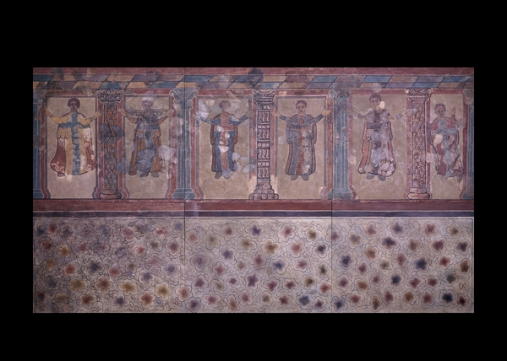
The Roman
Empire

Slide 2
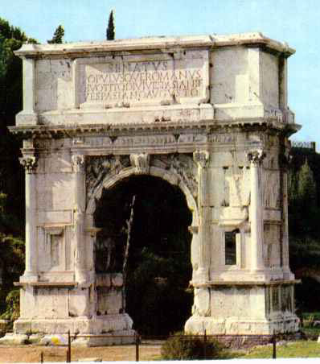
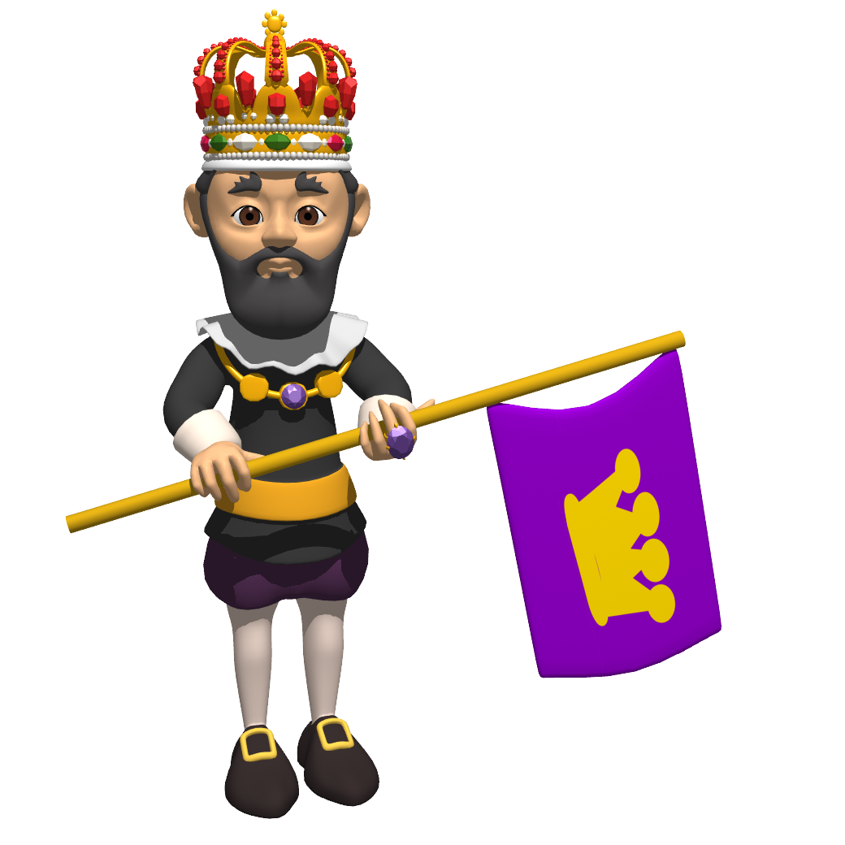
Rule by One Man
The Roman Republic was based on the principle that “there would be no king.”
The Republic began its decline when single rulers became too powerful.
Caesar was killed, in part, because he tried to set himself up as a king.

Slide 3
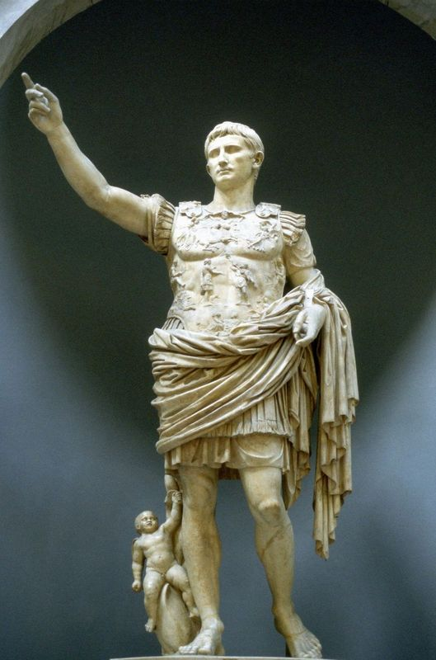
Rule by One Man
It is ironic, then, that the Roman Empire is characterized by rule by single, powerful individuals.
“Good” and “bad” emperors are determined on whether they were good or bad for the empire.

Slide 4
Octavian/Augustus Caesar

Slide 5
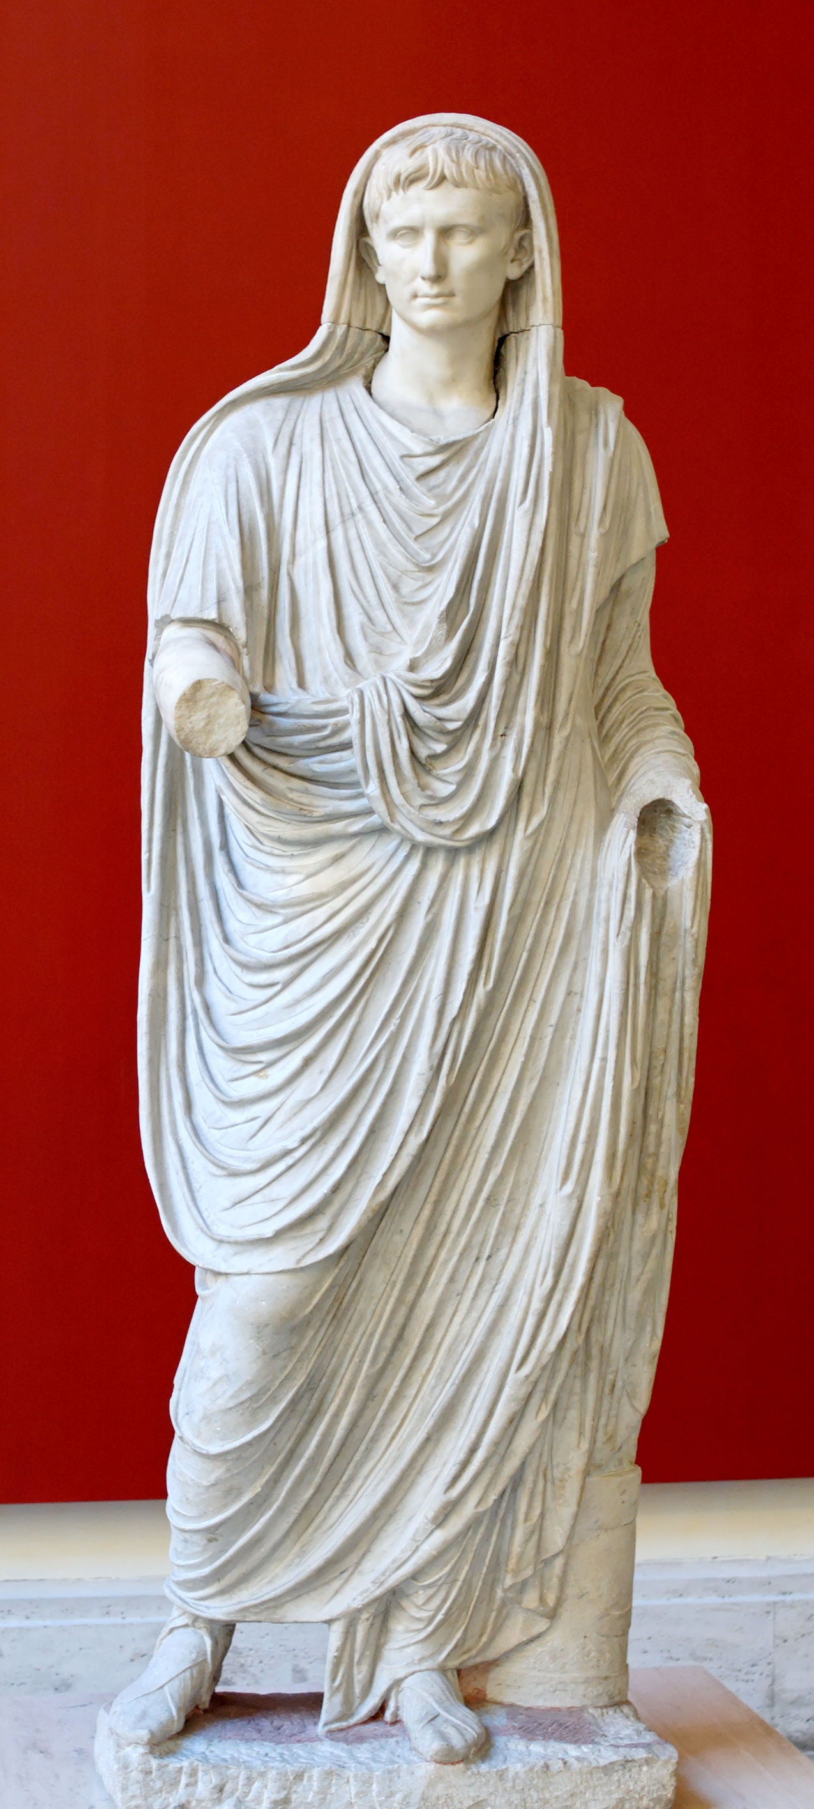
Caesar Augustus
Ruled: 27 BC–AD 14
Octavian, nephew of Julius
Augustus—“the greatest”
Declared to be son of a god
His title for himself: Princeps civitatis
Auctoritas = prestige, power from trust, influence
Discussion
Who else has had this kind of power?
How does a leader get this kind of power?

Slide 6
Caesar Augustus

Slide 7
Time Span Dynasty Rulers
Augustus,
Tiberius,
27 BC–AD 69
Julio-Claudians
Gaius (Caligula),
Claudius,
Nero,
Year of the Four Emperors
69–96
Flavians
Vespasian,
Titus,
Domitian
Nerva,
Trajan,
96–193
Nervan-Antonian
Antoninus Pius,
Marcus Aurelius,
Commodus
193–284
Crisis during the
3rd Century
Many military emperors
284–308
Tetrarchy
Diocletian
308–337
Constantinian
Constantine the Great
Julian the Apostate,
337–476
Post-Constantinian
Theodocius,
Romulus Augustus

Slide 8
Claudius, Aggripina, and Nero

Slide 9
Nero

Slide 10
Time Span Dynasty Rulers
Augustus,
Tiberius,
27 BC–AD 69
Julio-Claudians
Gaius (Caligula),
Claudius,
Nero,
Year of the Four Emperors
69–96
Flavians
Vespasian,
Titus,
Domitian
Nerva,
Trajan,
96–193
Nervan-Antonian
Antoninus Pius,
Marcus Aurelius,
Commodus
193–284
Crisis during the
3rd Century
Many military emperors
284–308
Tetrarchy
Diocletian
308–337
Constantinian
Constantine the Great
Julian the Apostate,
337–476
Post-Constantinian
Theodocius,
Romulus Augustus

Slide 11
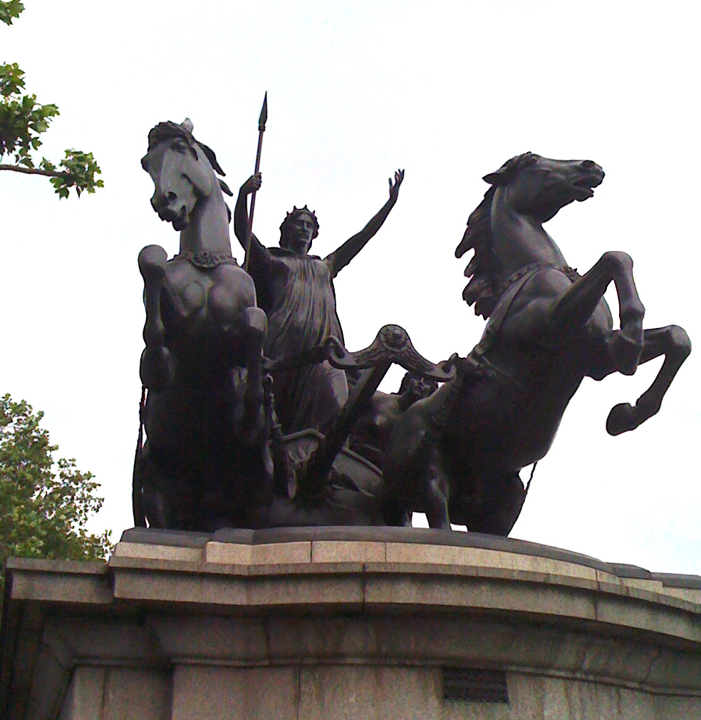
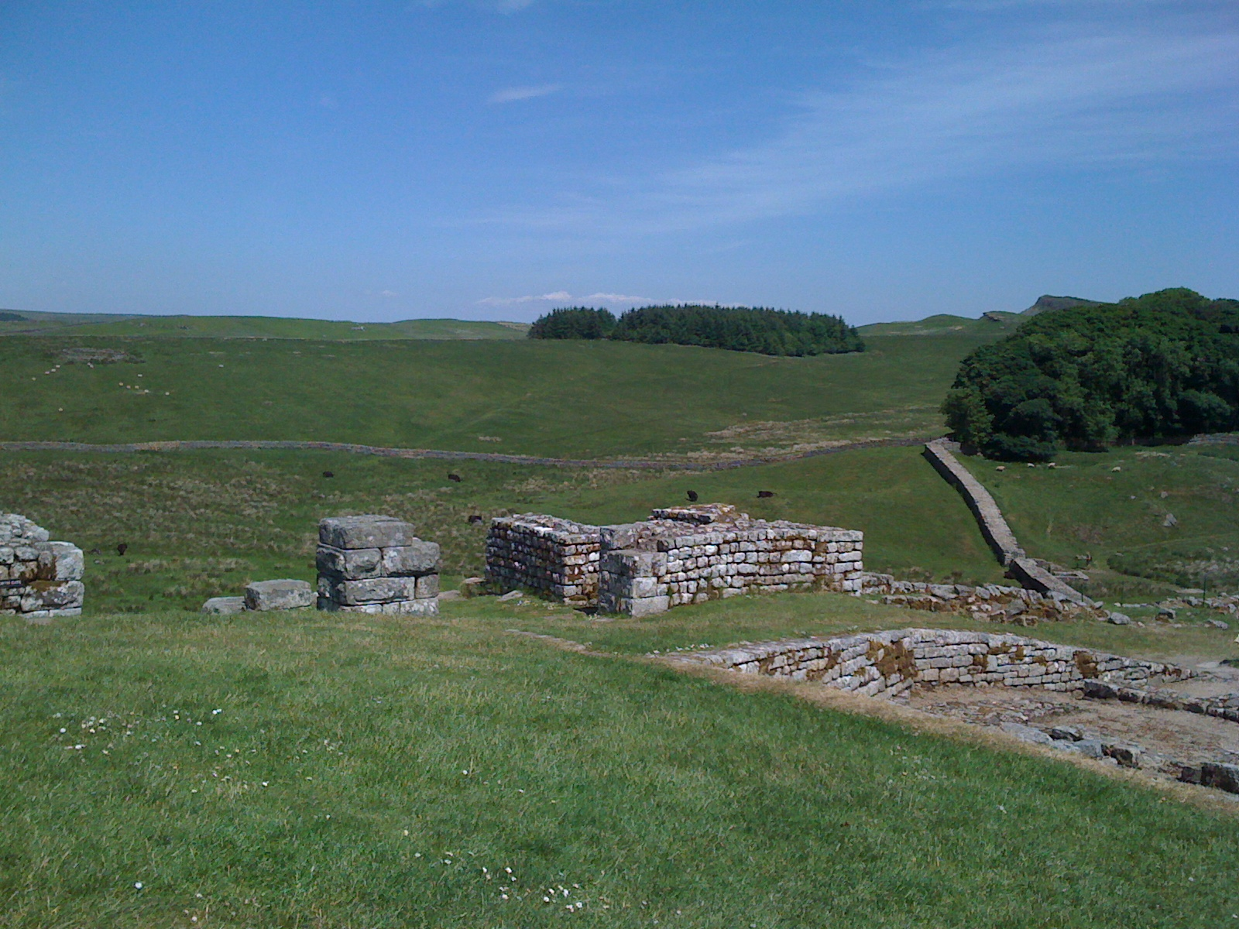
Flavians
Military leaders
Brought stability after the “crazies” of the late Julio-Claudians
Great expansion of the Empire
Resistance
Britain (farthest frontier)

Slide 12
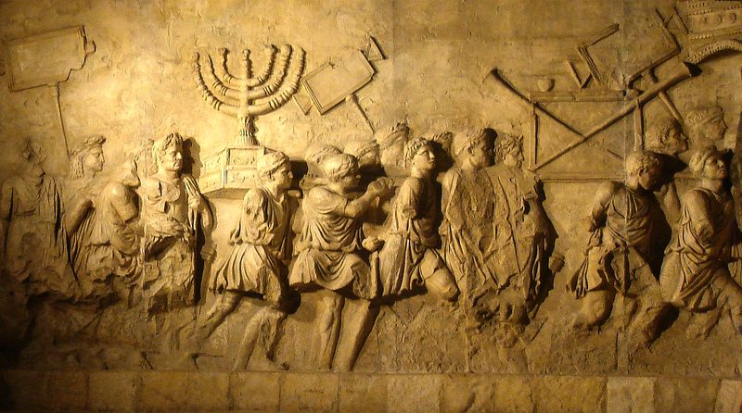
Flavians
Put down the revolts of the Jews

Slide 13
Time Span Dynasty Rulers
Augustus,
Tiberius,
27 BC–AD 69
Julio-Claudians
Gaius (Caligula),
Claudius,
Nero,
Year of the Four Emperors
69–96
Flavians
Vespasian,
Titus,
Domitian
Nerva,
Trajan,
96–193
Nervan-Antonian
Antoninus Pius,
Marcus Aurelius,
Commodus
193–284
Crisis during the
3rd Century
Many military emperors
284–308
Tetrarchy
Diocletian
308–337
Constantinian
Constantine the Great
Julian the Apostate,
337–476
Post-Constantinian
Theodocius,
Romulus Augustus

Slide 14
The Golden Age: Nervan-Antonian

Slide 15
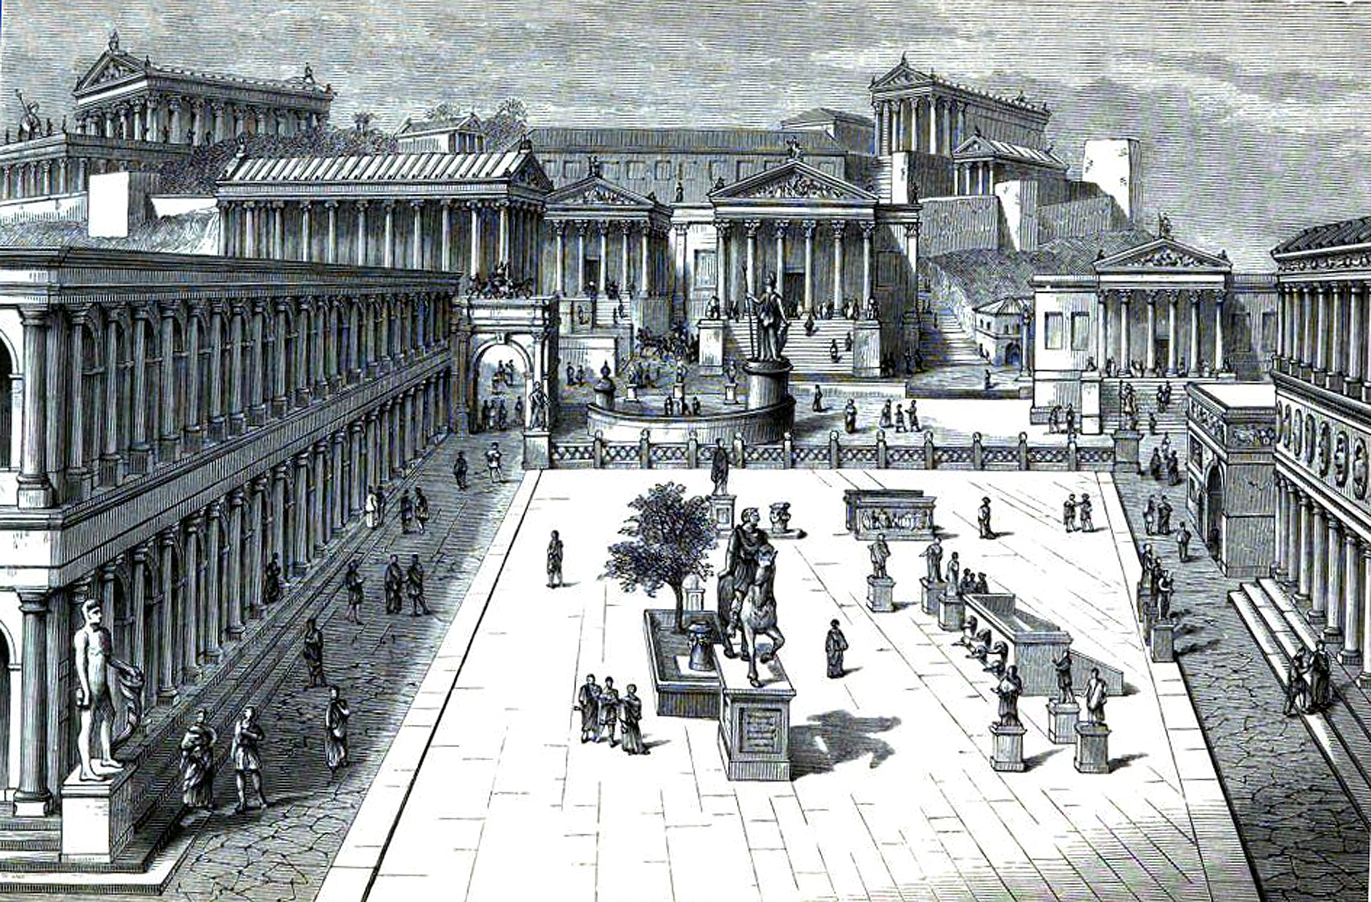
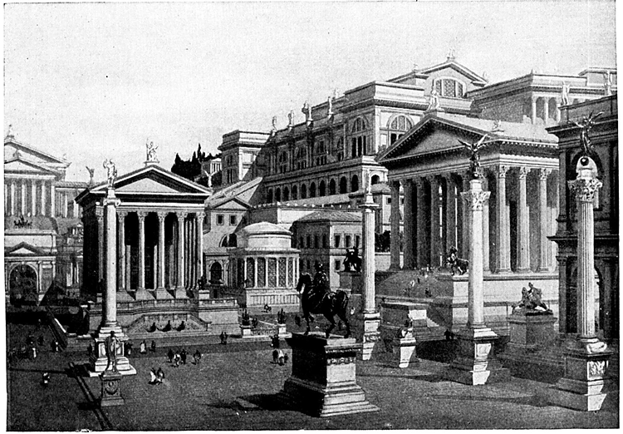
The Golden Age (Nervan-Antonian)
Life in the Golden Age
Rome was the largest
city (perhaps 1 million)
Prosperity through trade and population expansion
Strong Stoicism

Slide 16
The Golden Age (Nervan-Antonian)

Slide 17
Time Span Dynasty Rulers
Augustus,
Tiberius,
27 BC–AD 69
Julio-Claudians
Gaius (Caligula),
Claudius,
Nero,
Year of the Four Emperors
69–96
Flavians
Vespasian,
Titus,
Domitian
Nerva,
Trajan,
96–193
Nervan-Antonian
Antoninus Pius,
Marcus Aurelius,
Commodus
193–284
Crisis during the
3rd Century
Many military emperors
284–308
Tetrarchy
Diocletian
308–337
Constantinian
Constantine the Great
Julian the Apostate,
337–476
Post-Constantinian
Theodocius,
Romulus Augustus

Slide 18
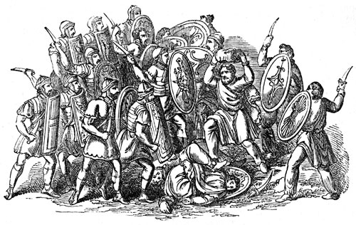
Third Century Disaster
Near collapse of the empire
Military-oriented emperors
Threat from consolidated Germans
24 emperors and 24 claimants/usurpers
45 killed by assassination
(usually by their own troops)
1 died in battle
1 died in captivity
1 died of plague
Name of a Caesar reflects self-importance

Slide 19
Title Crazy
“Emperor Caesar Galerius Valerius Maximianus Invictus Augustus, Pontifex Maximus, Germanicus Maximus, Egyptiacus Maximus, Thebaicus Maximus, Sarmaticus Maximus five times, Persicus Maximus twice, Carpicus Maximus, Holder of Tribunician Authority for the twentieth time, Imperator for the nineteenth, Consul for the eighth, Pater Patriae, Proconsul.”

Slide 20
Time Span Dynasty Rulers
Augustus,
Tiberius,
27 BC–AD 69
Julio-Claudians
Gaius (Caligula),
Claudius,
Nero,
Year of the Four Emperors
69–96
Flavians
Vespasian,
Titus,
Domitian
Nerva,
Trajan,
96–193
Nervan-Antonian
Antoninus Pius,
Marcus Aurelius,
Commodus
193–284
Crisis during the
3rd Century
Many military emperors
284–308
Tetrarchy
Diocletian
308–337
Constantinian
Constantine the Great
Julian the Apostate,
337–476
Post-Constantinian
Theodocius,
Romulus Augustus

Slide 21
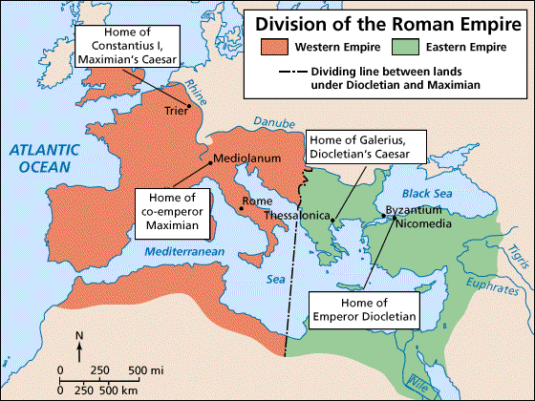
Tetrarchy
Divided the empire
Stabilized the empire
Tetrarchy (4 rulers)
Office: Augustus
Diocletian: east
Maximian: west
Office: Caesar
two ruled from different cities
Trier
Thessalonica
Diocletian retired and forced Maximian to retire
Chaos followed

Slide 22
Time Span Dynasty Rulers
Augustus,
Tiberius,
27 BC–AD 69
Julio-Claudians
Gaius (Caligula),
Claudius,
Nero,
Year of the Four Emperors
69–96
Flavians
Vespasian,
Titus,
Domitian
Nerva,
Trajan,
96–193
Nervan-Antonian
Antoninus Pius,
Marcus Aurelius,
Commodus
193–284
Crisis during the
3rd Century
Many military emperors
284–308
Tetrarchy
Diocletian
308–337
Constantinian
Constantine the Great
Julian the Apostate,
337–476
Post-Constantinian
Theodocius,
Romulus Augustus

Slide 23
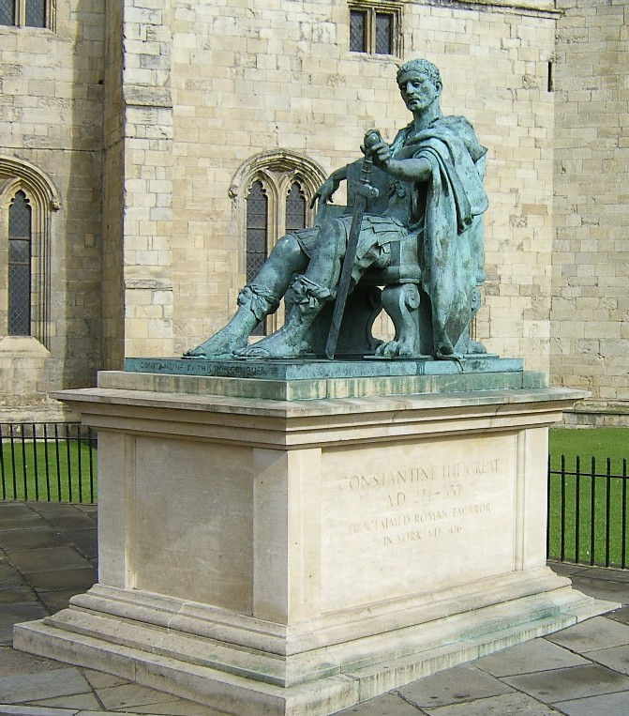
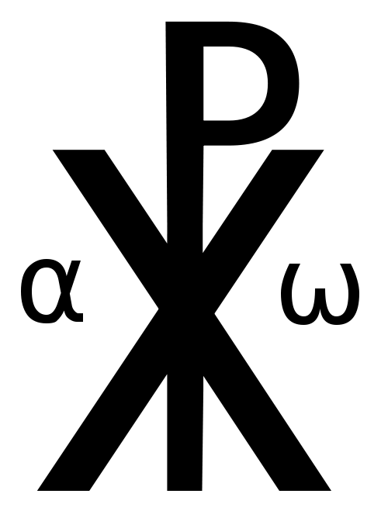
Constantine
Fought wars to decide emperor
Vision of a burning Christian symbol (chi-rho)
United the troops
Gave them courage that "a god" wanted them to win

Slide 24
Constantine at Milvian Bridge

Slide 25
Constantine
Acceptance of Christianity
Edict of Milan
Ruled all but divided for administrative purposes
New capital = Constantinople (Nova Roma)
Built on ancient site
(Byzantium)
Western capital = Milan (trade)
Later capital = Ravenna (port)
West Roman Empire
East Roman Empire

Slide 26
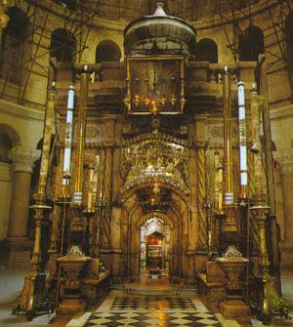
Constantine
Favored Christianity
Constantine’s mother (St. Helena) visited the Holy Land and picked out places where she thought special events occurred
Hill of Calvary and Christ’s tomb = Church of the Holy Spulcher
Fragment of the “True Cross”
Christ’s tomb?

Slide 27
Time Span Dynasty Rulers
Augustus,
Tiberius,
27 BC–AD 69
Julio-Claudians
Gaius (Caligula),
Claudius,
Nero,
Year of the Four Emperors
69–96
Flavians
Vespasian,
Titus,
Domitian
Nerva,
Trajan,
96–193
Nervan-Antonian
Antoninus Pius,
Marcus Aurelius,
Commodus
193–284
Crisis during the
3rd Century
Many military emperors
284–308
Tetrarchy
Diocletian
308–337
Constantinian
Constantine the Great
Julian the Apostate,
337–476
Post-Constantinian
Theodocius,
Romulus Augustus

Slide 28
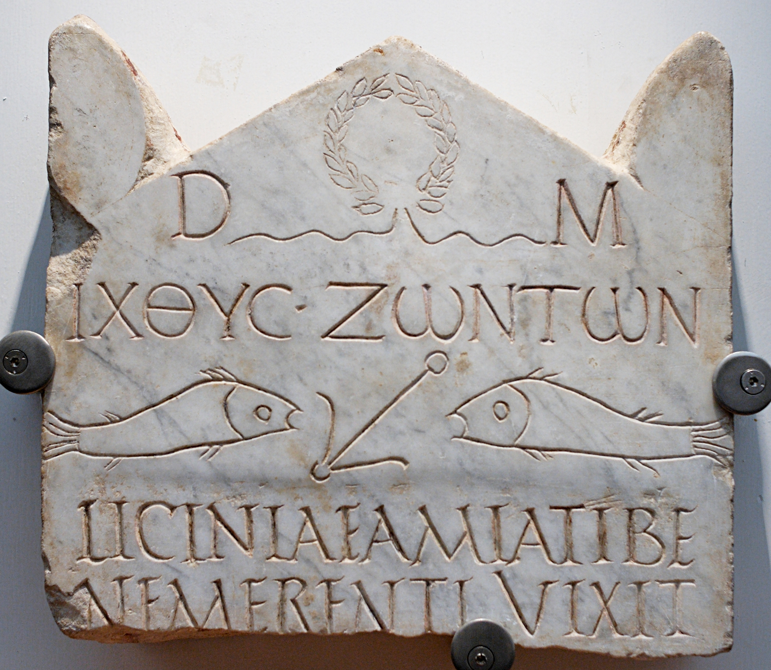
Post-Constantinian
All emperors, except one, were Christian.
Gibbons, in Decline and Fall of the Roman Empire, says that the fall came because these emperors were confused over the concept of Christian love versus the need for military power.

Slide 29
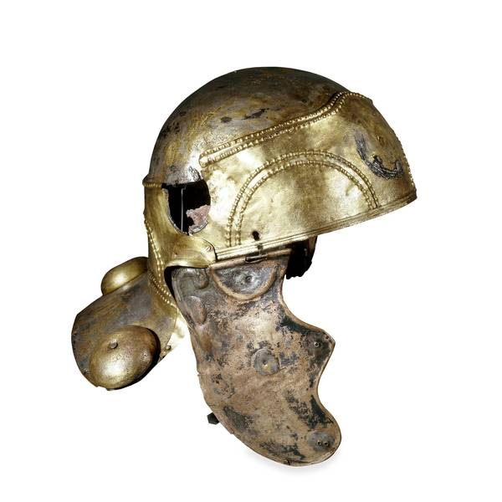
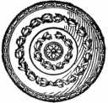
Post-Constantinian
Romans stopped joining the army and so mercenaries were used instead.
The empire did not expand and therefore the army became merely a job and not a way to advance in society.

Slide 30
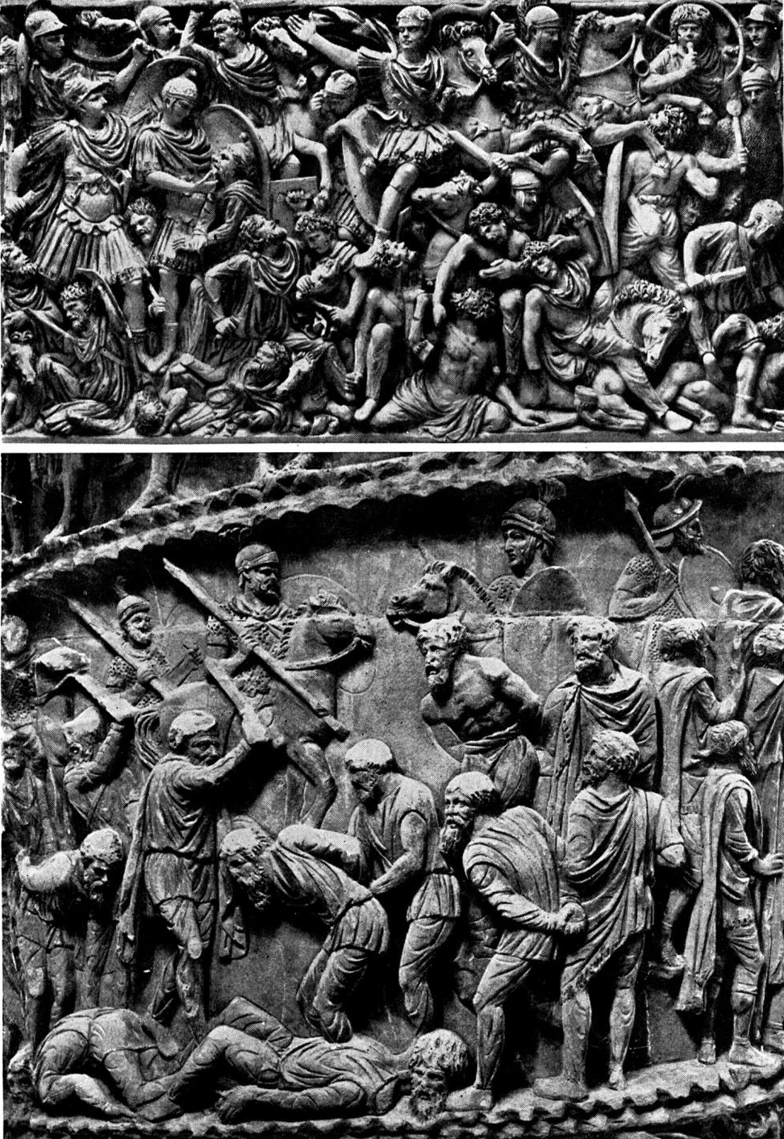
Post-Constantinian
Germans invaded successfully in the West.
Army was not able to defeat the greater numbers and greater desire to win
Many of the mercenaries were also German

Slide 31
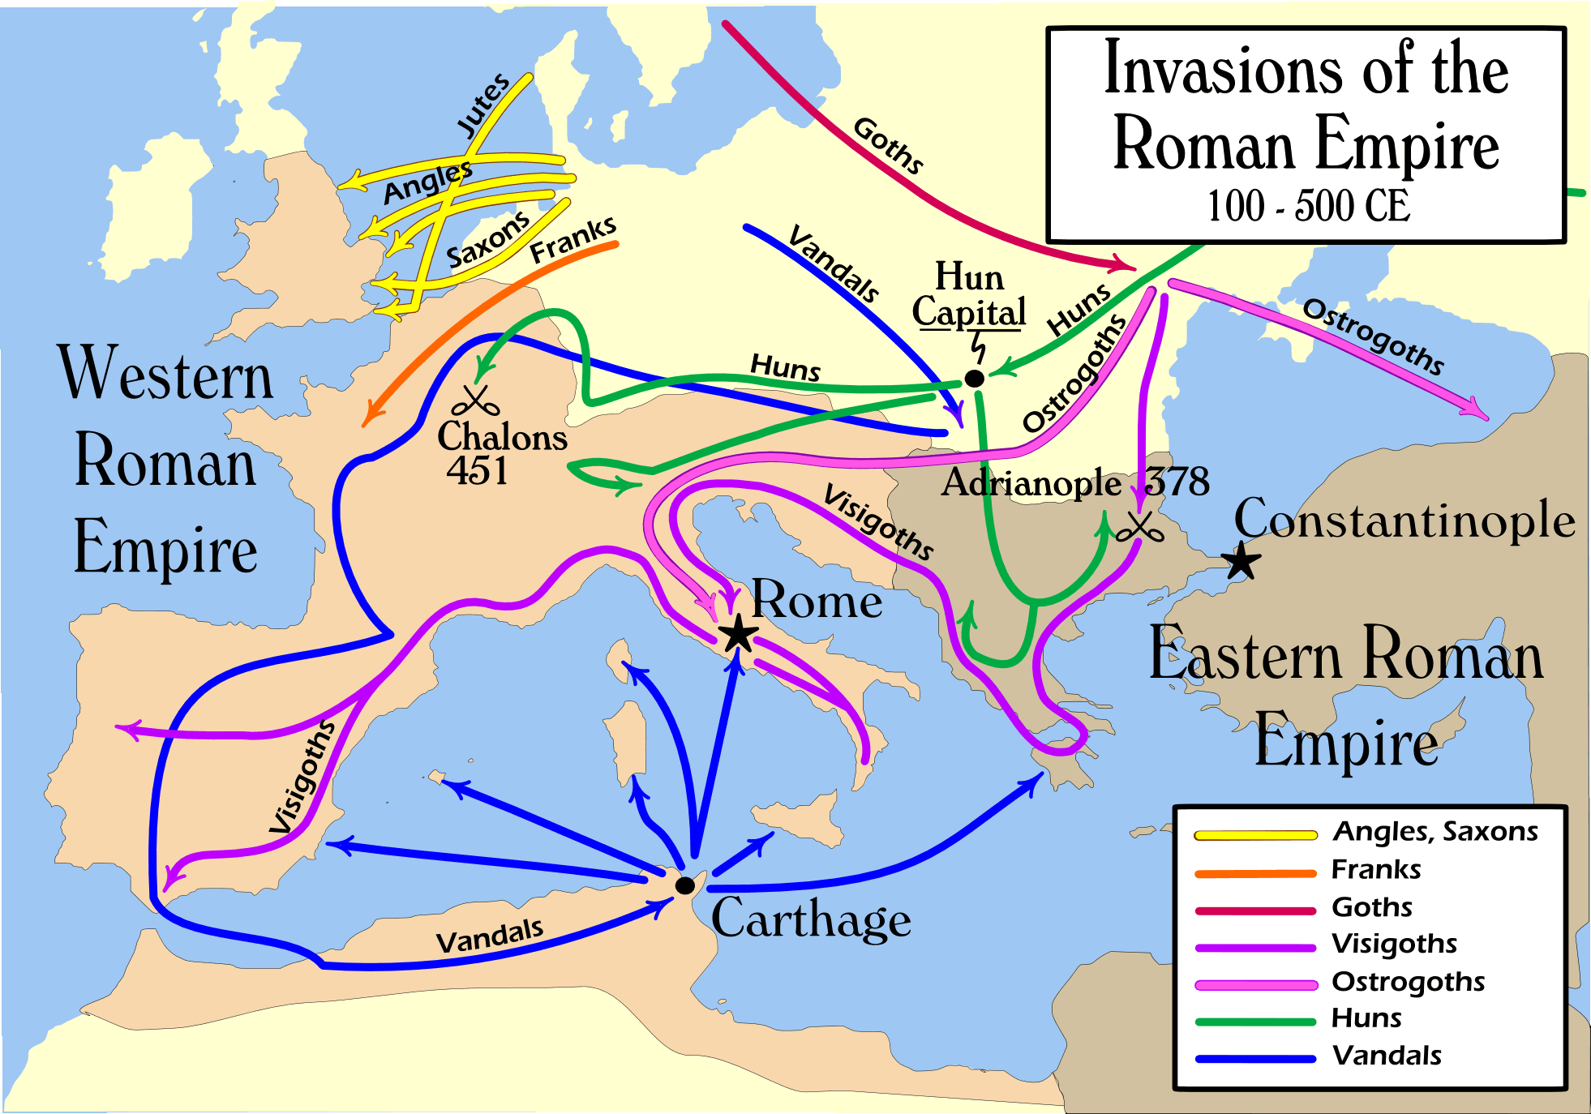
Barbarian Invasions

Slide 32
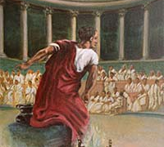
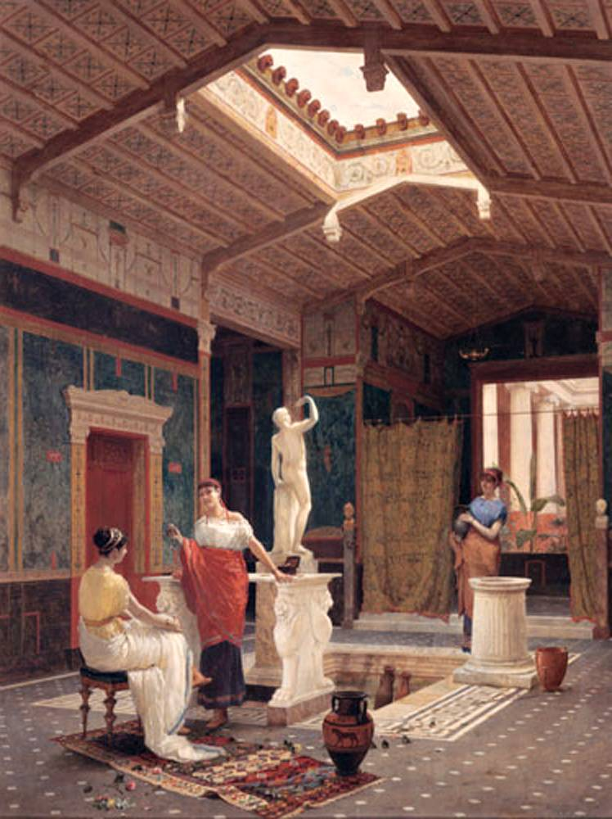
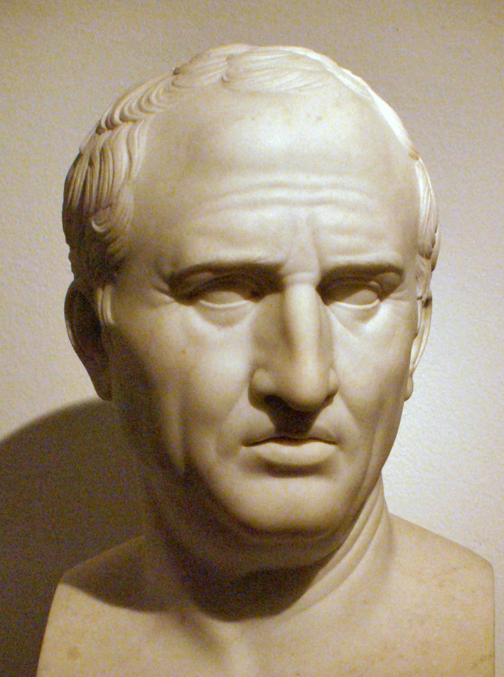
How Rome Succeeded
Discussion
What led to Roman success?
Kept their empire (military discipline)
Passion for the legal system
Stability
Fairness in Roman law
Inclusion
Gave citizenship
Granted land
Appealing lifestyle
Strong leaders

Slide 33
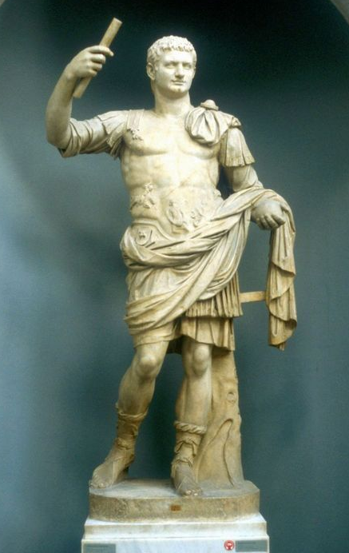
How Rome Failed
Discussion
What caused Rome to ultimately fail?
Loss of good leaders
Loss of values
Reliance on mercenaries

Slide 34
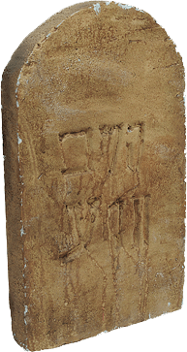
How Rome Failed
A close study of each of these dead civilizations indicates that they usually started on their road to glory because of fortuitous circumstances exploited by a strong, inspiring leader. The nation then carried on for a period under its own momentum. Finally, creeping vanity led the people to become enamored of their undisputed superiority; they became so impressed with their past achievements that they lost interest in working for further change. Soon their sons, coddled in the use of all the great things their fathers and grandfathers had pioneered, became as helpless as new-born babes when faced with the harsh reality of an aggressive and changing world.
—Eugene K. Von Fange, Professional Creativity

Slide 35
How Rome Failed
A close study of each of these dead civilizations indicates that they usually started on their road to glory because of fortuitous circumstances exploited by a strong, inspiring leader. The nation then carried on for a period under its own momentum. Finally, creeping vanity led the people to become enamored of their undisputed superiority; they became so impressed with their past achievements that they lost interest in working for further change. Soon their sons, coddled in the use of all the great things their fathers and grandfathers had pioneered, became as helpless as new-born babes when faced with the harsh reality of an aggressive and changing world.
—Eugene K. Von Fange, Professional Creativity

Slide 36
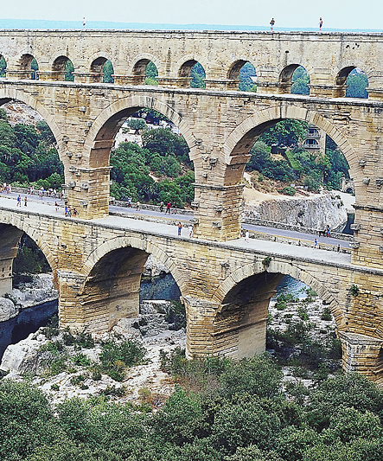
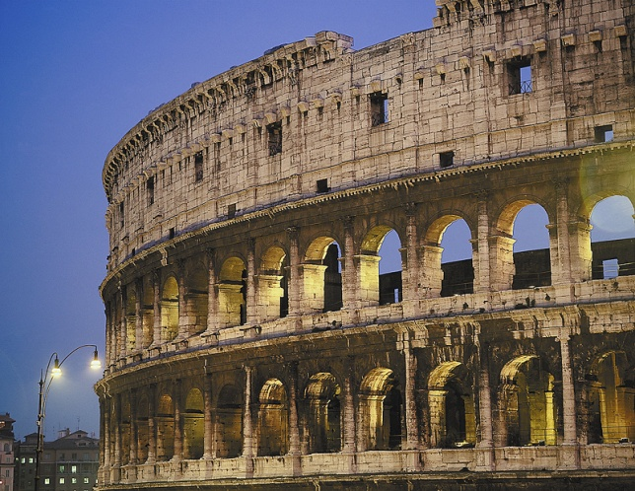
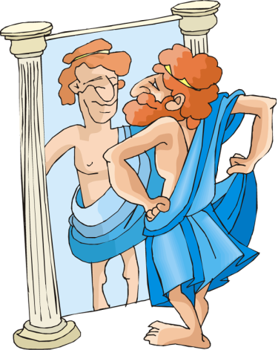
The Legacy
Lessons from the fall
Highly materialistic
Excited by travel, news, and entertainment
Success gauged by power
Greed and pride accepted
Lost desire for the values on which the Republic was founded
Preoccupied with personal appearance

Slide 37
Keep Creative
Values
Thank You

