Slide 1
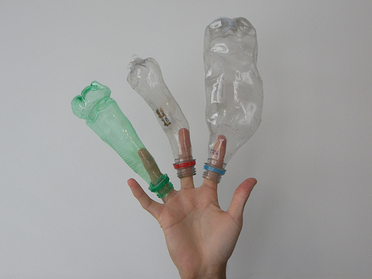
Blow Molding
MFG 355

Slide 2
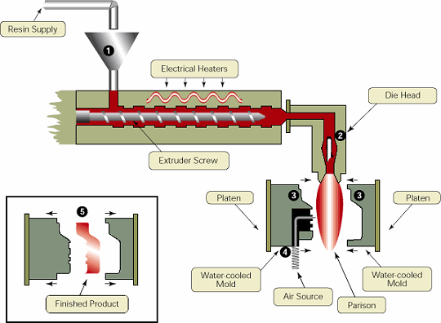
Extrusion Blow Molding

Slide 3
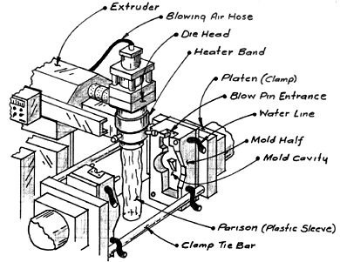
Basic Blow Molding Extrusion Head

Slide 4
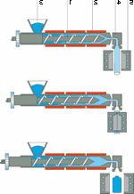
Extrusion Blow Molding
Parison
Mold Open
Mold Closed
Pressurization of Parison
Mold Open
Cooled Part

Slide 5
Extrusion Blow Molding

Slide 6
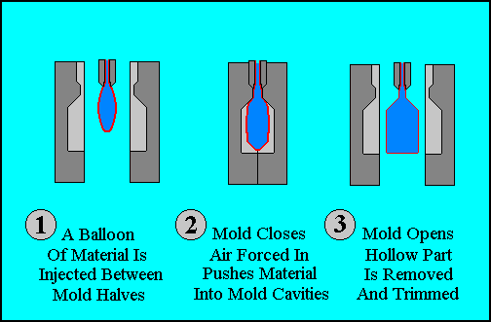
Blowing Sequence

Slide 7
Extrusion Blow Molding Swing Mold
No sound

Slide 8
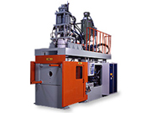
Extrusion Blow Molding with Accumulator
Accumulator

Slide 9
Large Mold Using Accumulator
No sound

Slide 10
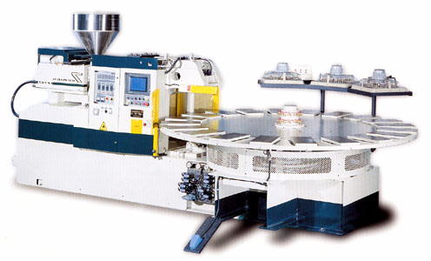
Circular Blow Molding Machine

Slide 11
Injection Blow Molding
Preform is injection molded
Preform is placed in the blow molding machine
Preform is heated
Preform is pressurized
Part is removed
PET Preform

Slide 12
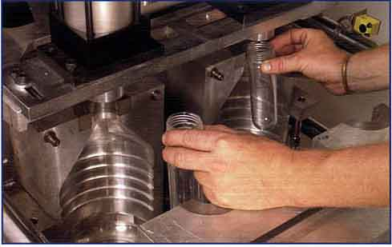
Preforms Placed in Mold

Slide 13
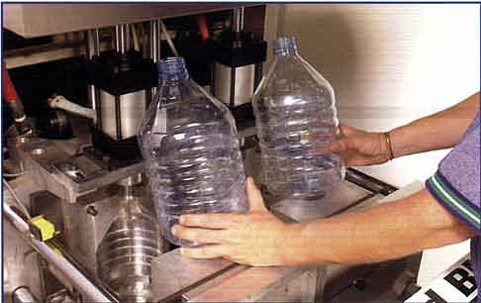
Formed Bottles

Slide 14
Injection Blow Molding
No sound

Slide 15
Molds and Dies
General die and mold considerations (for injecting the preforms)
Tool steel
Multicavity

Slide 16
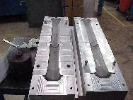
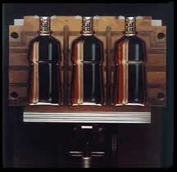
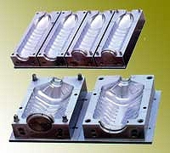
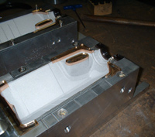
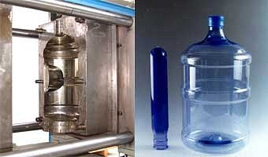
General Mold Considerations (for the mold in which the part is blown)
Blow molding is lower pressure that injection molding
Blow molding molds don’t have the strength requirements
Aluminum molds are most common
Machined or cast
Venting
Symmetry

Slide 17
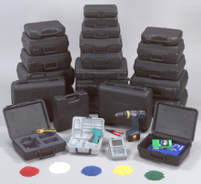
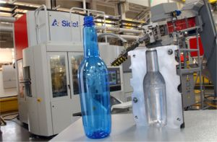
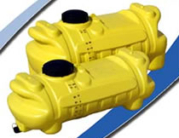
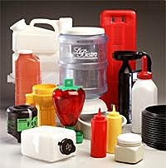
Other Blow Molded Parts

Slide 18
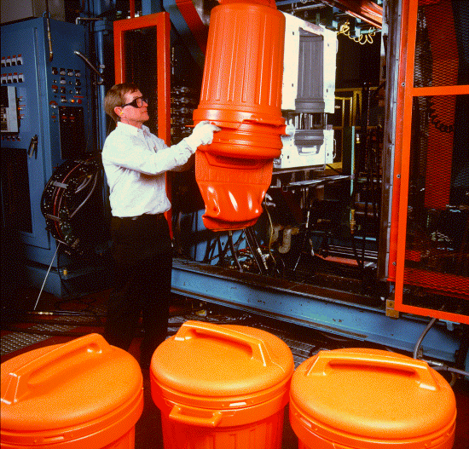
Plant Concepts
No extensive cooling needed
Scrap removal and handling important
Needs to be
removed
Photo Courtesy of Phillips Petroleum Company

Slide 19
Flash Removal
No sound

Slide 20
Material Considerations
Most thermoplastics can be blow molded (in theory)
High melt strength is necessary
Polyolefins are the easiest to process
PVC is temperature sensitive
Some materials require Coblow-Molding

Slide 21
Shapes
Basically hollow
Typically of a cubic or cylindrical shape
Bottles, barrels, tanks, ducts, trash carts, flower pots, double wall cases (for tools), and toys
Care must be taken to not have corners that are too thin
Threads for caps are typically not of the highest tolerance
Handles can be made using pinch points in the mold

Slide 22
Shapes
Mold Diameter
Blow Ratio=
Parison Diameter

Slide 23
Thank You

