Slide 1
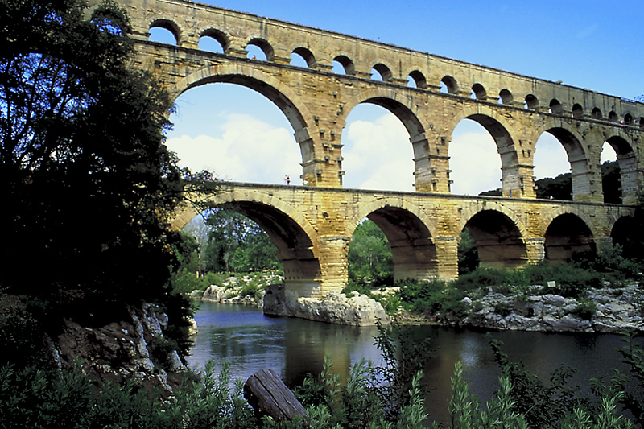
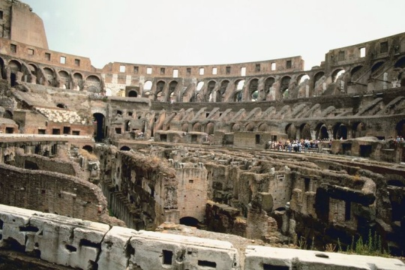
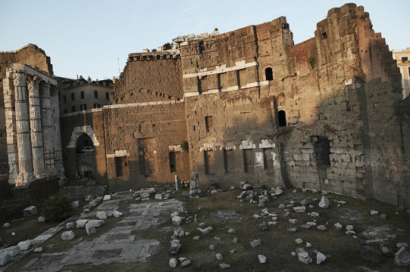
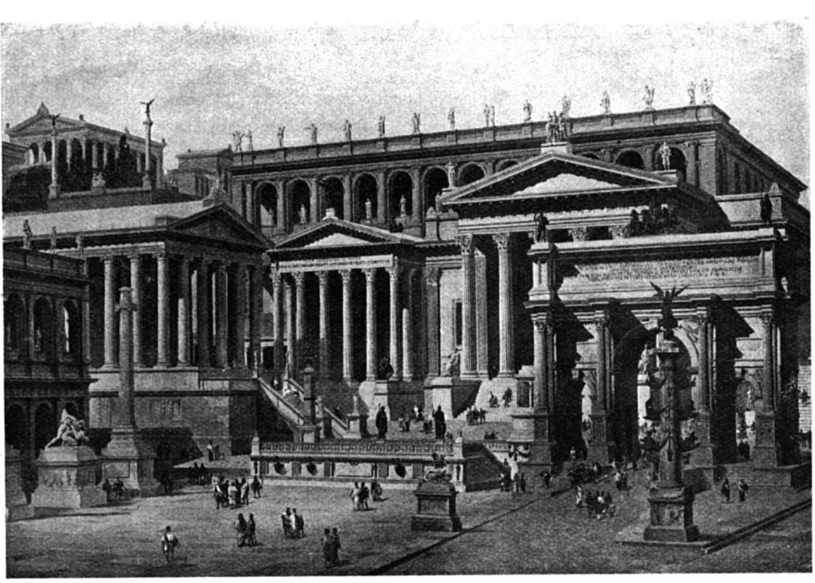
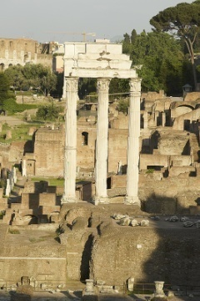
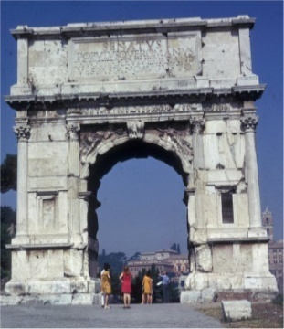
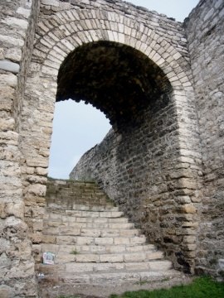
Roman Science, Technology, and Art

Slide 2
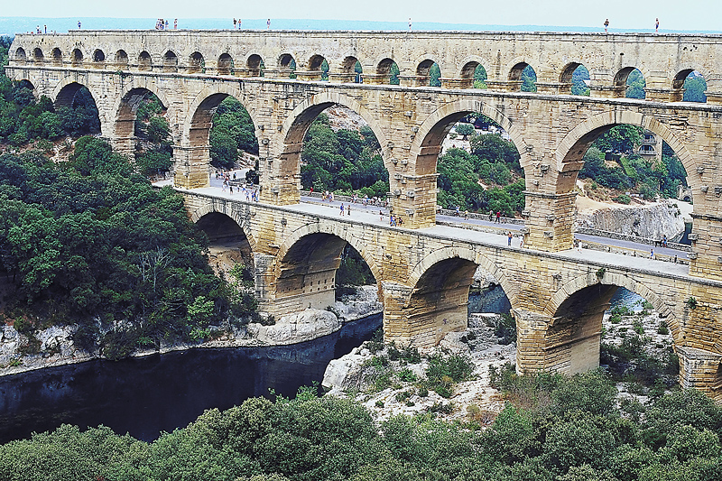
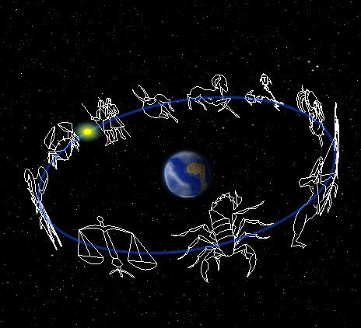
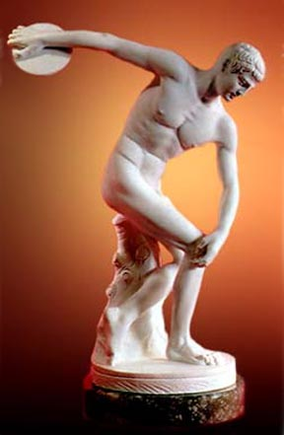
Cultural Background
Questions asked by various cultures:
What is out there? (Egyptians/Mesopotamians)
Why does it exist? (Greeks)
What is it good for? (Romans)

Slide 3
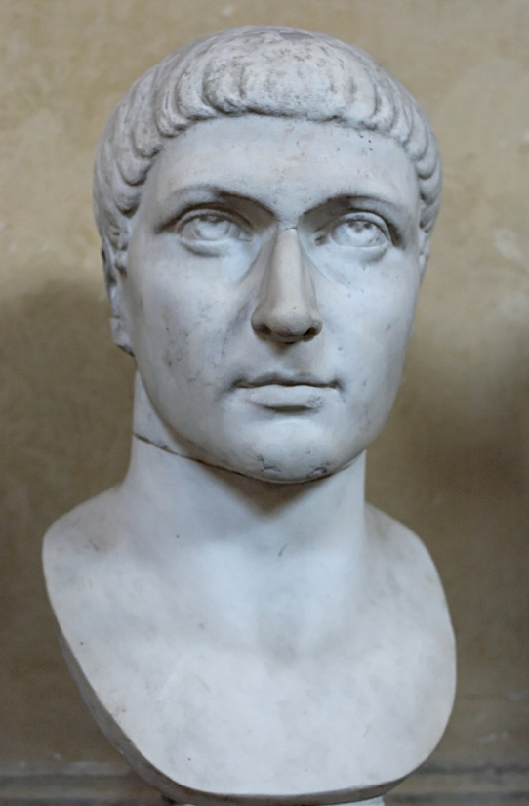
Architecture and Engineering
We need as many engineers as possible. As there is a lack of them, invite to this study persons of about 18 years who have already studied the necessary sciences. Relieve the parents of taxes and grant [them] sufficient means.
—Emperor Constantine
Caesar’s bridge, an example of Roman engineering prowess.

Slide 4
Caesar’s Bridge

Slide 5
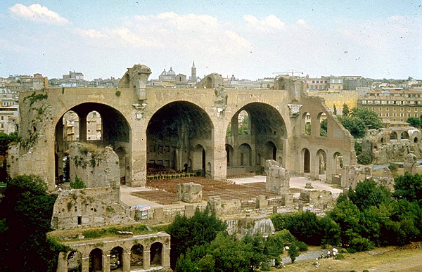
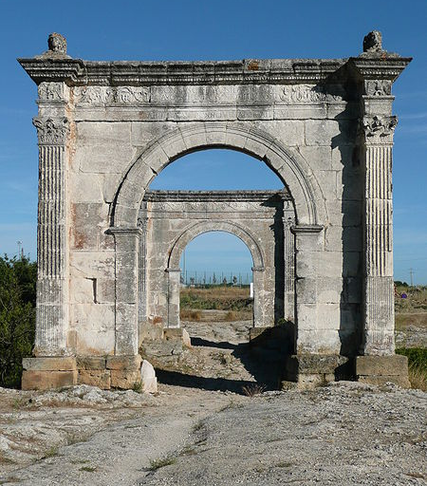
Roman engineering strengths
Organization and discipline
Borrowing concepts
Example: Arches
Long term view and vision of the whole endeavor

Slide 6
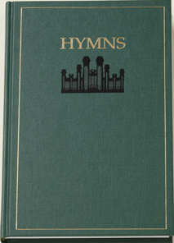
Construction
Rules for the project
(Bridges made only from cereal boxes)
Using only a single cereal box, construct a structure that will support the most 6″ x 9″ books, approximately 1″ thick.
The structure must be at least 4 inches high (that is, the books must be 4 inches off the table).
Which of the bridges do you think will support the most books?

Slide 7
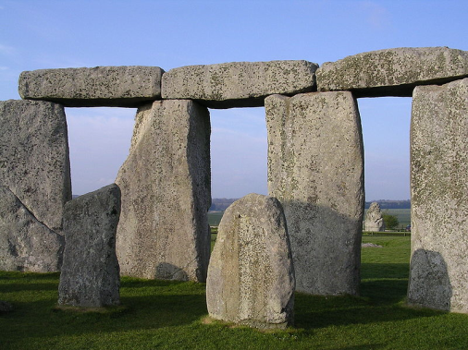
Post and Lintel Forces

Slide 8
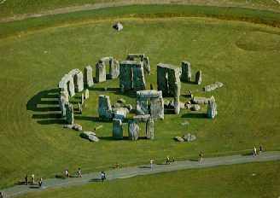
Post and Lintel
Used by Egyptians and Greeks

Slide 9
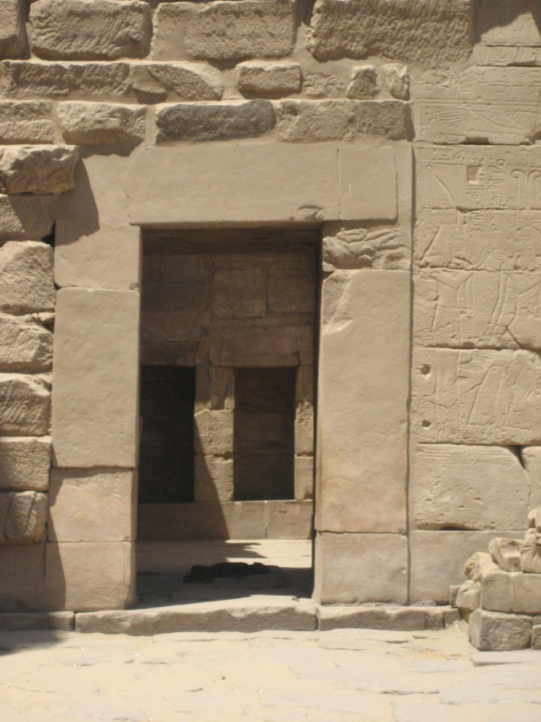
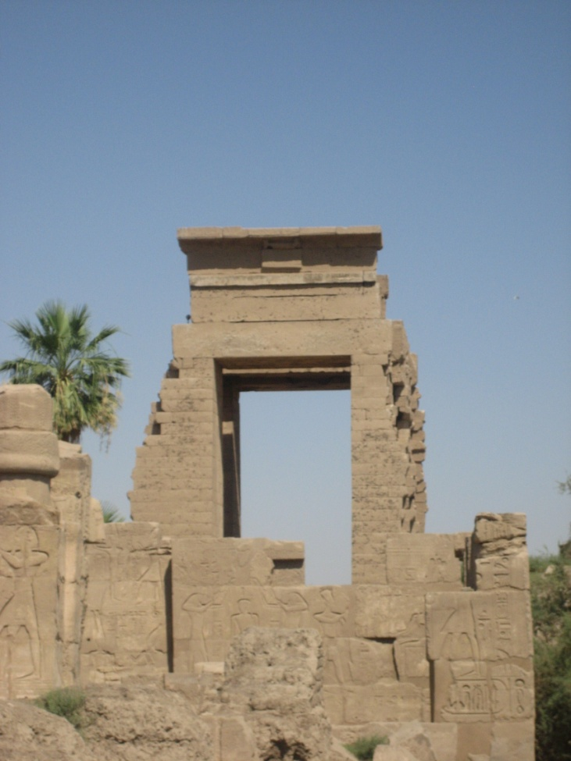
Egyptian Post and Lintel
Karnak Temple

Slide 10
Arches

Slide 11
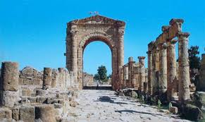
Arches–Forces

Slide 12
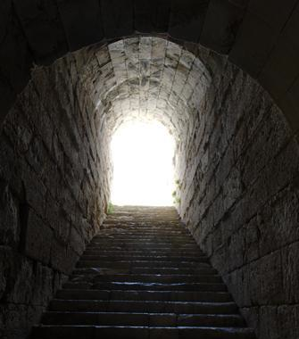
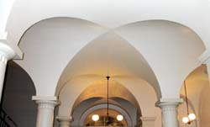
Arches
Developed by the Etruscans and
refined by the Romans

Slide 13
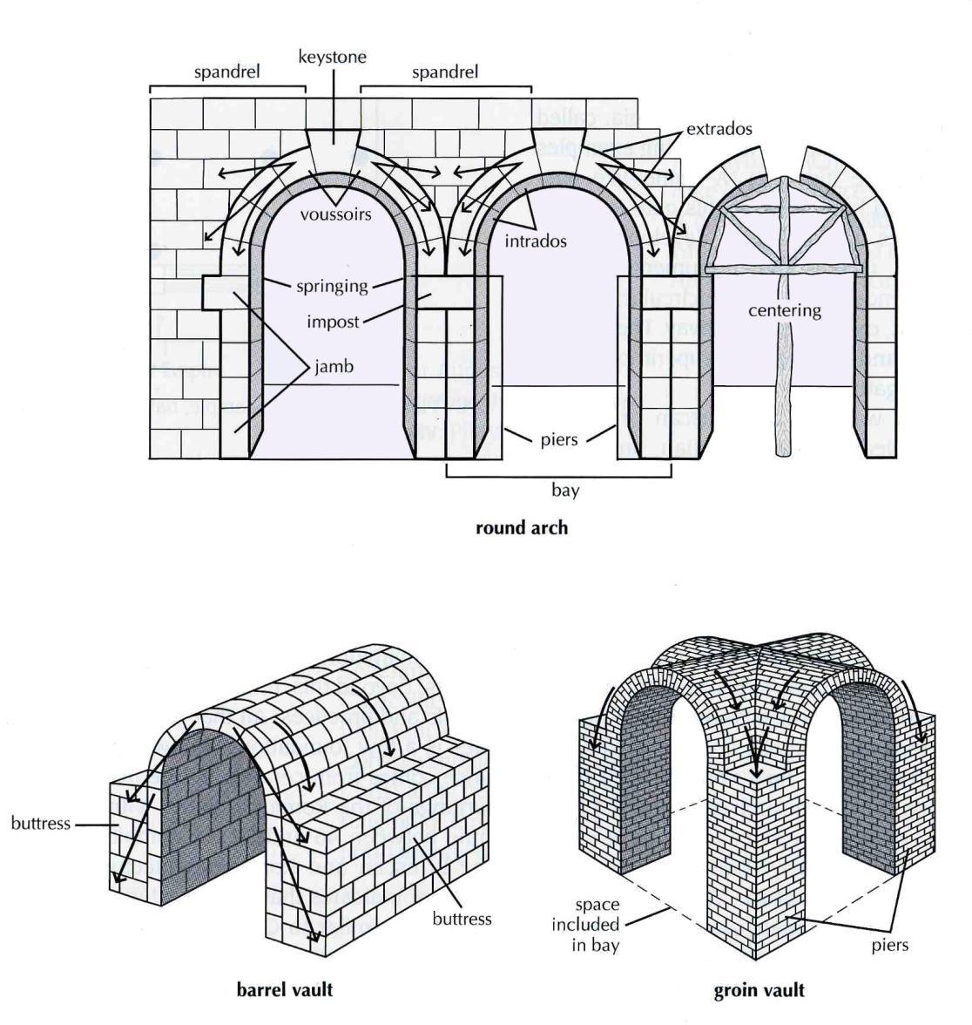
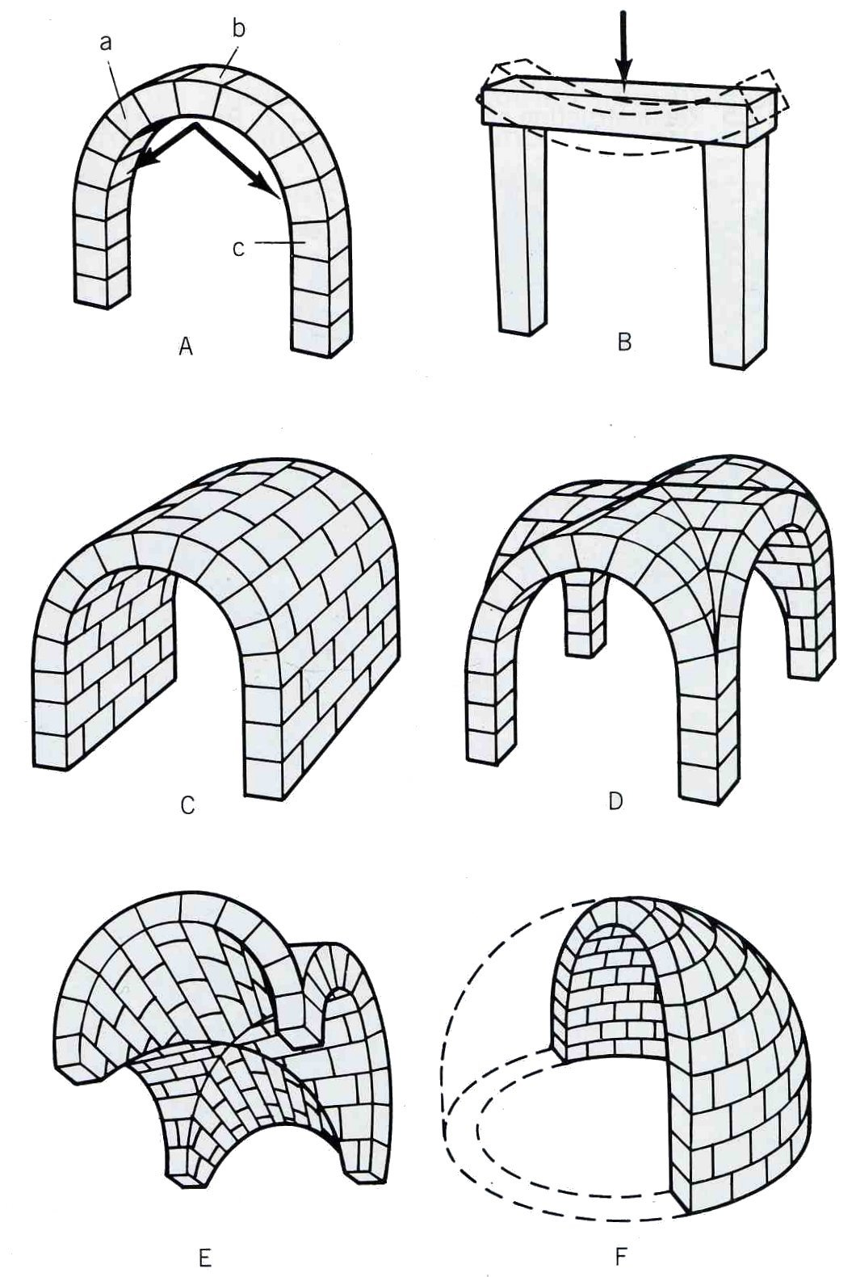
Arches

Slide 14
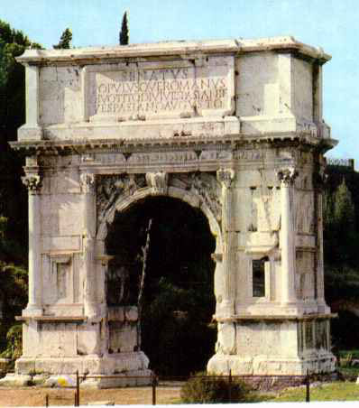
Arches
Triumphal arches and columns
commemorate victories.

Slide 15
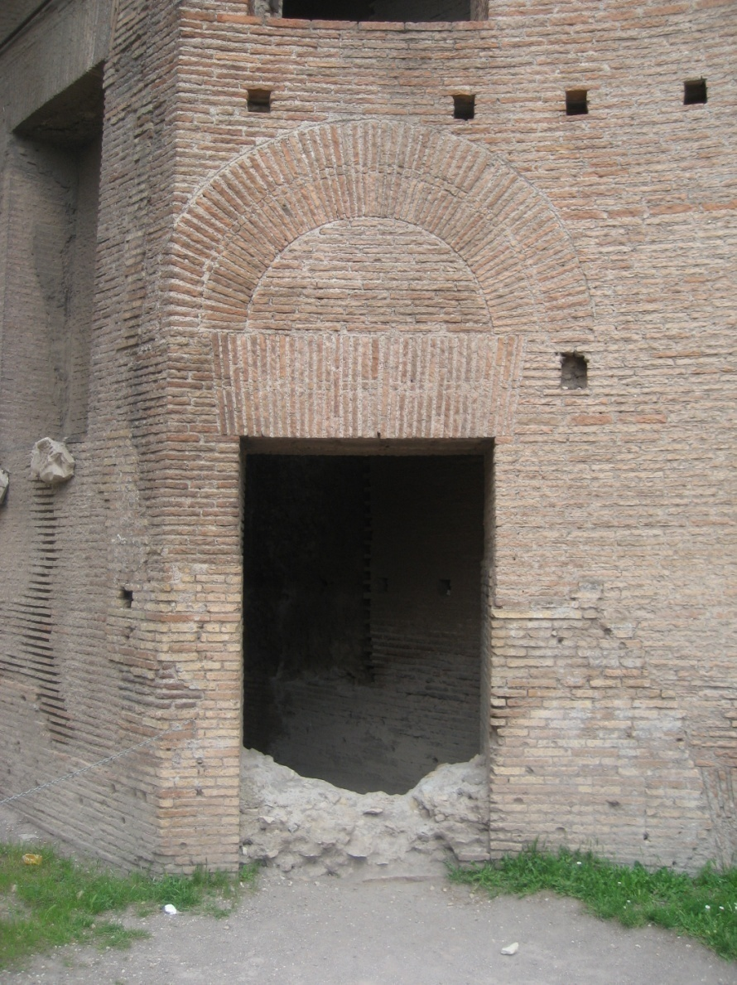
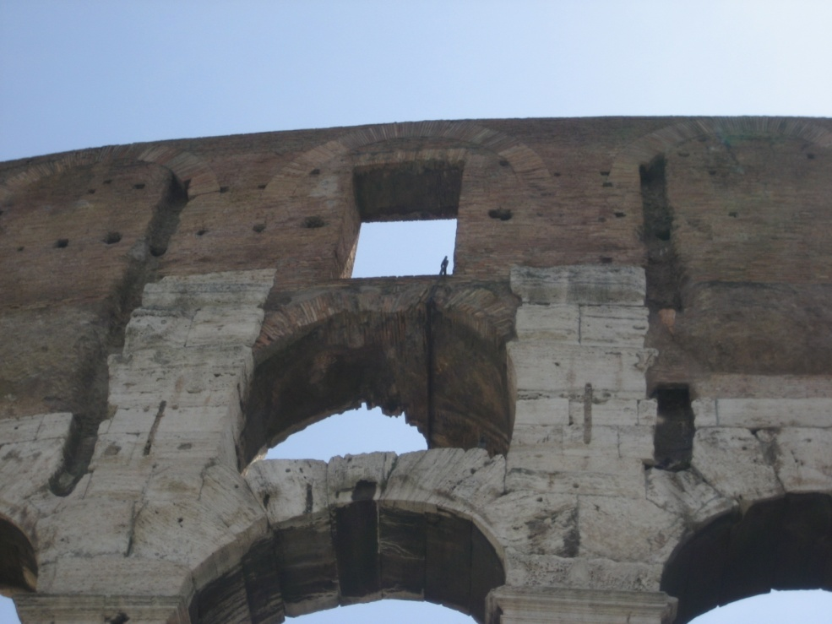
Arches with Post and Lintels

Slide 16
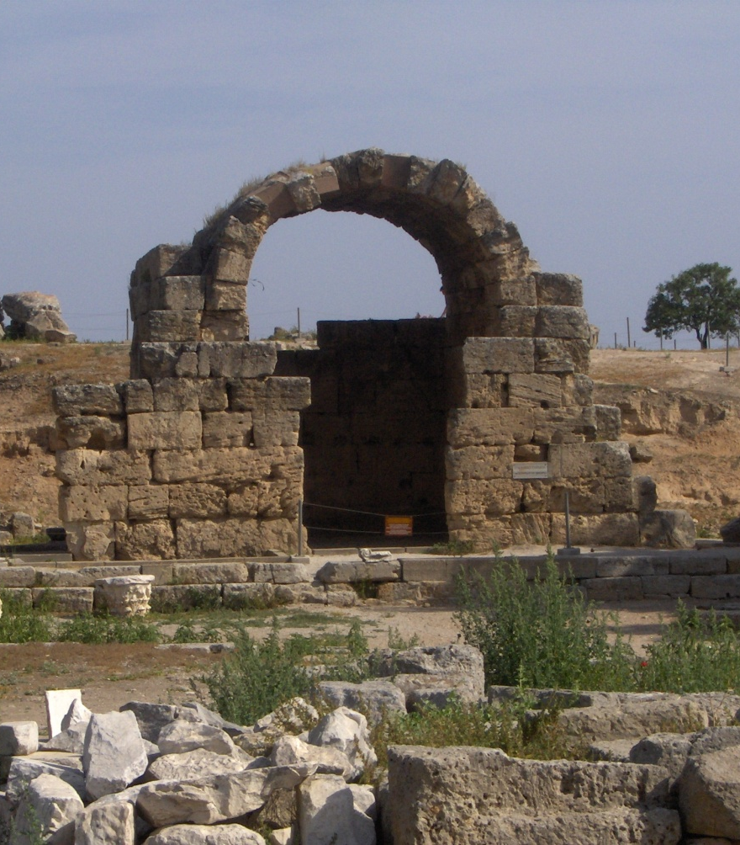
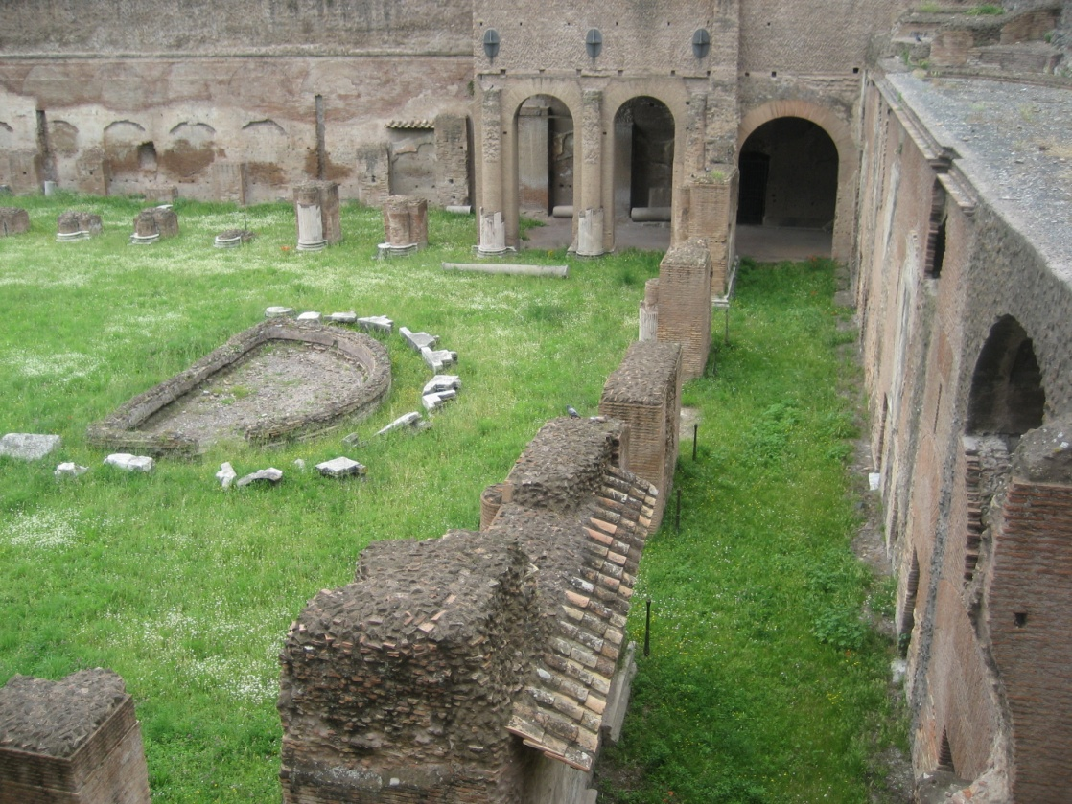
Arches remain when walls are gone

Slide 17
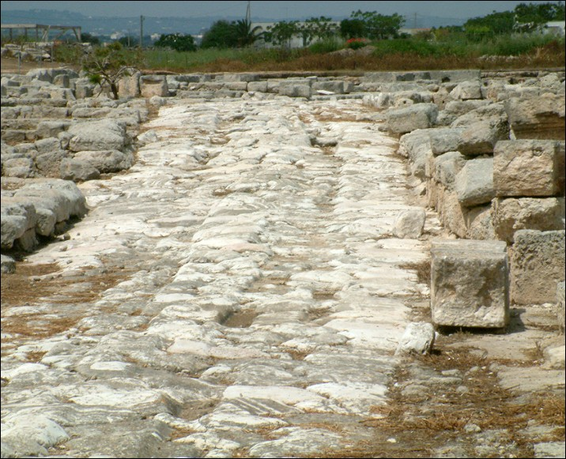
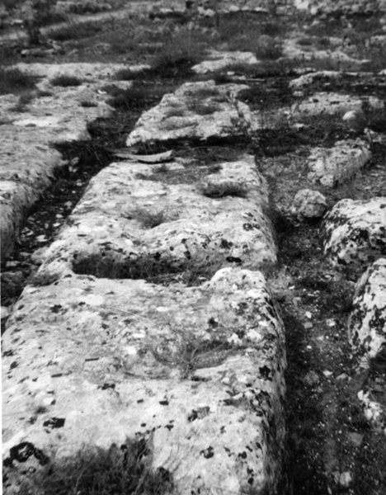
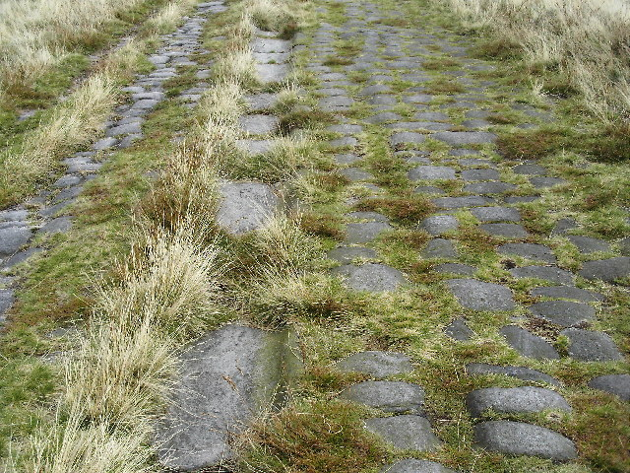
Roads
Extensive road system
Grid pattern
Used for military and commerce
53,000 miles of road
Multi-layers thick
Rutted through extensive use
Commercial wagons adapted to fit the ruts
Determined RR gauge

Slide 18
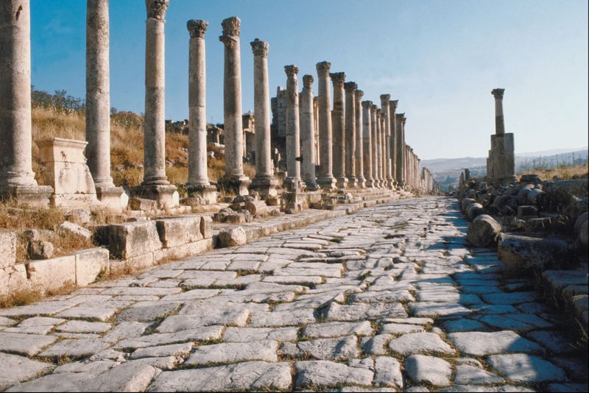
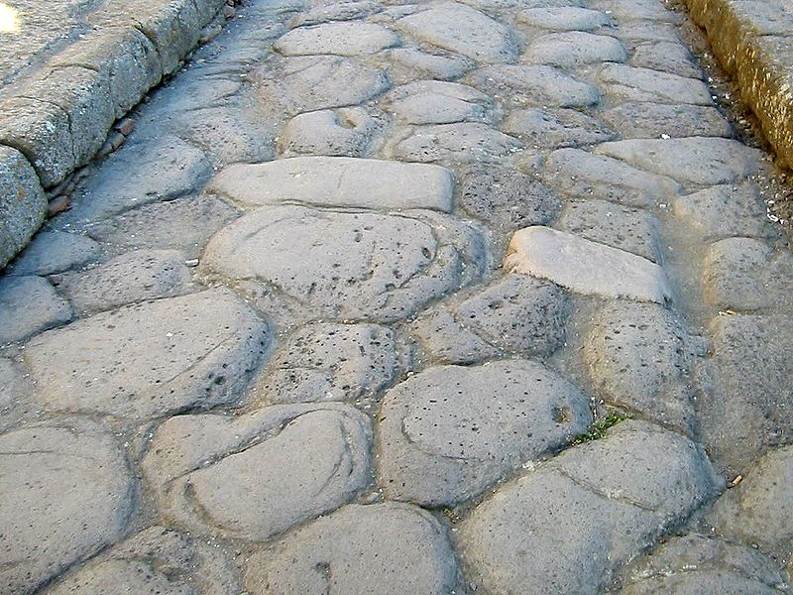
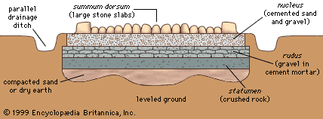
Roads

Slide 19
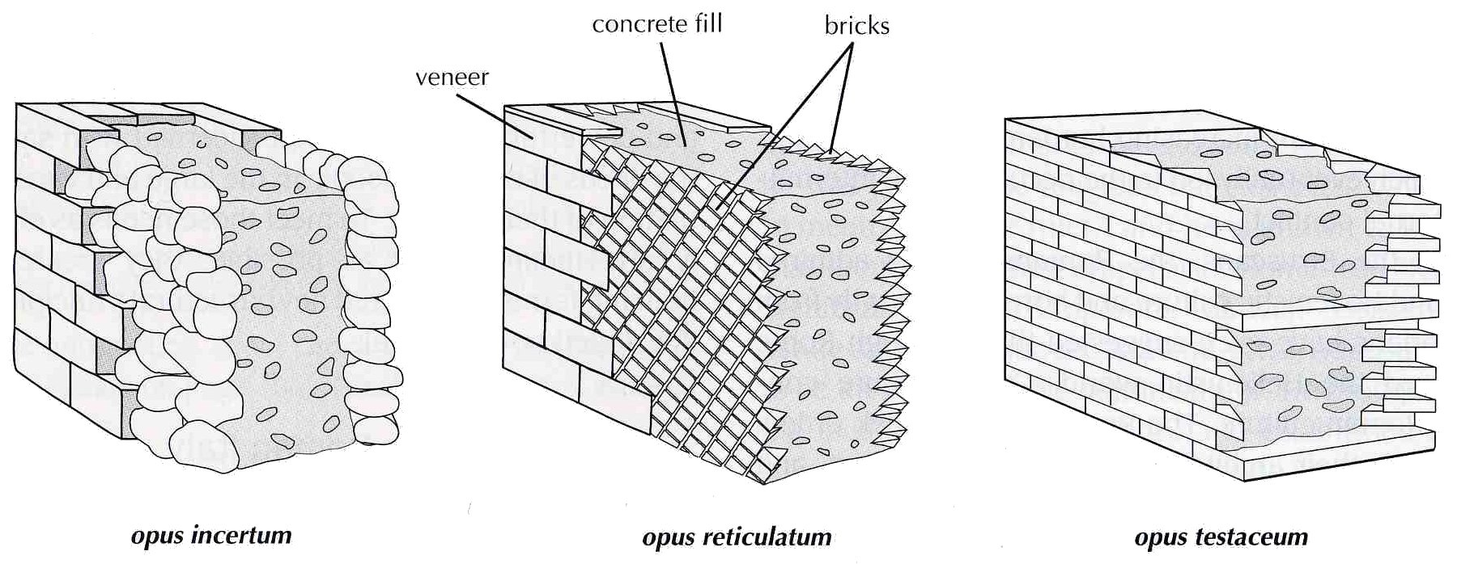
Concrete
Romans used a sand that reacted with the cement and thus strengthened the cured concrete.

Slide 20
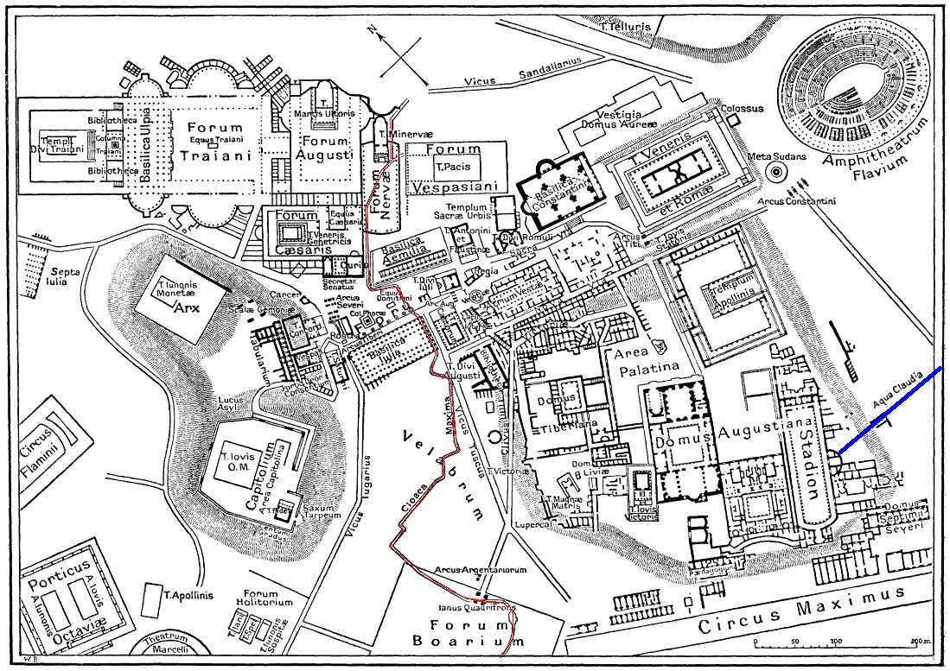
Cities
Contained forum, theater, circus, temples, commercial center
Map of Rome

Slide 21
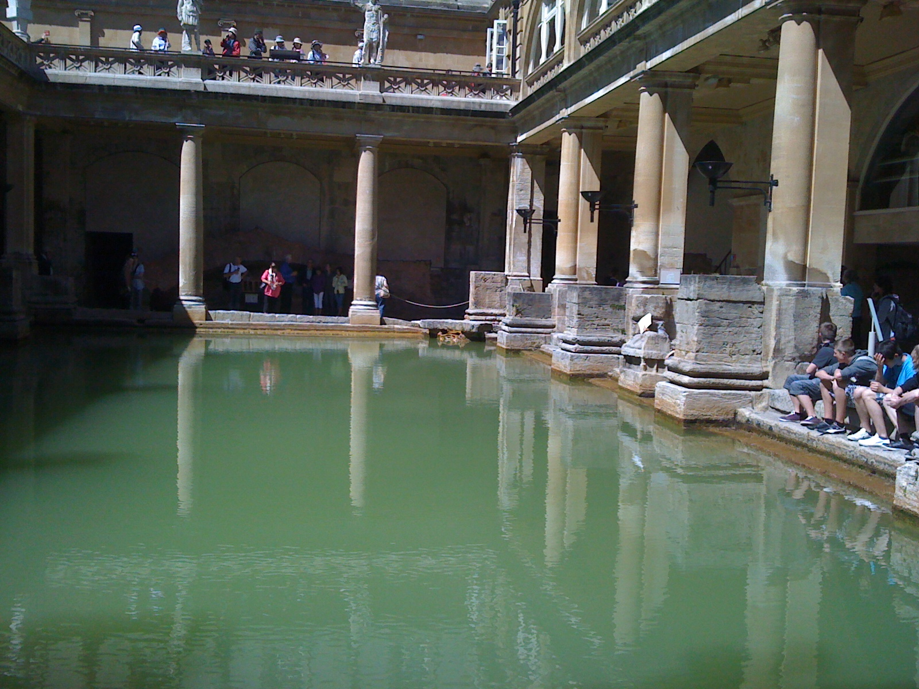
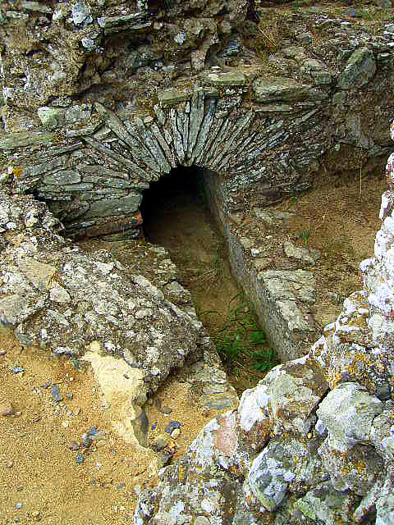
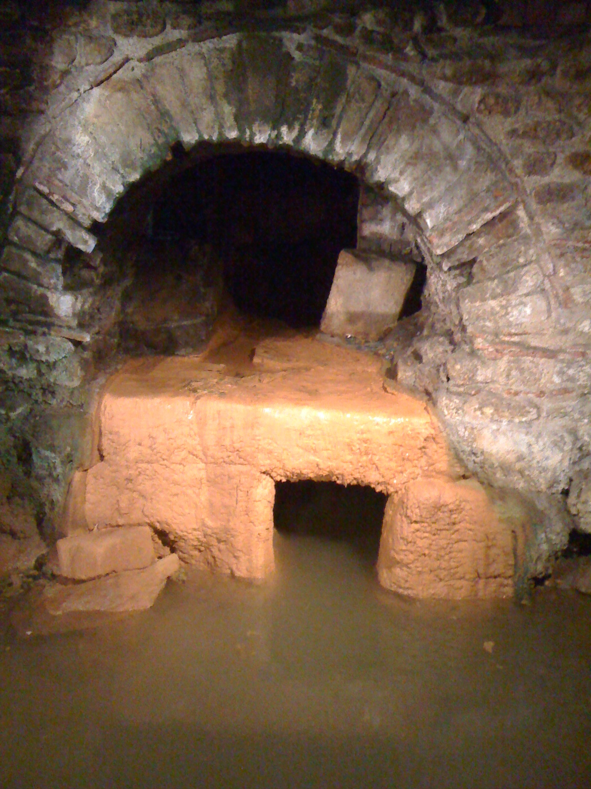
Cities
Support facilities: sewers, inside bathroom water
Baths

Slide 22
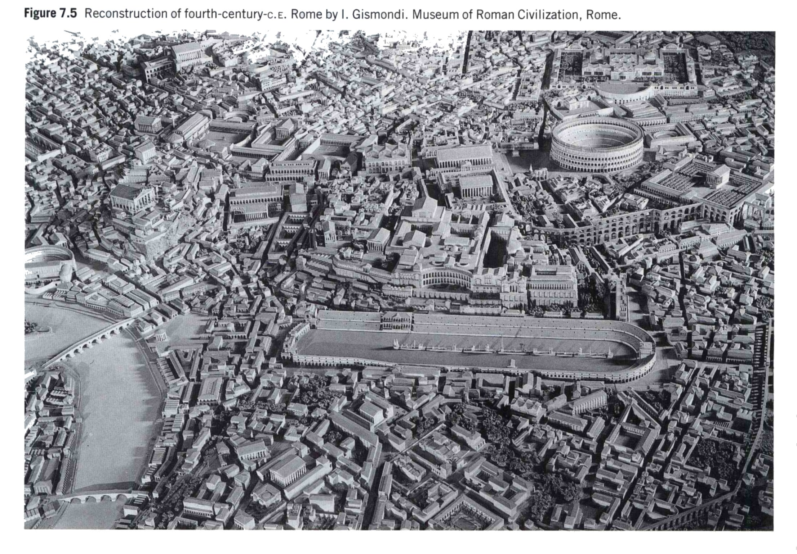
Model of Ancient Rome
Basilica of
Constantine
Coliseum
Forum
Palatine Hill
Circus
Maximus

Slide 23
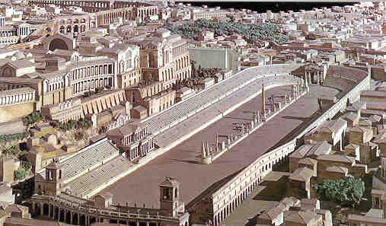
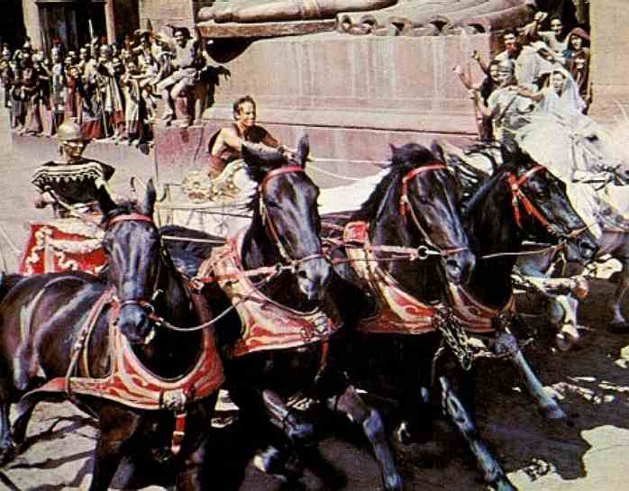
Cities
Circus Maximus
(Model)
Largest sports edifice ever erected (seated over 200,000)
Used for chariot races

Slide 24
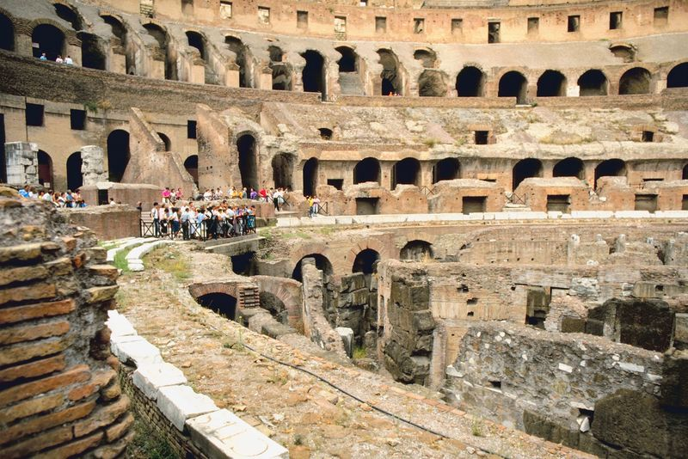
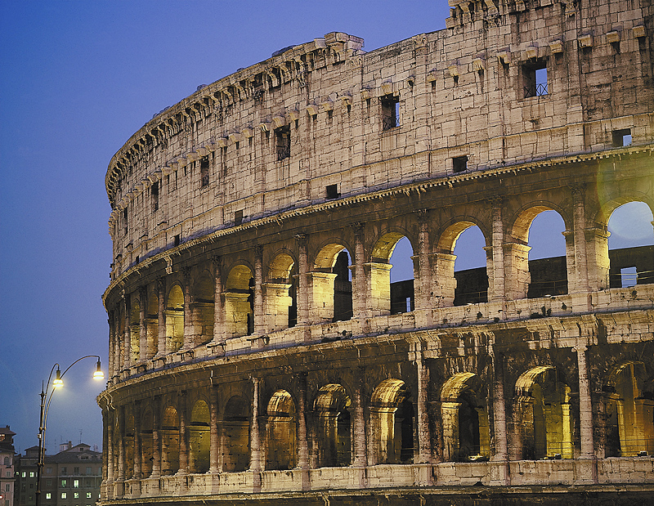
Coliseum

Slide 25
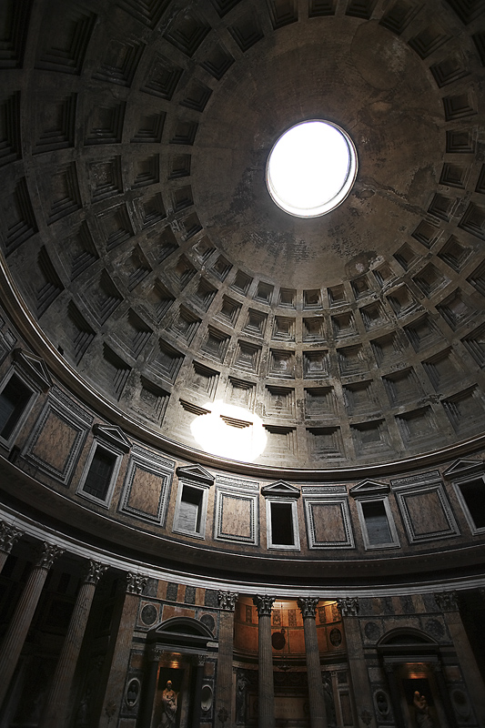
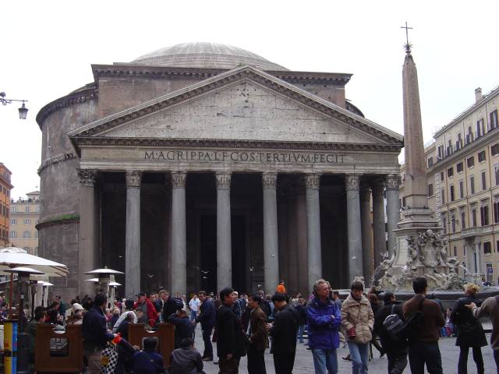
Architecture and Engineering Major buildings
Pantheon
Temple to all the gods
Burial for ancient and modern heroes

Slide 26
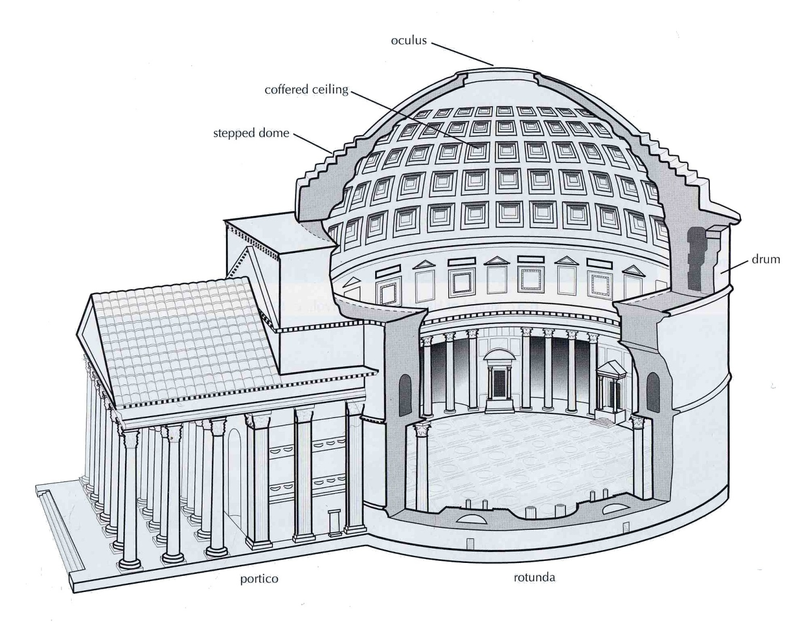
Architecture and Engineering Major buildings
Pantheon

Slide 27
Aqueducts

Slide 28
Aqueducts

Slide 29
Aqueducts

Slide 30
Pont du Gard

Slide 31
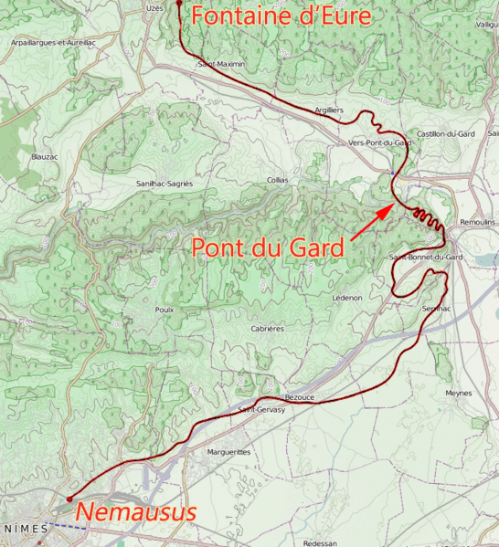
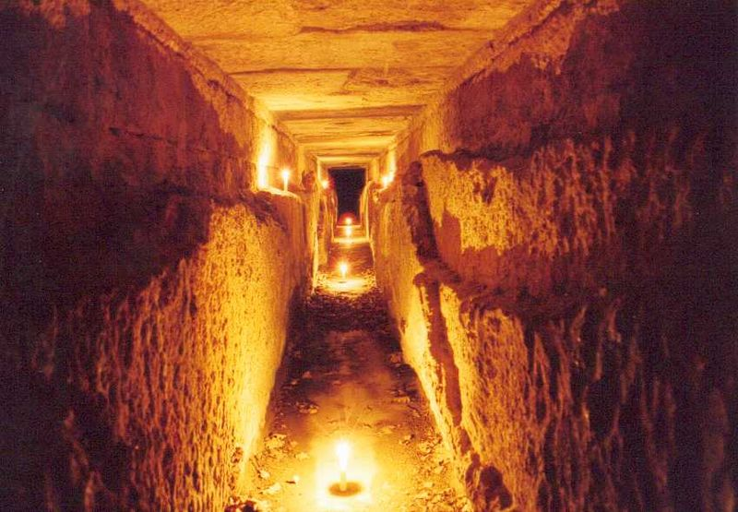
Pont du Gard
Uzes
Part of an aqueduct from Uzes to Nimes
30 miles long
Gradient of 1/3000
Drop of 54 feet
Southern France
Pont du Gard
Delivered 5 million gallons per day
Nimes

Slide 32
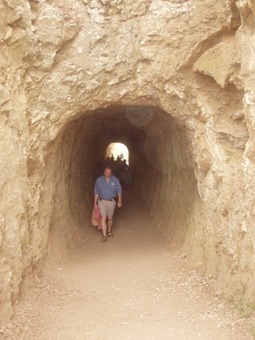
Pont du Gard

Slide 33
Aqueducts
Segovia

Slide 34
Pompeii

Slide 35
Pompeii
Carbonized dates, walnuts, sunflower seeds, and bread from Pompeii.
Casts of people trapped in volcanic pumice during eruption of Vesuvius.

Slide 36
Provinces
Forts (Kerak)
Jordan

Slide 37
Provinces
Engineering advancements
Jerash
Moving columns
Sewers
Steps

Slide 38
Science
Ptolemy
Astronomy (Almagest)
Geography
Optics
Concept of cone vision
Rules of reflection
Laws of refraction

Slide 39
Medicine
Galen
Influenced by Hippocrates
Defined methods in modern medicine
Purpose of organs
Medical and mental health
Observations and notes assisted diagnosis
Physician to several emperors
Advanced knowledge in anatomy
Wrote 22 volumes
Classified diseases and normal treatments
Used as text until 1700

Slide 40
Discussion
What is creative about the following?
Medicine
Science
Arches
Domes
Aqueducts
Cement
Sewers
City infrastructure
Roads

Slide 41
Discussion
Is adoption of another culture creative?
Were the Romans truly creative?

Slide 42
Creativity
Creativity is seeing what everybody else has seen and thinking what nobody has thought.
—Albert Szant-Gyrgyi

Slide 43
The Legacy—Creativity
Language
Roman alphabet
Romance languages
Many phrases from Latin in other languages
Laws
Protected individuals from one another and the state
Rule of law
Carpe Diem

Slide 44
The Legacy–Creativity
Organization of government
Bicameral legislative government
Checks and balances
Government values
Washington as Cincinnatus
Engineering and Technology
Experiments
Respect for actual data
Making theories work
Growth of engineering as a respected discipline

Slide 45
The Legacy—Values
Ask not what your country can do for you,
but rather what you can do for your country.
—Cicero, 106–43 BC

Slide 46
Who are the modern-day Greeks and Romans?
Greeks = English or French
Romans = Americans

Slide 47
Thank You
Borrow Wisely

