Slide 1
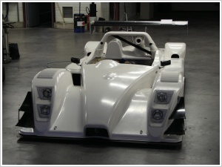
Thermoforming
MFG 355

Slide 2
Thermoforming Characteristics
Not dependent on extrusion/melting
Sheets are used as the starting material
This increases the raw material cost over “melted” processes
High raw material waste
Recycled but not at original cost

Slide 3
Thermoforming Variations
Vacuum
Pressure
Plug assist
Reverse draw
Free
Drape
Snap-back, reverse draw, billow
Matched die
Mechanical

Slide 4
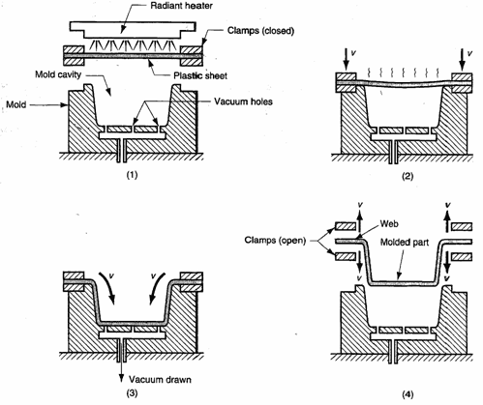
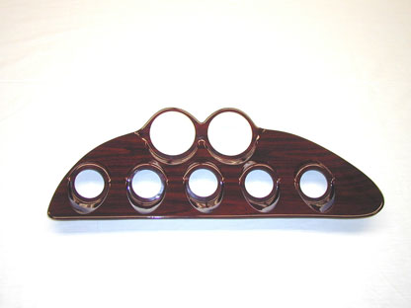
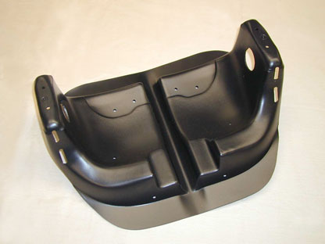
Vacuum Forming
Vacuum draws the part against the mold “cavity”

Slide 5
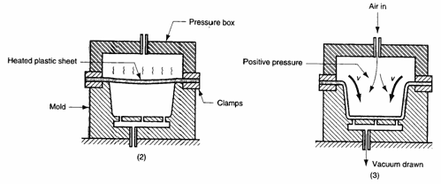
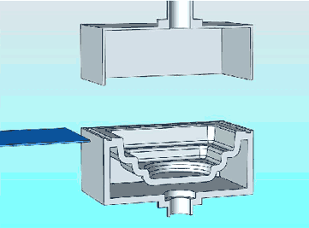
Pressure Forming
Air pressure presses the sheet against the mold “cavity”
No sound

Slide 6
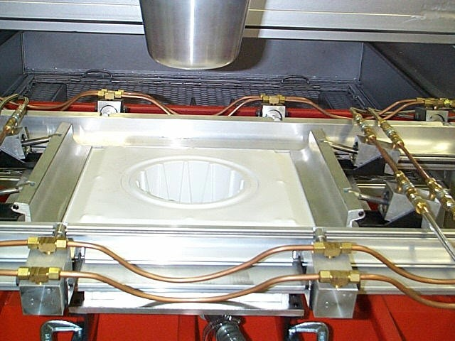
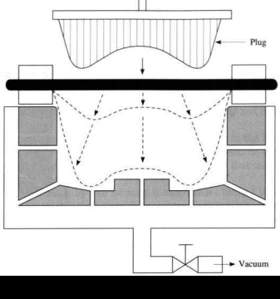
Plug Assist Forming
Plug stretches the material for a more evenly distributed part

Slide 7
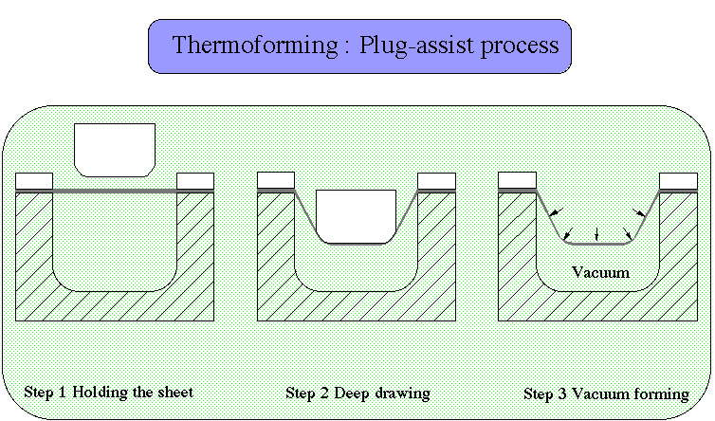
Plug Assist
Plastic does not thin when in contact with the plug (or wall)

Slide 8
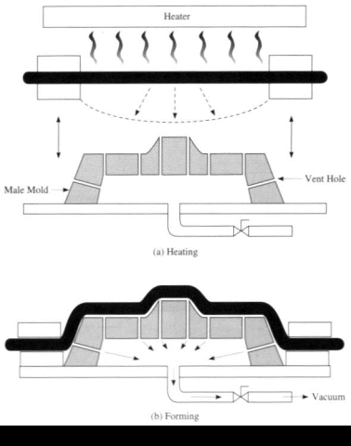
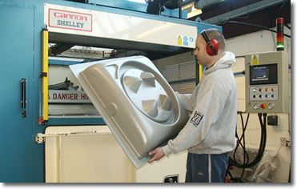
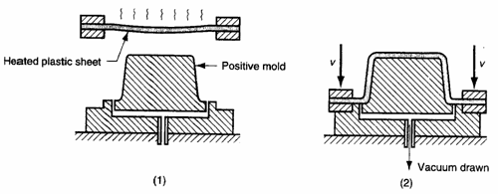
Drape Forming
Mold “cavity” protrudes upward

Slide 9
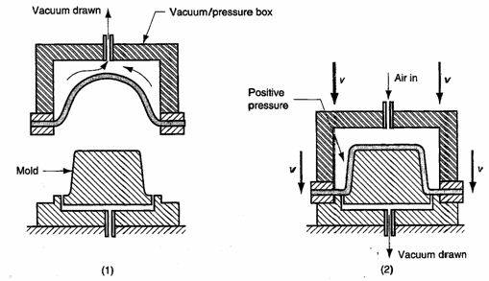
Reverse Draw Forming
Vacuum stretches material before forming for a more uniform part

Slide 10
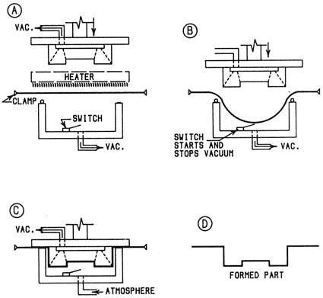
Snap-Back Forming
Two stage vacuum forming process
Stage one pre-stretches material
Stage two forms the material on the mold

Slide 11
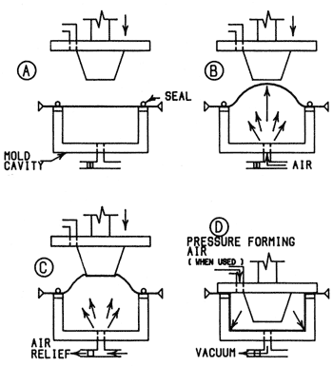
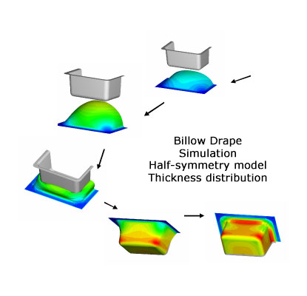
Billow Forming

Slide 12
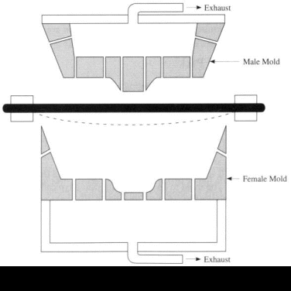
Matched Die Forming
Upper and lower mold “cavities” mate up or match
For greater detail
For complexity
High tolerances

Slide 13
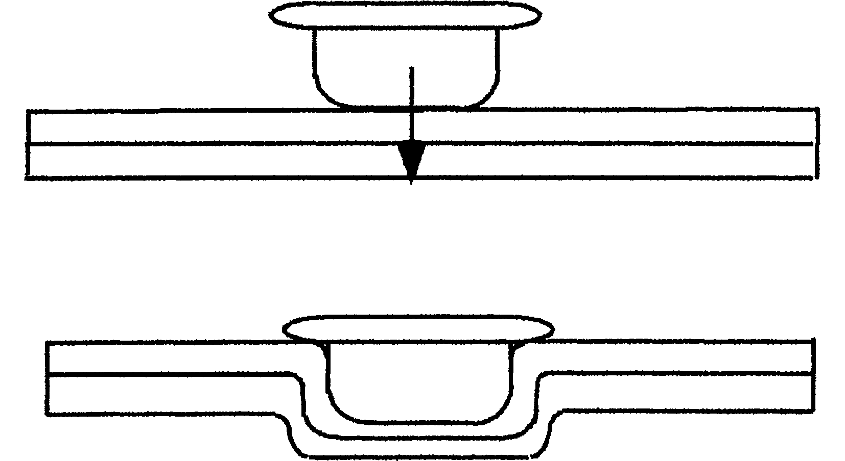
Mechanical Forming
No positive or negative air pressure applied to mole
All molding is done by mechanical means
There is less detail than most of the other processes

Slide 14
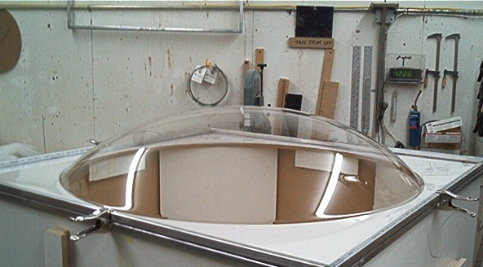
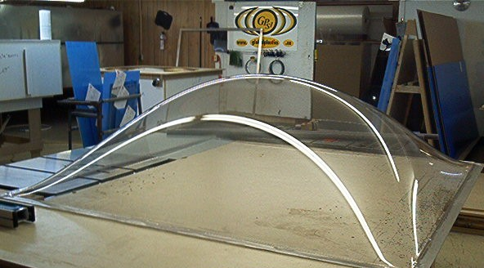
Free Forming
Parts are blown
No contact with mold surfaces
Excellent optical clarity

Slide 15
Automation

Slide 16
Blister Pack and Skin Pack
Blister pack has space between material and packaged part
Usually a moderately rigid material
A mold is still needed
Skin pack sheet is held firmly against part
Flexible materials are used
No mold is needed

Slide 17
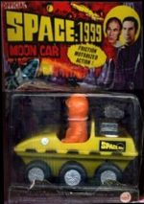
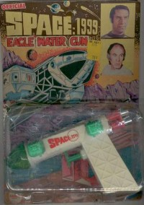
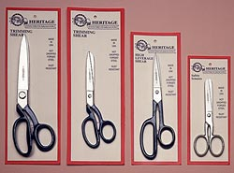
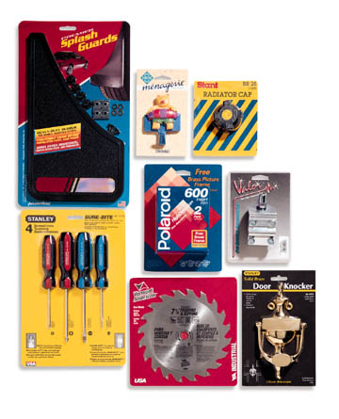
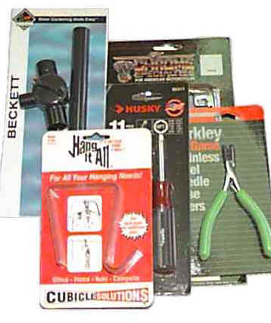
Blister Pack and Skin Pack
Blister Packs
Formed blister pack material
Skin Packs

Slide 18
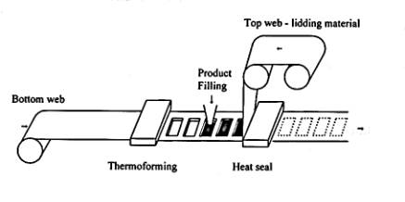
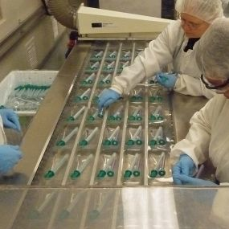
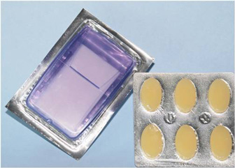
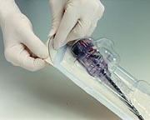
Form, Fill and Seal

Slide 19
Form, Fill, and Seal
No sound

Slide 20
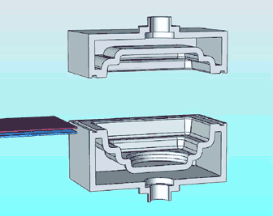
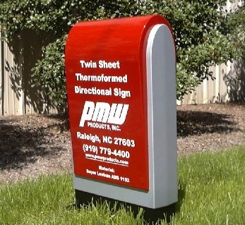
Twin Sheet Thermoforming
Thermoforming of two sheets simultaneously
Multiple colors or textures
No sound

Slide 21
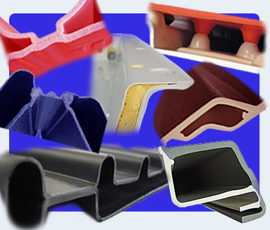
Twin Sheet Thermoforming

Slide 22
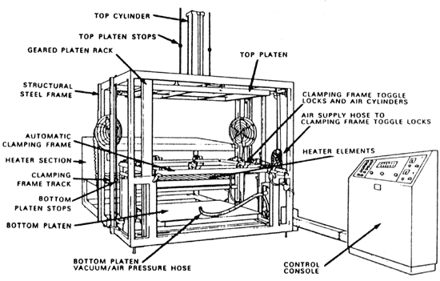
Equipment
Machines

Slide 23
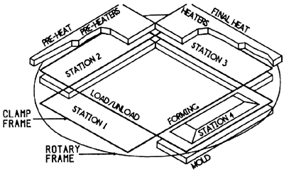
Equipment
Machines

Slide 24
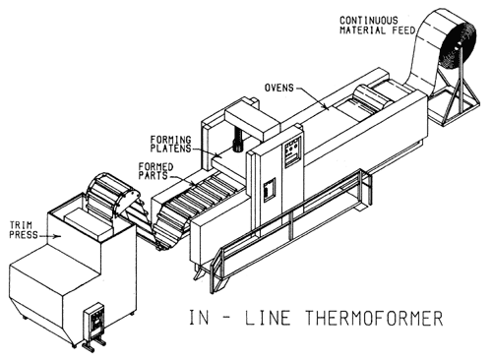
Equipment
Machines

Slide 25
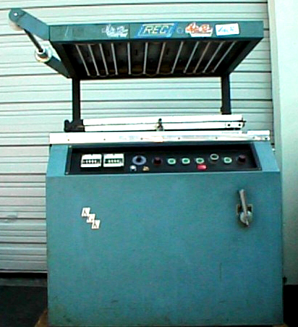
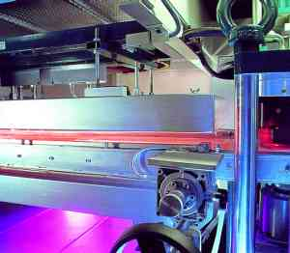
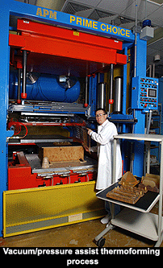
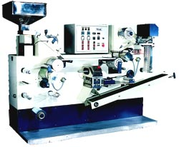
Equipment
Skin Pack Machine
Machines
Shuttle Mold Machine
Vacuum Former
Blister Pack Machine

Slide 26
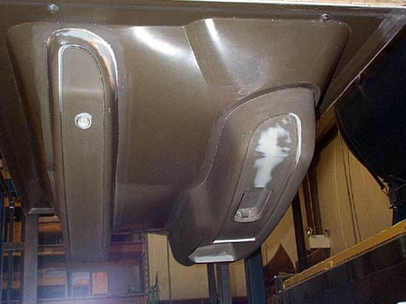
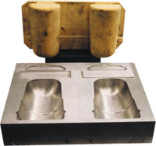
Equipment
Molds
Materials
Wood
50-100 parts
Fiberglass
Up to 50,000 parts
Metal
Millions of parts
Wooden mold (treated for longer life)
Fiberglass mold
Metal Mold

Slide 27
Thermoforming Molds

Slide 28
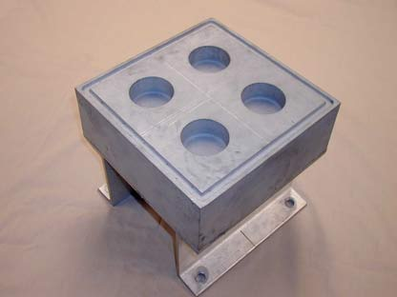
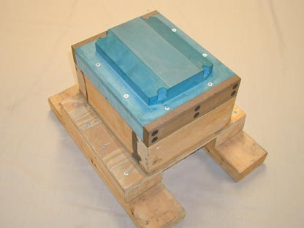
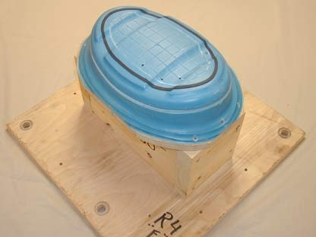
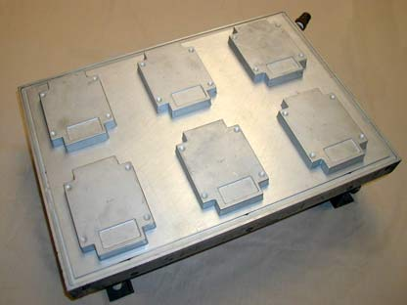
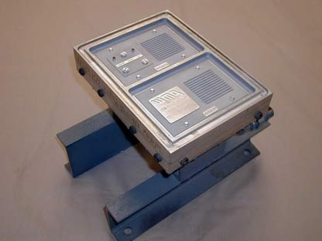
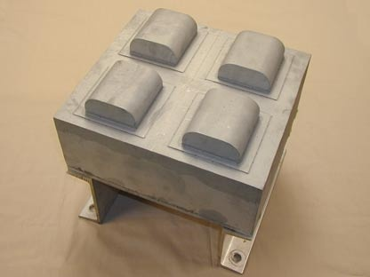
Equipment
Molds

Slide 29
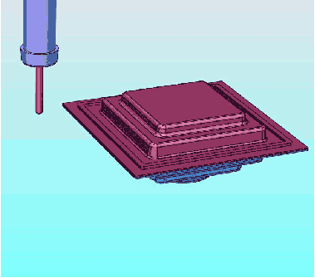
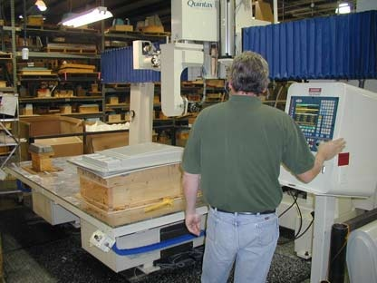
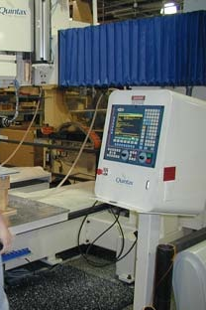
Equipment
Trimming
Robotic trimming
Die cutting
No sound

Slide 30
Equipment
Plant Considerations
Material handling
Sheets
Rolls
Part handling
Secondary processes
Trimming
Scrap handling
Regrind/disposal

Slide 31
Product Considerations
Materials
Thermal profile
Thermoforming does not take the material to T_{m}
Material must have a T_{g}
Thermal degradation is possible
Extruded or cast sheet
Specialty Handling
Drying, pre-conditioning

Slide 32
Product Considerations
Shapes and Part Design
Undercuts
Core pulls
Size
Depth, surface area

Slide 33
Products

Slide 34
Product Considerations
Draw Ratio (depth to width)
Normally should not exceed 2:1 but can go to 7:1
Area Ratio (area before forming to area after forming)
Measures the amount of thinning, for instance, 1:2 means that the material is half as thick (assuming uniform thinning)

Slide 35
Thermoforming Part Distortion

Slide 36
Operation and Control
Speed of vacuum application
Temperature of the mold
Size of the bubble
Plug size

Slide 37
Thank You

