Slide 1
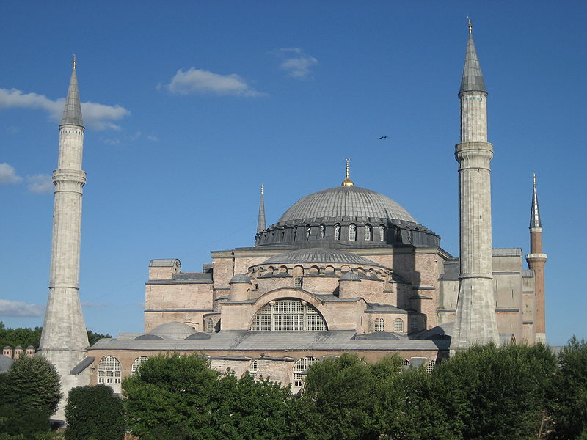
Byzantium
Creativity Holding On

Slide 2
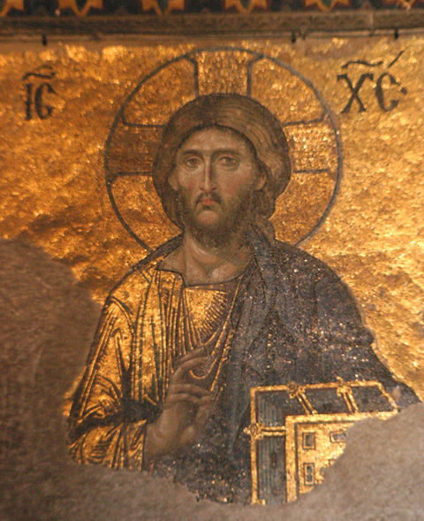
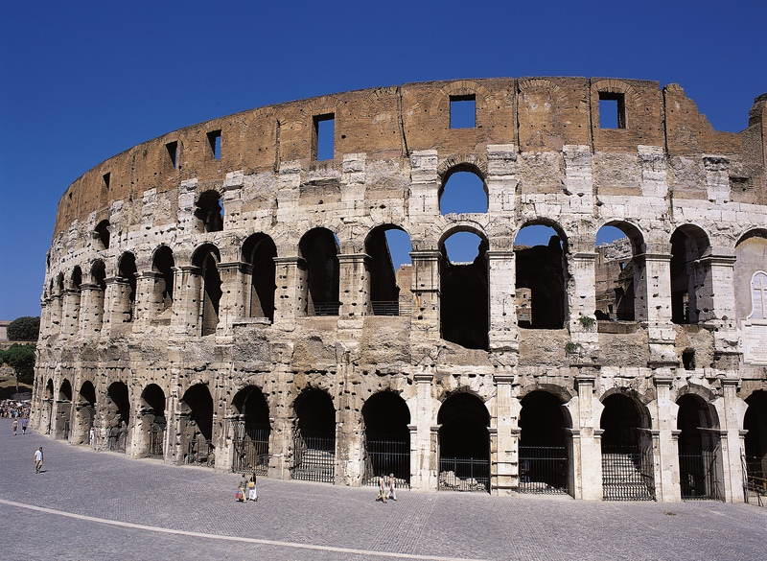
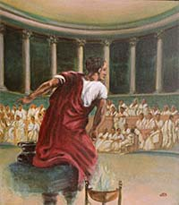
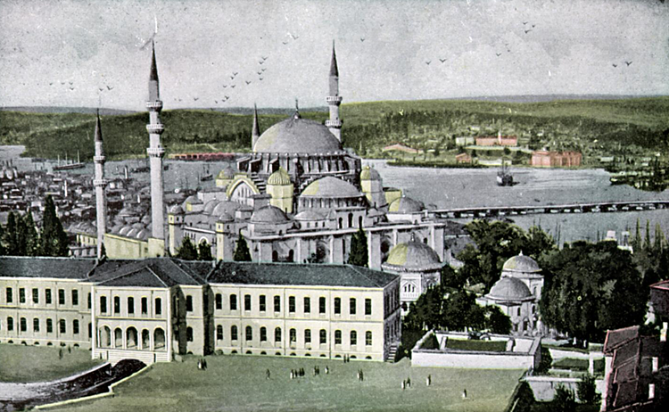
What is Rome?
Rome is a city, area, and empire
Concept associated with laws, and way of life
Comparable to concept of Zion
Constantinople considered the “New Rome (Nova Roma)”

Slide 3
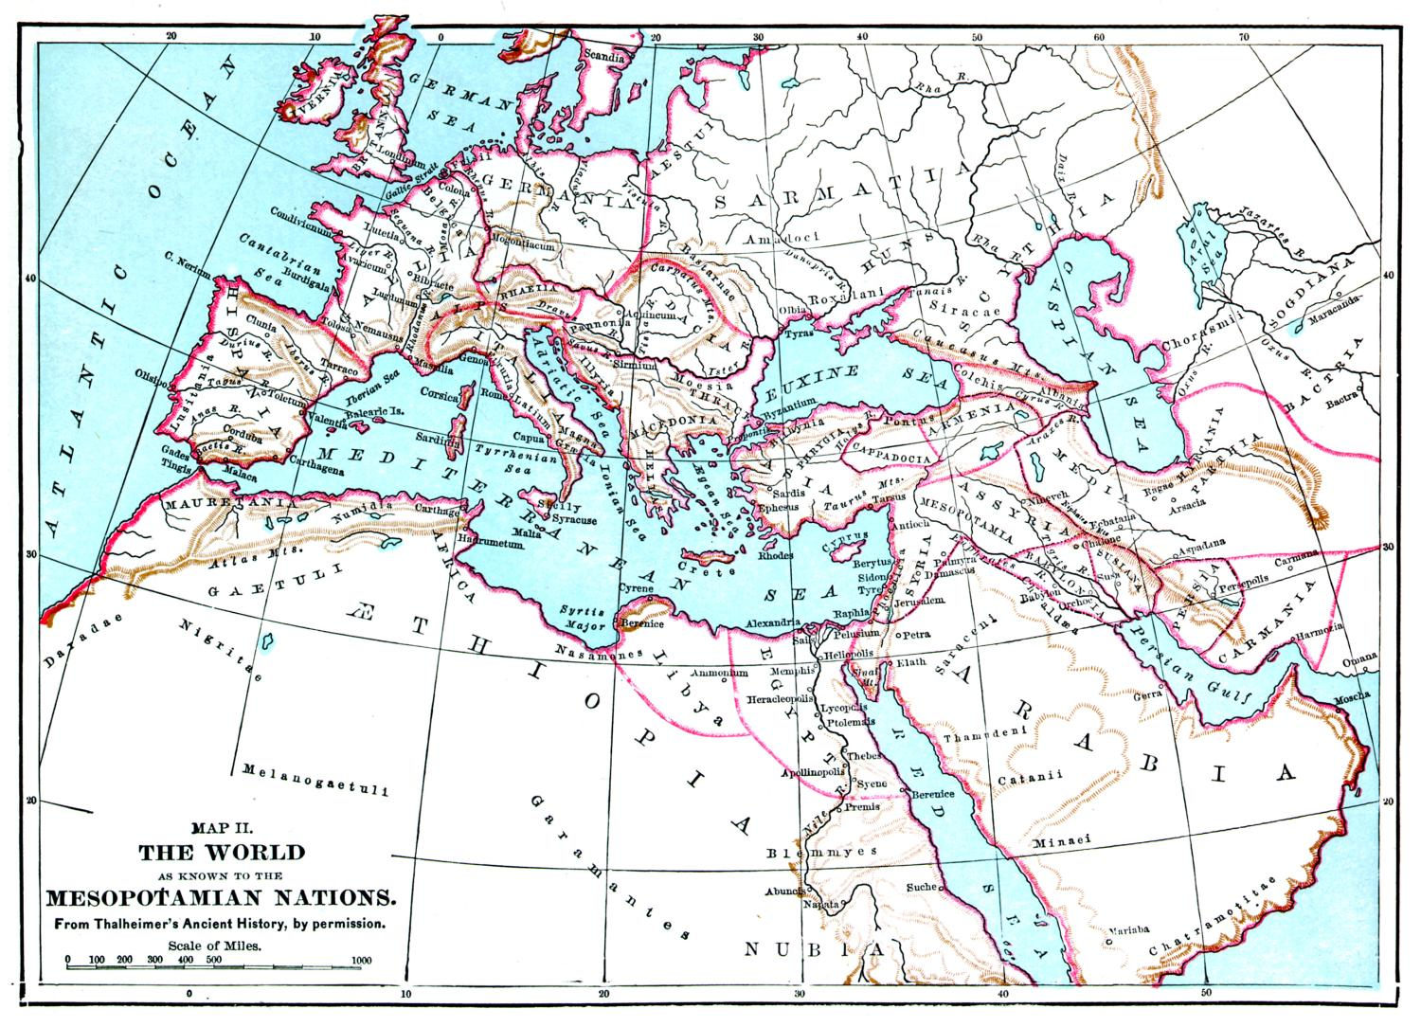
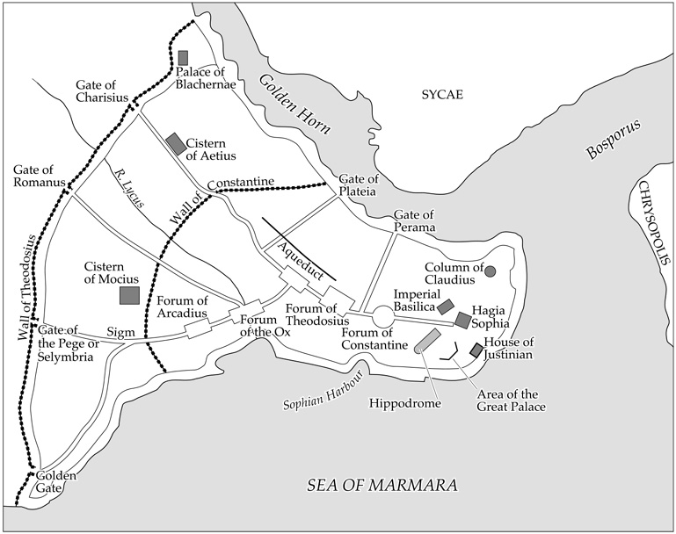
Building of Constantinople
Site selected by Constantine
Triangular peninsula on European shore

Slide 4
Constantinople’s Walls

Slide 5
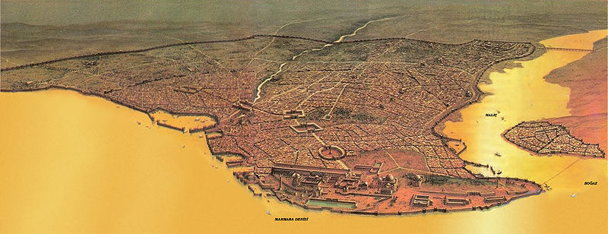
Constantinople was a Roman City
• Major building • Major roads • Major water needs

Slide 6
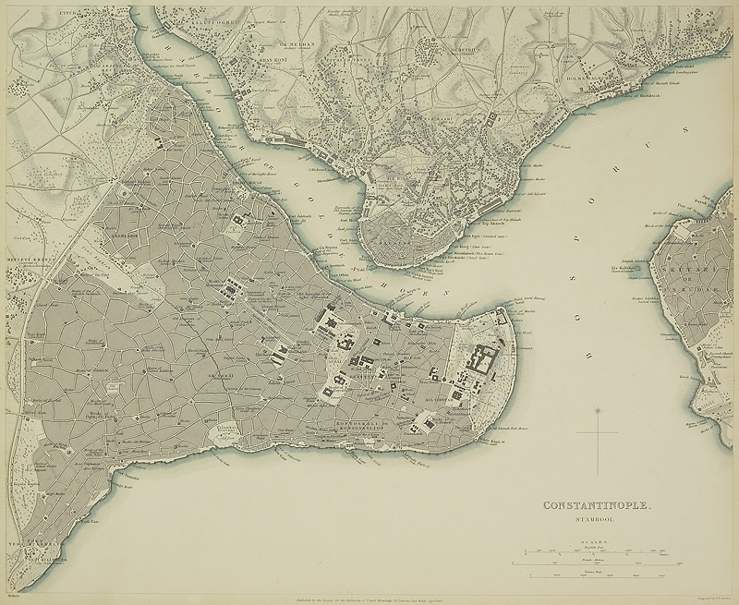
Byzantium
Name comes from Greek name of village on the previous site of Constantinople
“Byzantine” politics
Complicated
Evil or devious
Mother kills emperor son
Brother kills brother at high mass on Christmas
Brother allows invaders into the city to dethrone bother

Slide 7
Justinian

Slide 8
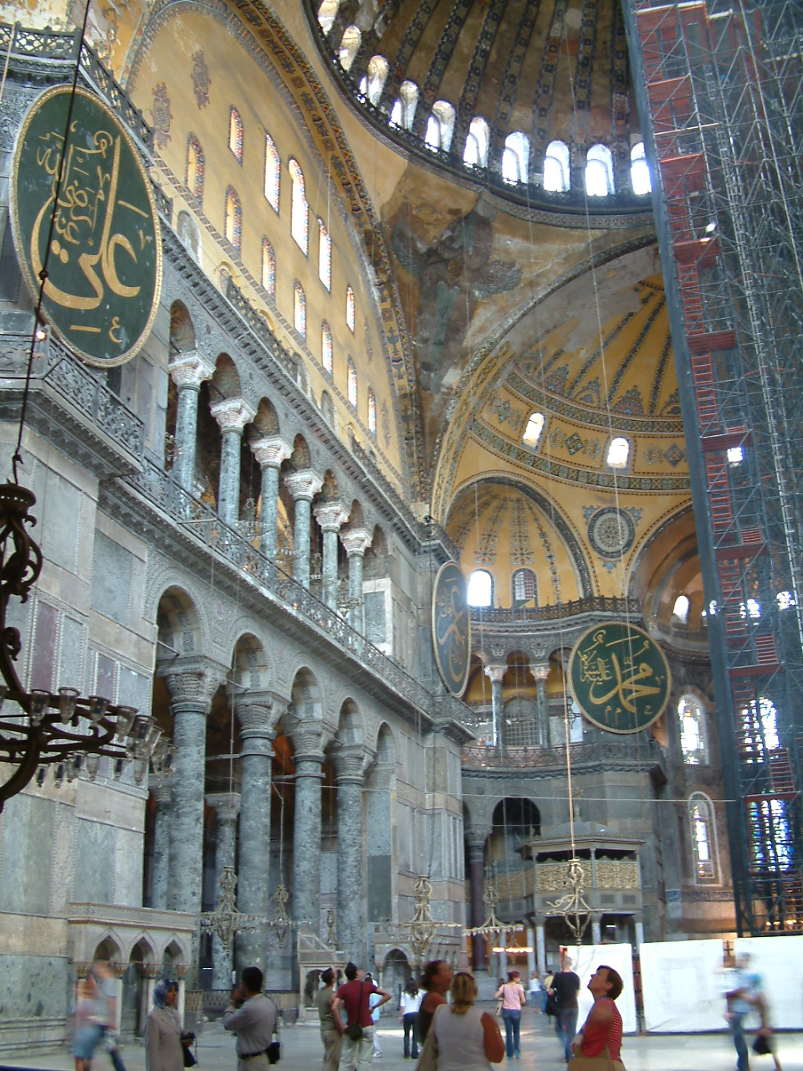
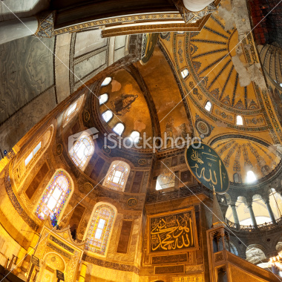
Hagia Interior
The dome [of Hagia Sophia] is a work admirable and terrifying...seeming not to rest on the masonry below it, but to be suspended by a chain of gold from the height of the sky.
Justinian said:
O Solomon, I have outdone thee.
20,000 pounds of gold used in the building

Slide 9
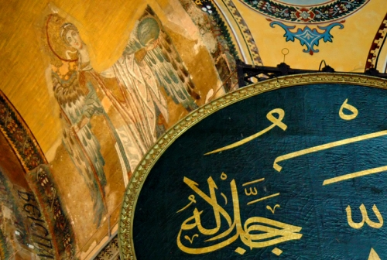
Hagia Interior
When one enters this building [Hagia Sophia] to pray, he feels that it is not the work of human power. . . . The soul, lifting itself to the sky, realizes that here God is close by, and that He takes delight in this, His chosen home.
—Procopius (Byzantine historian)
Mosaics plastered over when made a mosque and now being restored

Slide 10
Hagia Sophia

Slide 11
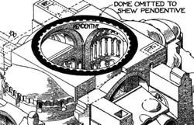
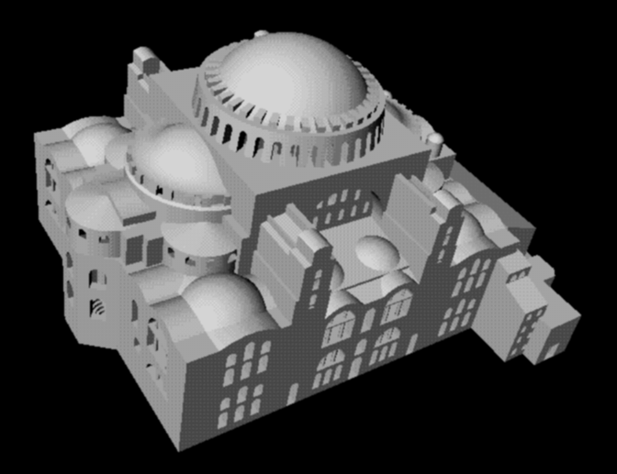
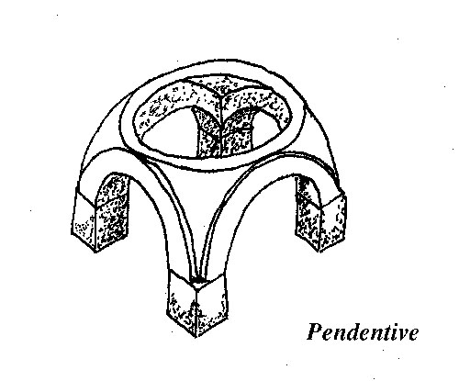
Hagia Sophia—Structure
Supporting domes and buttresses

Slide 12
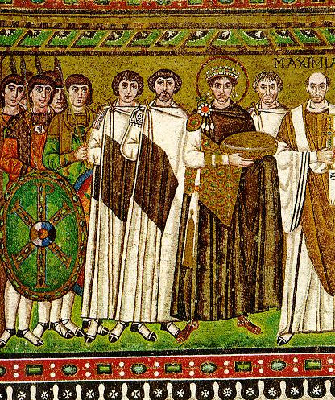
Justinian—Belisarius
Reunification of Roman Empire
• Persia • Africa • Italy
Discussion
Belisarius was offered the Emperorship in Italy,
what would you do
if you were Belisarius?
What would you do if you were Justinian?
Belisarius, Justinian

Slide 13
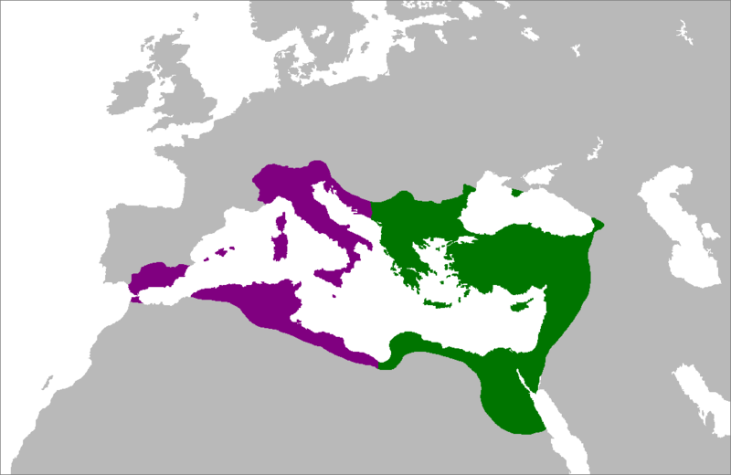
Justinian
Re-acquired under Justinian
Byzantine Empire before Justinian

Slide 14
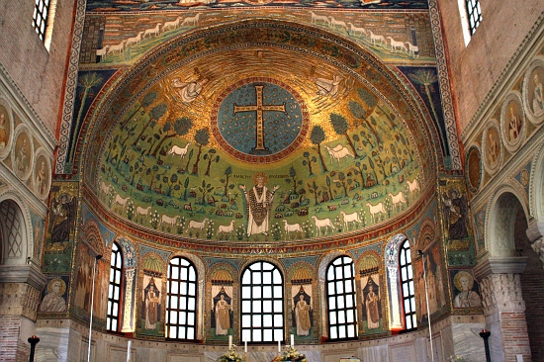
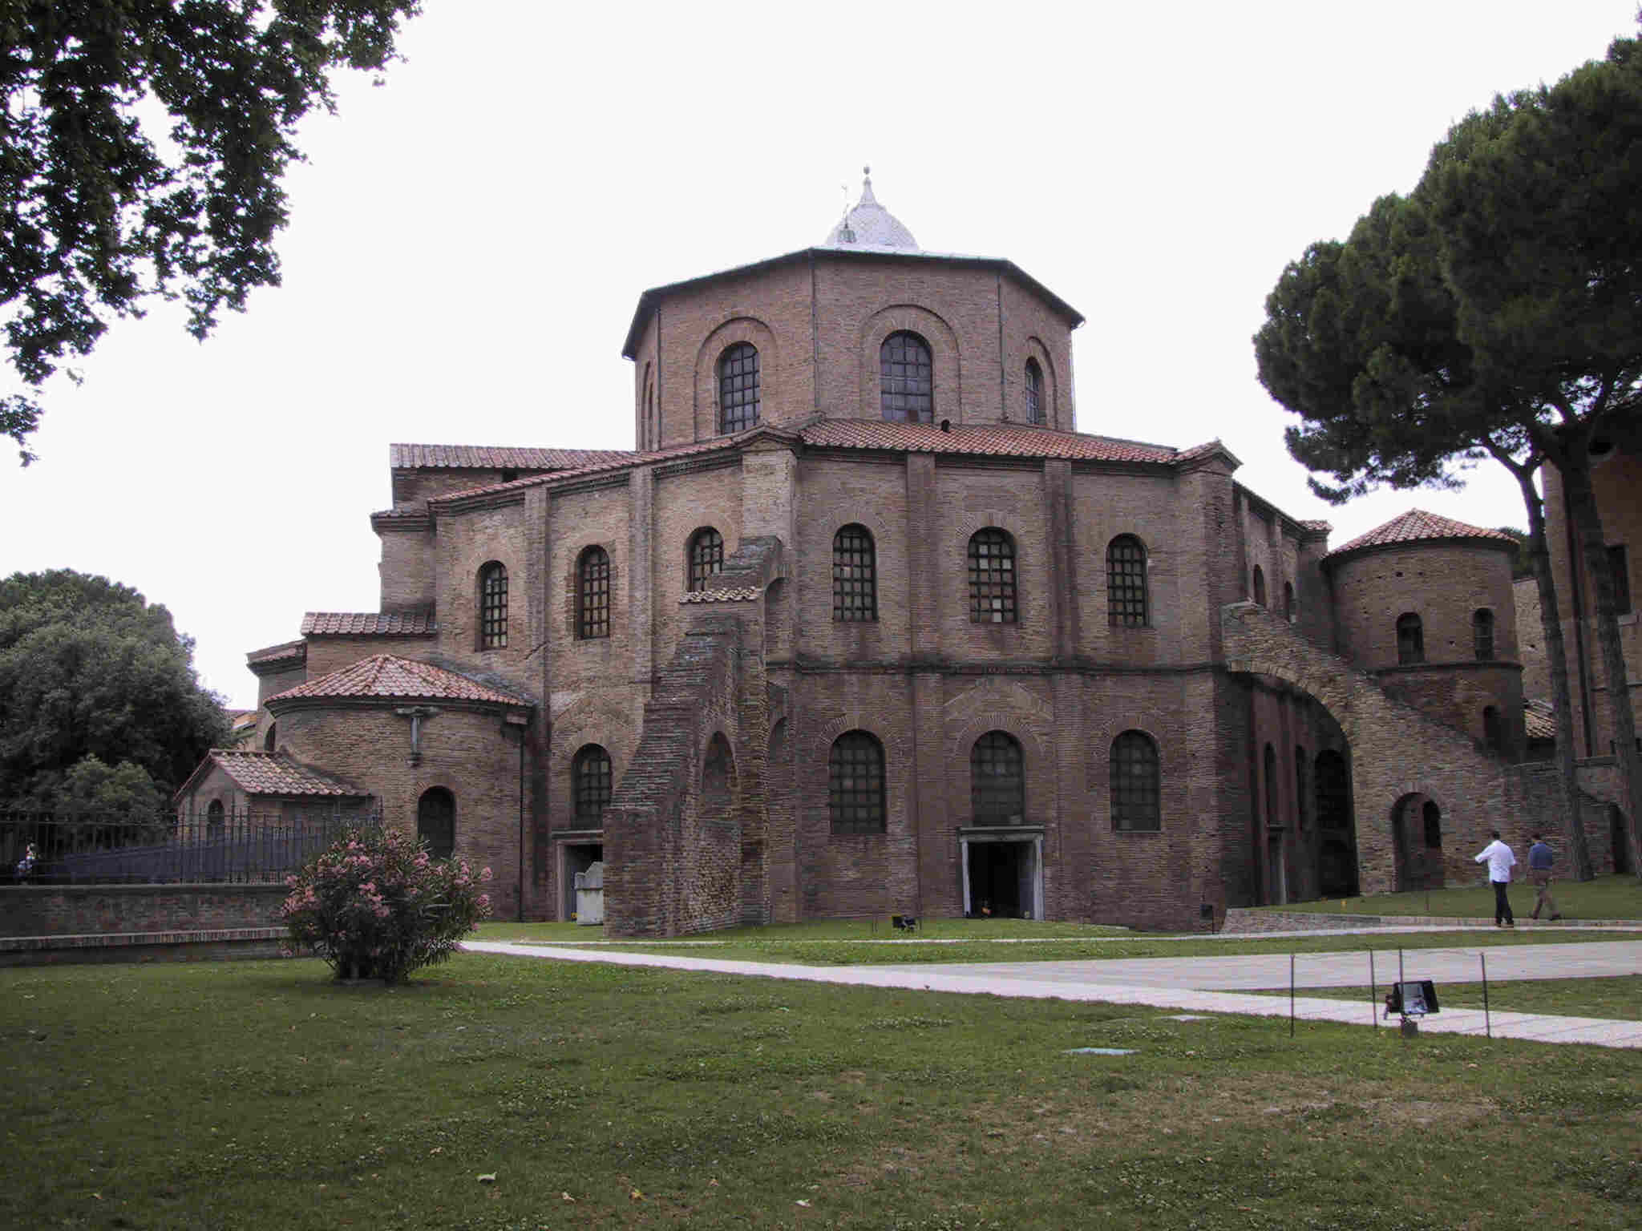
Justinian
Several Ravenna churches were built to honor Justinian and Theodora
Sant’Apollinare
Octagonal baptistry, Arian
San Vitale
Octagonal, mosaics of Justinian and Theodora

Slide 15
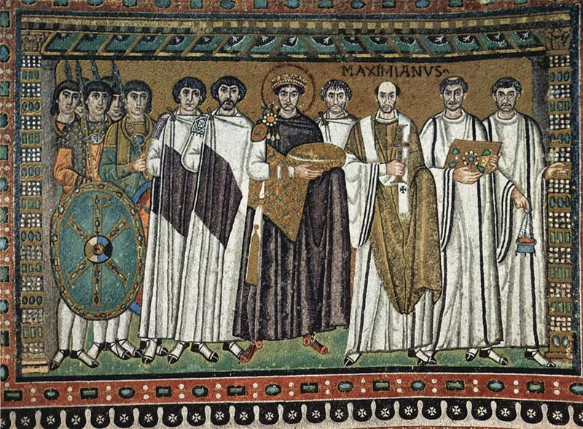
Ravenna Mosaics (San Vitale)
Constantine symbol on shield (chi-rho)
Belisarius
Justinian

Slide 16
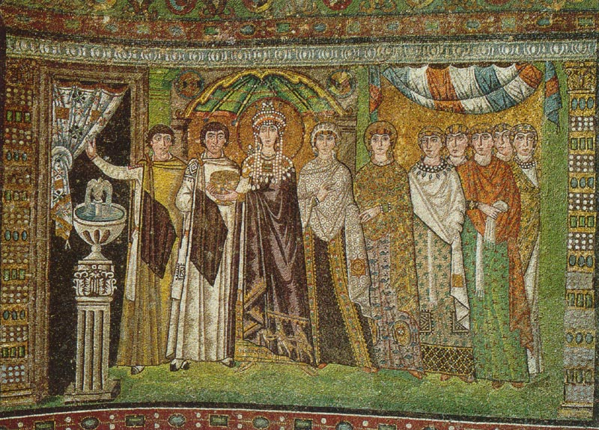
Ravenna Mosaics (San Vitale)
Mother of pearl in Theodora’s headdress

Slide 17
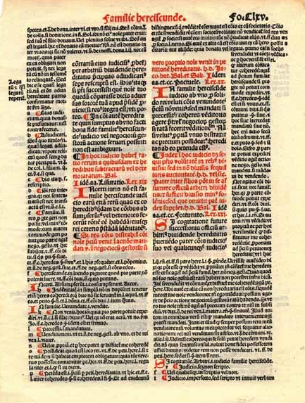
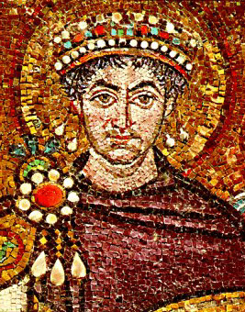
Justinian
The Justinian Code
Conflicts between laws of various conquered peoples
No rewrite for 500 years (since time of Augustus)
Simplified 2-3 million lines of laws to just 150,000 lines

Slide 18
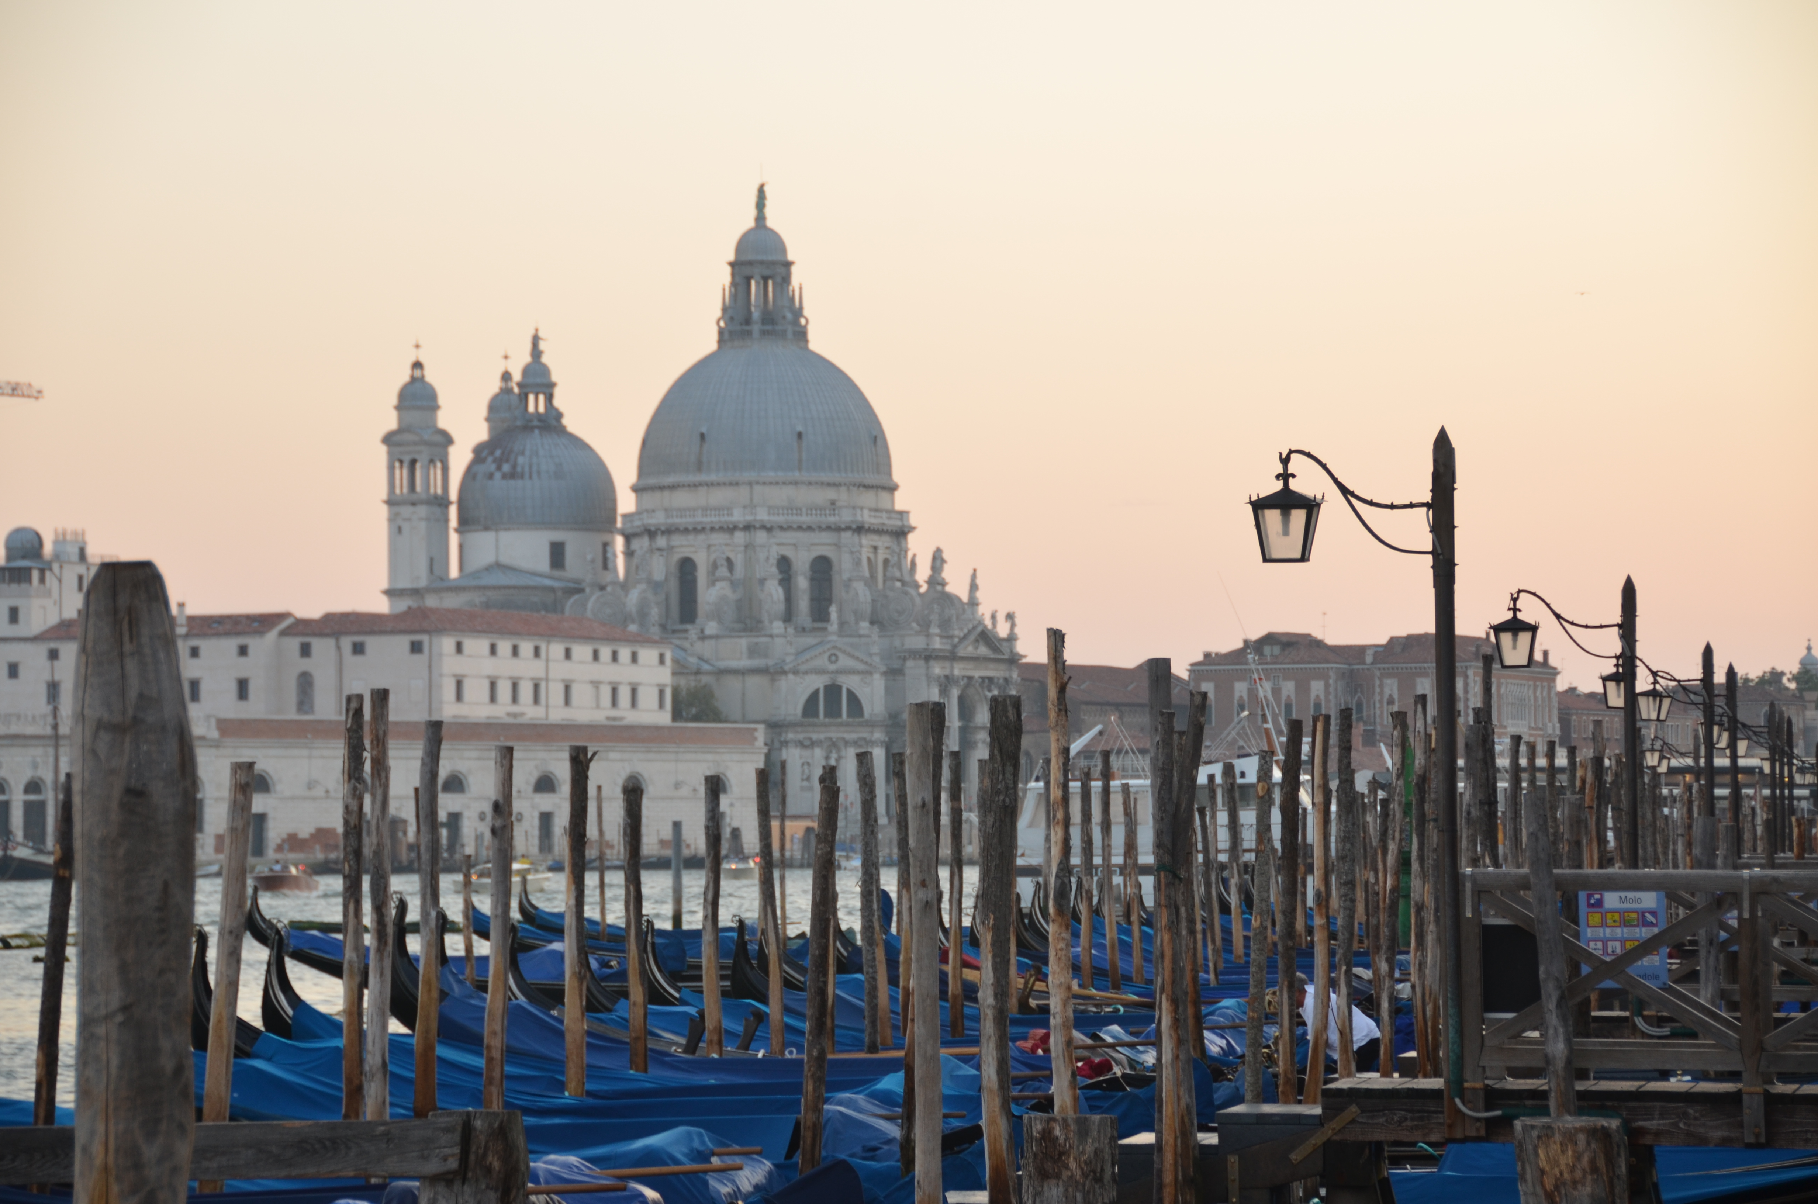
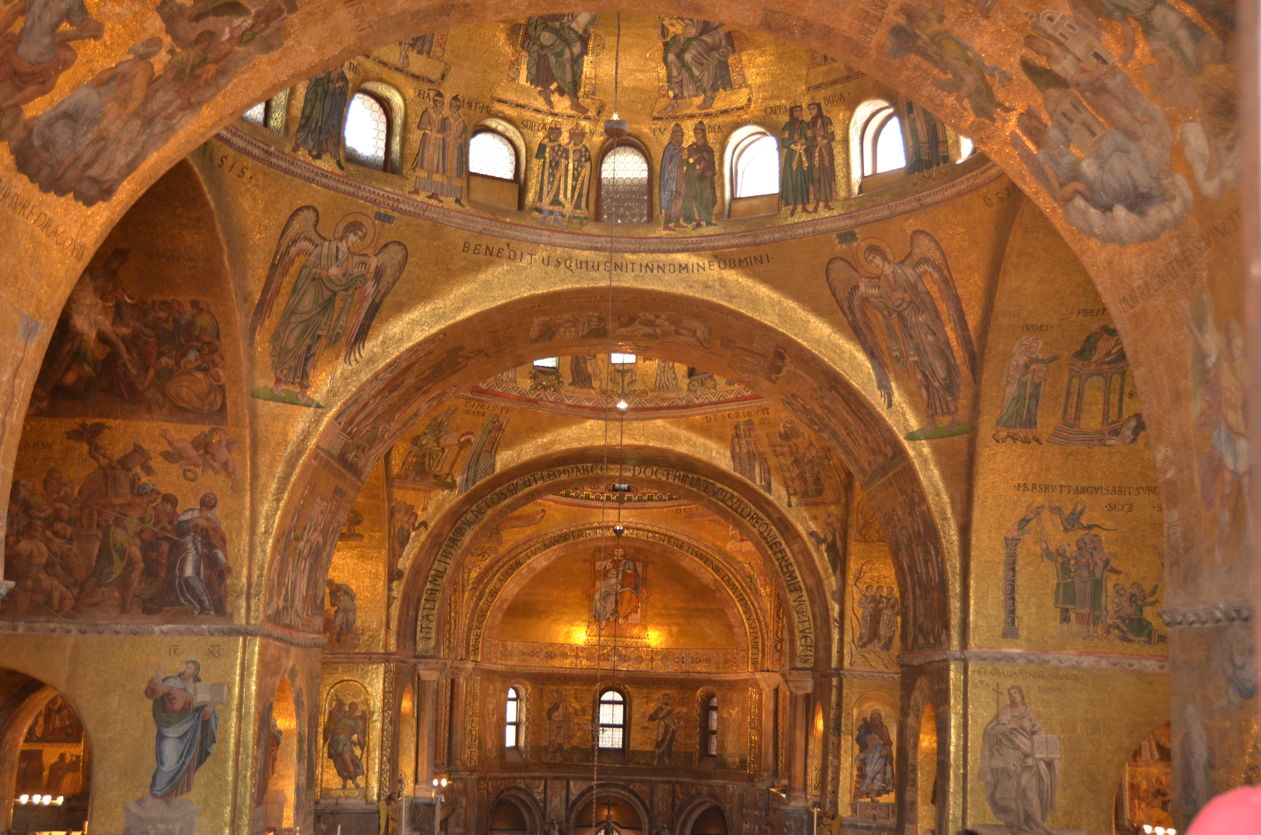
Byzantium (6th, 7th, 8th, & 9th C)
Established Venice as gateway to Europe

Slide 19
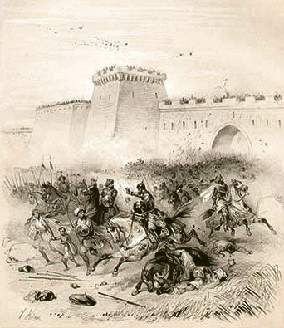
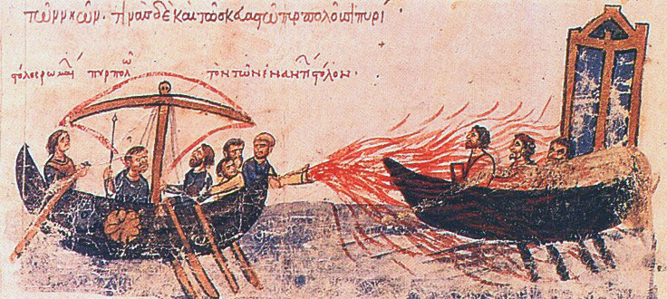
Byzantium (6th, 7th, & 8th, & 9th C)
Attacks by Muslims
Very successful via land
Not successful via sea
Constantinople protected
Greek Fire

Slide 20
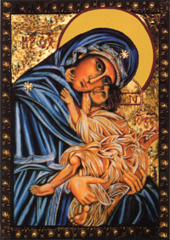
Byzantium (6th, 7th, & 8th, & 9th C)
Iconoclasm
Emperor Leo III ordered all images to be destroyed
The followers of the emperor broke the icons but most people resisted.
The Roman Church refused to break icons (statues).
The controversy continued for several decades and was eventually solved by accepting icons.

Slide 21
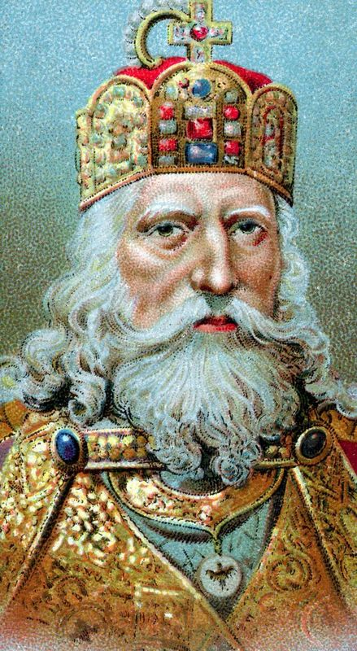
Byzantium (6th, 7th, & 8th, & 9th C)
Imperial church
Emperors confirmed the choice of pope (in the West) and patriarch (in the East).
Popes resented the interference.
In AD 800 the pope crowned a new emperor (Charlemagne).
Charlemagne took over the right to confirm the choice of pope.

Slide 22
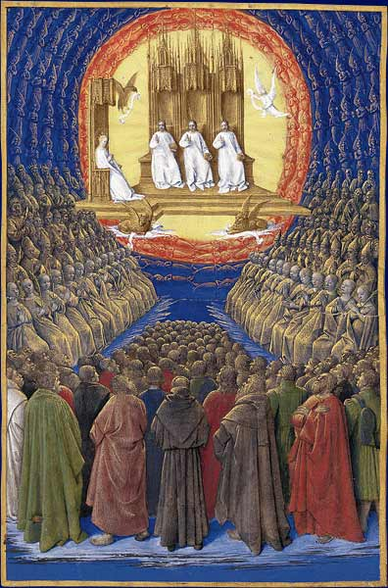
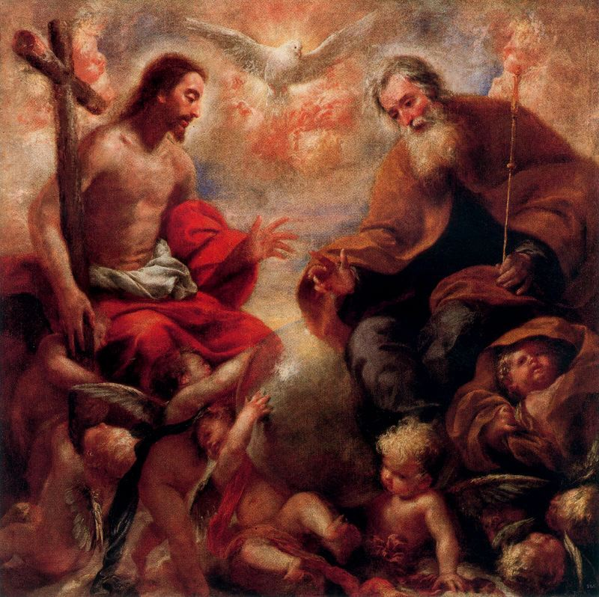
Macedonian Dynasty (11th C)
In 1054 Roman and Orthodox schism
View of the Pope
Views on the Trinity
Immaculate Conception
Priest Celibacy

Slide 23
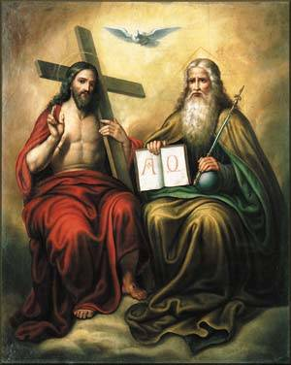
Creeds
The basis of the division between eastern and western empires, between Constantinople and Rome, came down to three words. The difference was about the nature of the Trinity, God as Father, Son and Holy Spirit….

Slide 24
Creeds
In Orthodox dogma from the sixth century, the Holy Spirit proceeded ‛from the Father' and thus through the Son. In Roman dogma, the Spirit proceeded ‛from the Father and the Son', a phrase incorporated into the Creed in 1020.
—Man, John, Gutenberg, John Wiley and Sons, 2002, p.90.

Slide 25
Fall of Constantinople

Slide 26
Thank You
Rejuvenate
Creativity

