Slide 1
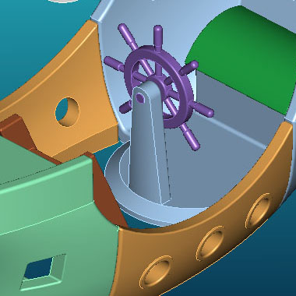
Rotational Molding
MFG 355

Slide 2
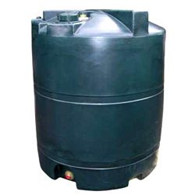
Introduction
Also known as rotomolding or rotocasting
Large, hollow, one-piece plastic products
Toys (Little-Tykes)
Suitable for small and slightly complex shapes

Slide 3
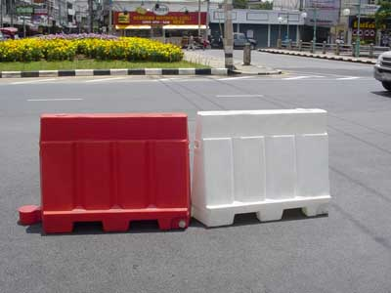
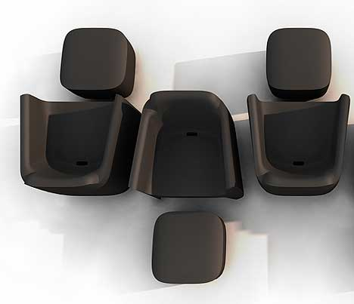
Example Products

Slide 4
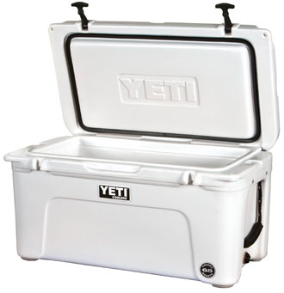
Example Products

Slide 5
Example Products

Slide 6
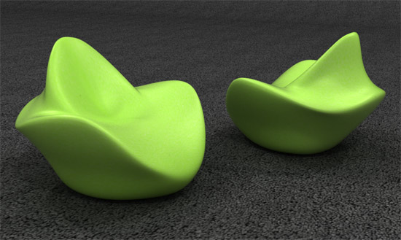
Example Products

Slide 7
Example Products

Slide 8
Example Product

Slide 9
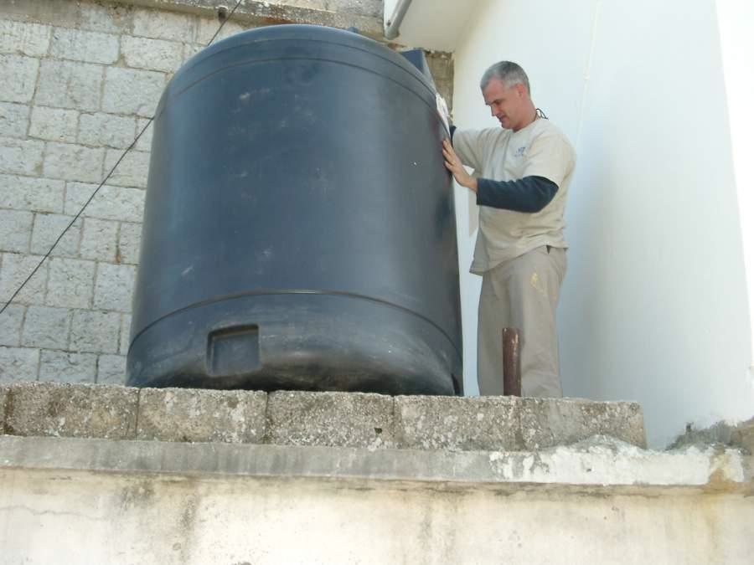
House Water Tanks

Slide 10
World Wide Molders
One of the easiest plastics processes to begin in an under-developed country

Slide 11
Rotomolding Overview

Slide 12
The Process

Slide 13
The Method - Loading
A predetermined amount of resin is loaded into the mold
The mold is closed after the flanges have been cleared of resin particles
Rotate the mold to ensure no tools have been left on the machine

Slide 14
The Method - Heating
Rotate the mold in a high-temperature environment
The resin will always sit at the lowest point of the cavity (powder pool)
It will slowly coat the mold interior until all the resin has melted
The resin will then continue to densify as the gap between the particles disappears
Remove the mold from the oven when the powder has completely melted and densified

Slide 15
The Method - Cooling
Rotate the mold in a room temperature environment
This allows the layer of resin to cool and solidify
Water can also be used, but care should be exercised

Slide 16
The Method - Unloading
Remove the clamping system
“Pry” open the mold
Lift the completed, hollow, one-piece part from the mold.
Repeat the cycle

Slide 17
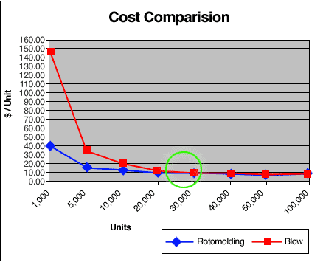
Process Comparisons
Strengths
Small production runs
Large part capability
Low tooling costs
‘Stress-free” products
Short product development lead times

Slide 18
Process Comparisons
Weaknesses
Slow cycle times
Limited material choices
Difficult to automate
Poor image
Low technology culture

Slide 19
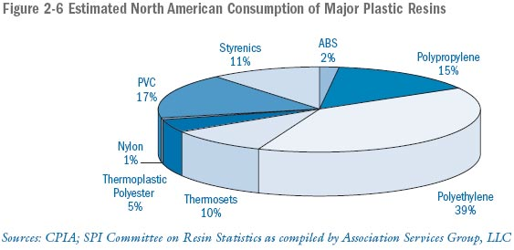
Materials

Slide 20
The Materials
Low Zero Shear Viscosity is required to aid in the flow of the polymer within mold
MFI
Lower MFI resins – high strength products
Higher MFI – good surface finish and surface detail

Slide 21
The Materials
Particle shape and size is crucial to the flow characteristics as the mold is rotating
Standard size is a 35 mesh powder (500 micron, 0.0197 inches)

Slide 22
The Materials
Other Material
Foams
Post-process
In-process
Liquid reactive polymers
Micro-pellets
Additives
Ceramics

Slide 23
Fixed Carousel Machines

Slide 24
Independent Carousel Machines

Slide 25
Rock-and-Roll Machines

Slide 26
Rock-and-Roll Machines

Slide 27
Clamshell Machines

Slide 28
Shuttle Machines

Slide 29
The Molds
Materials
Steel
Mild
Stainless
Aluminum
Cast
Machined
Plate

Slide 30
The Molds – Frame and Spider

Slide 31
The Molds - Parting Line

Slide 32
The Molds - Mold Sections

Slide 33
The Molds - Clamping Hardware

Slide 34
The Molds - Vents

Slide 35
The Molds - Vents

Slide 36
The Molds – Kiss-Offs

Slide 37
The Molds - Threads

Slide 38
The Molds - Inserts

Slide 39
The Method
The concern
How do you really know when it is time to do the next step?
When is the resin melted?
When is it cooled?
In the early 90’s, QUB invented an instrument that revolutionized process comprehension and control
The Rotolog™

Slide 40
The Method – Rotolog™

Slide 41
The Method – Rotolog™

Slide 42
The Method – Temperature Profiles

Slide 43
The Method – IAT Profile

Slide 44
The Method – IAT Profile

Slide 45
The Method – IAT Profile

Slide 46
The Method – IAT Profile

Slide 47
The Method – IAT Profile

Slide 48
The Method – IAT Profile

Slide 49
The Method – IAT Profile
We can thus observe:
When powder first sticks to the mold
When the powder has been consumed
When optimal melt sintering has occurred
When solidification is occurring
When the plastic separates from the mold
C
B
D
A
E

Slide 50
The Method – IAT Profile
The Peak Internal Air Temperature (PIAT) is the key process control parameter and is independent of all other process variables (point C)
C

Slide 51
Conclusion
Though in a state of infancy, Rotomolding offers unique advantages over other plastics processes
There are endless opportunities for research and development
Rotomolding has a very promising future, more so than many competing processes

Slide 52
Thank You

