Slide 1
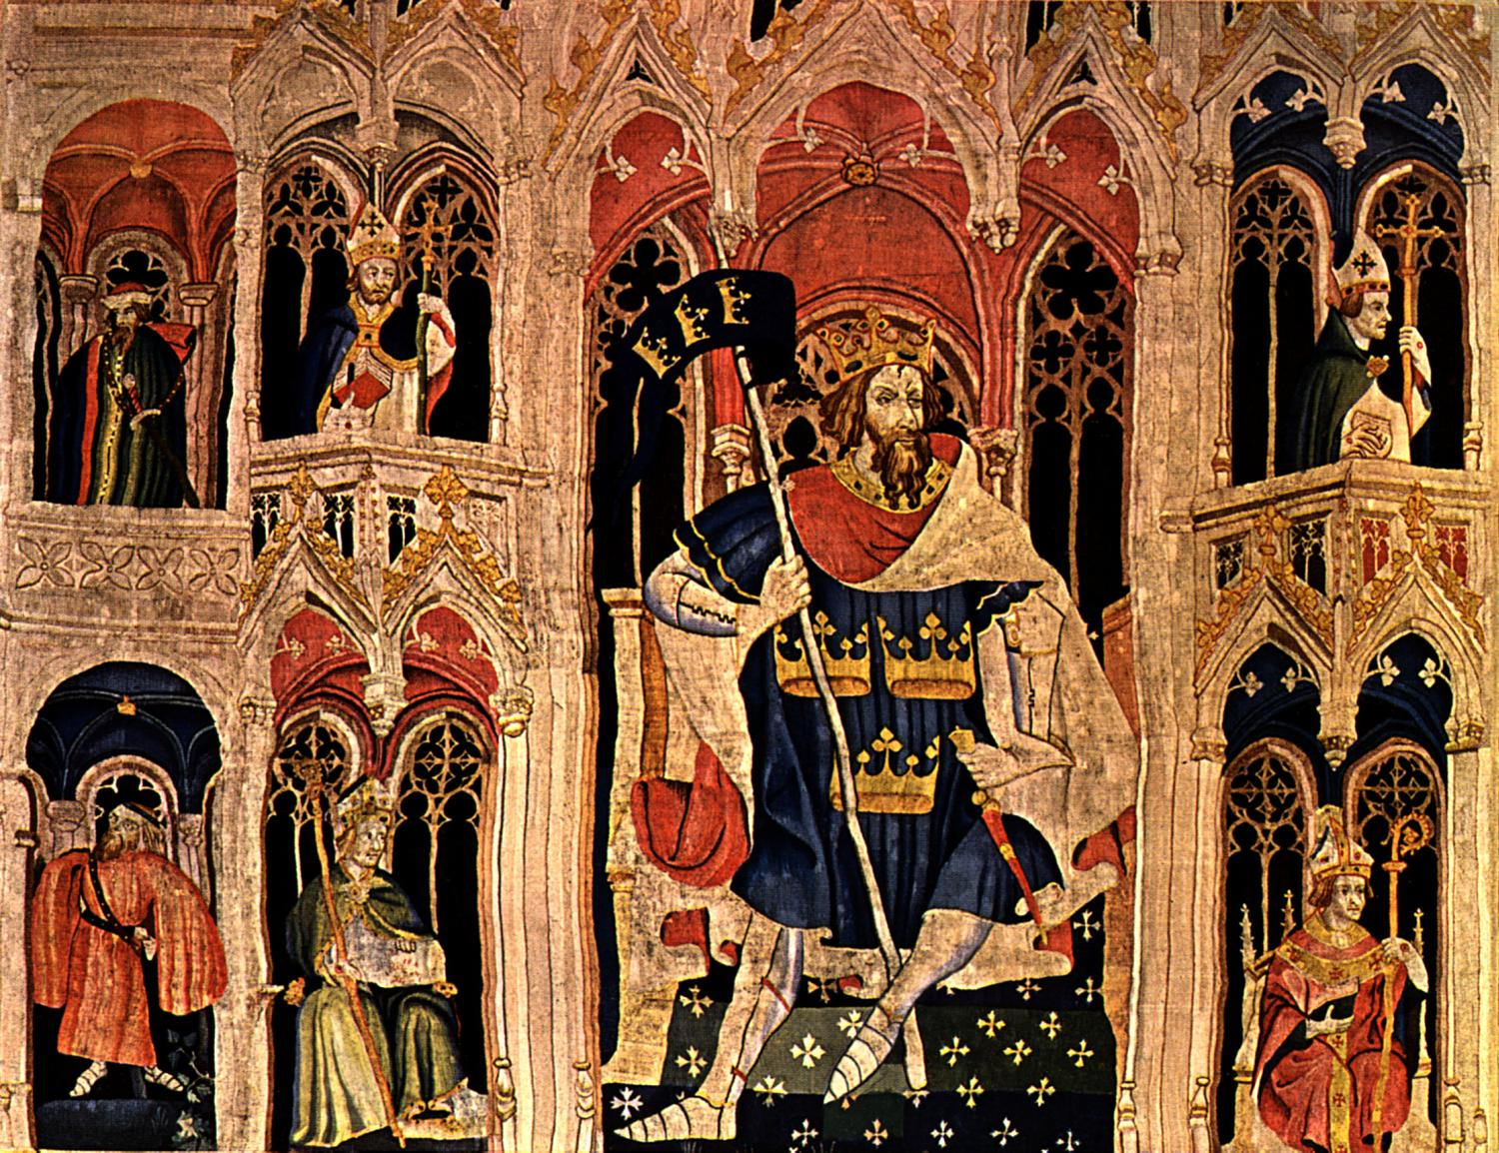
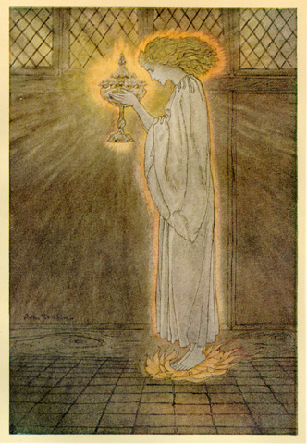
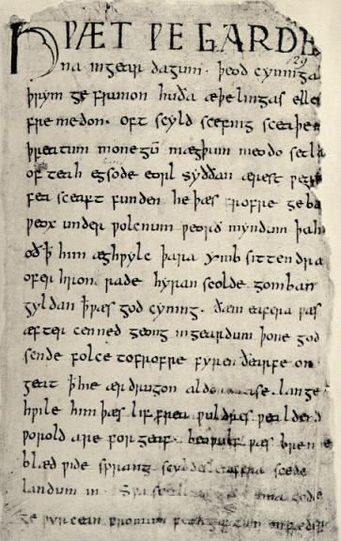
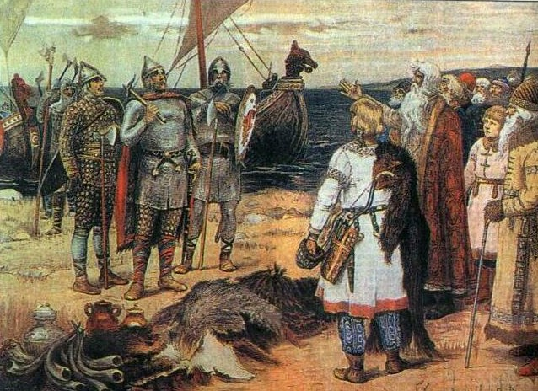
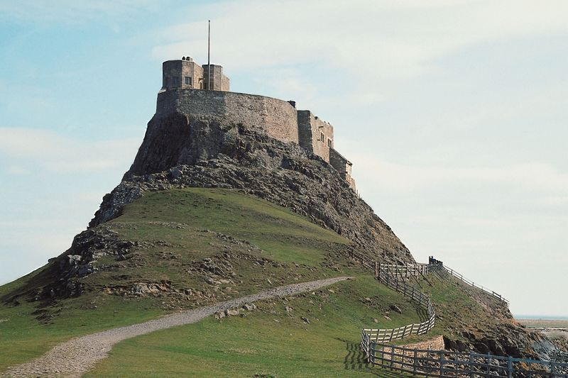
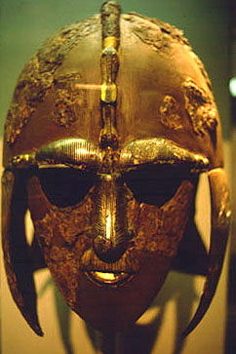
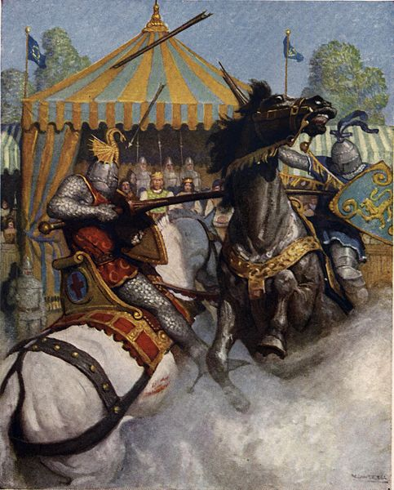
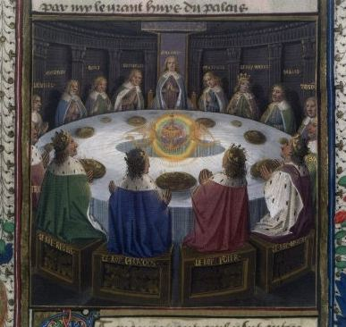
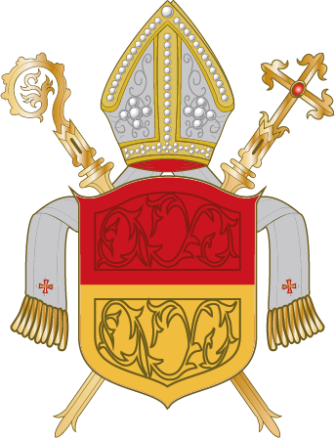
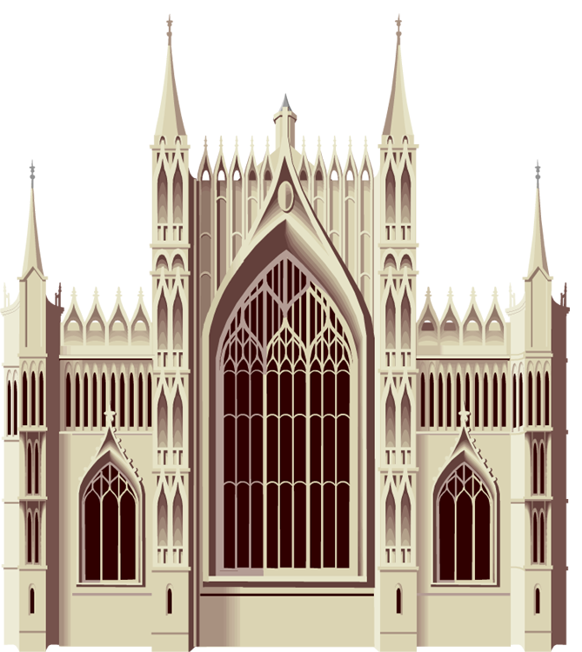
Early Medieval Europe

Slide 2
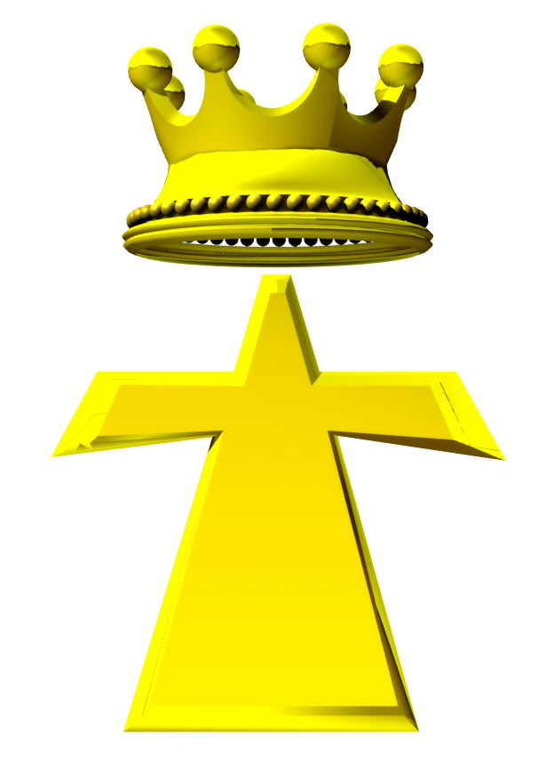
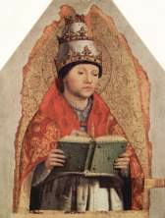
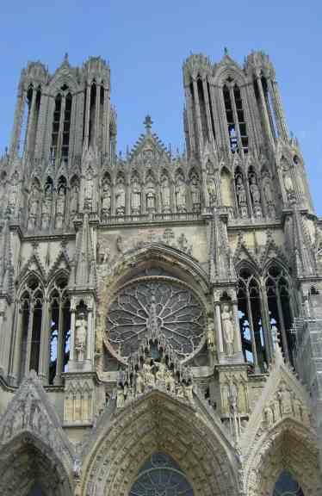
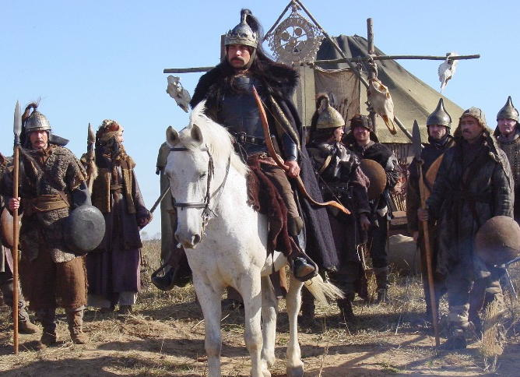
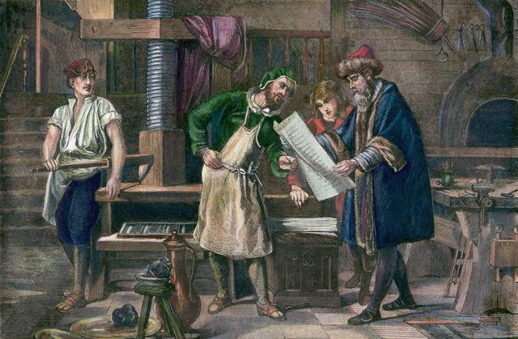
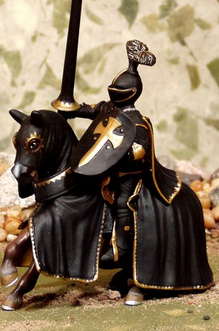
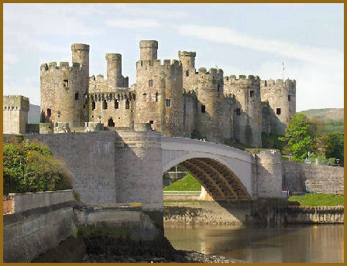
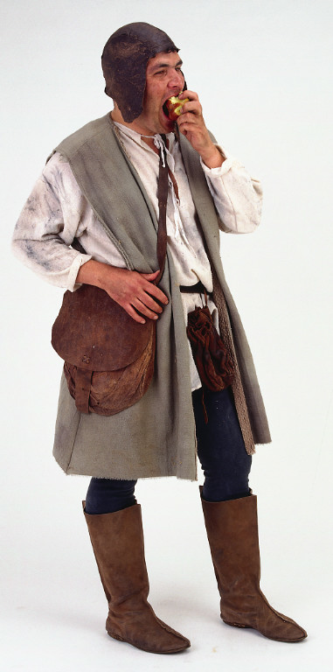
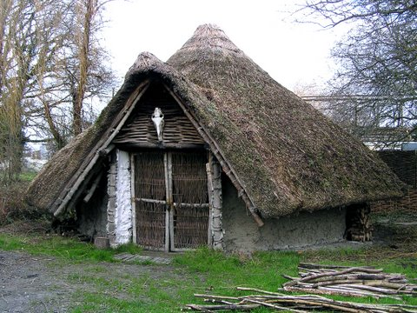
Middle Ages
AD 476
Middle Ages
AD 1450
Renaissance
Ancient
Barbarians defeat Rome
Printing press invented

Slide 3
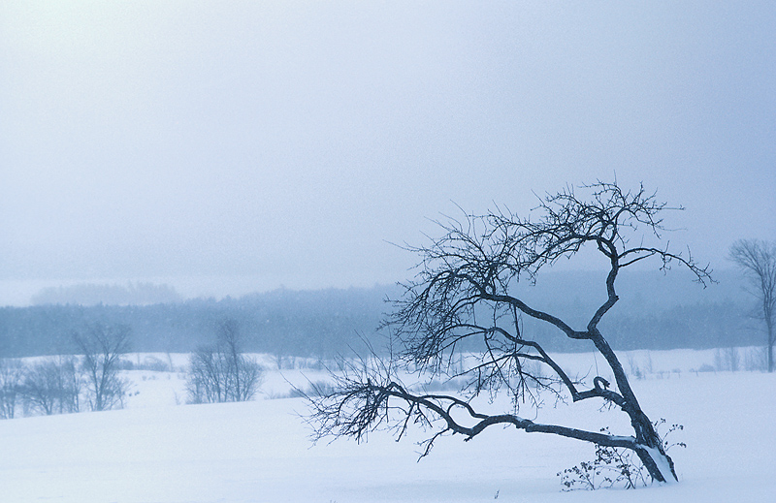
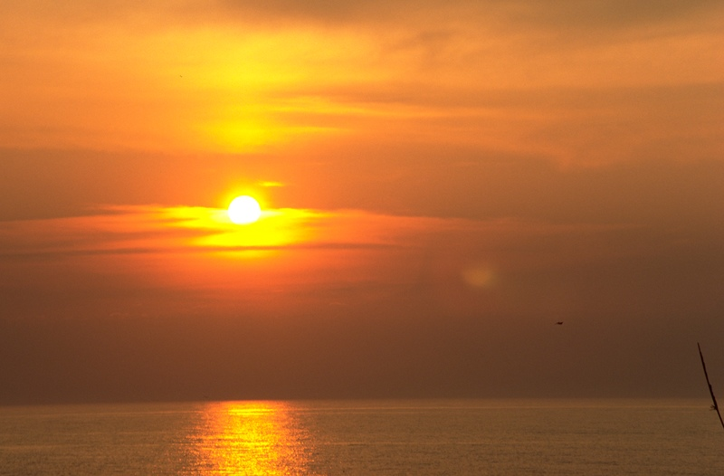
Middle Ages
Dark Ages
AD 1000
High Middle Ages
Lawlessness
Decline of cities
Church absolutism
Cool weather
Survival attitude
Countries gain power
Cities and culture revive
Church versus kings
Warmer weather
Creativity reawakened
Renaissance

Slide 4
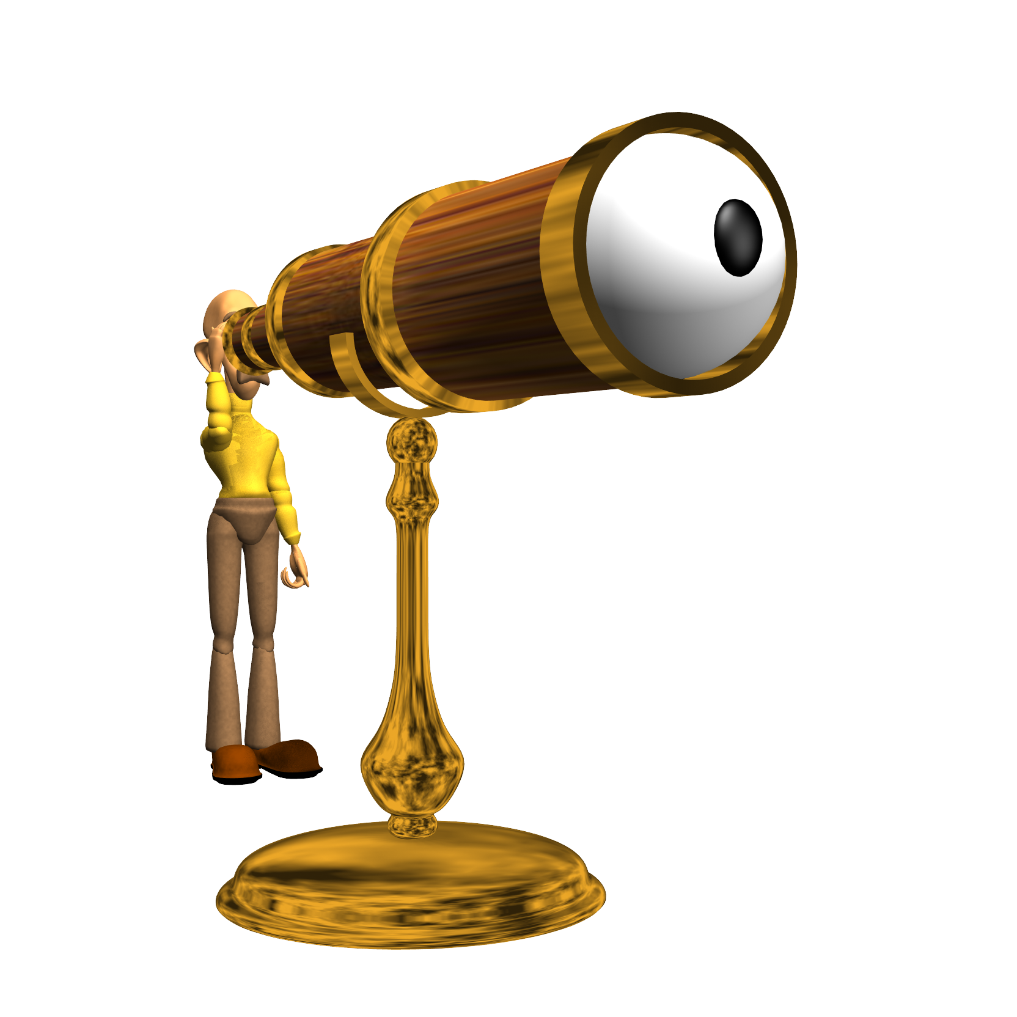
Dark Ages
What does it mean when we refer to these times as the “Dark Ages”?
An exercise in perception:
Ancient History
AD 476
Renaissance
AD 1450

Slide 5
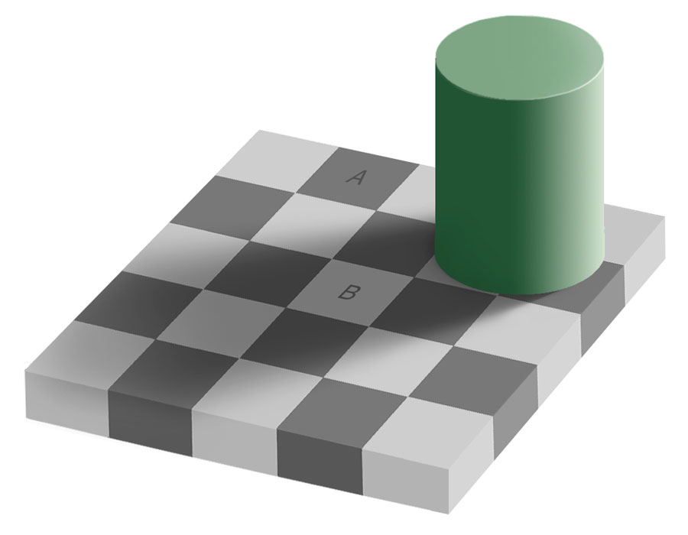
Perception
Are squares A and B the same color and shade?
AD 1000
High Middle Ages
Ancient History
AD 476
Renaissance
AD 1450

Slide 6
Perception
Sampling the Squares
AD 1000
High Middle Ages
Ancient History
AD 476
Renaissance
AD 1450

Slide 7
Perception
Covering the surrounding squares
AD 1000
High Middle Ages
Ancient History
AD 476
Renaissance
AD 1450

Slide 8
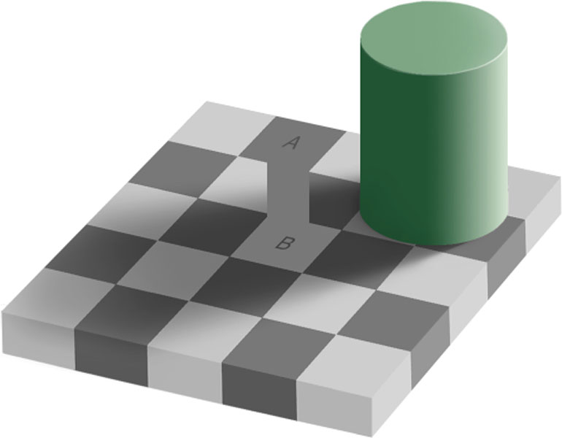
Perception
Showing the connection
AD 1000
High Middle Ages
Ancient History
AD 476
Renaissance

Slide 9
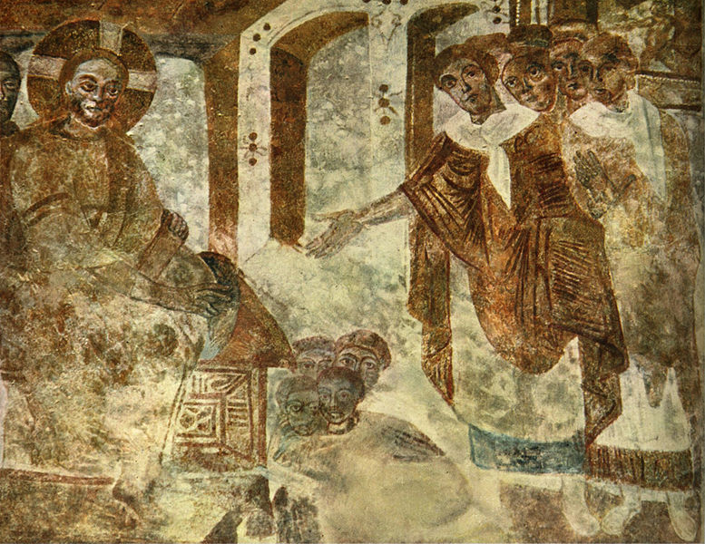
Dark Ages
High Middle Ages
What does it mean when we refer to these times as the “Dark Ages”?
The Dark Ages are dark by comparison.
Ancient History
AD 476
Renaissance

Slide 10
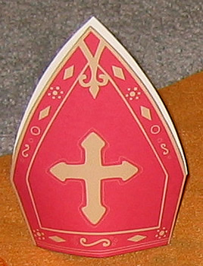
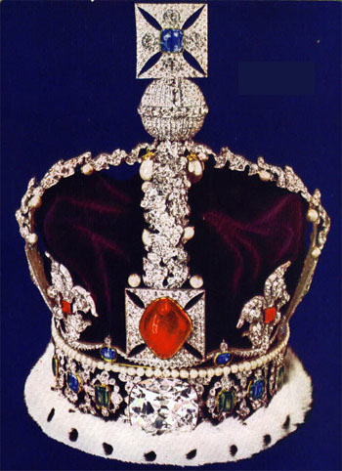
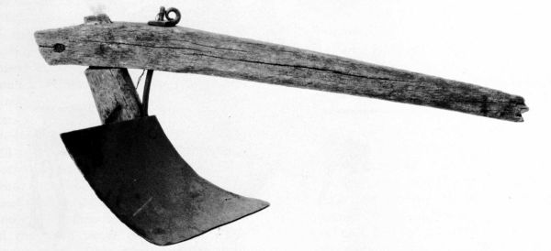
Dark Ages
1st Estate = The Roman Catholic Clergy
Purpose = Do good deeds
2nd Estate = The Nobility
(both local and “national”)
Purpose = Govern/Fight
3rd Estate = The Commoners (all others)
Purpose = Work
AD 476

Slide 11
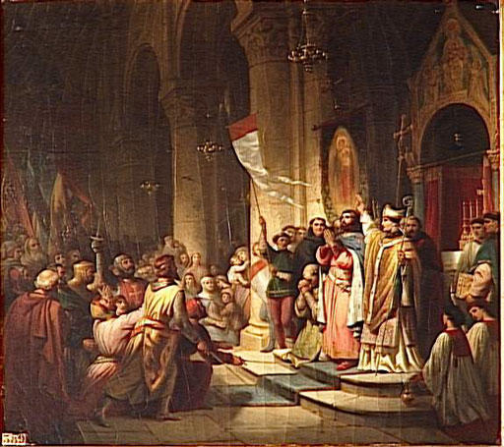
Church Absolutism—Dark Ages
Imperial church left over from Roman Empire
Emperor approved/nominated the pope/patriarch
But, emperor was in Constantinople
Therefore, popes were locally chosen and ratified by the emperor afterwards
AD 476

Slide 12
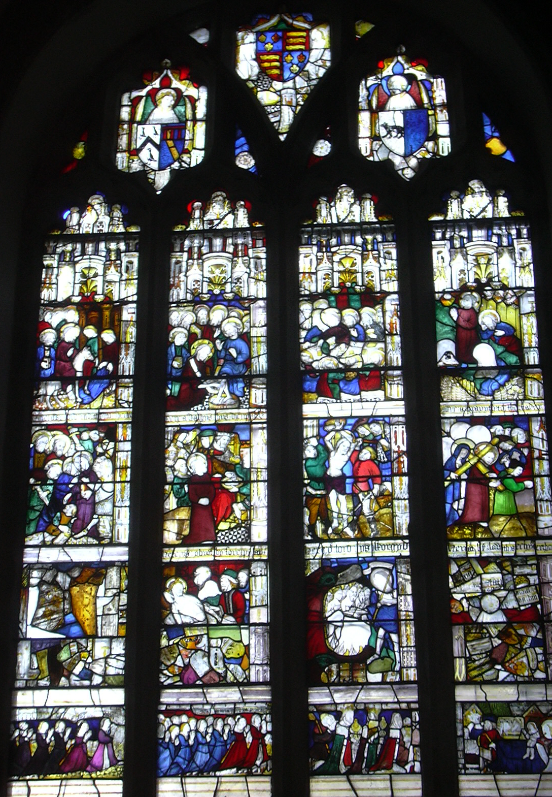
Church Absolutism—Dark Ages
No powerful kings in Europe
Church was everywhere
Became the legal authority (basilica, judge, etc)
Gained taxing authority
Popes became substitutes for the Emperor.
AD 476

Slide 13
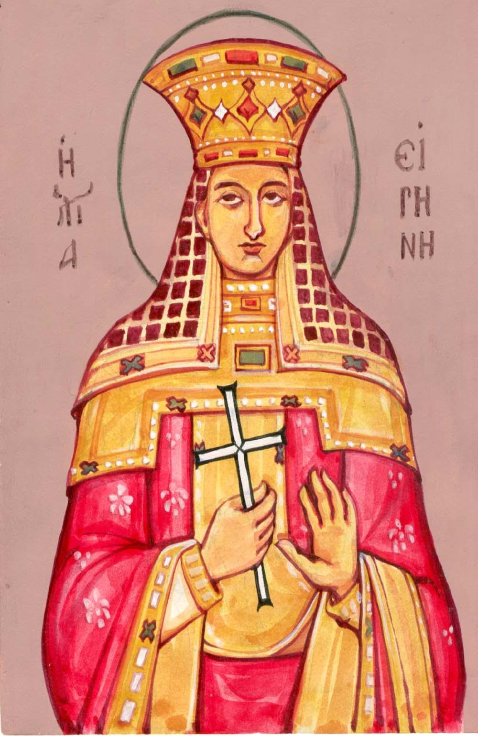
Church Absolutism—Dark Ages
Problems
Popes chosen primarily from among the elite families of Rome (like the emperors)
1/3 of early popes were killed violently (like the emperors)
Several sects of Christians had no allegiance to pope
Geographical independence
(Example: England)
Doctrinal independence
(Example: Arianism/Monophysitism)
Large non-Christian population in Europe
AD 476

Slide 14
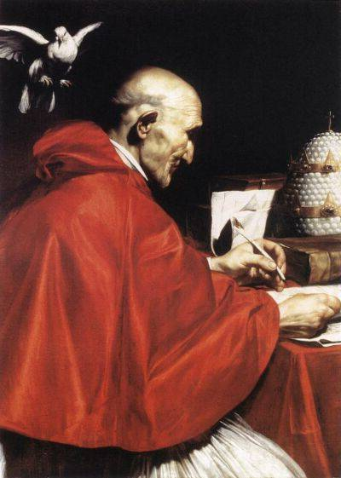
Gregory I (about 600 AD)—Creativity
Strengthened the office of the papacy
Sent delegates to all European Christian groups to unify them under the pope
Accommodation of the pagans
Pagan Mother Goddess (Virgin Mary)
Holidays (Ex: Christmas, Easter, Halloween)
AD 476

Slide 15
Gregory I (about 600 AD)—Creativity
Solidified the rules of the church
Celibacy for priests
Solidified the mass
Created concept of liturgical singing (Gregorian chants)
AD 476

Slide 16
Discussion
Was Pope Gregory’s “Christianization” of pagan beliefs good or bad?
Is it acceptable for a church to change?
AD 476

Slide 17
Great Chain of Being
Religious Chain
Political Chain
God
Pope
Bishop
Priest
Peasant
God
King
Lord
Knight
Peasant
AD 476

Slide 18
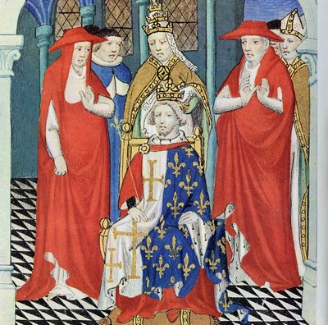
Great Chain of Being
During this period of time, the religious chain was stronger than the political chain.
Kings received their “grant” of permission (authority) from the pope.
Kings were crowned by the pope.
AD 476

Slide 19
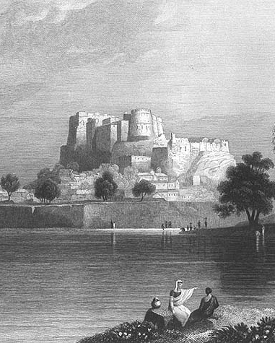
Feudal System—How did it happen?
Loss of government and law
Travel restricted (dangerous)
Reduction of cities
Cold weather brought low food
Little time for anything but work
Loss of creativity
Marauder exploitation of people
Peasant deals with marauders
Marauder deals with marauders
AD 476

Slide 20
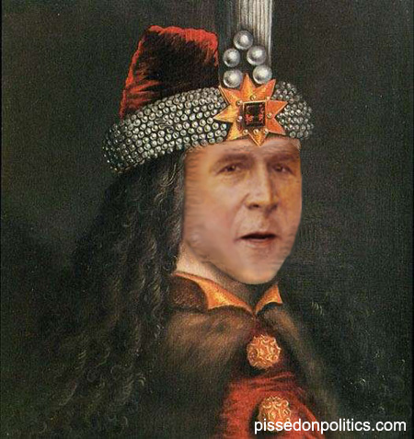
Feudal System
Emergence of a nobility class
People gave up rights to their Lord
Local ruler was often a Count
From which we get “county”
In a democracy it’s your vote that counts; in feudalism, it’s your Count that votes.
AD 476

Slide 21
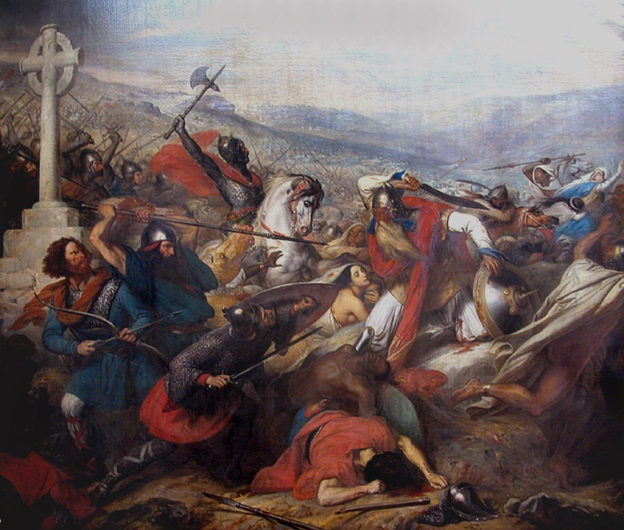
Kingdom of the Franks
Franks (from Germany) settled in Gaul
Clovis—King of Merovingian dynasty
Converted to Christianity
Accepted Roman Catholic authority
Charles Martel's rise
Master (mayor) of the palace
Defeat of the Moslems at Tours (also called Poitiers) in 732
AD 476

Slide 22
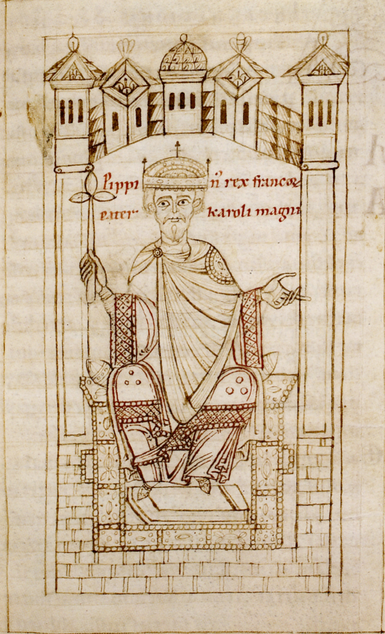
Kingdom of the Franks
Pepin the Short
Son of Charles Martel
Mayor of the palace
Conquered the Lombards in Italy (in part).
The pope agreed to make him the “legal” king of France.
Pepin agreed to support the pope and recognize Papal States.
AD 476

Slide 23
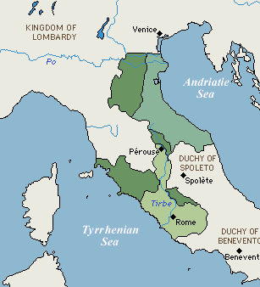
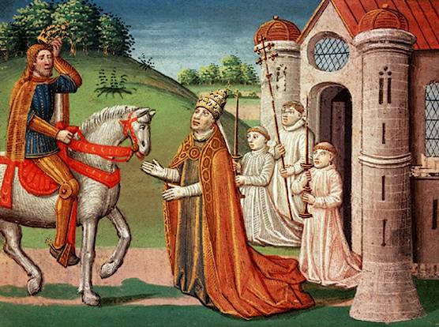
Kingdom of the Franks
Donated by Pepin
Pepin gave the pope the territories which added to the Papal States.
Pepin’s son, Charlemagne, also gave lands to the pope.
Donated by Charlemagne
Original area under
papal control

Slide 24
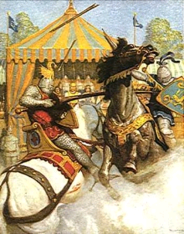
Carolingian Dynasty
Charlemagne
Son of Pepin the Short
Became sole king of the Franks (France), Lombards (Italy), Saxons (Germany)
Creatively developed knights as a war technique
Stirrups
High-backed saddle
Chivalry became a code of conduct to control knights

Slide 25
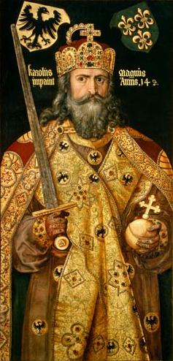
Carolingian Dynasty
Charlemagne
Crowned as Holy Roman Emperor
(AD 800) by the pope.
This step angered the Byzantine Emperor.
It made the pope independent of the Byzantine Emperor.
Tried to emulate (recreate) the Roman Empire
Buildings
Learning and culture

Slide 26
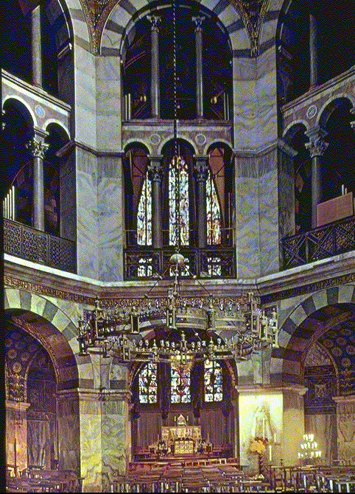
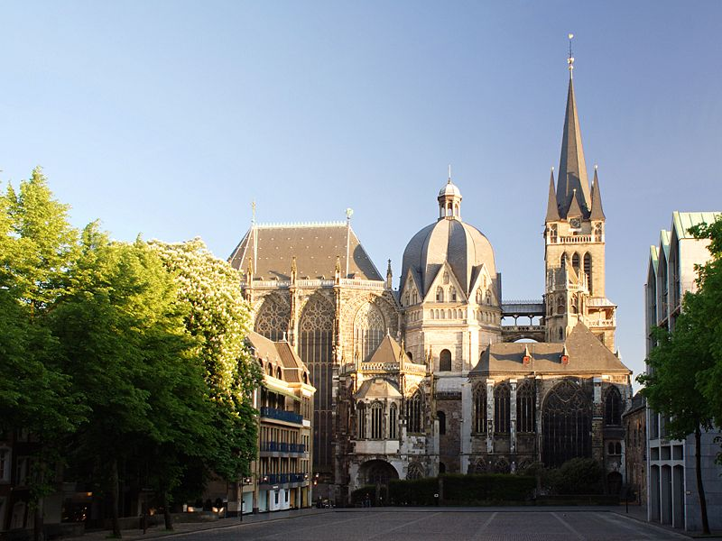
Carolingian Dynasty
Octagonal, like Justinian’s church in Ravenna
The portion of the church built by Charlemagne

Slide 27
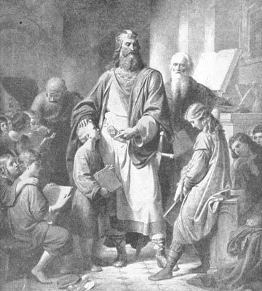
Carolingian Dynasty
Governmental reform
Legal system
Tax system
Intellectual revival
Influenced by Northumbria and Alcuin
Educational system made mandatory in every bishopric

Slide 28
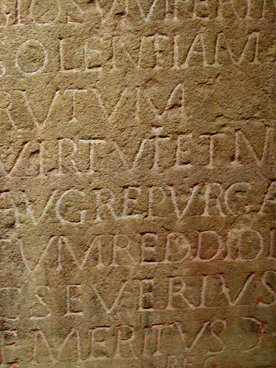
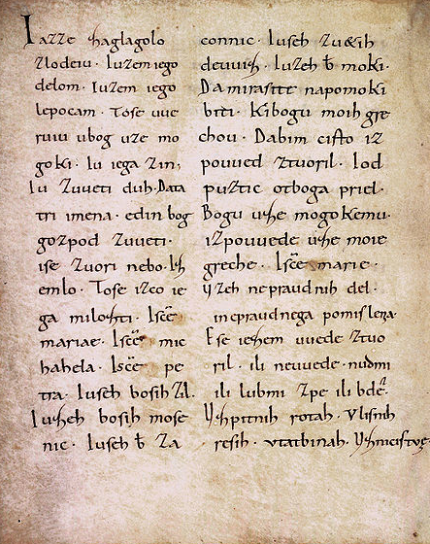
Carolingian Dynasty
Scholars copied books in the new Carolingian script
Old script
Carolingian miniscule (new script)

Slide 29
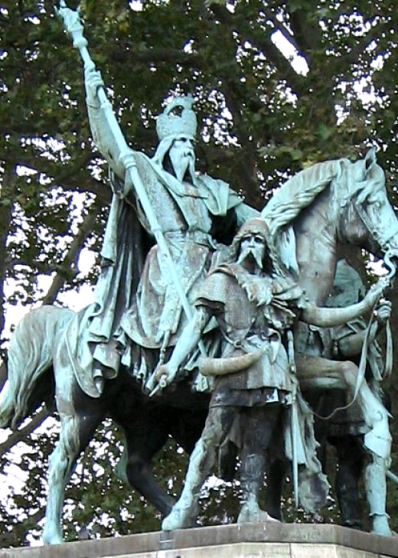
Carolingian Renaissance
Solidified French as a language
People in France thought they were speaking Latin
Charlemagne’s language experts realized that Latin had been corrupted
The Latin language was reformed to be like old Latin
This separated Latin from the language of the people (French) and the people realized that they were speaking a new language

Slide 30
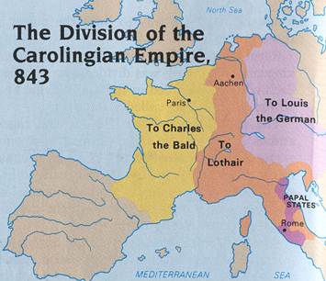
Carolingian Renaissance
End of the Carolingian period
Charlemagne’s son succeeded him
Louis the Pious was a weak leader
Louis’ 3 sons divided the kingdom
Treaty of Verdun
“Birth of Europe”

Slide 31
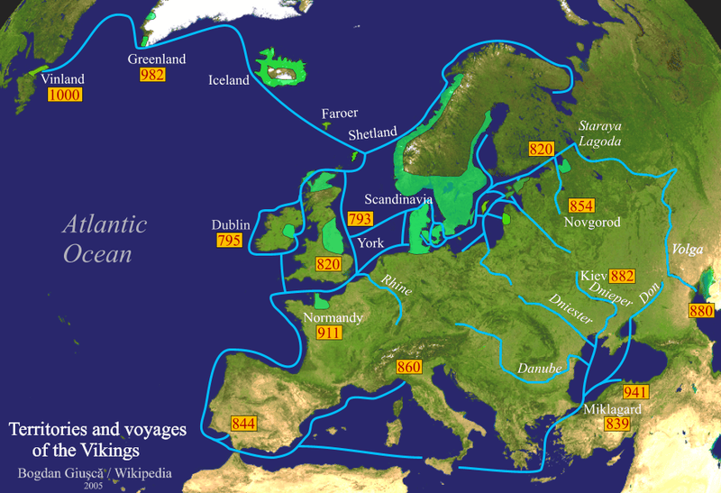
Viking Invasions
South to Florida

Slide 32
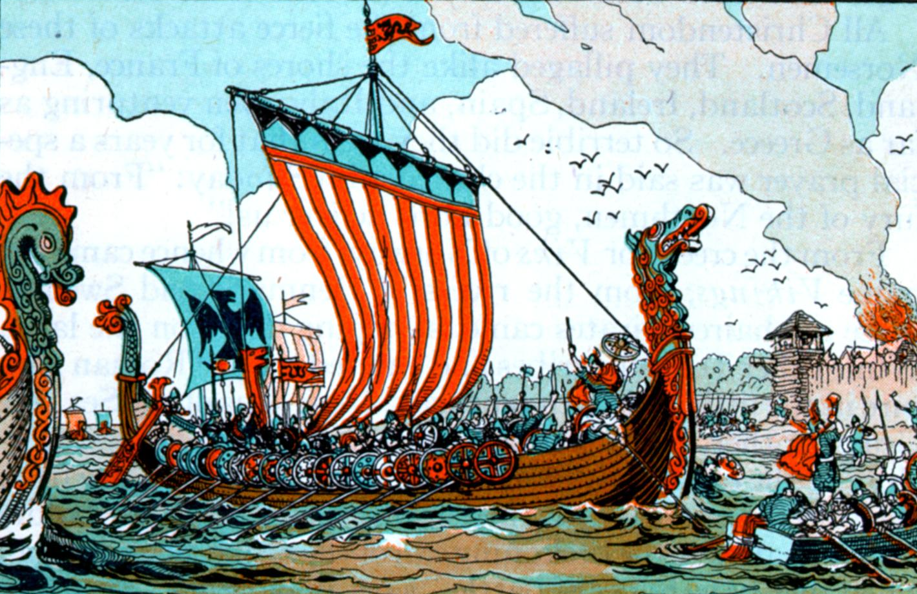
Viking Invasions—Creativity
Shallow draft to invade up rivers
Enough keel for ocean stability
Sailors/fighters

Slide 33
Carolingian Collapse
Invasions
Norseman or Vikings
Magyars from Hungry
Muslims from N. Africa
Effects
Built stone castles
Power devolved to local leaders

Slide 34
England
Early Christianity in England (legend)
Joseph of Arimathea and Mary Magdalene to Avalon (Glastonbury)
Holy Grail
(San Grael or
Sangre Real)
Reaction of Jim Platts, Professor at Cambridge

Slide 35
England
Early Christianity in England (Historical evidence)
The Britons preserved the Faith which they had received under King Lucius [AD 170] uncorrupted, and continued in peace and tranquility until the time of the Emperor Diocletian.
Quote from the Venerable Bede’s History of England

Slide 36
England
King Arthur
Celtic king (Britons)
Lived in AD 450-550 .period
Christian
Ruled from Camelot
Cadbury is suspected site
Cadbury is about 30 miles west of Glastonbury

Slide 37
England
King Arthur
Resisted the Anglo-Saxon invasion
Established a round table to get support of local lords
Actual round table in church in Winchester
Victory of Britons over Anglo-Saxon invasion in AD 496 by Ambrosius (Arthur?)—man of temperance—at Mount Baden

Slide 38
King Arthur—Camelot is dead

Slide 39
King Arthur—Camelot the dream

Slide 40
England
King Arthur
Last battle fought at Camlann
About 20 miles from Glastonbury
Arthur taken to Glastonbury for medical help
Arthur died and was buried at Glastonbury
Bodies of a king and queen facing Glastonbury Tor (Avalon)

Slide 41
England
Alfred the Great
Anglo-Saxon
Nearly wiped out by Danes
Determined reconquest (partial)
Danelaw
Beowulf written (oldest northern European epic)
Limited vocabulary and so words needed to be invented
Kenning
First page of Beowulf

Slide 42
Beowulf—Kenning
Kenning
Modern Word
Whale road
Helmet bearers
Wave steed
Sky candle
Breaker of trees
Learning knight
John the Fully Wetter
Sea
Warriors
Ship
Sun
Wind
Disciple
John the Baptist

Slide 43
Beowulf—Kenning
English Word
Norse Word
Shirt
Rear
Want
Skill
Skin
Church
Foxes
Skirt
Raise
Wish
Craft
Hide
Kirk
Vixen

Slide 44
Thank you It takes time to be creative

