Slide 1
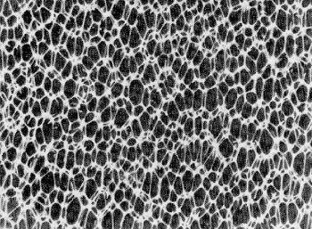
Foaming
MFG 355

Slide 2
Foaming Overview
Processes to create foams
Mechanical, Chemical, Physical, Syntactic (hollow spheres)
Open and closed cell foams
Flexible and rigid foams
Processes to shape and solidify foams
Molding, RIM, Foam-in-place, Extrusion, Casting, Expanded foam molding
Rebond materials
Foam product characteristics

Slide 3
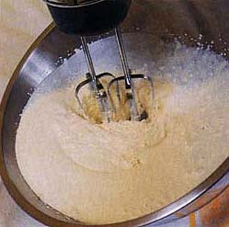
Foaming
Mechanical foaming
Mix air into the resin while in a liquid state
Plastisols, vinyl esters, urea formaldehydes, phenolics, polyesters

Slide 4
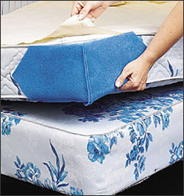
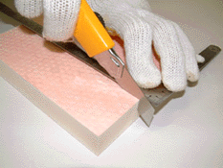
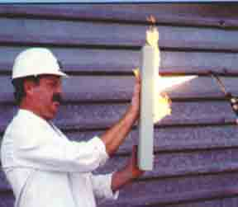
Foaming
Mechanical foaming
Mix air into the resin while in a liquid state
Plastisols, vinyl esters, urea formaldehydes, phenolics, polyesters
Phenolic foam
Phenolic foam
Polyester foam

Slide 5
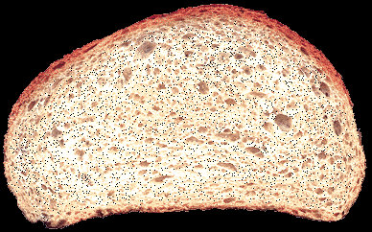
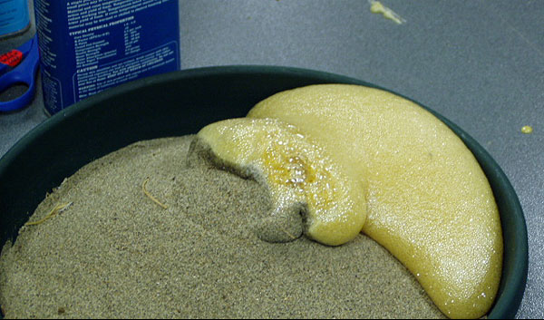
Foaming
Chemical foaming
Foaming agents or blowing agents
Chemical reaction that forms a gas/vapor
Bread (yeast foam)
Urethane foam

Slide 6
Urethane Foam
Polymerization reaction creates CO₂
The first step reacts isocyanate with water (instead of with a polyol as in a standard urethane reaction)
The first product is unstable and decompostes
This causes foaming as the polymer is formed
Polyurea

Slide 7
Foaming

Slide 8
Foaming
Physical foaming
Gas is forced into a liquid or molten resin
Pressure is released quickly
Foam is created
Shaving cream

Slide 9
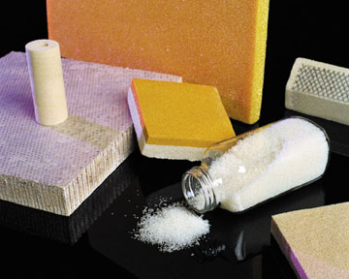
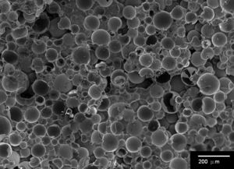
Foaming
Interesting Application
1998 World Cup Soccer Ball
Featured a newly engineered hi-tech syntactic foam layer. This new foam material had better compression and more explosive rebound characteristics, making the ball softer and faster than its predecessor, Questra.
Syntactic foams
Physically mix in hollow beads
Beads are usually glass or plastic
Wide density capability
Glass micro-balloons in epoxy

Slide 10
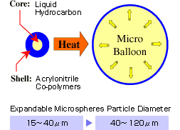
Thermoplastic Microspheres
Syntactic foam with another advantage
Thermoplastic beads (acrylic, acrylonitrile, polyvinylidene chloride, etc.)
Filled with low-boiling liquid (isobutene, isopentane)
Heated to expand

Slide 11
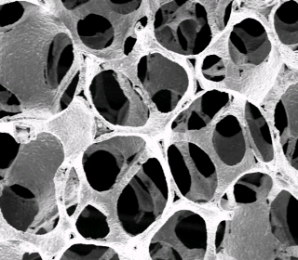
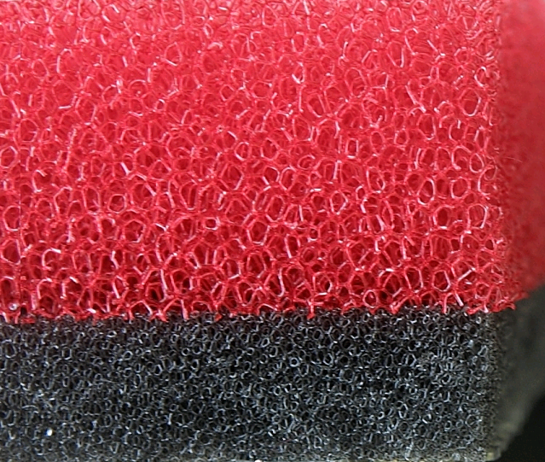
Open Cell Foams
Open cell foams
Cells are interconnected
Air will pass through the foam structure
Uses
Cushions
Filters

Slide 12
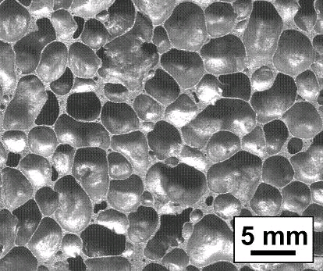
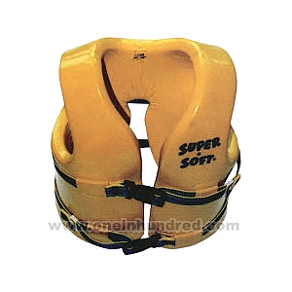
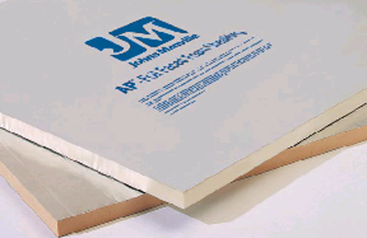
Closed cell foam
Each cell is independent
Cells don’t interconnect with other cells
Cells can hold a gas
Uses
Life vests (or any other water-contact application)
Cups, plates, etc.
Insulation

Slide 13
Processes
Molding
RIM
Foam-in-place
Extrusion
Casting
Expanded foam molding (EPS)
Rebond

Slide 14
Foam Molding
Foam Inlet
Fill Position
Expandable Mold
Liquid Resin with
Foaming Agent

Slide 15
Foam Molding
Foam Inlet
Expandable Mold
Expanded Position
Liquid Resin with
Foaming Agent

Slide 16
Molding and cell structure
Conversion from closed cell to open cell
Faster expansion
Higher temperature

Slide 17
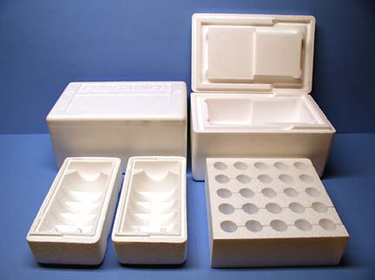
Molded foams

Slide 18
Reaction Injection Molding
Foaming Agent
Resin
Part A
Resin
Part B
In-line
Mixer
Foamed
Part
Mold

Slide 19
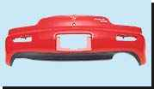
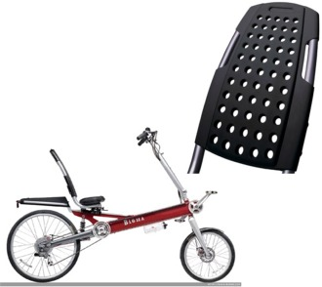
RIM

Slide 20
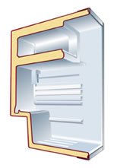
Foam-in-place
Foaming Injector
Nozzle
Refrigerator Walls
Foam

Slide 21
Extrusion Foaming
Paper
Saw
Extruder
(Resin and Foaming
Agent)
Belt Drive
Paper
Expanded Foam

Slide 22
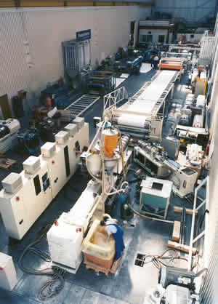
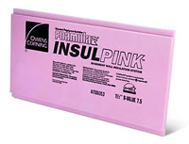
Extrusion foam line

Slide 23
Casting Foams
Expanded
Foam
Open Pan
Resin and
Foaming Agent

Slide 24
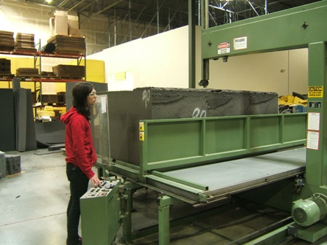
Casting Foams
Skiving the Foamed Bun

Slide 25
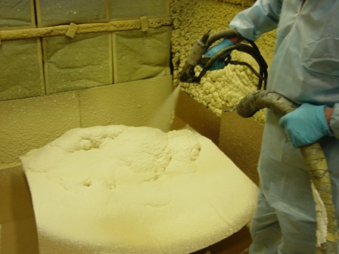
Foam Spraying
Foaming agents mixed as they exit the spray nozzle

Slide 26
The Foam Test
AFFF system at Ellsworth AFB
Was only supposed to last a few seconds
System wouldn't shut off…
I’d hate to have to explain this.

Slide 27
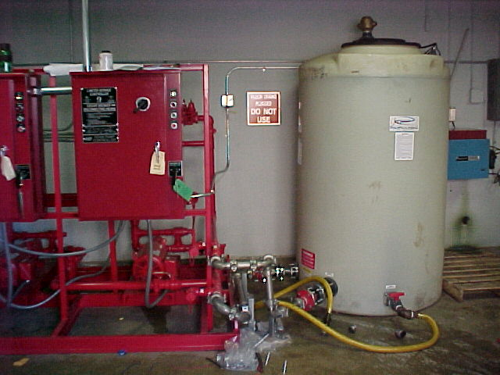

Slide 28
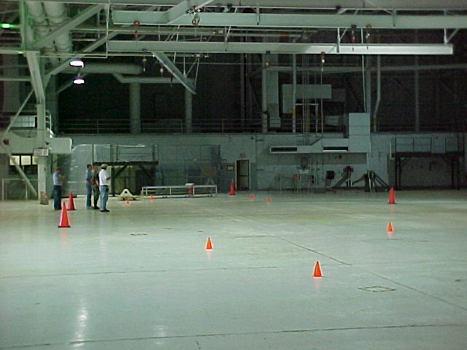

Slide 29
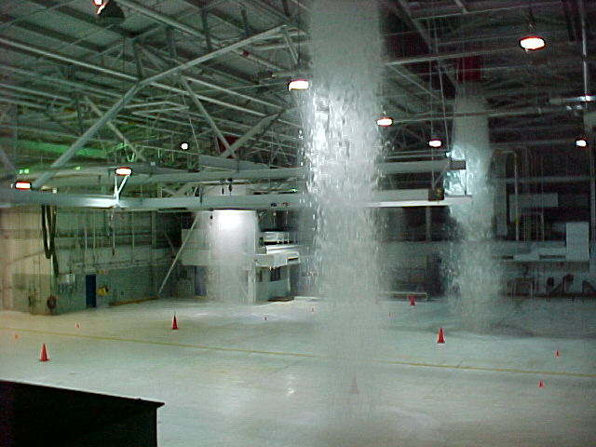

Slide 30
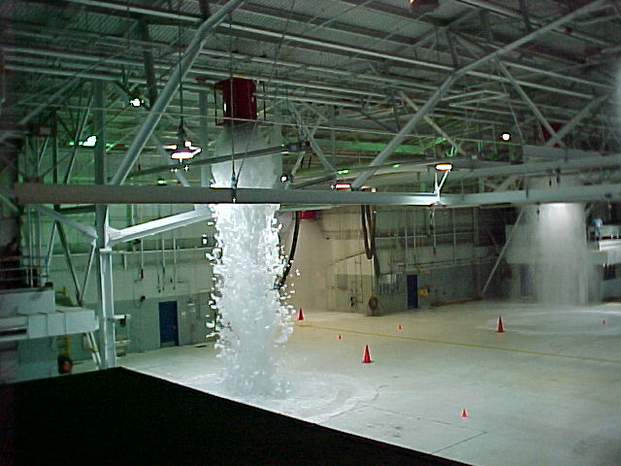

Slide 31
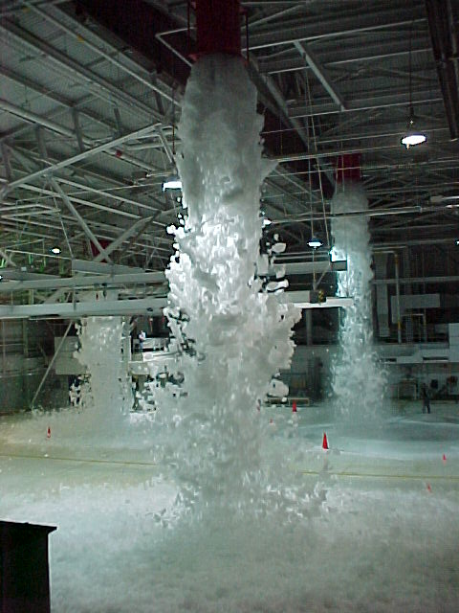

Slide 32
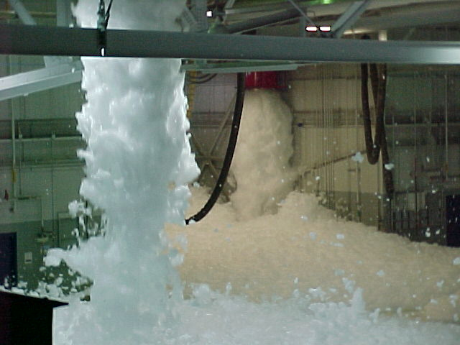

Slide 33
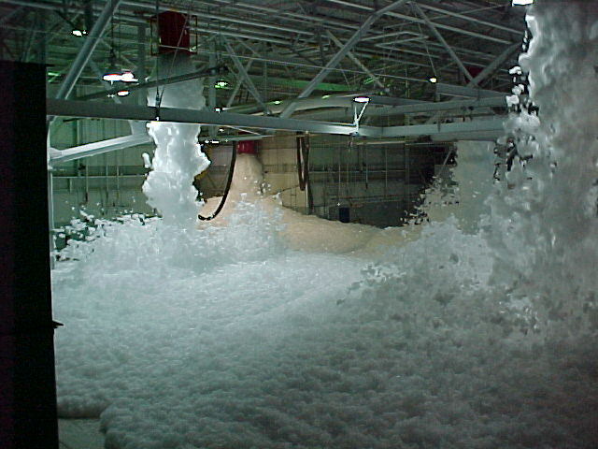

Slide 34
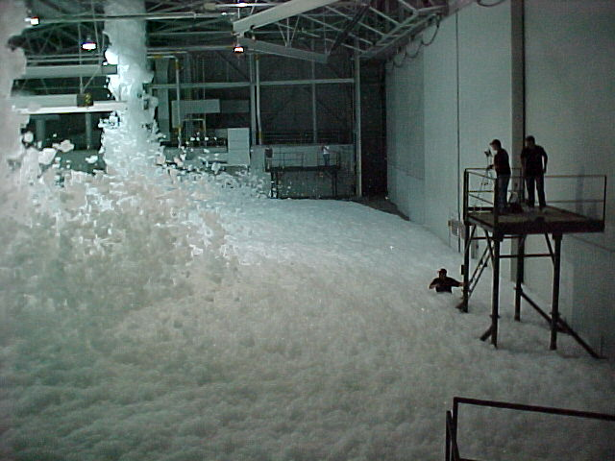

Slide 35
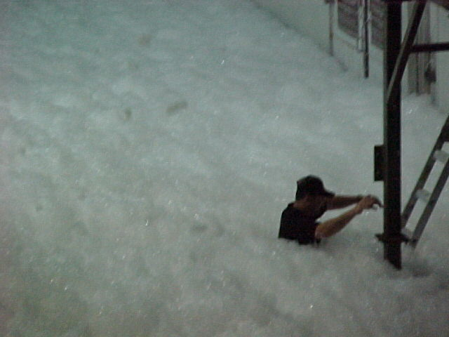

Slide 36
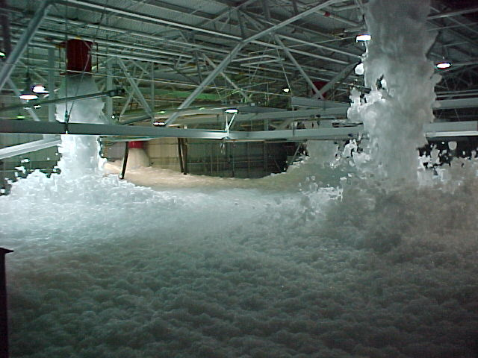

Slide 38
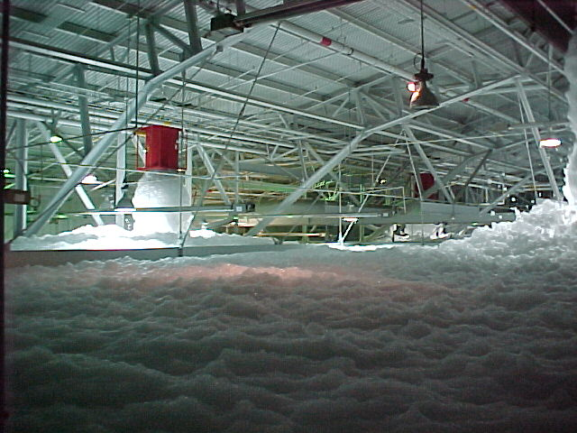

Slide 39
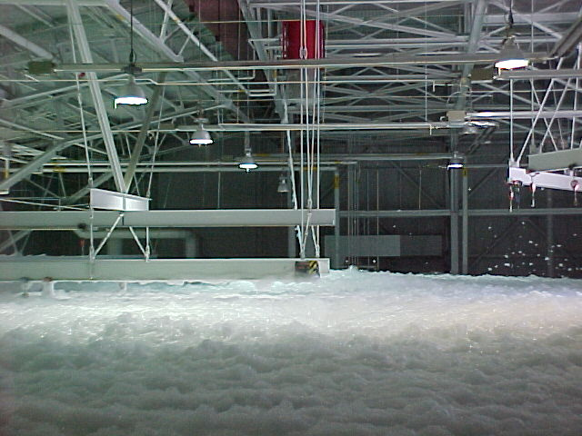

Slide 41
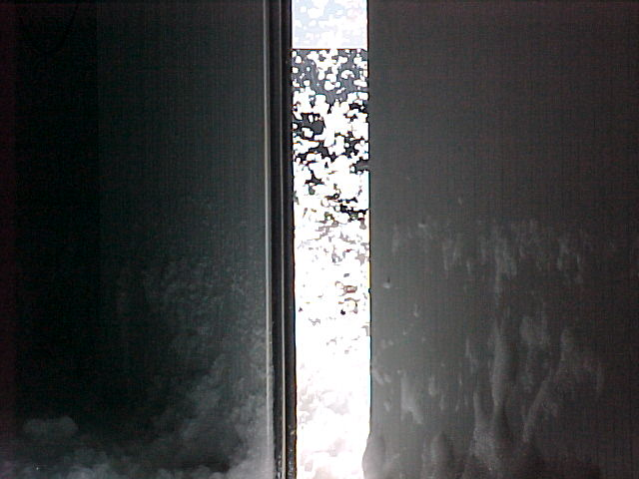

Slide 42
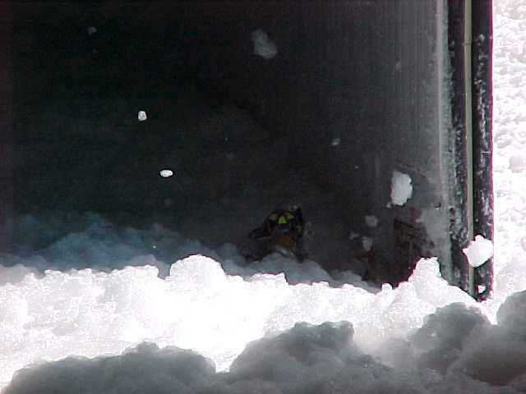
Firefighter trying to get the doors open

Slide 43
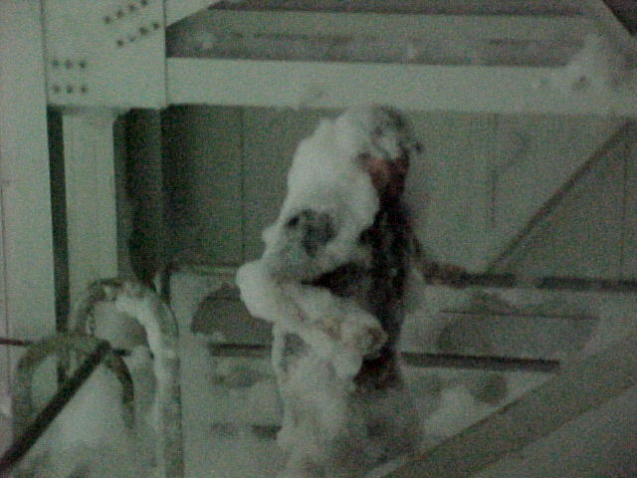

Slide 44
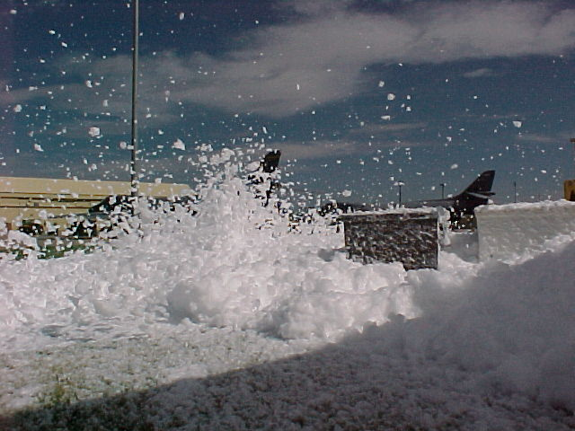

Slide 45
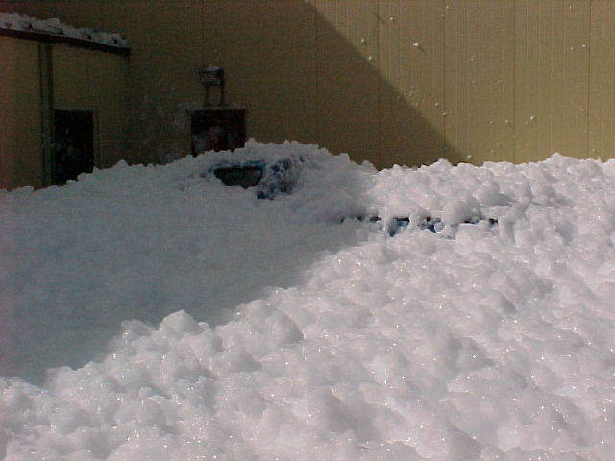
Buddle parked this truck here

Slide 46
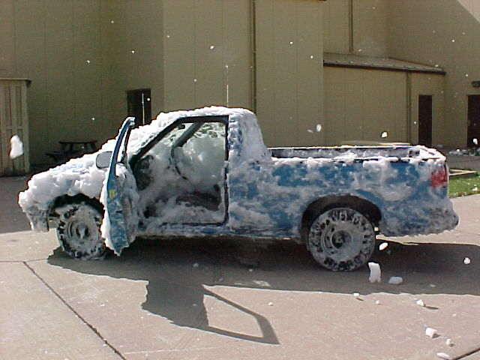
Buddle forgot to close the windows
when he parked the truck!!

Slide 48
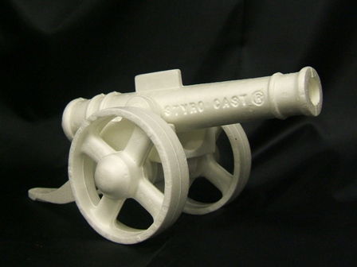
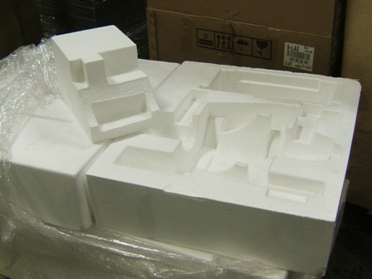
Expanded Foam Molding
PS is the standard material used
Can be done with PP or PE as well

Slide 49
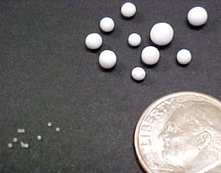
Expanded Foam Molding
Storage
Expansion
Chamber
Tiny Beads
Part
Mold
Unexpanded
Expanded
Steam or Hot Air
Steam or Hot Air

Slide 50
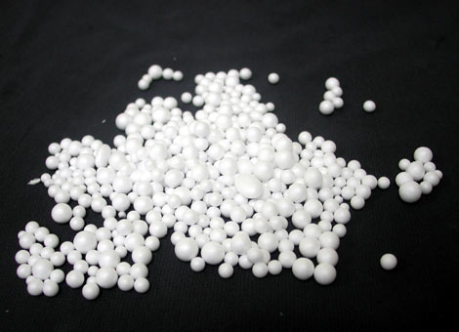
EPS beads

Slide 51
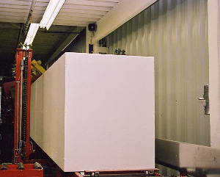
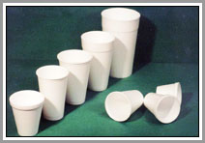
EPS

Slide 52
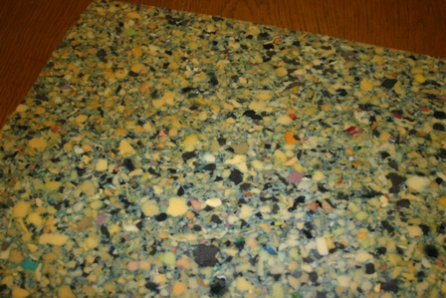
Rebond
Scrap from other foaming processes
Ground/chopped up
Molded into sheets

Slide 53
Material Considerations for Foamed Parts
Most thermoplastic and thermoset materials can foamed by one or more of the methods
The most commonly foamed resins are PVC, Polyurethane, PS, PE, PP, Epoxy Phenolic, ABS, Ureaformaldehyde, Silicone, Ionomers and Cellulose Acetates

Slide 54
Foam Applications
Strength to weight ratios
Thermal insulation (Celestia product)
Energy absorption
Load bearing

Slide 55
Energy Transmitted
Natural vibration frequency
Energy (g's)
Frequency (Hz)
Truck = 4-6, 12-14/ Train = 2-7, 50-70/ Ship = 2-20; Airplane = 1-3, 25-200

Slide 56
Load bearing
Polyurethane foam
Natural rubber foam
Stress
Vinyl foam
Strain

Slide 57
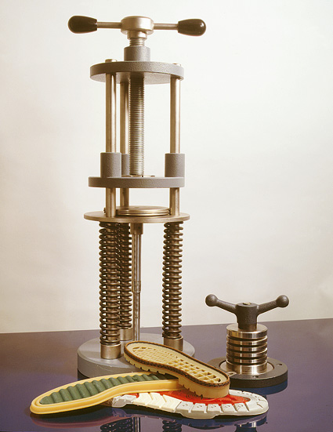
Compression Set

Slide 58
Thank You

