Slide 1
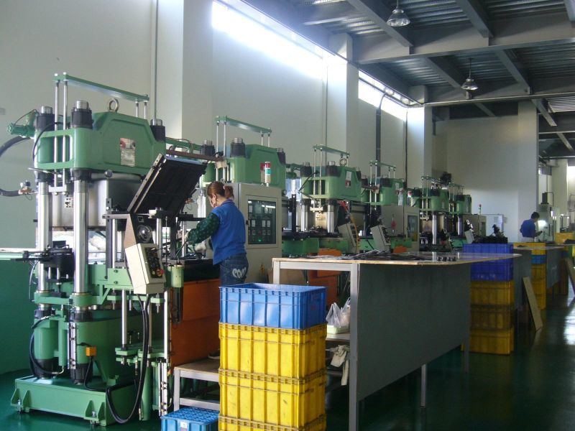
Compression and Transfer Molding
MFG 355

Slide 2
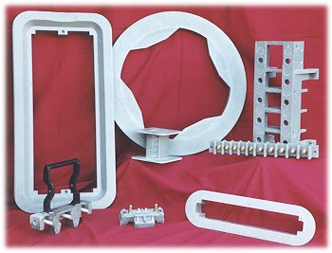
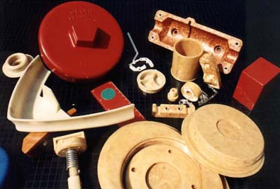
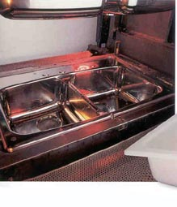
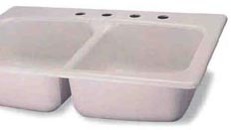
Compression Molded Parts
Mold
Part

Slide 3
Compression Molding

Slide 4
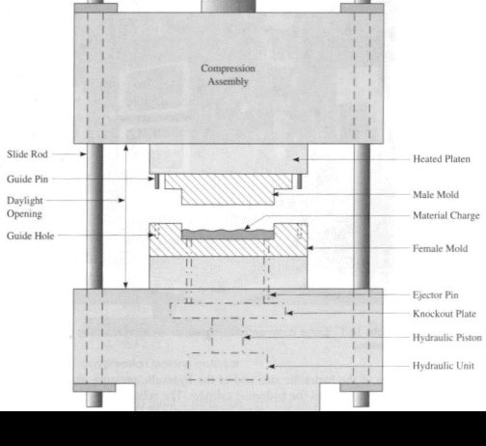
Compression Molding

Slide 5
Process Overview
Charge is placed in cavity of matched mold in the open position
Mold is closed by bringing the two halves together
Pressure is exerted to squeeze the resin so that it fills the mold cavity
While under pressure the mold is heated which cures the resin
Thermosets

Slide 6
Mold Closure Types
Flash
Upper
Mold
Horizontal
Flash
Part
Lower
Mold

Slide 7
Mold Closure Types
Positive
Upper
Mold
Part
Lower
Mold
Small Gap
(no flash)

Slide 8
Mold Closure Types
Semi-positive
Upper
Mold
Part
Lower
Mold
Horizontal Land
Separated Flash

Slide 9
Materials
Standard thermosets of various types
Molding compounds (mixtures of materials)
Thermoset resin (30%)
Reinforcement fibers (10%)
Fillers (60%)
Bulk Molding Compound (BMC)
Sheet Molding Compound (SMC)

Slide 10
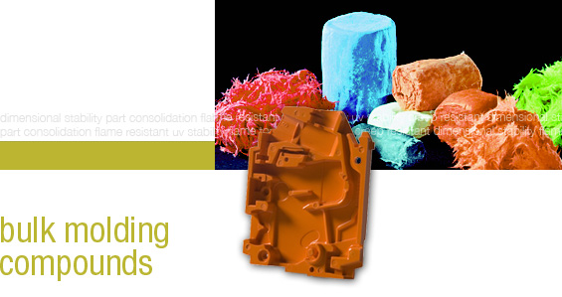
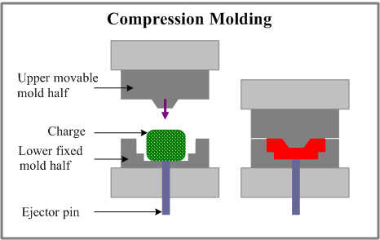
Bulk Molding Compound

Slide 11
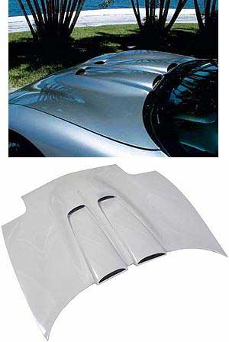
SMC Parts

Slide 12
SMC Equipment

Slide 13
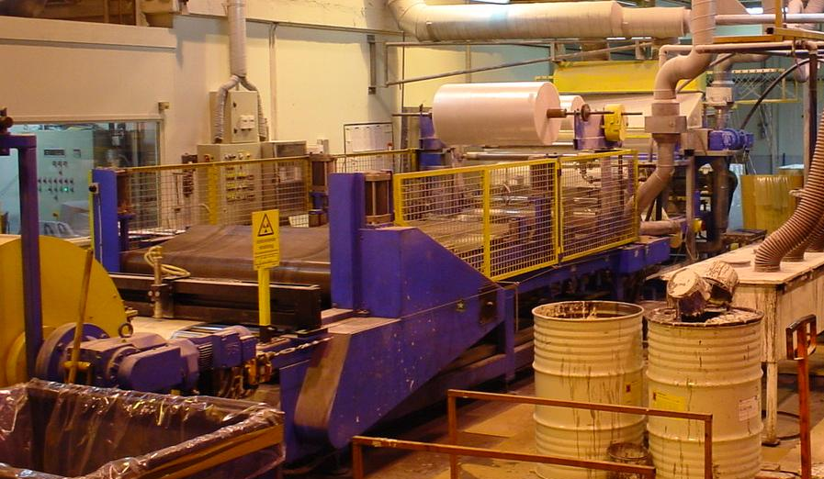
SMC Equipment

Slide 14
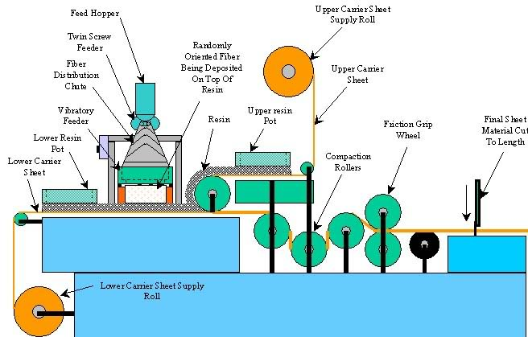
SMC Machine

Slide 15
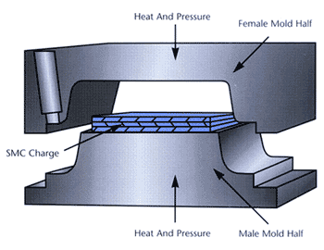
Sheet Molding Compound
Charge is made up from thermoset materials
Charge is rolled flat
Multiple layers of SMC can be used in a mold
Longer fibers than BMC

Slide 16
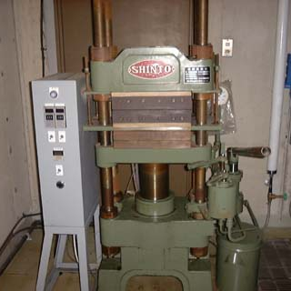
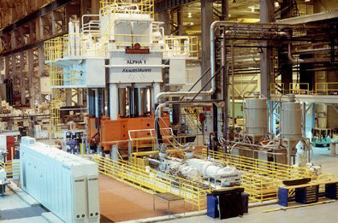
Compression Machines

Slide 17
Force Required
Total force needed per part is determined by:
Projected area of the part (A)
Required cavity pressure for the resin (P_{A})
Pressure factor that accounts for depth (ρ)
Depth in excess of the minimum amount (d_{e})
F = (A) [(P_{A}) + (ρd_{e})]

Slide 18
Compression Molding
Compression molding machines
Total force that can be exerted is called:
Press capacity
Machine rating
Machine size
Rated in Newtons or Tons
Determined by the area of the hydraulic ram and the hydraulic pressure in the line
Press Capacity (tons) =
Area of Ram (inches²) X Hydraulic Pressure (psi)
2000 (pounds/ton)

Slide 19
Compression Molding vs Injection Molding
Compression Molding
Injection Molding
Heated mold
Thermoset material
Long cycle time (minutes)
Can’t recycle flash or waste parts
Low part complexity
No undercuts
No sprue or runners
Reinforcement material can be long (inches)
Cooled mold
Thermoplastic material
Short cycle time (seconds)
Can reprocess flash and waste parts
High part complexity
Undercuts are possible
Uses sprue and runners
Some reinforcement material possible, must be short (whisker length)

Slide 20
Transfer Molding
Mixed resin is placed in the transfer chamber
Resin is heated to liquid state
Plunger presses liquid resin through sprue and runner system to mold cavities
Mold is heated
After resin is cured, parts are removed

Slide 21
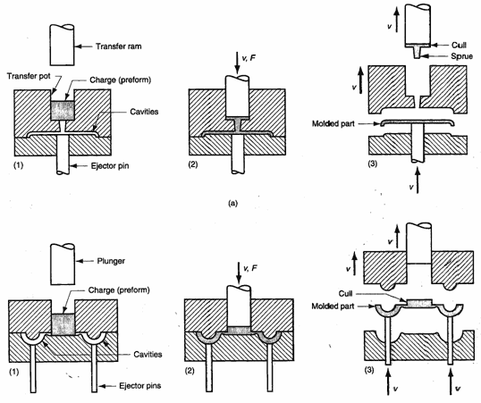
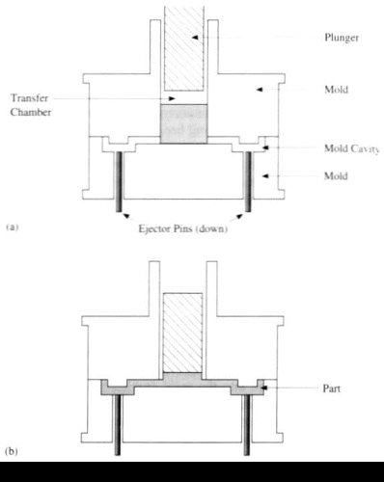
Transfer Molding

Slide 22
Injection Transfer Molding

Slide 23
Product Considerations
Practically all thermosets can be compression or transfer molded
Liquids
Pastes
Liquid resin with filler
Doughs
Pastes with reinforcement
Granules
B-staged resin (phenolics)
Preforms
Granules pressed into a pre-measured shape for easier handling

Slide 24
Thermoplastic Compression Molding
Recycling restrictions on European automakers
Strong push for thermoplastics
Attempts to retain molding operations

Slide 25
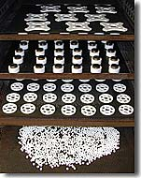
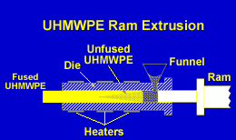
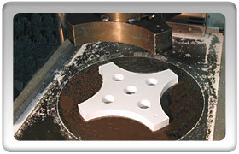
Cold Forming, Sintering and Ram Extrusion
Used where heat processing is difficult or impossible
High pressures
Lower temperatures

Slide 26
Thank You

