Slide 1
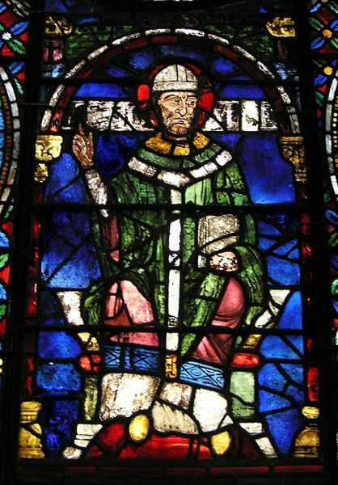
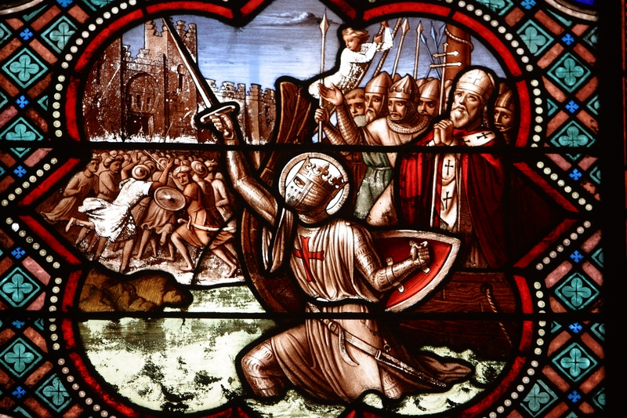
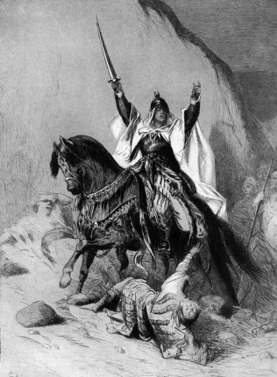
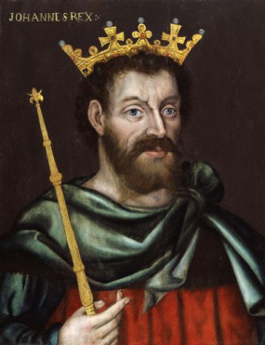
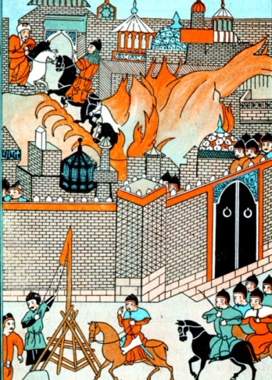
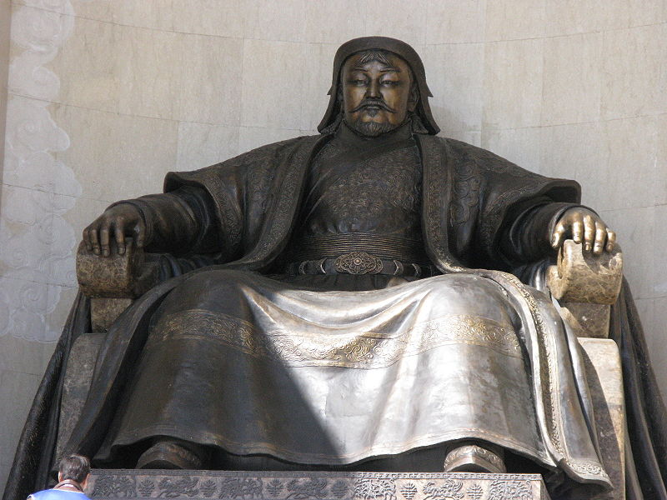
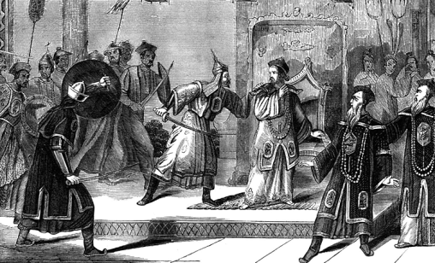
Crusades
Nations
Creativity Rekindled
Mongols

Slide 2
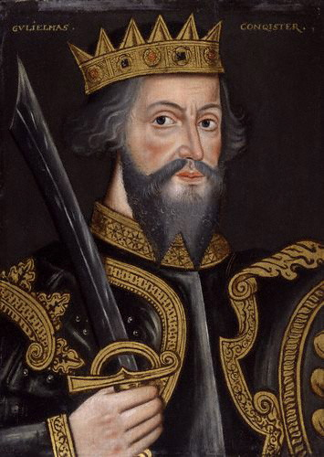
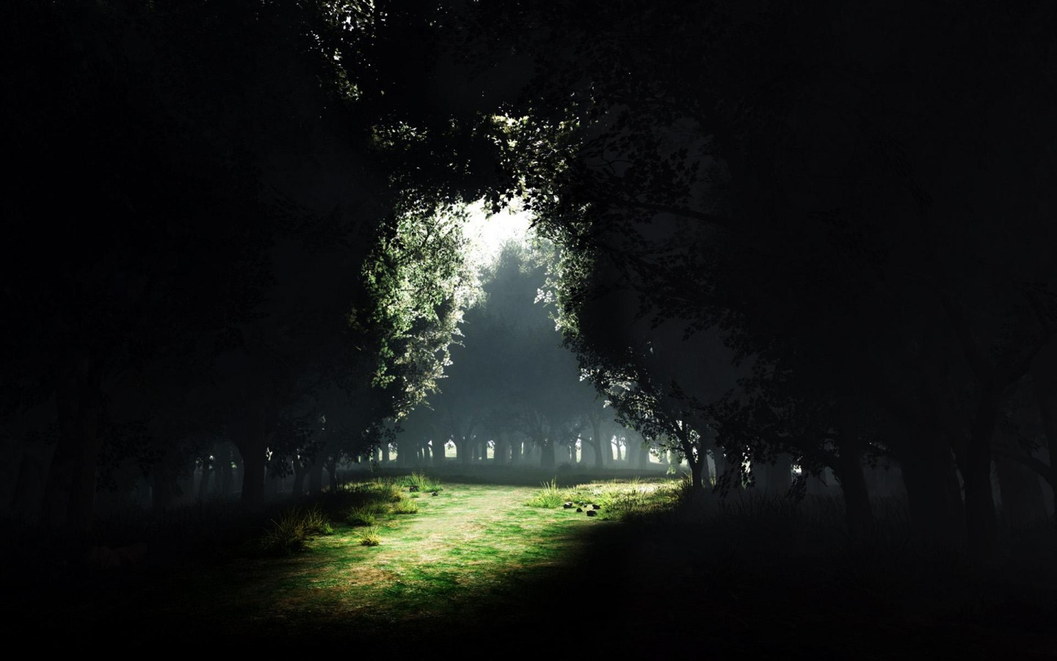
Transition
AD 476
Renaissance
Dark Ages
Middle Ages

Slide 3
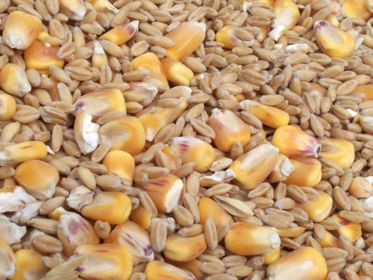
Why did the changes occur?
External elements (like weather and social stability) brought more food
More food brought population increase
Population increase brought diversity
Diversity brought creativity
Creativity brought progress
Progress required more creativity
AD 476
Renaissance

Slide 4
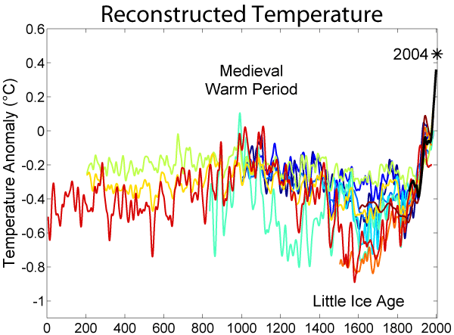
AD 1000
Climate changes
Ancient History
AD 476
Renaissance
AD 1450
Note: Colors are data by different researchers

Slide 5
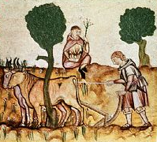
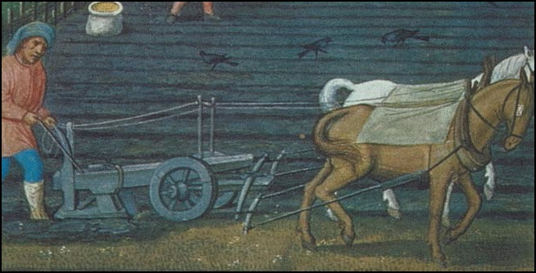
Changes
Ancient History
AD 476
Renaissance
AD 1450
Agriculture innovations (some borrowed)
Curved metal plow
Horse instead of ox
Horse collar
Three field system
Old
New

Slide 6
Changes
Ancient History
AD 476
Renaissance
AD 1450

Slide 7
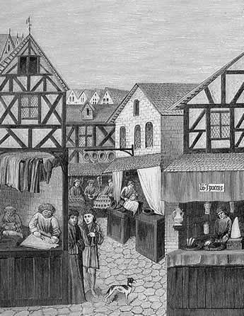
Changes
Ancient History
AD 476
AD 1450
More food meant increased population
Rise of towns
Specialized labor—artisans
Guilds
Control of trade (Hanseatic League)
Technology and science (agriculture and industry)
Water wheels
Windmills
Renaissance

Slide 8
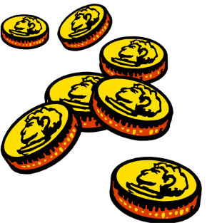
Changes
Quantifications of life
Dark ages had no precise time or distance measurements (canonical hours, foot)
Triangulation (needed for land ownership)
Standardized money (needed for trade)
Statistics (for manufacturing)
Trial of the pyx (box with minted coins)
Number system (needed for business)
Fibonacci, Arabic/Indian number system
Beginning of modern accounting systems
Interest calculations
Conversions of weights and measures
AD 476
Renaissance
1 2 3 4 5 6

Slide 9
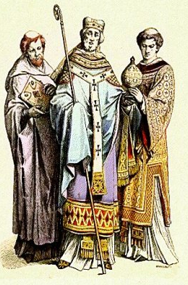
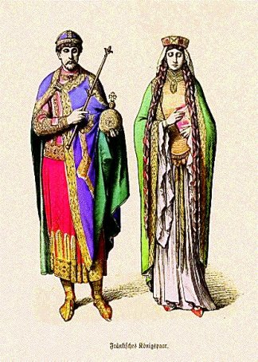
Emergence of Nations:
Conflicts between church and state
Ancient History
Renaissance
AD 1450
France
Germany
England
vs

Slide 10
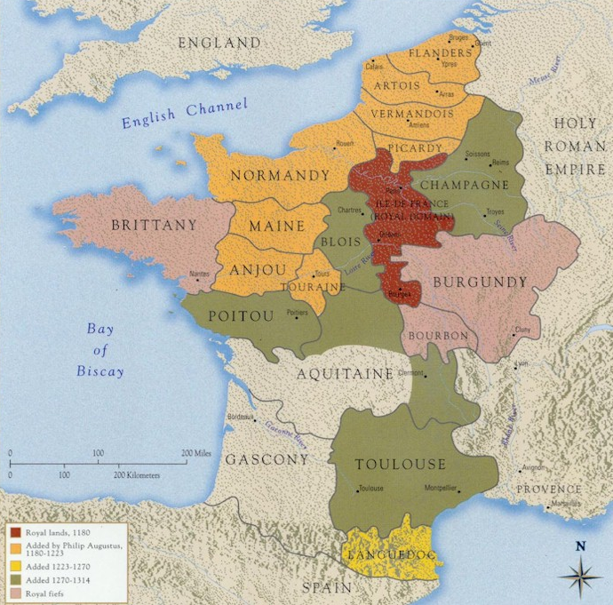
France: State
Ancient History
Capetian dynasty
Hugh Capet became king (about 1000 AD)
Ile de France
Hugh Capet’s territory
Beginning of the French nation
Previously it was part of the Carolingian realm and was linked to Germany and Italy
AD 1450
Renaissance

Slide 11
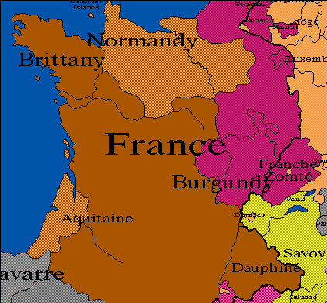
France in 1300
Capetian Dynasty: Stable succession for 300 years
Always a father to son transfer
Dynastic strength
Stable in church relations
France was the most “Catholic” nation
France was divided but gradually consolidating
Ancient History
Renaissance
AD 1450

Slide 12
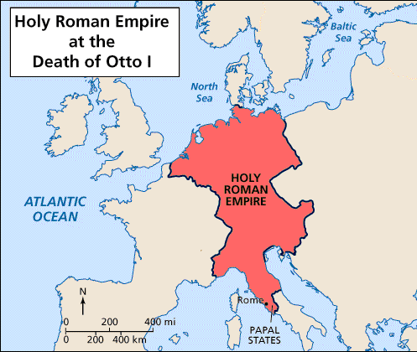
Germany in 1000
Otto the Great
United lords in Germany and Italy
Crowned as 2nd Holy Roman Emperor
Assumed the traditional role of approving the election of a pope
Control of Italy brought conflicts (over many generations) with popes over the Papal States and the rights of the church
Renaissance
AD 1450

Slide 13
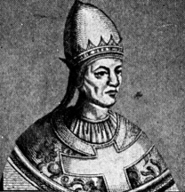
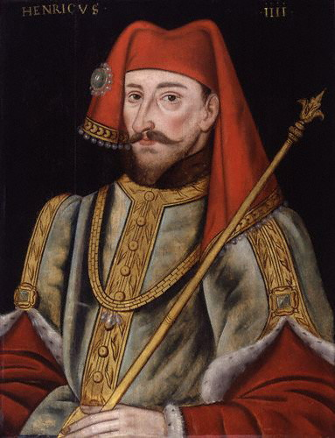
Germany
AD 1450
Church vs. State clash (1084-1105)
Pope Gregory VII
Henry IV

Slide 14
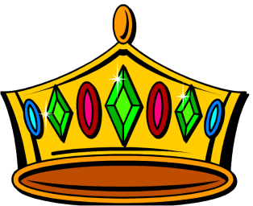
Germany
AD 1450
Young man recently elected Holy Roman Emperor
Wanted to demonstrate his power to control the church within the Holy Roman Empire
Asserted his emperor’s right of naming Bishops within the empire

Slide 15
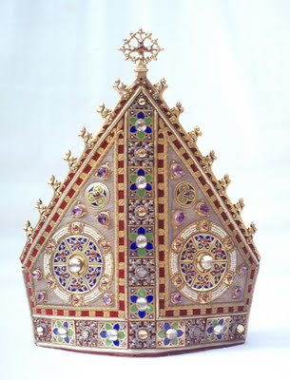
Gregory’s position
Newly elected as a pope
Strongly involved in the movement to reform the church
Stop corruption
Assert the rules of celibacy, loyalty, religiosity
Make the election of the pope purely within the church (eliminate the emperor’s role)
Assert the church’s right to control the clergy everywhere
AD 1450

Slide 16
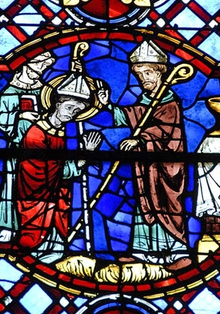
Henry IV vs Gregory
AD 1450
Disagreement over who can name a bishop in Germany
The pope insisted that only bishops could ordain other bishops.
When a non-church official names a bishop, it is called “lay investiture.”

Slide 17
Henry IV vs Gregory
Henry named a German bishop and was supported by most of the clergy in Germany
Most were named by kings and, therefore, loyal to him
Gregory excommunicated Henry
(and the supporting bishops) over lay investiture.
This included a release of all feudal oaths from Henry’s lords.
The lords were pleased with this occurrence because it gave them more power.
AD 1450

Slide 18
Henry IV vs Gregory
Gregory left Rome on his way to crown a new Holy Roman Emperor.
Henry sensed that he had little support from the nobles.
Henry met the pope in the Italian alps.
Henry begged for forgiveness and the pope was obligated to forgive him (and lift the excommunication).
Gregory established the principle that holy roman emperors are elected by the German nobility, thus weakening the emperors.
AD 1450

Slide 19
Henry IV vs Gregory
AD 1450
Over the ensuing years, Henry gained power.
Gregory continued reforms and made enemies who disliked his heavy-handed ways.

Slide 20
Henry IV vs Gregory
Henry marched his army to Rome and deposed Gregory.
This was an assertion of the old “emperor’s right.”
Henry named a new pope.
Called an anti-pope by the Catholic Church today.
Gregory died in exile.
AD 1450

Slide 21
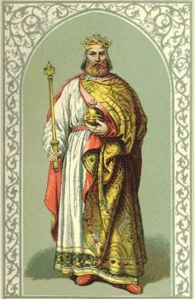
Germany
Later Holy Roman Emperors
Weakened by the principle that they are elected by German nobility rather than succeeding to the throne by descent
Sought land in Italy and therefore had continual conflicts with the popes
Emperors versus popes caused two political parties to be formed in Germany and Italy
Guelphs (pope supporters)
Ghibillines (emperor supporters)
AD 1450

Slide 22
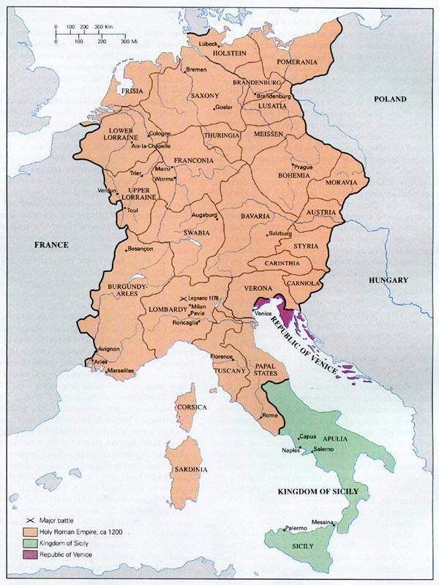
Medieval Holy Roman Empire
AD 1450
Many states, lack of unity

Slide 23
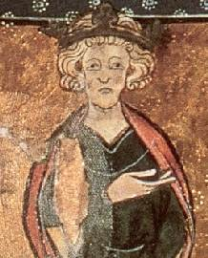
England
AD 1450
Edward the Confessor (about AD 1000)
No heir
Harold (Anglo-Saxon) tried to become the heir.
Edward seemed to support both Harold and William of Normandy.

Slide 24
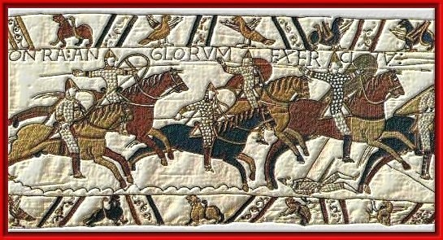
England
William I (the Conqueror)
Leader of Normandy
(French-speaking Vikings)
Harold saved by William (Harold swore support on a relic)
Conquest of England
1st invasion—contrary winds
Invasion by Norway
Battle of Hastings
Bayeux tapestry
AD 1450

Slide 25
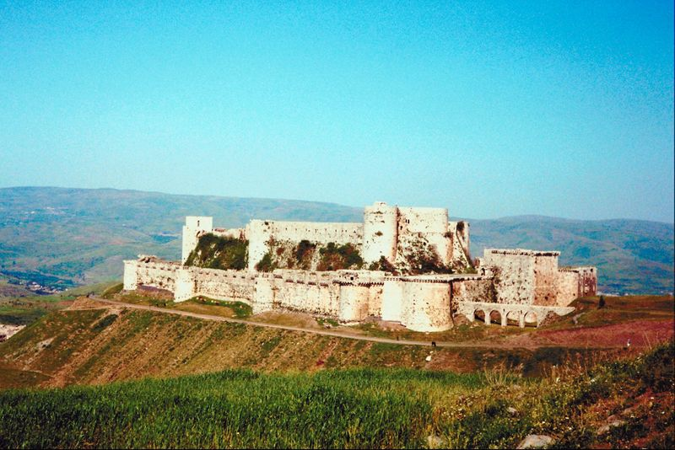
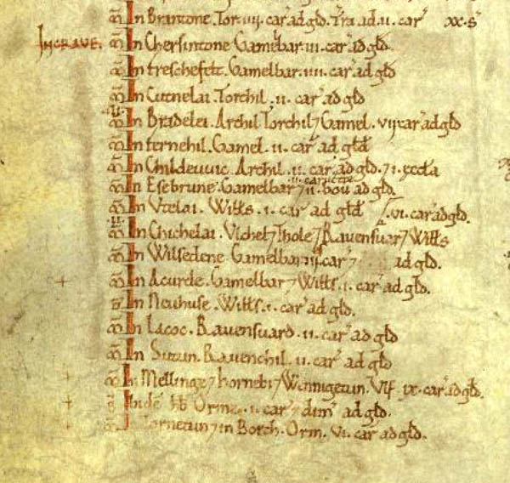
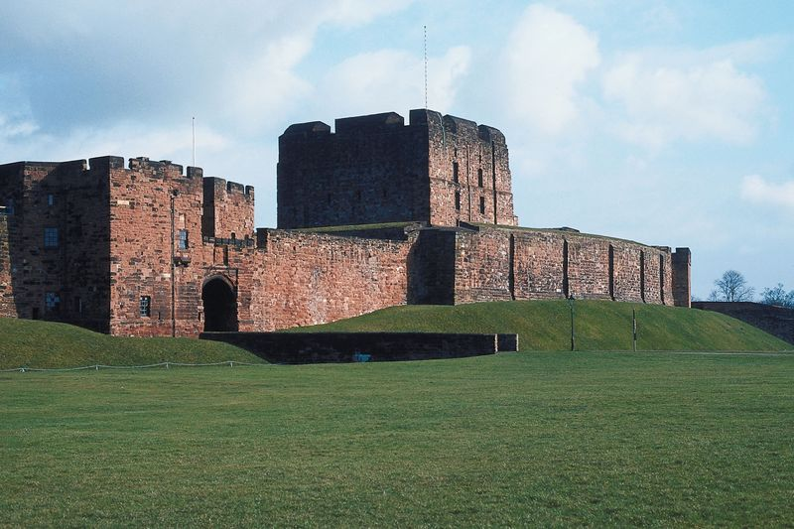
Normans in England
AD 1450
Built castles for security
Created new royalty/clergy
Domesday book

Slide 26
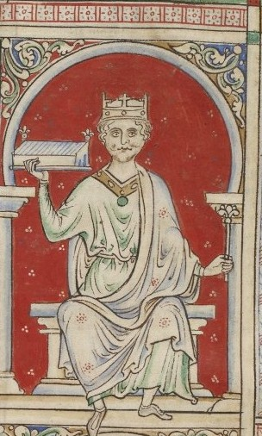
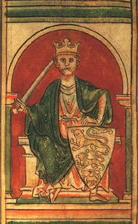
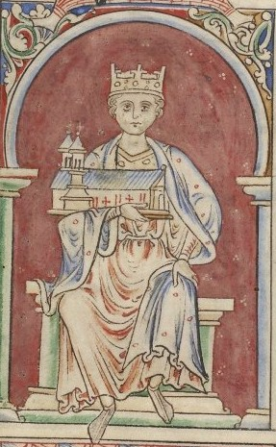
England
William the Conqueror's death
3 sons
William II (Normandy)
Richard (England)
Henry (nothing)
Richard and Henry hunting “accident” (Richard died)
William II and Henry war; Henry won and declared himself Henry I of England and Normandy.
AD 1450

Slide 27
England
Henry I
Ruled both kingdoms
Named Matilda (daughter) as the heir but her cousin Stephen usurped
Civil war
Agreement: Stephen would rule but would be succeeded by Matilda's son, Henry II
AD 1450

Slide 28
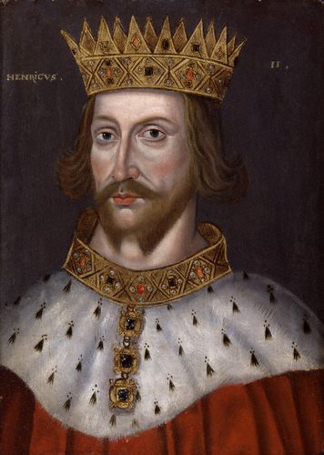
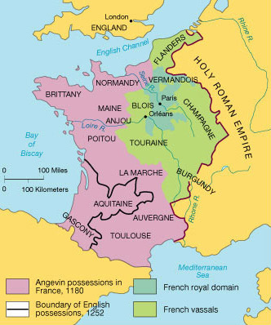
England
Henry II—1180
AD 1450
Married Eleanor of Aquitaine
Created English common law
Thomas Becket
Best friend and chancellor of the king
Named Archbishop of Canterbury to solve a fight with the church

Slide 29
Henry II and Becket
AD 1450

Slide 30
Henry II and Becket
AD 1450
Henry was embarrassed and aggravated at Becket’s independence.
Henry wanted to “solve” the problem.

Slide 31
Henry II and Becket
AD 1450

Slide 32
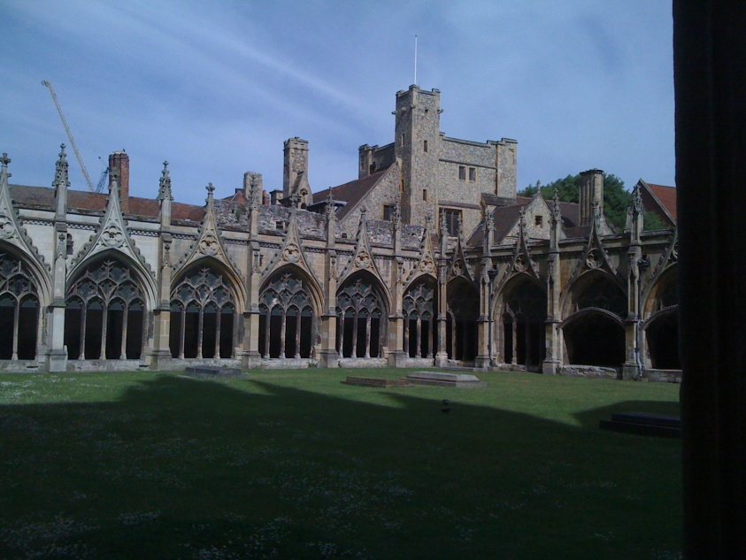
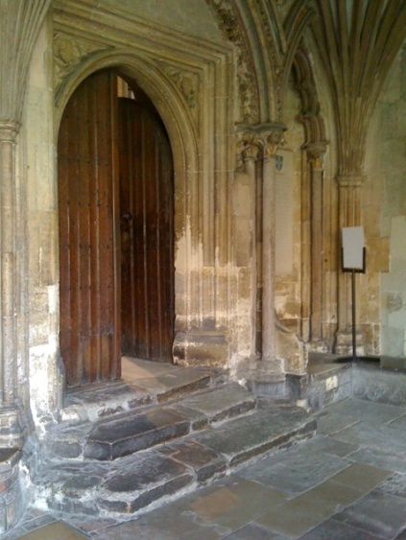
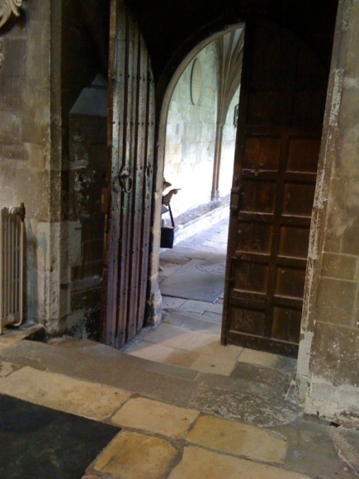
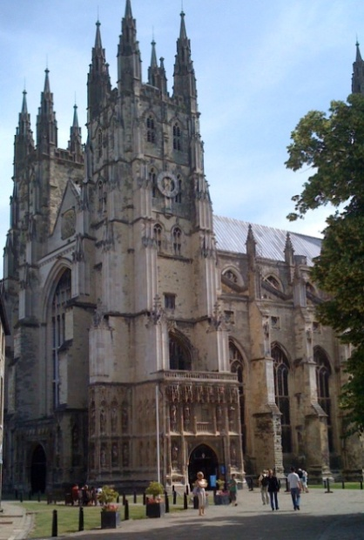
Henry II and Becket
AD 1450

Slide 33
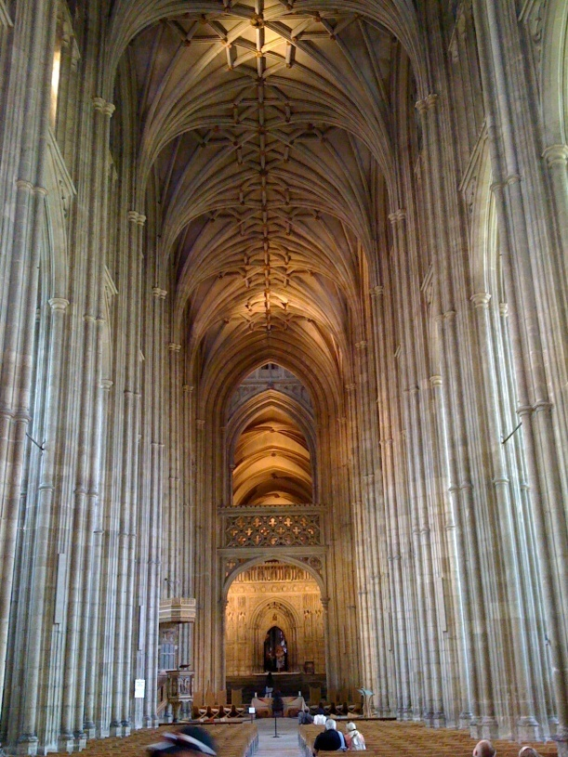
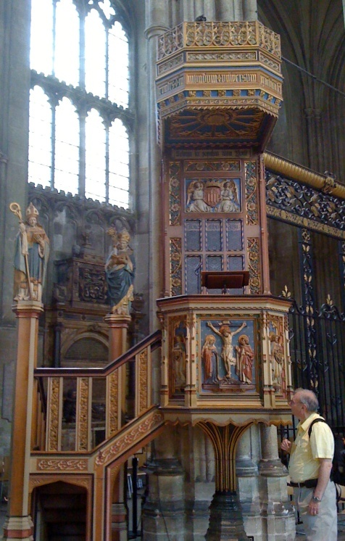
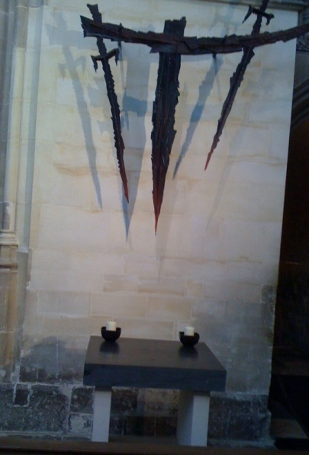
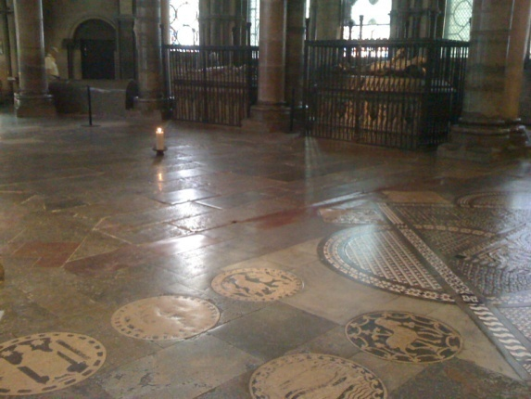
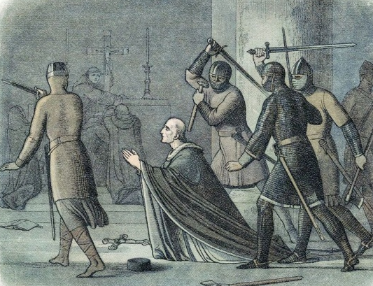
Henry II and Becket
AD 1450

Slide 34
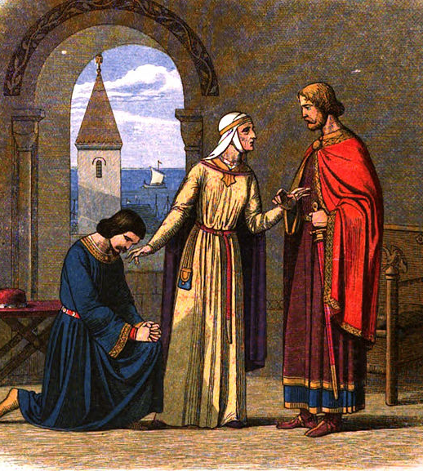
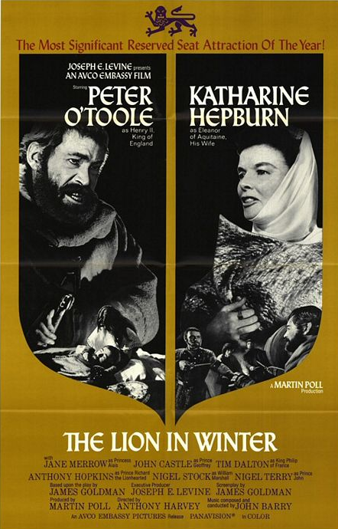
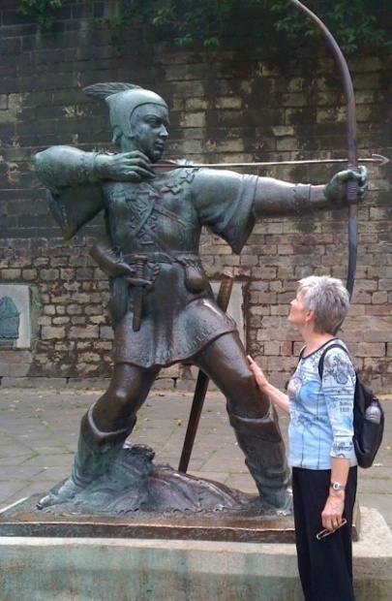
England—Henry II
AD 1450
Fought with Eleanor and children (Lion in Winter)
Succeeded by Richard (the Lionhearted) and then by John
Dissent over Norman arrogance and Anglo-Saxon poverty (Robin Hood)

Slide 35
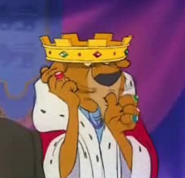
John I
Became king when Richard I died in warfare in France
Weak king
Lost English territories in Normandy
Nobility angry over their lost territories
Alienated the pope over lay investiture
The pope punished England by stopping all sacraments.
John finally gave in to all papal demands.
John was forced by nobles and church to sign Magna Carta.
AD 1450

Slide 36
Magna Carta
AD 1450
FIRST, THAT WE HAVE GRANTED TO GOD, and by this present charter have confirmed for us and our heirs in perpetuity, that the English Church shall be free, and shall have its rights undiminished, and its liberties unimpaired. Article 1

Slide 37
Magna Carta
AD 1450
No free man shall be seized or imprisoned, or stripped of his rights or possessions, or outlawed or exiled, or deprived of his standing in any other way, nor will we proceed with force against him, or send others to do so, except by the lawful judgment of his equals or by the law of the land.
Article 39

Slide 38
England
Origins of Parliament
Anticipated in Magna Carta (25 elected to insure peace and liberties granted)
Nobles created Provisions of Oxford (regular meetings of Parliament)
Kings had to support Parliament in order to receive money
AD 1450

Slide 39
Discussion
Why did the rise of nations help creativity?
AD 1450

Slide 40
The Crusades
A cooperation between church and state
AD 1450
Precipitated by:
A new Muslim group controlled Jerusalem, burned shrines, and killed some pilgrims.
A series of defeats for the Byzantine Emperor and the emperor’s call to Europe for help.
The pope called for a Holy War to recapture the Holy Land.

Slide 41
The Crusades
AD 1450

Slide 42
The Crusades
AD 1450

Slide 43
The Crusades
AD 1450
Status in 1150
Crusaders had established a kingdom in the Levant with Jerusalem as the headquarters.
Saladin, a Kurd, had begun a conquest (uniting) of the Muslims.

Slide 44
Third Crusade—Richard vs Saladin
AD 1450

Slide 45
Third Crusade—Richard vs Saladin
Saladin defeated the crusaders at the Battle of Hattim
Good strategy (long, hot march and no water)
Saladin captured Jerusalem
No slaughter of Christians
Saladin captured most of the crusader territory
The fort of Acre remained in crusader control
AD 1450

Slide 46
Third Crusade—Richard vs Saladin
AD 1450

Slide 47
Third Crusade—Richard vs Saladin
Previous European kings (Phillip II of France and Barbarossa of Germany) decided to not wait for others in the 3rd Crusade and have been defeated by Saladin
Richard landed in the Holy Land and had immediate success
Especially conquest of Jaffa
AD 1450

Slide 48
Third Crusade—Richard vs Saladin
AD 1450

Slide 49
Third Crusade—Richard vs Saladin
Richard began the fight from Jaffa to the outskirts of Jerusalem
This was a very difficult series of battles
AD 1450

Slide 50
Third Crusade—Richard vs Saladin
AD 1450

Slide 51
Third Crusade—Richard vs Saladin
Richard was forced to return to England to counter the threat of revolt from John, his younger brother.
Richard was captured in Austria and held for ransom.
John, reluctantly, paid the ransom.
Probably forced to pay it by the Lords of England
Richard returned to England but continued wars and died a few years later in France.
AD 1450

Slide 52
The Crusades—Results
Knightly orders.
Templars, Hospitaliers, Teutonic
Took vows of poverty and warfare
Rewarded with land after crusades
Became very powerful and threatened the kings where they lived (especially France)
Exiled from France
Are the Muslims correct in stating that the crusades began the warfare between Islam and Christianity?
AD 1450

Slide 53
Effects of the Crusades
AD 1450

Slide 54
Mongols
Genghis Khan (great leader)
AD 1450
Temujin
Conquered China—Yuan Dynasty
Conquered central Asia (Silk Road)
Children and grandchildren conquered Bagdad and Russia/Poland

Slide 55
Mongols
Innovations
AD 1450
Warriors and warfare
Tartars—”those from hell”
Used intimidation
Promoted according to skill
Mounted messenger system
System of flags
Compound bow development
Attack on Krakow, Poland
Controlled trade throughout Asia for over 100 years

Slide 56
Mongols
AD 1450
Kublai Kahn, grandson of Genghis Khan, established the Yuan Dynasty.
Marco Polo used as emissary
Attack on Japan (Kamikaze)

Slide 57
The Mongol Dominions 1300–1405
AD 1450

Slide 58
Mongols
AD 1450
Marched through Russia and Poland
Trumpeter of Krakow
Continued to the gates of Vienna but were defeated
Retreated to Kyiv, Ukraine and ruled there (collecting tribute) for 200 years

Slide 59
Thank
You
Make creativity while the sun shines.

