Slide 1
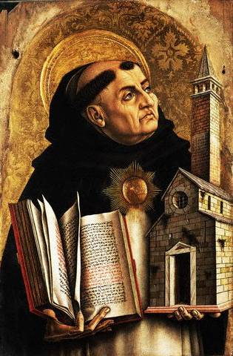
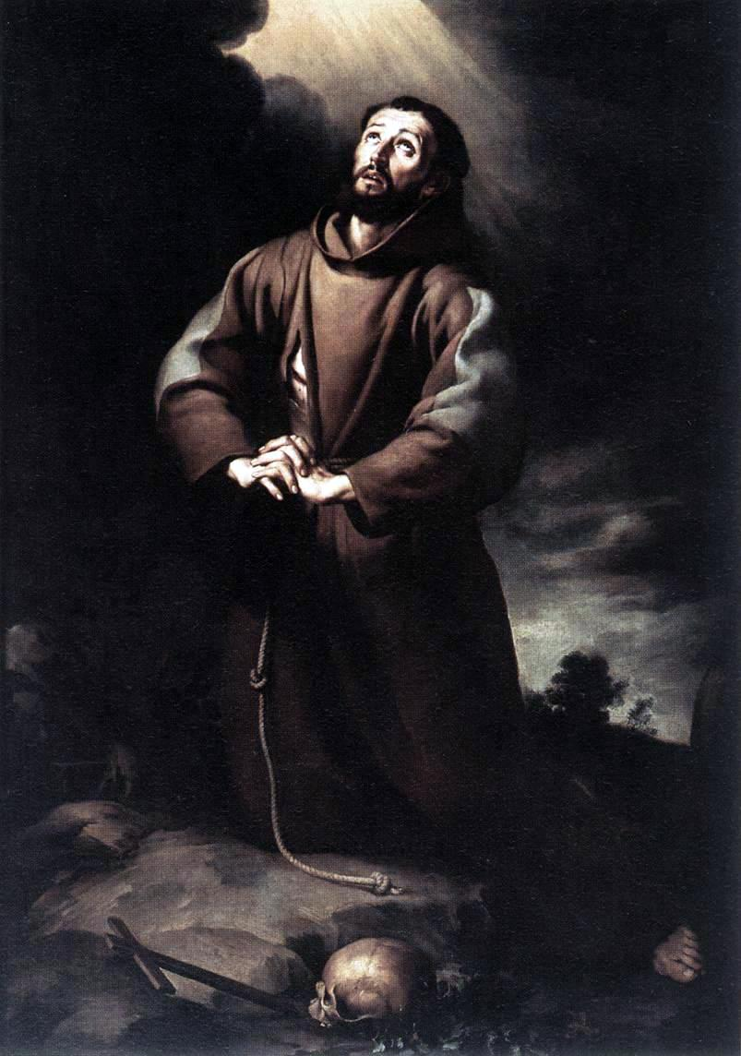
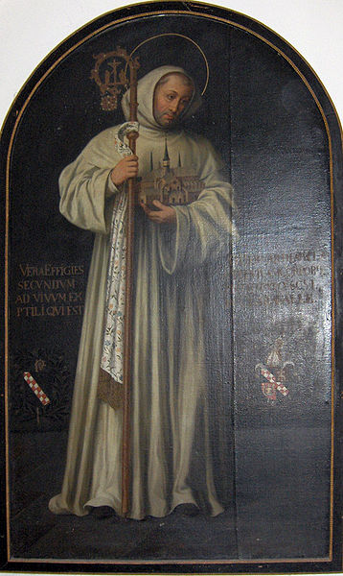
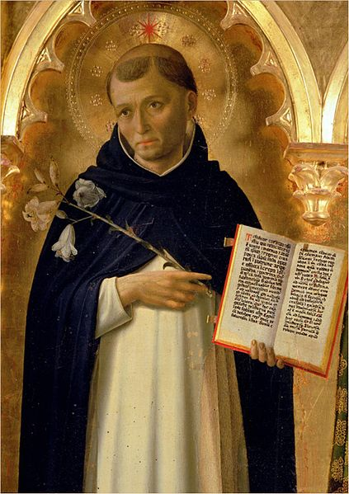
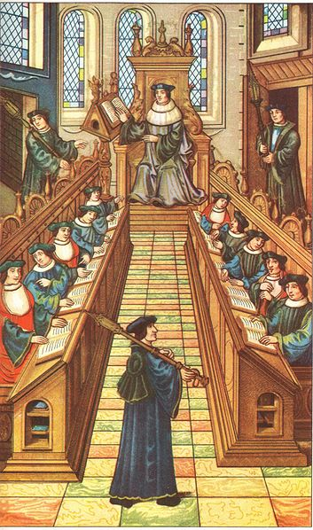
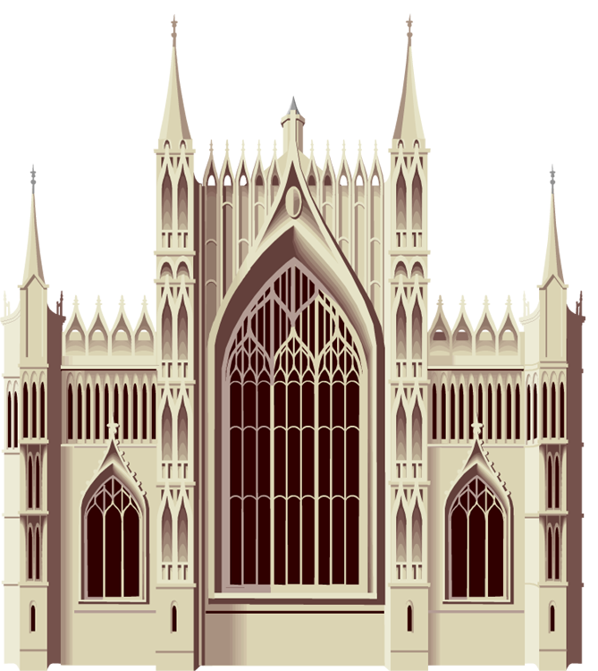
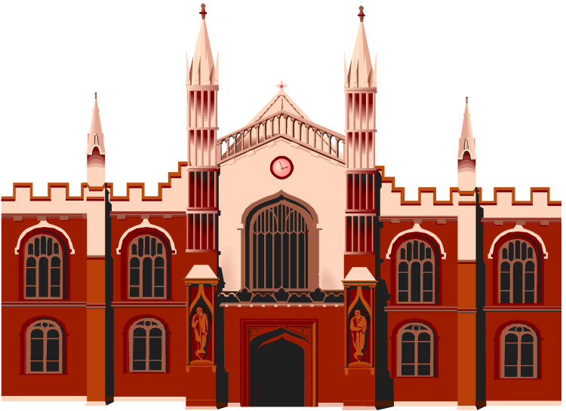
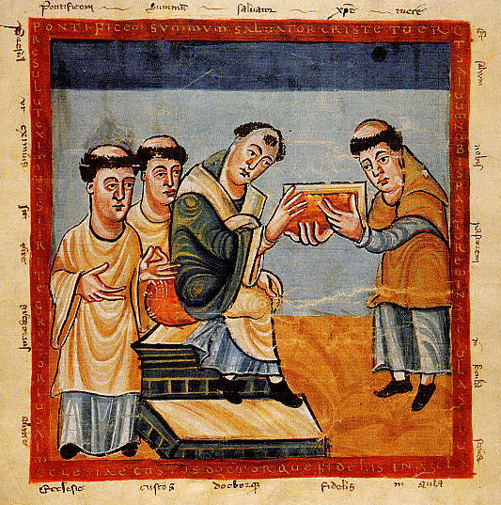
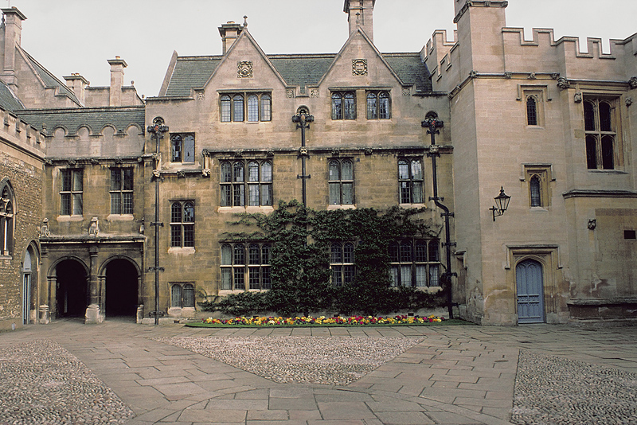
Church and University

Slide 2
Creativity and Churches
Thought questions
AD 476
Renaissance
To what extent was the medieval church the promoter of creativity?
To what extent was the medieval church the inhibitor of creativity?

Slide 3
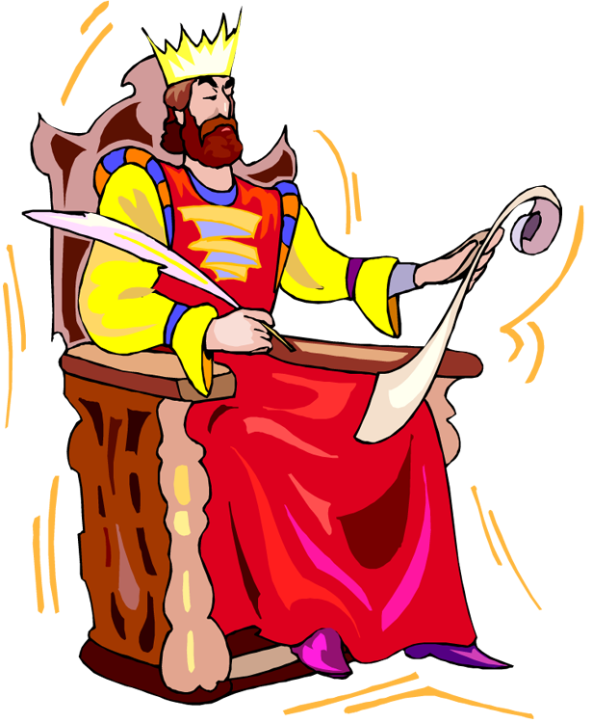
Church and Nations
AD 476
With the rise of nations, the church lost some political power to the kings.
The church was often still stronger than the kings but clearly there were rivalries.
What did the church do to win the hearts and minds of the people during the period when nations were rising (from AD 1000)?
Renaissance

Slide 4
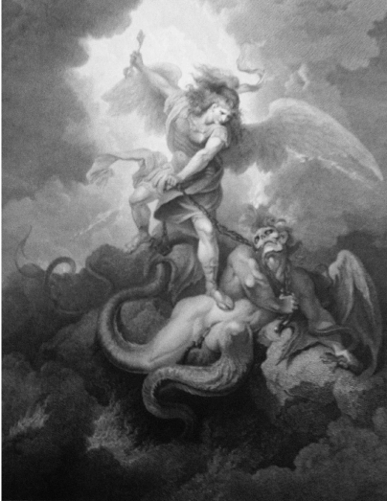
Religious Life at the Millennium
AD 1000
And I saw an angel come down from heaven have the key of the bottomless pit and a great chain in his hand. And he laid hold on the dragon . . . which is the Devil . . . and bound him a thousand years . . . and after that he must be loosed a little season. Rev.20: 1-3
AD 476
Renaissance
Christians believed that the 1000 years began with the birth of Christ and therefore they reassessed personal life and goals.

Slide 5
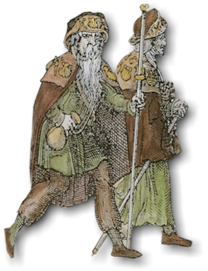
Personal Reform and Pilgrimages
AD 476
Pilgrimages
World safer for travel
Identified and protected by clothes
Purposes
Draw close to God
Fulfill a promise or obligation
Share in grace
Obtain a cure
Adventure
Renaissance

Slide 6
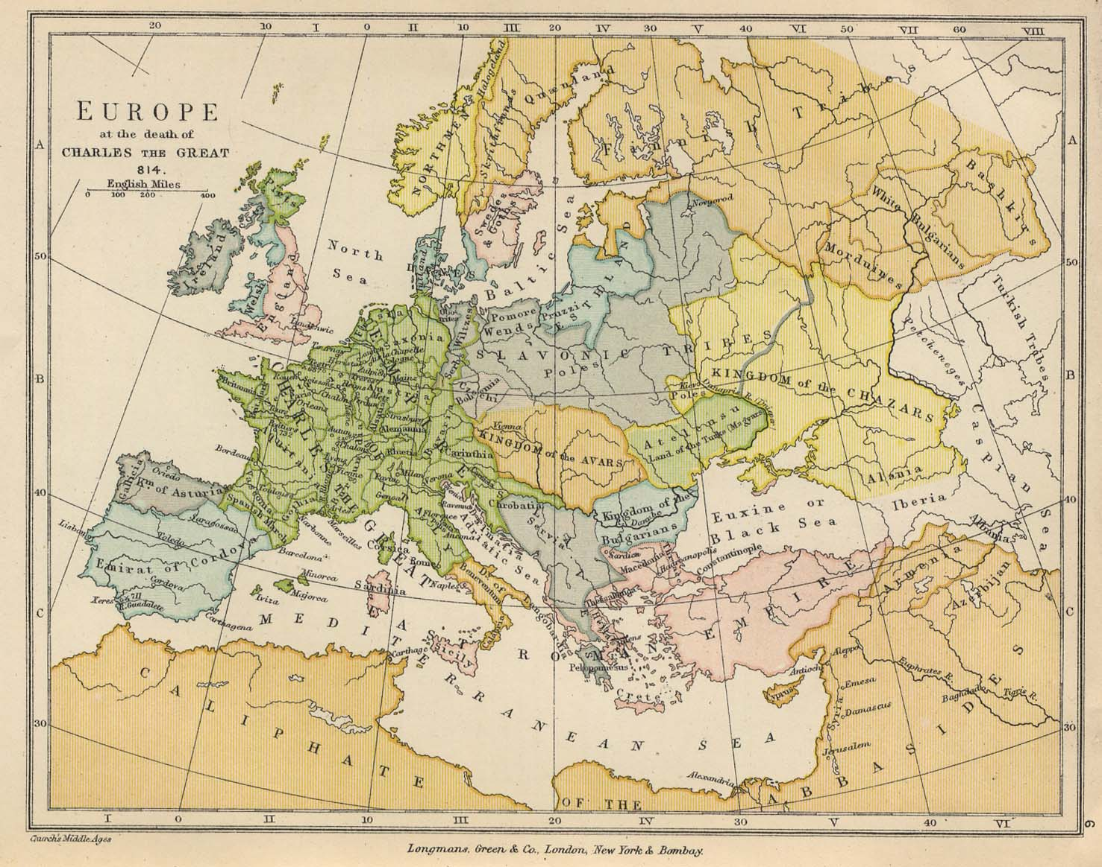
Pilgrimages
AD 476
Major pilgrimage locations
Renaissance
Also,
Locations of miraculous cures
Locations of visions
Canterbury
Santiago de Campostela
Jerusalem

Slide 7
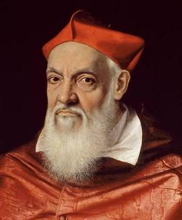
Church Reform 1000–1300 AD
Corruption
Councils to reform method of selecting pope and other abuses
College of Cardinals created and empowered with selection of pope
Rules of chastity restated

Slide 8
Church Reform 1000–1300 AD
Corruption
Church authorities still focused on wealth and political position
Most bishops appointed from powerful families
Selling of church positions still common
Benedictine order reformed
Cluny was largest monastery

Slide 9
Monasteries
AD 476
Renaissance

Slide 10
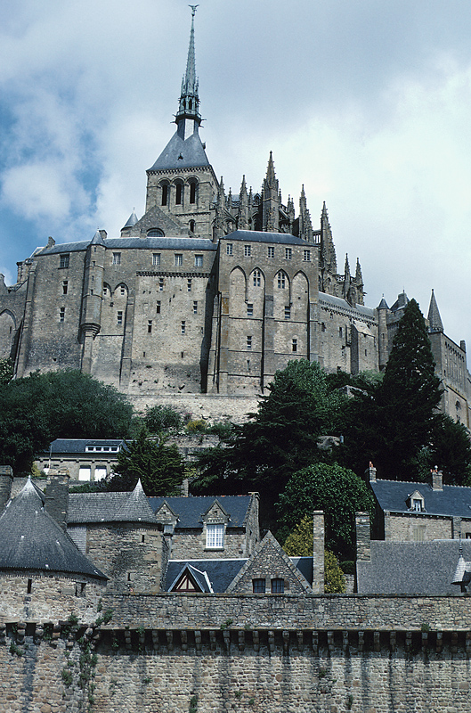
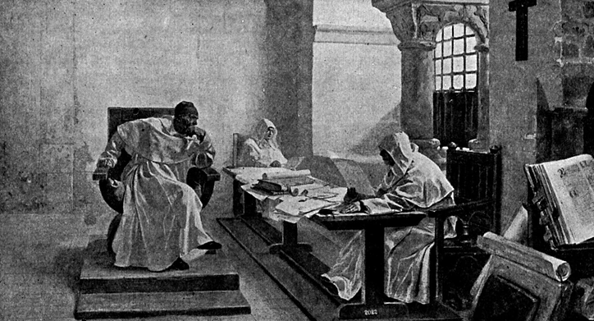
Monasteries
New orders formed to correct the abuses of the old orders
Benedictines were isolated from society (even Cluny).
Benedictines still owned vast properties (even Cluny).
New orders were located within cities and refused to own property.
Mendicant (begging) orders

Slide 11
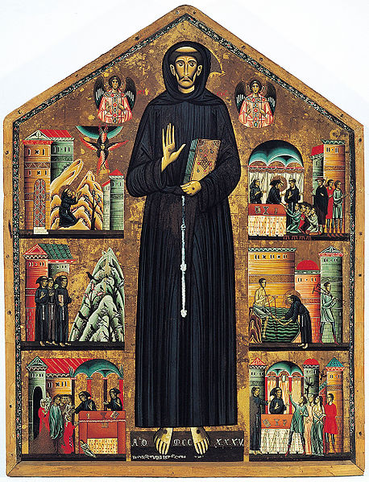
Franciscans
Began by St. Francis of Assisi
Mendicant Order
Literal interpretation of the scriptures
Loved God’s creations ("All Creatures of Our God and King")
Focus:
Controlling "The Will"
Repenting of wayward actions

Slide 12
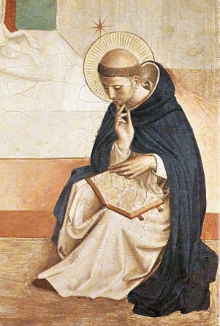
Dominicans
Founded by St. Dominic (Spainard)
Order of Friars Preachers
“The Intellect” and understanding true doctrine
Power in universities
Vows of obedience, chastity, poverty
Several became Popes
Some became famous painters
Fra Angelico
Fra Bartolomeo
Enforced rules of the church

Slide 13
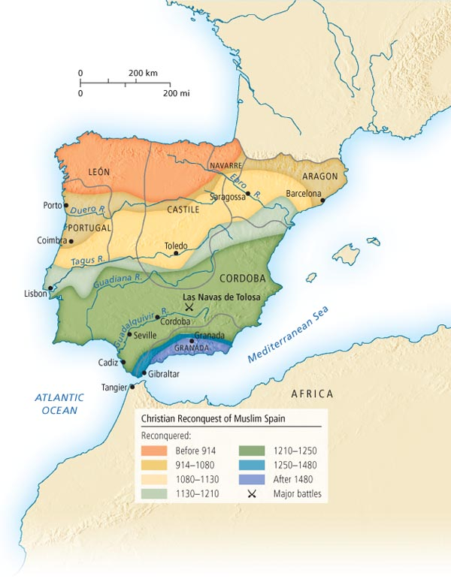
Reconquest
As the Christians gained
territory, they forced conversion
of Muslims and Jews
In 1492 the Reconquest was
complete and the Church
decided to “purify” all of Spain
The Inquisition was instituted

Slide 14
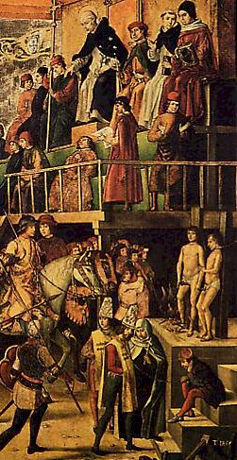
Inquisition
Discussion:
Should a church defend itself and punish heretics?
What is the nature of a disciplinary council in the LDS Church?

Slide 15
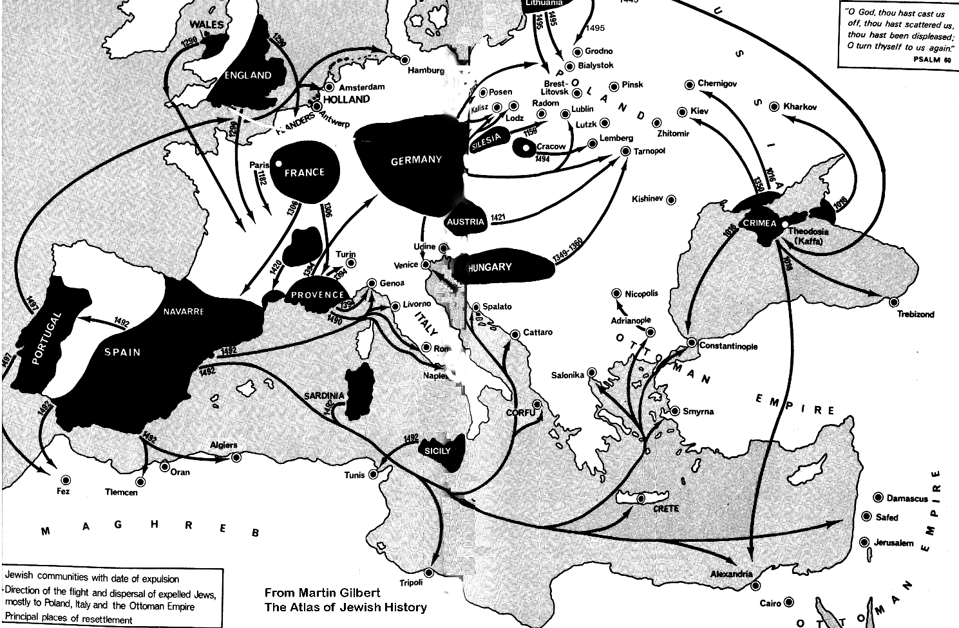
Discussion
Why were the Jews in Europe persecuted?

Slide 16
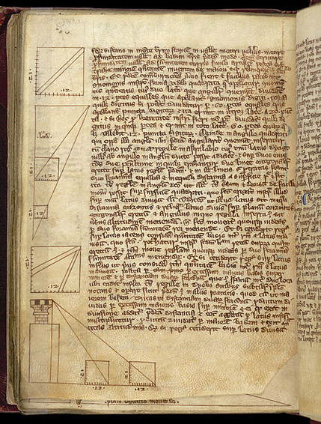
Universities: Winning the mind
Began in Spain and Africa by 8th C
Under the Muslims
Christian Europe in 11-12th C
European desire for reform and Dominican emphasis on learning
Discussion:
What is the value of a university with respect to creativity?

Slide 17
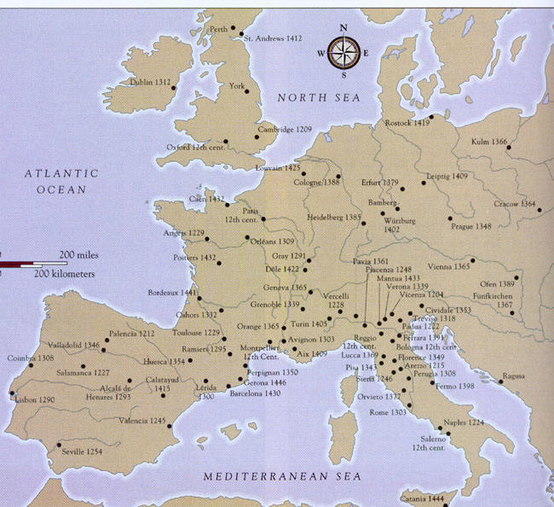
Universities: Winning the mind

Slide 18
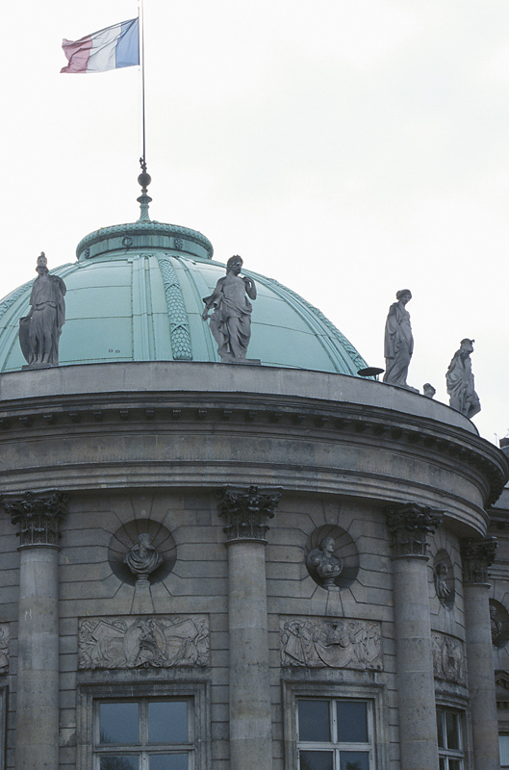
Universities
Curriculum and organization
Faculty of arts: 7 liberating arts
Trivium (grammar, rhetoric, logic)
Bachelors degree
Quadrivium (arithmetic, geometry, astronomy, music)
Masters degree
Faculties of Theology, Medicine and Law
Doctors degree
Theology and Arts split in Paris
Arts to the left bank (Latin Quarter)
Renamed: Sorbonne

Slide 19
Monastic Learning
Traditional teaching method in Middle Ages
Glossing
Elaboration on a text
Bernard of Clairvaux
Taught by glossing (86 sermons from chapters 1 and 2 of Song of Solomon)
"Jesus, The Very Thought of You"
Strongly influenced choice of Pope
Strongly influenced formation of 2nd Crusade
Strongly disagreed with other teaching methods

Slide 20
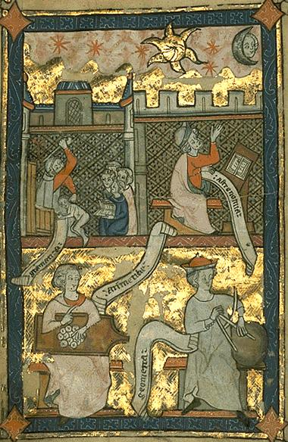
Scholastic Method (Scholasticism)
An alternate to the Monastic learning method
Popular in universities rather than abbeys
A philosophical and theological method
Began at University of Paris about 1100

Slide 21
Scholasticism
Based on the assumption that philosophy and theology are in ultimate agreement
Philosophy based on the Greeks
Plato―long recognized
(St. Augustine)
Aristotle―available through the Muslims
Theology based on revelation and tradition (Bible and Church)

Slide 22
Scholasticism
Typical classroom experience
Morning—readings to develop arguments
Afternoon—discussion, using didactic method
Next morning—resolution of issue
Scholastic topics
Example: "Can God do everything?"
Example: "Can a man see God?"
Example: "Is it ever permissible to lie?"

Slide 23
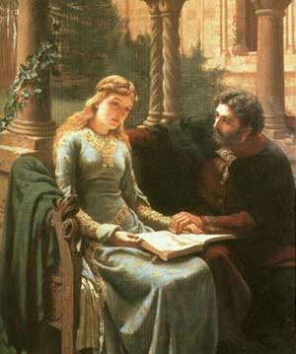
Peter Abelard
Teacher at the University of Paris Sic et Non (Yes and No)
Conflicts not resolved in book
Chastised by the Pope
Bernard of Clairvaux
Heloise
Illegitimate son and secret marriage
Castration
Remainder of lives as abbot and abbess

Slide 24
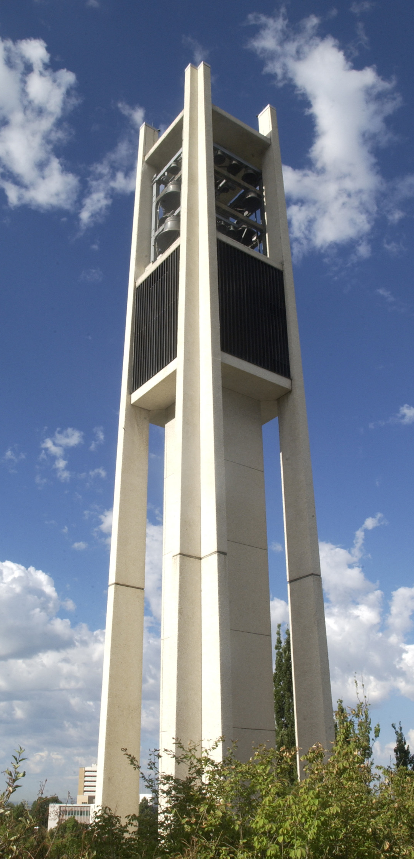
Discussion
Should religious universities teach all concepts or should they teach to strengthen faith?
Preserve, then, the freedom of your mind in education and in religion, and be unafraid to express your thoughts and to insist upon your right to examine every proposition. We are not so much concerned with whether your thoughts are orthodox or heterodox as we are that you shall have thoughts.
—President Hugh B. Brown, First Presidency

Slide 25
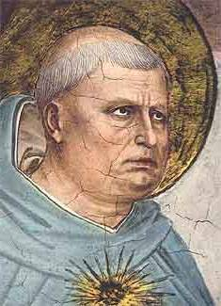
Thomas Aquinas
From a wealthy family in Italy
Large, clumsy man
Ridiculed as a youth (flying cow)
Father’s desire: Benedictine abbot like his uncle (wealthy)
Attended a university in Naples
Wanted to become a Dominican
Imprisoned by his parents
Memorized the Bible while imprisoned
Tempted with prostitute
Released and became a Dominican

Slide 26
Thomas Aquinas
Moved to University of Paris
Studied theology
Taught by Albertus Magnus
Thomas became an expert in languages, literature, astronomy, mathematics, theology
Later taught at 3 universities
Pope named him Doctor of the Church
Example: Why did Christ come to earth (that is, the incarnation)

Slide 27
Thomas Aquinas—Scholasticism

Slide 28
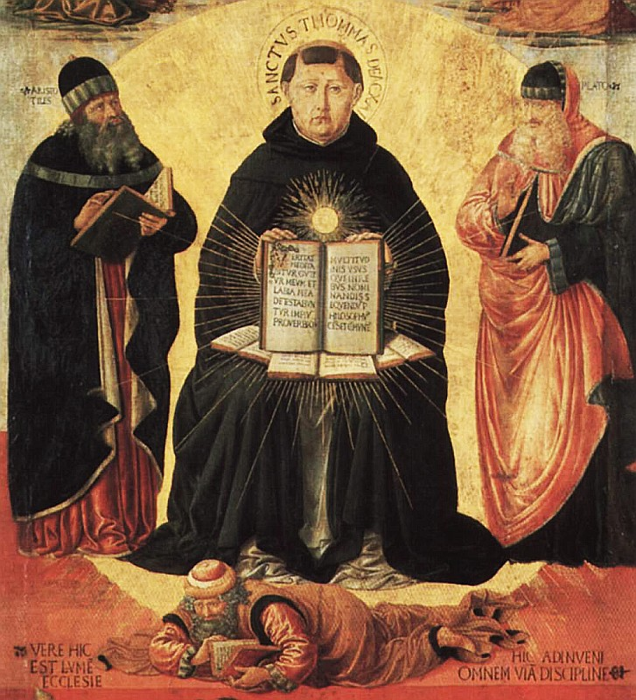
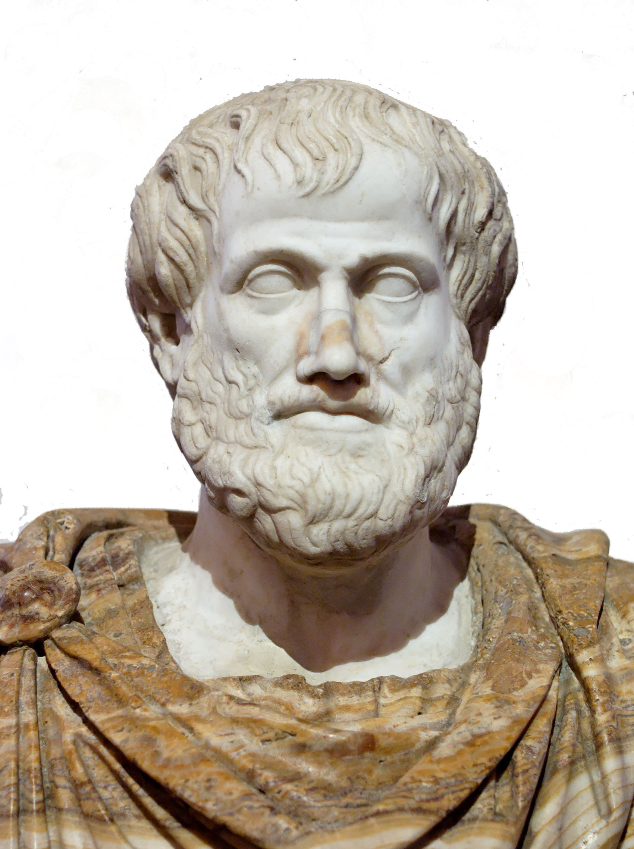
Thomas Aquinas
Wrote over 40 books and several hymns
Summa Theologica
Used Aristotle’s logic and philosophy

Slide 29
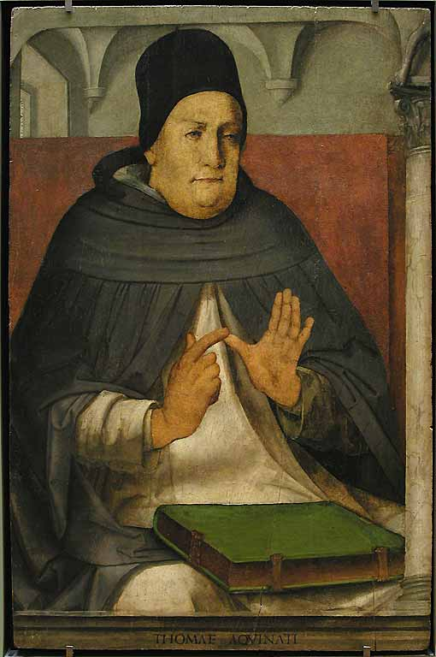
5 Proofs of God’s Existence
Things are in motion, hence there is a first mover. Things are caused, hence there is a first cause. Things exist, hence there is a creator. Perfect goodness exists, hence it has a sourcer. Things are designed, hence they serve a purpose.
—Thomas Aquinas

Slide 30
Thomas Aquinas – 5 Proofs

Slide 31
Discussion
Did universities improve creativity?
If so, why?

Slide 32
Is BYU improving your Creativity?
Thank You

