Slide 1
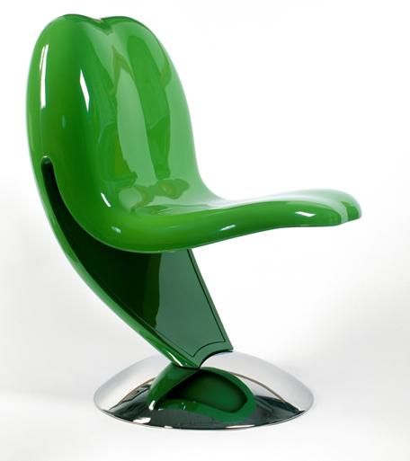
Reinforced Plastics
MFG 355

Slide 2
Advanced Composites
Long (continuous) fibers
Very high performance reinforcements
Carbon and aramid
Resins are also very high performance
Typically aerospace applications

Slide 3
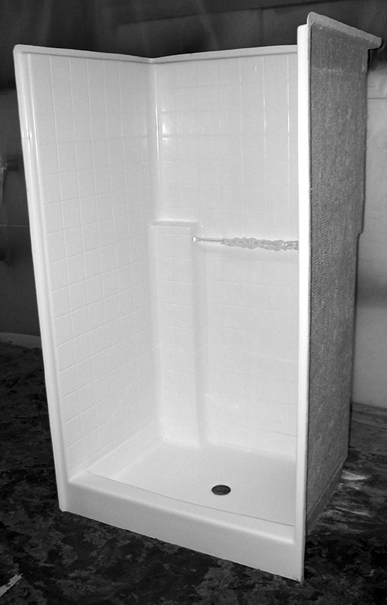
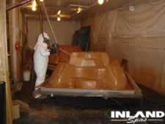
Engineering Composites
Shorter fibers/fiberglass
Lower mechanical properties (stiffness)
Lower performance resins

Slide 4
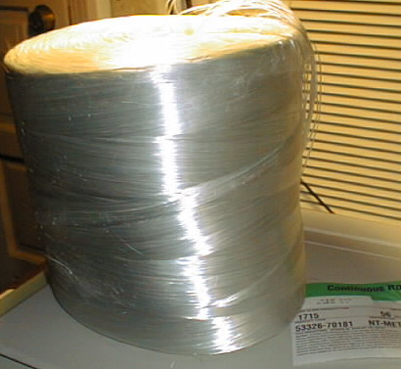
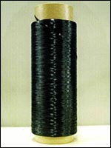
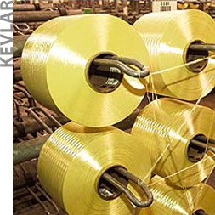
Reinforcements
Three main types of fibers
Fiberglass
Carbon fiber or Graphite
Organic fibers, aramids (kevlar)

Slide 5
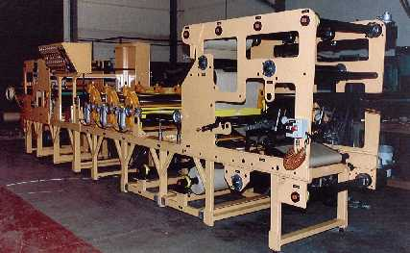
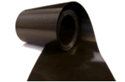
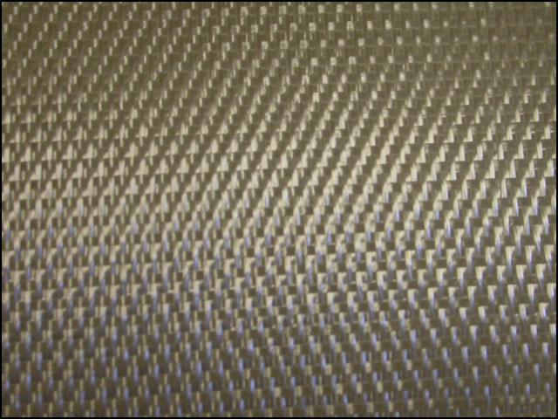
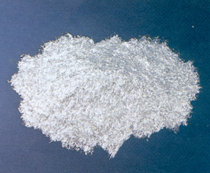
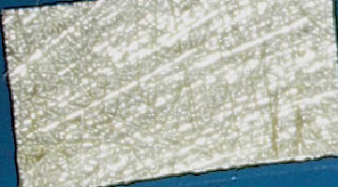
Reinforcement Forms
Fiber manufacturers package the fibers on spools called tows
Fibers are generally converted to other forms after manufacturing
Chopped fibers (including whiskers)
Mat (random)
Woven fibers
Tapes
Prepregs

Slide 6
Manufacturing Methods
Thermoplastic processes using short fibers
Injection molding
Extrusion
Minor changes are made to accommodate the fiber reinforcements
All gaps in flow path should be increased
A resin viscosity decrease may be necessary

Slide 7
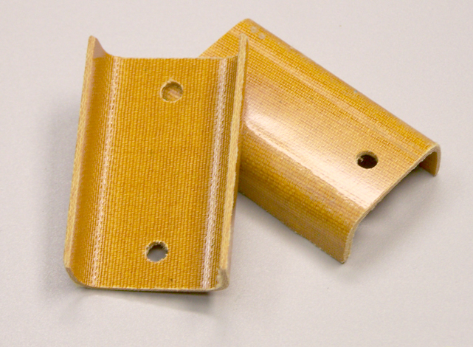
Manufacturing Methods
Matched die or Compression molding
Reduced flow path over injection or extrusion
SMC compression molding allows for continuous fibers, mats or weaves
These processes offer parts that are finished on both sides where most other composite processes do not

Slide 8
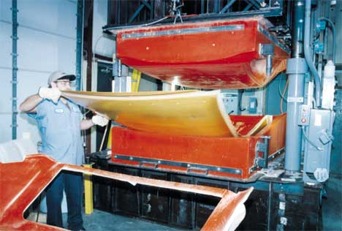
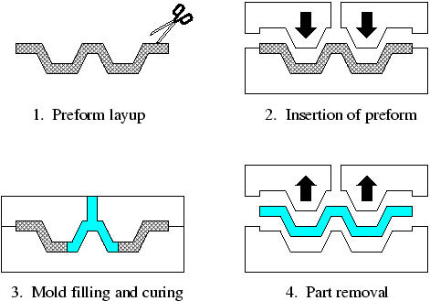
Manufacturing Methods
Resin transfer molding
Fiber preform is placed in the mold cavity
Preform doesn’t move—resin is pulled/pushed in

Slide 9
RTM

Slide 10
Schematic of a Typical RTM Process
Composite Preform
Vacuum
Pressure
Resin Flow
Vacuum
Resin Source
Resin Trap
Tooling/Matched Die Mold

Slide 11
Schematic of a Typical RTM Process
Composite Preform
Vacuum
Pressure
Resin Flow
Vacuum
Resin Source
Resin Trap
Tooling/Matched Die Mold

Slide 12
Schematic of a Typical RTM Process
Composite Preform
Vacuum
Pressure
Resin Flow
Vacuum
Resin Source
Resin Trap
Tooling/Matched Die Mold

Slide 13
Schematic of a Typical RTM Process
Composite Preform
Vacuum
Pressure
Resin Flow
Vacuum
Resin Source
Resin Trap
Tooling/Matched Die Mold

Slide 14
VARTM
Vacuum assist resin transfer molding
Using vacuum and not positive pressure
Can use less sturdy molds
May have bagging materials on one side

Slide 15
Typical VARTM Process Setup
Resin Trap
Resin Supply
Vacuum Bag
Vacuum
Vacuum
Degas
Porous Release Film
Resin
Flow
Distribution Media
Sealant
Tape
Preform
Tool

Slide 16
Typical VARTM Process Setup
Resin Trap
Resin Supply
Vacuum Bag
Vacuum
Vacuum
Degas
Porous Release Film
Resin
Flow
Distribution Media
Sealant
Tape
Preform
Tool

Slide 17
Typical VARTM Process Setup
Resin Trap
Resin Supply
Vacuum Bag
Vacuum
Vacuum
Degas
Porous Release Film
Resin
Flow
Distribution Media
Sealant
Tape
Preform
Tool

Slide 18
Typical VARTM Process Setup
Resin Trap
Resin Supply
Vacuum Bag
Vacuum
Vacuum
Degas
Porous Release Film
Resin
Flow
Distribution Media
Sealant
Tape
Preform
Tool

Slide 19
Typical VARTM Process Setup
Resin Trap
Resin Supply
Vacuum Bag
Vacuum
Vacuum
Degas
Porous Release Film
Resin
Flow
Distribution Media
Sealant
Tape
Preform
Tool

Slide 20
Typical VARTM Process Setup
Resin Trap
Resin Supply
Vacuum Bag
Vacuum
Vacuum
Degas
Porous Release Film
Resin
Flow
Distribution Media
Sealant
Tape
Preform
Tool

Slide 21
Resin Film Infusion (RFI)
Uses layers of film resin with layers of preforms
Assembly is bagged and heated

Slide 22
Layered RFI
Vacuum bag
Resin film layer
Fiber preform layer
Tool

Slide 23
T1 (Resin flows and infuses preform)
T2 (Consolidation under pressure)

Slide 24
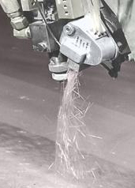
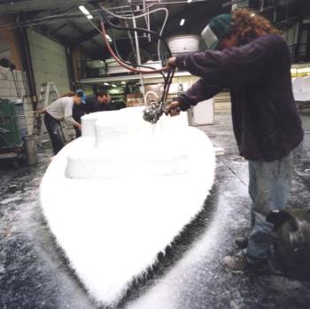
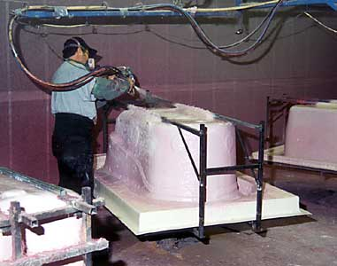
Manufacturing Methods
Spray-up
Fibers are chopped, coated with resin and sprayed onto the mold

Slide 25
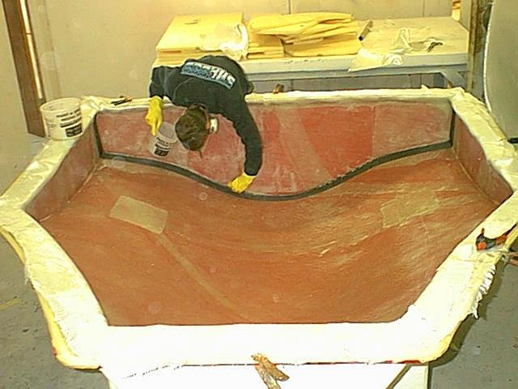
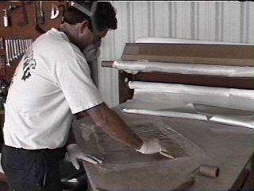
Manufacturing Methods
Hand Lay-up (wet)

Slide 26
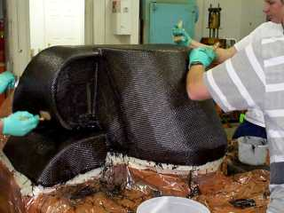
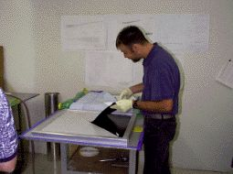
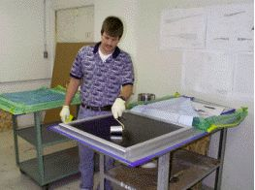
Manufacturing Methods
Hand Lay-up (prepreg)

Slide 27
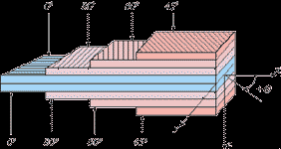
Fiber Orientations
Isometric materials have equal strength in all directions
Composites can be lighter weight by not having strength in the directions that it is not needed
Lay-up still has to have some balance and symmetry

Slide 28
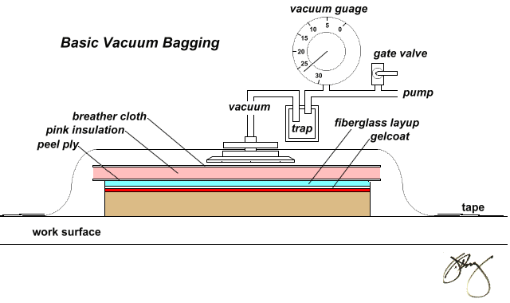
Vacuum Bagging
Provides for increased part consolidation
Reduces matched die mold costs

Slide 29
Vacuum bagging

Slide 30
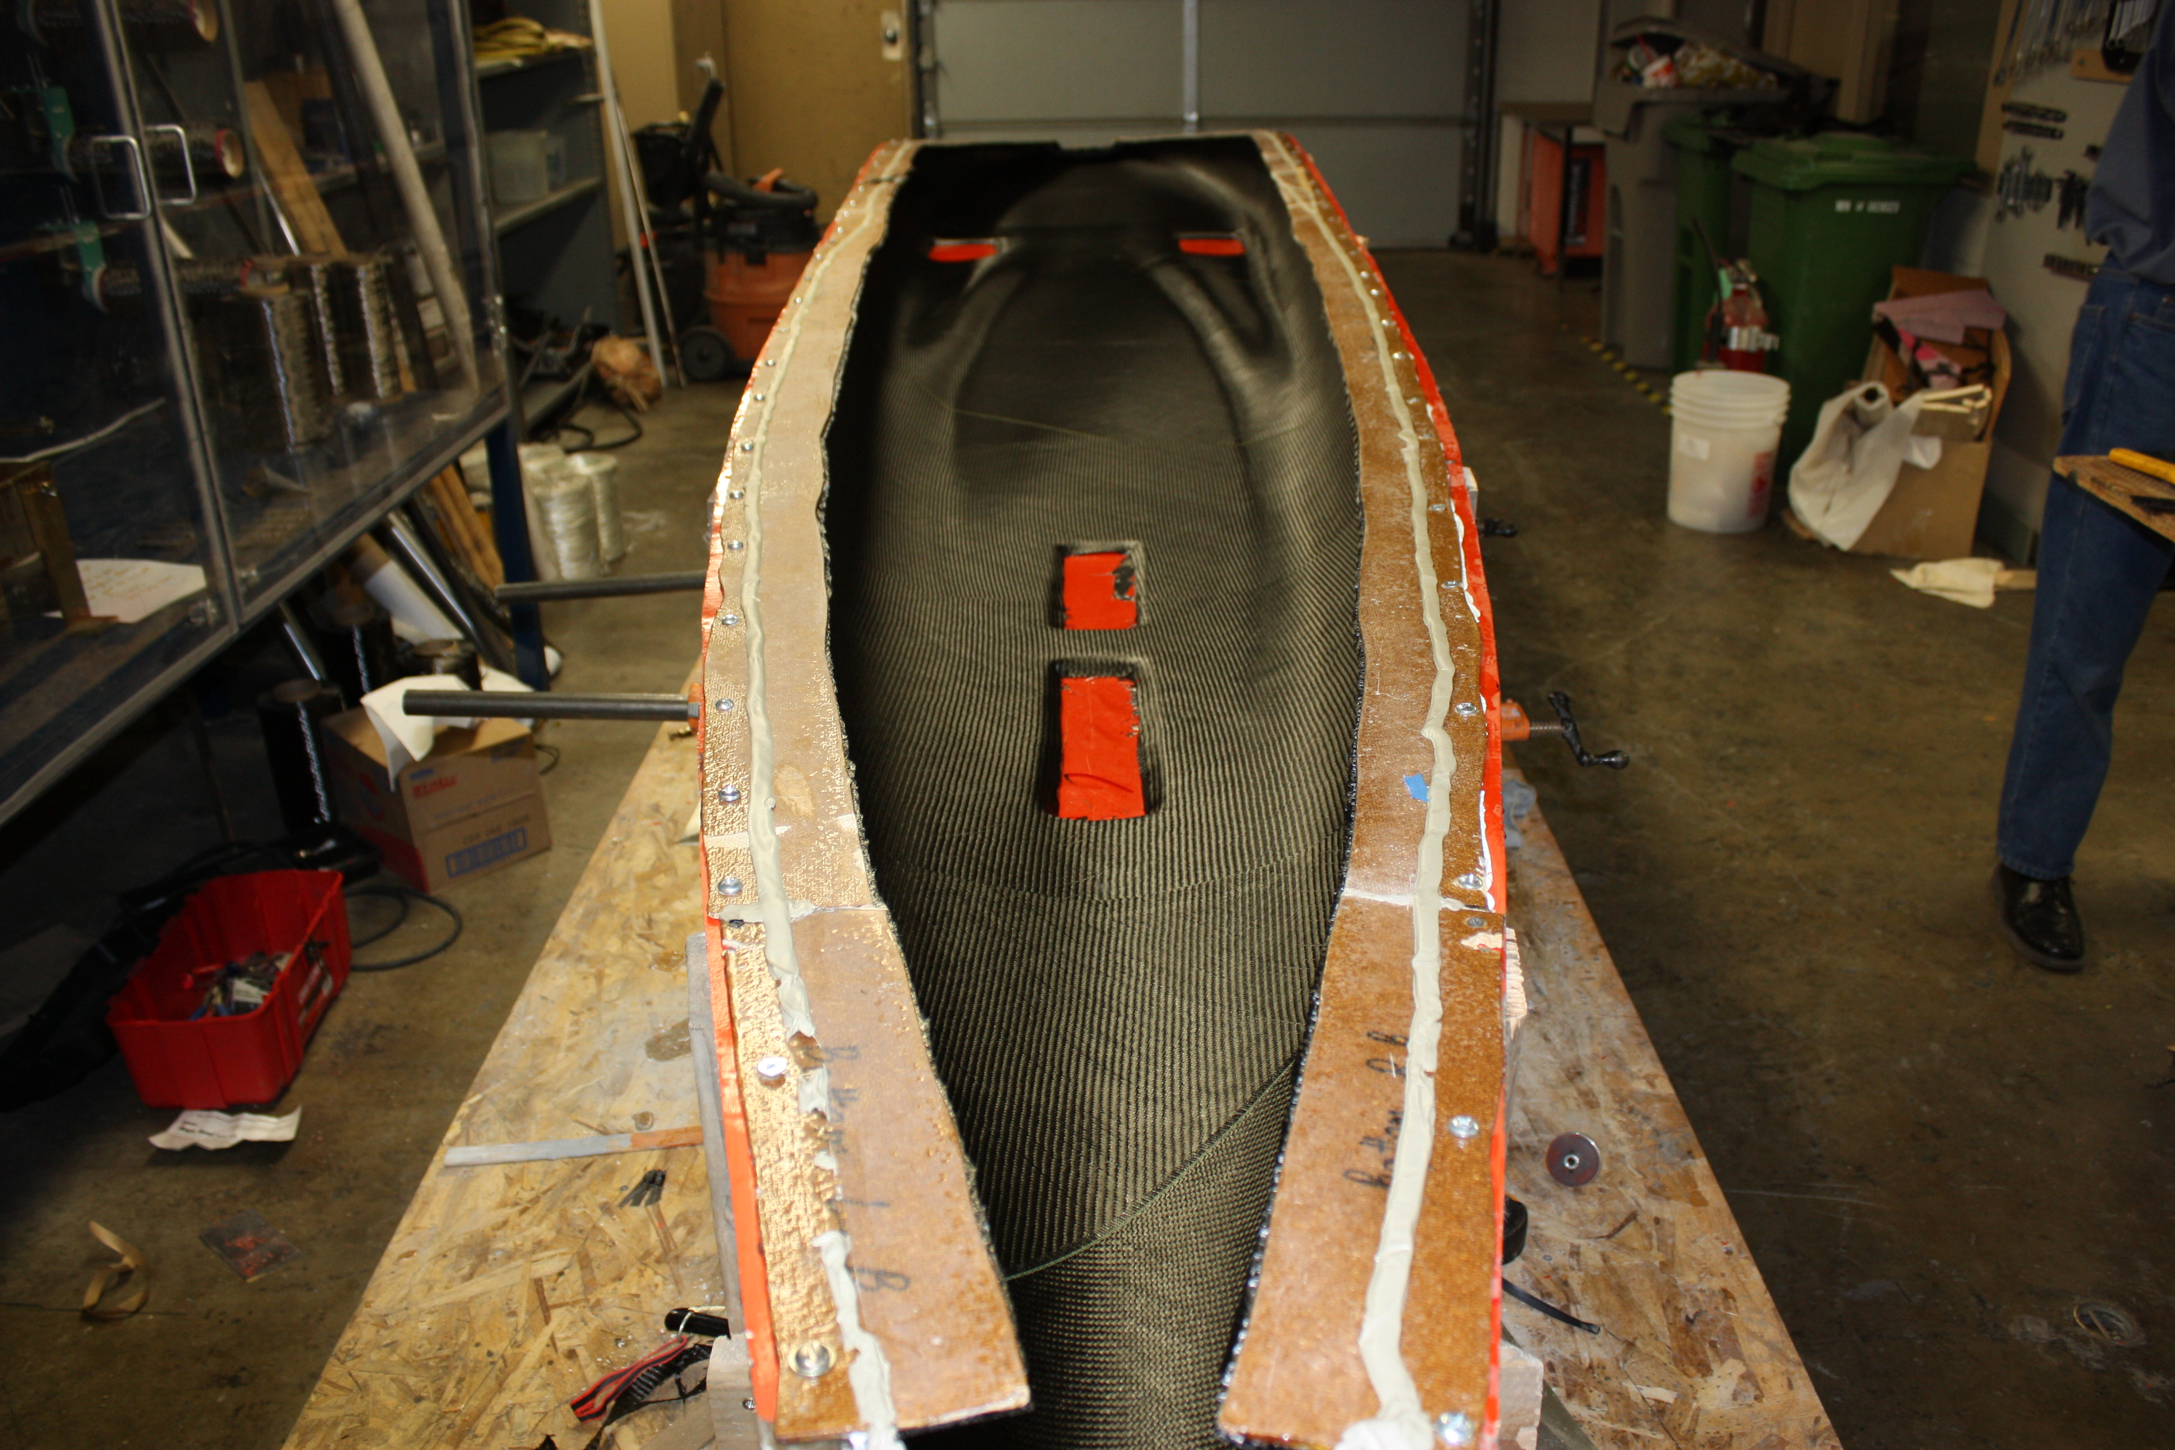
Vacuum bagging

Slide 31
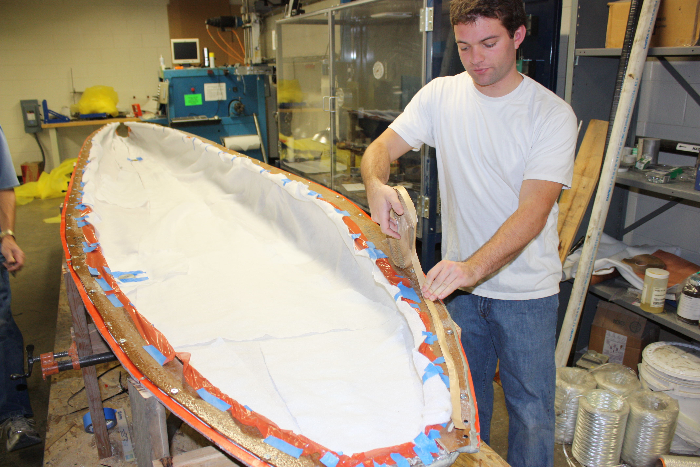
Vacuum bagging

Slide 32
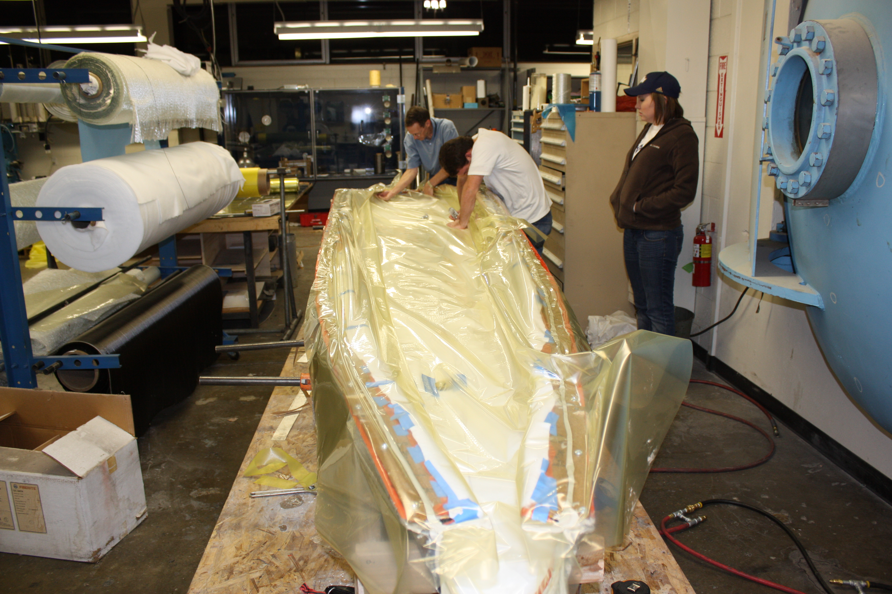
Vacuum bagging

Slide 33
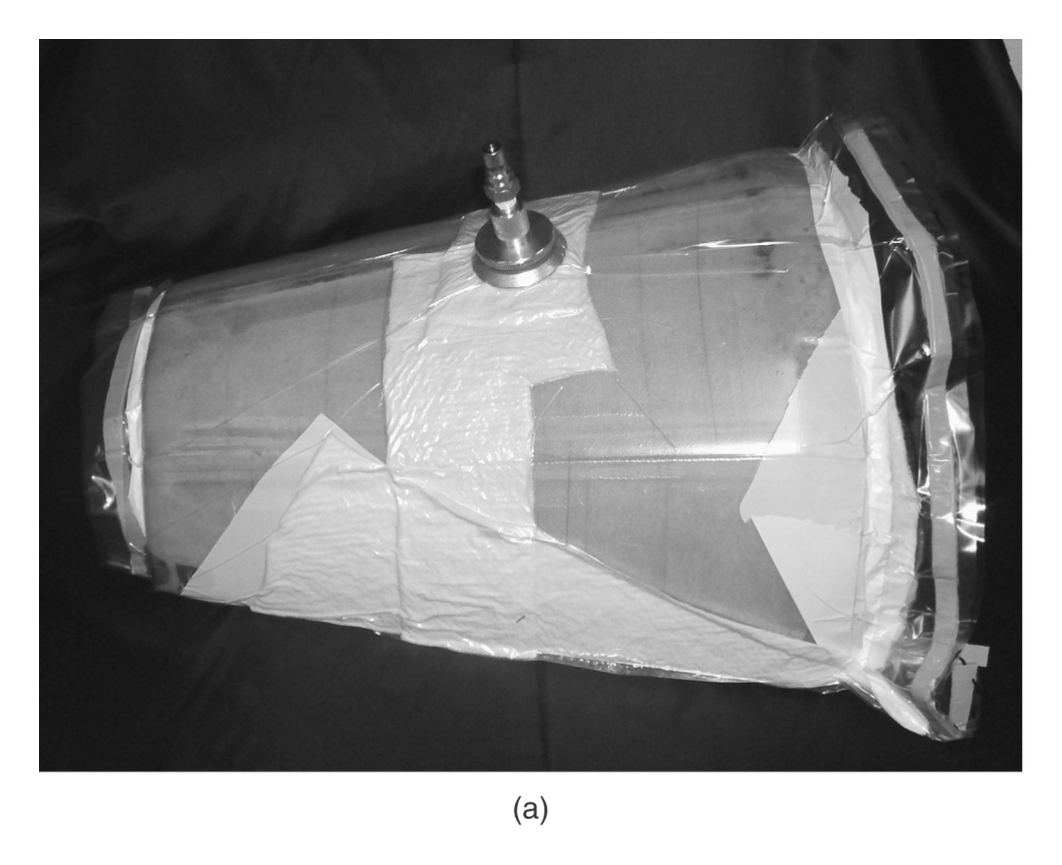
Vacuum bagging

Slide 34
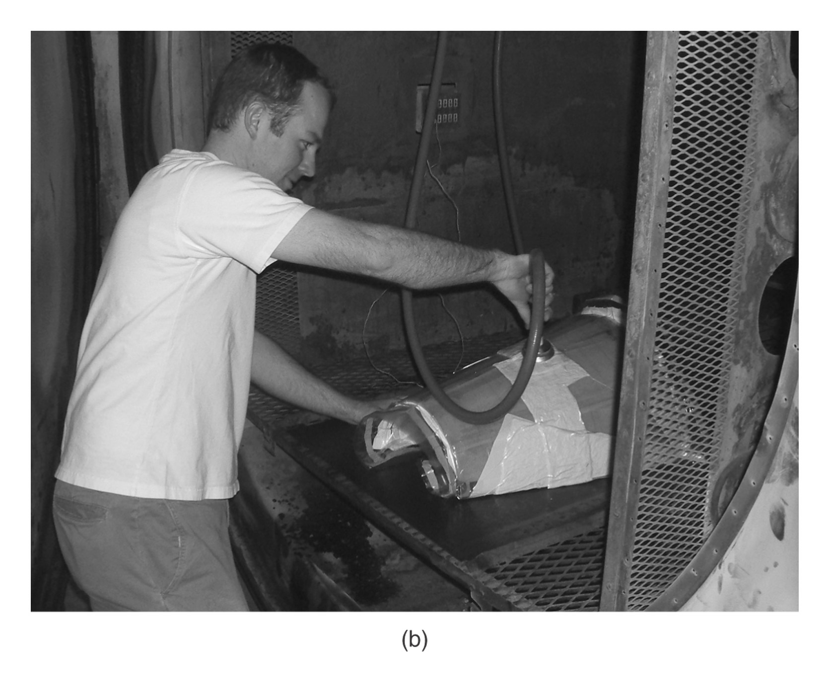
Vacuum bagging

Slide 35
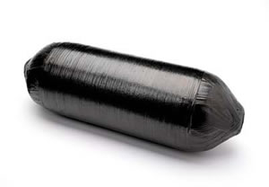
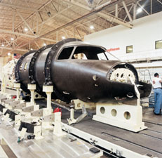
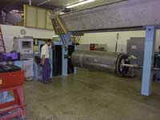
Manufacturing Methods
Filament winding and fiber placement
Fiber placement has greater accuracy
Fiber placement can wind on less symmetrical and even partially concave mandrels
Tubes, tanks, wind turbine blades and rockets

Slide 36
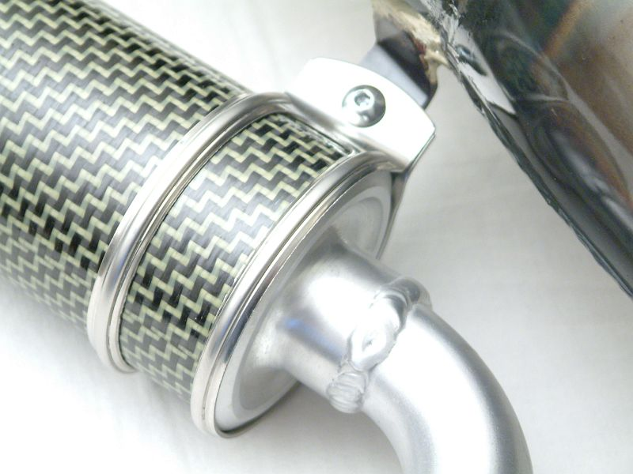
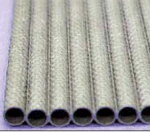
Manufacturing Methods
Roll wrapping
Faster than filament winding
Limited to symmetrical mandrels

Slide 37
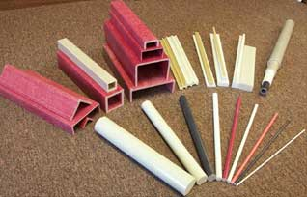
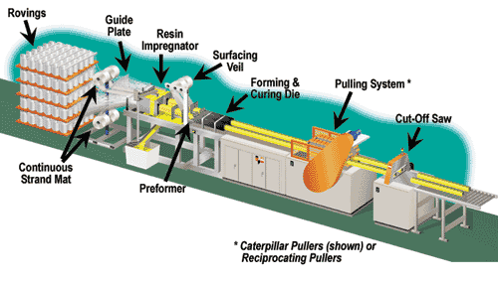
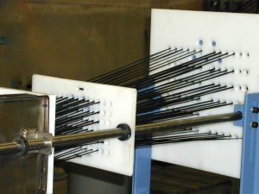
Manufacturing Methods
Pultrusion
High volume production
Comparable to extrusion but the main processing force is tension
Profile is pulled from the machine

Slide 38
Manufacturing Methods
Advanced thermoplastic composites
Difficulties with resin wet-out of the fibers
High viscosity of the resin
High temperature for processing

Slide 39
Advanced Thermoplastics
All highly aromatic
Most common types:
Thermoplastic polyimides (TPI, PAI, PEI, PBI)
Polyetheretherketone (PEEK, and related)
Sulfone and related (PSU, PAS, PES, PPS)
Liquid crystal polymers (LCP)
Fluoropolymers (PTFE, PVDF)

Slide 40
Thermoplastic − Thermoforming
Press (in two modes)
Blanks
Clamp
Finished
Part
Oven
Clamping
Pressing

Slide 41
Glass Mat Thermoplastic Compression Molding

Slide 42
Plant Concepts
Many of the processes require considerable space
Curing equipment for large parts can be very large (and expensive)
Controlling volatiles (solvents and resins) must be taken care of
Molds can be both expensive and fragile

Slide 43
Thank You

