Slide 1
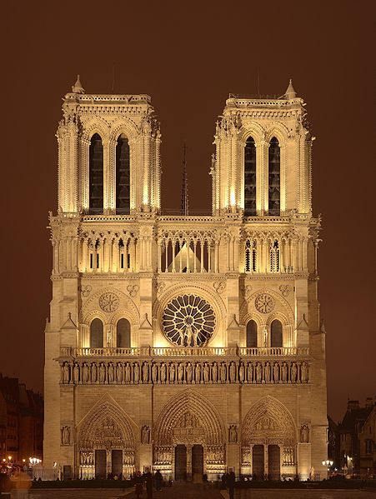
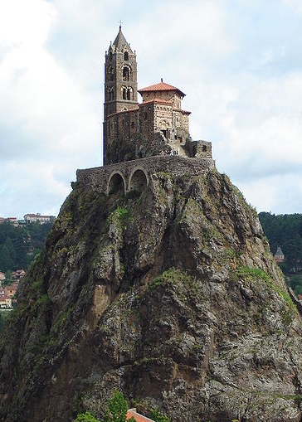
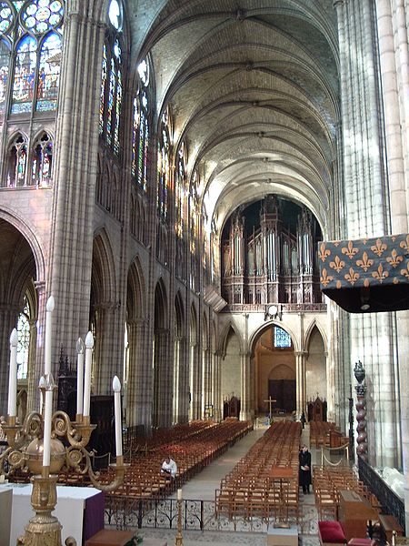
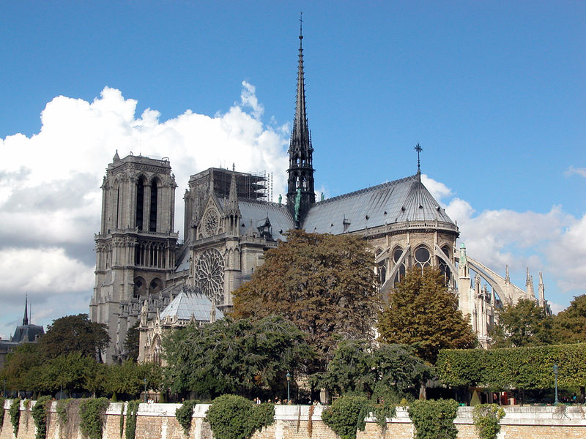
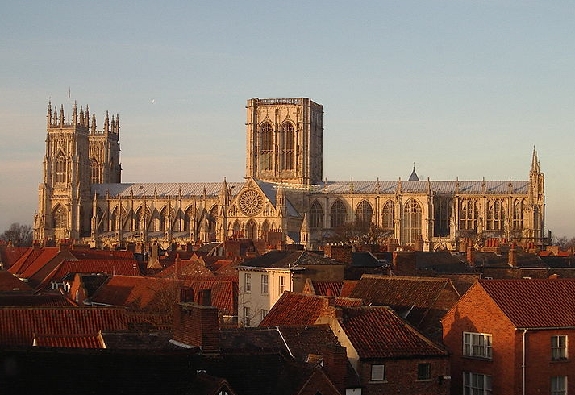
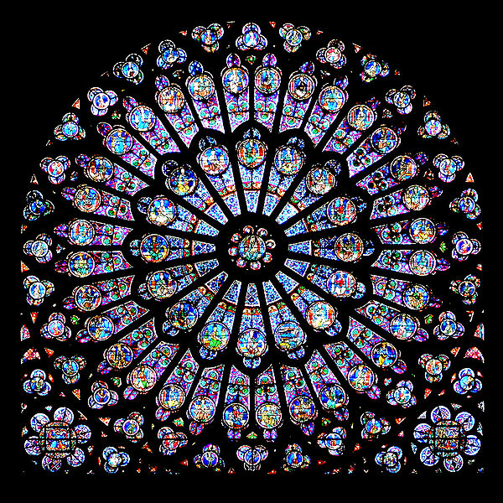
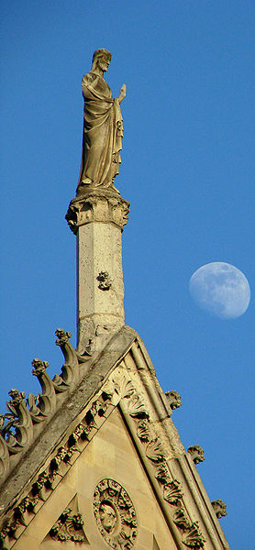
Middle Ages Architecture
High Creativity
High Creativity

Slide 2
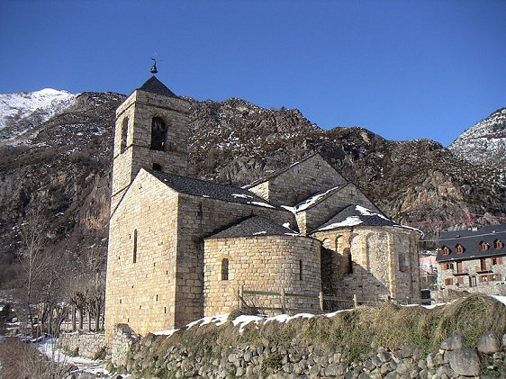
Romanesque
In the Roman manner
Everything done in Western European art and architecture between the:
Fall of the Roman Empire
(AD 476)
Gothic Period (about AD 1100)
Ancient History
Renaissance
AD 1450

Slide 3
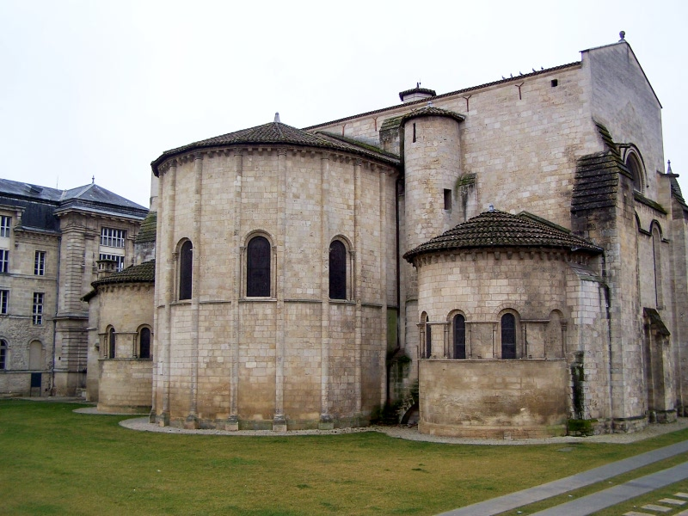
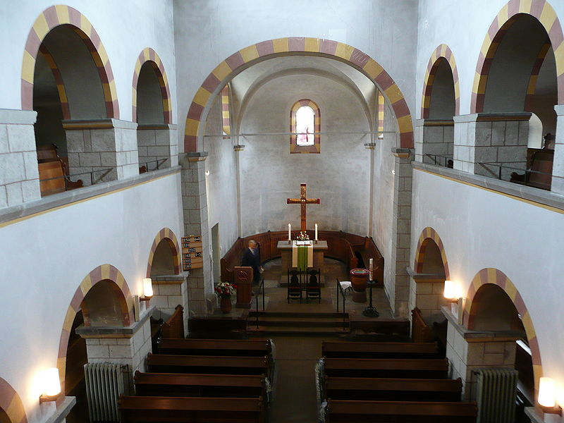
Romanesque Churches
Heavy walls
Built at the same time as fortress castles
Round arches and vaults
Small windows
Small area (not many people inside)
Stark on the inside
Ancient History
AD 476
Renaissance
AD 1450

Slide 4
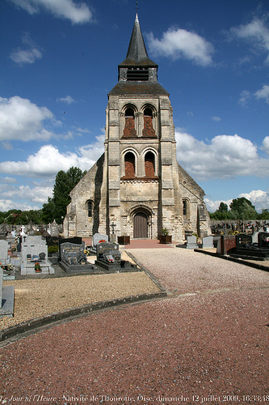
Romanesque
AD 476
Renaissance
AD 1450

Slide 5
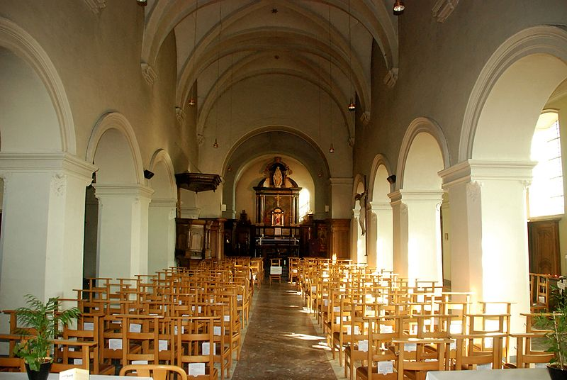
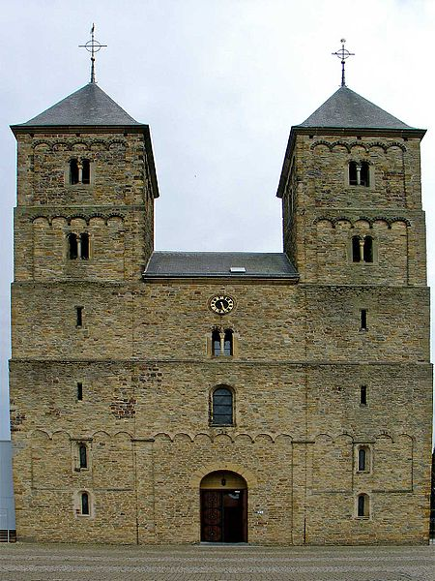
Romanesque
AD 476
Renaissance
AD 1450

Slide 6
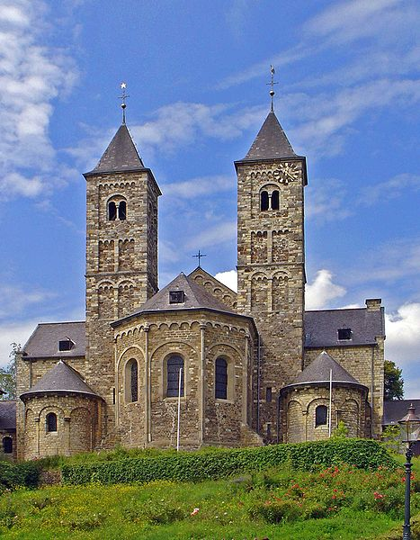
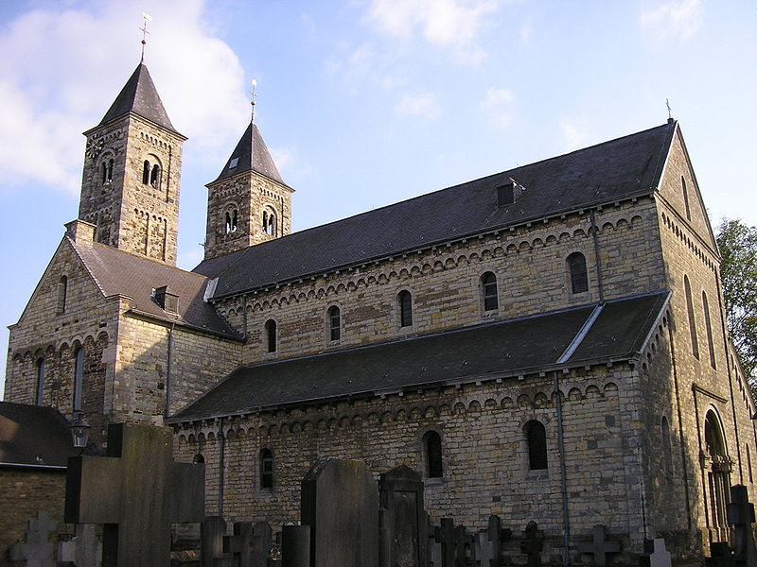
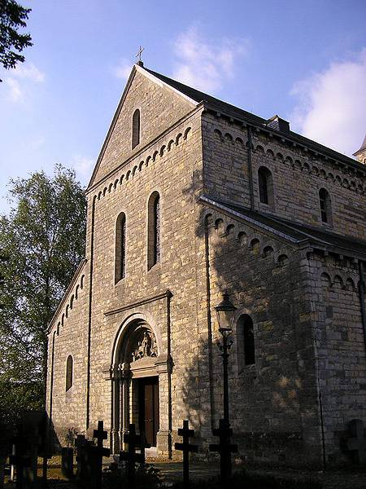
Romanesque
AD 476
Renaissance
AD 1450

Slide 7
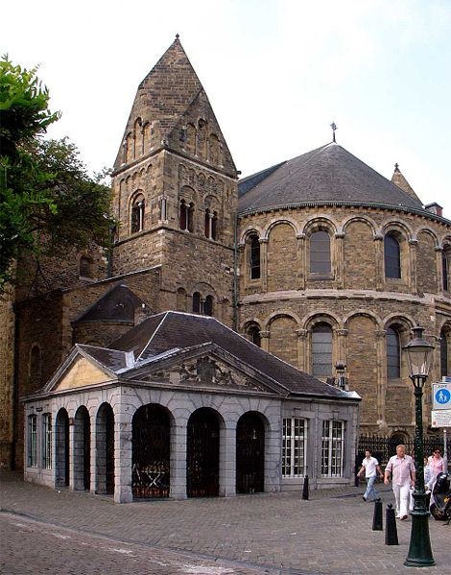
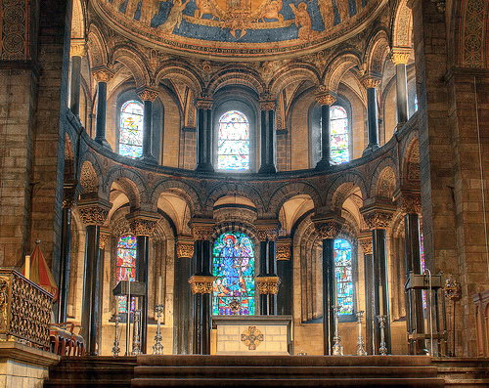
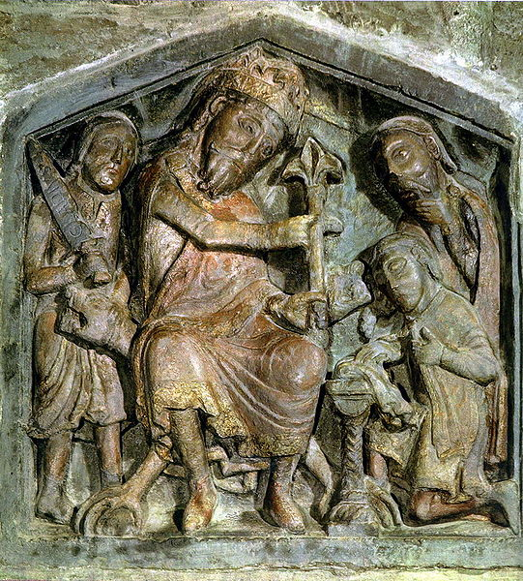
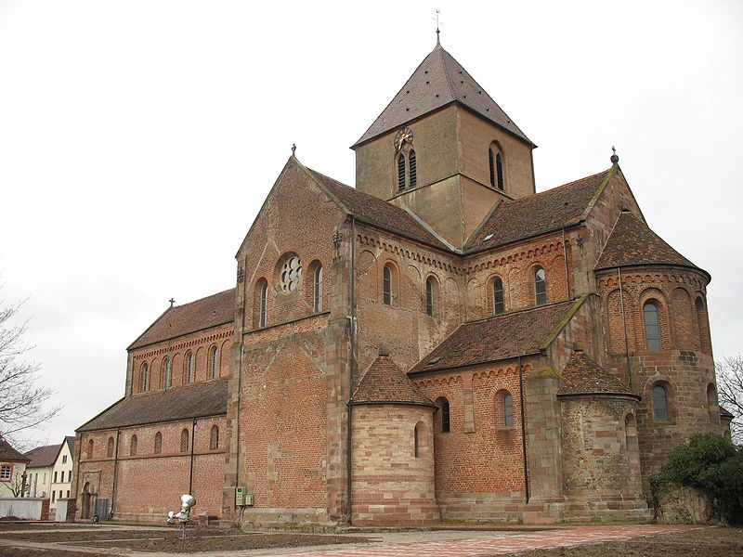
Romanesque
AD 476
AD 1450

Slide 8
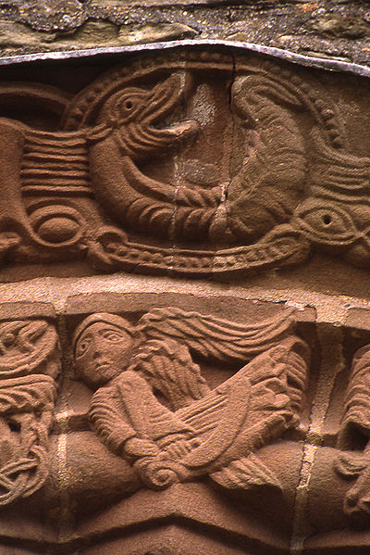
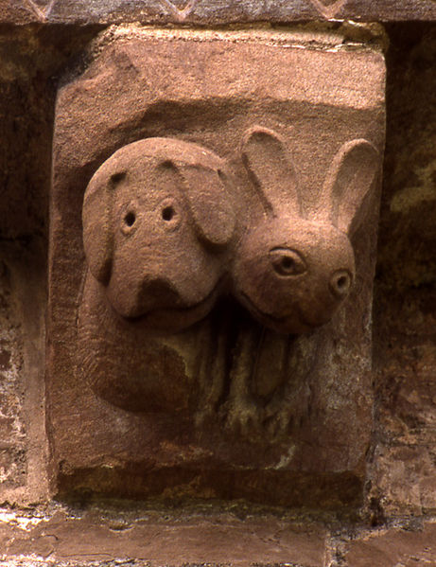
Romanesque
AD 476
AD 1450

Slide 9
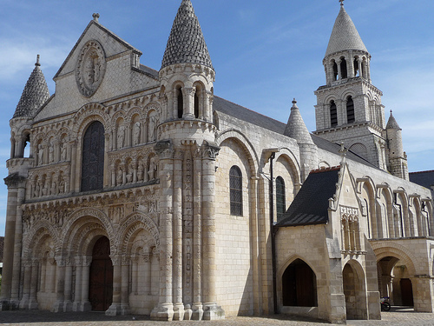
Romanesque
AD 476
AD 1450

Slide 10
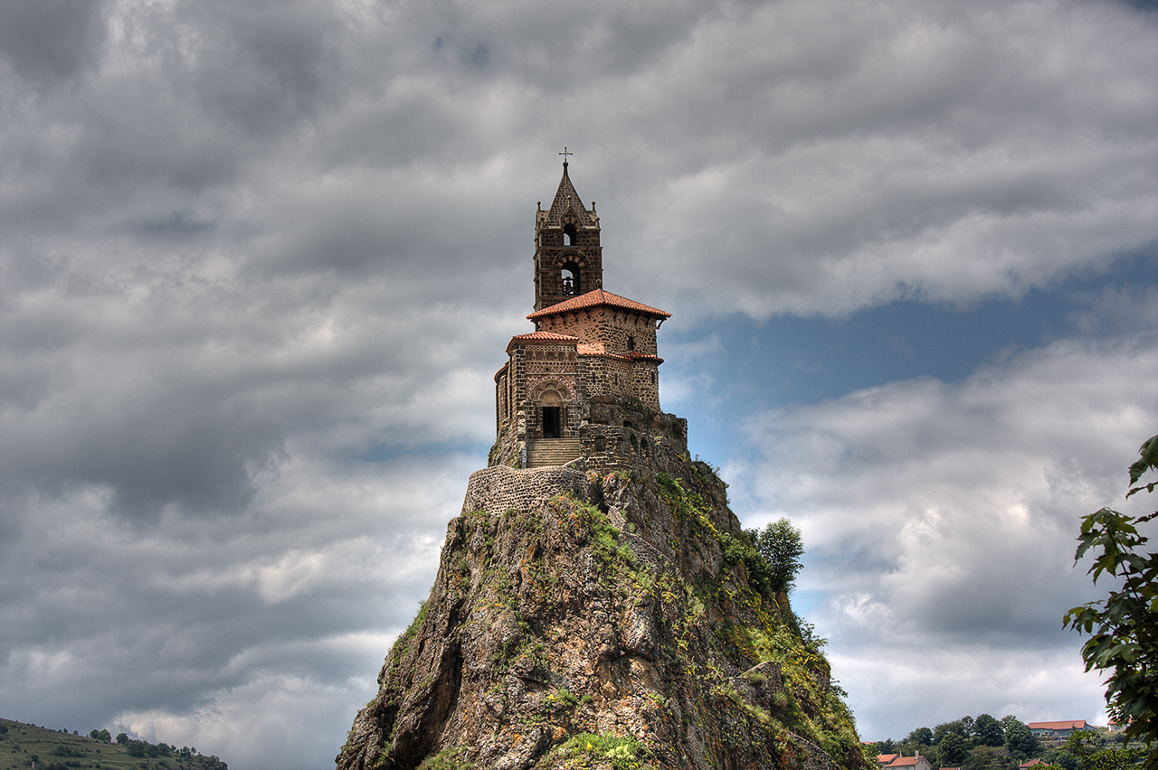
Romanesque
AD 476
Renaissance
AD 1450

Slide 11
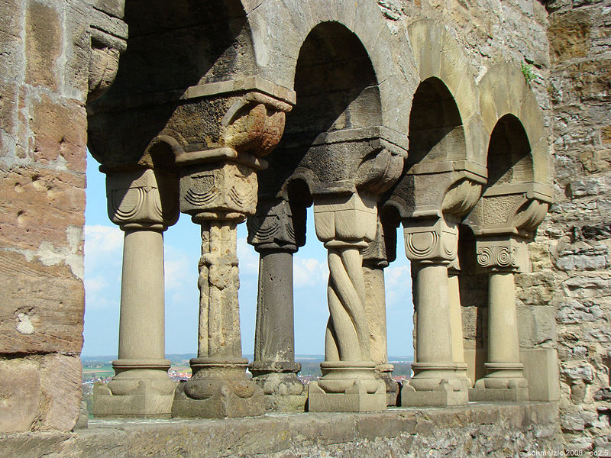
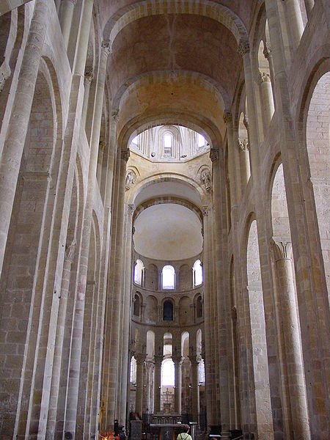
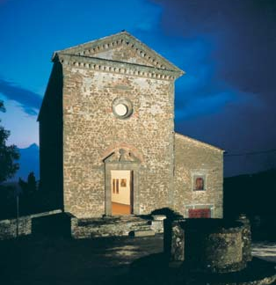
Romanesque
AD 476
AD 1450

Slide 12
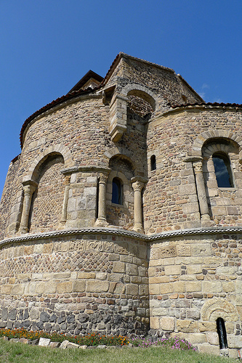
Romanesque
AD 476
AD 1450

Slide 13
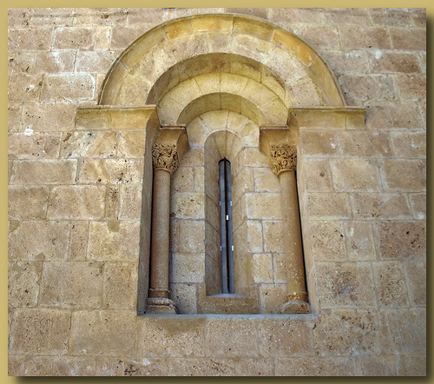
Romanesque
AD 476
AD 1450

Slide 14
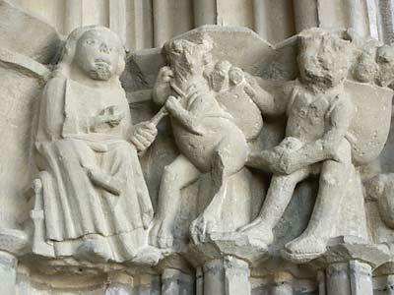
Romanesque
AD 476
AD 1450

Slide 15
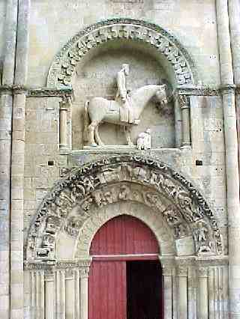
Romanesque
AD 476
AD 1450

Slide 16
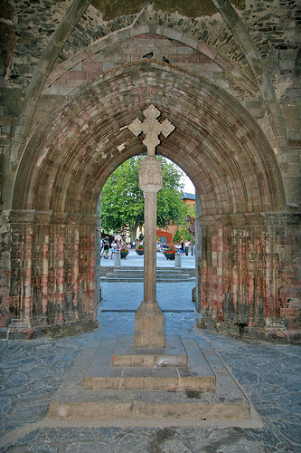
Romanesque
AD 476
AD 1450

Slide 17
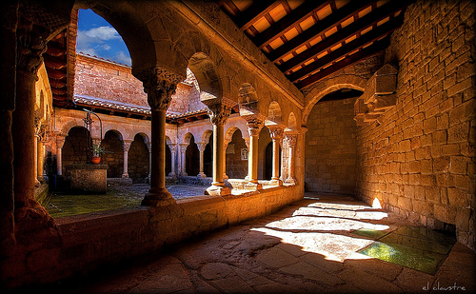
Romanesque
AD 476
AD 1450

Slide 18
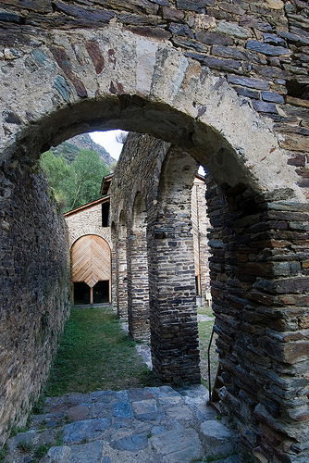
Romanesque
AD 476
AD 1450

Slide 19
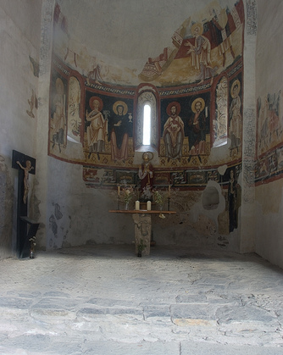
Romanesque
AD 476
AD 1450

Slide 20
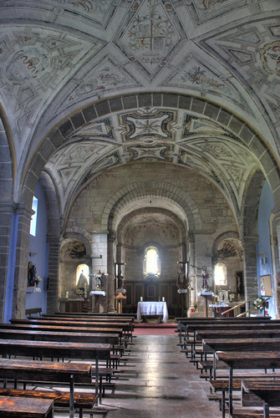
Romanesque
AD 476
AD 1450

Slide 21
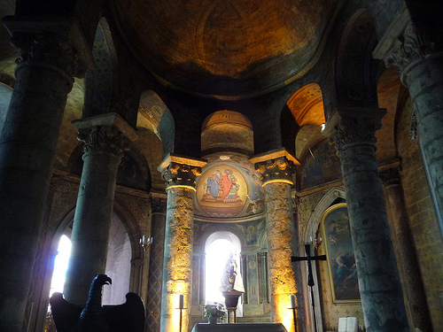
Romanesque
AD 476
AD 1450

Slide 22
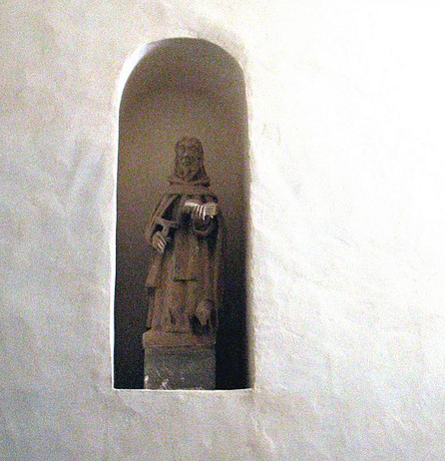
Romanesque
AD 476
AD 1450

Slide 23
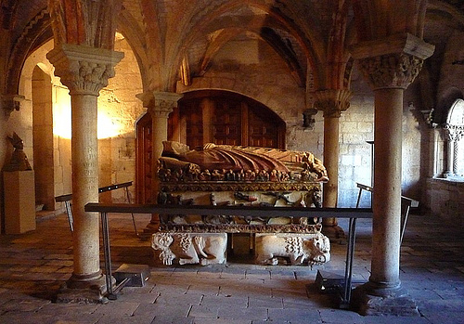
Romanesque
AD 476
AD 1450

Slide 24
How the Gothic style works
Demonstration
Would 9 healthy volunteers
please come forward.
AD 476
AD 1450

Slide 25
High Romanesque Arches
AD 476
AD 1450

Slide 26
Gothic Arches
AD 476
AD 1450

Slide 27
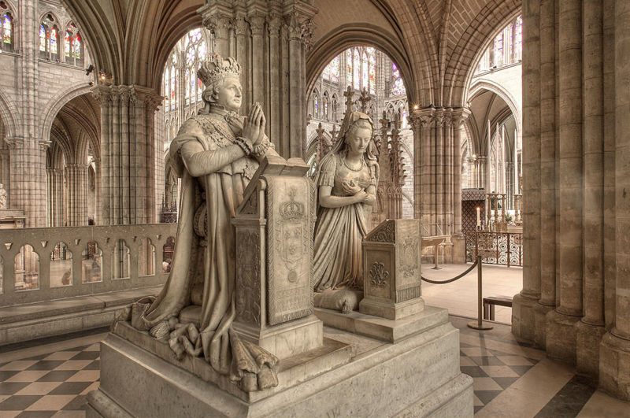
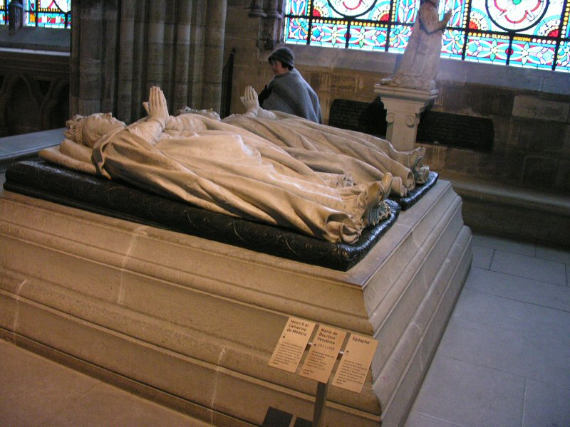
St. Denis
Built on the burial place of St. Denis
Beheaded for Christianity
Patron saint of France
National mausoleum of French royalty
Located in the north of Paris
Abbott Suger wanted to repair the church
AD 1137
AD 1450

Slide 28
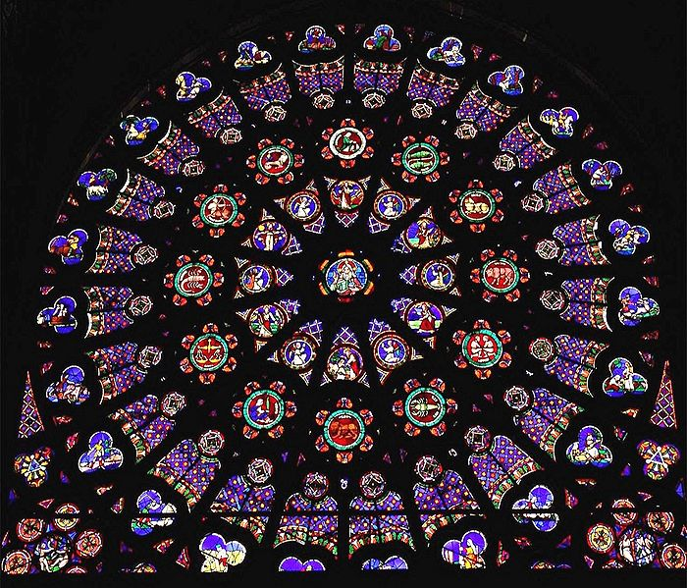
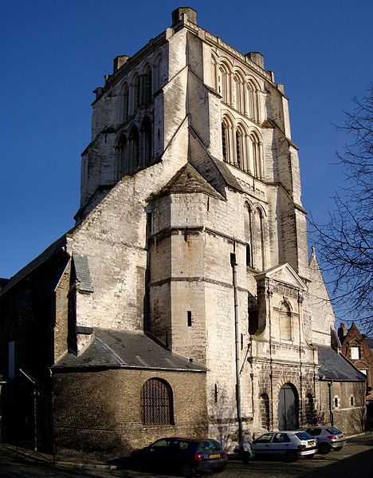
St. Denis
Abbott Suger retained much of the current church (built at time of Charlemagne)
Added rose window
Added gothic arches and raised the roof
AD 1450

Slide 29
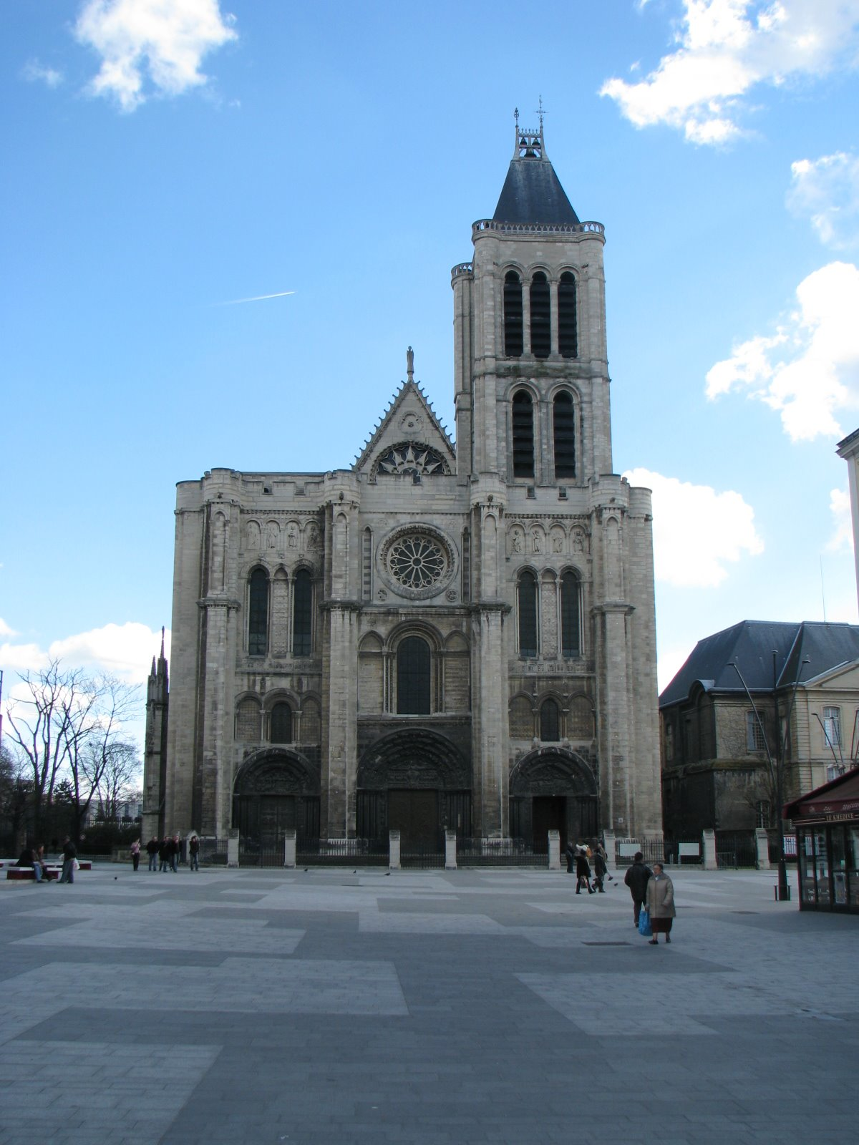
St. Denis
Mixed Romanesque and Gothic styles
A “nice church” but not impressive enough for the king
Holy site in the center of Paris (on the island) would be a better place for the main cathedral of Paris
AD 1450

Slide 30
Notre Dame de Paris
AD 1450

Slide 31
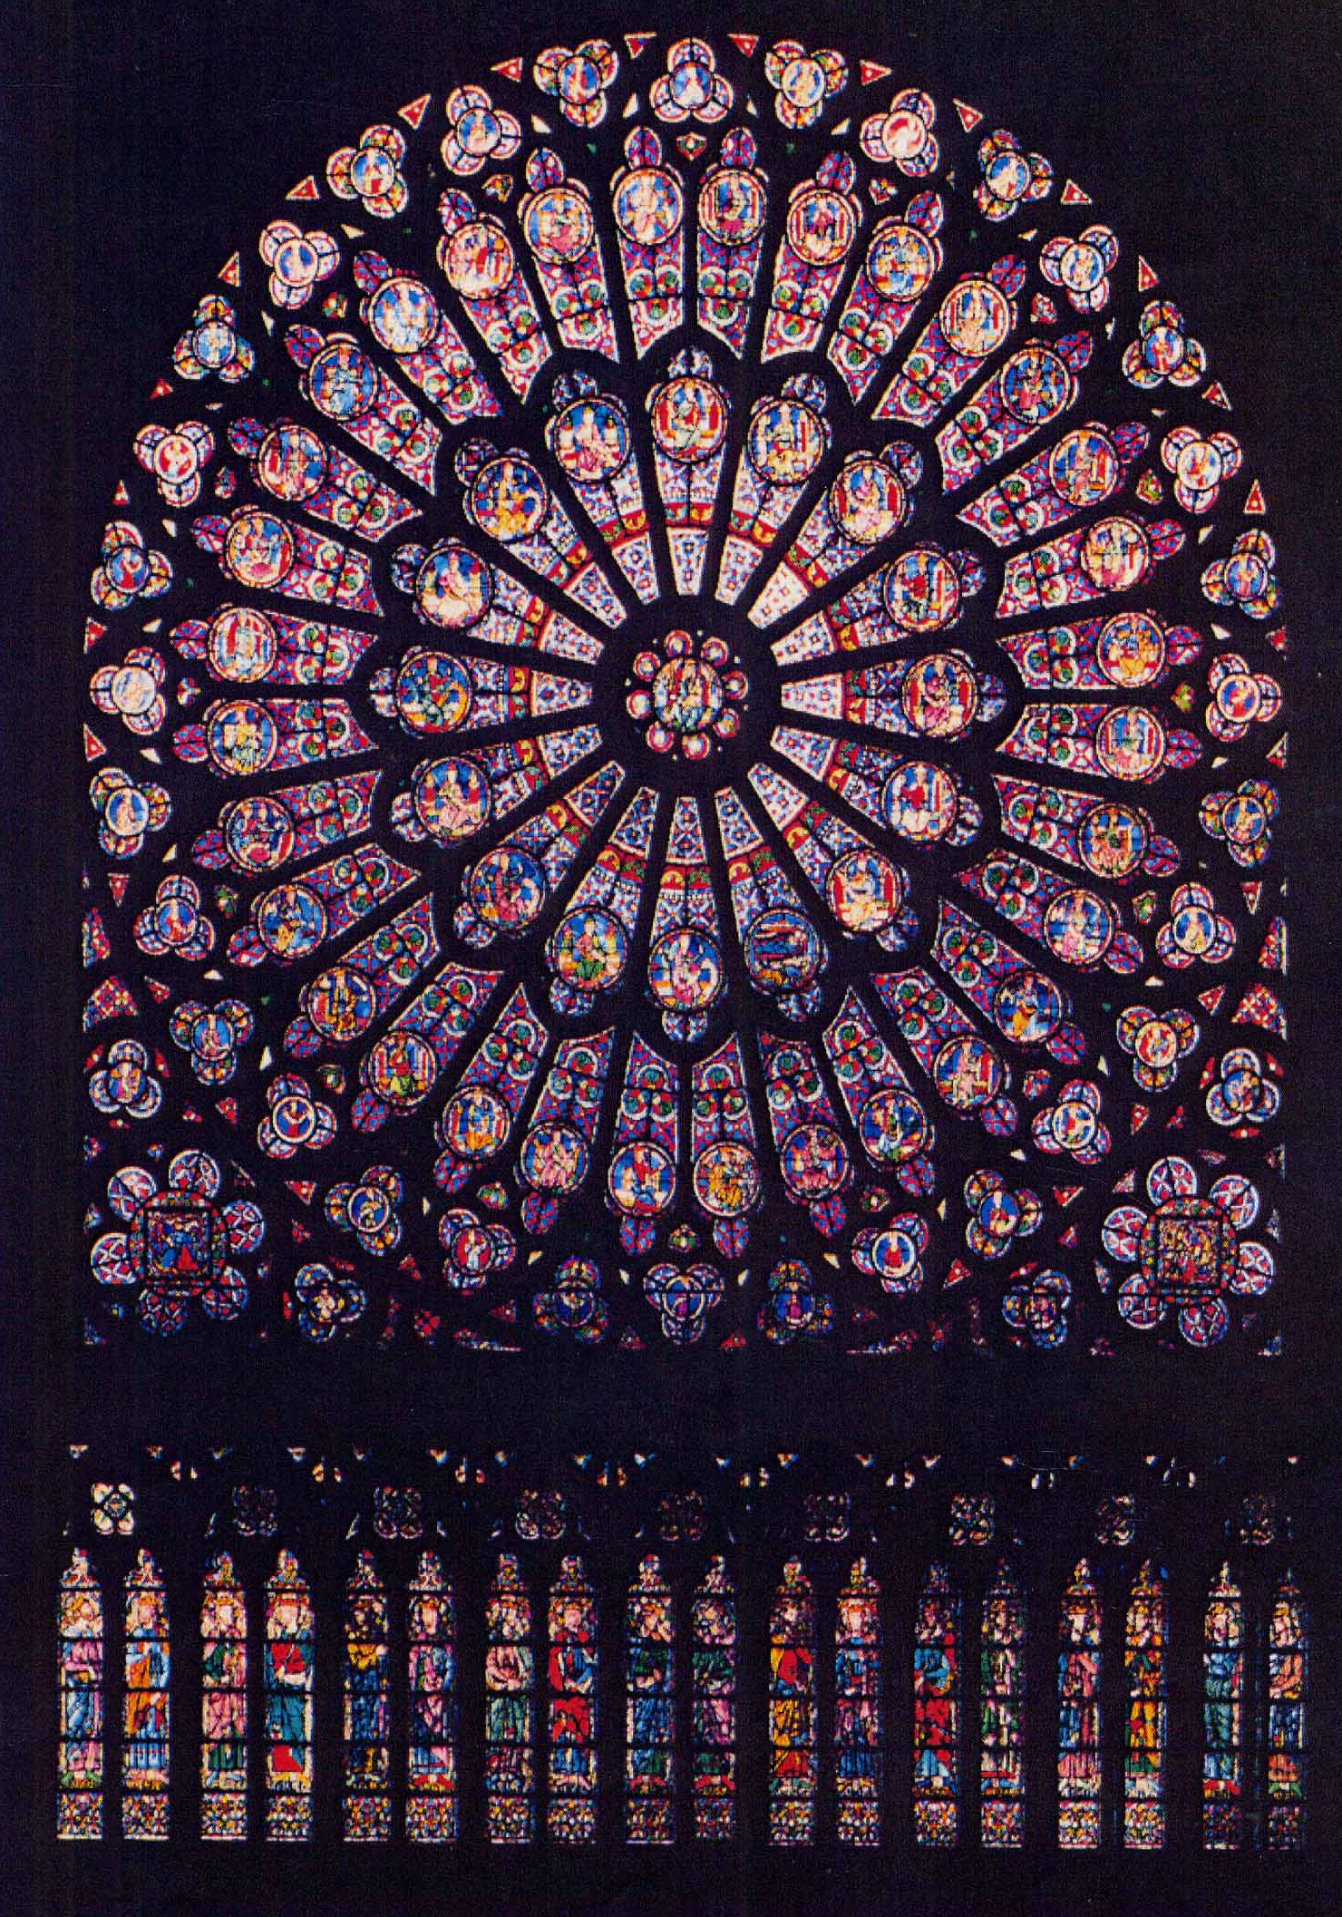
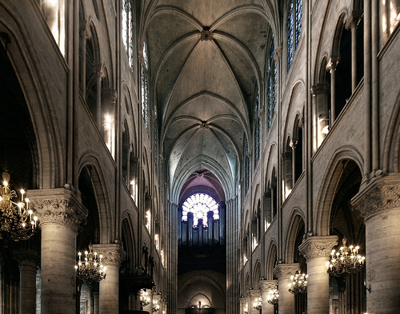
Notre Dame de Paris
Elements from St. Denis
Rose windows
Pointed arches
AD 1450

Slide 32
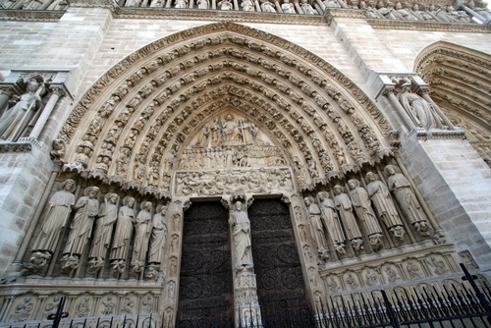
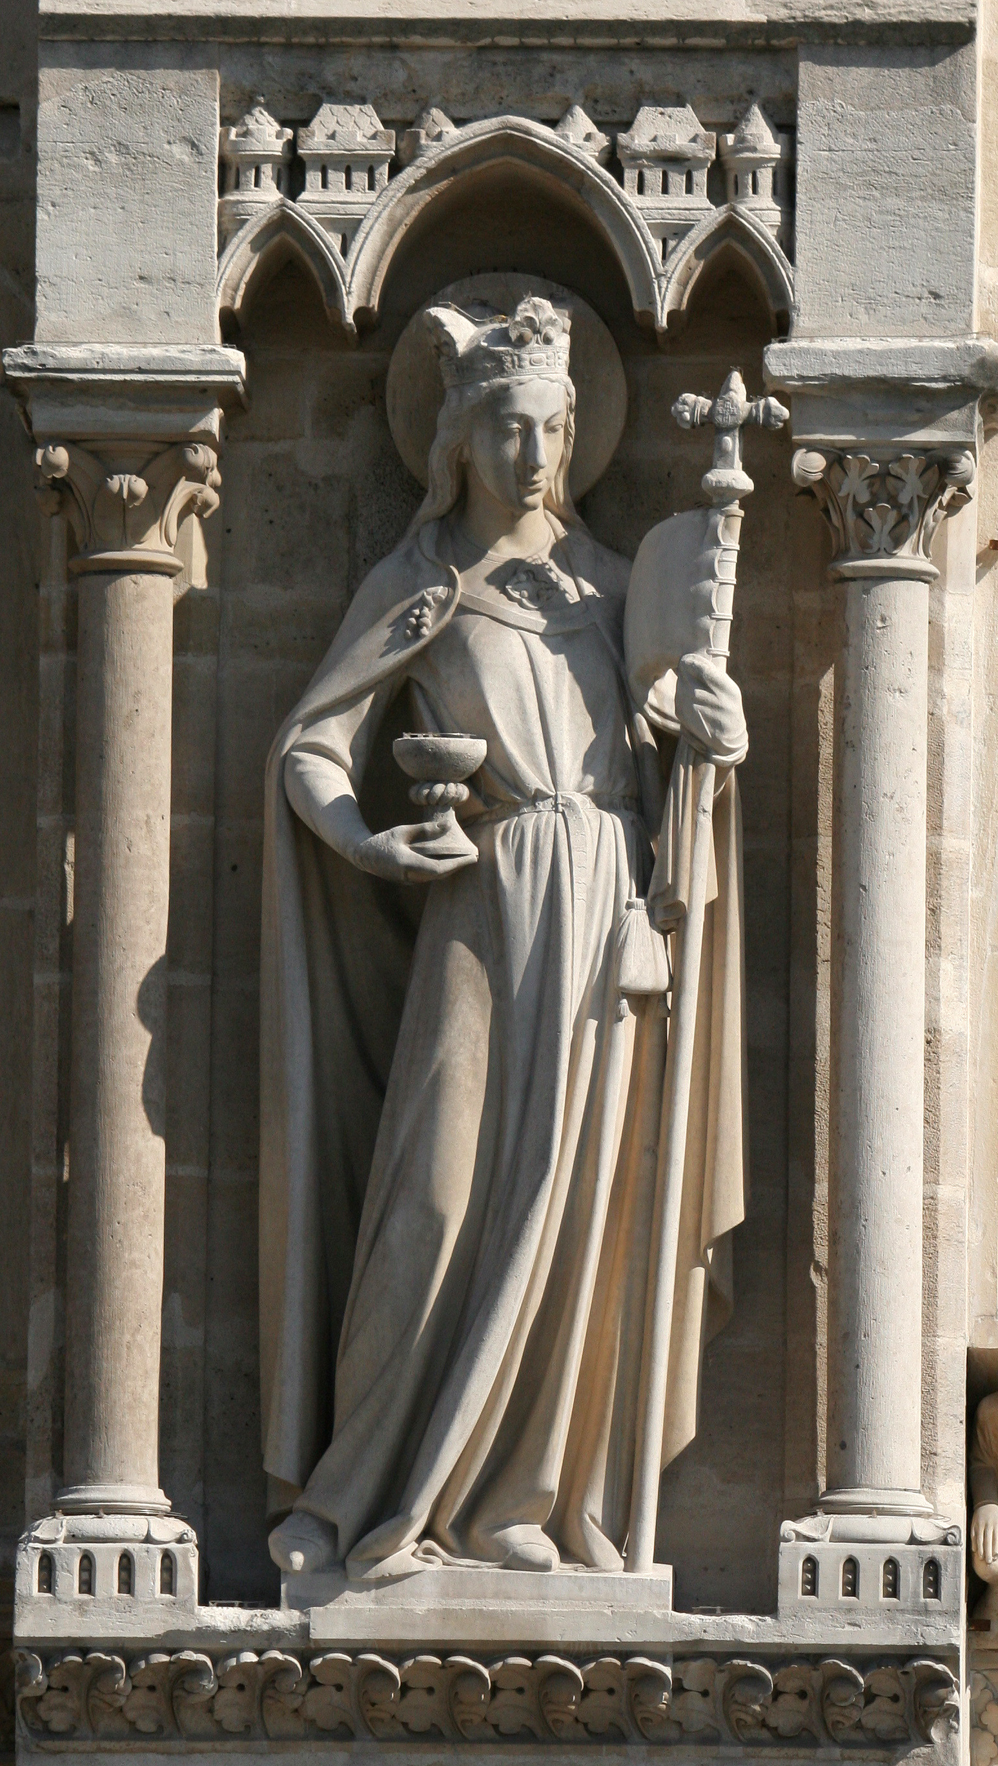
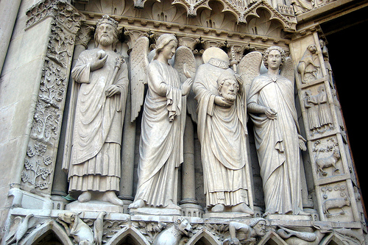
Notre Dame de Paris
Retained Romanesque elements
Towers
Statues
Exterior decorations
AD 1450

Slide 33
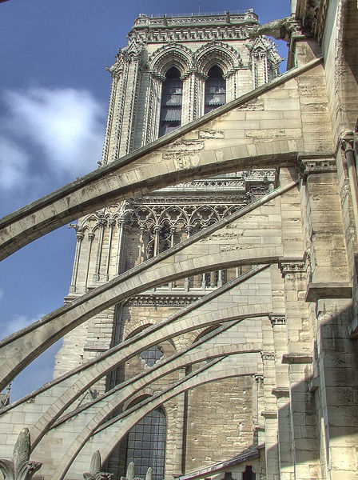
Notre Dame de Paris
New elements
Size (area)
Height
Flying buttresses
Crepes
AD 1450

Slide 34
Notre Dame de Paris—Gargoyles
Functional decorations
Frighten away evil spirits
Drain spouts
AD 1450

Slide 35
Sainte Chappelle
Royal family’s private church
About 3 blocks from Notre Dame
Scripture windows
Modern concerts
AD 1450

Slide 36
Rivalry churches—Chartres
CHAPELS
AMBULATORY
AD 1450

Slide 37
Notre Dame de Chartres
A major pilgrimage site because of the relic of Mary’s tunic
Chartres is about 50 miles southwest of Paris
Four fairs were held there each year
The bishop was afraid that other cities would build new gothic cathedrals and take the fair and pilgrimage traffic away from Chartres
AD 1450

Slide 38
Notre Dame de Chartres
AD 1450

Slide 39
Chartres
Retained all previous elements of gothic style
Higher than Notre Dame de Paris by 150 feet
New elements
Claims to have first flying buttresses
Labyrinth
Gift windows
Theme of heavenly city
AD 1450

Slide 40
Cathedral Economics
Decorations were donations
Guilds
Wealthy patrons
Bell making
AD 1450

Slide 41
Chartres and other cathedrals
AD 1450

Slide 42
English Vertical Gothic Style
AD 1450

Slide 43
Canterbury Cathedral
AD 476
AD 1450

Slide 44
Canterbury Cathedral
AD 476
AD 1450

Slide 45
English—York Minster
AD 476
AD 1450

Slide 46
English—York Minster
AD 476
AD 1450
Note new head on Henry VI

Slide 47
Hammer Beamed Ceilings
Hampton Court Palace
Westminster Hall, Houses of Parliament
AD 476
AD 1450

Slide 48
German and Italian Gothic
German churches were slow in adopting gothic styles.
Cologne cathedral
Cathedral at Milan
Great prestige for the city
Florence refused to build in the Gothic style (competition versus Milan).
AD 476
AD 1450

Slide 49
Competition
Cathedrals competed for bigger and higher
Collapse of some towers
See floor of St. Peter’s today
Compare to the desire for pharaoh to build bigger or better pyramids or temples
Compare to the competition of highest skyscraper
Compare to the competition of the biggest and most elaborate football stadium
AD 476
AD 1450

Slide 50
Discussion
What was creative about gothic cathedrals?
Why do we build great edifices?
How do gothic cathedrals compare to temples?
Why was the gothic considered ugly by those in the Renaissance?
What is the meaning of gothic today?
AD 1450

Slide 51
Thank You
High Creativity
Build Creatively

