Slide 1
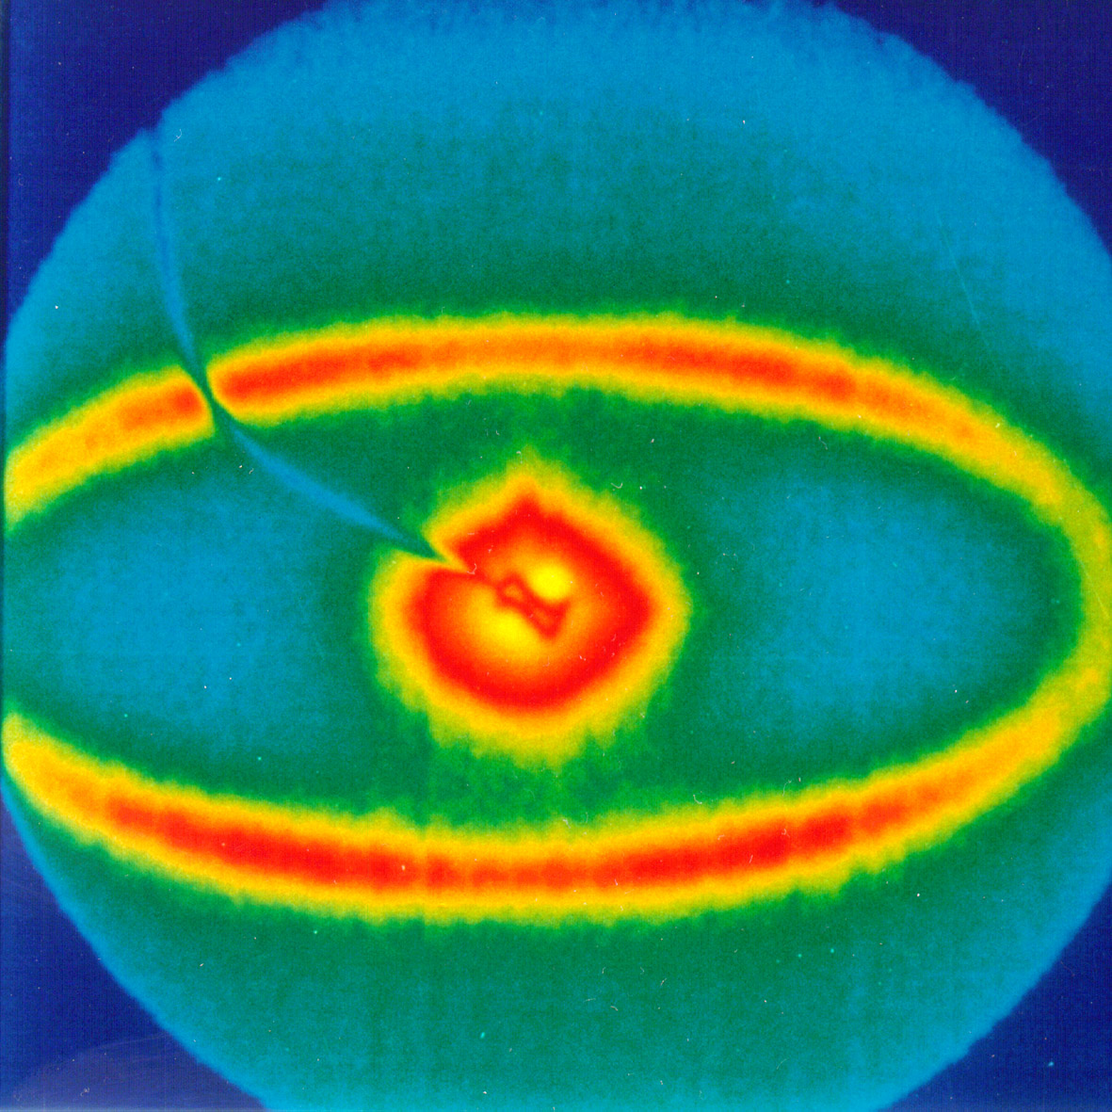
Radiation Processing
MFG 355
Plastics

Slide 2
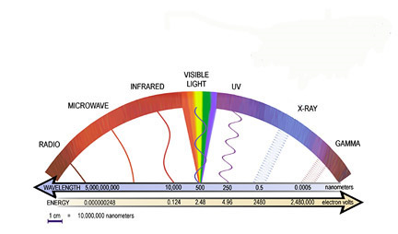
Energy is Energy!

Slide 3
Advantages of Tuned Radiation Processing
Efficient (less power/faster) use of energy
Microwave (focused at 2450 MHz) versus thermal heating (very broad band)
Water dipole alignment
Movement
Heating

Slide 4
Disadvantages of Tuned Radiation Processing
May have high capital cost
May increase safety risks

Slide 5
Using tuned energy sources
Energy Band | Energy (eV) | Application
Rf | <10⁻⁵ | Plasma, curing
Microwave | 10⁻⁵ – 10⁻² | Curing/heating
IR | 10⁻² – 2 | Thermal heating
Visible | 2 – 3 | Spectra
UV | 3 – 10³ | Curing
X-ray | 10³ – 10⁵ | Electron beam
Gamma | >10⁵ | Sterilization

Slide 6
Plasma Polymerization and Reactions
Plasma = highly ionized gas
Hot plasmas occur in the sun
Cold plasmas occur using Rf (radio frequency) power
Temperatures are near room temperature

Slide 7
Rf Plasma Generator

Slide 8
Rf Plasma Uses
Polymerization
Create an active gas plasma using a new monomer (would not otherwise be activated)
The monomer will then recombine in a lower energy form (usually a highly-crosslinked polymer)
Example: Coating with fluorocarbons (coating often can be very thin)
Surface activation (example: O₂ on PE for printing)
Surface cleaning (with argon)
Surface pacification (with ammonia)

Slide 9
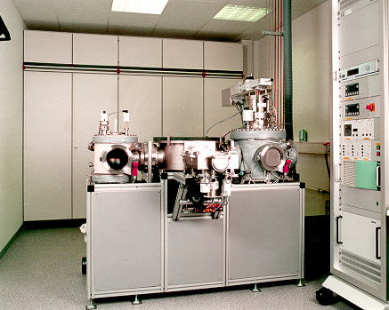
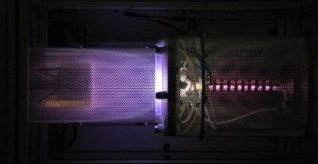
Rf Plasma Machines

Slide 10
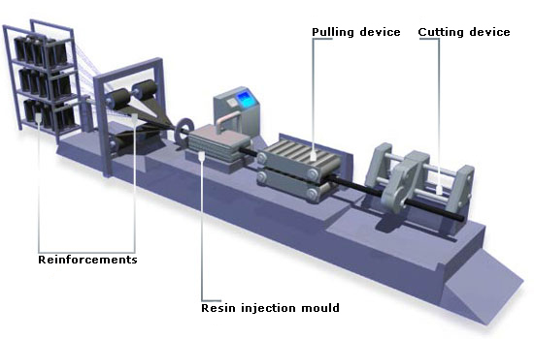
Microwaves
Curing thermosets
Efficient heating source
Tunable frequency (adjusted for the polymer)
Microwave heated

Slide 11
IR Energy Range
Normal thermal heating
Spectrographic investigations (FTIR)

Slide 12
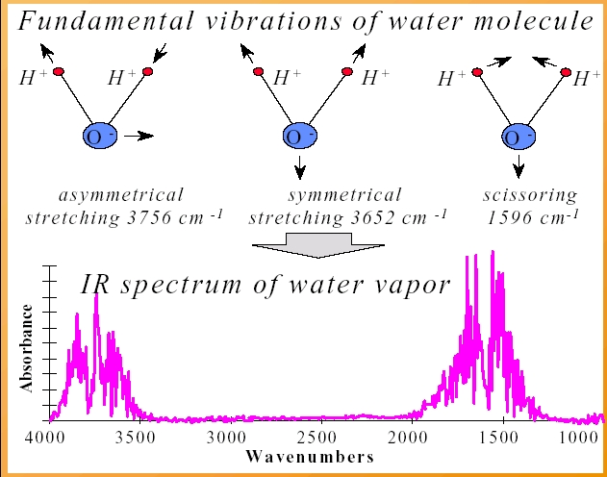
IR vibrations

Slide 13
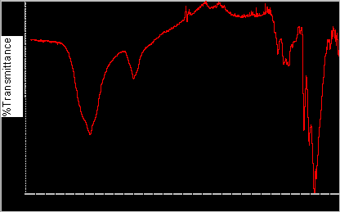
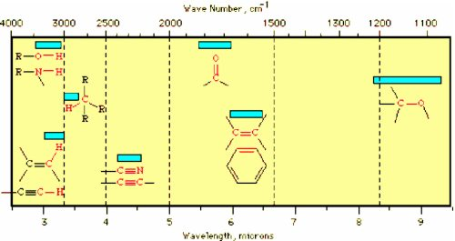

Slide 14
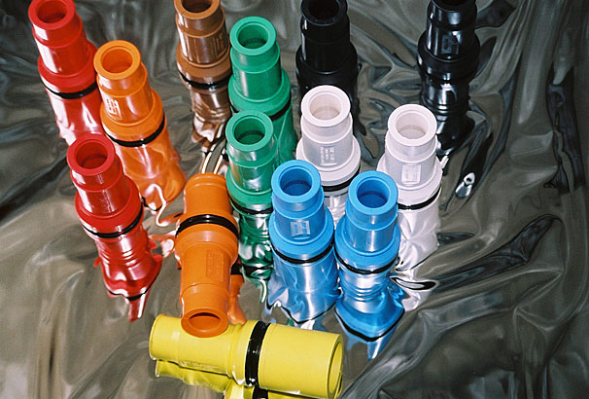
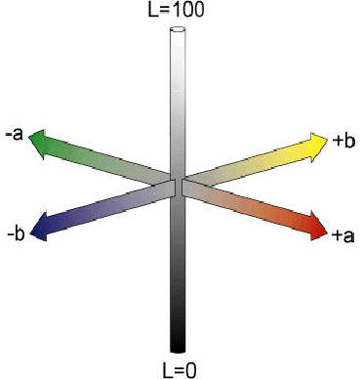
Visible Spectrum
Color matching
Software with known colorants
Color/clarity change detection (weathering, thermal degradation, etc)

Slide 15
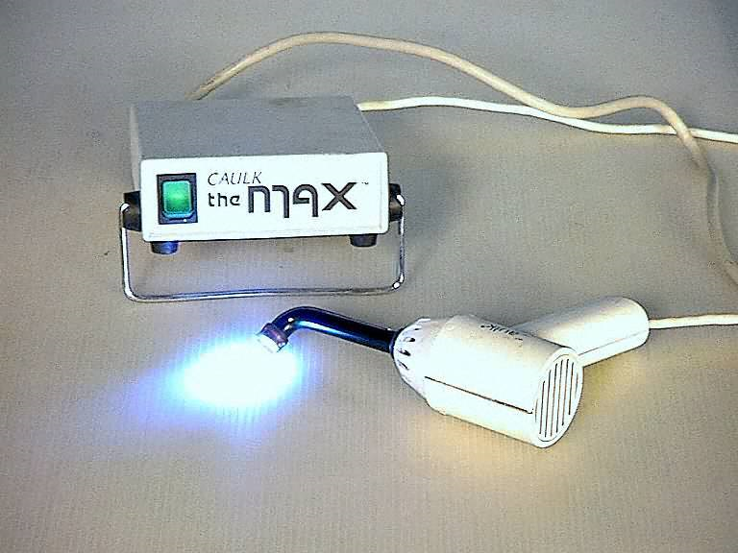
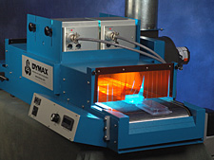
UV Radiation
Curing
Thermosets (Example: dental resins)
Inks (Example: graphics)
Adhesives

Slide 16
Electron Beam Radiation
Accelerating emitted electrons
X-ray region (high energy)

Slide 17
Electron Beam Plant Layout

Slide 18
Electron Beam Reactions

Slide 19
Electron Beam Reactions

Slide 20
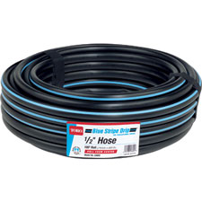
Electron Beam Crosslinking

Slide 21
Polymer Grafting

Slide 22
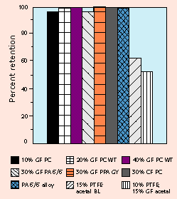
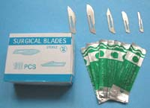
Gamma Radiation
Sterilization
Gamma
Electron beam
Chemical (ethylene oxide)

Slide 23
Thank You

