Slide 1
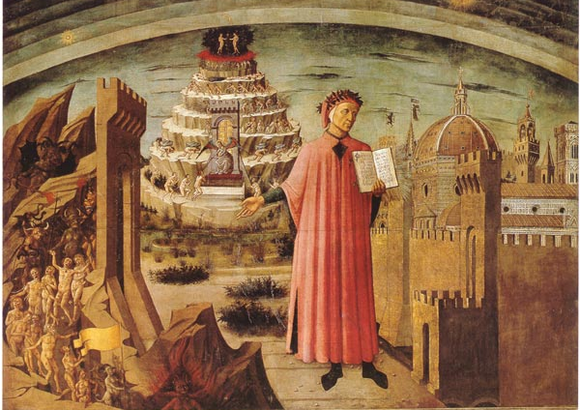
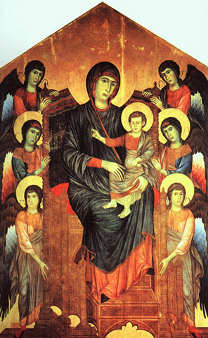
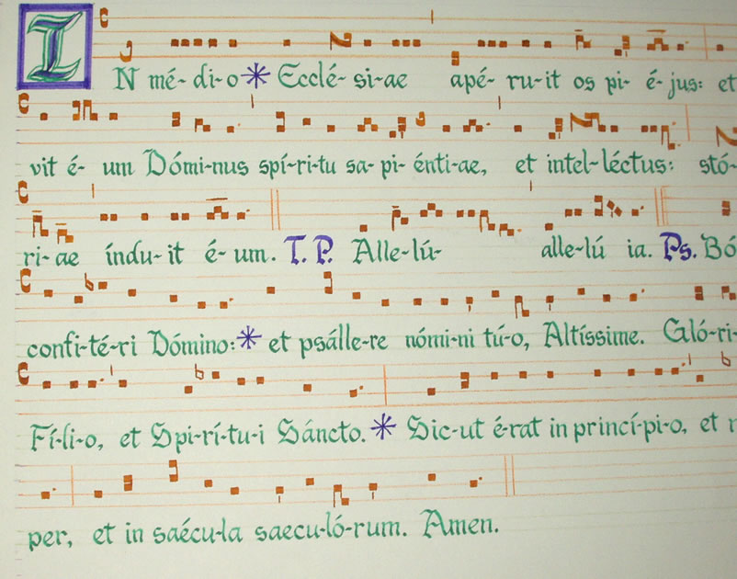
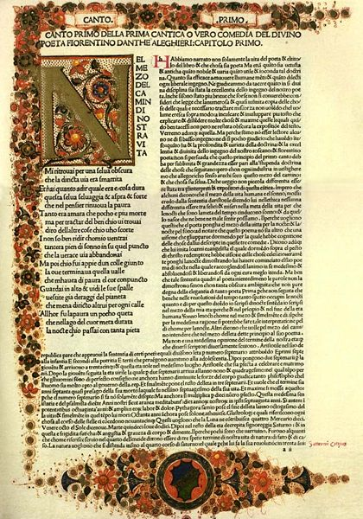
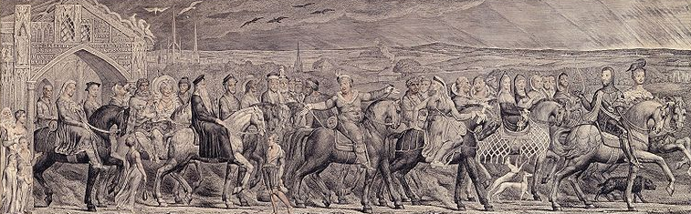
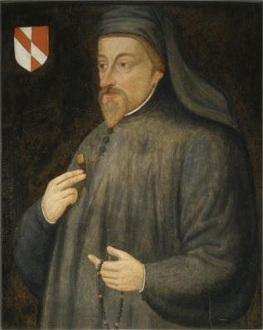
Medieval Arts and Literature
Middle Ages Arts and Literature

Slide 2
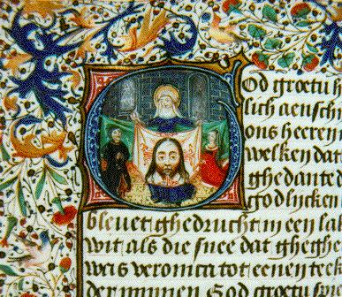
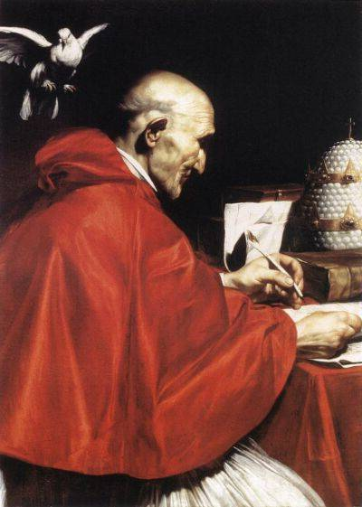
Music
Gregorian Chant (Plainchant)
Established by Pope Gregory I
Method of enhancing worship
Monophonic (single, unaccompanied melody line)
Sung in unison
Highly conjunct (close transitions)
One note per syllable
Subjects:
Psalms or other scriptures
Accompany the mass
AD 476
AD 1450

Slide 3
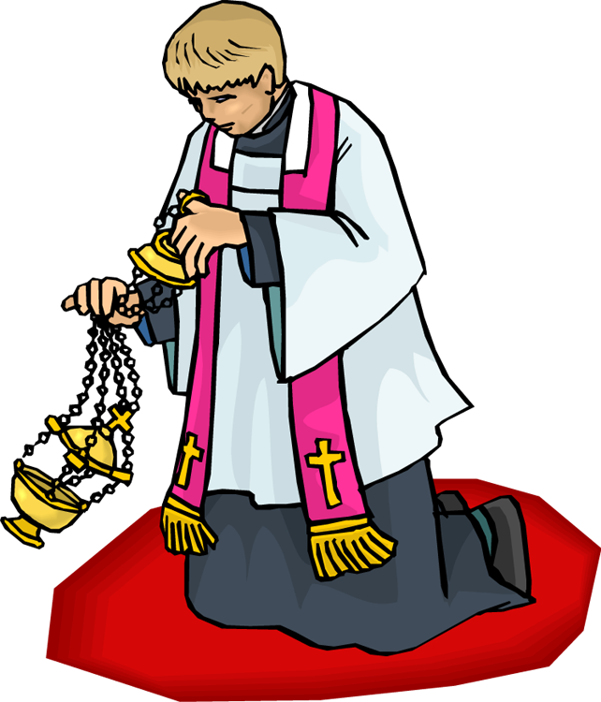
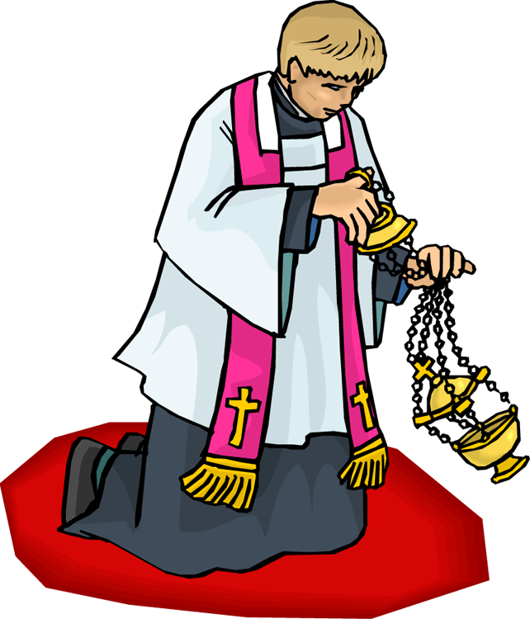
Mass Presentation Order
Proper (changed daily)
Introit (Entrance)
Collect (Short joint prayer)
Epistle (Reading)
Gradual (Responsive chant)
Alleluia (Praise chant)
Evangelium (Reading)
Sermon (Anglican)
Offertory (Bread and wine)
Secret (Soft prayer)
Preface (Beginning prayer)
Canon (Long prayer)
Communion (Chant)
Post-Communion (Prayer)
Ordinary (fixed)
Kyrie (Opening prayer)
Gloria (Hymn of praise)
Credo (Nicene Creed)
Sanctus (Praise for God)
Agnus Dei (Forgiveness)
Ite missa est (Dismissal)
AD 476
AD 1450

Slide 4
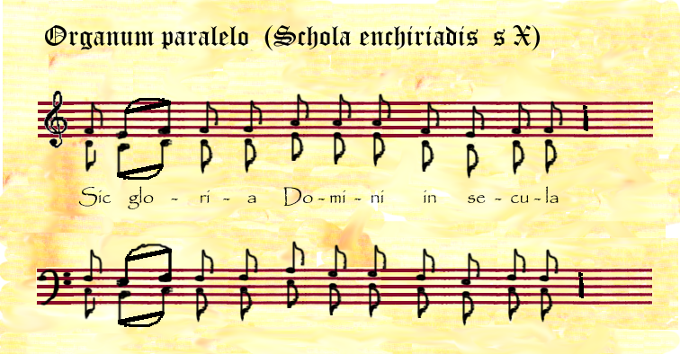
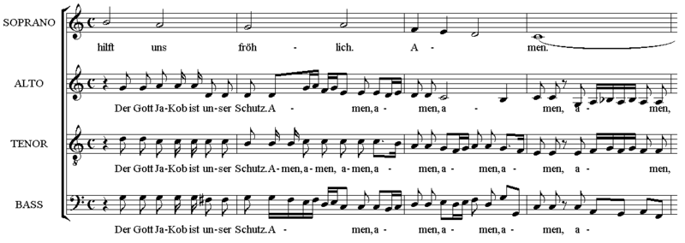
Beyond Plainchant
Melisma (about 800 AD)
More than one note per syllable
Organum (about 1000 AD)
Same text (chants)
Cantus firmus (tenor) is same melody
Polyphonic (multiple melody lines)
Flourished at Notre Dame
Motet (about 1200 AD)
Non-religious
Addition of words to music
2 or more melodies with their own texts (derivatives of chants)
Ars Nova (about 1300 AD)
Complexity in rhythm with each part having a melody and rhythm

Slide 5
Music Notation
Guido d'Arezzo
10th Century
Squares on a 4-line staff
Treble and bass clef
Music terminology
Crescendo, forte, etc.
Notes a to g
Solimation (do, re, mi, etc.)
Ut, re, mi, fa, so, la
Taken from a hymn to John the Baptist
AD 1450

Slide 6
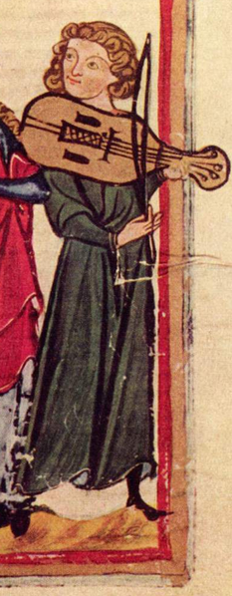
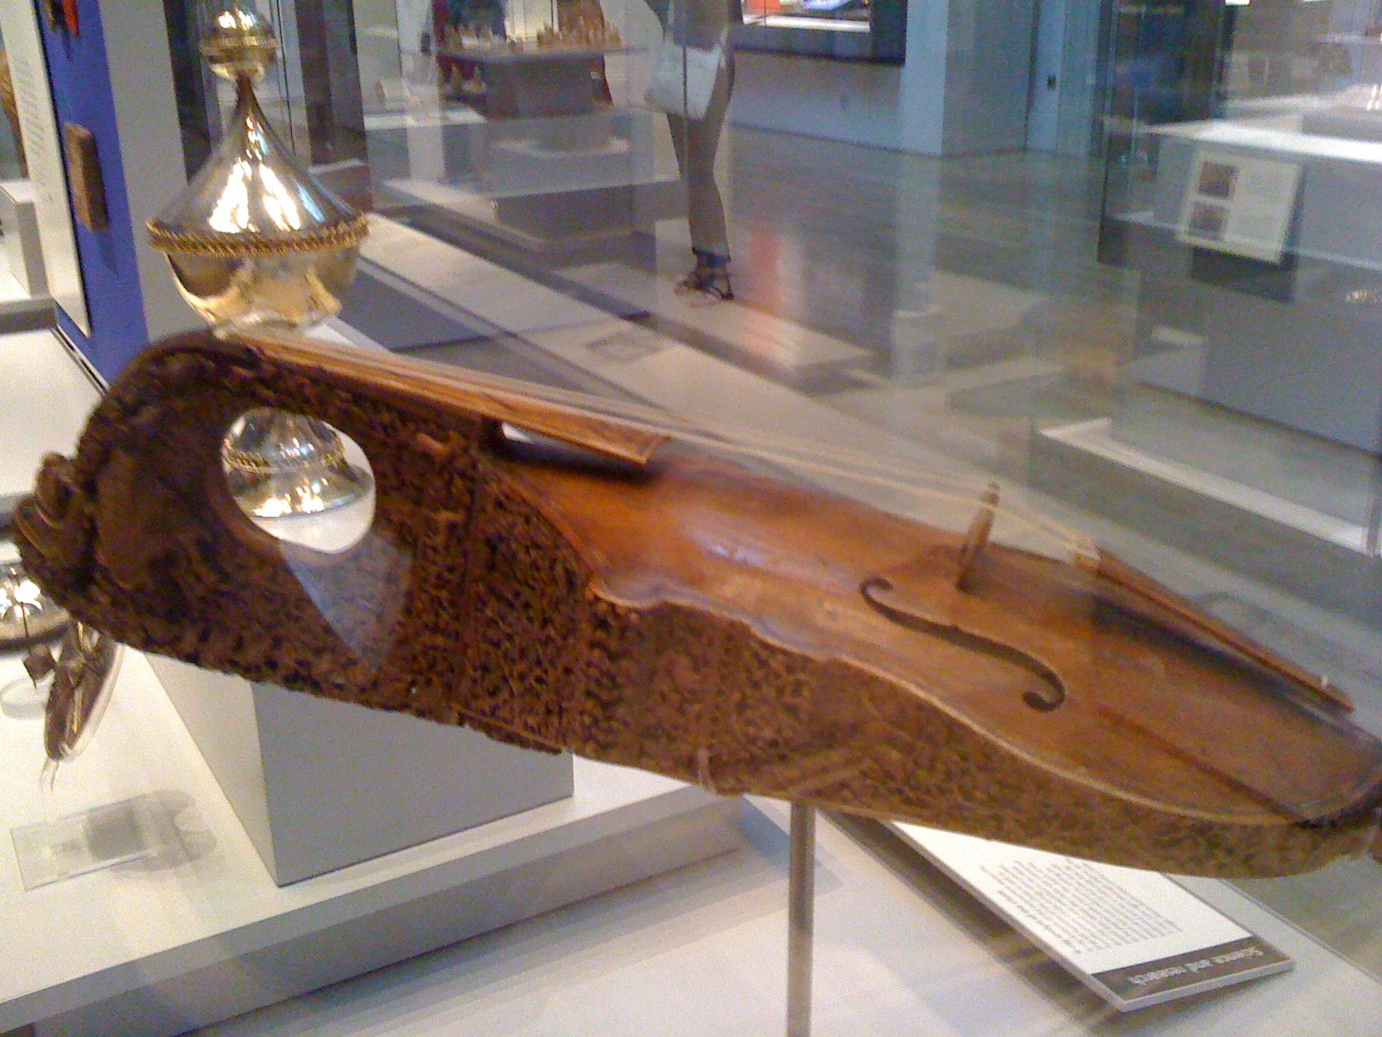
Troubadour Poetry
Trobar: “to sing poetry”
First strongly non-religious music
Sung mostly at court
Itinerant singers
Early guitar
AD 1450

Slide 7
Art in the Late Middle Ages
Characteristics
2-dimensional
Depicted God’s power and authority
Other figures have symbolic meanings
AD 1450

Slide 8
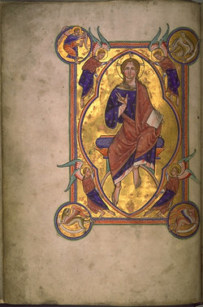
Art in the Late Middle Ages
Decorated manuscripts
Illuminated manuscripts
AD 1450

Slide 9
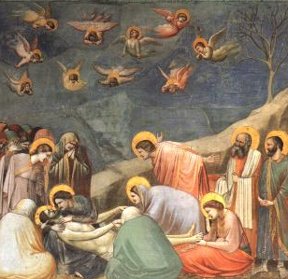
Art in the Late Middle Ages
Giotto (1267-1337)
Lamentation
Beginning of Realism
Emotion
Perspective
Background
Geometry (hill)
AD 1450

Slide 10
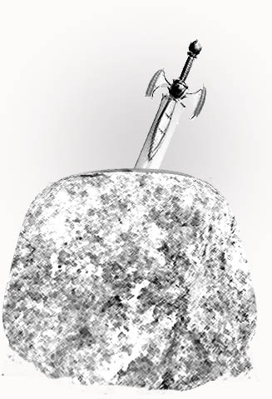
Literature in the Late Middle Ages
Arthurian legend
King Arthur (foundation story)
Victory of Britons over Germanic invasion in AD 496 by Ambrosius (man of temperance) (Arthur?)
Died in AD 542
Writings:
Geoffrey of Monmouth (1135)
Crétien de Troyes (1135-1183)
Mallory (1469)
AD 1450

Slide 11
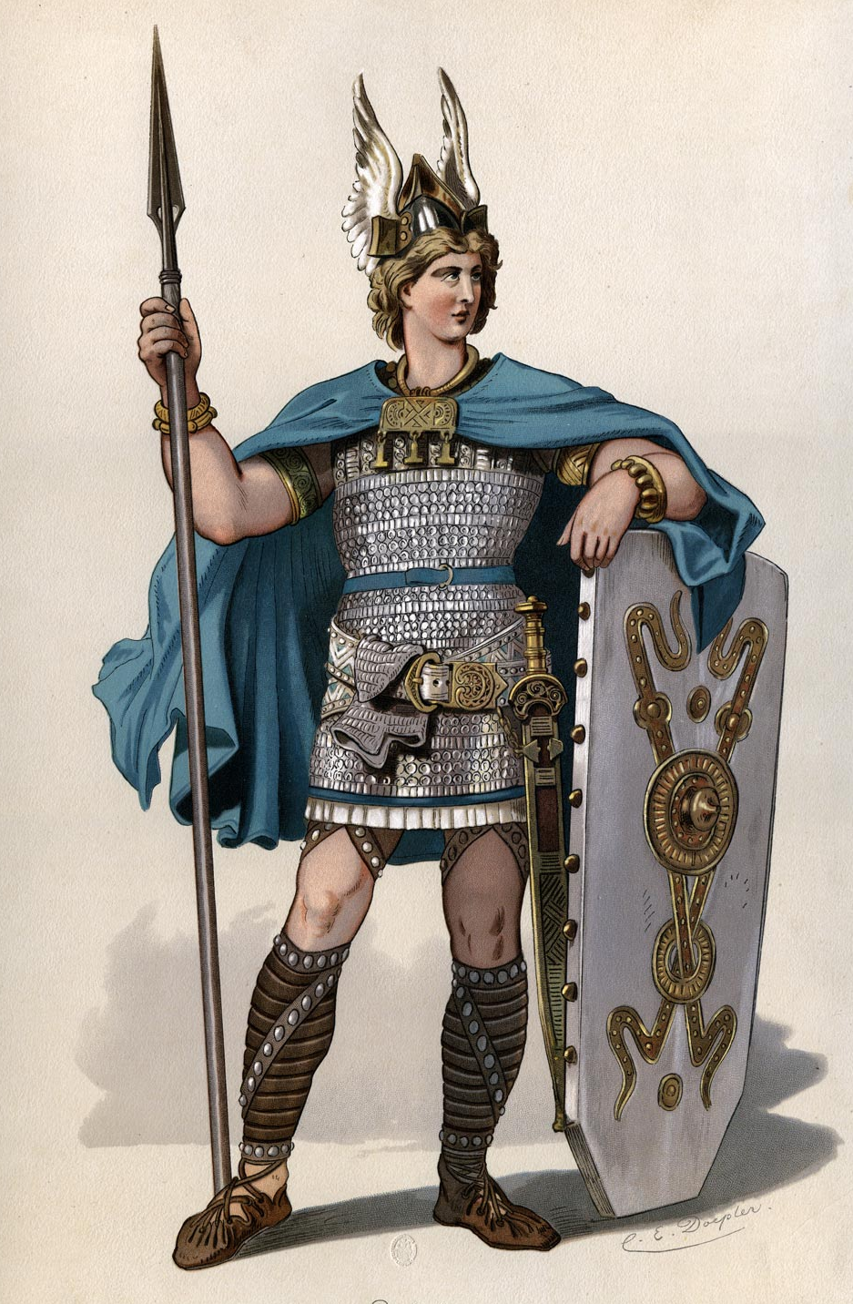
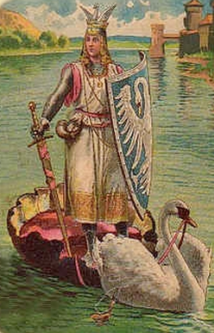
Literature in the Late Middle Ages
Other Knight Epics
Die Nibelungenlied (foundation story for Germany)
Siegfried
Brunhilde
Lohengrin,
Tristan and Isolde
Song of Roland
(foundation story for France)
AD 1450

Slide 12
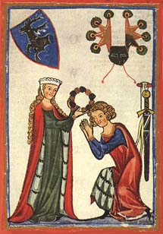
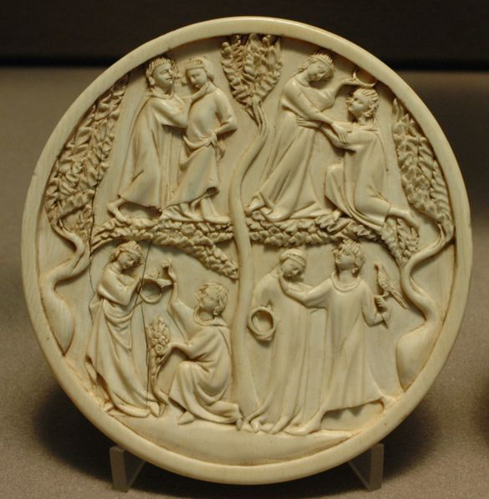
Courtly Love
Books were entertaining
Instructions for proper behavior
Pure love of a knight for a lady
Note the relationship to Platonic love
Rules:
Marriage is no excuse
for not loving
Made public, love rarely endures
Jealously increases the feeling of love
AD 1450

Slide 13
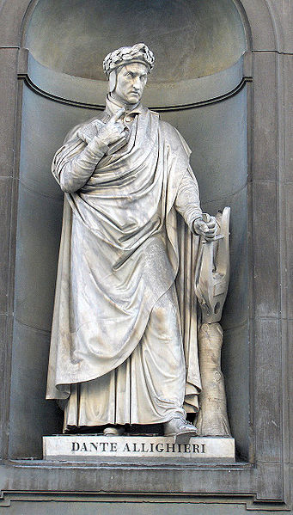
Dante Alighieri
Life in Florence
Politics
Well educated
Intrigued by astronomy, mathematics, numerology
Deeply spiritual
AD 1450

Slide 14
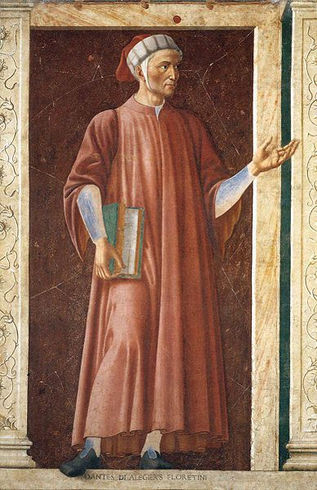
Dante Alighieri
Relationship with Beatrice
Fell in love at age 9
Married other people by arrangement
Beatrice died in her early 20s
Book of poems was dedicated to Beatrice
AD 1450

Slide 15
Dante Alighieri
Dante’s family
Married his promised wife
4 children
Wife did not accompany when exiled
Close to his daughter Antonia who became a nun and took, as her veil name, Beatrice
AD 1450

Slide 16
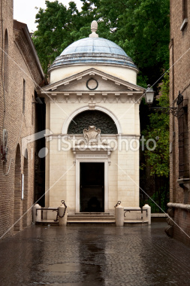
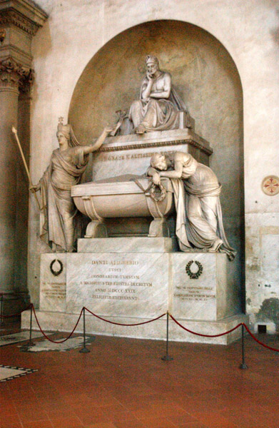
Dante Alighieri
Dante’s life in exile
Worked in many courts throughout Italy
“Smartest man alive”
Died in Ravenna
Florence tried to honor him but was rejected.
Ravenna tomb
Florence "tomb"
AD 1450

Slide 17
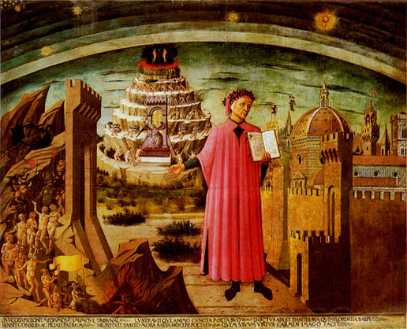
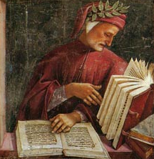
Divine Comedy
“Divine” means perfection.
“Comedy” means it starts sad and ends happy.
Dante’s travel through the afterlife
Epic poem
Solidified the Italian language
Assumed Catholic church was the only truth
AD 1450

Slide 18
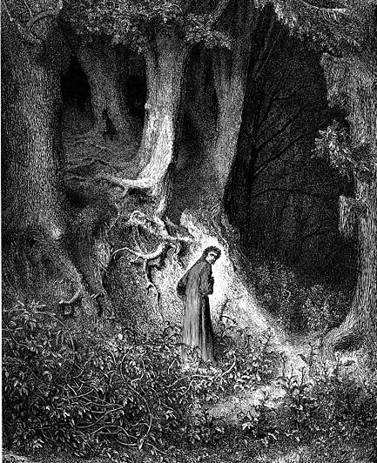
Divine Comedy
Midway in our life’s journey I went astray
from the straight road and woke to find myself
alone in a dark wood.
Dante lost in the forest
Struggling with life
Trying to find meaning to life
Realizes he has erred
AD 1450

Slide 19
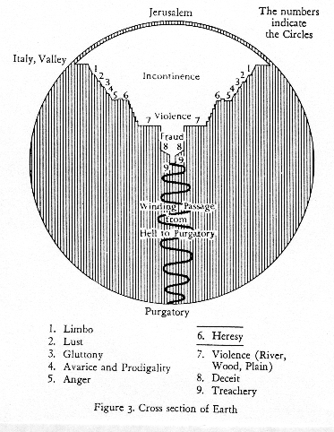
Divine Comedy
Hell (inferno)
Guided by Virgil
Exit by going down through the center of the earth
Focus is on the seven deadly sins
Purgatory on the other side of the earth
Guided partly by Virgil and then by Beatrice
Focus is on repentance
Paradise in the sky above the earth
Guided by Bernard of Clairvaux
Focus is on knowledge of God
AD 1450

Slide 20
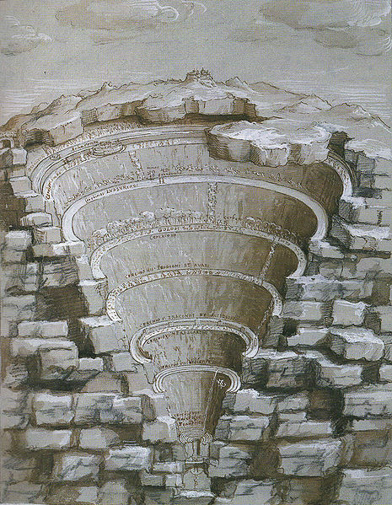
Inferno
Sinners
Punishments
Run after banners
Virtuous pagans–melancholy
Blown forever by storm winds
Discomfort, all senses punished
Push great rocks against others
Immersed in slime
In burning tombs
Lake of boiling blood, inanimate
Tormented by demons, in excrement
Buried in lake of ice
Vestibule
Limbo
Lustful
Upper Hell
(Incontinence)
Gluttons
Hoarders/wasters
Wrathful/sullen
Heretics
Lower Hell
(Violence, Fraud)
Violent
Fraud (10 levels)
AD 1450
Treason

Slide 21
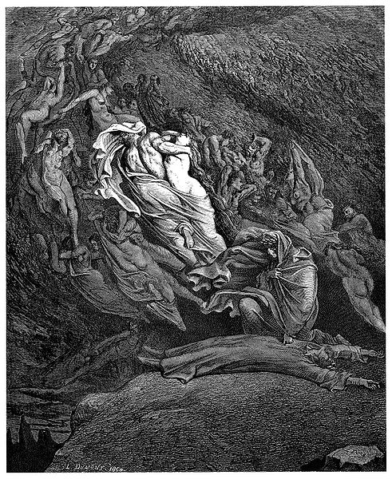
The Circle of Lust (Carnality)
Who is there (examples)?
Dido, Cleopatra, Helen/Paris, Achilles, Tristan, Francesca/Paolo
Sin: Abandon themselves to their passions
Punishment: Swept forever in winds past each other but never able to materialize
AD 1450

Slide 22
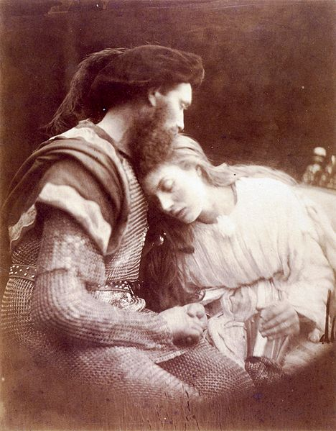
The Circle of Lust (Carnality)
Who is at fault? (Francesca/Paolo reading about Lancelot and Guinevere)
Love, which permits no loved one not to love, took me so strongly with delight in him that we are one in Hell, as we were above.
Love itself
For when we read how her fond smile was kissed by such a lover, he who is one with me alive and dead breathed on my lips the tremor of his kiss.
My lover
That book, and he who wrote it, was a pander. That day we read no further.
The book and author
AD 1450

Slide 23
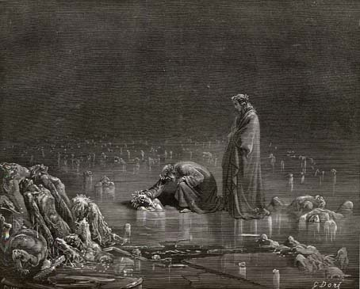
Divine Comedy—Inferno
Hell is the realm of non-repentant sinners
AD 1450

Slide 24
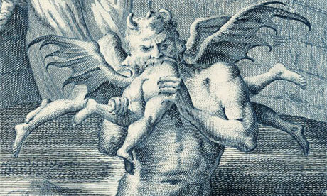
Inferno—Satan
D&C 124:52
And I will answer judgment, wrath, and indignation, wailing, and anguish, and gnashing of teeth upon their heads, unto the third and fourth generation, so long as they repent not and hate me, saith the Lord your God.
AD 1450

Slide 25
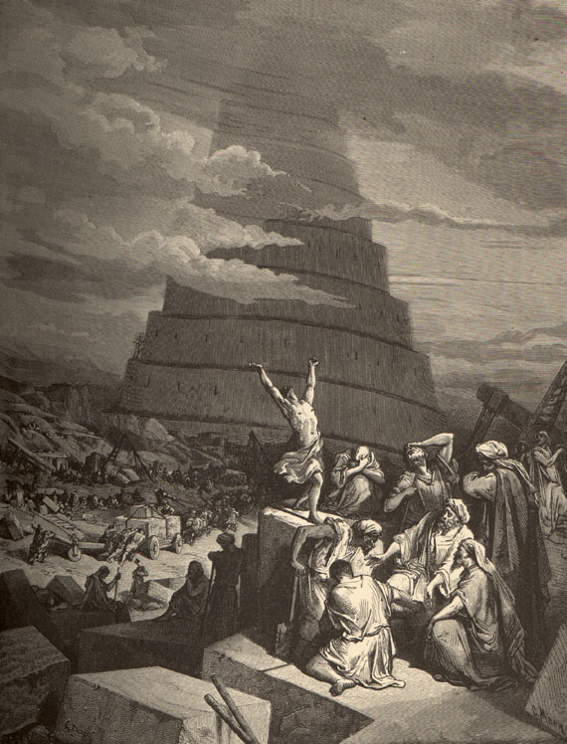
Divine Comedy—Purgatory
The realm of those with sinful traits but with hearts that want to change
Purgatory begins with a washing off of Inferno’s evil (baptism?)
The ascent up the mountain of purgatory is hard work
Success is recorded by the removal of a “p” (peccato) from a person’s forehead
AD 1450

Slide 26
Divine Comedy—Purgatory
About half way up the mountain Virgil leaves
Pagans are not permitted beyond a certain distance into Purgatory
Beatrice guides
Dante continues to repent and progress
Dante accepts humility wherein he understands that he cannot understand all things
Purgatory ends
River of forgetfulness
AD 1450

Slide 27
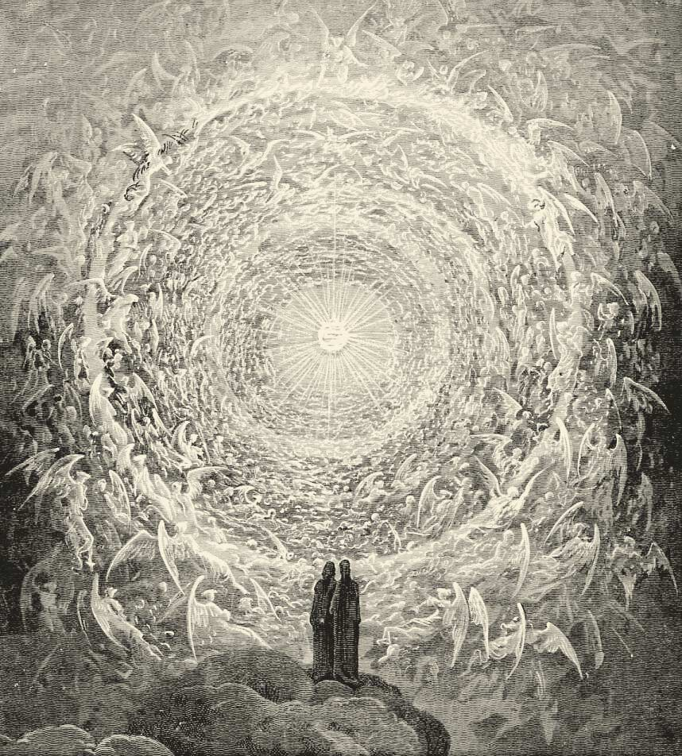
Divine Comedy—Paradise
10 spheres (Aristotelean)
Beatrice guides until the final sphere
Last guide is Bernard of Clairvaux (Crusader for truth)
Enter the Empyrean
Dante sees God
Love of humanity moves the sun, moon, etc
AD 1450

Slide 28
Style/Numerical Intricacies
Rhyming pattern (ABA/BCB/CDC)
Cantos (groups of verses)
Vertical and horizontal reading
Rationale for numerology
Memory
Made more meaningful
Intricacies of God
Other Medieval authors using numerology
AD 1450

Slide 29
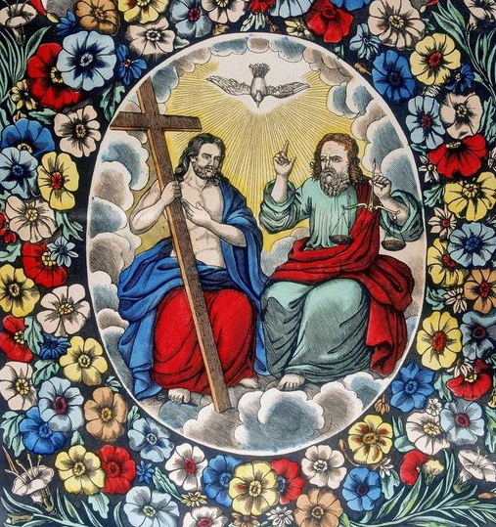
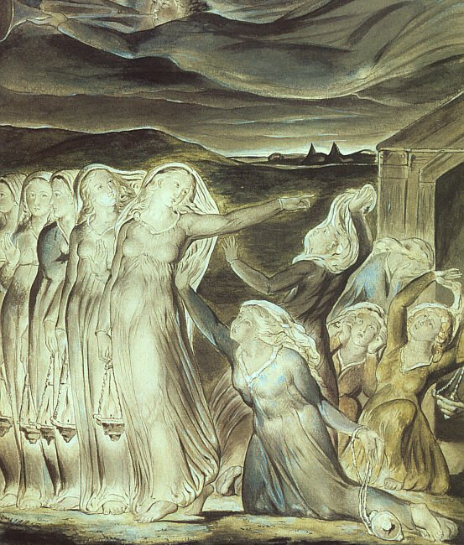
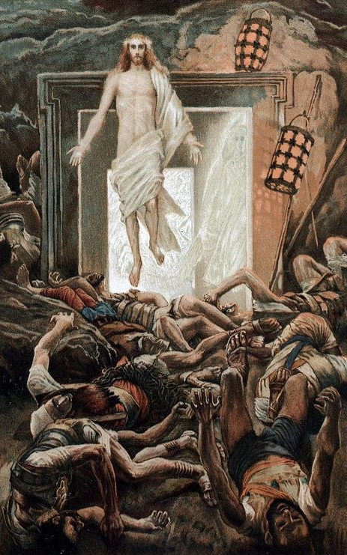
Numerical Intricacies
1 = unity
2 = duality of nature
3 = trinity
4 = material universe
5 = wounds of Christ, books of Moses, wise virgins
6 = completion
7 = rest, deadly sins, sacraments
8 = resurrection, baptisms
9 = angelic order, trinity x itself

Slide 30
Numerology Example: Baptism 8
8
The 8th day was for resurrection and, traditionally, for baptism.
The baptism signified entry into the new kingdom just like resurrection was into the heavenly kingdom
Old baptisteries were octagonal
In the old testament, the 8th day was the day for circumcision (new covenant).
Noah and his family (8 souls) were saved from the flood (like baptism).
In Dante, the seven-walled noble castle or Castle of Fame, is in Limbo and houses good people who do not have baptism (that is, they are missing one thing).
AD 1450

Slide 31
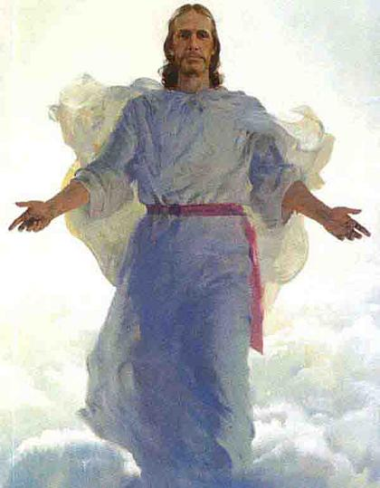
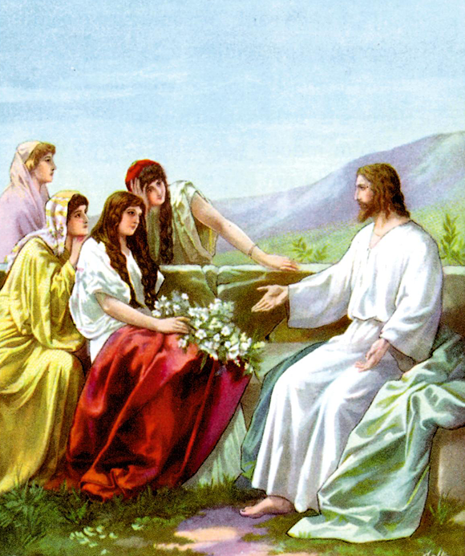
Numerical Intricacies
10 = perfection
12 = tribes, trinity x the world
13 = evil
30 = Christ started preaching
33 = Christ’s completion age
35 = apex of life
40 = days between resurrection and
ascension, days in wilderness,
elder of Israel
100 = super perfection

Slide 32
100
Numerology Example:
Perfection 10 and 100
Organization of Divine Comedy
Sectional:
Hell= 9 circles + vestibule = 10
Purgatory= ante purgatory + 7 terraces + shore of purgatory + after purgatory= 10
Paradise = 10 heavens
Cantos:
1 Intro + 33 hell + 33 purgatory + 33 paradise=100 total
AD 1450

Slide 33
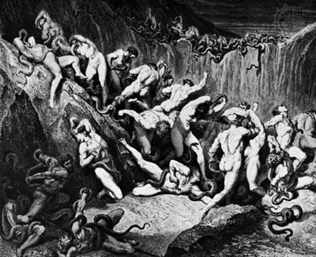
Divine Comedy Between sections
Inferno
1 = water (evil)
6 = politics of Florence
33 = stars
Purgatory
1 = water (good)
6 = politics of Italy
33 = stars
Paradise
1 = water (heavenly)
6 = politics in Europe
33 = stars
AD 1450

Slide 34
Discussion of The Divine Comedy
Dante’s journey is like other epics.
Current and universal application
Political
We are all like Dante
Truth is absolute.
Knowledge gets us only so far.
Making choices determines our life eternally (consequences).
AD 1450

Slide 35
Discussion of The Divine Comedy
Hell is not the pivotal point (as it is in The Aeneid and in The Odyssey) but is the beginning point where the failed values are seen and then the better life comes after.
The pivotal point of The Divine Comedy is Purgatory (where Dante realizes his errors and works them out).
AD 1450

Slide 36
Discussion of The Divine Comedy
Virgil, the “master” who leads Dante is found to be lacking (non-Christian)
Virgil must leave Dante in Purgatory
Dante realizes that the wisdom of men alone is lacking and he needs more
Paradise is the completion and it is filled with great Christians who teach Dante
Dante sees that Christian love is the ultimate reward
The central (pivotal) verse discusses ROMA and that is an anagram for AMOR
AD 1450

Slide 37
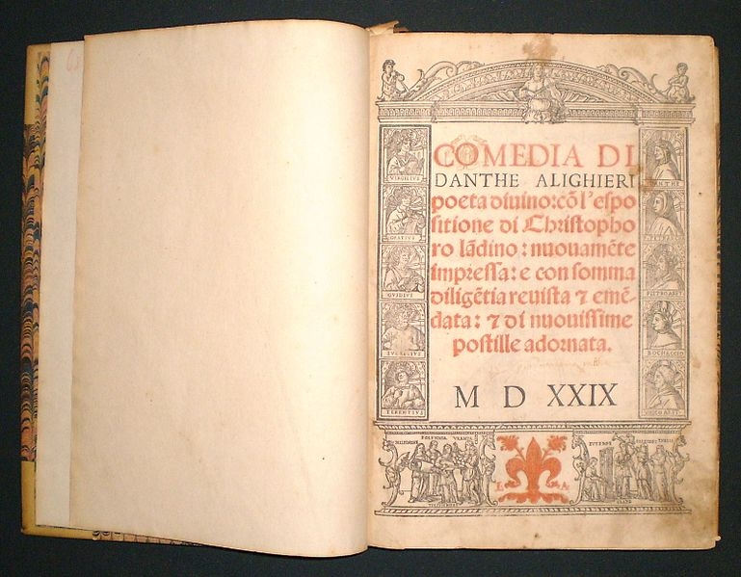
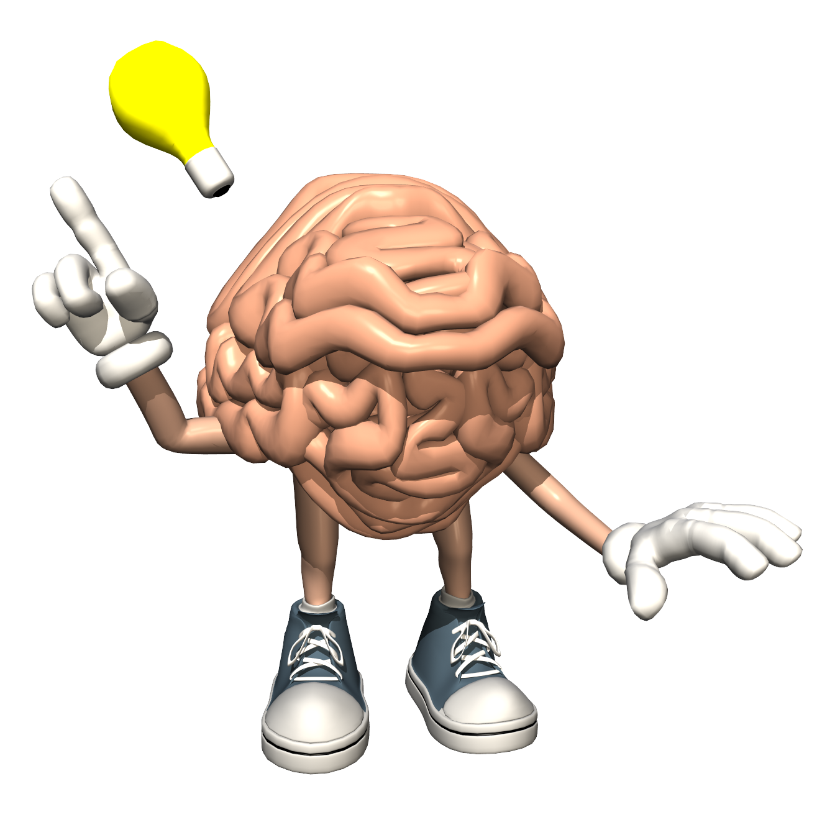
Discussion
How is Dante’s Divine Comedy creative?
AD 1450

Slide 38
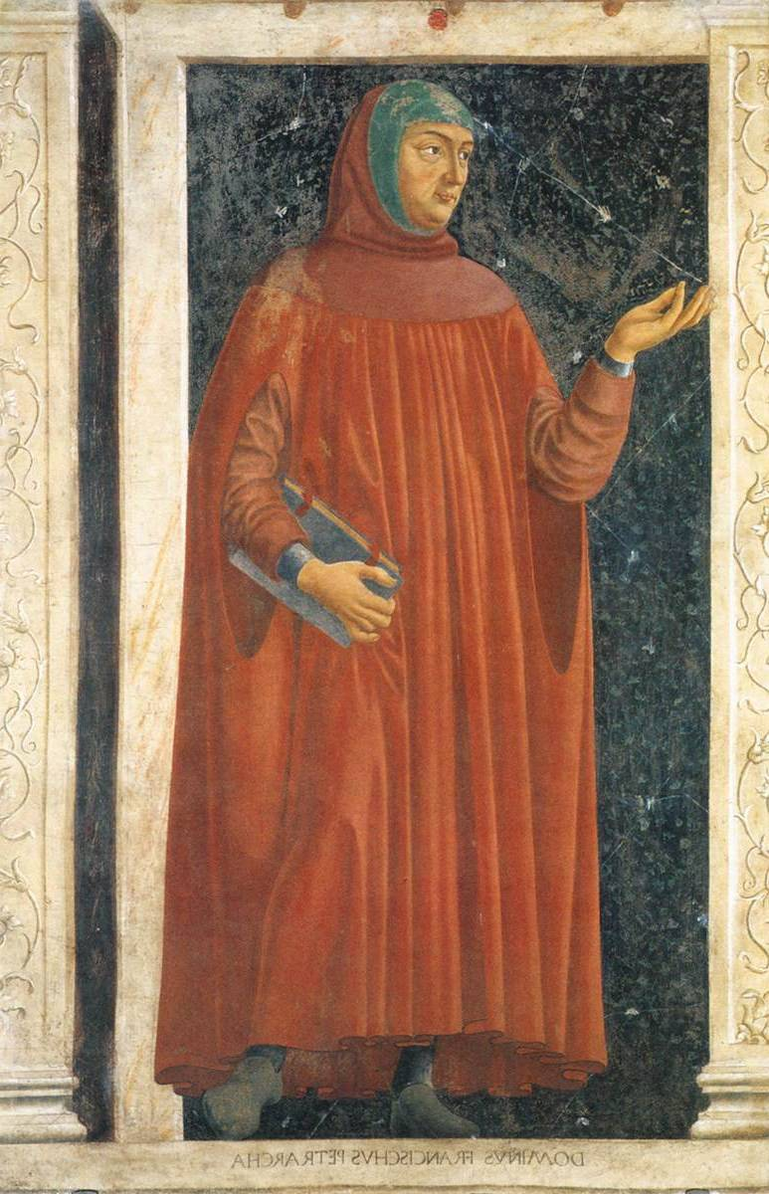
Francesco Petrarch (1304-1374)
Multi-talented— “Renaissance man” and first Poet Laureate
Florentine family living in Avignon
Added French culture to his Italian roots
Studied ancient writers
Founder of the Renaissance
Believed ancient knowledge was good as a guide to life
Believed a person could break free of the boundaries of society
Humanism
AD 1450

Slide 39
Humanist Education
Medieval Trivium
Humanist Liberal Arts
Logic
Grammar
Rhetoric
Ethics and History
Literature and Language
Rhetoric
AD 1450

Slide 40
Looking toward the Renaissance
Medieval Thinking
Humanist Thinking
“My position in life is fixed through the Great Chain of Being.”
“Knowledge from ancient (pagan) authors is dangerous and entices away from God.”
“I can become whatever I want to make of myself.”
“Ancient (pagan) authors were often good people and they developed methods of living a good life that we should emulate.”
AD 1450

Slide 41
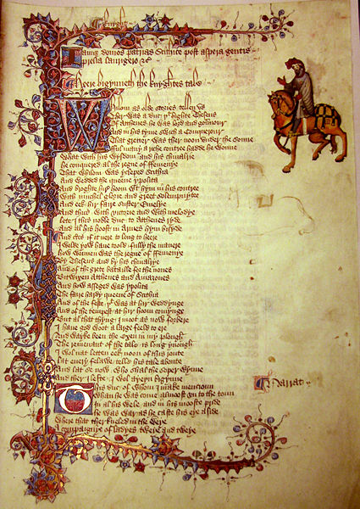
The Development of the English Language
Old English (Old Anglo-Saxon)
Germanic language (Dutch similarities)
Kenning and word endings (not word order)
Zustershelpvereniging (relief society)
Avondsmaalsvergadering (sacrament meeting)
Short words with strong consonants
Latin-based words tend to be polysyllabic and use soft sounds
Alliteration for rhyming
When to the sessions of sweet silent thought, I summon up remembrance of things past (Shakespeare)
AD 1450

Slide 42
Middle English
Why Middle English occurred when it did (1300).
England was more interactive with Europe (hundred years war, trade, etc.).
English was the language of the court and the peasants adopted the words for prestige and economic reasons.
AD 1450

Slide 43
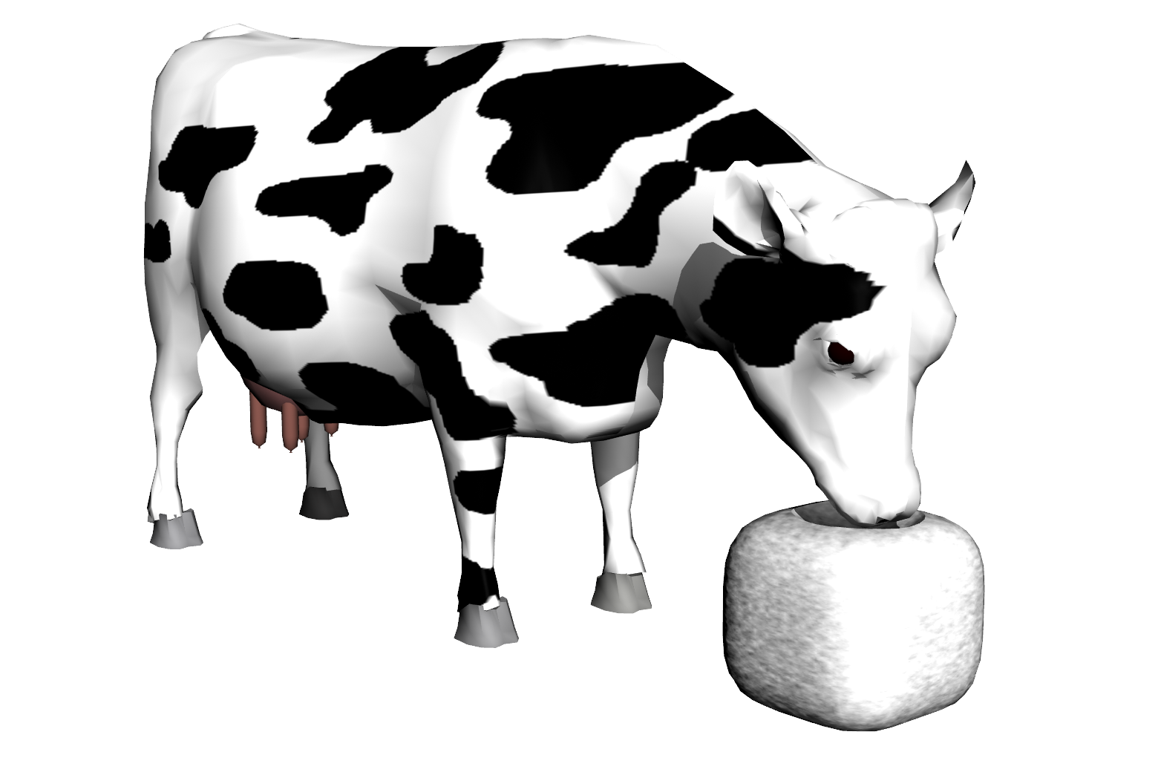
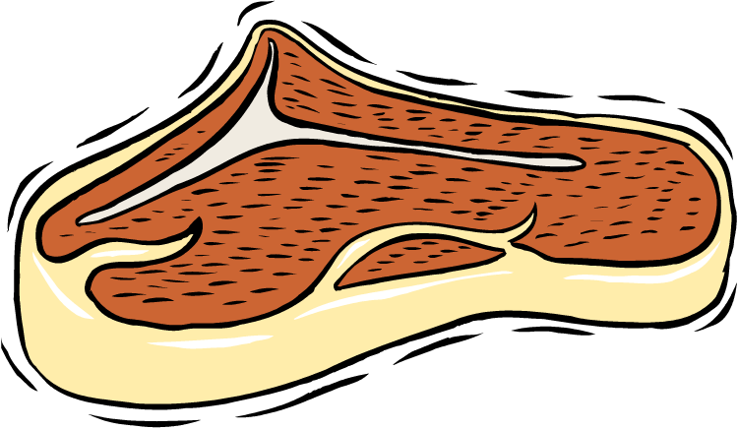
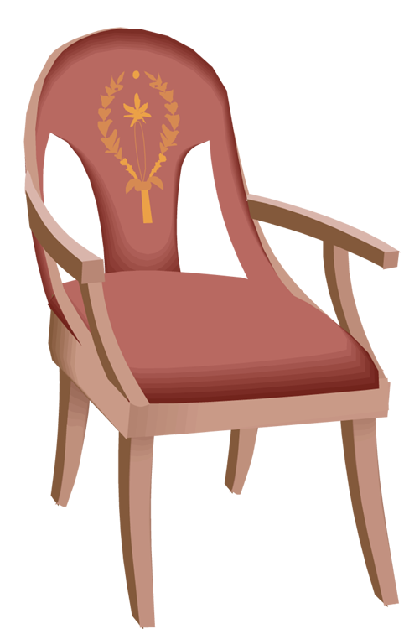
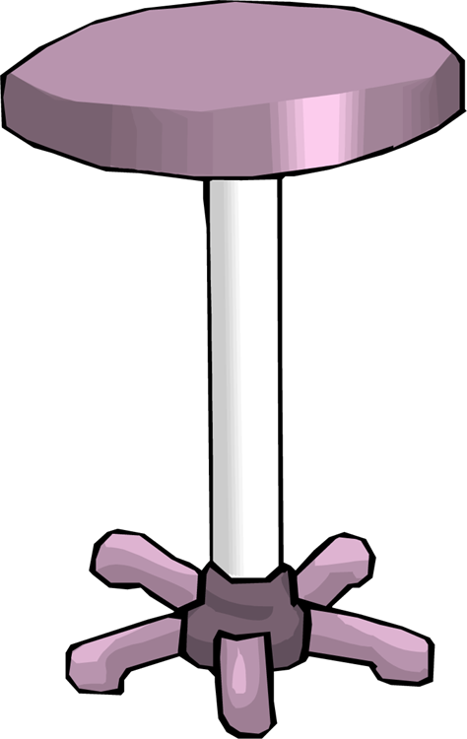
Middle English
Added words from other languages
(especially from French)
(Words entered because of class superiority)
English (German Origin)
House (Haus)
Cow (Kuh)
Calf (Kalb)
Swine (Schwein)
Stool (Stuhl)
End (Enden)
English (French Origin)
Mansion (Maison)
Beef (Boeuf)
Veal (Veau)
Pork (Porc)
Chair (Chaise)
Cease (Cesser)
AD 1450

Slide 44
Tri-lingual English
Just as the second estate (nobility) added to English, so too did the first estate (clergy).
The nobility added French words.
The clergy added Latin words.
Example:
In the marriage ceremony, the husband and wife were asked to:
Love (Anglo-Saxon)
Honor (Latin)
Cherish (French)
All three words meant the same thing.
AD 1450

Slide 45
Middle English
Sound of language changed in part because of the addition of Parisian French Words in English
(Richness of Dialect)
Norman used hard “c”
Castle
Cattle
Cap
Parisian used “ch”
Chateau
Chattel
Chapeau
Norman used “w”
Warden
Wiley
War
Parisian used “gu”
Guardian
Guile
Guerre
AD 1450

Slide 46
Middle English
English needed to be simplified
It eliminated linguistic gender
German Example
Der Wagen (the car)
Das Auto (the auto)
French Example
La maison (house)
Le château (castle)
AD 1450

Slide 47
Middle English
English needed to be simplified
English eliminated declining of nouns/adjectives
Examples from German (like Old English)
Nominative Case
The father (der Vater) is old.
The child (das Kind) is small.
Dative Case
He gives the father (dem Vater) a book.
Give the child (dem Kinde)
a book.
AD 1450

Slide 48
English is Easy??
The bandage was wound around the wound.
The farm was used to produce produce.
The dump was so full that it had to refuse more refuse.
We must polish the Polish furniture.
AD 1450

Slide 49
English is Easy??
The soldier decided to desert his dessert in the desert.
Since there is no time like the present, he thought it was time to present the present.
The buck does funny things when the does are present.
AD 1450

Slide 50
English is a Crazy Language
There is no egg in an eggplant nor ham in hamburger; neither apple nor pine in pineapple.
Boxing rings are square.
You park in the driveway but you drive on the parkway.
AD 1450

Slide 51
English is a Crazy Language
Your house can burn up as it burns down.
An alarm goes off by going on.
To shut down your computer you have to hit Start.
start
AD 1450

Slide 52
Geoffrey Chaucer—Life
Son of London merchant
Good education
Involved in court life
Capture and ransomed during 100 years war
Traveled widely
Expert in physics, medicine, astronomy, Latin
Wrote poetry
Used classical allusions (only known to the upper class and royalty)
AD 1450

Slide 53
Geoffrey Chaucer
Canterbury Tales
Written in Middle English
Innovative but risky because he wrote for a French-speaking class.
Legitimized Middle English
Rhymed and metered (pentameter)
Wide vocabulary
Clever phrases
Basis for other writers
AD 1450

Slide 54
Geoffrey Chaucer
Canterbury Tales
The General Prologue
Introduces the characters
Literary beauty (form)
Wide angle view of nature
Moves to specifics of plants
Then moves to specifics of people
AD 1450

Slide 55
Here bygynneth the Book of the Tales of Caunterbury
Whan that Aprill, with his shoures soote
The droghte of March hath perced to the roote
And bathed every veyne in swich licour,
Of which vertu engendred is the flour;
Whan Zephirus eek with his sweete breeth
Inspired hath in every holt and heeth
The tendre croppes, and the yonge sonne
Hath in the Ram his halfe cours yronne,
And smale foweles maken melodye,
That slepen al the nyght with open eye –
(So priketh hem Nature in hir corages);
Than longen folk to goon on pilgrimages
And palmeres for to seken straunge strondes
Top ferne halwes, kowthe in sondry londes;
And specially from every shires ende
Of Engelond, to Caunterbury they wende,
The hooly blisful martir for the seke
That hem hath holpen, whan that they were seeke.

Slide 56
Here begins the Book of the Tales of Canterbury
When April with his showers sweet with fruit
The drought of March has pierced unto the root
And bathed each vein with liquor that has power
To generate therein and sire the flower;
When Zephyr also has, with his sweet breath,
Quickened again, in every holt and heath,
The tender shoots and buds, and the young sun
Into the Ram one half his course has run,
And many little birds make melody
That sleep through all the night with open eye
(So Nature pricks them on to ramp and rage) –
Then do folk long to go on pilgrimage,
And palmers to go seeking out strange strands,
To distant shrines well known in sundry lands.
And specially from every shire's end
Of England they to Canterbury wend,
The holy blessed martyr there to seek
Who helped them when they lay so ill and weak.

Slide 57
Geoffrey Chaucer
Canterbury Tales
The Story
30 pilgrims on their way to Canterbury
Tell tales to pass the time (contest)
Insights into Medieval life
AD 1450

Slide 58
Geoffrey Chaucer
Canterbury Tales
The Story
Tales related to the person telling the tale
Knight—chivalrous romance
Miller—wife cheating on her husband
Wife of bath—husbands trying to squelch wives
Prioress—wants to impress people
Reeve—administrative agent, “simpleton”
Canon Yeoman—deception
AD 1450

Slide 59
Medieval Arts and Literature
Thank You
Creativity Uses Language

