Slide 1
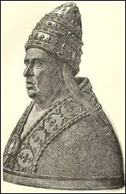
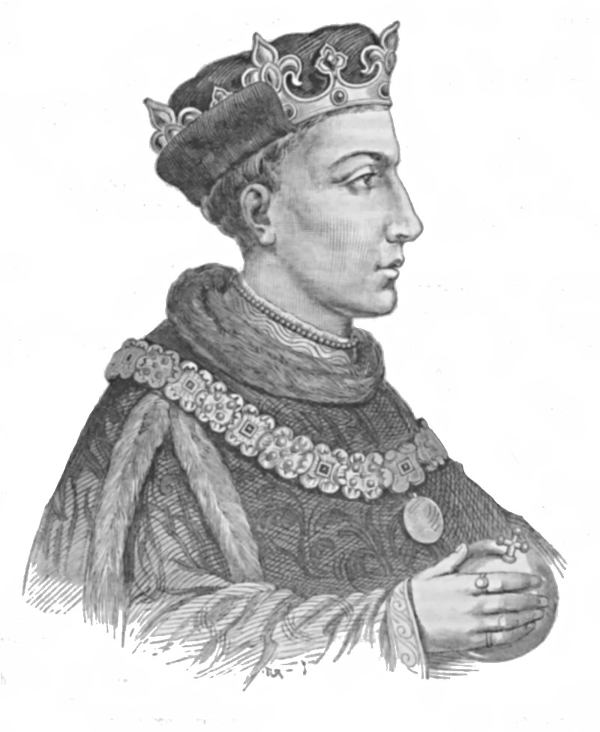
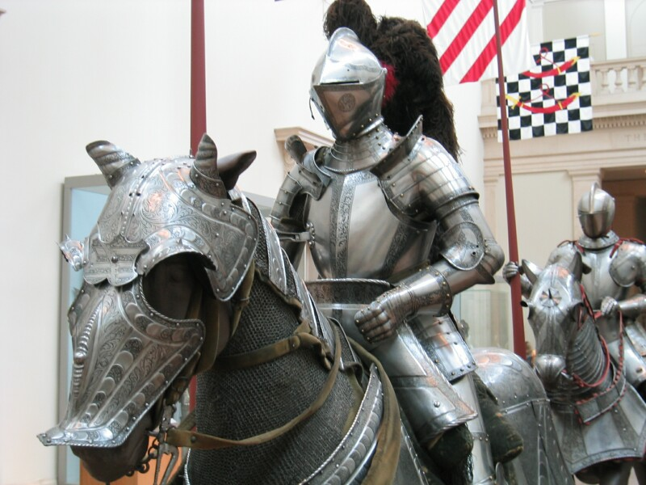
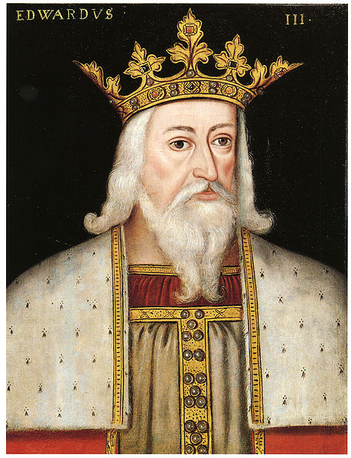
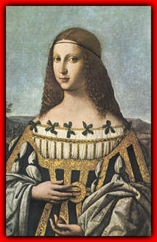
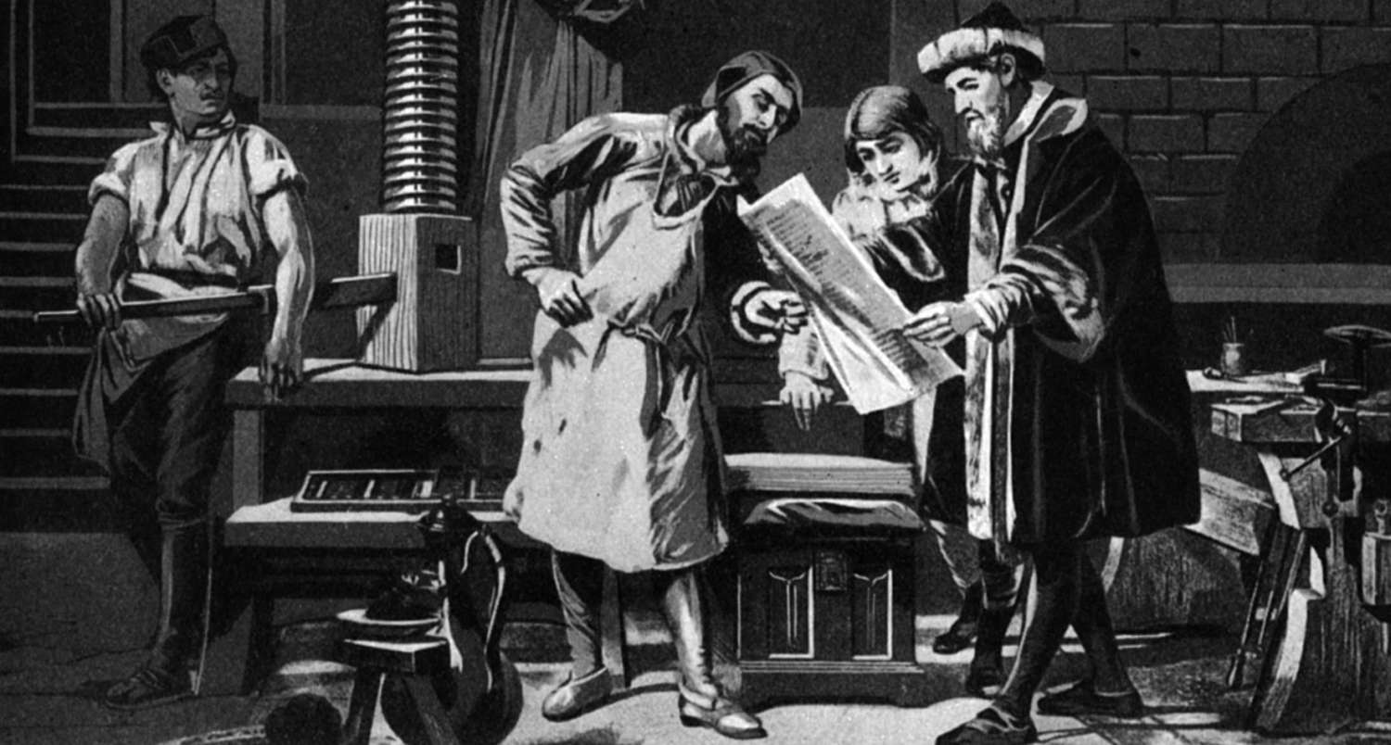
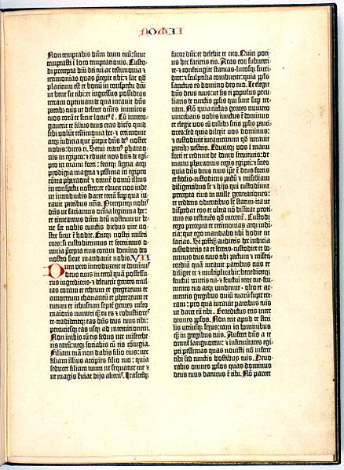
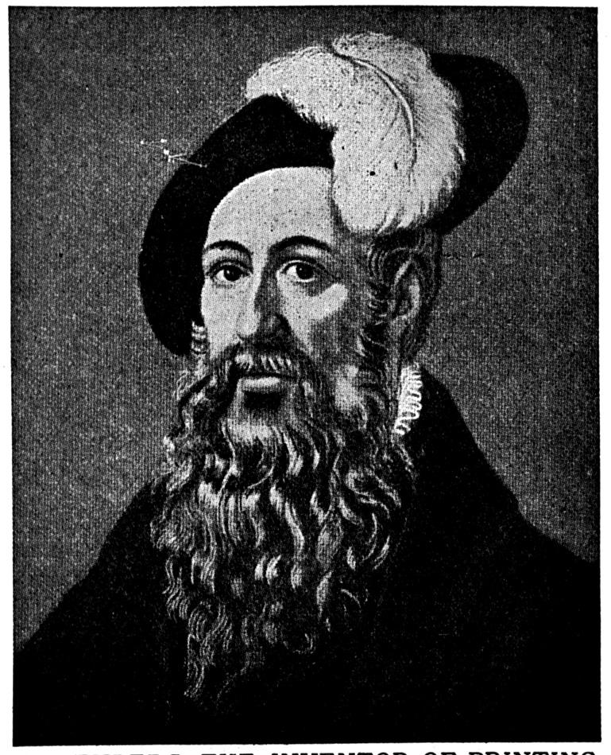
The End of the Middle Ages
14th Century

Slide 2
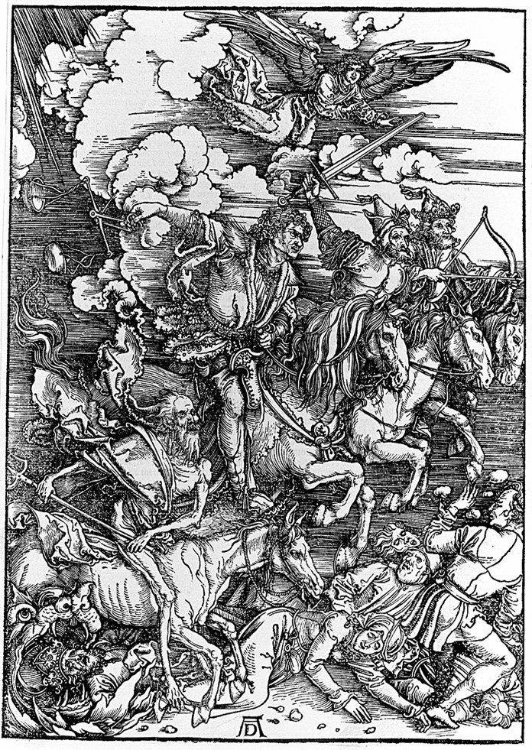
14th Century
The “worst” century in history
  Plague
  War
  Taxes
  Bad government
  Insurrection
  Schism in the church
Led to innovations and cultural changes
AD 476
AD 1450

Slide 3
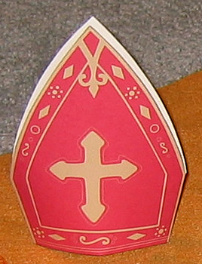
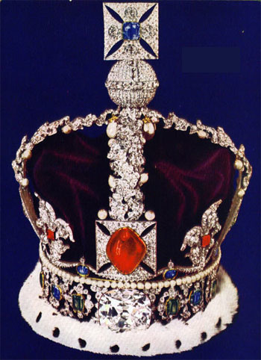
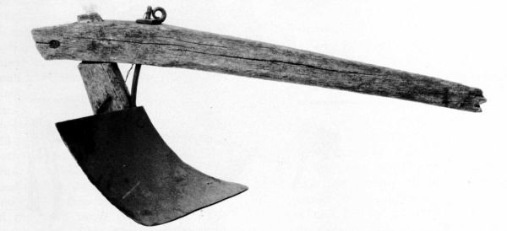
Estates (classes of society)
1st Estate = The Roman Catholic Church
  Purpose = Do good deeds
2nd Estate = The Nobility
(both local and “national”)
  Purpose = Govern/Fight
3rd Estate = The Commoners
(all others)
  Purpose = Work
AD 476
AD 1450

Slide 4
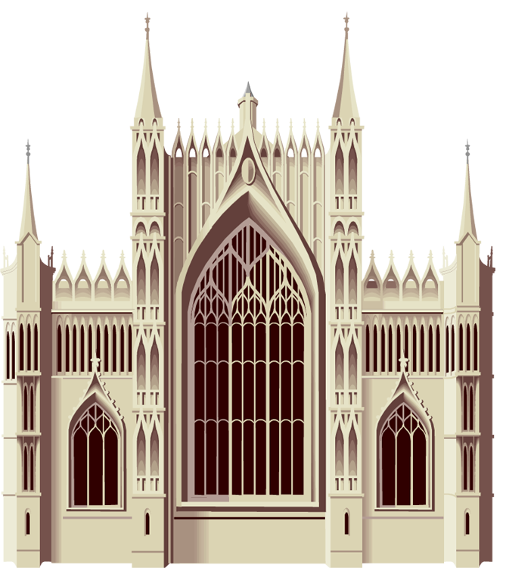
Changing Nature of the
Catholic Church—1st Estate
  The church is not susceptible of being reformed in her doctrines. . . The church is the work of God and, like all of God's works, it is perfect . . . . The church is independent of any earthly power, not merely in regard to her lawful end and purpose, but also in regard to whatever means she may deem suitable and necessary to attain them.
    –Stated by a 14th Century pope
AD 1450

Slide 5
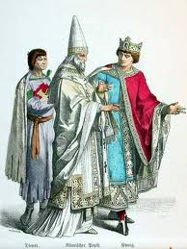
Changing Nature of the
Catholic Church—1st Estate
The Donation of Constantine
  A document signed by Constantine in which he gave the pope authority over kings
  Used by popes to justify their dominance over royalty
  Discovered to be a forgery of the 8th Century
AD 1450

Slide 6
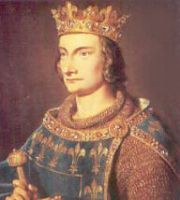
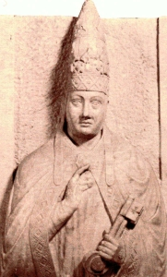
The Babylonian Captivity
Philip IV, the Fair (France)
  Wanted to tax the clergy
Pope Boniface VIII
  Originally not elected but he forced the hermit pope to resign and was then elected
  Resisted Philip and issued the Bull Unan Sanctum
  Philip’s army invaded and captured the pope who died shortly thereafter
AD 476
AD 1450

Slide 7
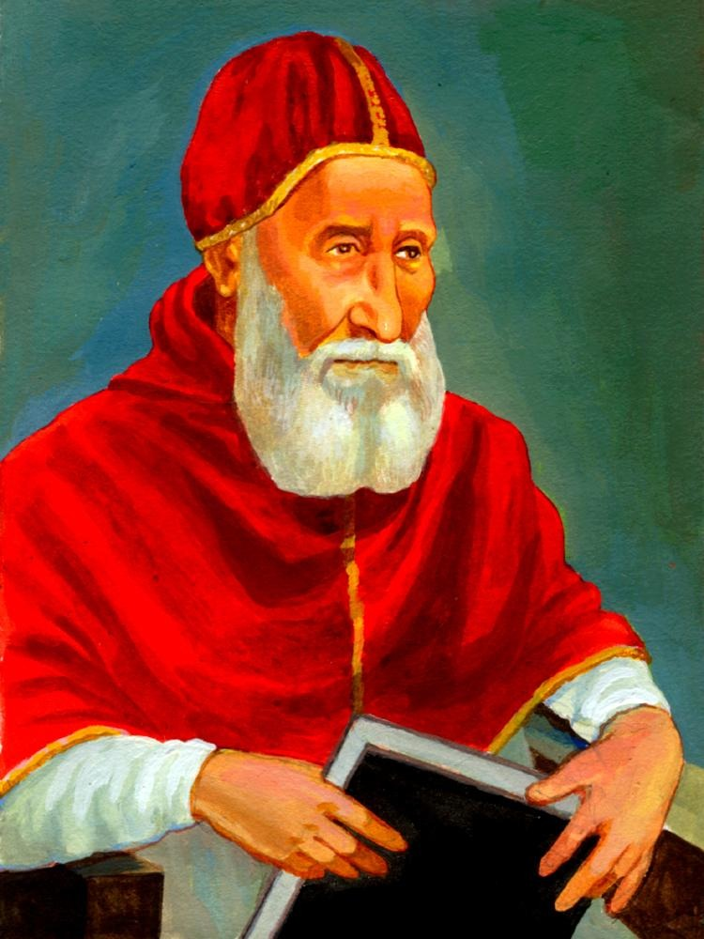
Catholic Supremacy Over Nations
That there is one Holy Catholic and Apostolic Church we are impelled by our faith to believe and to hold— this we do firmly believe and openly confess—and outside of this there is neither salvation or remission of sins . . . We moreover, proclaim, declare, and pronounce that it is altogether necessary to salvation for every human being to be subject to the Roman Pontiff.
—The Bull Unam Sanctum of Boniface VIII
AD 1450

Slide 8
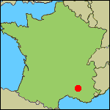
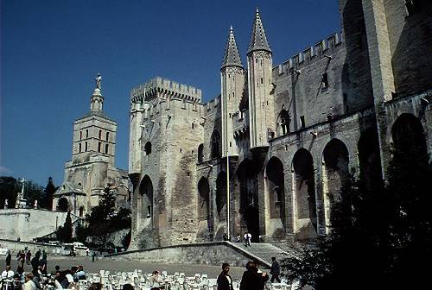
The Babylonian Captivity
Philip forced the election of Clement V (a Frenchman) as Pope
  The king was more powerful than the pope at this historical time.
Avignon
Church headquarters moved to Avignon, France
  7 popes
  Corruption (money)
City of Rome fell into ruin
AD 1450

Slide 9
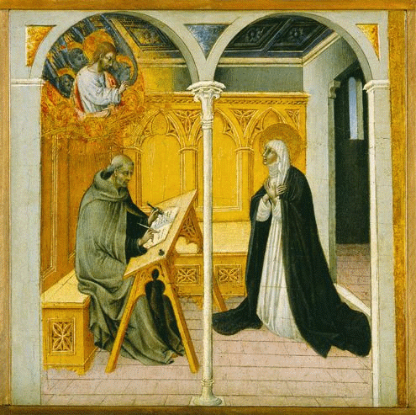
The Great Schism
Catherine of Siena
  Received revelations while in a state of ecstasy.
  She frightened Gregory XI (an Avignon pope) about damnation if he died outside of Rome.
Pope Gregory XI moved back to Rome to die.
AD 1450

Slide 10
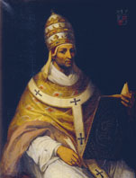
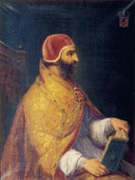
The Great Schism
New pope elected in Rome.
  Cardinals under duress from Roman people to elect an Italian as pope.
  An Italian cardinal agreed to return to Avignon if elected pope.
  Italian cardinal broke his promise after elected pope.
  Cardinals returned to Avignon and elected a different pope.
Two popes excommunicated each other.
Europe was divided.
AD 1450

Slide 11
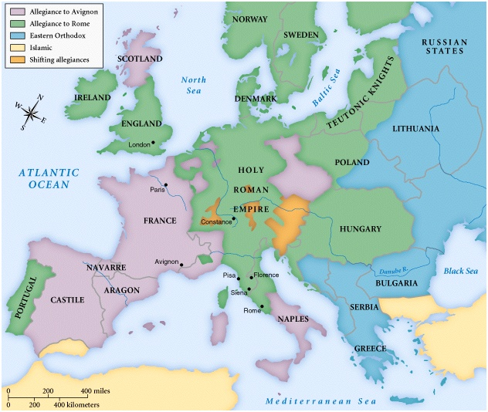
The Great Schism
AD 1450

Slide 12
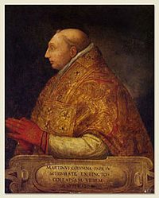
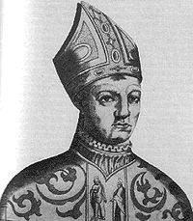
The Great Schism
Council held in Pisa to resolve the problem.
  Two popes agreed to resign and support a new pope.
  After the new pope was elected, the two refused to resign.
  Three papal claimants
  The pope named in Pisa died in a few years.
New pope elected at a conference in Constance and all supported him.
AD 1450

Slide 13
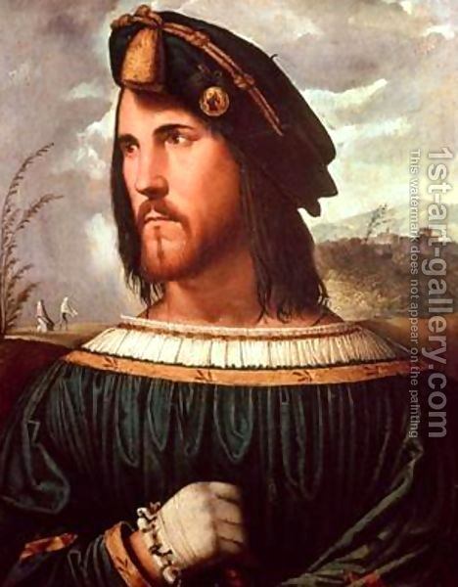
After The Great Schism
Continued papal decline and corruption
  Borgia family
  Model for Machiavelli’s The Prince
Papal corruption continued into the period known as the Reformation (beginning in 1517)
AD 1450

Slide 14
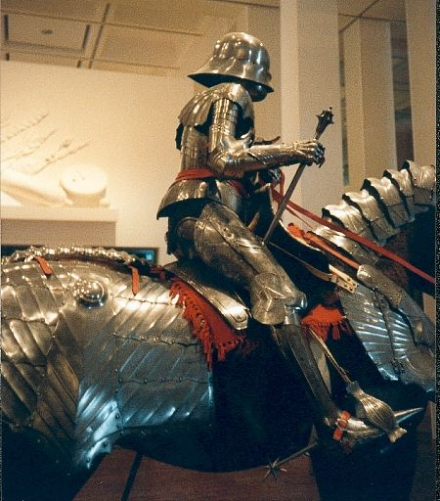
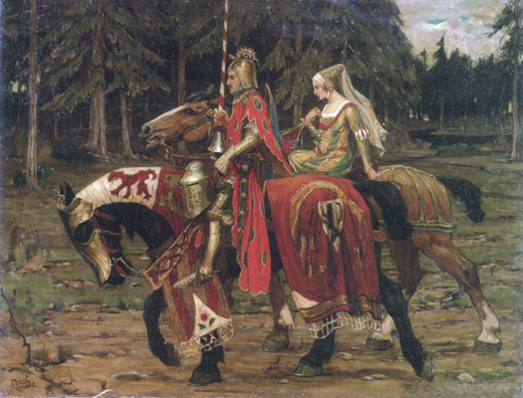
Changing Nature of the
Noble Class—2nd Estate
Who were the nobles
  Rulers
  Warriors (knights)
  Land holders
Rules of Chivalry
  To regulate behavior of the noble class
Nobles fought tournaments to practice and seek glory
AD 1450

Slide 15
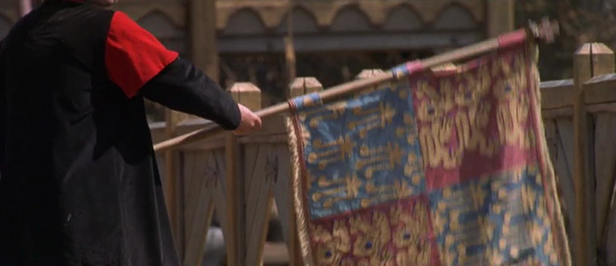
Nobles and Chivalry
AD 1450

Slide 16
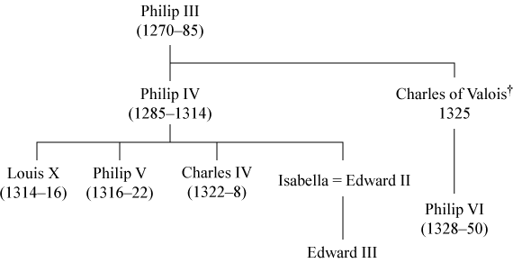
The Hundred Year's War
The Capetian Dynasty ended after 300 years of father-to-son succession with the death of Charles IV.
  Claimants: Joan of Navarre, Isabella, Philip VI
  Salic law (male line only) prevailed and Philip VI became king (starting the Valois dynasty)
AD 1450
Joan of Navarre

Slide 17
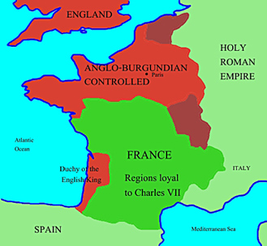
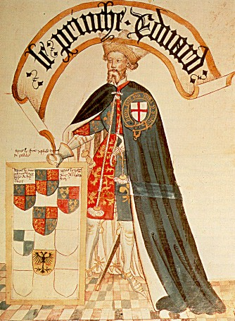
The Hundred Year's War
England disputed the Valois claim to the throne
  England had extensive lands that were part of “greater France”
  Edward III began a war to assert his claims
AD 1450

Slide 18
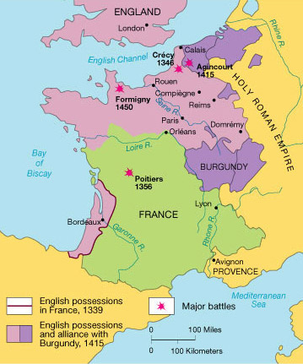
The Hundred Year's War
Early battles won by England
  Crécy
  Poitiers
AD 1450

Slide 19
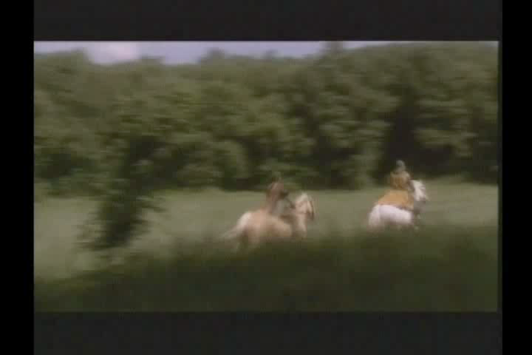
The Hundred Year's War
AD 1450

Slide 20
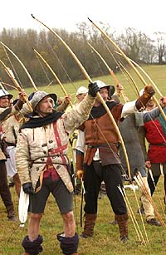
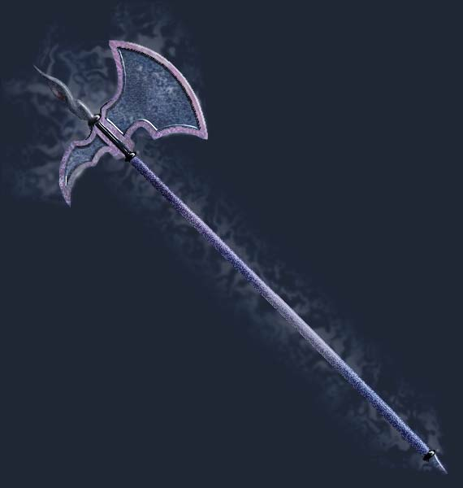
Changes in the Nature of Warfare
Old tactics and weapons
  Knights charging on horses
  Swords
  Crossbows
New tactics and weapons
  Long bows
  Pikes and halbrids
The French lost even though they outnumbered the English 2:1.
AD 1450

Slide 21
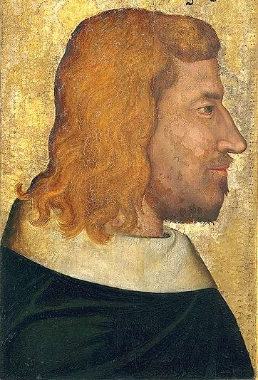
Hundred Years War
  John II of France
    Fought against the Black Knight of England (son of Edward III) at Poitiers and was taken captive.
  Ransom for John II
    His son was held hostage while John returned to get the money.
  John’s son escaped from the English.
  John volunteered to return to be a captive and he died in England.
    “It is a matter of honor”
AD 1450

Slide 22
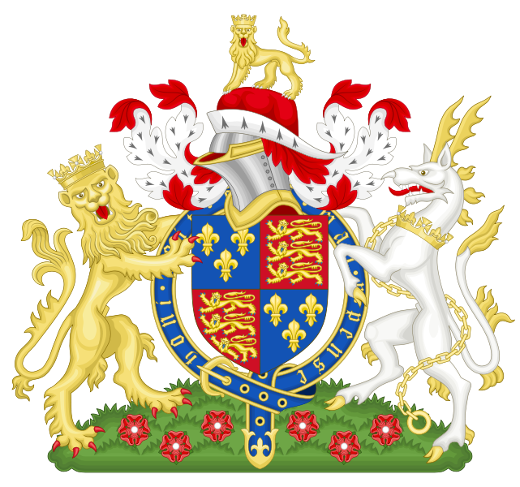
Changes in the Nature of Warfare
The war waxed and waned for the French over the next decades.
  English were involved with internal dissent and had no ability to maintain a strong presence in France.
The ascension of Henry V to the throne of England brought stability to the English throne and a desire for Henry to recapture the French lands.
Henry took his army to Agincourt (northern France) and prepared for battle.
  The French outnumbered the English 5-10:1
AD 1450

Slide 23
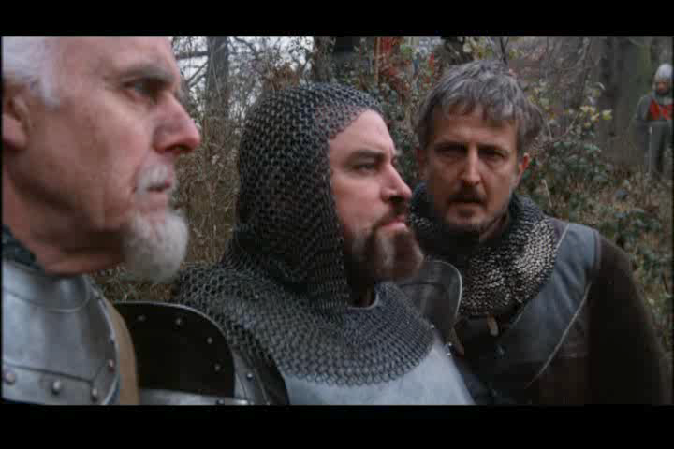
St. Crispin’s Day Speech—Henry V
AD 1450

Slide 24
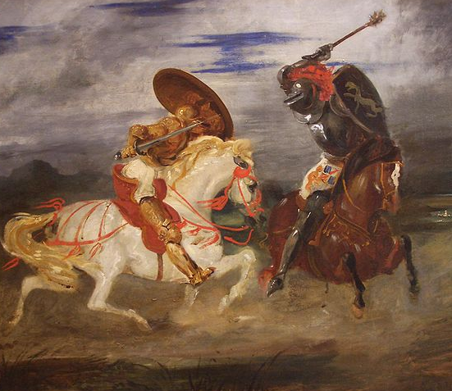
Hundred Years War
Henry V was victorious at Agincourt.
  French knights advanced with heavy armor and visors down because of arrows.
  Heavy mud made the movement difficult.
  The English scurried around and killed the French.
English occupation of much of France
  French king was forced to recognize Henry’s son as the rightful successor to the king of France.
AD 1450

Slide 25
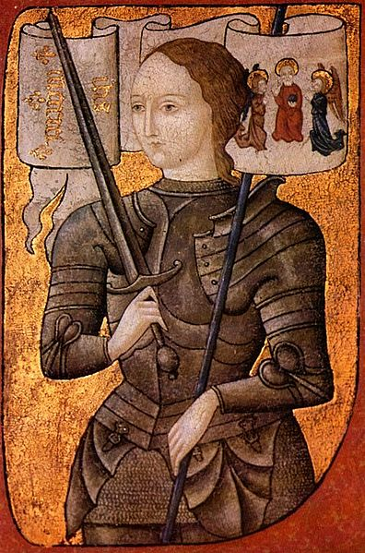
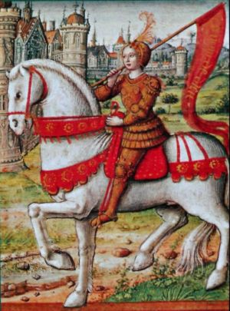
Hundred Years War
Many in France refused to accept Henry VI as king of France.
  These people rallied behind the Dauphine (traditional successor to the king of France).
Joan of Arc was a strong supporter of the Dauphine.
Joan rallied the French to several victories (especially lifting the siege of Orleans).
AD 1450

Slide 26
Discussion
Why do you think Joan of Arc made such a difference in the outcome of the Hundred Years War?
What did she do that was creative?
AD 1450

Slide 27
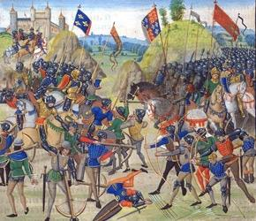
Changes in the Noble Class
Lords became less important compared to kings
  Irrelevance of knights
    New warfare weapons/tactics
  Loss of castles
    Gunpowder and canons
  Growth of paid armies (under kings)
  Became courtiers for kings
AD 1450

Slide 28
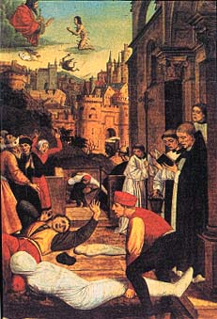
The Black Death
Famine in N. Europe
Plague of 1347
  Sailors on ship from Crimea
  Disease spread through Europe
  Symptoms (type 1)
  Symptoms (type 2)
Results
  Affected the 3rd estate most
  Reduced labor force
  Stronger bargaining position
  Excess materials (cloth, tools, etc.)
AD 1450

Slide 29
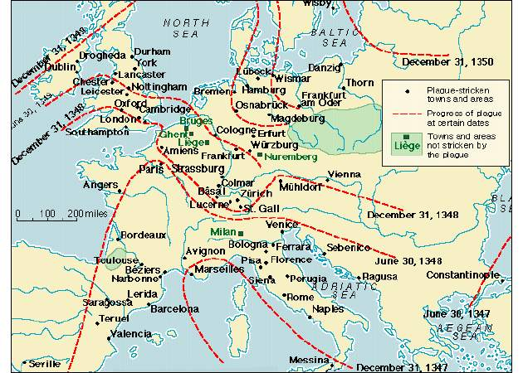
The Black Death
AD 1450

Slide 30
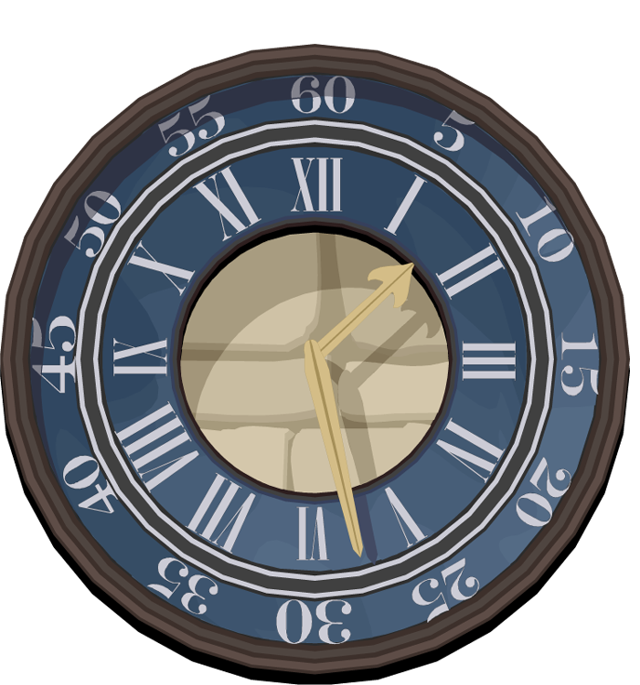

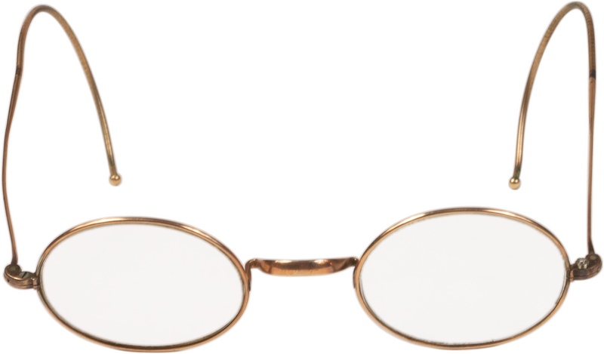
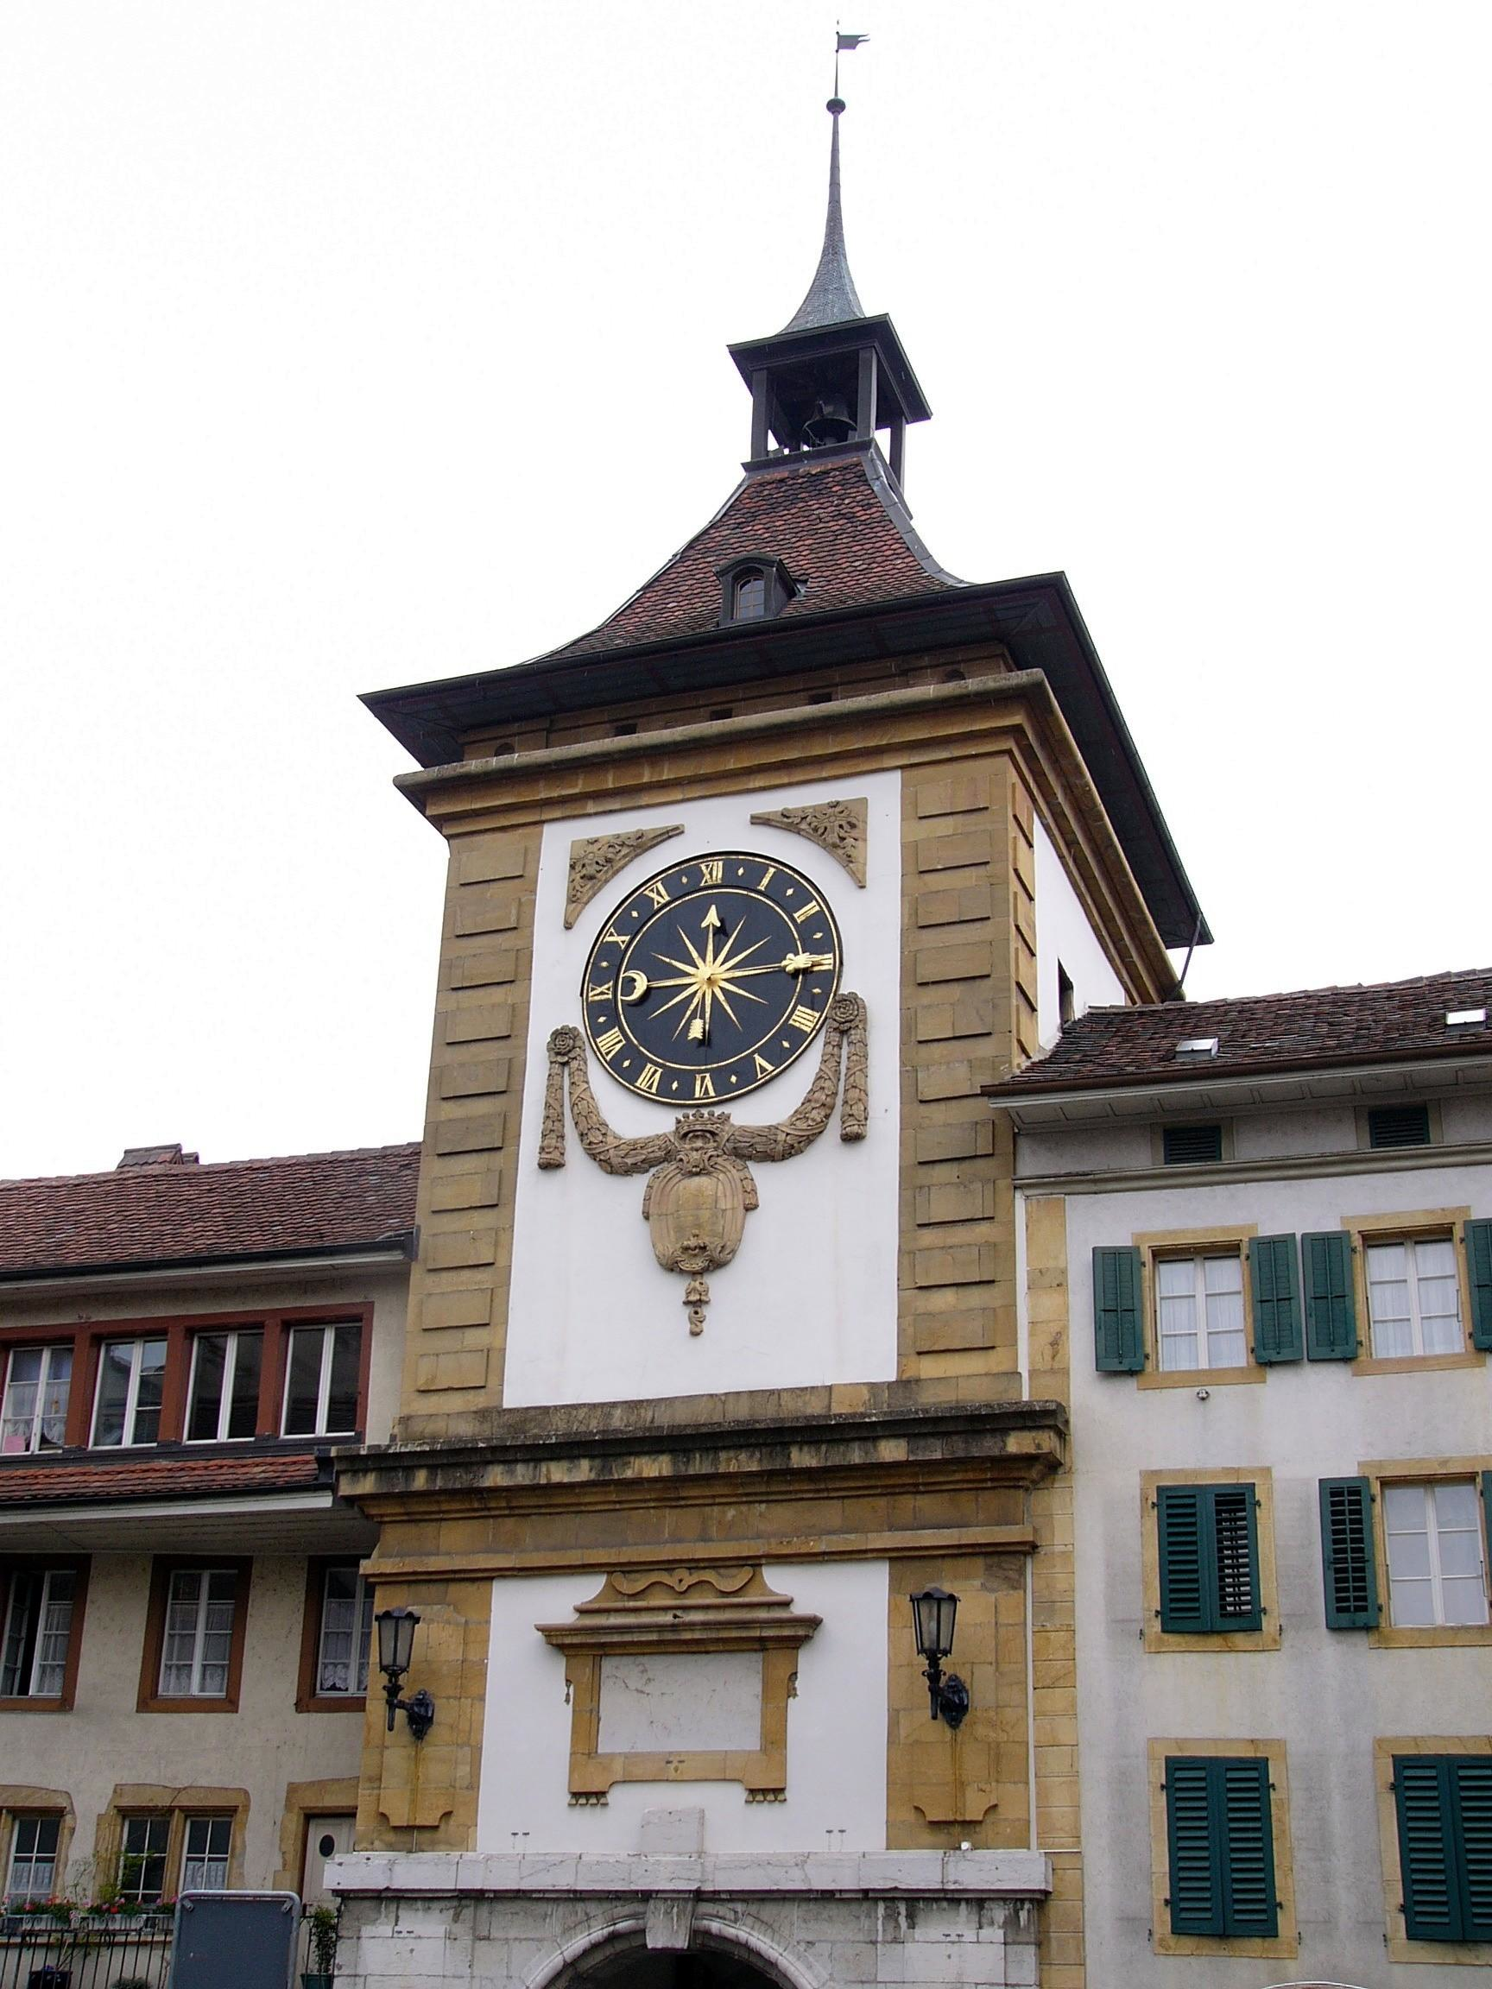
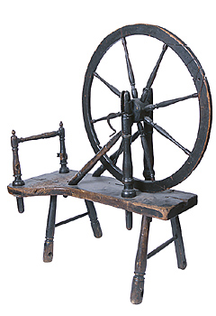
Technology
Imported technologies from China and Islamic lands
  Magnetic compasses
  Paper
  Eye glasses
Mechanical clocks
  Put on civic buildings rather than churches
Machine tools
Spinning wheels
Calendar reform
AD 1450

Slide 31



Why the Asians didn't invent moveable type printing
Asian writing systems were too complex: printing needs an alphabetical base.
Established writing systems are intrinsically conservative: no one [in Asia] was interested in change . . .
The paper was the wrong sort: Chinese paper was [soft and therefore] suitable only for calligraphy or block-printing
There were no screw-based presses in the East, because they were not wine-drinkers and didn't have olives . . .
Printing is expensive and in [Asia] there was no system to release capital for research and development
—John Man, Gutenberg, John Wiley and Sons, Inc. 2002, pp. 115.
AD 1450

Slide 32
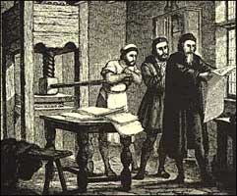
Technology
Gutenberg’s invention
  Vision (creative idea)
  Entrepreneurship (assembled money men)
  Stamping mold and patrix/matrix type casting
  Die alloy
  Paper
  Printing ink
  Printing press
AD 1450

Slide 33


Gutenberg—Project
Duplicate, from drawings and other technology records, the following:
  Investing (visiting the actual locales)
  Type (using Gutenberg’s technology)
  Paper (made in a paper mill from Gutenberg’s time)
  Ink (using formulas of the day)
  Press (made by hand using authentic tools)
AD 1450

Slide 34

Gutenberg—Project
AD 1450

Slide 35

Gutenberg—Type
AD 1450

Slide 36

Gutenberg—Related Technologies
Paper
AD 1450

Slide 37

Gutenberg—Paper
AD 1450

Slide 38
Gutenberg—Related Technologies
Press
AD 1450

Slide 39

Gutenberg—Wine Press
AD 1450

Slide 40

Gutenberg—Press Details
AD 1450

Slide 41

Gutenberg—Project
Each of the participants assembled to prove the technology.
  Press maker
  Type maker
  Inker
  Reporter
AD 1450

Slide 42

Gutenberg—Project
AD 1450

Slide 43

Gutenberg—Finished
AD 1450

Slide 44

Gutenberg—Finished
Printing with movable type was both inspiration and perspiration, an idea and an invention. The birth of the idea sounds as if it ought to have been a sudden revelation, a Eureka! moment like the one that inspired Archimedes to leap from his bath with his famous yell. But ideas seldom jump into the mind from nowhere. If they do, like Leonardo da Vinci's sketch for a helicopter, they remain science fictions until technological advance makes them seem prescient. Ideas are seeded in frameworks of previous growths and need those same frameworks—in this case, punch-making, casting, metallurgical skills, wine- and oil-pressing, paper-making—to flourish.
—John Man, Gutenberg, John Wiley and Sons, 2002, p.122.
AD 1450

Slide 45


Discussion
Do you agree that Gutenberg was the man of the millennium?
AD 1450

Slide 46
End of Middle Ages—Creativity
Changes in the church
negative
Changes in the nobility
kings gained power at expense of church and minor nobles
Changes in the commoners
much gain in power and development of technology helped
AD 1450

Slide 47
Thank You
Creativity in the worst of times

