Slide 1
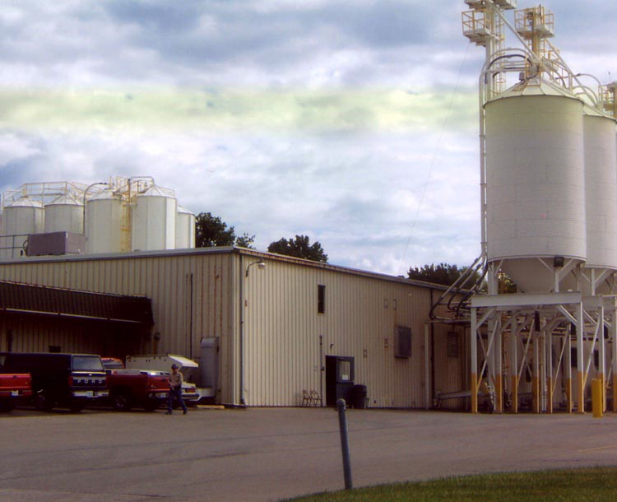
Operations
MFG 355

Slide 2
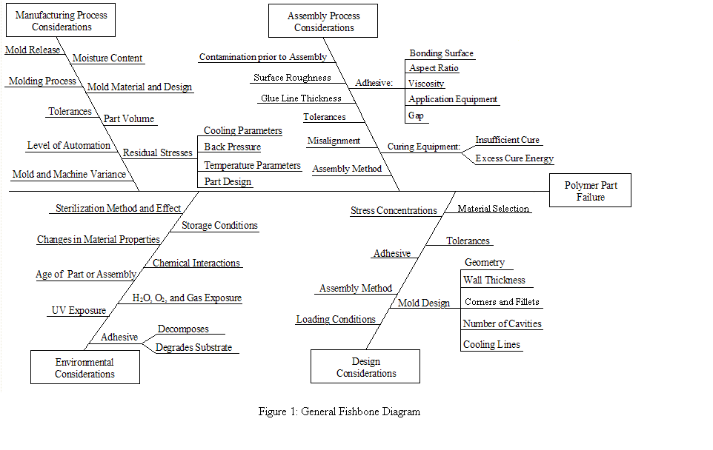
Fishbone (Isikawa) Diagram

Slide 3
Deming’s 14 Quality Points
1. Constancy of purpose. (Continuous improvement, Alignment)
2. The new philosophy. (New methods of thinking)
3. Cease dependence on mass inspection.
4. End lowest-tender contracts. (Supplier relationships, 80/20)
5. Improve every process.
6. Institute training.
7. Institute leadership of people. (Empowerment, motivation)
8. Drive out fear. (Communications)
9. Break down barriers. (Silos of expertise)
10. Eliminate exhortations. (Not a campaign but, rather, a life)
11. Eliminate arbitrary numerical targets.
12. Permit pride or workmanship.
13. Encourage education.
14. Top management and commitment to action.

Slide 4
Safety Issues
Mechanical and pressure dangers
Thermal dangers
Eye protection (plastics are brittle)
Proper tools
Workable safety rules
Compliance with legal rules and guidelines
Gloves
Loose clothing
Emergency procedures
Proper training
Cleanliness

Slide 5
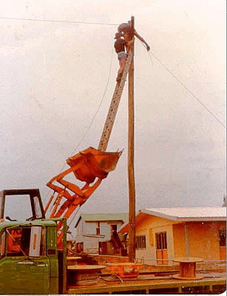
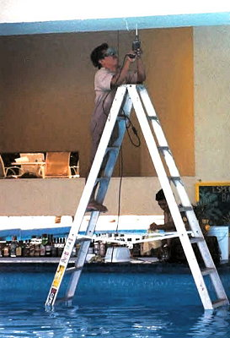
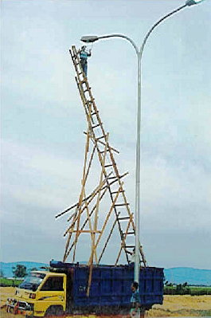
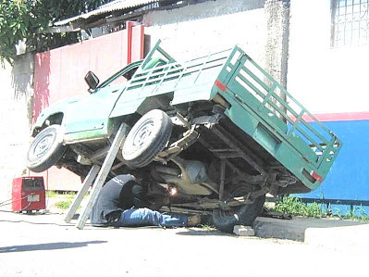
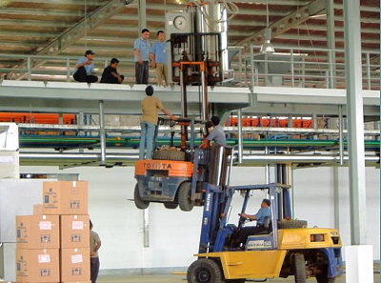
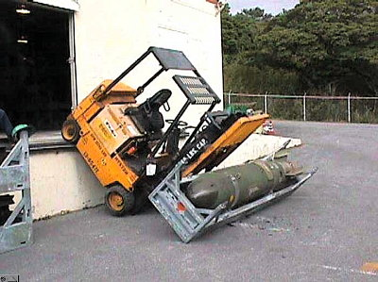
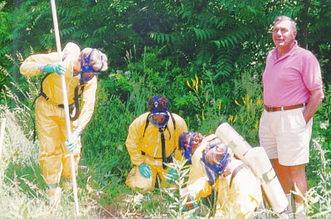
Safety First

Slide 6
Preventable Accidents

Slide 7
The Slip

Slide 8
Forklift in Factory

Slide 9
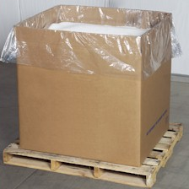
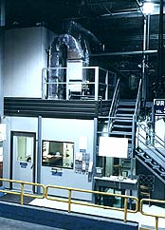
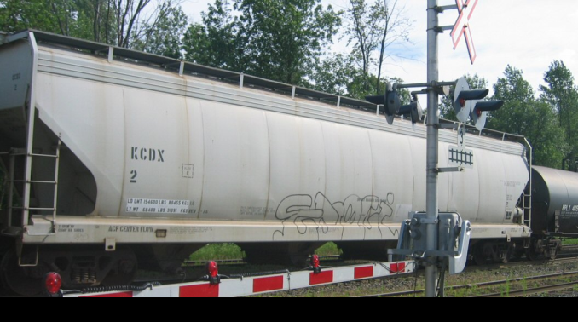
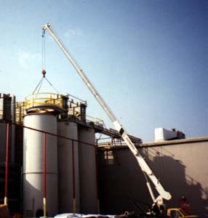
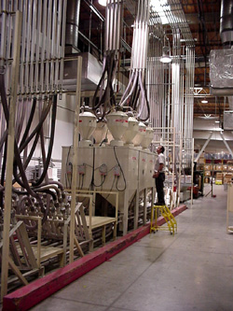
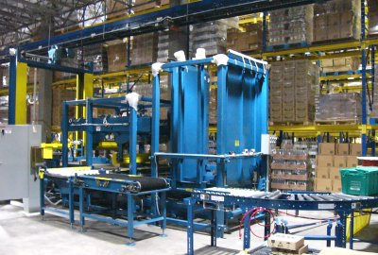
Plastic Handling
Railcar
Gaylord
Vacuum system
Storage silo
Vacuum system
Delivery to process

Slide 10
Leadership/Management
On-time performance
Community responsibility
Profits
Employees
Customers
Suppliers

Slide 11
Supplier Relationships
Good specifications
Acceptance criteria
Evaluate supplier’s satisfaction level to other companies
Reasonable and flexible in negotiations
Communication lines
Loyalty (allocation)
Expectations on both sides

Slide 12
Thank You

