Slide 1
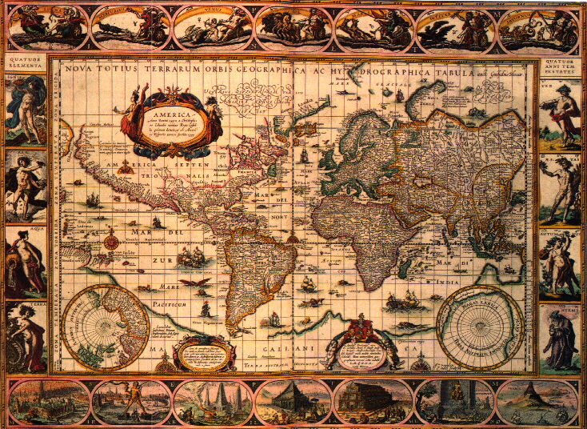
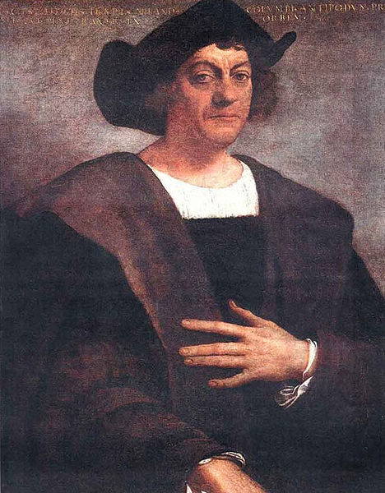
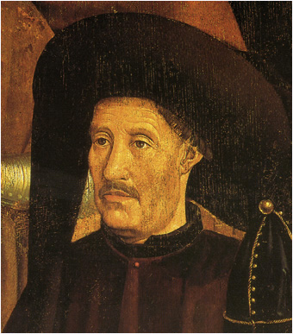
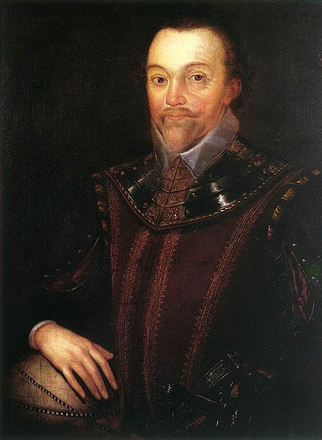
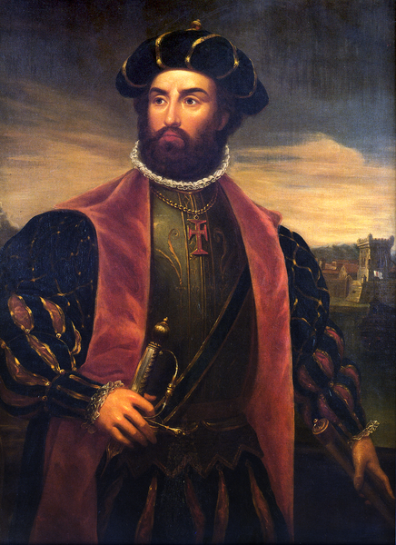
The Age of Exploration
Discovering Creativity

Slide 2
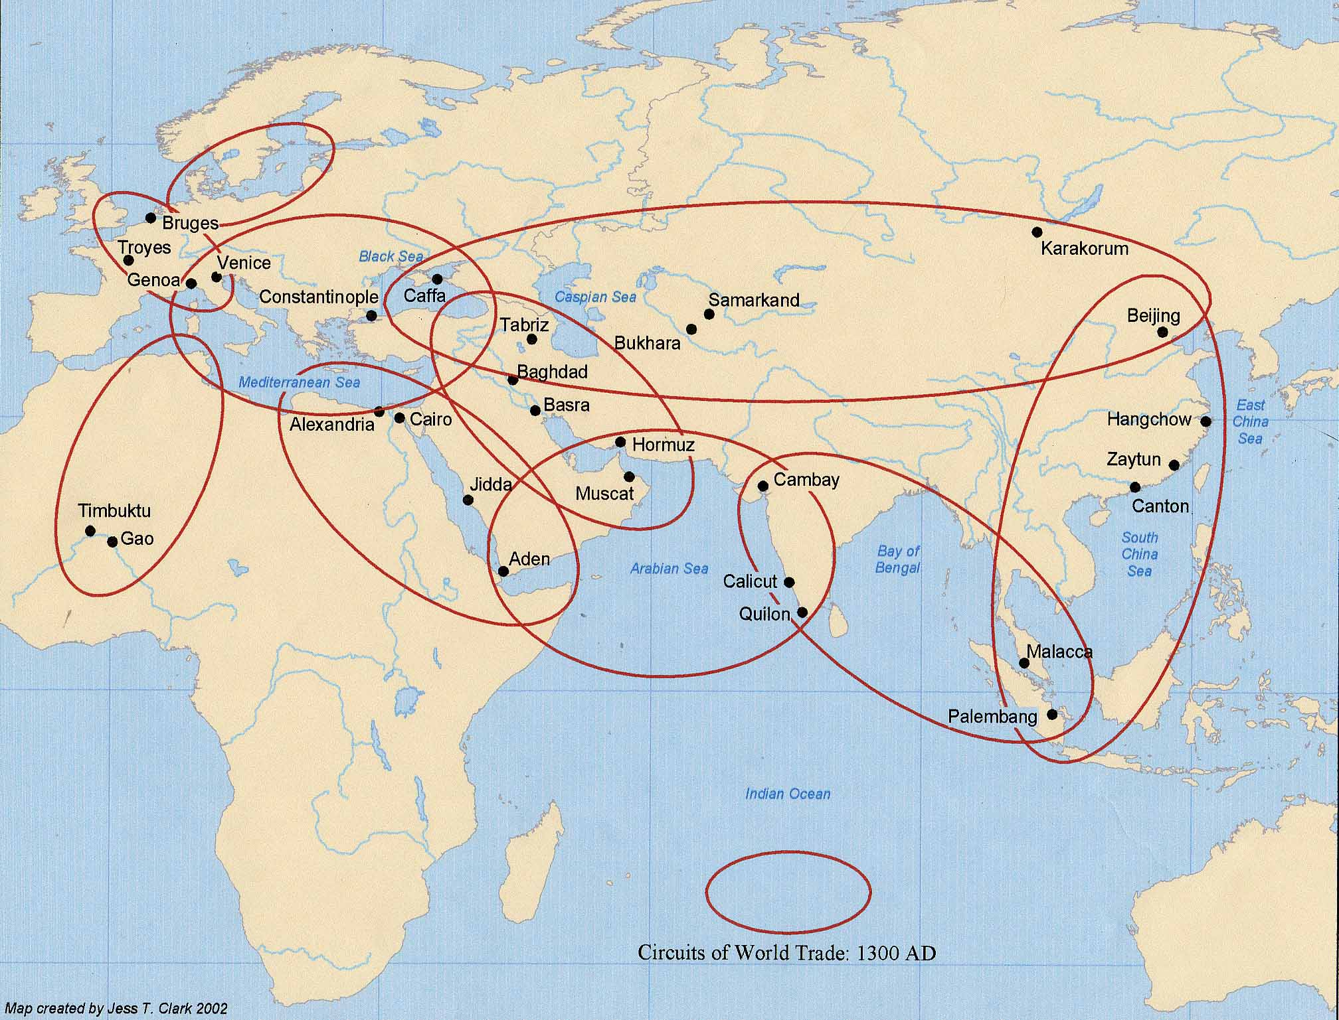
Why the age of discovery?
Loss of Constantinople
European trade zones collapsed
Trade Zones
AD 476
AD 1450

Slide 3
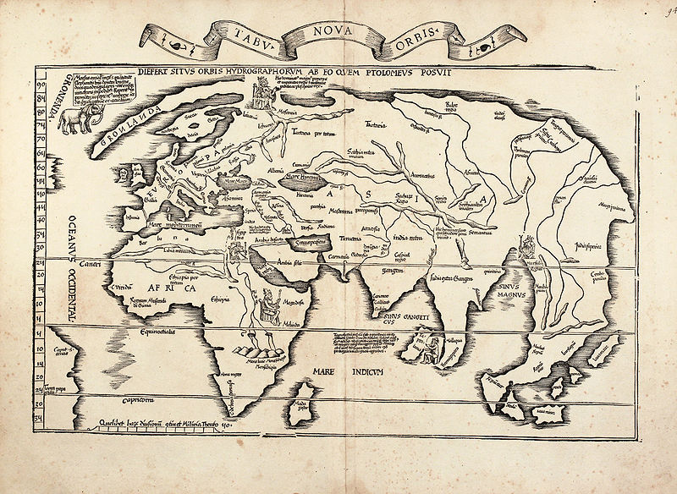
How to get to the eastern trade zones from Europe?
Around
Africa
AD 476
AD 1450

Slide 4
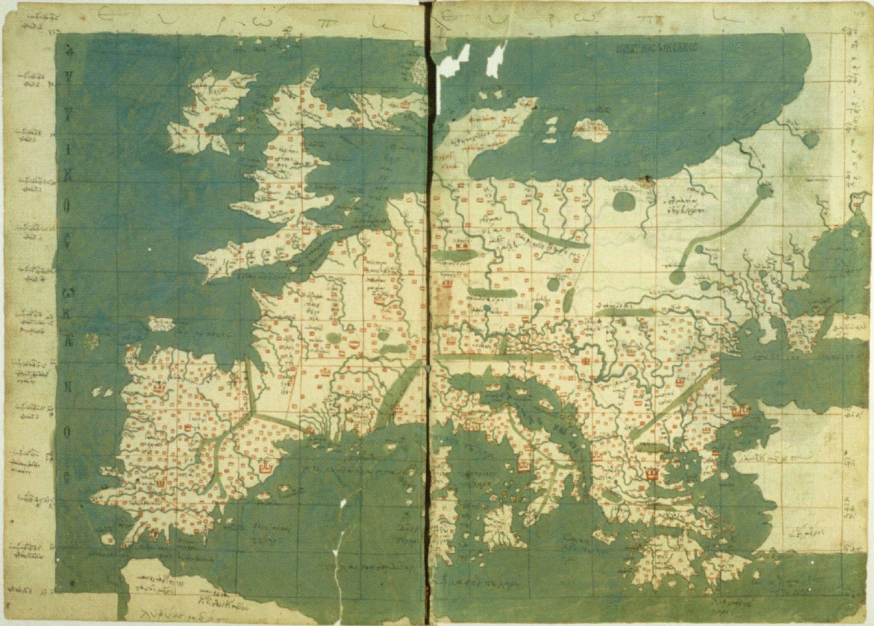
Portugal
Committed to sail to the Indies
Closest nation to the West Coast of Africa
Never strongly involved in Mediterranean trade
Henry the Navigator (1394-1460)
Established school for maritime pursuits
Compass, astrolabe, cartography
AD 1450

Slide 5
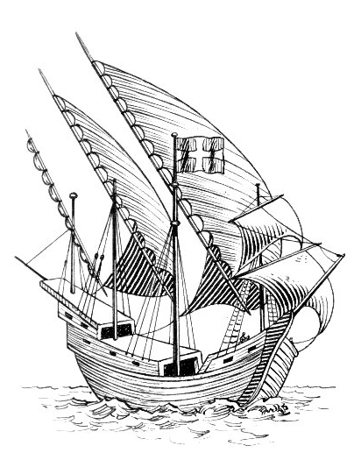
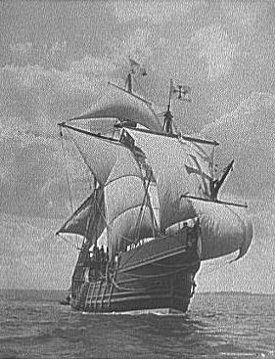
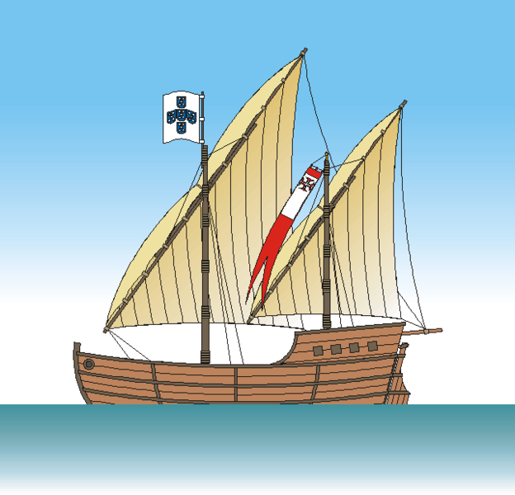
Portugal
Developed the caravel
Suitable for ocean travel
Deep draft
Lots of sails
AD 1450

Slide 6
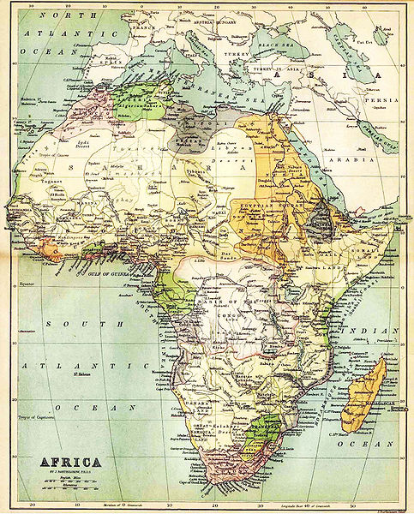
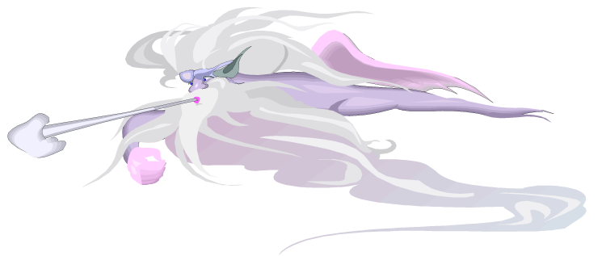
Portugal
Established trading sites along the coast of West Africa
Problem: winds below the bulge of Africa blew westward
Solution: Hug the coast
Portugal
AD 1450

Slide 7
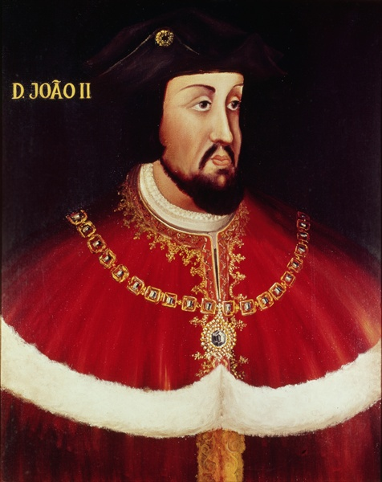
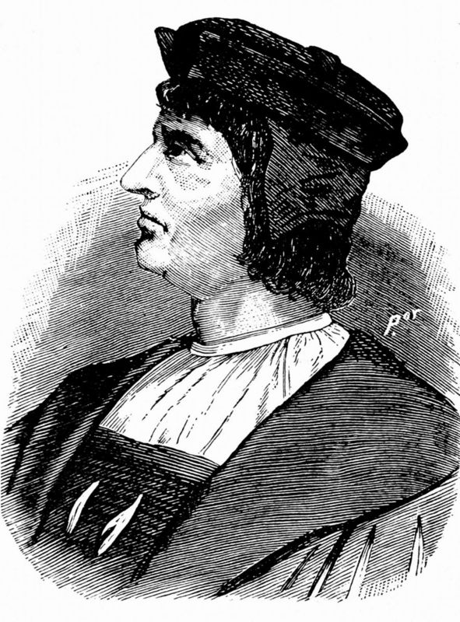
Portugal
King John II (1481-1495)
Bartholomew Diaz (1487)
Discovered the Cape of Good Hope
Confirmed possibility of sailing around Africa
Turned down Columbus
Portugal did not need to fund a radical venture because they already had a safe route confirmed.
But they had not rounded the Cape yet.
AD 1450

Slide 8
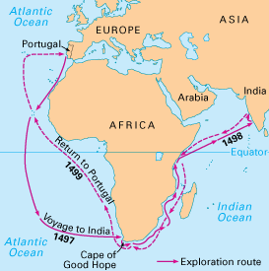
Portugal
Manuel the Fortunate (1495-1521)
Panicked because of Columbus
Urgently needed to get to the Indies to establish trading sites
Vasco da Gama (1497-1499)
Used winds to sweep him toward the Cape of Good Hope
Rounded the Cape and proceeded to India
Gained control of spice trade
Cannons used on second trip
Vasco De Gama
AD 1450

Slide 9
Spain
Decision to fund Columbus
Aware of Portugal’s success
Successful reconquest (of Moors)
Columbus’ demands were extravagant but so were the potential rewards
Initially turned Columbus down, but friends convinced Ferdinand and Isabella to fund him
Vasco De Gama
AD 1450

Slide 10
Spain
Columbus’ life (1451-1506)
Always believed he discovered India.
Became the governor of all he discovered and got a royalty.
Governed poorly and constantly had problems both in America and Spain over his governorship.
Died without full appreciation of his talents or full glory for what he did.
Vasco De Gama
AD 1450

Slide 11
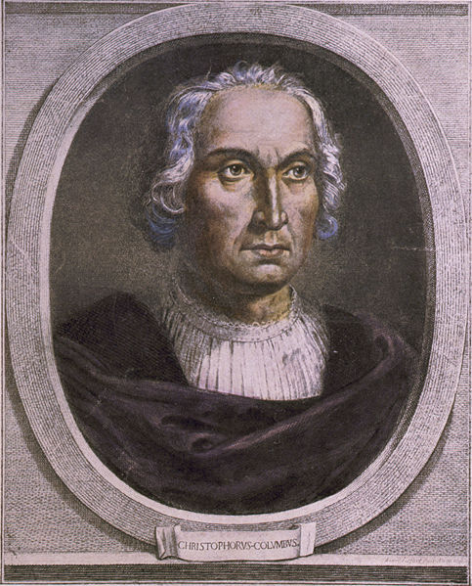
Spain
The story you have heard about Christopher Columbus was backwards. Columbus was the guy that had it wrong. There was a good reason that everyone laughed at him. Christopher Columbus wanted to sail west to Asia. It was an incredibly stupid idea. The leading navigators and scientists knew that the earth was round. But they also knew that Asia was much too far away to be reached by sailing west. Fifteenth century boats were incapable of making the journey…
AD 1450

Slide 12
Spain
If it hadn't been for the totally unexpected intervention of the Americas, Columbus and his crews would have died at sea somewhere southeast of Hawaii. Columbus had the facts all wrong. But Columbus's idea, wrong as it was, did get him out of a centuries-old rut. When he was finally given the resources to test his idea, he made a brilliant discovery . . .
AD 1450

Slide 13
Spain
It was not the discovery he wanted to make, or thought he had made, but it was still important. All bad ideas are potential 'Chris Concepts'. They may not be the solution you are looking for, but they could still carry you forward to a solution that no one has even imagined . . . Bad ideas, or Chris Concepts, are essential to developing good solutions. Innovation is rarely a direct line from problem to solution. The path to a great solution twists, turns, and doubles back. Along the way there are many failures that are essential to developing the final solution.
—Thorpe, Scott, How to Think Like Einstein,
Barnes & Noble Books, Inc., 2000, p. 47-49.
AD 1450

Slide 14
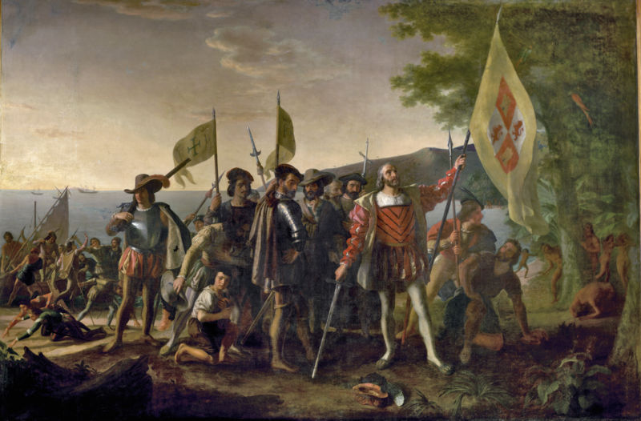
“Chris Concepts”
Can a person be creative even if their concept is wrong?
AD 1450

Slide 15
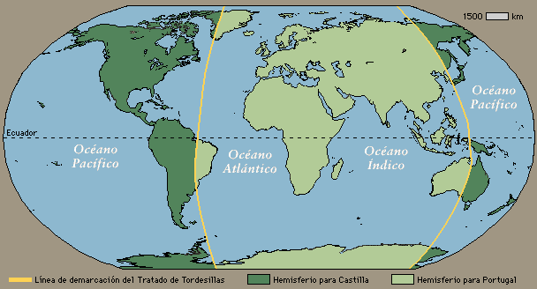
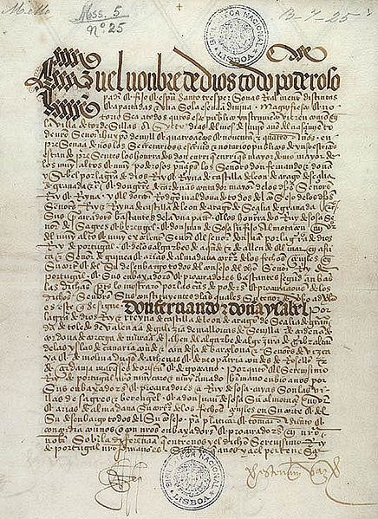
Spain and Portugal
Treaty of Tordesillas (Line of Demarcation)
AD 1450

Slide 16
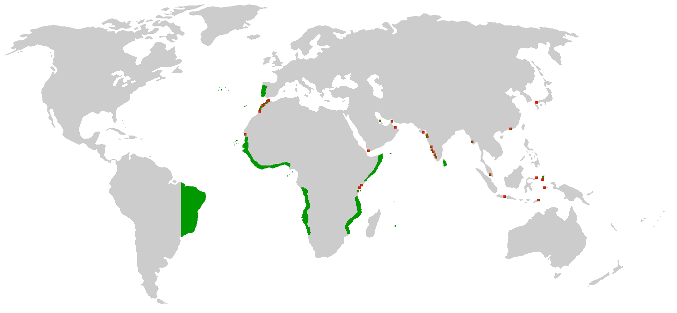
Portuguese Colonies
AD 1450

Slide 17
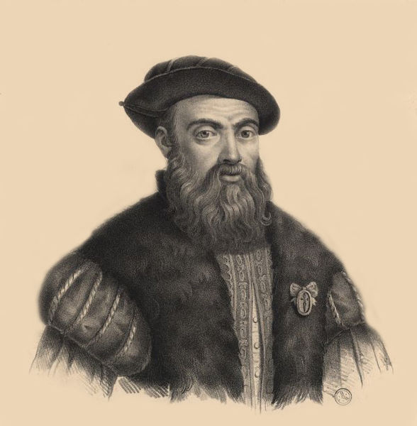
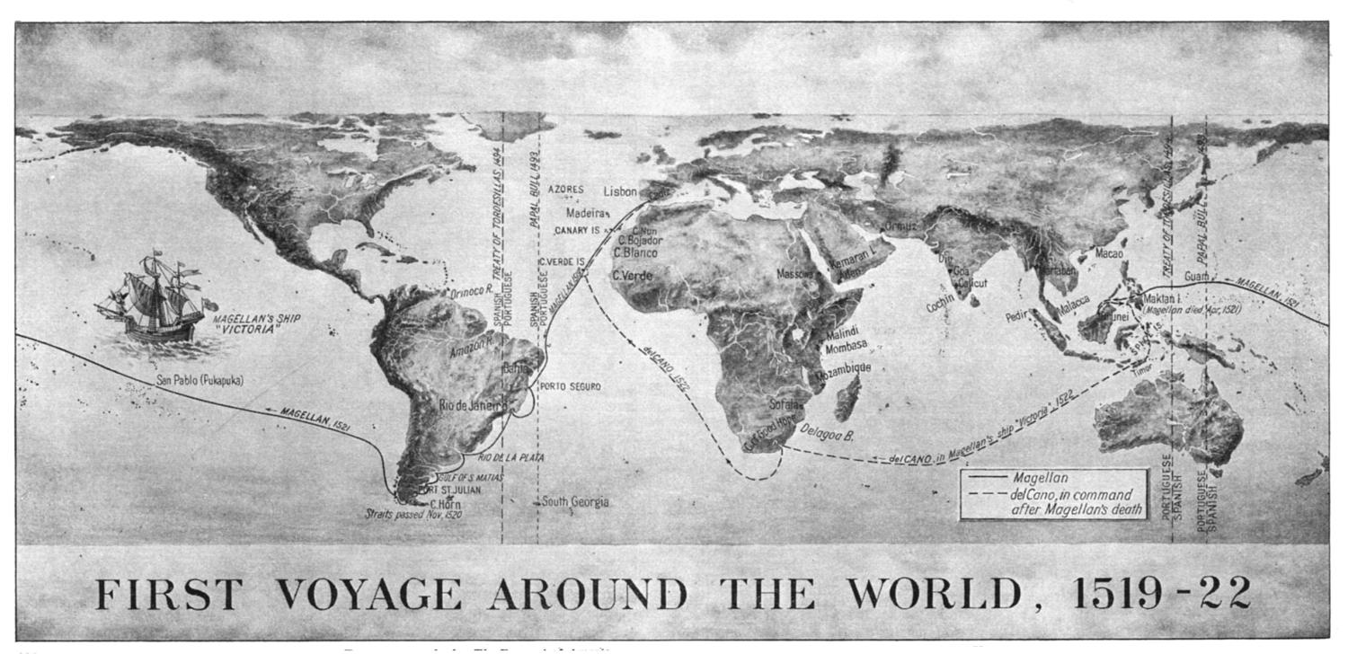
Spain
Magellan (trip = 1519-1522)
Portuguese; but lost favor with King
Didn’t claim the Philippines when he discovered it for Portugal
Established westward route around Cape Horn
Saved by bumping into Guam
Killed in Philippines
AD 1450

Slide 18
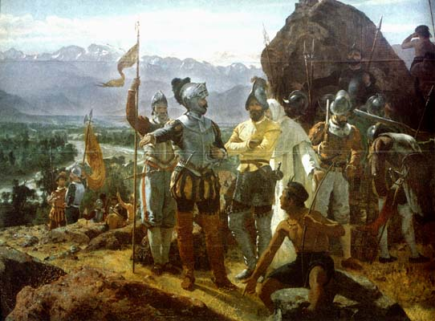
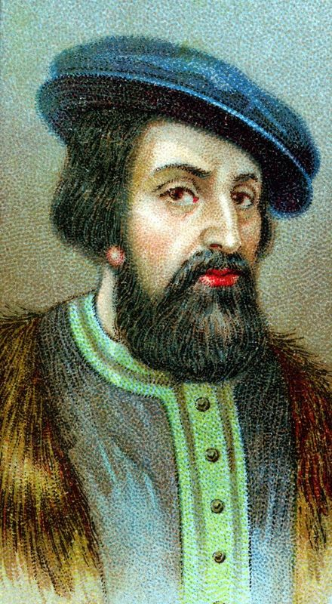
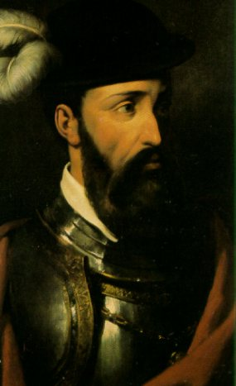
Spain
Conquistadores
Cortes defeated the Aztecs (Mexico)
Awe of firearms and horses
Surprise of violence and kidnapping
Quetzalcoatl
Pizarro defeated the Incas (Peru)
Learned from Cortes
AD 1450

Slide 19
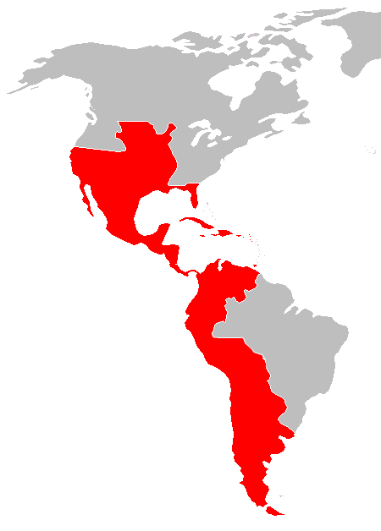
Spanish Colonies
Many cities of large population before
1600 with sophisticated infrastructure
AD 1450

Slide 20
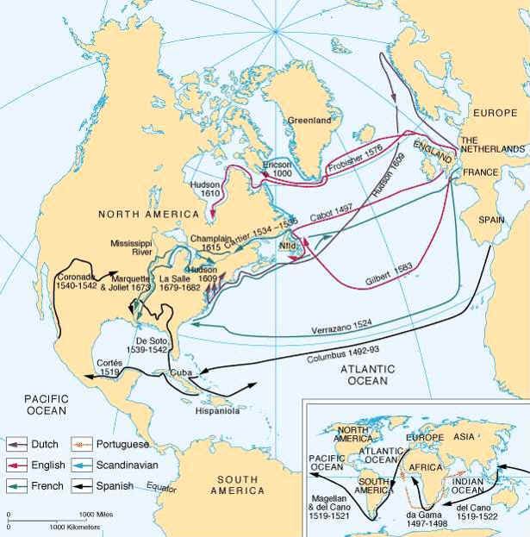
Northern European Countries: England and France
Started later
Looked for NW passage
North America
Traded rather than extracted
Privateers
Sir Francis Drake
AD 1450

Slide 21
Voyages of Discovery
Year Explorer Sponsor Area Explored
1418-1460 Various Portugal Madeira, Azores, west- African coast to cape Verde
1487-1488 Dias Portugal African coast to Cape of Good Hope
1492 Columbus Spain Bahamas, Santo Domingo
Columbus Spain West Indian Islands
1497-1498 Cabot England Newfoundland, Nova Scotia
1497-1499 da Gama Portugal Cape of Good Hope, Indian Ocean
1498 Columbus Spain Trinidad, Venezuela
1499 Vespucci Spain Northeastern coast of S. America
1500 Cabral Portugal Brazil, Indian Ocean to W. India
1502-1504 Columbus Spain Central American Coast
1519-1522 Magellan Spain First circumnavigation of globe, Cape Horn, Pacific Ocean
1524 Verrazano France American coast from Virginia to Newfoundland
1533, 1534 Cartier France Quebec, St. Lawrence River
1577-1580 Drake England Circumnavigation of globe, W. coast of N. and S. America

Slide 22
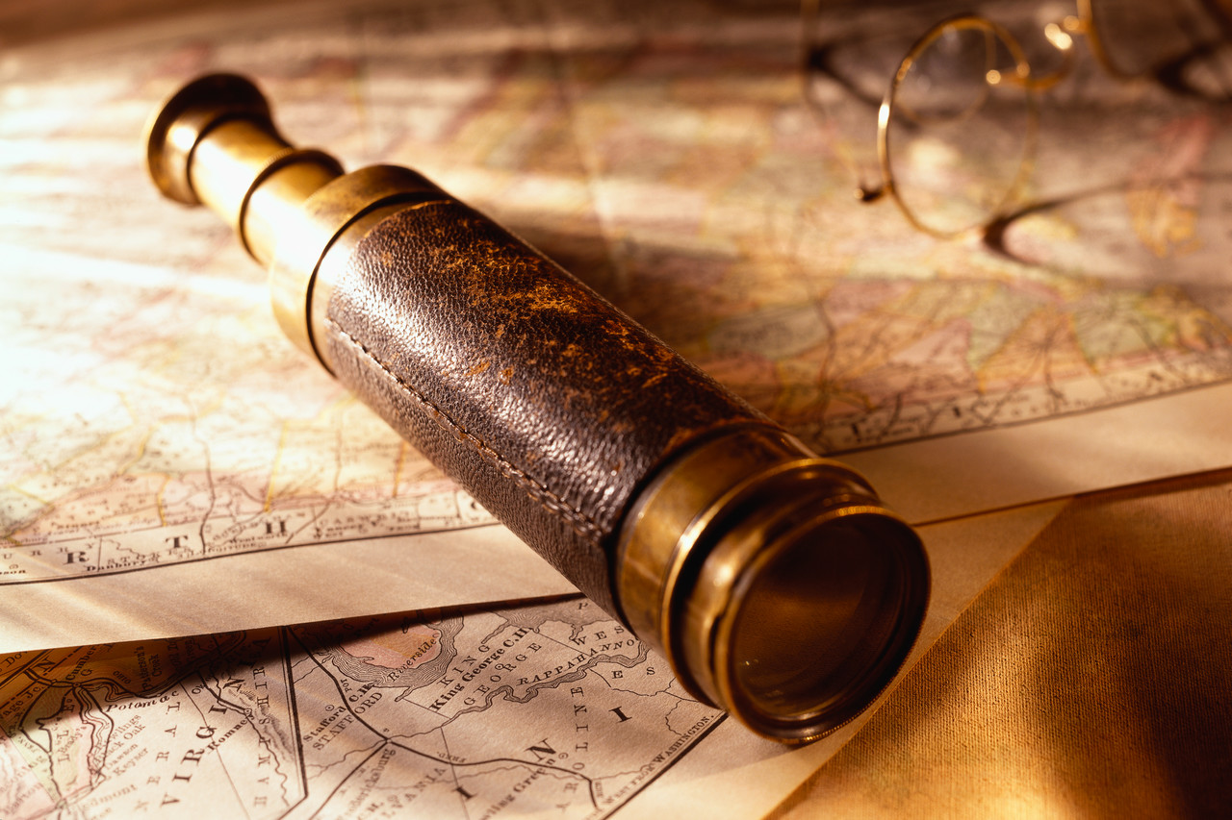
Discussion
Is discovery a creative act?
What were the motivations for exploration?
Was the discovery by Europeans good or bad for the native Americans?
AD 1450

Slide 23
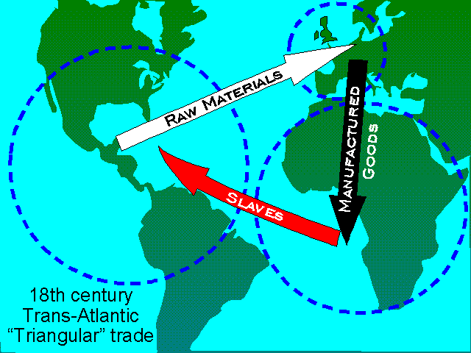
Slave Trade
AD 1450

Slide 24
Thank You
Creativity can
make you rich

