Slide 1
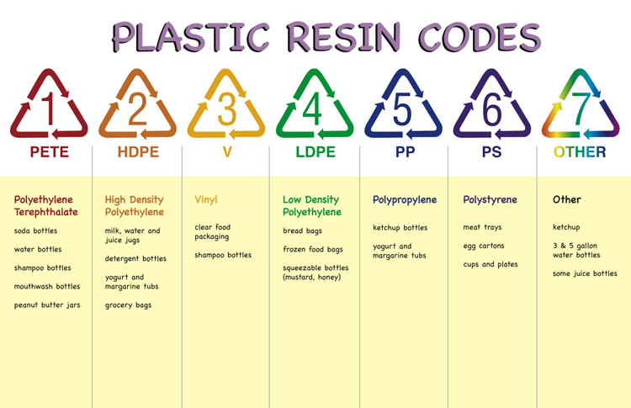
Environmental Aspects of Plastics
MFG 355

Slide 2
Garbage

Slide 3
Overview
Source Reduction
Recycling
Degradation
Landfill
Incineration
Regeneration
Total product life cycle
Future

Slide 4
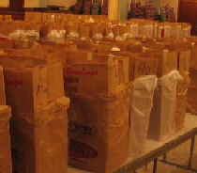
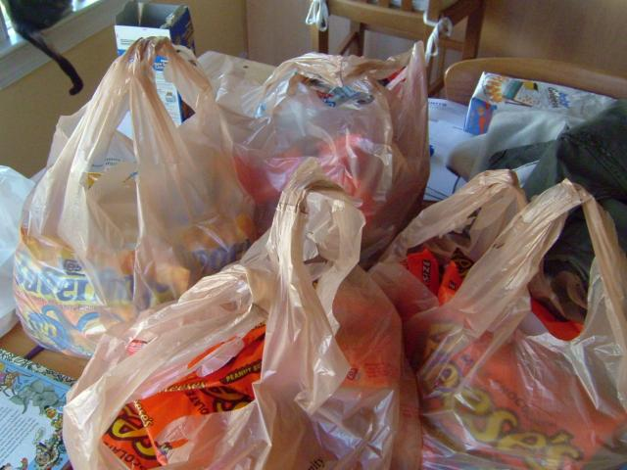
Source Reduction
Replacing bulky/heavy products with properly engineered, lighter, lower volume per part products
“In a comparison of the two types of grocery bags, Franklin Associates* concluded that the manufacture of plastic bags produced considerably less air pollution, water borne wastes, and industrial solid-waste than the manufacture of paper. Because plastic bags are lighter, they also produce less post-consumer solid waste, taking up less space in landfills. Researchers found that plastic sacks have these advantages even when grocery store clerks pack less in each bag, thereby using 1.5 or 2 times as many plastic bags to pack the same groceries as paper.” Brower, Michael & Leon, Warren (1999) The Consumer's Guide to Effective Environmental Choices - Practical Advice from the Union of Concerned Scientists, Three Rivers Press, New York, p. 132-133.

Slide 5
Reduction
 | Original | Current
Milk Jugs | 95 grams | 60 grams
Trash Bags | 3 mils | 1 mil

Slide 6
Paper or Plastic
Paper
1000 Grocery sacks of both
paper and plastic (to scale)
46 inches
Plastic
3.5 inches
Weight = 140 pounds
Weight = 15.6 pounds

Slide 7
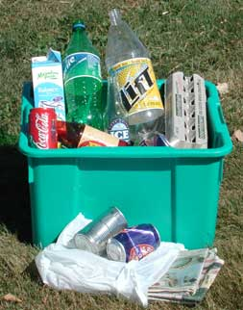
Recycling
Reprocessing and refabrication of a material that has been used and discarded by a consumer
Postcunsumer recycle (PCR)

Slide 8
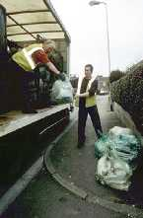
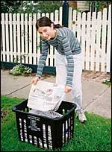
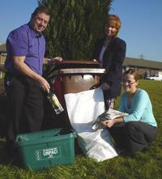
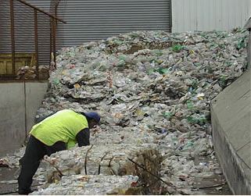
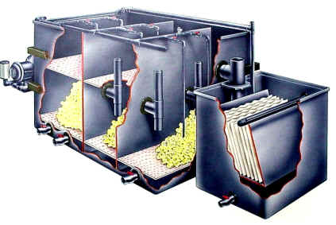
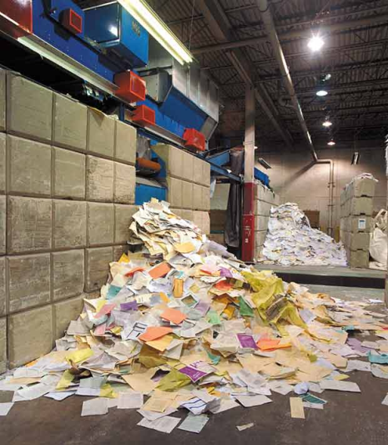
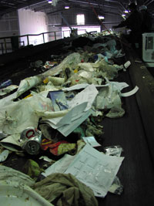
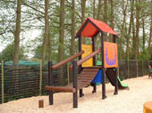
Recycling
Collection
Handling/Sorting
Reclamation/Cleaning
End uses

Slide 9
Recycling Problem

Slide 10
Degradation
Plastics that can break down into smaller molecules by natural means are degradable
Degraded byproducts are sometimes more dangerous than original product

Slide 11
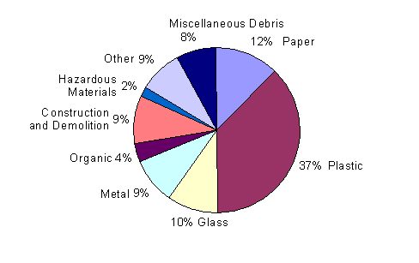
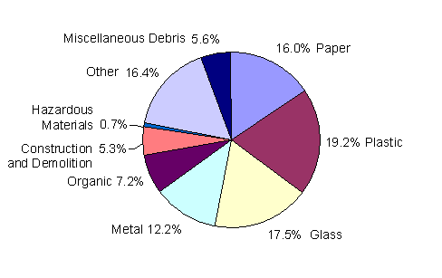
Waste Left to Degrade
Volume of waste found on Ohio’s roadside
Weight of waste found on Ohio’s roadside
“the total annual estimated roadside litter in Ohio for all road types and interchanges is 11,772 TONS!” http://www.dnr.state.oh.us/recycling/news/040716litterstudy.htm

Slide 12
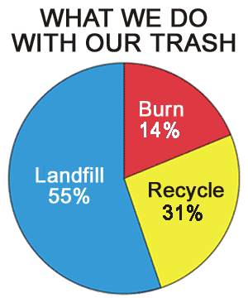
Where does it go?
Source: www.eia.doe.gov

Slide 13
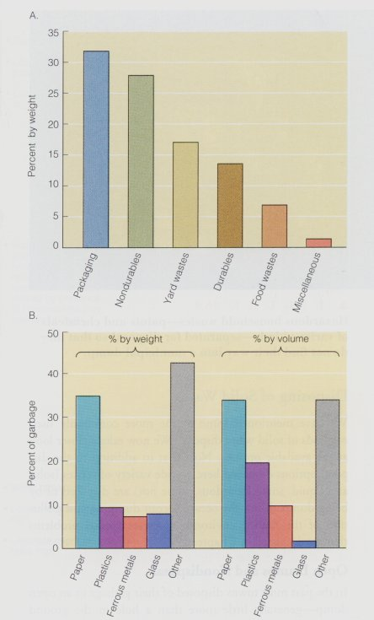
Landfill Waste

Slide 14
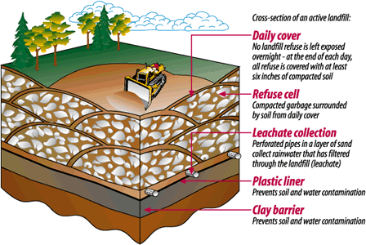
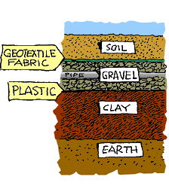
Landfills

Slide 15
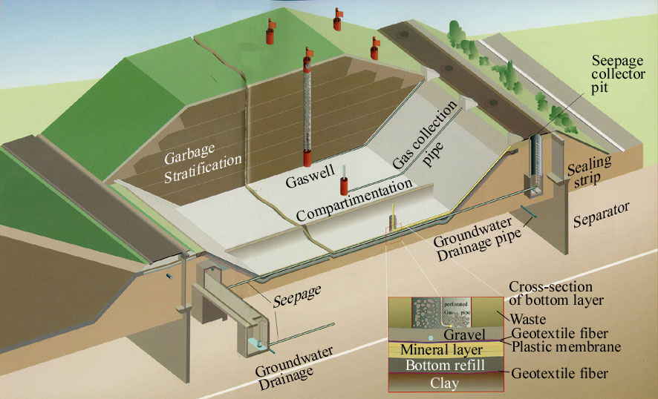
Landfills

Slide 16
Incineration
British Thermal Units (BTU) is the standard for measuring heat generated from incineration
Particulate Parts per Million (PPM) is one standard unit of measure to determine pollution when burning
MATERIAL | FUEL VALUE(BTUs)
Polyethylene | 19,900
Polypropylene | 19,850
Newspaper | 8,000
Fuel Oil | 20,900
Source: Data from Council on Plastics and Packaging in the Environment Waste to Energy Fact Sheet 1989
Air quality standards in the US are determined by the EPA and in accordance with international treaties. Any kind of incinerator must comply with these regulations

Slide 17
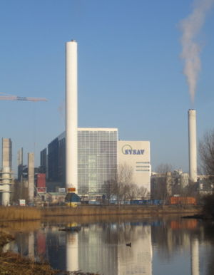
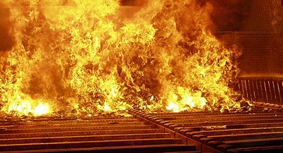
Incinerators
SYSAV incineration plant in Malmö, Sweden capable of handling 25 tonnes per hour household waste. (March 2007).
Inside a “moving grate incinerator”.

Slide 18
Regeneration
Breaking down the polymer molecules in the plastic in the basic chemicals
The chemicals are then used to create new polymers

Slide 19
Total Product Life Cycle
Item | Detail | Paper Cup | Plastic Cup
Raw mat'l | Wood, oil | 25g | 3.4g
Finish wt |  | 10.1g | 1.5g
Utilities | Steam, etc | 10,000kg | 5,000kg
Water | Volume | 100m³ | 3m³
Air | Emissions | 13kg | 40kg (pent.)
Recycle | Consumer | Difficult | Easy
Heat content | Incineration | 20MJ/kg | 40MJ/kg

Slide 20
Total Product Life Cycle
Energy Requirements to manufacture a grocery bag
 | Paper Bag | Plastic Bag
Energy required for 0 recycle | 16.2 | 9.8
Energy required for 100 recycle | 9.8 | 7.0

Slide 21
Total Product Life Cycle
Where do we look for production materials
How can we plan/engineer products so that they can be more readily reused/recycled/regenerated
Think ahead

Slide 22
Future
Rational analysis of each product type and its own particular use
Be open to suggestions from environmental lobbyists
Put aside emotional issues in favor of reasoned positions based on scientific principles

Slide 23
Thank You

