Slide 1
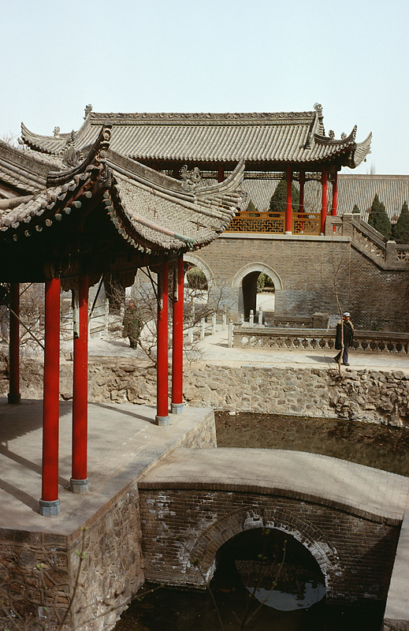
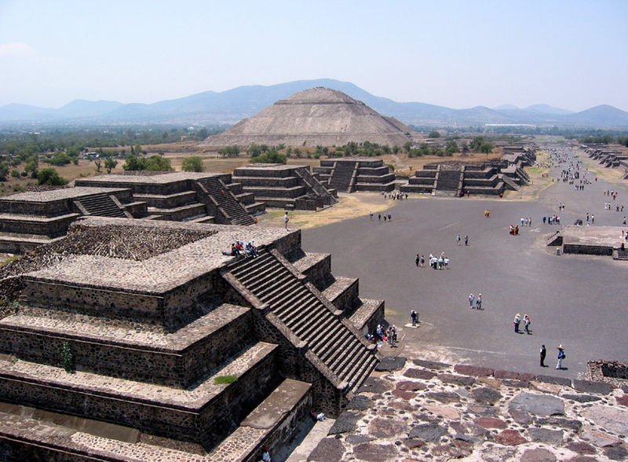
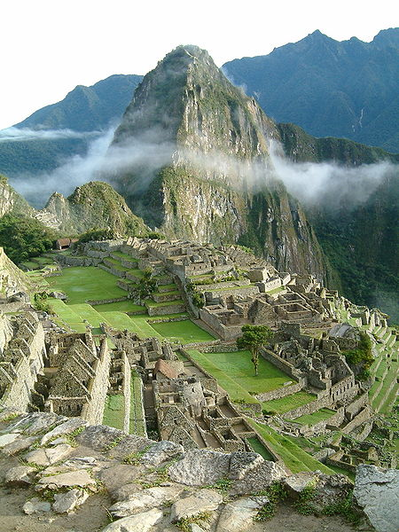
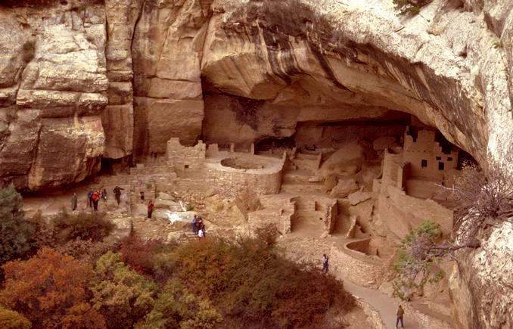
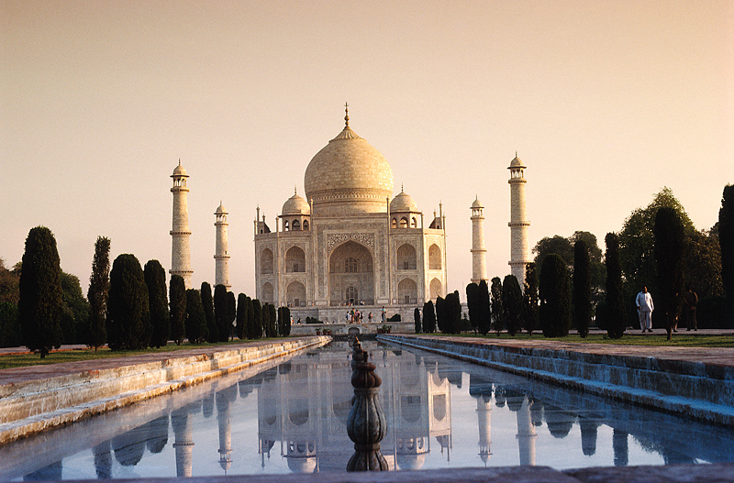
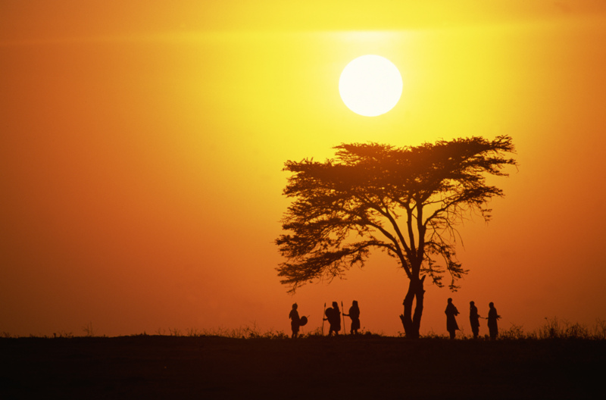
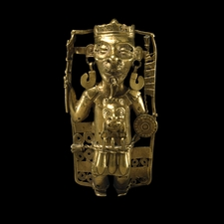
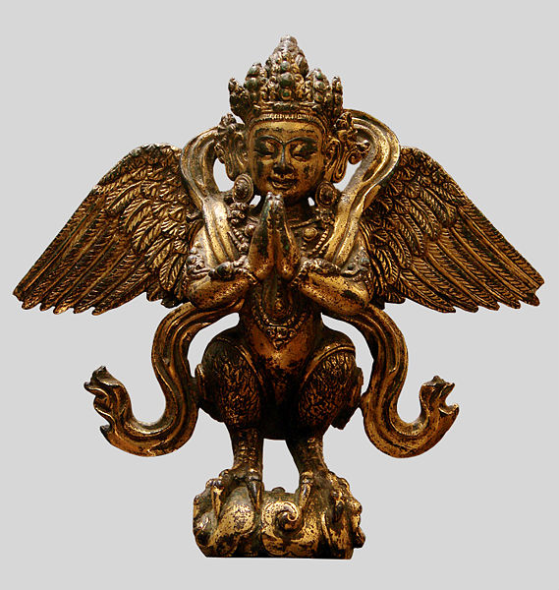
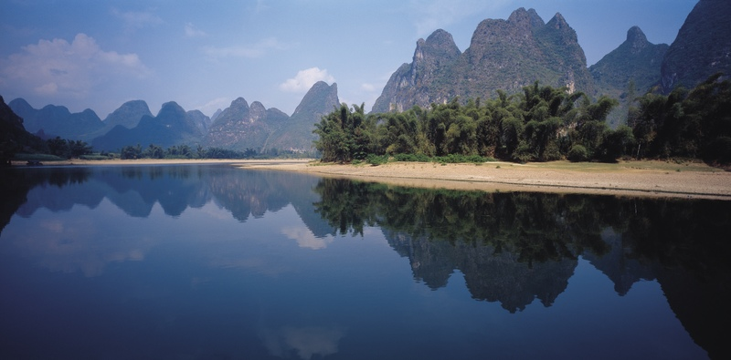
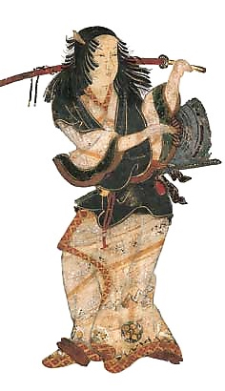
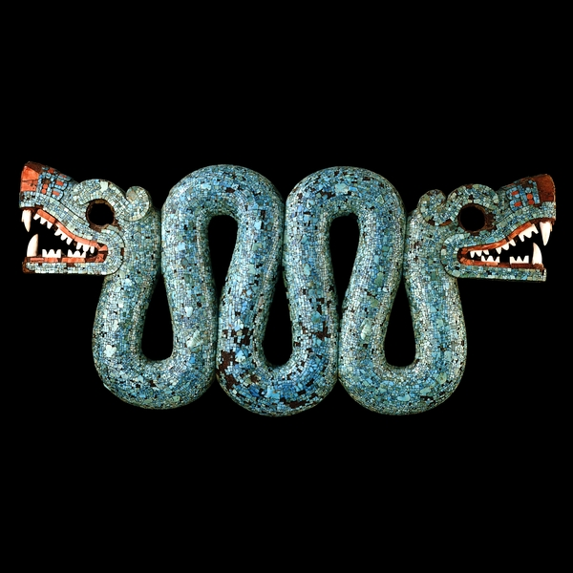
The Discovered World
Unknown Creativity

Slide 2
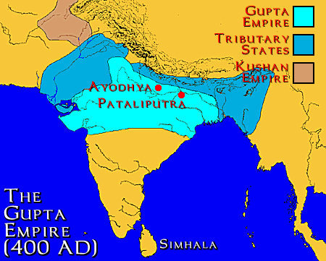
India
Gupta Empire (AD 320-535)
Major Hindu epics were written
Mahabharata
Ramayana
Persecution of Buddhists
Last Hindu rulers over India until modern times
AD 1450

Slide 3
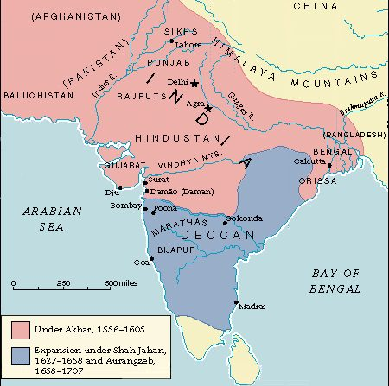
India
Muslim involvement
Delhi sultanate (11th C)
Delhi named the capital
Majority continued as Hindus
Mughal dynasty (1526)
Expansion under Shah Jahan
AD 1450

Slide 4
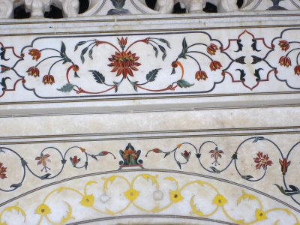
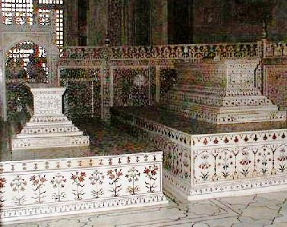
Taj Mahal
AD 1450

Slide 5
Taj Mahal
AD 1450

Slide 6
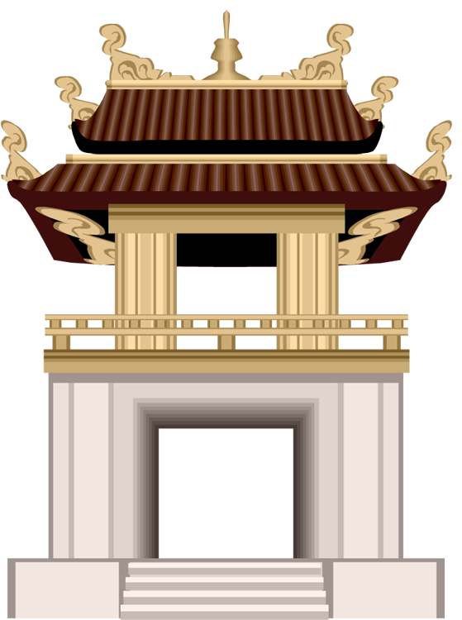
China
Pre-Middle Ages
Qin Dynasty
Han Dynasty
Middle Ages
Tang Dynasty
Song Dynasty
Yuan Dynasty
Ming Dynasty
AD 1450

Slide 7
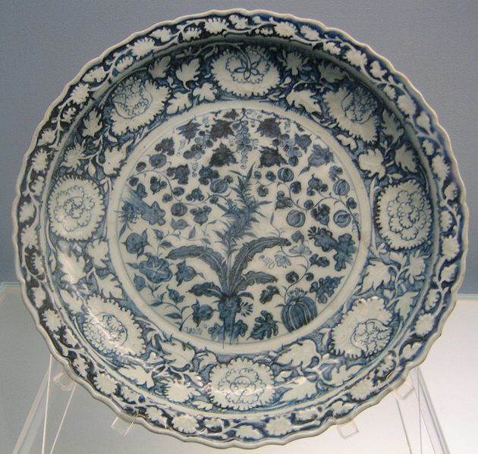
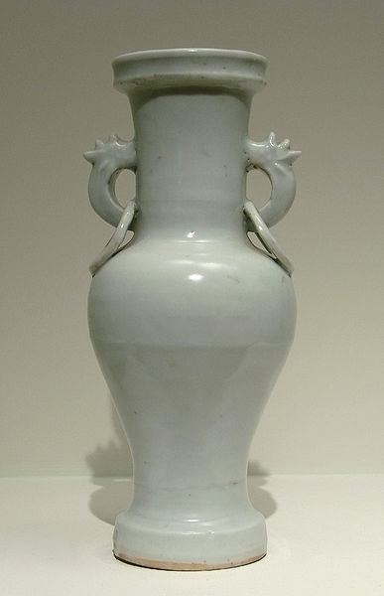
Yuan Dynasty (1260-1368)
Mongol conquerors
1st time non-Han people ruled
Capital moved to Beijing
Natives distrusted the Mongols
Economic and diplomatic difficulties
AD 1450

Slide 8
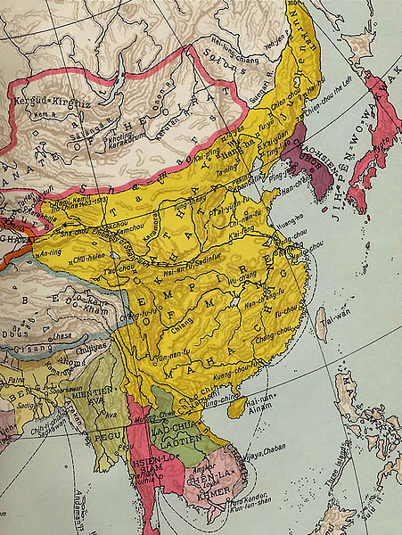
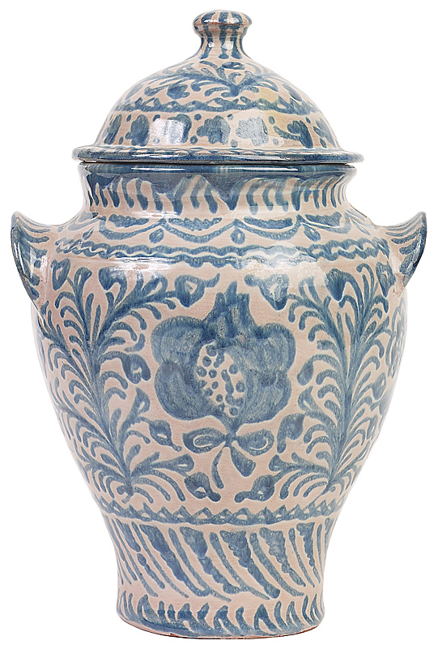
Ming Dynasty (1368-1644)
Native Chinese
Wanted to keep China free from invasion ― expand wall
Kept capital at Beijing
Built the Forbidden City
Merchants were given prestige
Comparable with European Renaissance
Ming
Empire
AD 1450

Slide 9
Ming Dynasty—Forbidden City
AD 1450

Slide 10
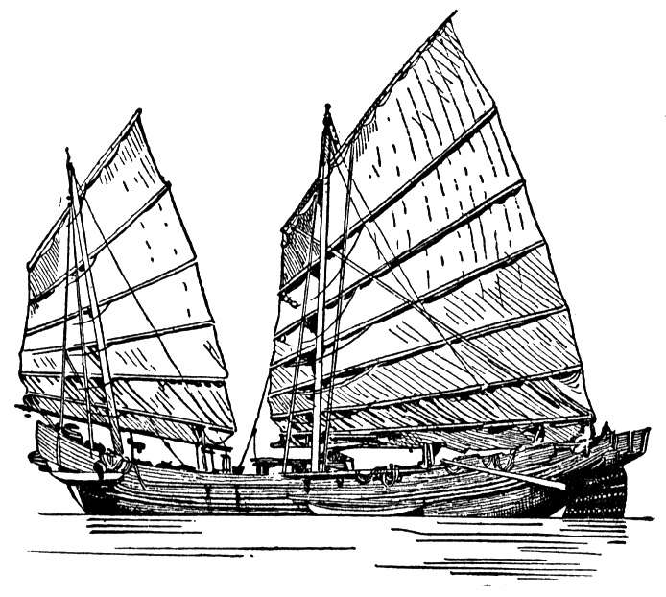
China—Isolation
Chinese fleet toured to India, Africa and the Middle East.
The admiral found no culture as advanced as the Chinese
When the fleet returned, the emperor decided to abandon trade because the Chinese didn't need anything from another country.
The fleet was destroyed.
China entered an extended period of isolation.
AD 1450

Slide 11
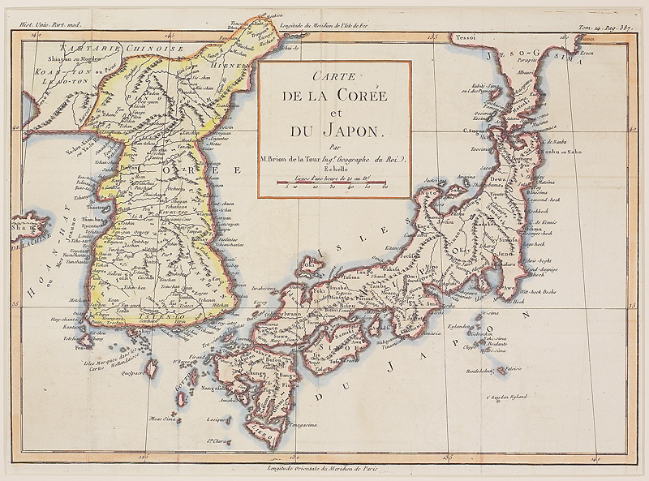
Japan
Between the ancient period and 1500
AD 1450

Slide 12
Japan
Settled by people from Korea
Culture (language, writing, early customs, religion) came from China.
Attempted invasion by the Yuan Dynasty (Mongols under Kublai Kahn).
Japan saved by a typhoon (Kamikaze)
Japan developed a class (stratified) society with Samurai at the highest level.
Samurai believed that honor was the highest good.
AD 1450

Slide 13
Samurai Death
AD 1450

Slide 14
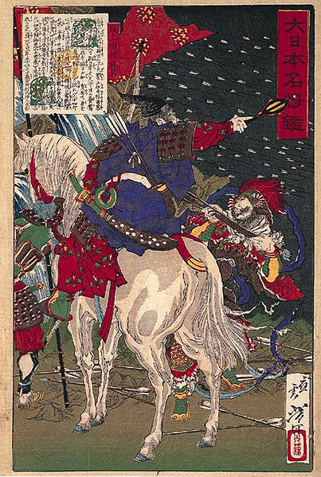
Japan
Muromachi-Momoyama Period (1333-1603)
Shoguns (heads of all the lords) ruled from near the emperor in Kyoto.
Portuguese introduced Christianity and firearms.
Christians persecuted and expelled because they introduced a change in Japanese culture.
AD 1450

Slide 15
Japan
Edo Period (1603-1868)
The shogun moved the government from Kyoto to Edo (present-day Tokyo) .
Separated from the immediate vicinity of the emperor
This further decreased the emperor's power
Ceremonies and arts flourished during the period of peace brought about by the strong shoguns of this period.
Over 85% of the population of Edo was literate.
Drama (Kabuki) was very popular.
AD 1450

Slide 16
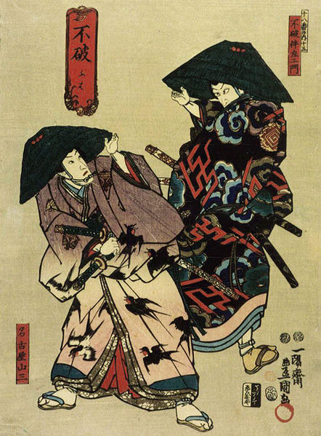
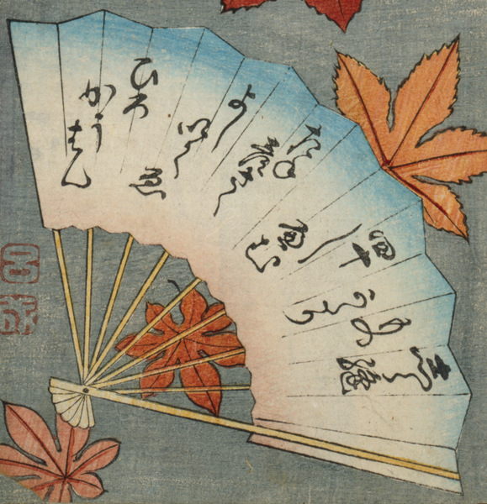
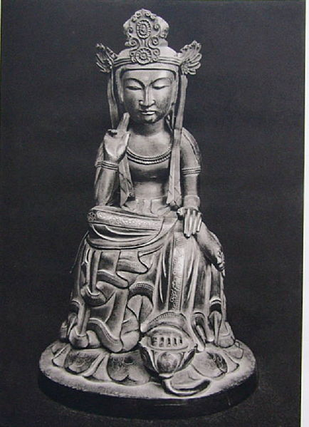
Japan: Isolation
The shogun wanted to maintain Japan’s high level of art and sophistication.
The shogun decided that isolation was the best way to ensure that Japan remained unique.
AD 1450

Slide 17
Japan: Isolation
AD 1450

Slide 18
Japan: Problems
Isolation maintains the purity of the culture but also freezes the culture in the past.
Compare to Egypt and China
Egypt froze because of religion.
China froze because they were more advanced and did not anticipate that others would catch up.
AD 1450

Slide 19
Japan: Isolation Problems
AD 1450

Slide 20
Japan: Modern World
Forces from the modern world inevitably impinged upon Japan.
Japan was in a dilemma—
Open their ports so that they could learn of the advances of the modern world
Or
Remain closed and suffer invasion
AD 1450

Slide 21
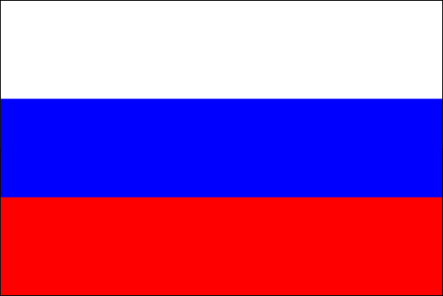
Japan: Modern World
Three western nations threatened Japan.
Russia England United States
The United States needed trade with Japan to secure coal and whales (for oil).
The first nation to establish trading rights would likely dominate Japanese trade.
Japan was unable to deal with the threat creatively.
AD 1450

Slide 22
Japan: Modern World
AD 1450

Slide 23
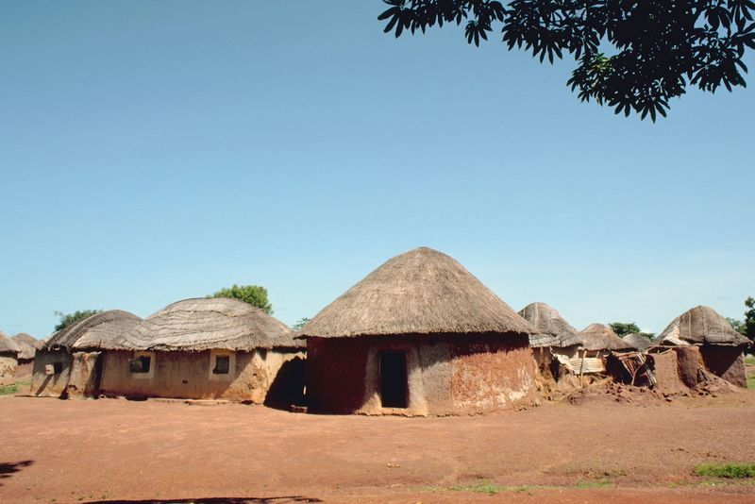
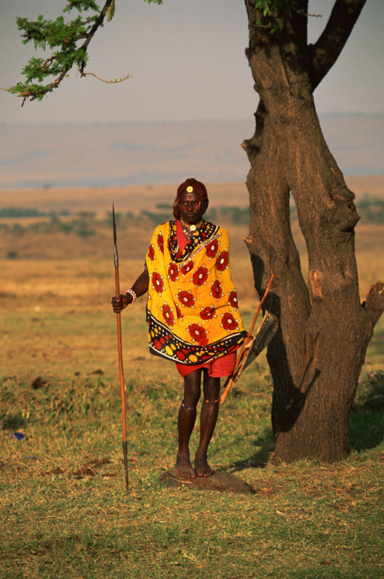
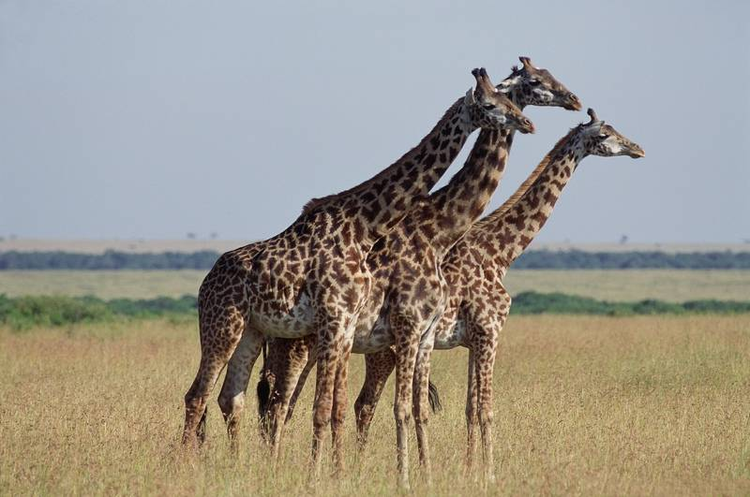
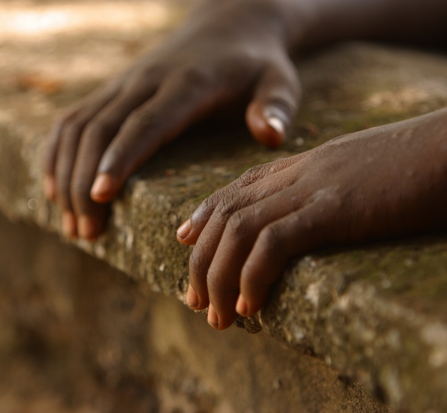
Africa
Between the ancient period and AD 1500.
AD 1450

Slide 24
Africa
Black-white interactions have changed over the centuries.
Originally the whites depreciated all black culture.
"There is no African history"
Whites discovered historical locations and tried to attribute them to whites.
This attitude justified white domination of Africa.
Whites learned to co-exist and then to cooperate.
Whites recognized their need to assist Africans.
AD 1450

Slide 25
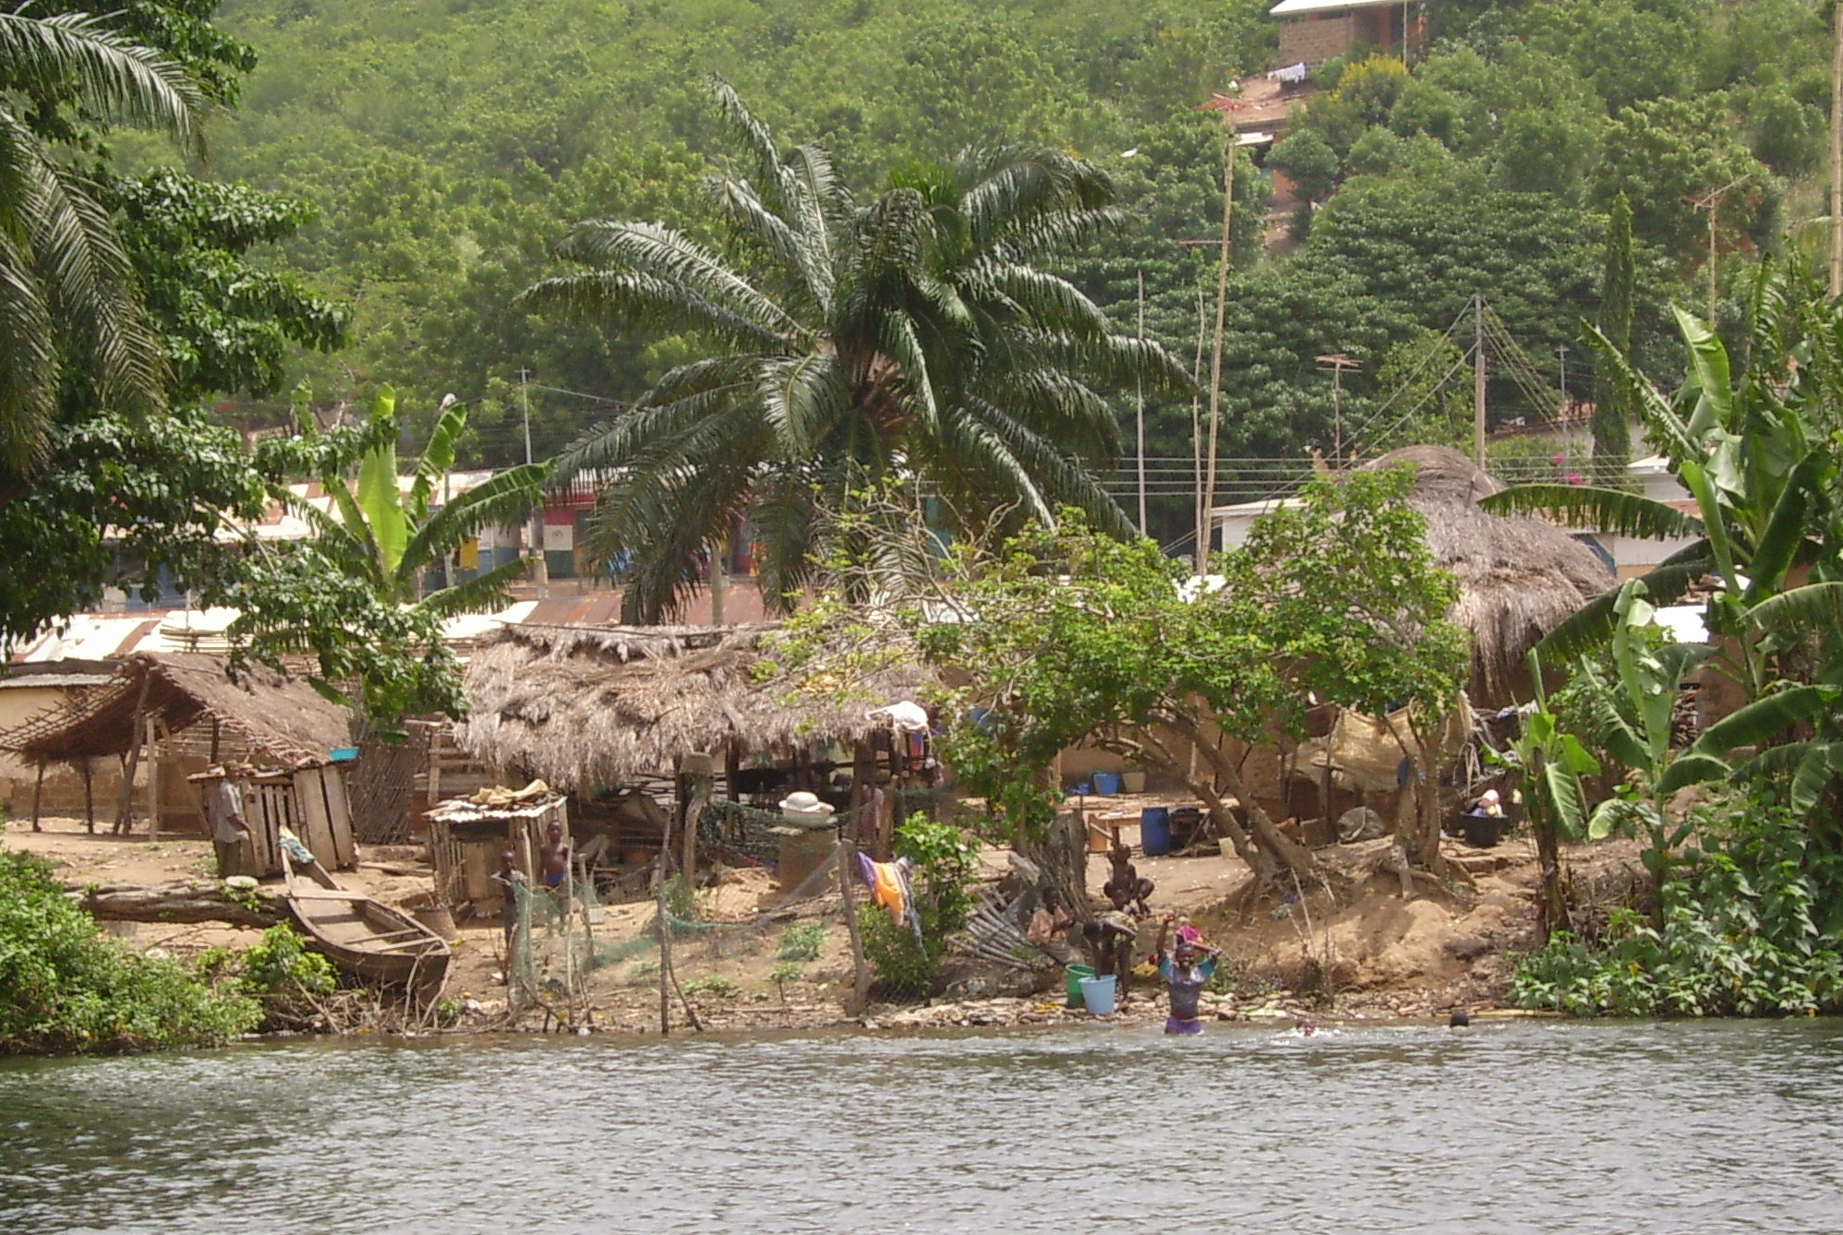
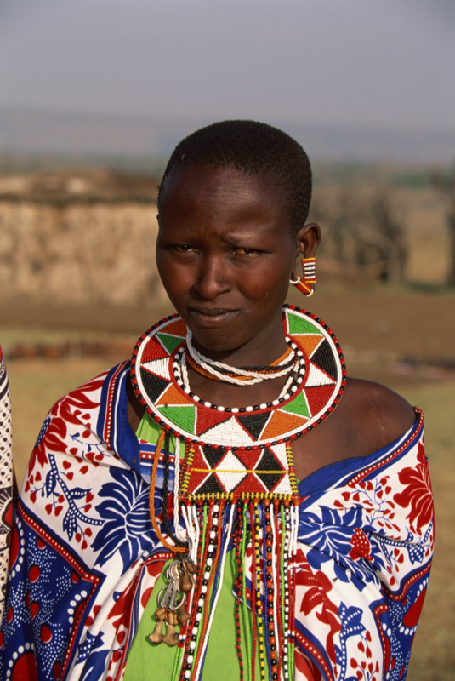
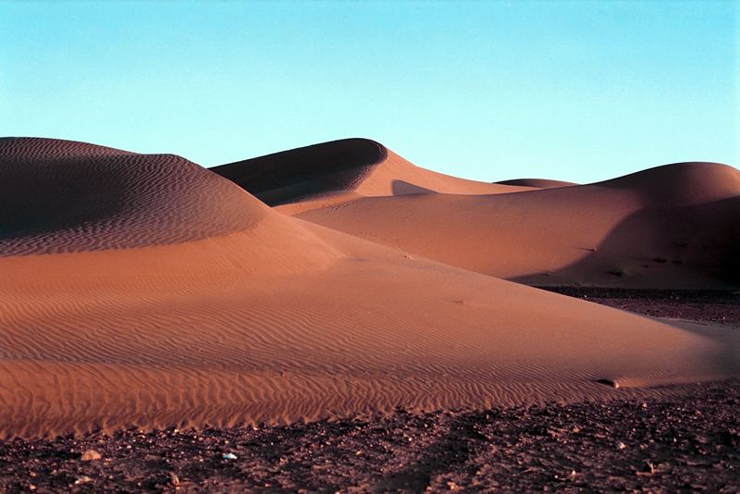
Africa
Unification of Africa was difficult.
Forested areas
Geographical isolation
History is largely lost because of oral traditions.
AD 1450

Slide 26
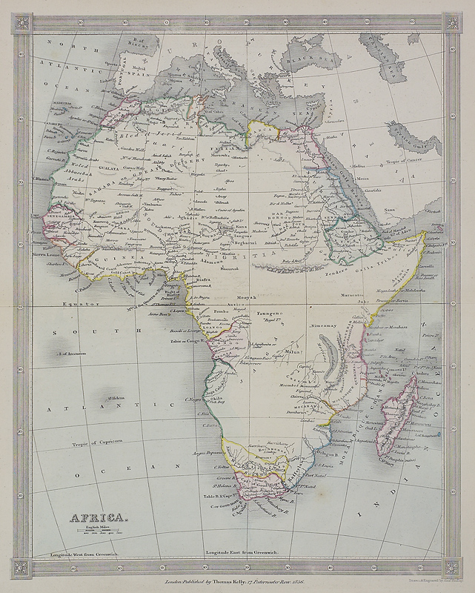
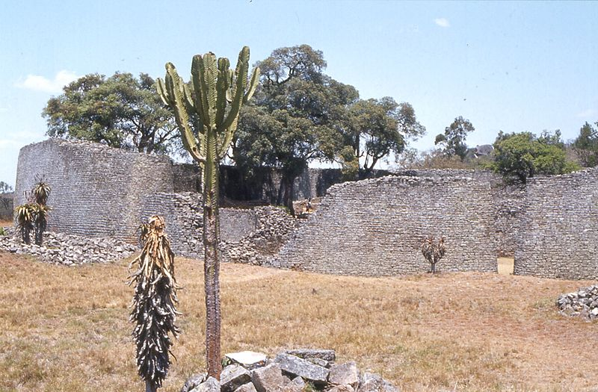
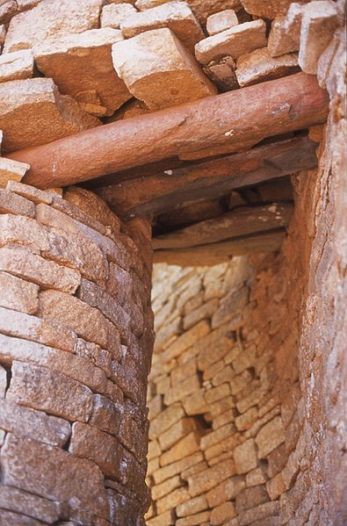
Great Zimbabwe
One of the major areas of southern Africa
Dated: AD 1000 to 1400
AD 1450

Slide 27
Great Zimbabwe
AD 1450

Slide 28
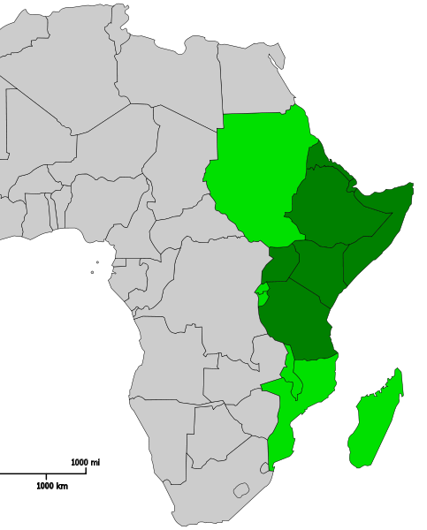
Africa
East African cultures
Strong Muslim influence
Swahili tribes
Dominated by Portuguese after Vasco da Gama.
SUDAN
ERITREA
DJIBOUTI
ETHIOPIA
SOMALIA
RWANDA
KENYA
BURUNDI
TANZANIA
KENYA
AD 1450

Slide 29
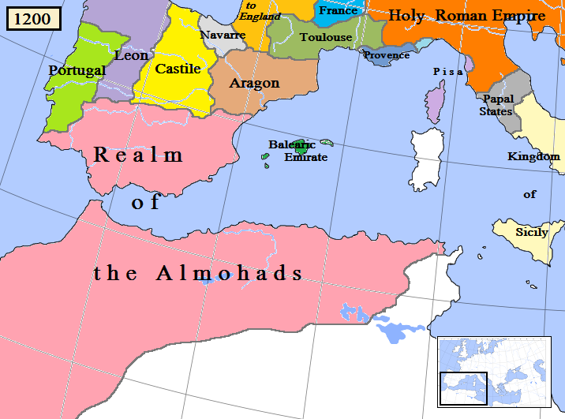
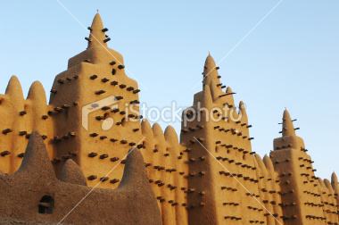
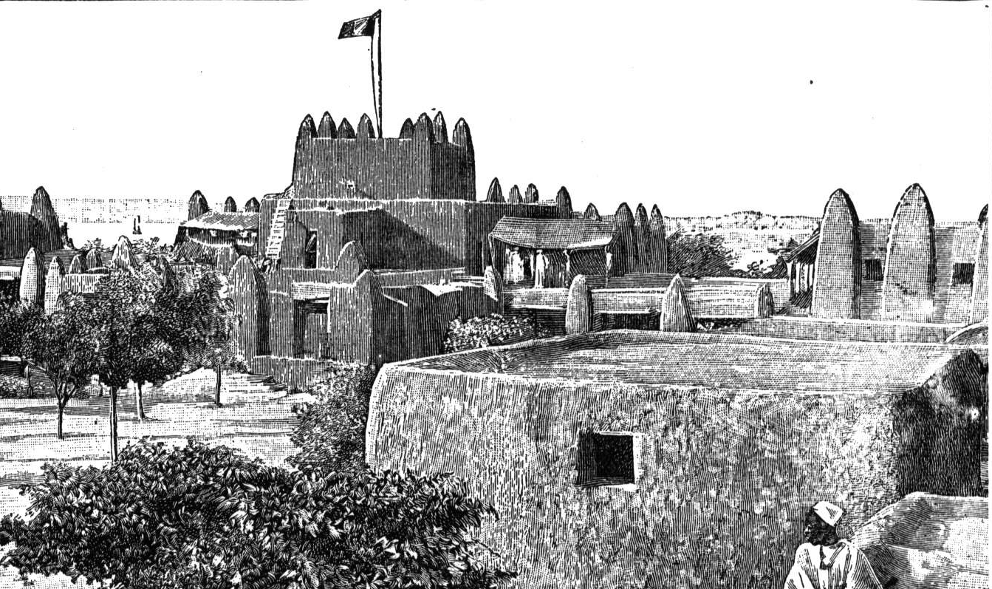
Africa
North African Culture
Conquered by Muslims in AD 650
Timbuktu was a major trading center.
Sub-Saharan trade
AD 1450

Slide 30
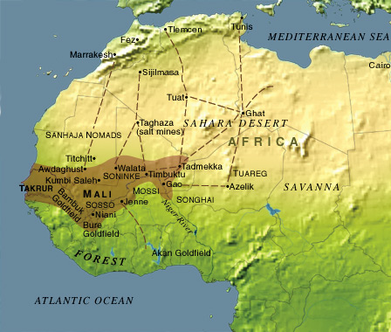
Africa
West African Culture
Began around Senegal River
Power through trade
Gold, hides, ivory, pepper and slaves
Expanded into central Africa by river and trail
Moved southward following minerals and trade goods (e.g. Gold Coast and Ivory Coast)
AD 1450

Slide 31
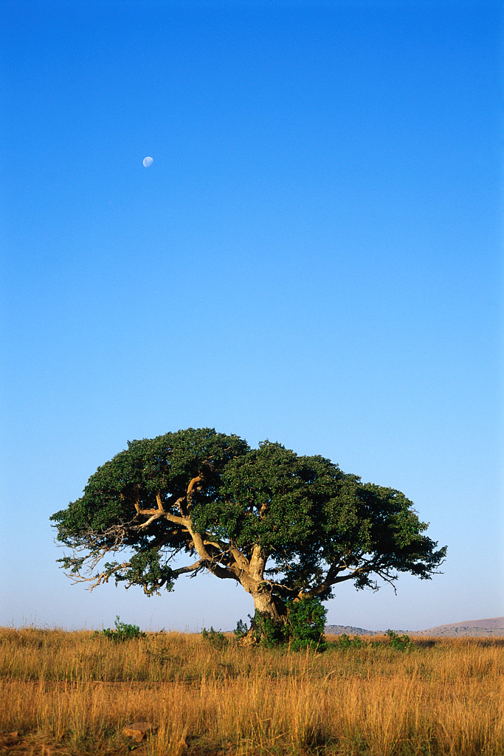
Africa
Prejudices made change difficult
Some people overcame those prejudices and established a basis for cooperation
Example: Cry, the Beloved Country
Cry,
The Beloved Country
Alan Paton
AD 1450

Slide 32
Africa
A white, South African, rancher’s son is a wonderful humanitarian serving blacks in Africa.
He is killed, inadvertently, during an attempted robbery by a black, South African minister’s son.
The fathers live in the same vicinity but the white father does not know the linkage of the killer with the black minister.
Cry,
The Beloved Country
Alan Paton
AD 1450

Slide 33
Cry, The Beloved Country
AD 1450

Slide 34
Cry, The Beloved Country
AD 1450

Slide 35
BYU Manufacturing Project
AD 1450

Slide 36
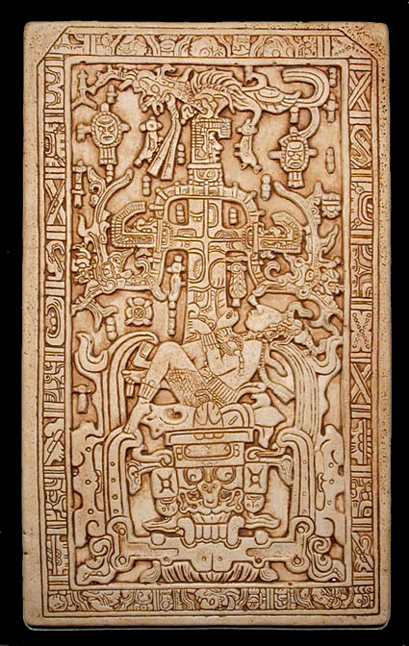
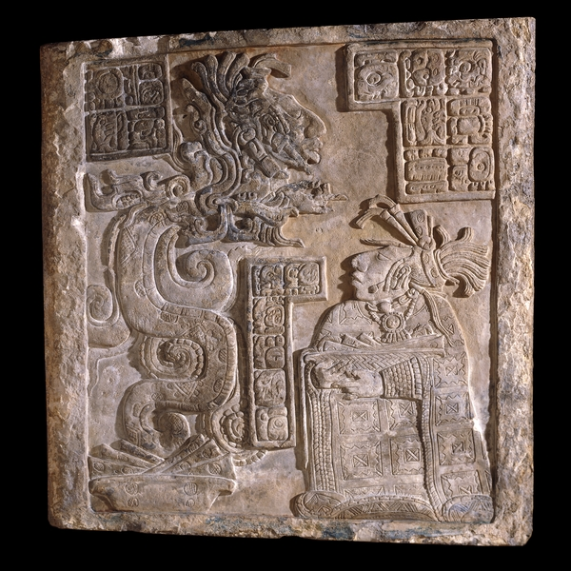
Pre-Columbian America
AD 1450

Slide 37
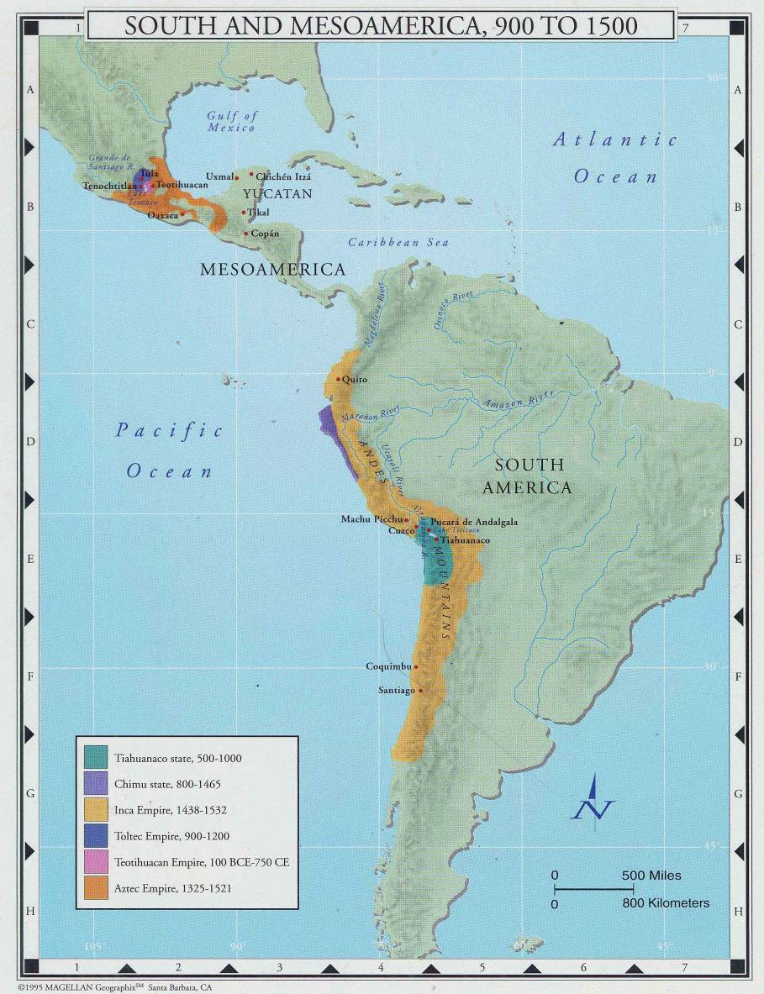
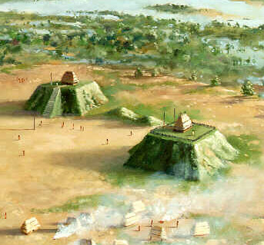
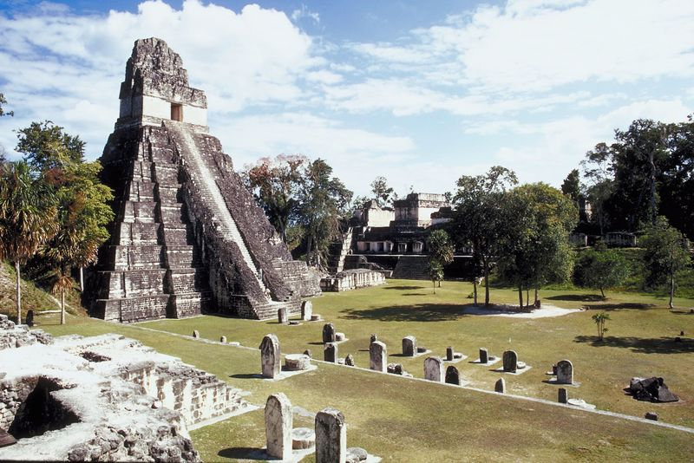
General
Areas of civilization
North America
Meso-America
South America
Civilization
Sophisticated cities and agriculture
North
Meso
South
AD 1450

Slide 38
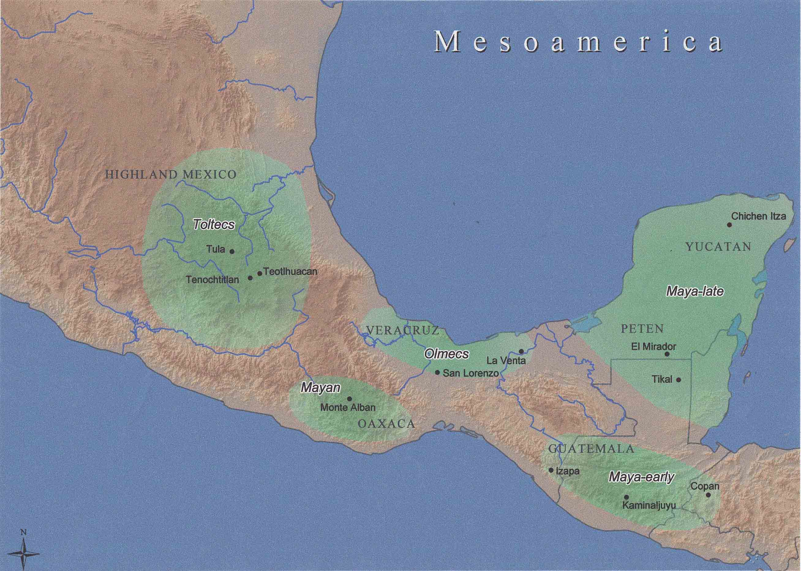
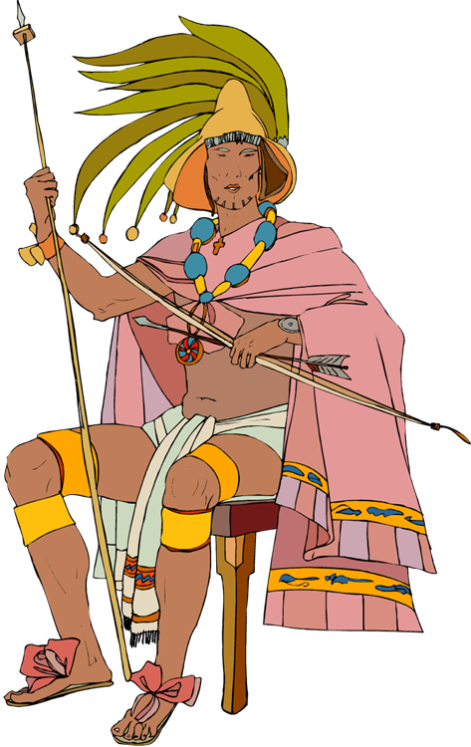
Meso- America
AD 1450

Slide 39
Mayans
Precursor civilization dated from 2000 BC
Mayans date from 500 BC
Isolated city states
Division of Labor
Commerce
Crushed Limestone Roads
Intensive irrigation
Abandoned about AD 900
AD 1450

Slide 40
Maya: General
AD 1450

Slide 41
Classic Mayan Period
Written language
Hieroglyphics
Idea and Phonetic-syllabic writing
Rebus and logographs
AD 1450

Slide 42
Mayan Science
Astronomy
Eclipses, solstices
Orbit of Venus
Calendars
Solar (365 days)
260 day lunar calendar
Long count
Mathematics
20-based
Positional Notation
Zero
AD 1450

Slide 43
Classic Maya Period (AD 250-900)
Architecture
Many rooms
No arches
Corbelled vaults
Fortified with ditches
Long masonry causeways
Aligned with astronomy
AD 1450

Slide 44
Mayan Blood Rite
Drawing blood and inflicting pain were part of the religion.
King performing blood rite on the queen
AD 1450

Slide 45
Maya: Architecture
AD 1450

Slide 46
Teotihuacan
Teotihuacan
“Place where men become Gods”
Trade and irrigation
Strong military
Pyramids and religious edifices
Largest pyramid in Mesoamerica
AD 1450

Slide 47
Mayans Today
Indigenous Languages
Dress
AD 1450

Slide 48
Mayans Today
Toltecs
Nahua-speaking people from North
Chichen Itza—Merge of Toltec and Maya religion and society
Quetzalcoatl was principal God
AD 1450

Slide 49
Maya Classical Period
Aztecs
Nomadic tribe from the north
Conquered Toltecs
Built capital (Tenochtitlan)
200,000 people
Site of Mexico City
Strongly religious
Human Sacrifice
Cortez conquered
AD 1450

Slide 50
South America
Peru
Nazca
Incas
Cuzco—capital
Machu Picchu
25,000 miles of foot roads
Conquered by Pizarro
AD 1450

Slide 51
Machu Picchu
AD 1450

Slide 52
Pacific/North America
Polynesians
Kon Tiki showed feasibility of travel
Southwest (Anasazi)
Houses (pueblos)
Sophisticated irrigation
Mississippi Basin
Hunter gather
AD 1450

Slide 53
How the Europeans conquered
Disease
Technology
Belief that Europeans were returning gods
Capture of divine kings
Conversion to the “stronger” god (Christianity)
Lack of internal unity
AD 1450

Slide 54
Discussion
What was the greatest contribution of the native Americans?
Why did the Europeans depreciate the creativity of the Native Americans?
What type of civilization would exist in America today without European contact?
AD 1450

Slide 55
Thank You

