Slide 1
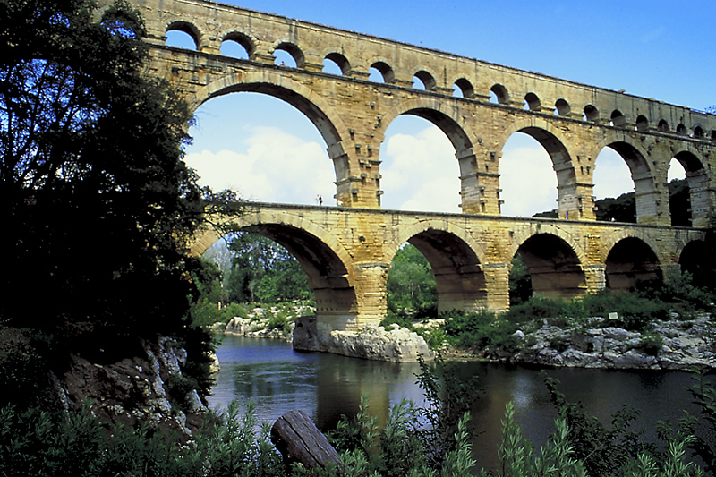
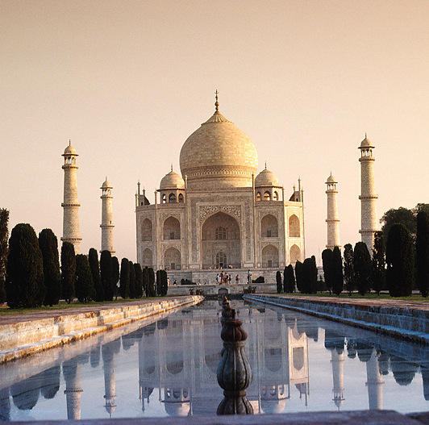
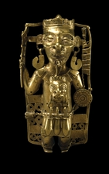
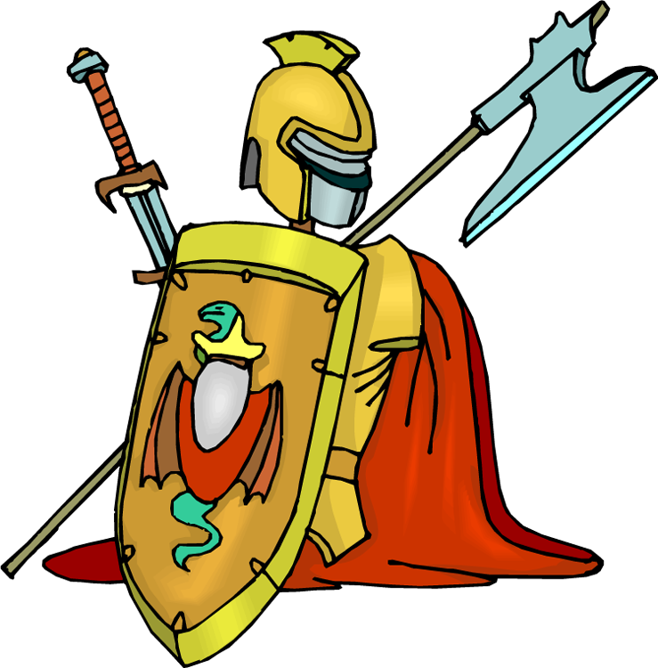
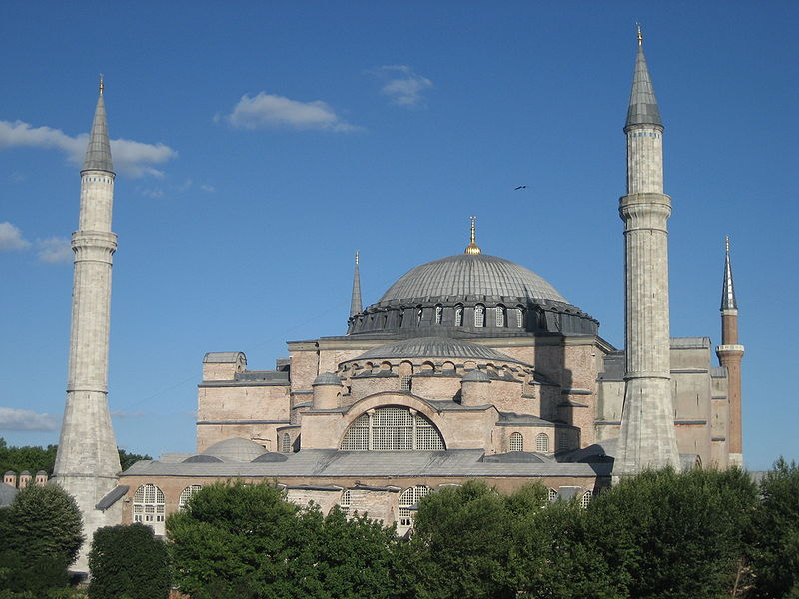
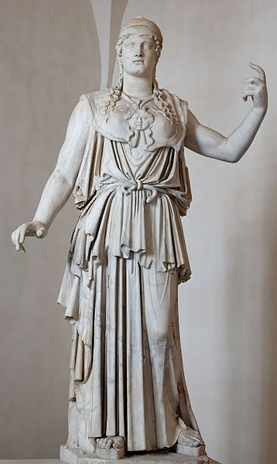
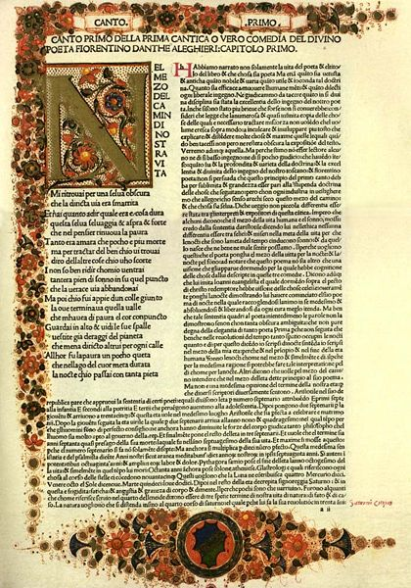
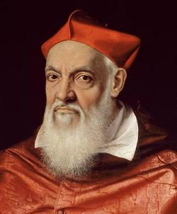
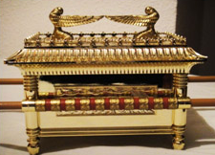
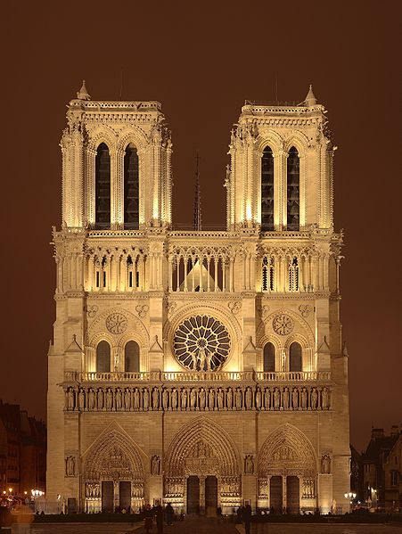
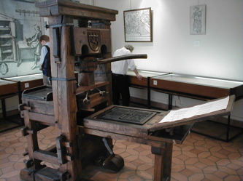
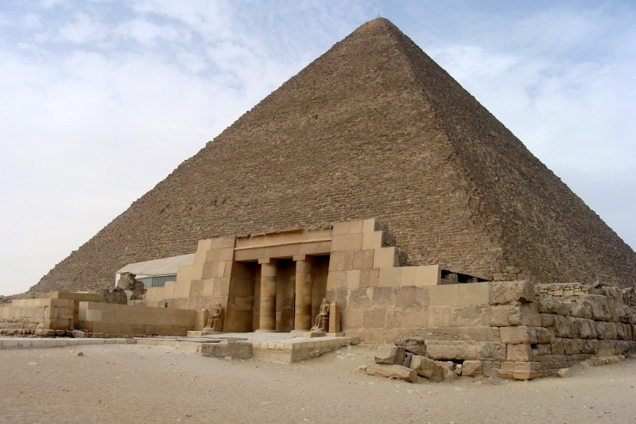
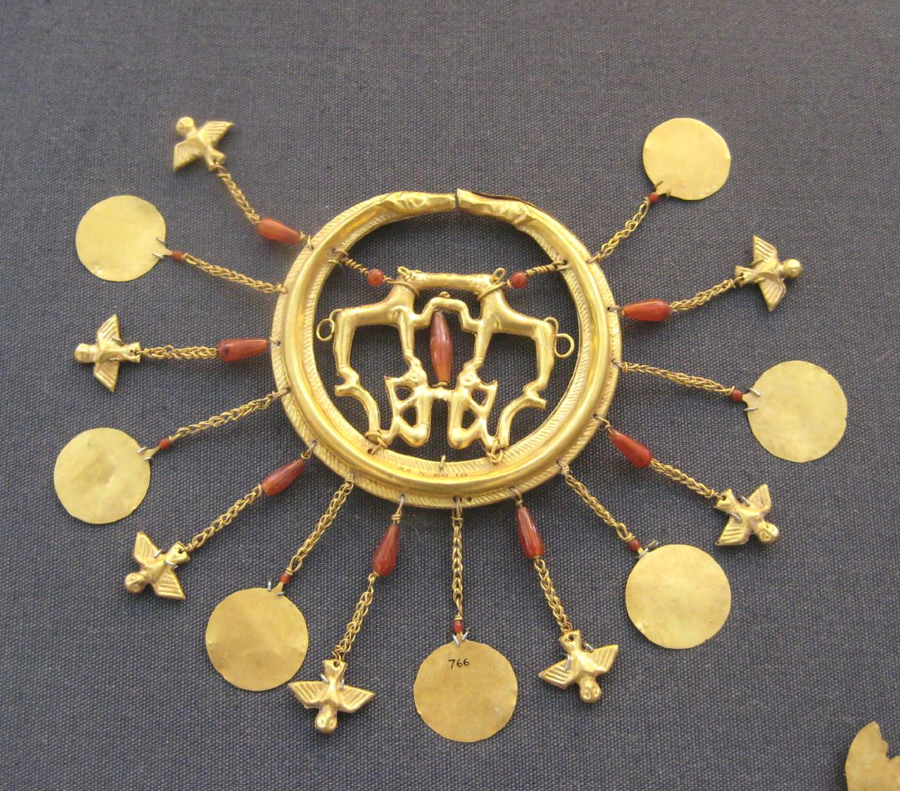
Creativity Revisited
Ω
0

Slide 2
A Creativity Project
AD 1450

Slide 3
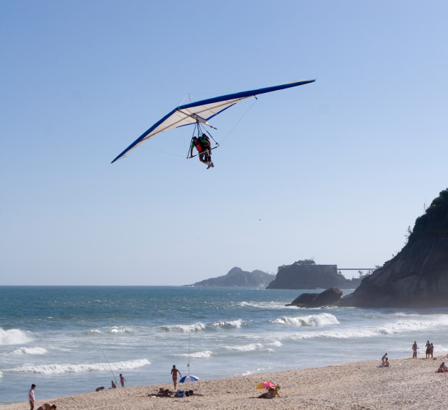
What do you think after seeing the video?
AD 1450

Slide 4
Creativity
There are indeed certain instances in which social/cultural realities largely determine the possibility or lack of possibility for developing creativity in a given field. —D. H. Feldman
AD 1450

Slide 5
Creativity and Freedom
So you feel that creativity comes from a balance of regimentation and freedom? Yes, but freedom is most important of all. Genius lies in developing complete and perfect freedom within a human being.
—Dr. Yoshiro NakaMats
(The man who has more patents
than any other person)
AD 1450

Slide 6
Creativity and Freedom
Creativity is the engine that drives cultural evolution.
—M. Csikszentmihalyi
AD 1450

Slide 7
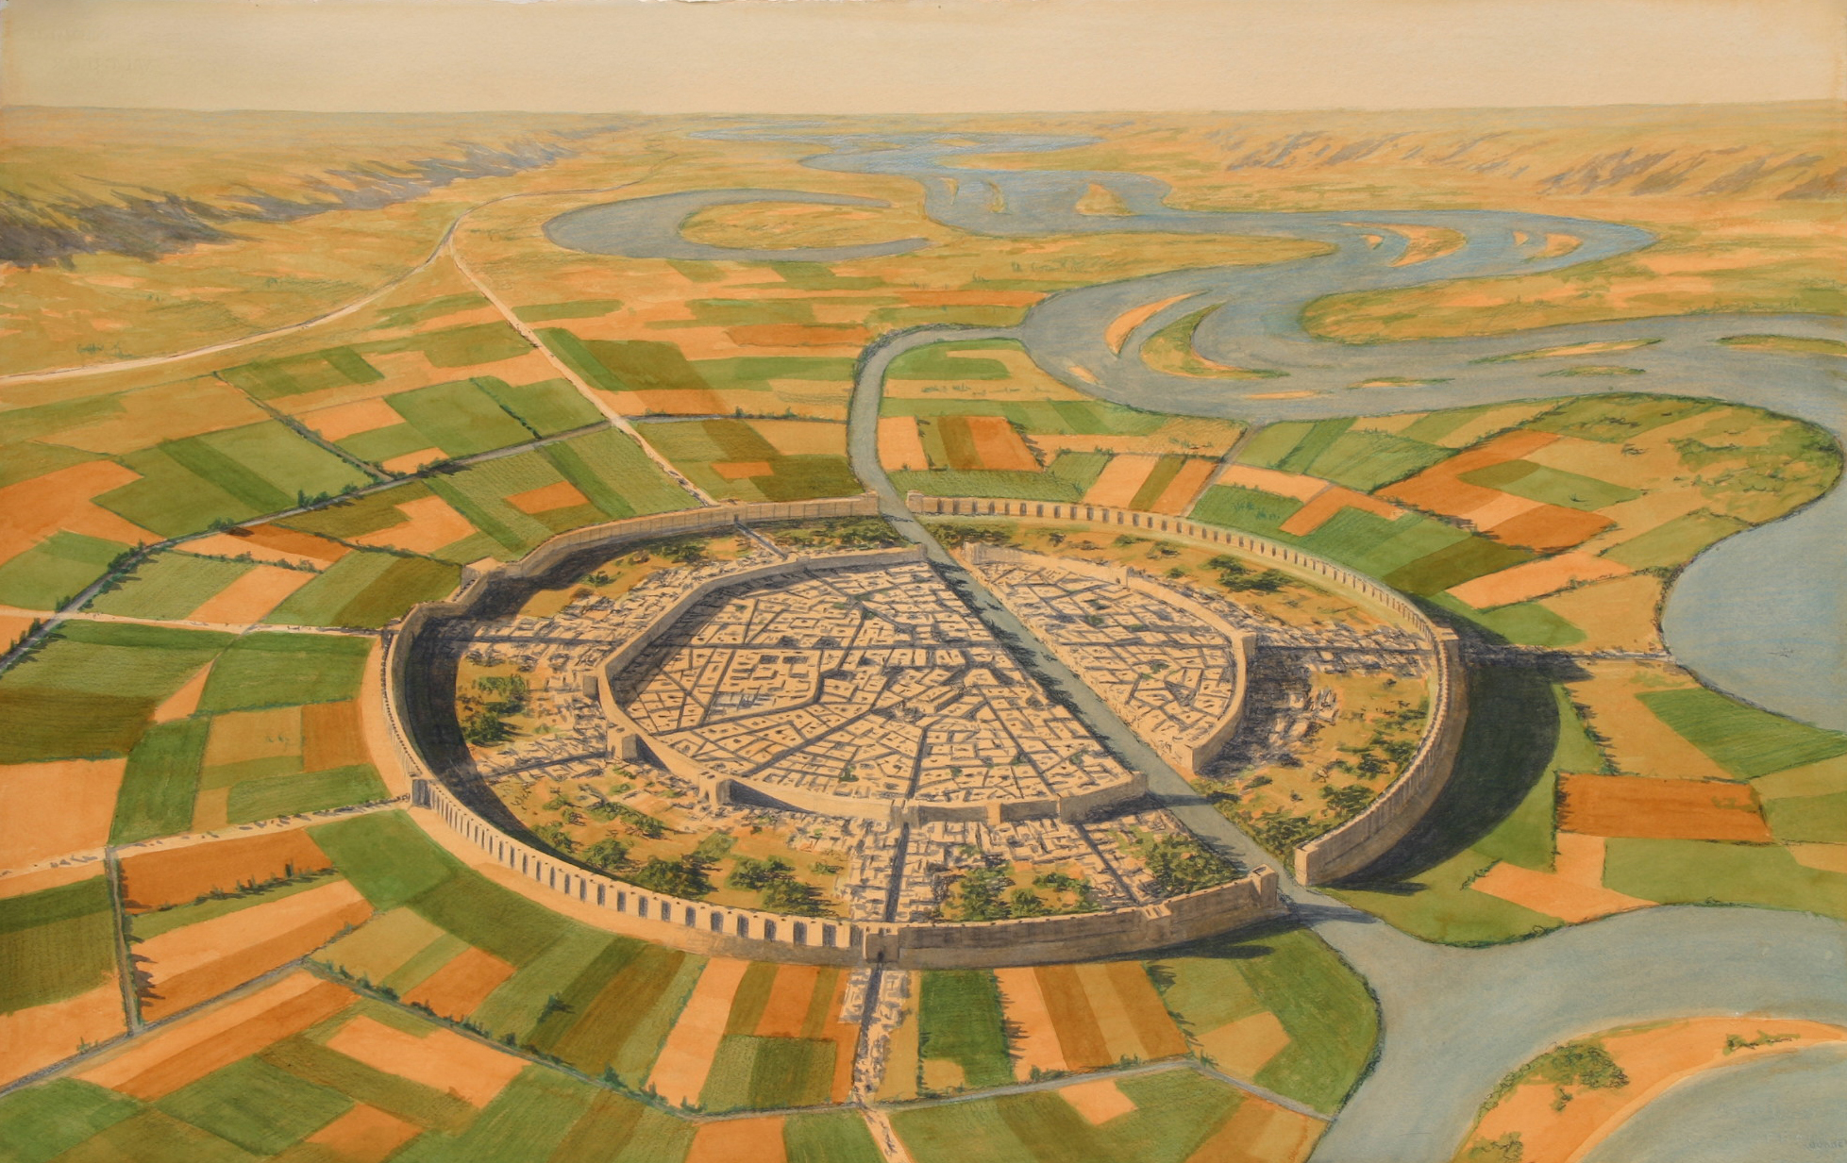
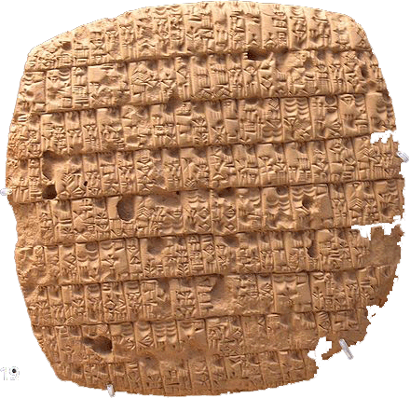
Mesopotamian Creativity
Agriculture
Cities
Differentiate occupation
Advances in metal use
Invasion brought new knowledge
Hebrew religion (separated from others)
AD 1450

Slide 8
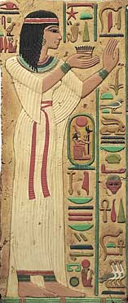
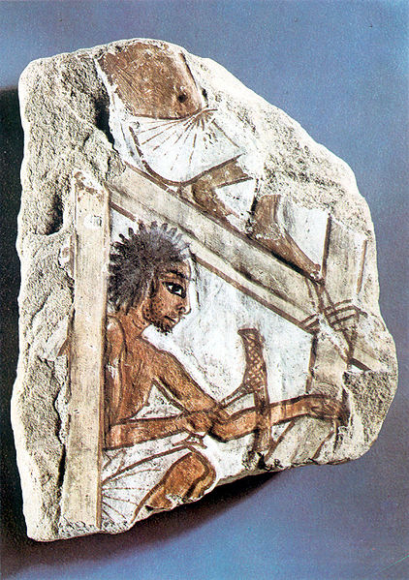
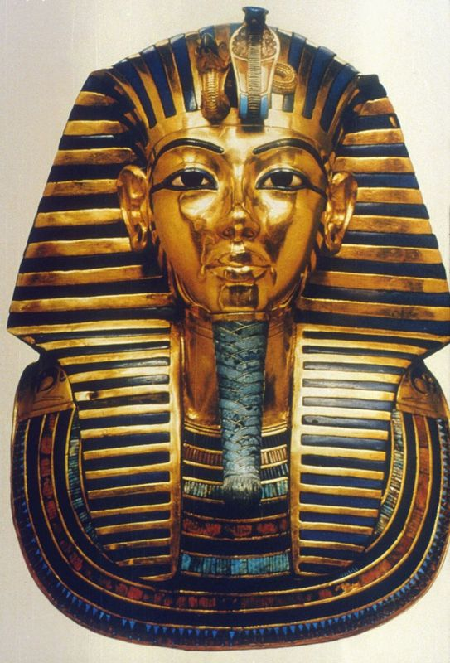
Egyptian Creativity
Initially highly innovative
Hieroglyphs
Religious beliefs
Pyramids
Valued priests
Isolated culture

Slide 9
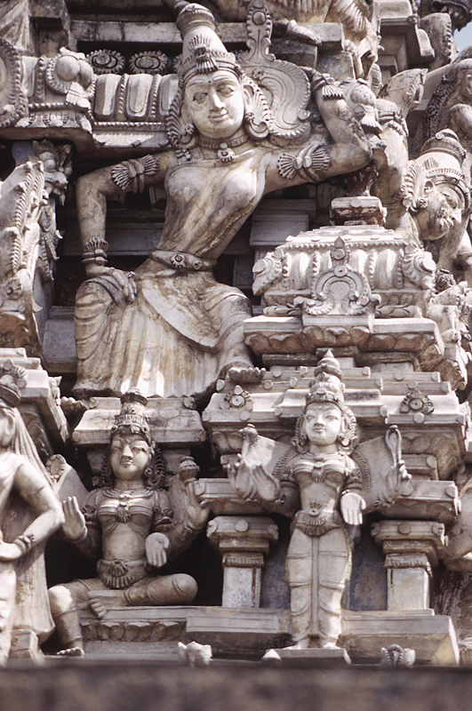
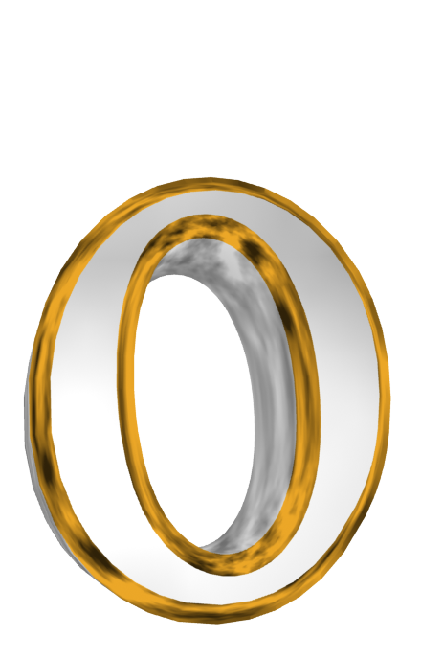
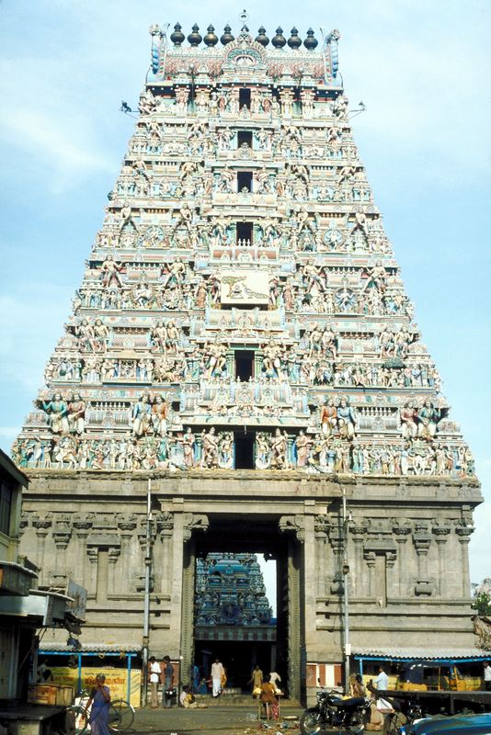
Indian Creativity
Often invaded
Caste system
Religion
Hinduism
Jainism
Sikhism
Buddhism
Concept of zero
Buildings

Slide 10
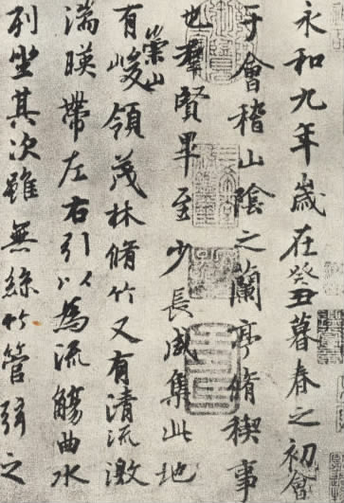
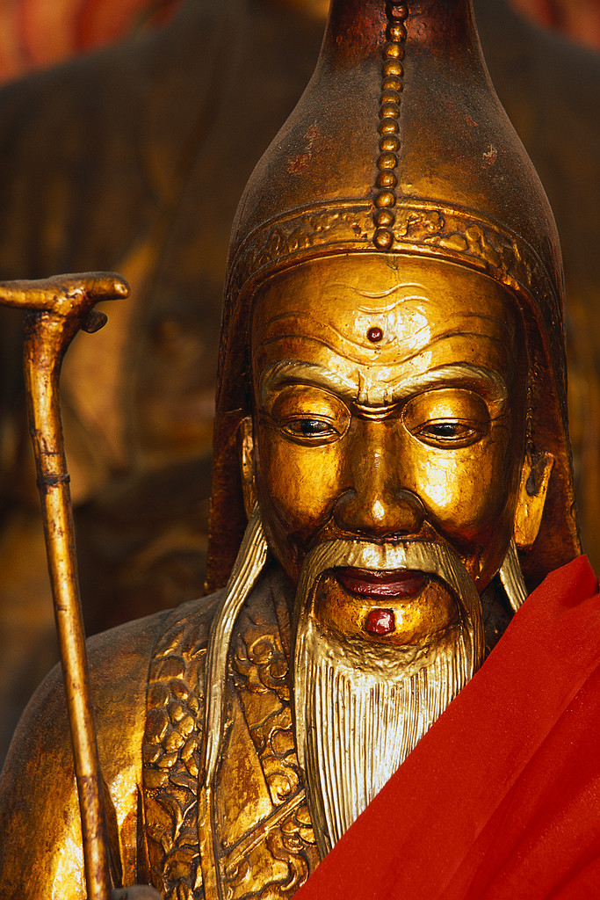
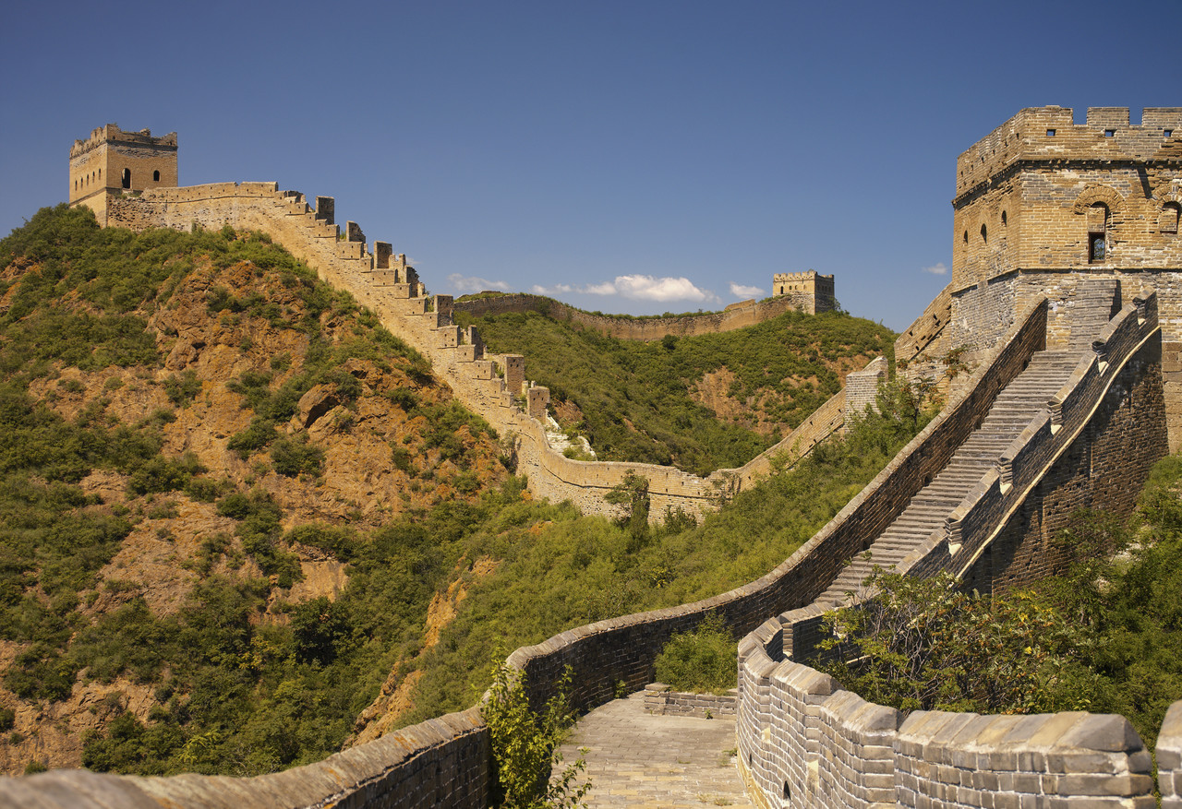
Chinese Creativity
Rarely invaded
Writing methods and materials
Bureaucracy based upon Confucius
Gun powder
Compass

Slide 11
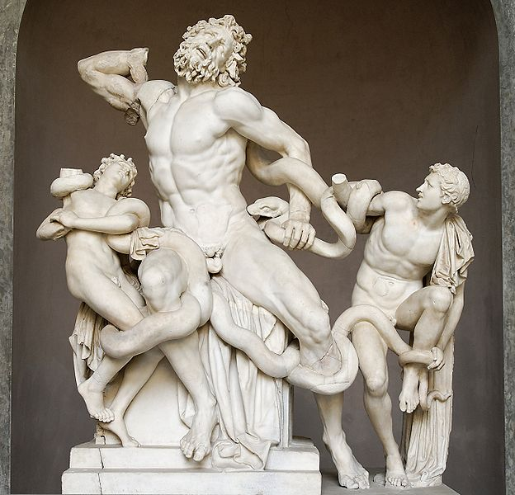
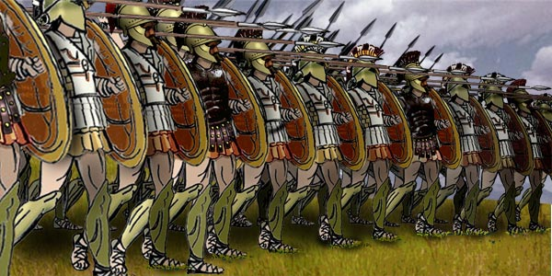
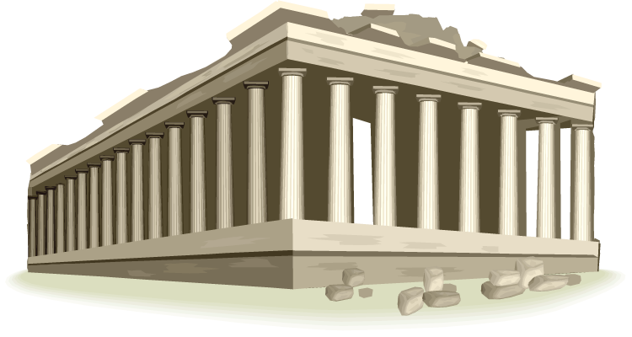
Greek and Hellenistic Creativity
Trade and education
Science
Vowels
Oral stories
Illiad and Odyssey
Leisure time vs. war
Ω
β
δ

Slide 12
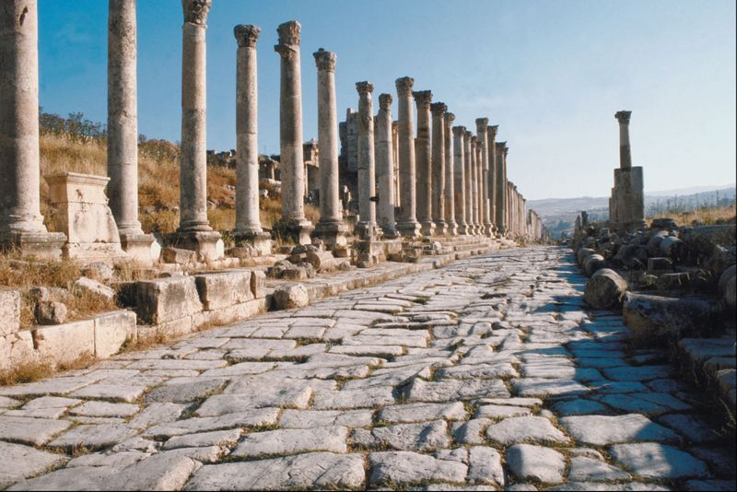
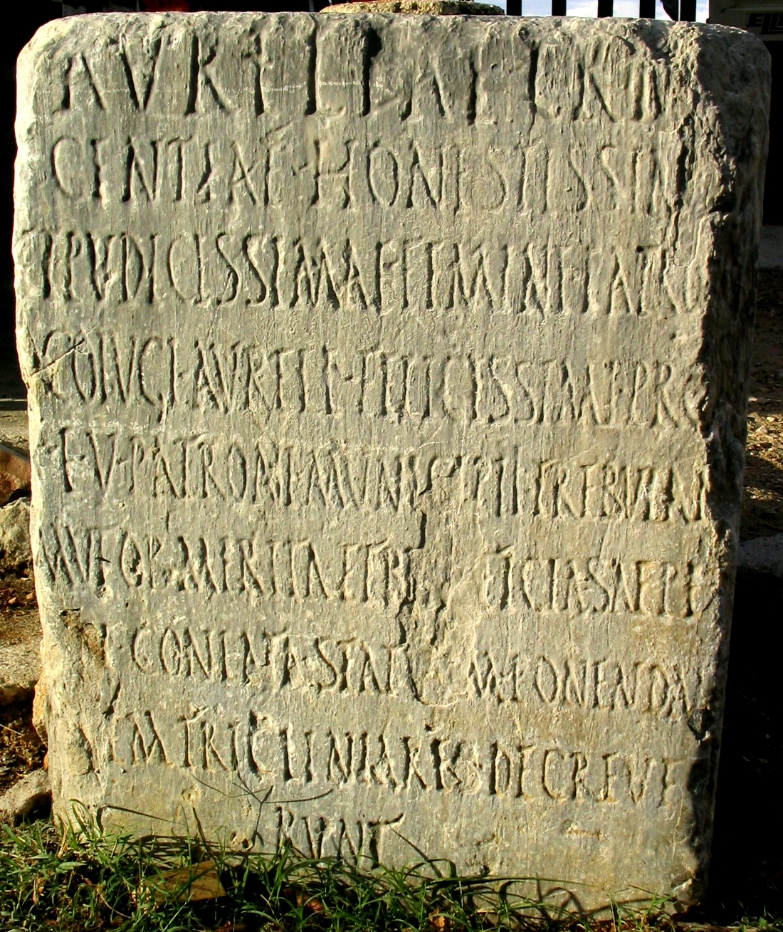
Roman Creativity
Modified others’ ideas
Checks and balances
Alphabet and number system
Aqueducts and buildings
Road system

Slide 13
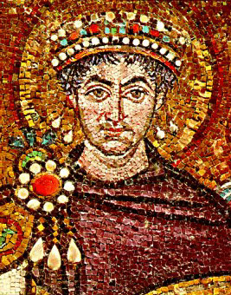
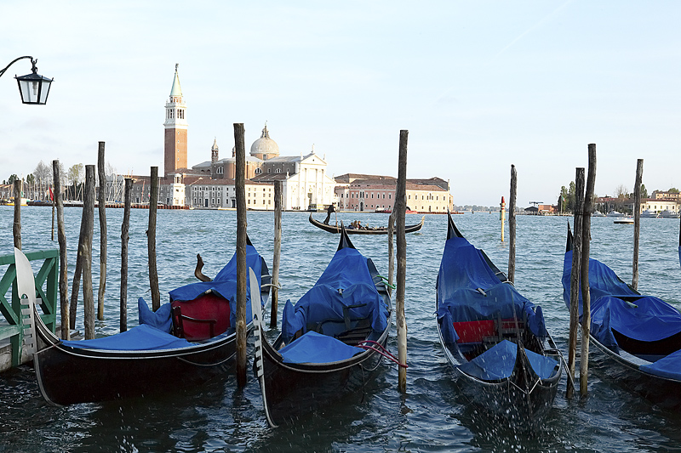
Byzantine Creativity
Mosaics
Hagia Sophia
Icons
Greek Fire
Defense system
Ports—Venice
Constantinople’s fall Rise of the Renaissance

Slide 14
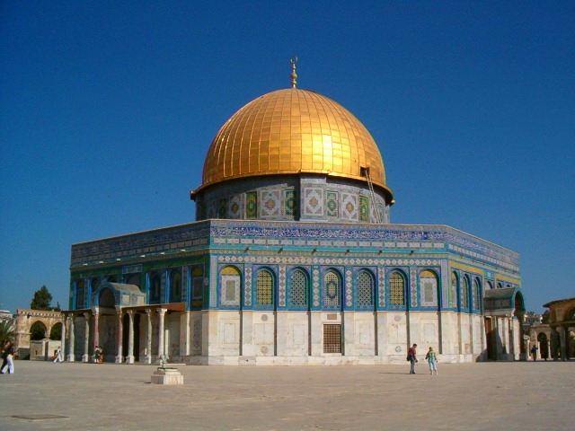
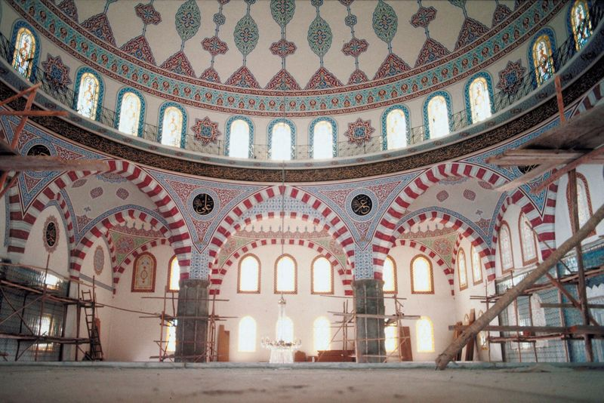
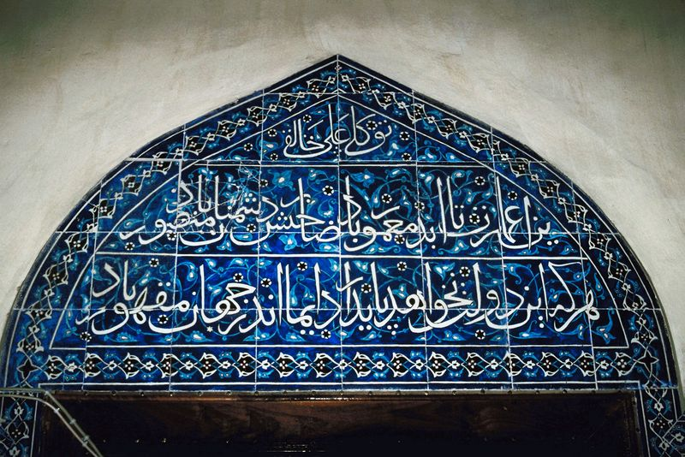
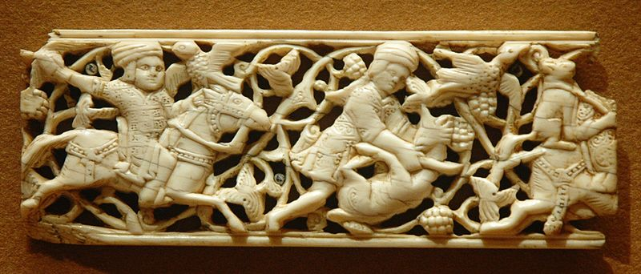
Islamic Creativity
Architecture
Dome of the Rock
Literature
Arabic script an art form
Science developed
Islamic influences added to other cultures

Slide 15
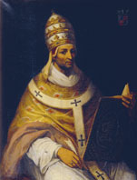
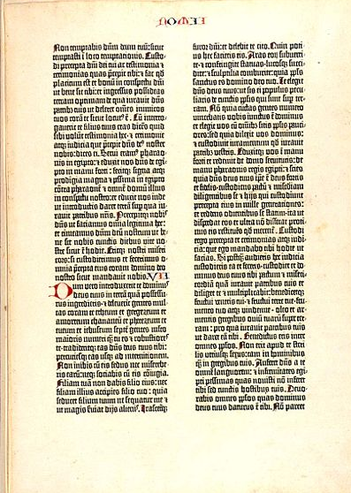
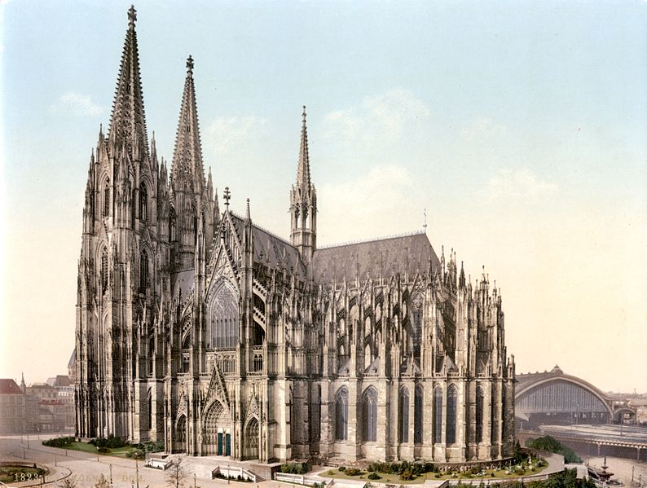
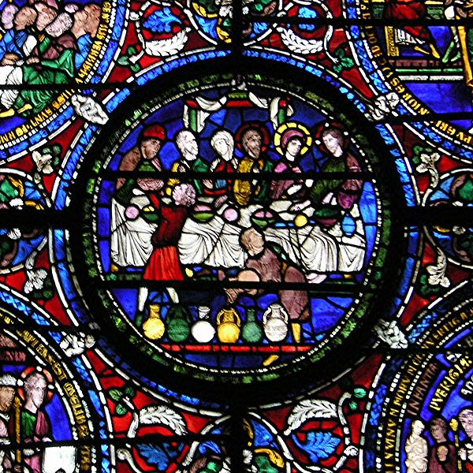
Medieval European Creativity
Gothic cathedrals
Literature and art
Catholic church
Politics and war
Language development
Interactions - lateral-thinking
Crusades - creativity
Printing press

Slide 16
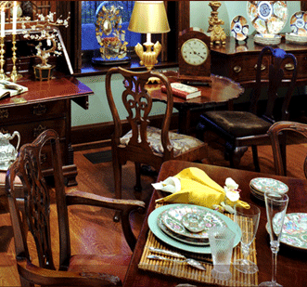
Creativity and Preparation
Solving a problem is like looking for valuable antiques. You will find only junk unless you know what you are looking for. Great new ideas are too different from our current thinking, and too similar to non-solutions to be casually recognized. But when we know what to look for, the probability of finding a great solution soars…

Slide 17
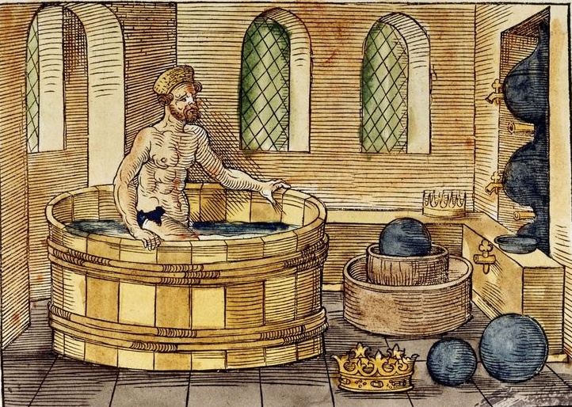
Creativity and Preparation
The ancient genius Archimedes took baths all of his life, and each time he entered the bath, the water rose. But only when he was looking for a way to measure the volume of the king’s crown did he recognize the rising water as a brilliant volume-measuring solution…
To find a breakthrough that exciting, you must have a clear vision of the solution that you are seeking. Then you too can recognize your answer when you step into it.
— Scott Thorpe

Slide 18
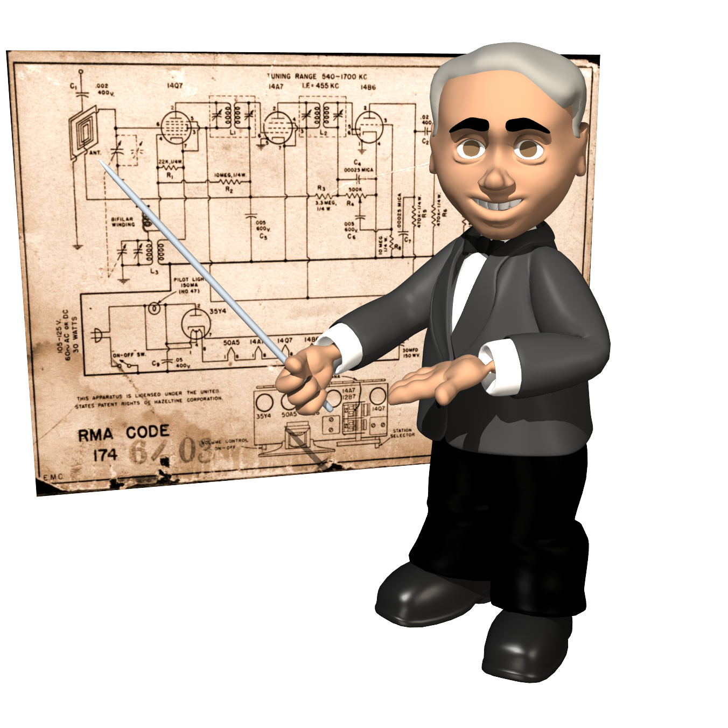
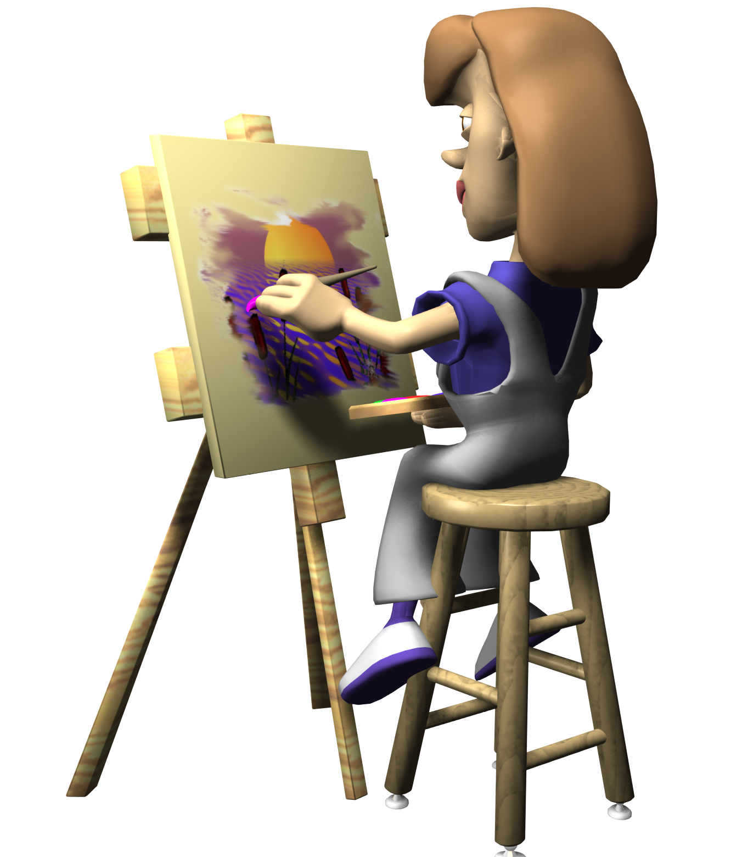
The Scope of MFG 201
Scientists
Humanists
(Derived from Snow, C.P., The Two Cultures, Cambridge University Press, 1998)

Slide 19
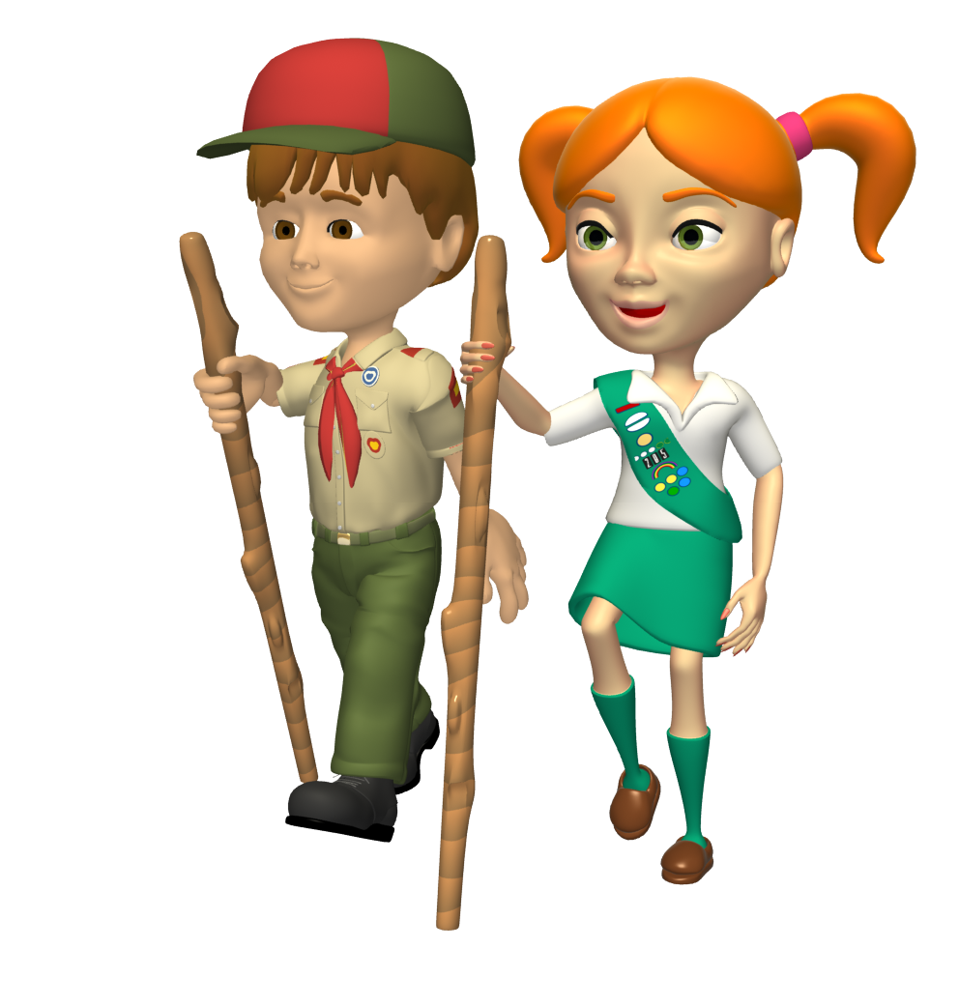
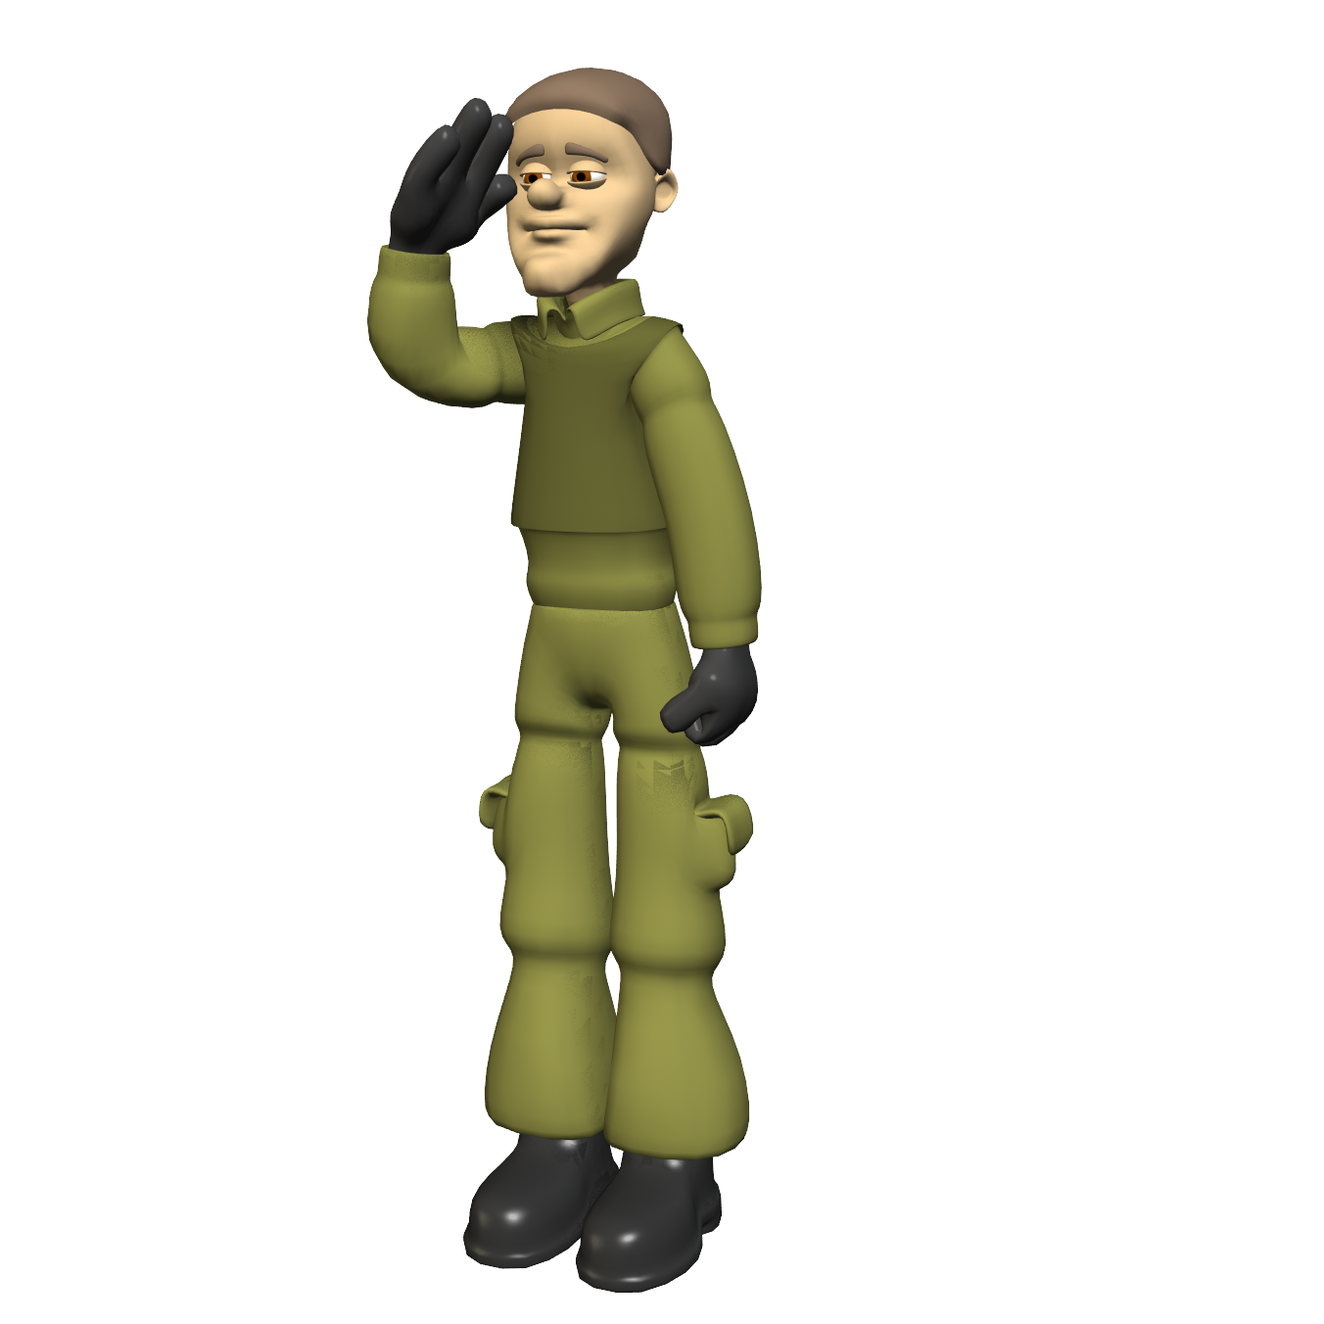
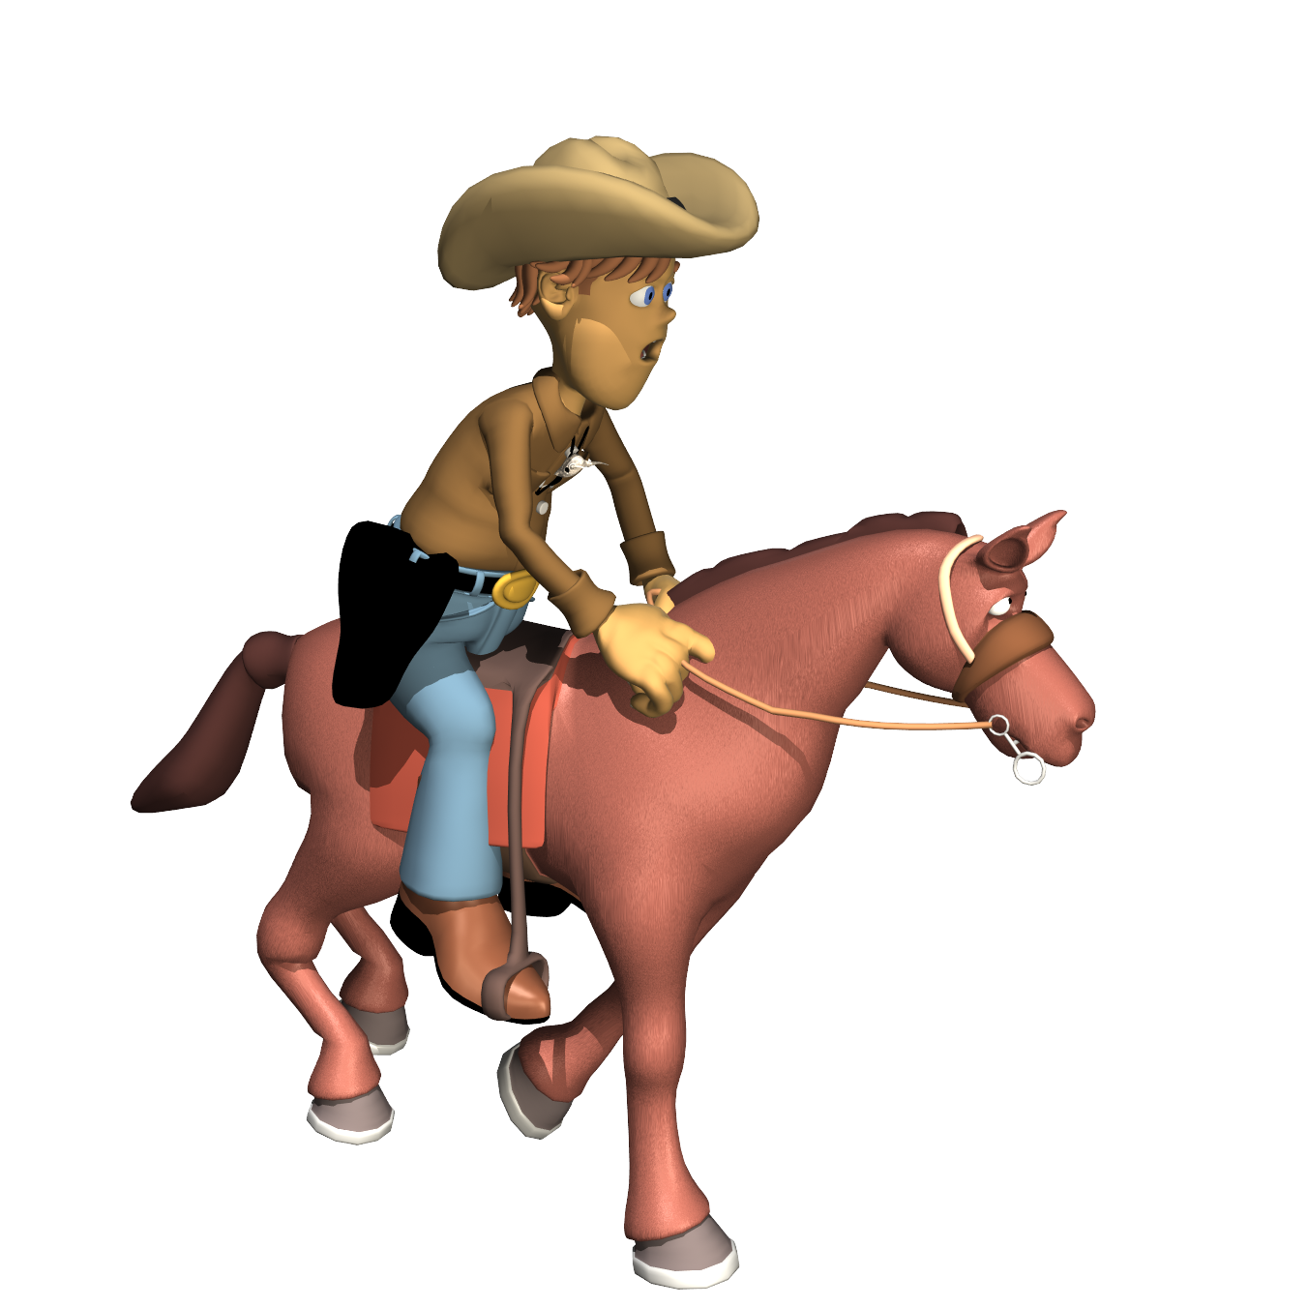
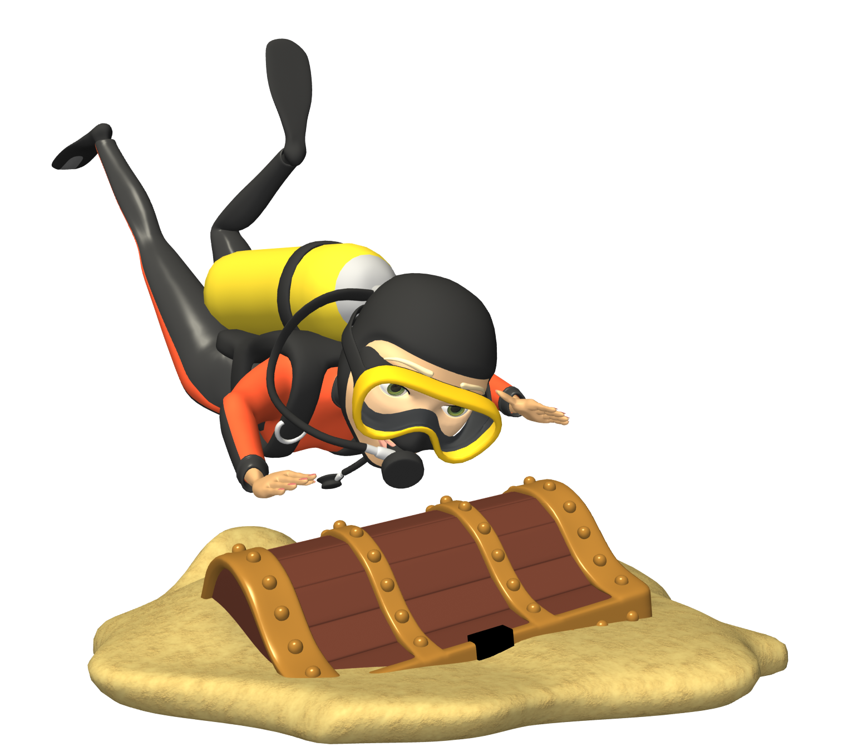
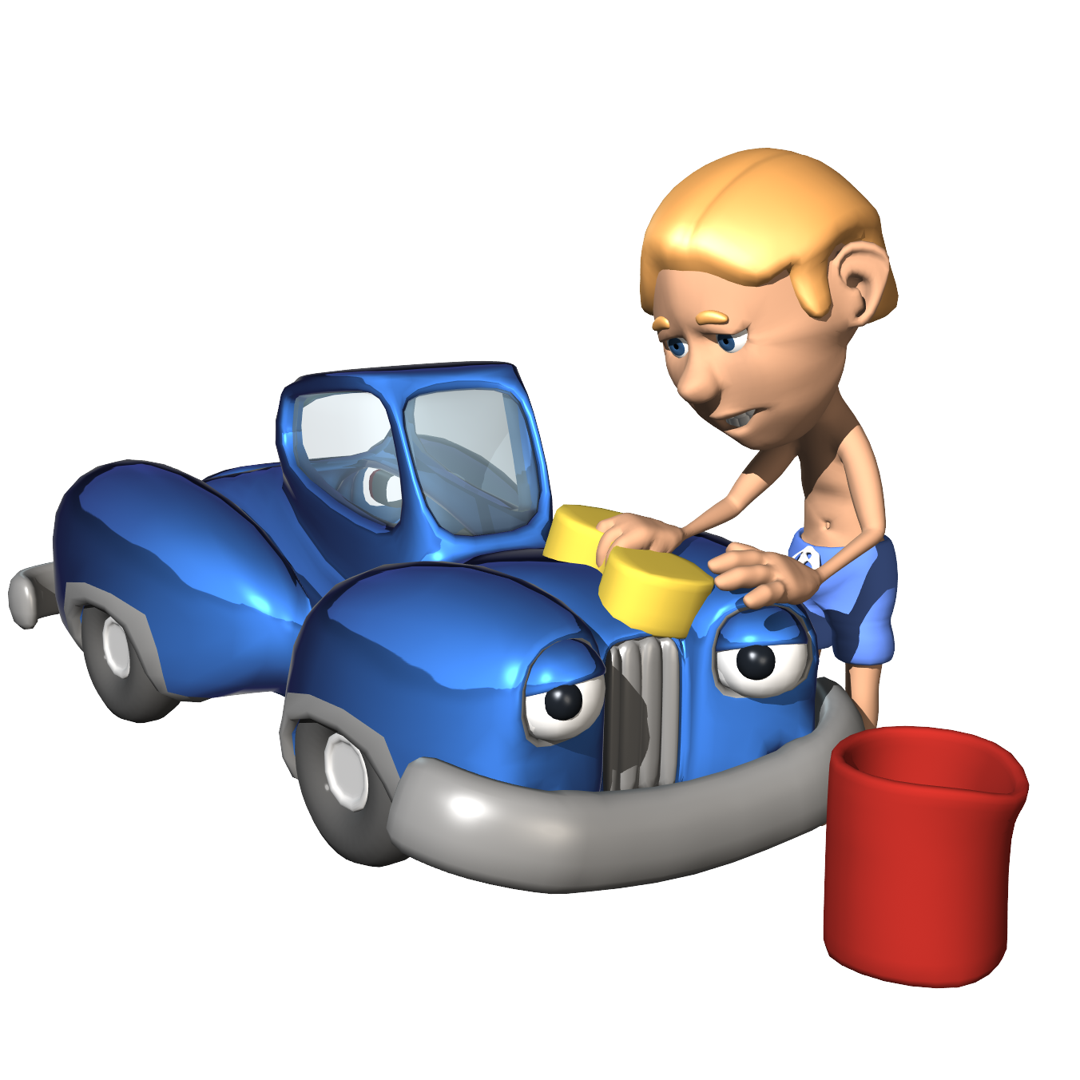
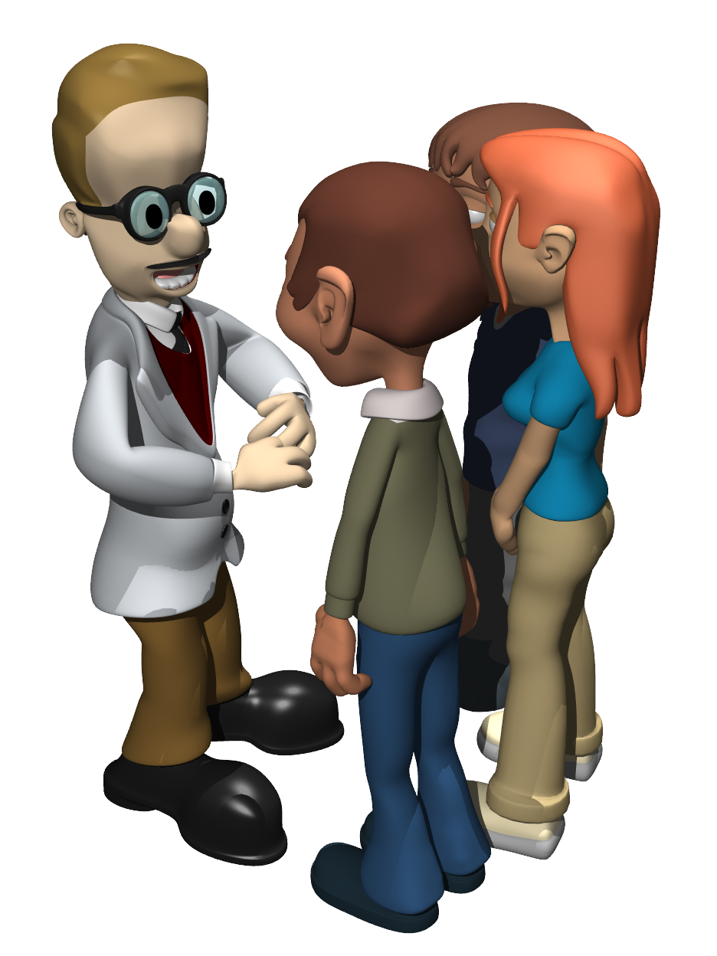
To maximize our creativity
Creativity
We must learn from many disciplines.

Slide 20
Historical Examination of Creativity (Case study method)
Look at people and times to understand creativity better.
What traits made them creative?
What environmental conditions existed?
What was the process of creativity?

Slide 21
Historical Examination of Creativity (Case study method)
History
Mesopotamia, Egypt, India, China
Greece
Rome
Byzantium
Islam
Middle Ages Europe
Pre-Colombian Americas

Slide 22
Learning from many disciplines
Law
Hammurabi
Bible
Draco
Augustian (Roman)
Justinian
Magna Carta

Slide 23
Learning from many disciplines
Government
Kings and pharaohs
Greek democracy
Roman Republic
Roman Empire
Religious
Feudal
Nation

Slide 24
Learning from many disciplines
Religion
Hebrew
Pagan
Hindu
Buddhism
Christianity
Islam

Slide 25
Learning from many disciplines
Architecture
Ziggurats and pyramids
Egyptian and Greek temples
Roman arches, vaults, domes
Islamic
Gothic

Slide 26
Learning from many disciplines
Science, engineering, and technology
"I can understand it."
Non-changing entity
Small whole numbers
Aristotelian method
Levers and catapults
Buoyancy
Euclidian geometry
Roman roads
Ptolemaic universe
Plows
Number systems

Slide 27
Learning from many disciplines
Sculpture
Egyptian
Greek
Helenistic
Roman
Medieval

Slide 28
Learning from many disciplines
Painting/mosaics
Egyptian
Greek
Medieval
Islamic

Slide 29
Learning from many disciplines
Music and drama
Greek tragedies
Musical scales
Gregorian chants
Polyphony (motets, Ars Nova, troubadour)

Slide 30
Learning from many disciplines
Philosophy
Dialectic method
The Form
Stoics
Epicureans
Scholasticism
Buddha
Confucius
Lao-Tzu

Slide 31
Learning from many disciplines
Literature
Homer
Aesop
Vergil
Chivalry legends
Dante
Chaucer

Slide 32
Maslow’s “Hierarchy of Needs”
Charity
Self- Actualization
Creativity
Self-Esteem
Love & Belonging
Safety
Physiological
Currently unsatisfied but felt needs are motivators
AD 1450

Slide 33
Thank You
You have learned to be creative
Ω
0

