Slide 1
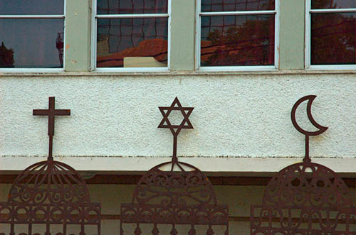
Understanding the Middle East

Slide 2
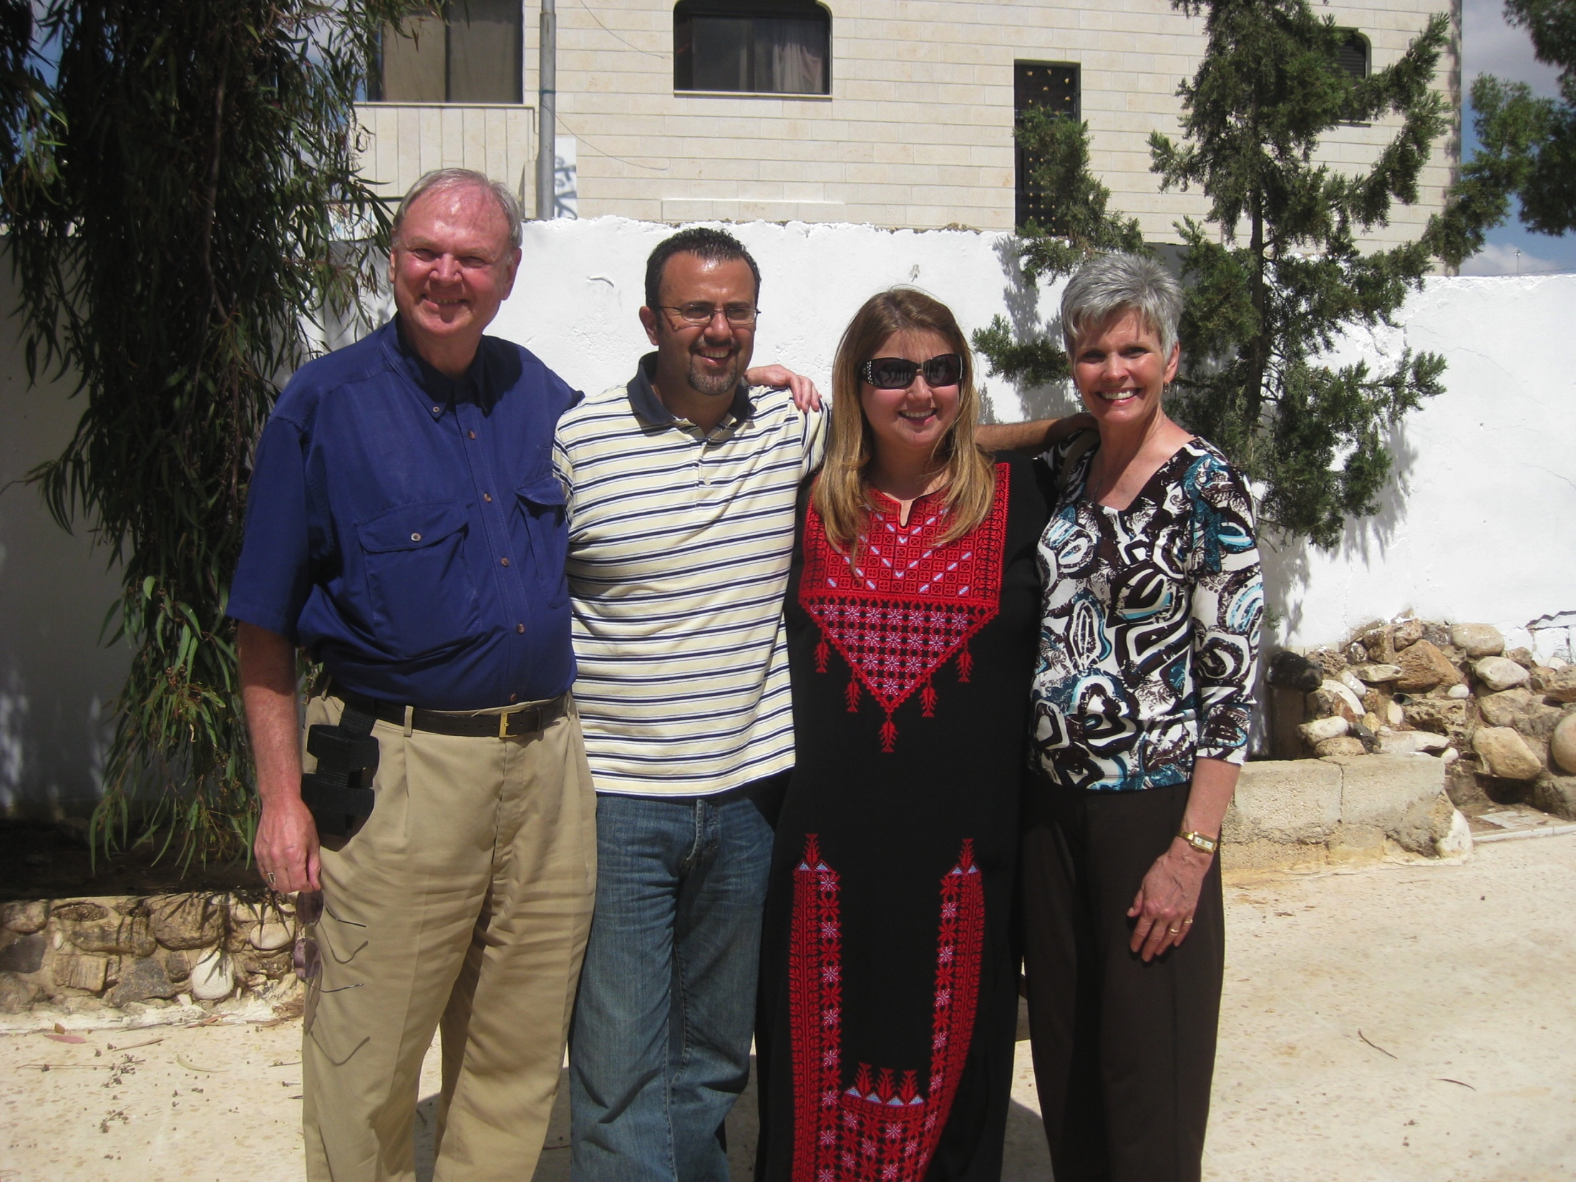
Understanding the Middle East
A story from Raed Al-Zubi

Slide 3
Know Your Customers
A disappointed salesman of a cola company returned from his Middle East assignment.
A friend asked, "Why weren't you successful with the Arabs?"

Slide 4
Know Your Customers
The salesman explained:
“When I got posted in the Middle East, I was very confident that I would make a good sales pitch as cola is virtually unknown there. But, I had a problem. I didn't speak Arabic. So, I planned to convey the message through three posters . . .

Slide 5
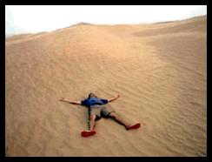
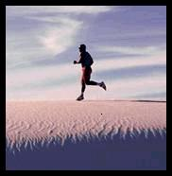
Know Your Customers
1
2
3
A man lying in the hot desert sand...totally exhausted and fainting.
The man is drinking our cola.
Our man is now totally refreshed.

Slide 6
Know Your Customers
And then these posters were pasted all over the place.”
"Then that should have worked!" said the friend.
"It should have!" said the salesman.

Slide 7
Know Your Customers
3
2
1
"But I didn't realize that Arabs read from right to left."

Slide 8
Get the History Right
The people in the area are focused on history
Ancient claims to land
Rights based on occupation of the land
History is not the same for Jews and Muslims
Jewish (Hebrew) and Muslim (Arab) histories begin with Abraham

Slide 9
Patriarchs
Abraham
Hagar
Ishmael
12 sons
Sarah
Isaac /Jacob
12 sons
Keturah
6 sons
Moses’ father-in-law
from this group

Slide 10
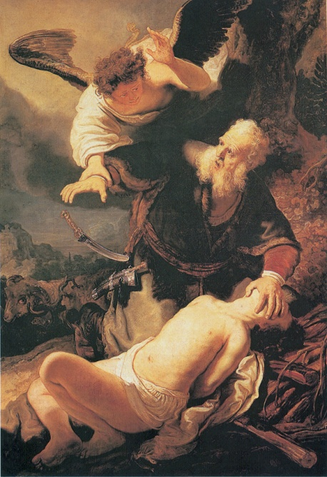
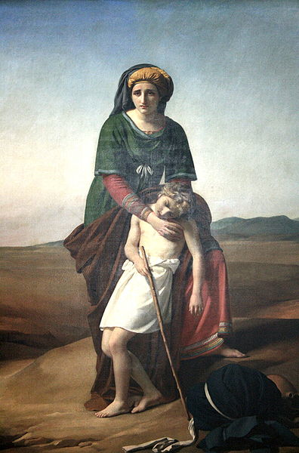
History
Abraham received a covenant for him and his posterity
Abraham nearly sacrificed Isaac/Ishmael
Birthright son(?)
Hagar and Ishmael cast into the desert
Saved by God (near Mecca)
Isaac and Ishmael both circumcised as mark of the covenant

Slide 11
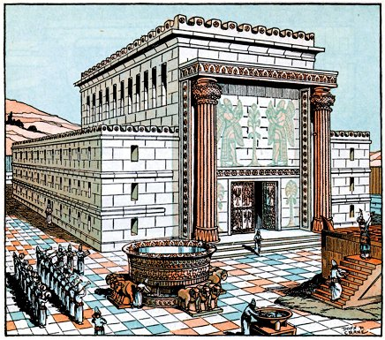
History – Jewish Version
Solomon, a descendent of Israel, built a temple and renewed the covenant
The Temple Mount was the place where Abraham’s sacrifice occurred (Mt. Moriah)
Jerusalem is the holiest city for Jews

Slide 12
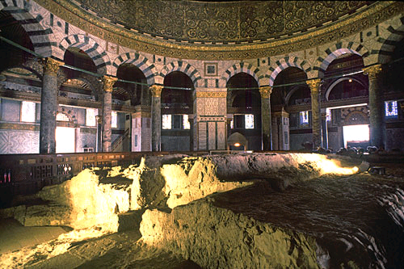
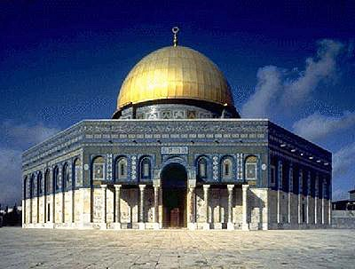
History – Muslim Version
Mohammed was taken to Jerusalem in a night vision and there ascended to heaven on a horse
The place from which he ascended is the rock on which Abraham nearly sacrificed Ishmael
The Dome of the Rock is built over this site
Jerusalem is 3rd most sacred city for Muslims

Slide 13
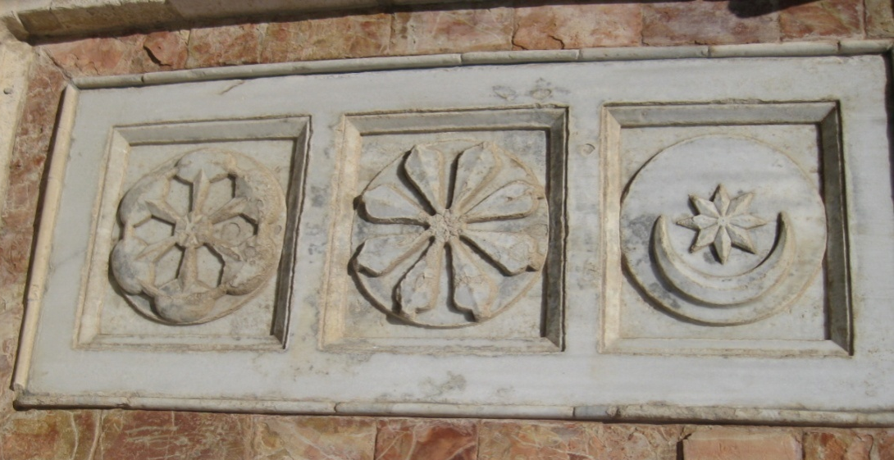
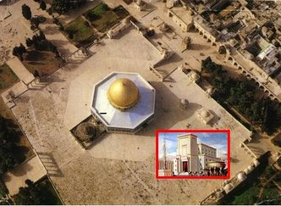
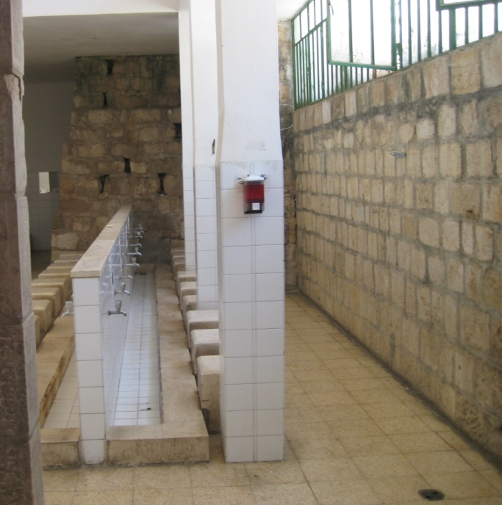
History – Muslim Version
The Noble Sanctuary
Built on a rubble-strewn cite in 700 AD
Sun, moon and star stone
Site for ritual washing

Slide 14
History – 20th Century
Jewish status (1900 AD)
Scattered around Europe and the U.S.
Only a few living in Middle East
Zionist movement began (late 1800s)
Palestinian status (1900 AD)
Living in Palestine but controlled by Ottoman Turks

Slide 15
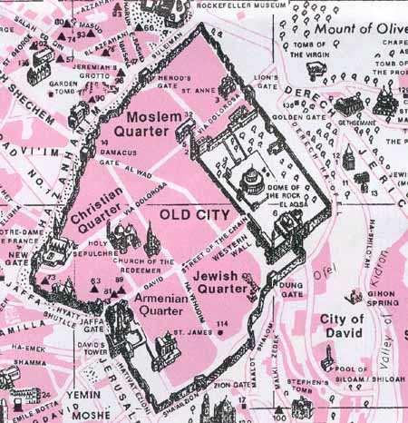
History – Jerusalem
Quarters of ”Old City” of Jerusalem
Temple Mount
(Noble Sanctuary)

Slide 16
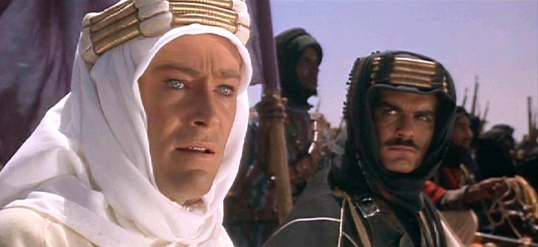
History – WWI
British received support of the Sharif of Mecca
Lawrence of Arabia
Promised an Arab nation under the Sharif and his sons
Defeated the Ottomans

Slide 17
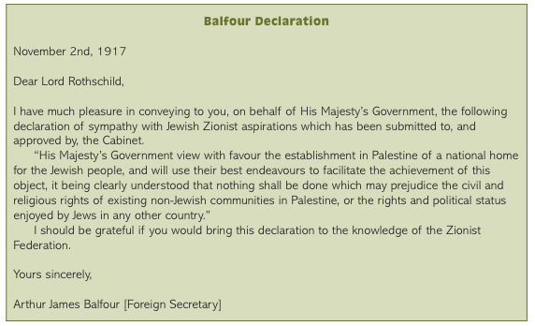
History – WWI

Slide 18
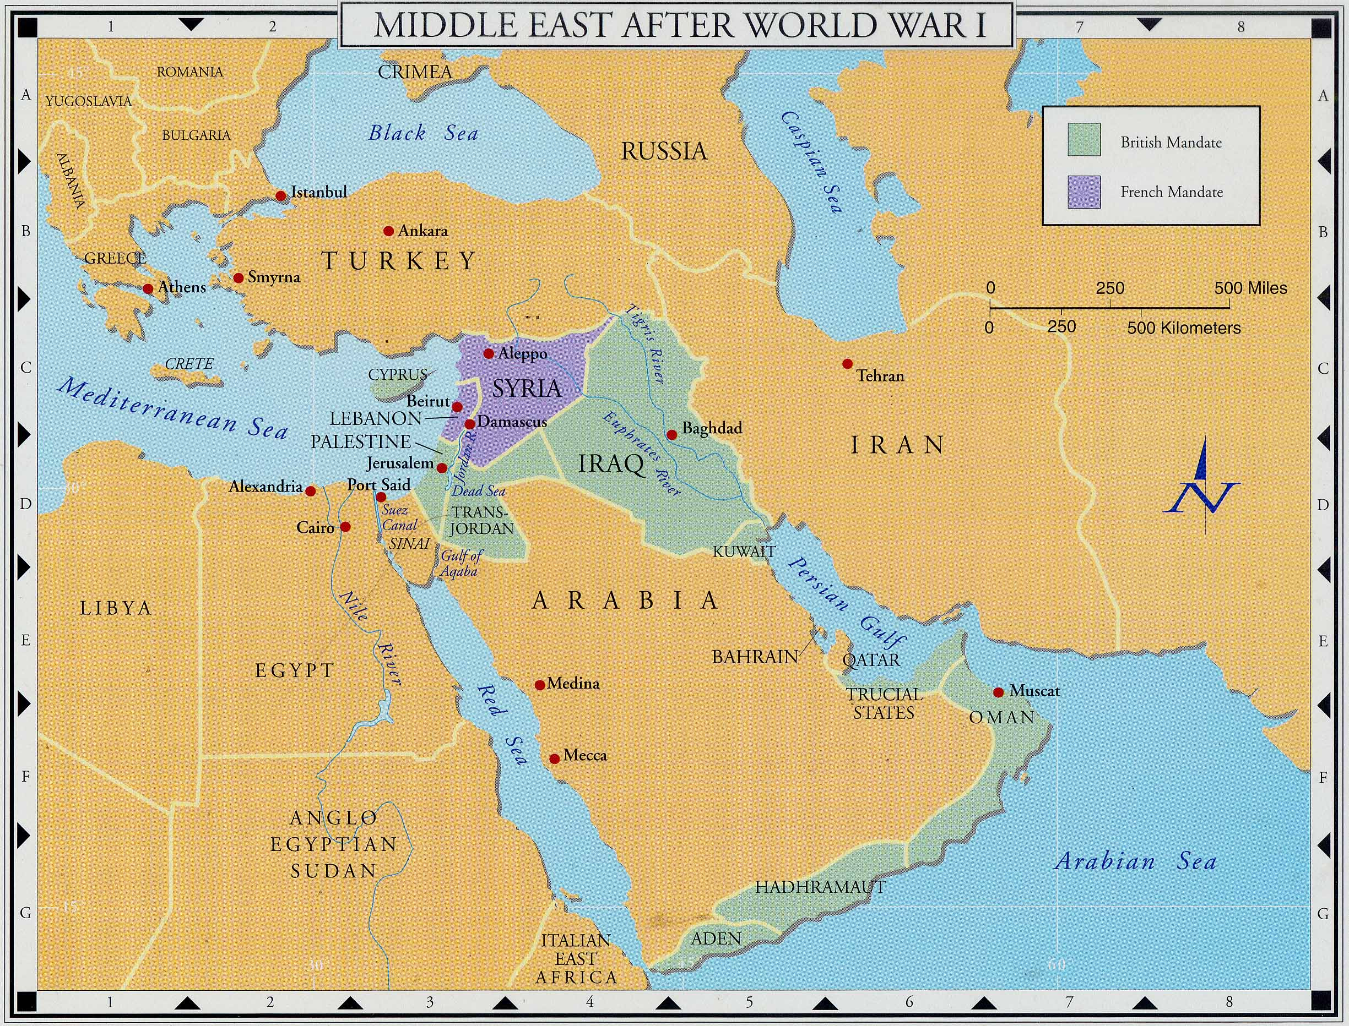
History – Between Wars
British and French protectorates established as “arbitrary” countries
From dissolution of the Ottoman Empire

Slide 19
History – Between Wars
Sharif of Mecca denied rule
British break their promise
No Arab homeland
Saudi-led unification of Arabian tribes in competition to Sharif of Mecca
Backed by European nations
Sons of Sharif eventually established as kings in Syria, Iraq, and Jordan
All under British/French supervision
Palestine retained as British protectorate

Slide 20
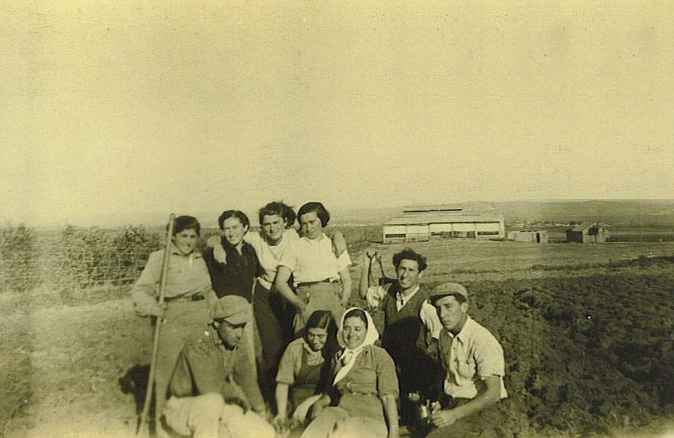
History – Between Wars
Israeli migration after WWI protected by Great Britain
Israelis purchased land from Palestinians
Many Israelis live on cooperative farms (Kibbutz)
Migration halted during WWII except for a few refugees

Slide 21
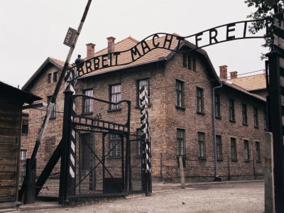
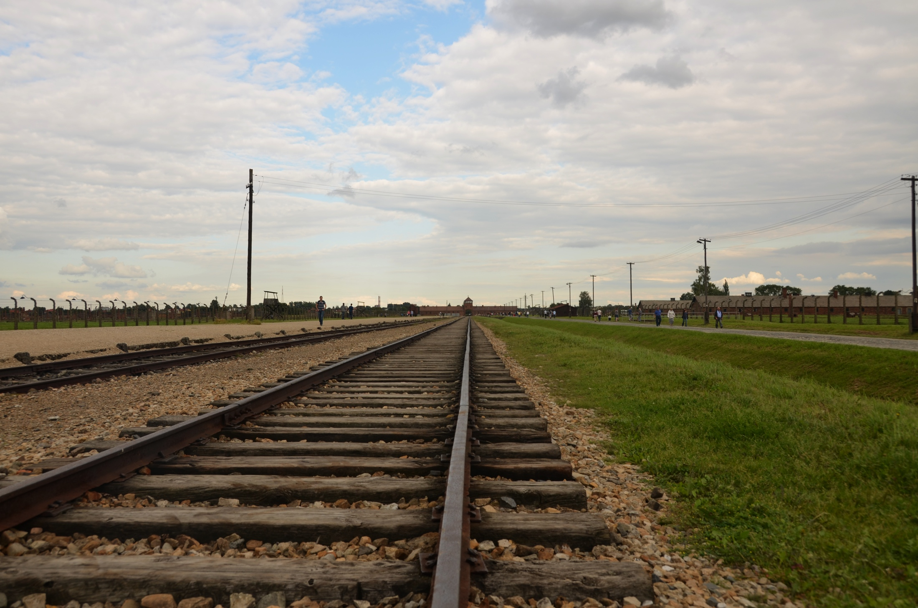
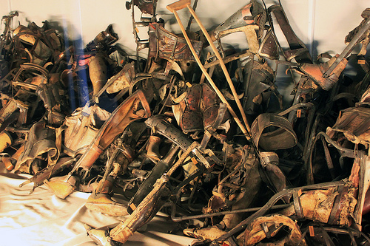
History – After WWII
Aftermath of WWII
Death camps liberated but Jews had no place to go
Birkenau
Auschwitz

Slide 22
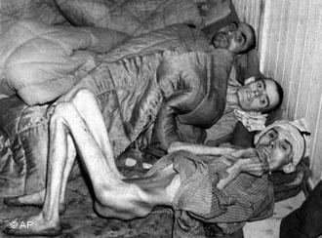
History – After WWII
Aftermath of WWII
Millions of refugees sought asylum in British-run Palestine

Slide 23
History – After WWII
British Mandate Problems
Britain became alarmed at the number of arriving Israelis and tried to stop immigration

Slide 24
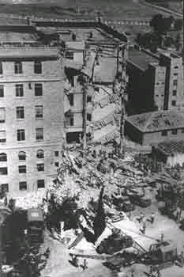
History – After WWII
British Mandate Problems
Israelis turn to terrorism to oust Britain
King David Hotel after Irgun (Israeli) bomb blast

Slide 25
History – After WWII
Britain withdrew from Palestine and turned it over to the United Nations

Slide 26
History – After WWII
United Nations agreed to decide question
Should the Palestinians rule the state?
Majority rule
Should the Jews be given a homeland?
Charity
Partition (1947-8)

Slide 27
History – After Partition
War at formation of Israel
Israel saved by US intervention
Millions of Palestinian refugees
Series of wars between Israelis and Arab neighbors
Israel supported by the United States
Eventually led to Israeli occupation of the West Bank (all Palestinian territory)
Tentative agreements on Palestinian territory under various US presidents
Disrupted by Israeli and Palestinian radicals

Slide 28
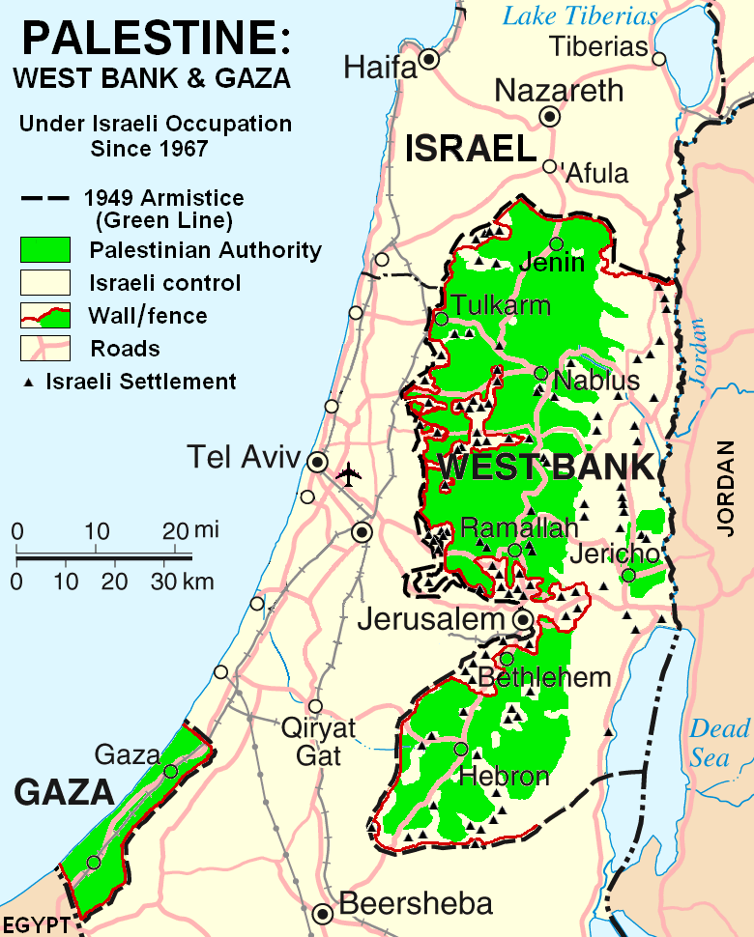
History – Today
Israelis control all land west of the Jordan River
Areas of dense Palestinian population given to Palestinian Authority
Israelis intervene when threatened by violence
Israeli wall
Israeli settlements within Palestinian Authority ( )

Slide 29
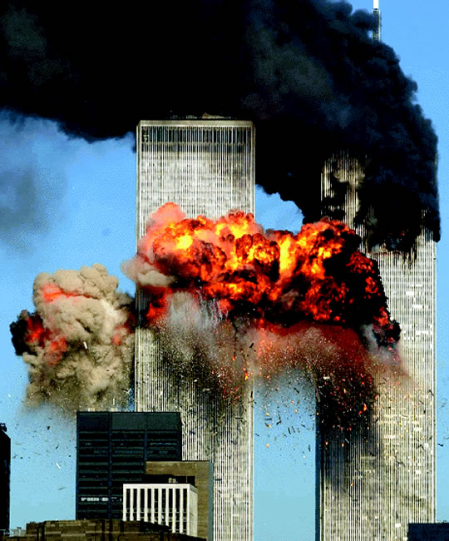
History – Today
The United States brought into the Middle East battle with 9/11
Resentment against United States common throughout Islamic world
Reaction against US continuing support for Israel
Frustration over Palestine

Slide 30
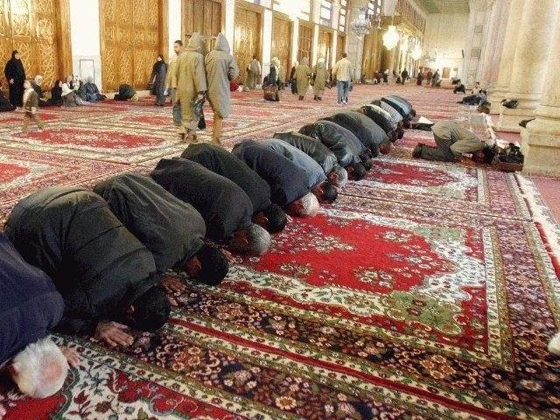
Islam and LDS
First Presidency: Mohammad had portion of the truth
Raised the level of spirituality of Arabs
Was his doctrine changed?
Qur’an
Hadith
Did he have all doctrine?
People not willing to accept full gospel?
School teacher to the eventual full gospel?

Slide 31
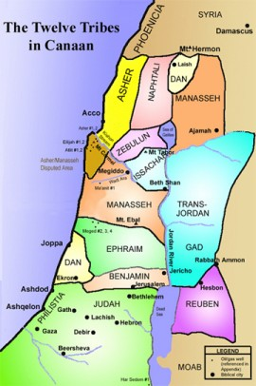
Islamic and LDS
Were the Jews entitled to the land as part of the Abrahamic promise?

Slide 32
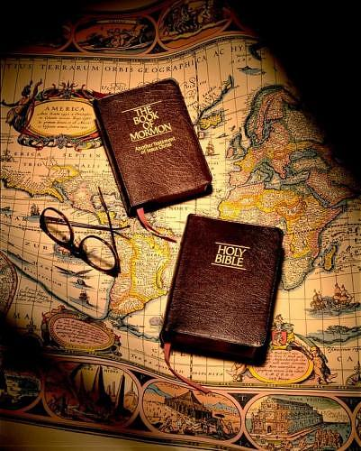
Islamic and LDS
3 Nephi 20:29
And I will remember the covenant which I have made with my people [the Jews]; and I have covenanted with them that I would gather them together in mine own due time, that I would give unto them again the land of their fathers for their inheritance, which is the land of Jerusalem, which is the promised land unto them forever, saith the Father.

Slide 33
Islamic and LDS
What were the conditions of God’s giving the land to the Jews as part of their inheritance?

Slide 34
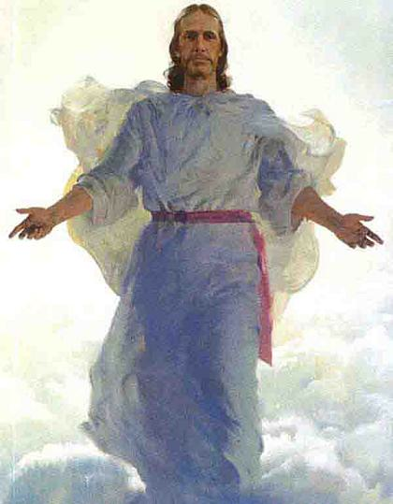
Islamic and LDS
3 Nephi 20:30-34
And it shall come to pass that the time cometh, when the fulness of my gospel shall be preached unto them [the Jews]; And they shall believe in me, that I am Jesus Christ, the Son of God, and shall pray unto the Father in my name…

Slide 35
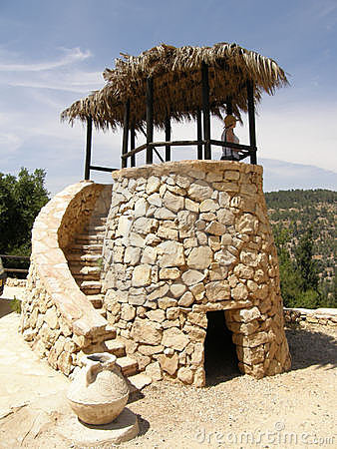
Islamic and LDS
3 Nephi 20:30-34 (cont.)
…Then shall their watchmen lift up their voice, and with the voice together shall they sing; for they shall see eye to eye…

Slide 36
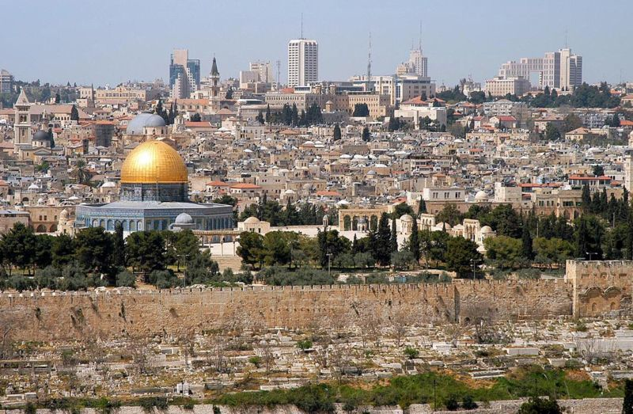
Islamic and LDS
3 Nephi 20:30-34 (cont.)
...Then will the Father gather them together again, and give unto them Jerusalem for the land of their inheritance.

Slide 37
Islamic and LDS
What would have been different if the returning Jews had waited until they had accepted Christ as outlined in the Book of Mormon?

Slide 38
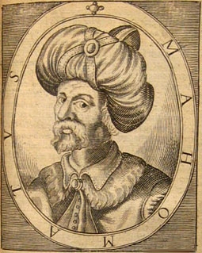
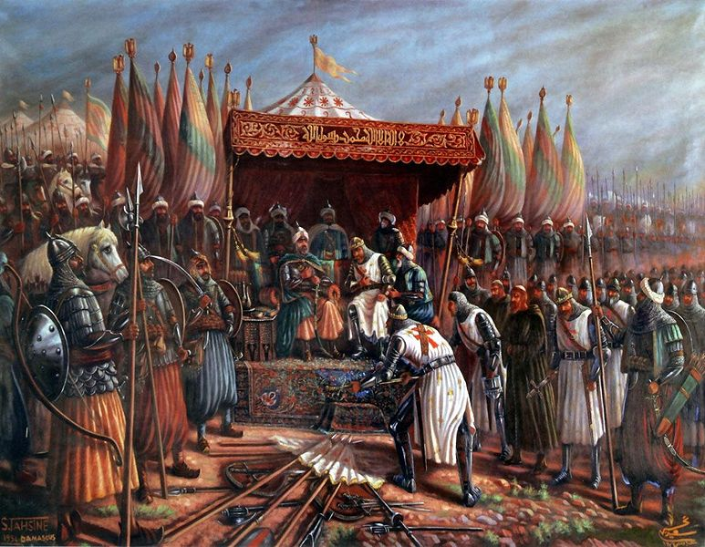
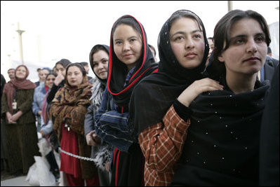
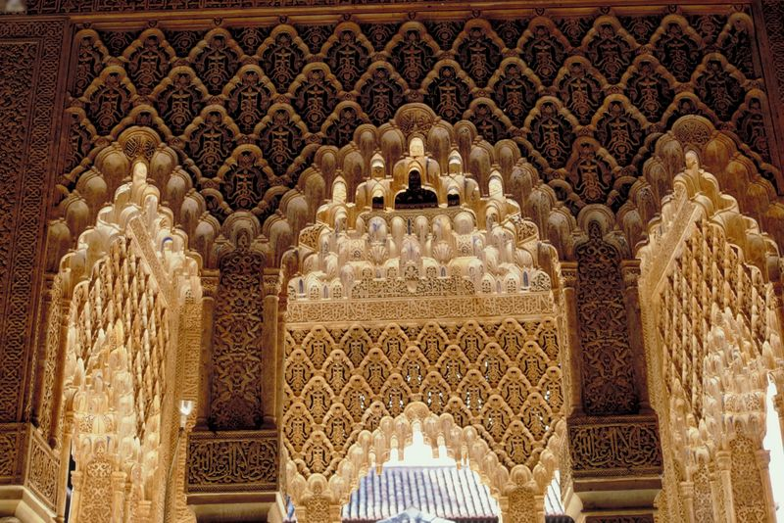
History – Today
With such a rich heritage, why aren't Muslims playing major role in culture today?
Case 1: They are but we are not aware of it.
Case 2: Muslims have different values.
Case 3: Domination by Turks and others.
Case 4: Muslims missed the Enlightenment and the Industrial Revolution.

Slide 39
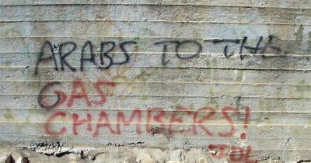
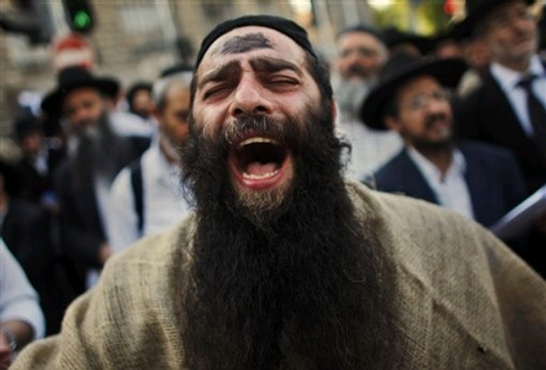
Bringing Peace to the Middle East
Recognize that Israel must take the first step because they have the power (US pressure)
Step 1: Establish Palestine as a sovereign country
Moderate Israelis will have to step forward to reduce influence of radical parties
Arabs need to recognize real situation

Slide 40
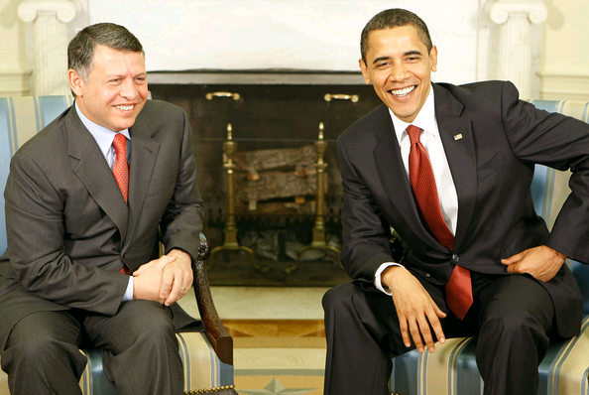
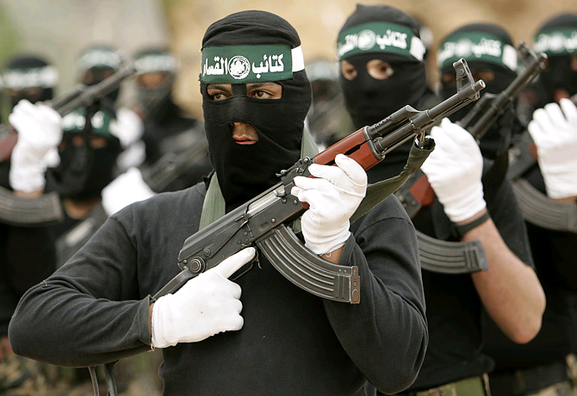
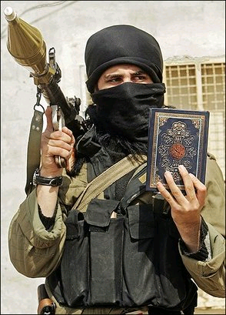
Bringing Peace to the Middle East
Recognize that terrorism can only be controlled by pressure from moderate Arabs
Step 2: US and Israel support moderate Arab states as a model for Palestinians (and others)
Fatah and Hamas rivalry/fighting must be internally controlled

Slide 41
Bringing Peace to the Middle East
Israelis must recognize that peace comes from politics and fairness (not bullying)
Step 3: Israelis stop actions that inflame
Brutality in responses to terrorism
Destruction of homes and delays in building permits
Economic subjugation
Water dominance and other land uses
Settlements in Palestinian areas
Refusal to let refugees return (to Palestinian areas)

Slide 42
Bringing Peace to the Middle East
Palestinians must realize that their actions have brought many of their problems
Step 4: Palestinians stop actions that inflame
Terrorism
Refusal of majority, media and governments to openly condemn terrorism
Stop involvement of non-Palestinian groups
Al-Qaeda
Hezbollah (Lebanese radicals)
Much of the rest of the Islamic world (Afghanistan, Pakistan, Saudi Arabia, etc.)

Slide 43
Bringing Peace to the Middle East
Recognize that Muslims (especially Arabs) are struggling with prejudice throughout the world and that they will continue to integrate into western countries
Step 5: Relieve Muslim frustration at current situation in the world by openly giving aid and respect to Muslim people/nations
Learn more about Islam
Compare to the feelings about Jews before WWII
Respect for Arabic culture and accomplishments
Support for Arabic freedom

Slide 44
Bringing Peace to the Middle East
Recognize that lasting peace requires a change in the emotions and attitudes of both Israelis and Palestinians
Step 6: Initiate programs that change attitudes
Concept: The Armenian Story

Slide 45
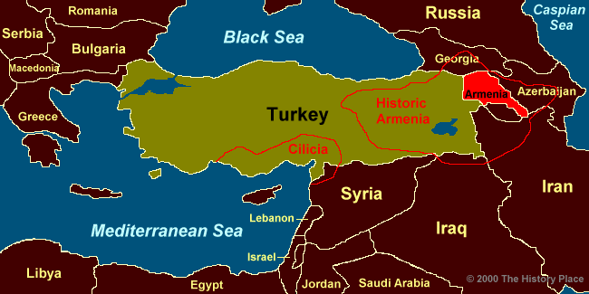
Bringing Peace to the Middle East
Armenian Story
One-third of total Armenian population was killed before and during WWI by the Turks
Worried about possible cooperation with the Russians (Armenians are Orthodox Christians)
Turkey still refuses to admit to the killing

Slide 46
Bringing Peace to the Middle East
Armenian Story
"In the course of the Armenian atrocities, a young woman and her brother were pursued down the street by a Turkish soldier, cornered in an angle of the wall, and the brother was slain before his sister’s eyes. She dodged down an alley, leaped a wall, and escaped…

Slide 47
Bringing Peace to the Middle East
Armenian Story
…Later, being a nurse, she was forced by the Turkish authorities to work in the military hospital. Into her ward was brought, one day, the same Turkish soldier who had slain her brother. He was very ill. A slight inattention would insure his death…

Slide 48
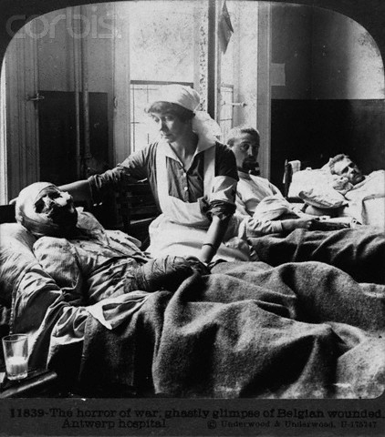
Bringing Peace to the Middle East
Armenian Story
…The young woman, now safe in America, confesses to the bitter struggle that took place in her mind. The old Adam cried “Vengeance,” and the new Christ cried, “Love”. The better side of her conquered, and she nursed him as carefully as any other patient in the ward.

Slide 49
Bringing Peace to the Middle East
Armenian Story
…The recognition had been mutual, and one day, unable to restrain his curiosity, the Turk asked his nurse why she had not let him die, and when she replied, “I am a follower of Him who said, ‘Love your enemies and do them good.’” He was silent for a long time. At last he spoke, “I never knew that there was such a religion. If that is your religion, tell me more about it, for I want it.”

Slide 50
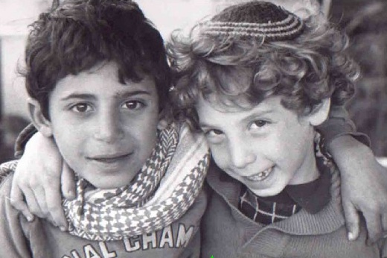
Bringing Peace to the Middle East
Religion can be a hope for the area but the best of the religions (Judaism, Islam and Christianity) must be shown

Slide 51
Bringing Peace to the Middle East
Both sides must also forgive and remember:
“Forgiveness is giving up all hope of a better past.”

Slide 52
Bringing Peace to the Middle East

Slide 53
Bringing Peace to the Middle East
May God Bless Us to Understand the Middle East

