Slide 1
Fundamentals of Composites Manufacturing Materials, Methods, & Applications
Chapter 10 : Quality and Testing

Slide 2
Chapter 10: Quality and Testing - Overview
History of composite materials testing
Quality control principles
Component materials testing
Mechanical testing
Thermal and environmental testing
Flammability testing
Non-destructive testing and inspection

Slide 3
History of Composite Materials Testing
Factors explaining the lack of accepted composited data
The complexity of composites
The relative newness of composites as materials
The continuous development of new composites
The scarcity of standardized tests for composites

Slide 4
Quality Control Principles
Quality is a process, not a destination.
5 primary functions that quality tools are to address
Documentation and certification programs
Analysis and statistical tools
Improvement methods
FMEA, Cause-and-effect diagram, QFD, Benchmarking, Taguchi loss function
System integration strategies
Management philosophies

Slide 5
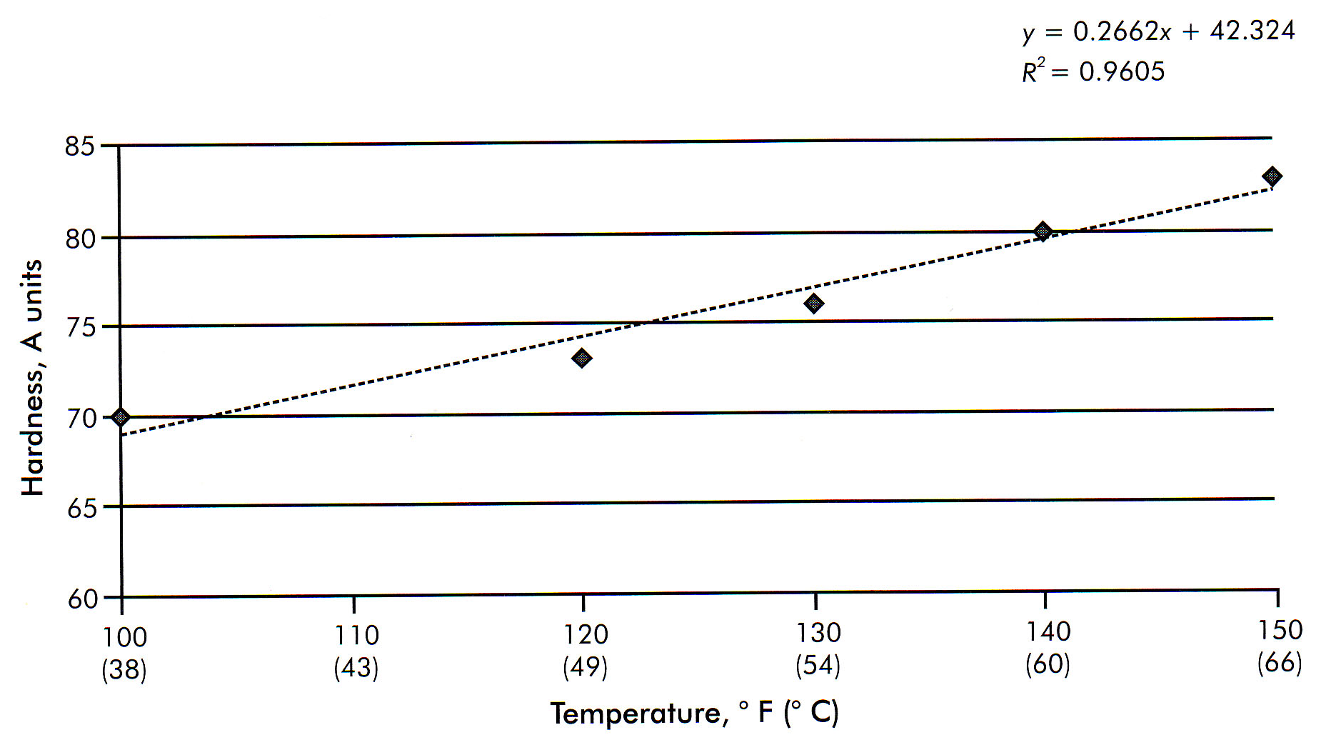
Quality Control Principles
Figure 10-1 Correlation plot of hardness versus temperature

Slide 6
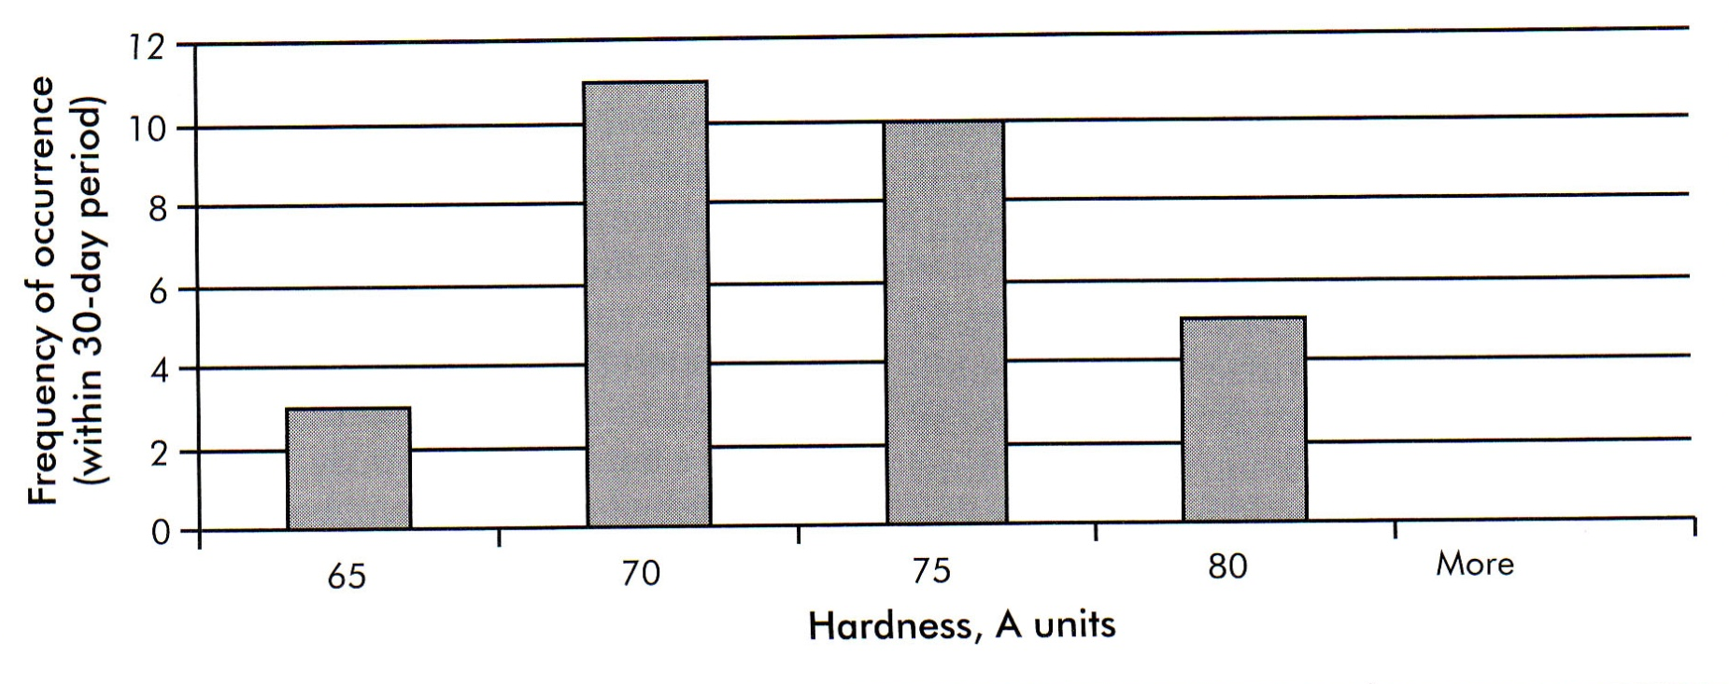
Quality Control Principles
Figure 10-2 Histogram

Slide 7
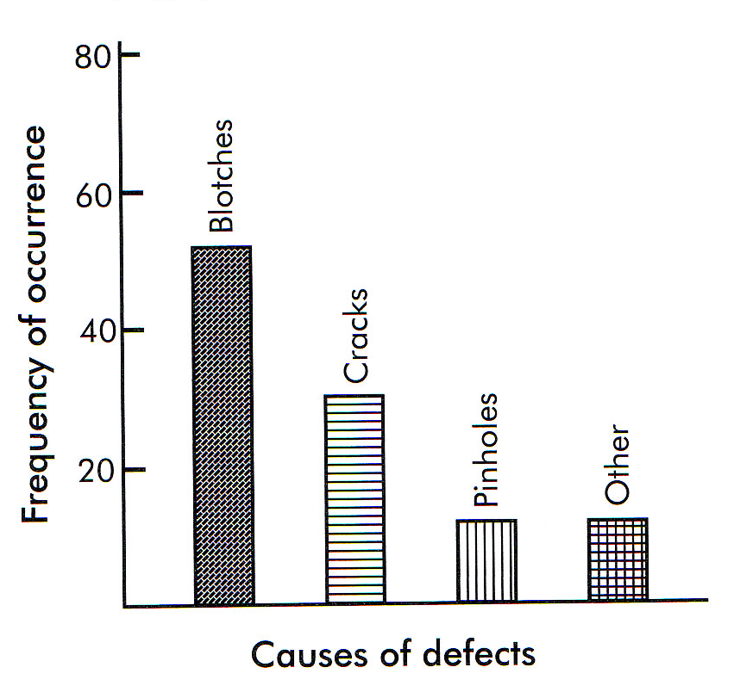
Quality Control Principles
Figure 10-3 Pareto chart

Slide 8
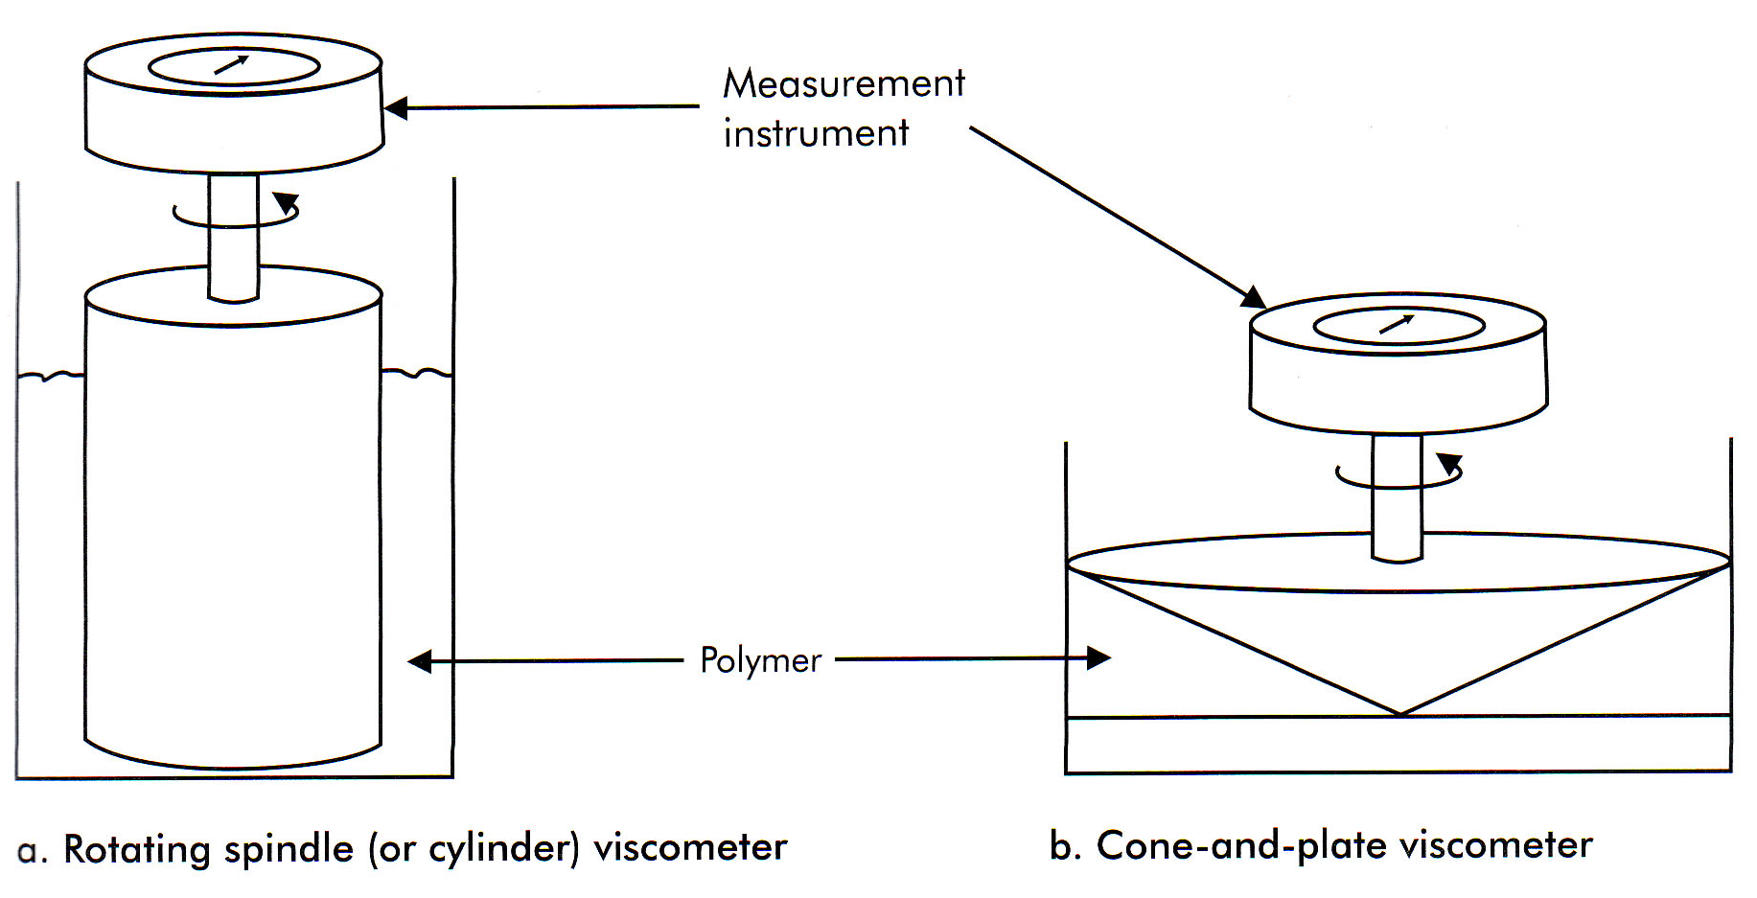
Component Material Testing
Figure 10-4 Viscosity measuring equipment

Slide 9
Component Material Testing
Raw Material Testing
Drape test
Tack Test
Curing Tests
DSC

Slide 10
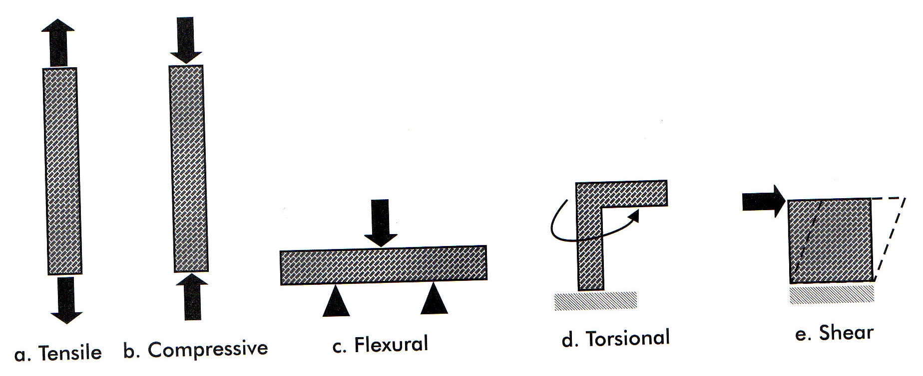
Mechanical Testing
Figure 10-5 Types of forces

Slide 11
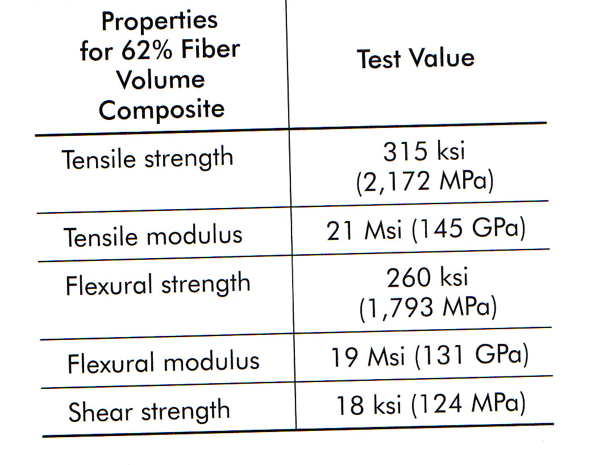
Mechanical Testing
Table 10-1 Mechanical properties of a typical carbon-epoxy composite

Slide 12
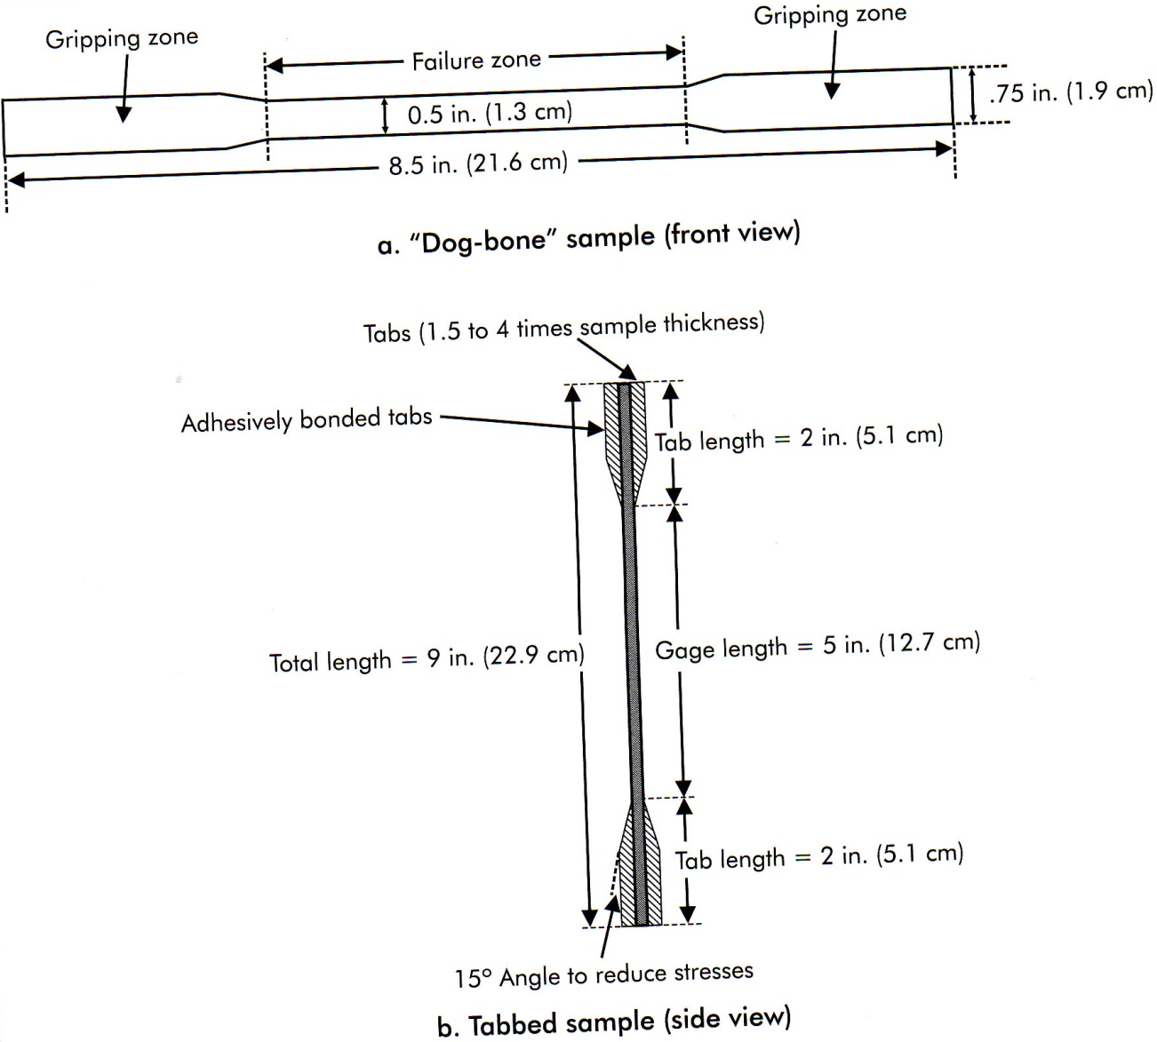
Mechanical Testing
Figure 10-6 Tensile test specimens

Slide 13
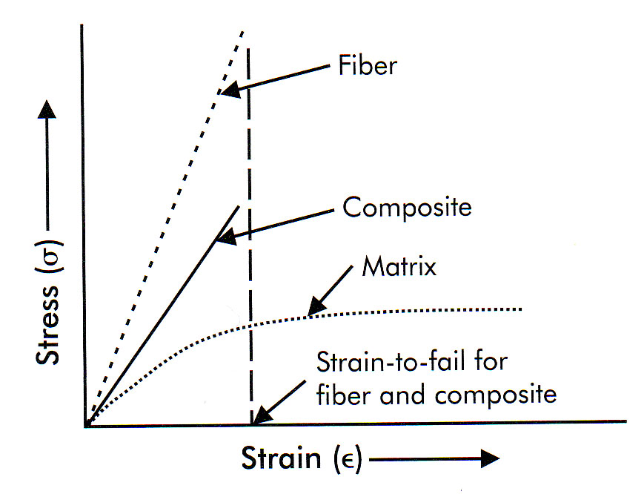
Mechanical Testing
Figure 10-7 Relationships of the tensile strength of fiber, matrix, and composite.

Slide 14
Mechanical Testing
Tensile Testing
Relationship between stress and strain
F/A = σ = Eε
where:
F = Force
A = cross-sectional area
σ = stress
ε = strain
E = modulus or Young’s modulus

Slide 15
Mechanical Testing
Tensile Testing
Burst Test
Open-hole tensile test
Compression and Compression-After-Impact Properties

Slide 16
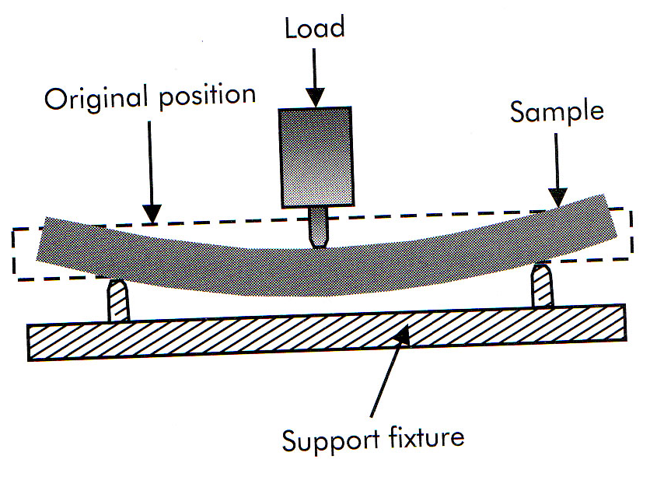
Mechanical Testing
Figure 10-8 flexural test

Slide 17
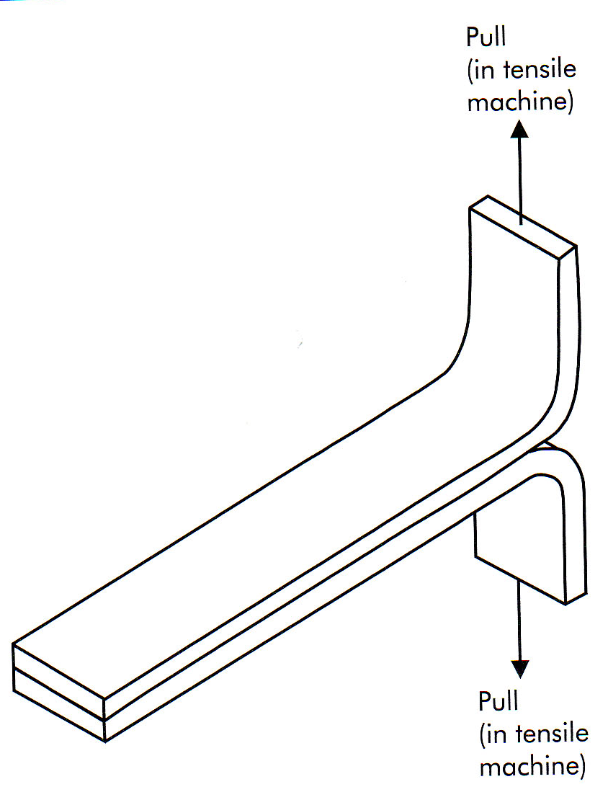
Mechanical Testing
Figure 10-9 Simple peel test

Slide 18
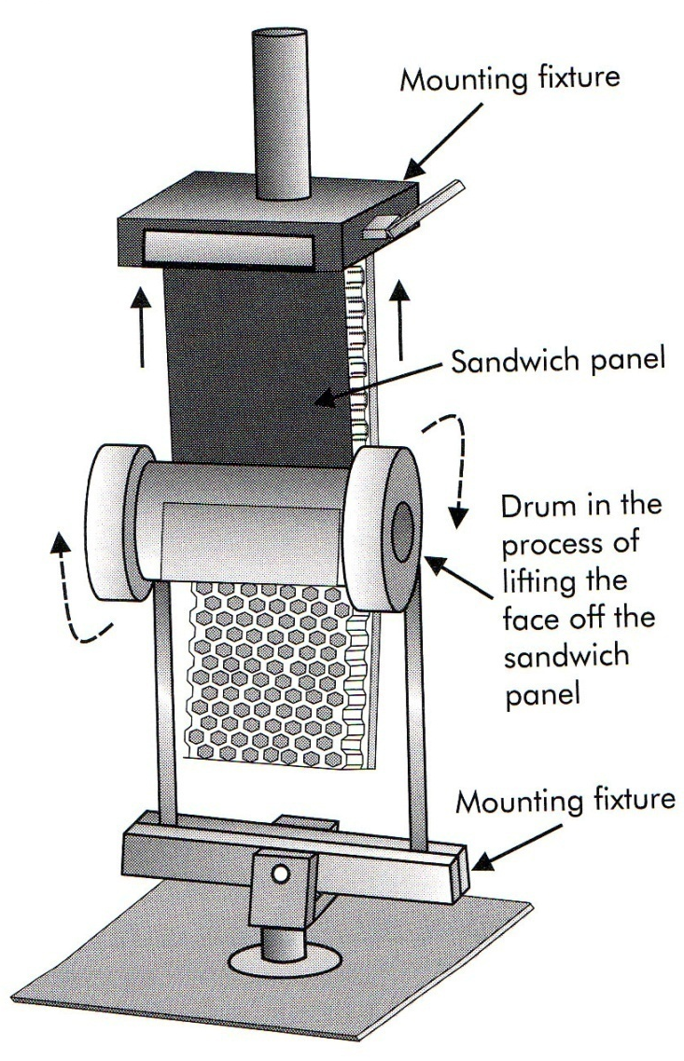
Mechanical Testing
Figure 10-10 Rolling drum peel test

Slide 19
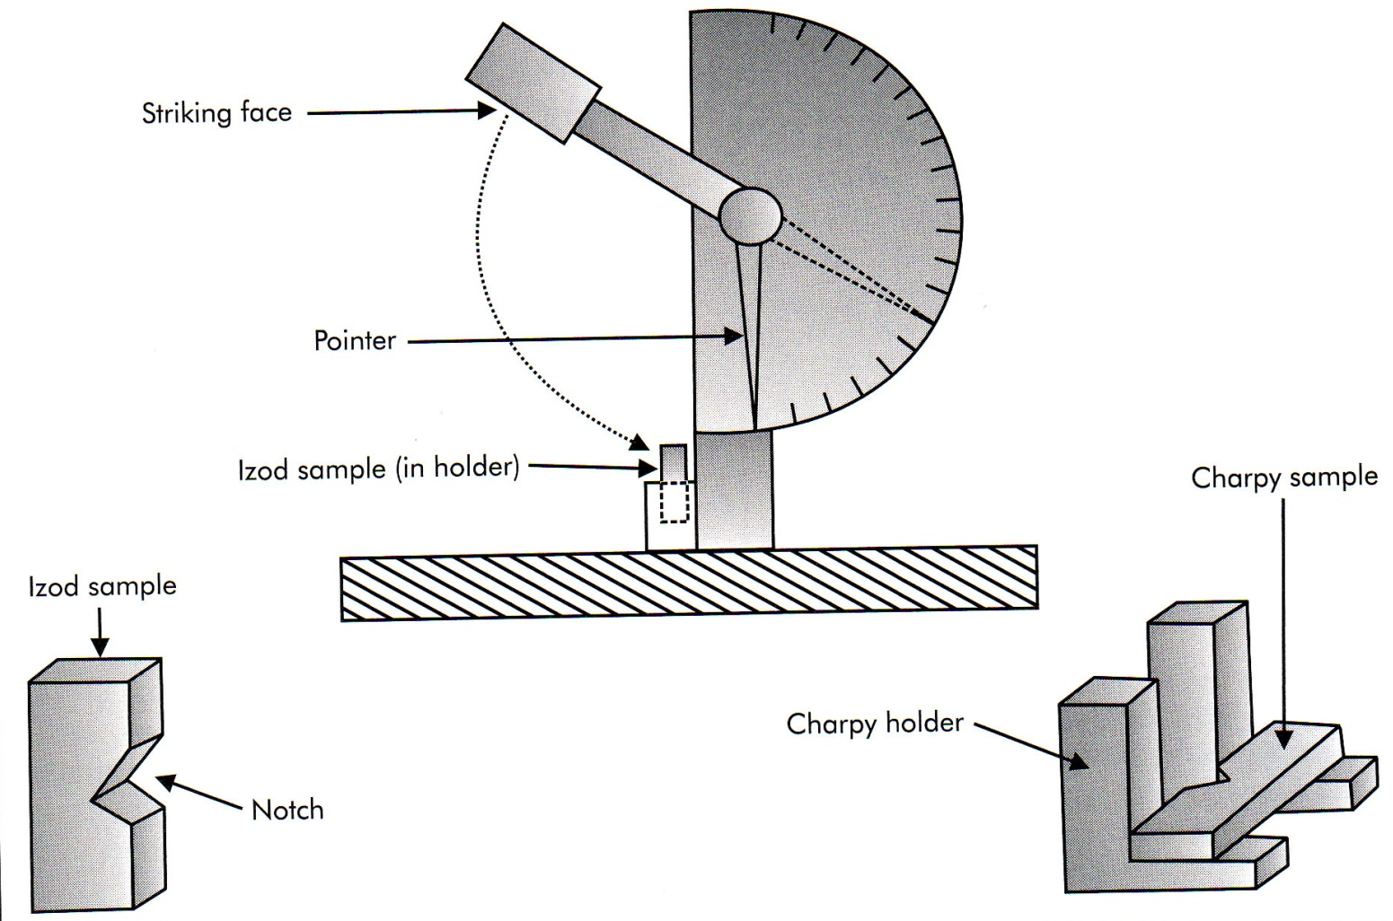
Mechanical Testing
Figure 10-11 Izod and Charpy impact tester and specimens

Slide 20
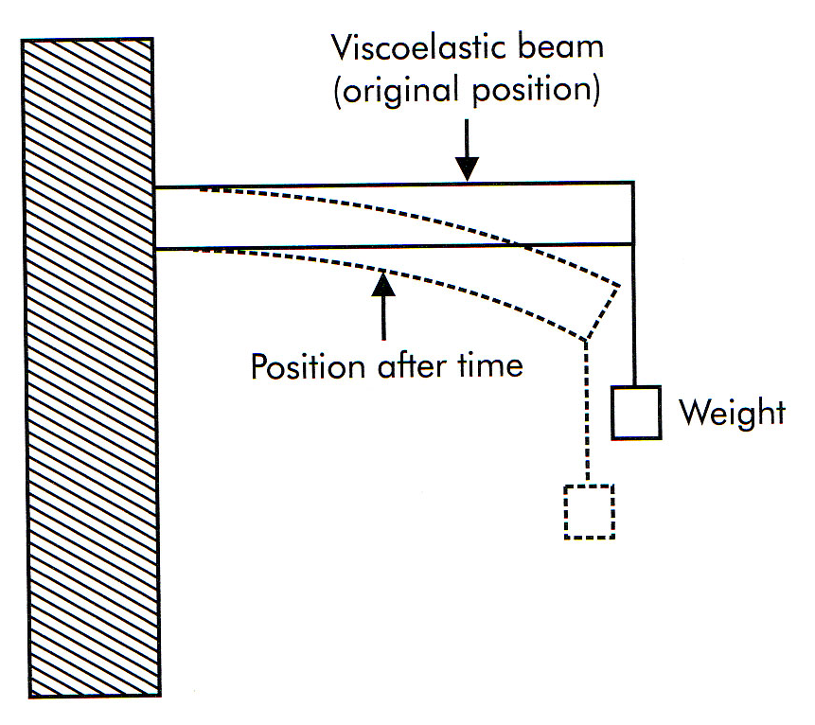
Mechanical Testing
Figure 10-12 Creep test

Slide 21
Mechanical Testing
Creep
σ₀ = E(t,T)ε(t,T)
_{Where:}
σ₀ = applied stress (usually a constant)
E = creep modulus
ε = amount of deformation (strain due to creep)

Slide 22
Mechanical Testing
Creep
Methods used to reduce creep
Orient fibers in directions of highest loads
Increase the fiber content
Select high-modulus fibers (increase stiffness)
Reduce the stress level
Reduce the temperature
Utilize initial loading cycles

Slide 23
Mechanical Testing
Fatigue
Composites tend to stabilize early in fatigue loading through the following mechanisms:
Matrix micro-cracking
Blunting of cracks at the fiber surface
Delaminations between layers
Stress redistribution and load sharing
Energy dissipation from visco-elastic effects of the matrix

Slide 24
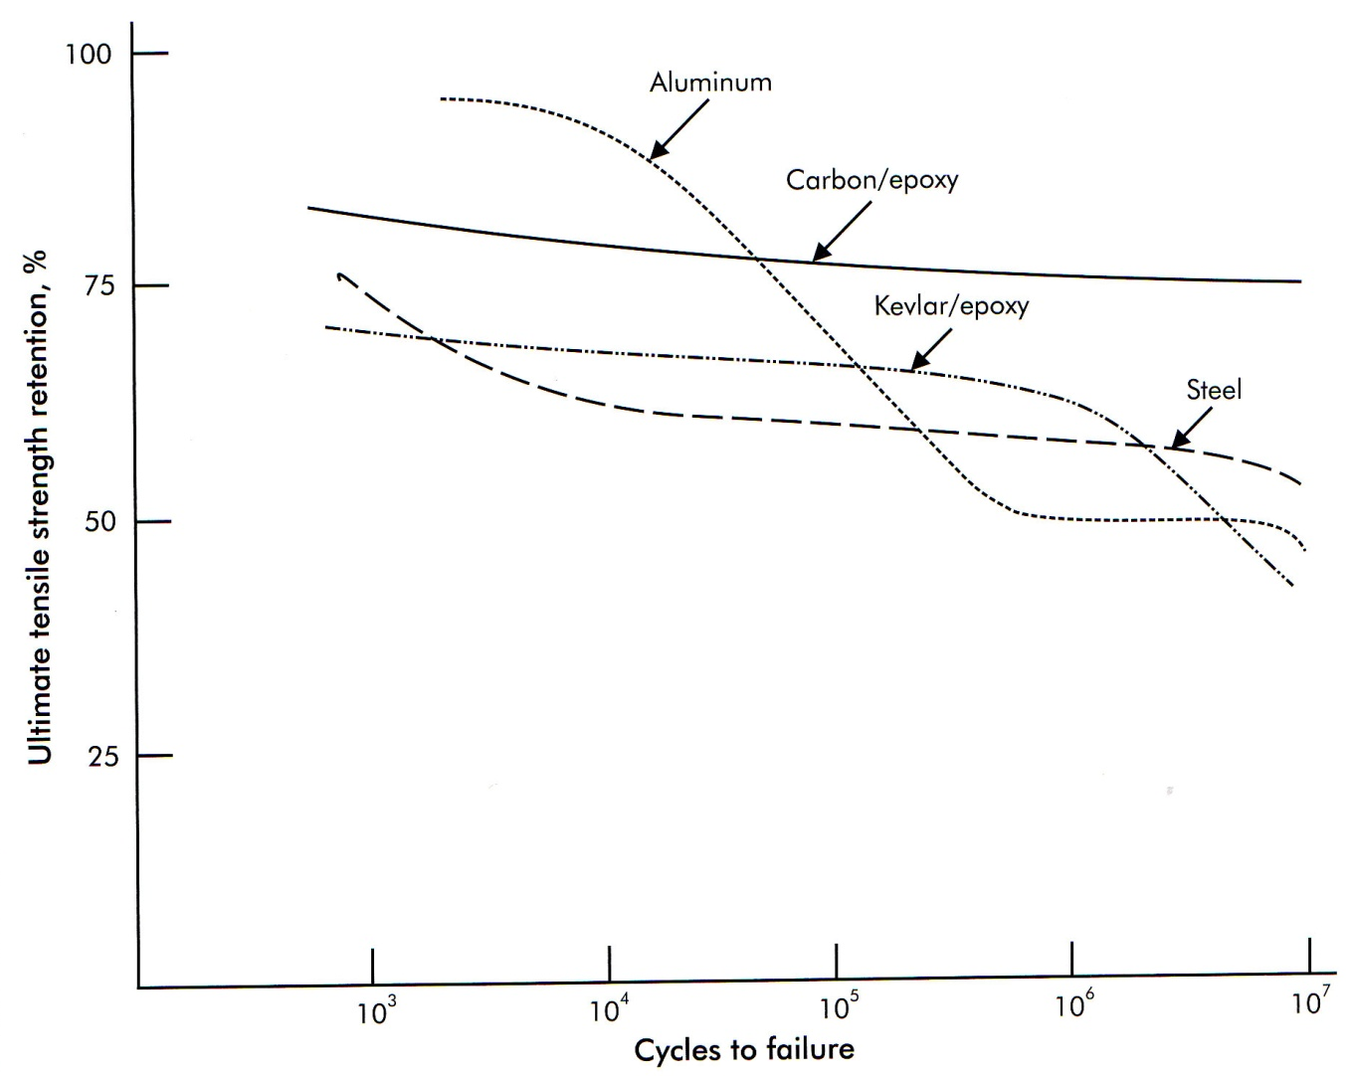
Mechanical Testing
Figure 10-13 Fatigue testing for various materials

Slide 25
Mechanical Testing
Vibration and Damping
Constrained layer damping
Active damping
Stress-couples activated damping

Slide 26
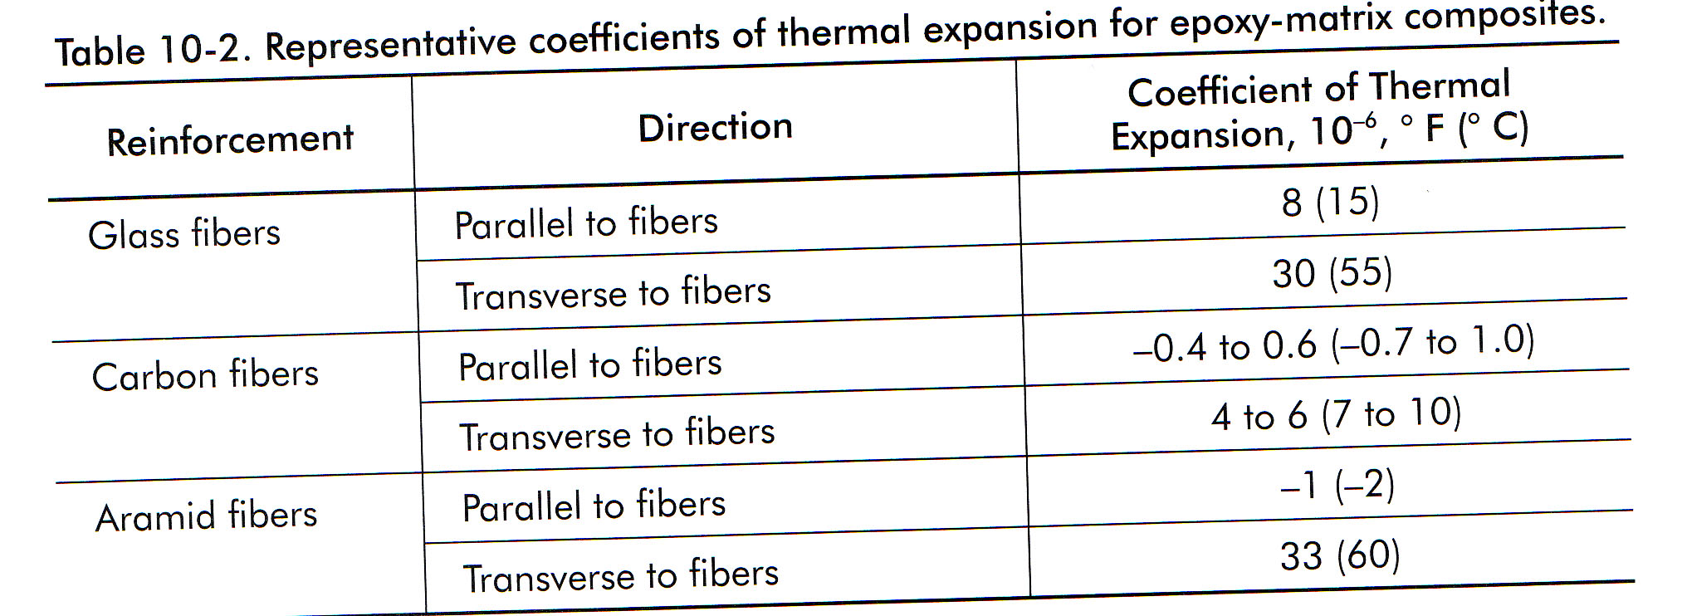
Thermal and Environmental Testing
Temperature Effects
Coefficient of thermal expansion (CTE)
Table 10-2 Representative coefficients of thermal expansion for epoxy-matrix composites

Slide 27
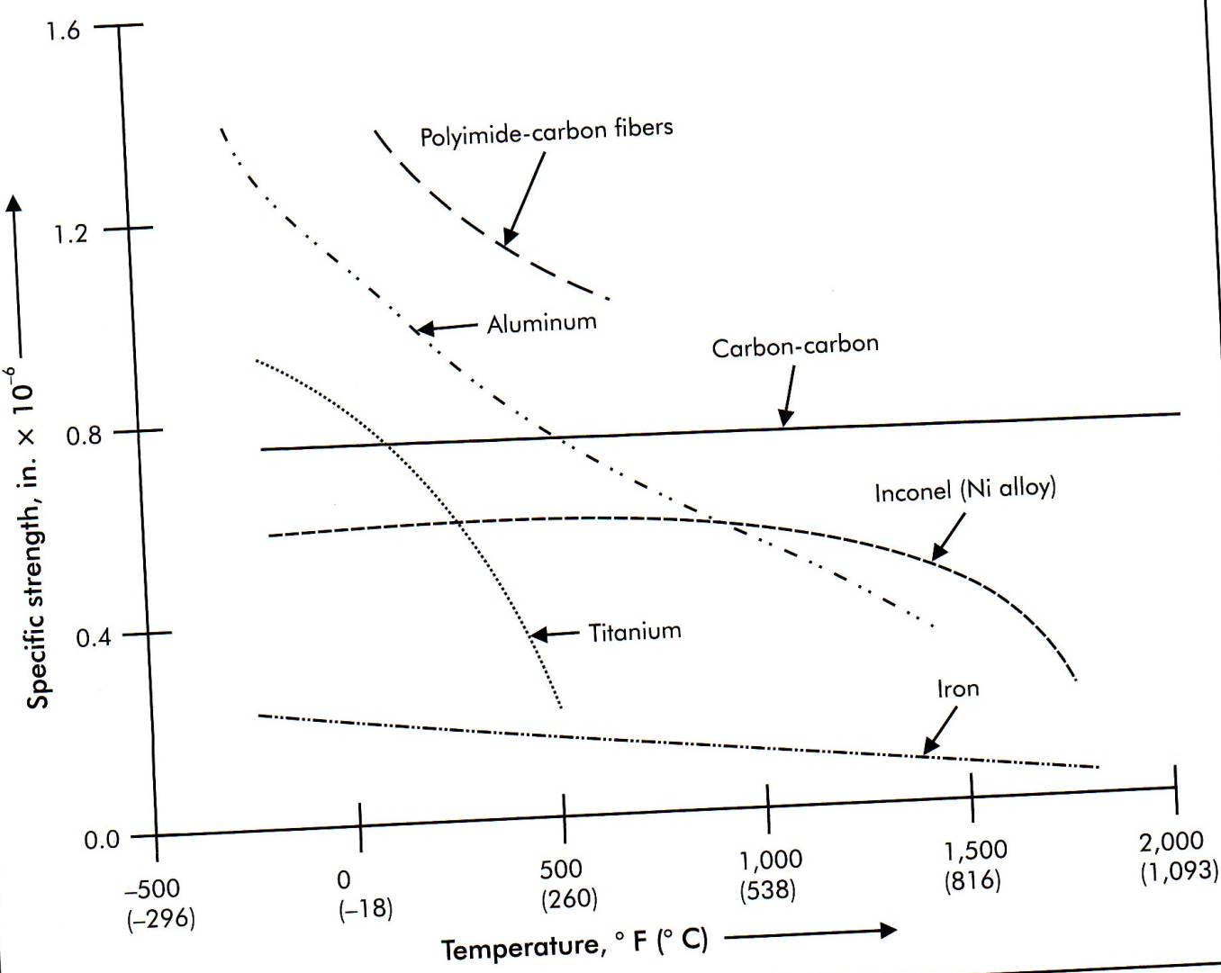
Thermal and Environmental Testing
Figure 10-14 Specific strength as a function of temperature

Slide 28
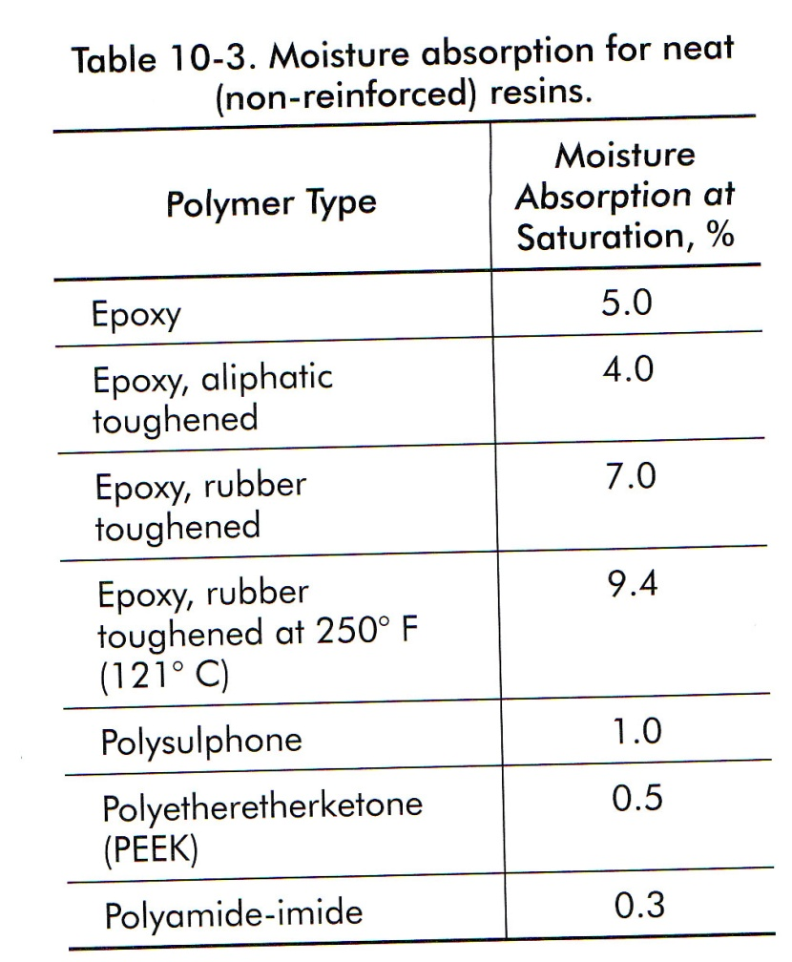
Thermal and Environmental Testing
Table 10-3 Moisture and absorption for neat (non-reinforced) resins

Slide 29
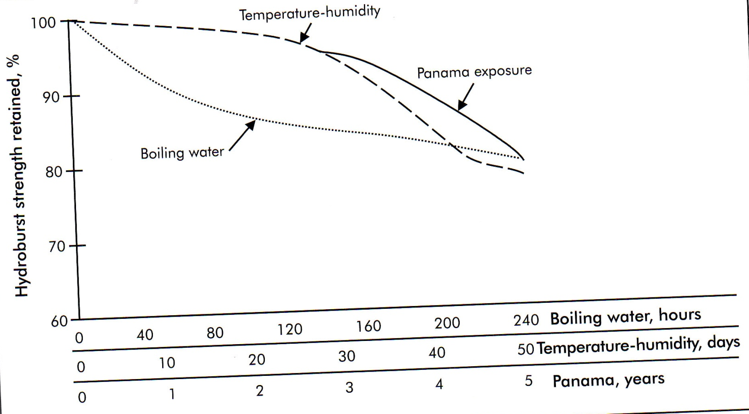
Thermal and Environmental Testing
Figure 10-15 Fiberglass-epoxy exposure to various moisture conditions

Slide 30
Thermal and Environmental Testing
Aging and Service Life Considerations
Suggestions for establishing a basis for predicting service life:
Define the service environment in terms of exposure time, temp, humidity, and loading conditions
Review the database after selecting materials to see what is already known about them
Conduct accelerated aging tests on the materials
Accelerated aging analysis
Verify the data

Slide 31
Flammability Testing
Understand How Composites Burn
Combustion Characteristics of Organic Resins and Plastics
Properties considered when examining the burning of composites/plastics
Ease of ignition/flame resistance
Flame spread/fire-retardant properties/surface flammability
Heat release rate
Fire endurance
Ease of extermination
Smoke emission/toxicity
Physical characteristics

Slide 32
Flammability Testing
Types of Flammability Testing
Test Categories
Official tests
Laboratory tests
Full-scale tests

Slide 33
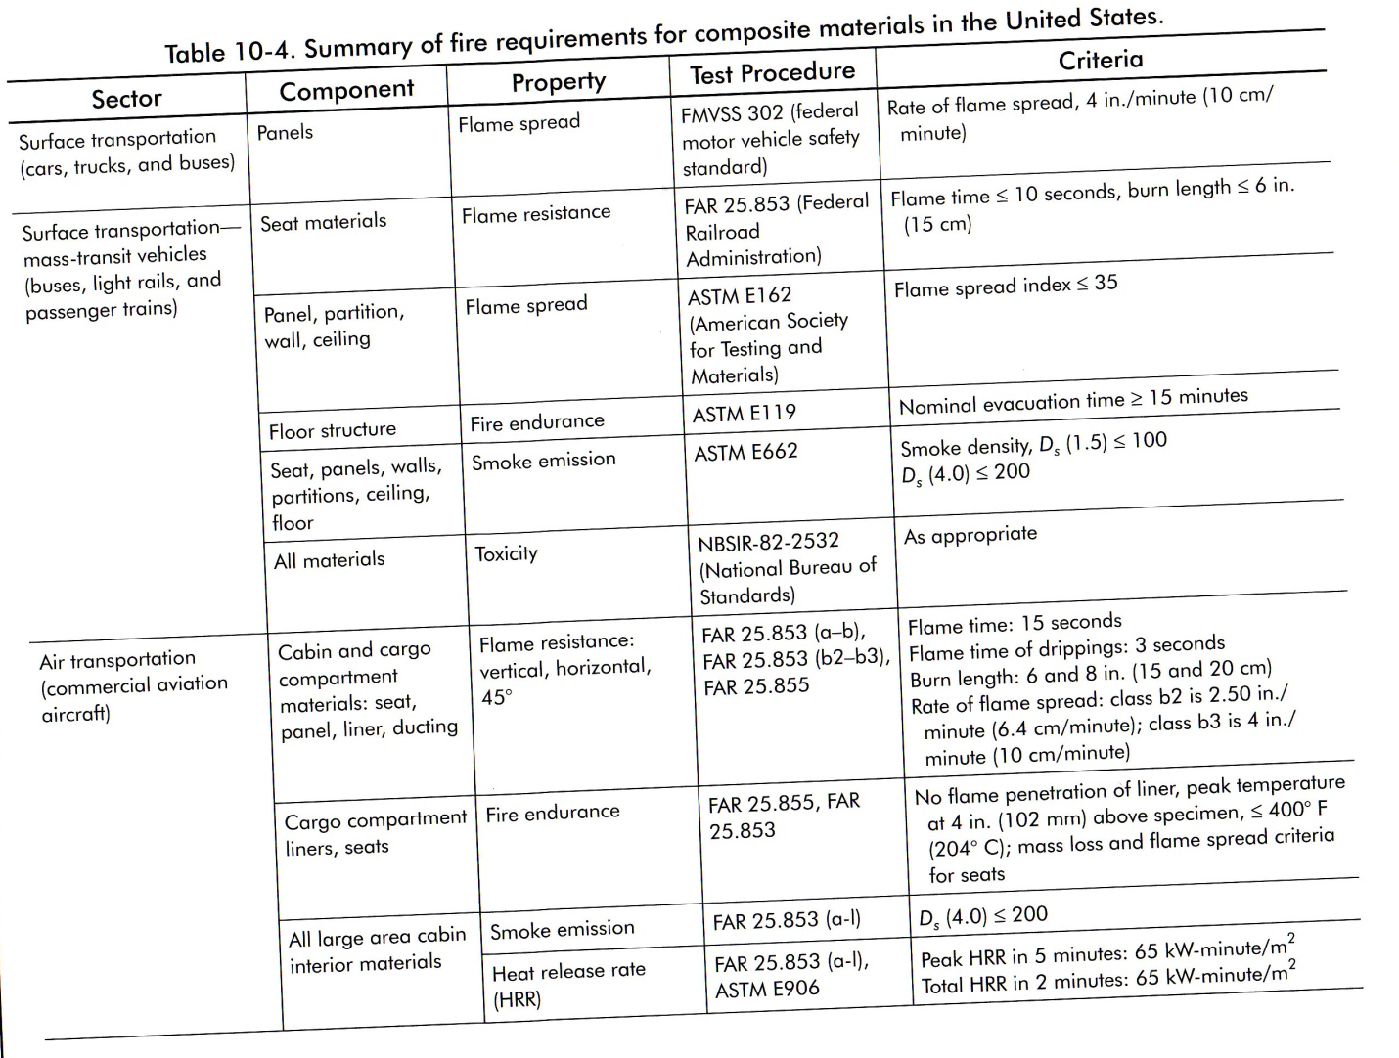
Flammability Testing
Table 10-4 Summary of fire requirements for composite materials in the US.

Slide 34
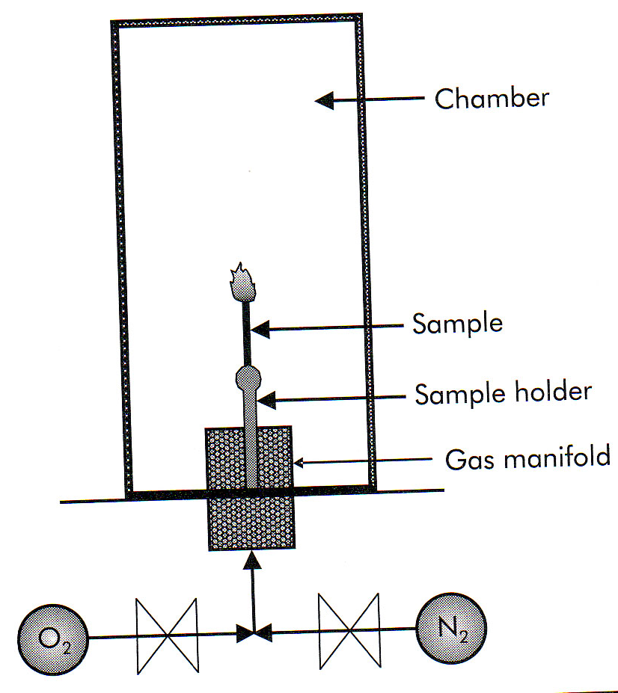
Flammability Testing
Figure 10-16 Limiting oxygen index test

Slide 35
Non-Destructive Testing and Inspection
General Principles
Sending an energy signal (wave) through or onto the part and then detecting changes in that signal compared to some standard.
Ultrasonic Testing
Acoustic Emission
Radiography
Thermography
Optical Holography
Microwave Frequencies
Eddy Current
Visual Inspeciton

