Slide 1
Fundamentals of Composites Manufacturing Materials, Methods, & Applications
Chapter 6: Thermoplastic Composites

Slide 2
Chapter 6 Thermoplastic Composites - Overview
Review of thermoset and thermoplastic composites
Engineering thermoplastic composites
High performance thermoplastic composites

Slide 3
Review of Thermoset and Thermoplastic Composites
Molecular weights
Crosslinking
Advantages/Disadvantages

Slide 4
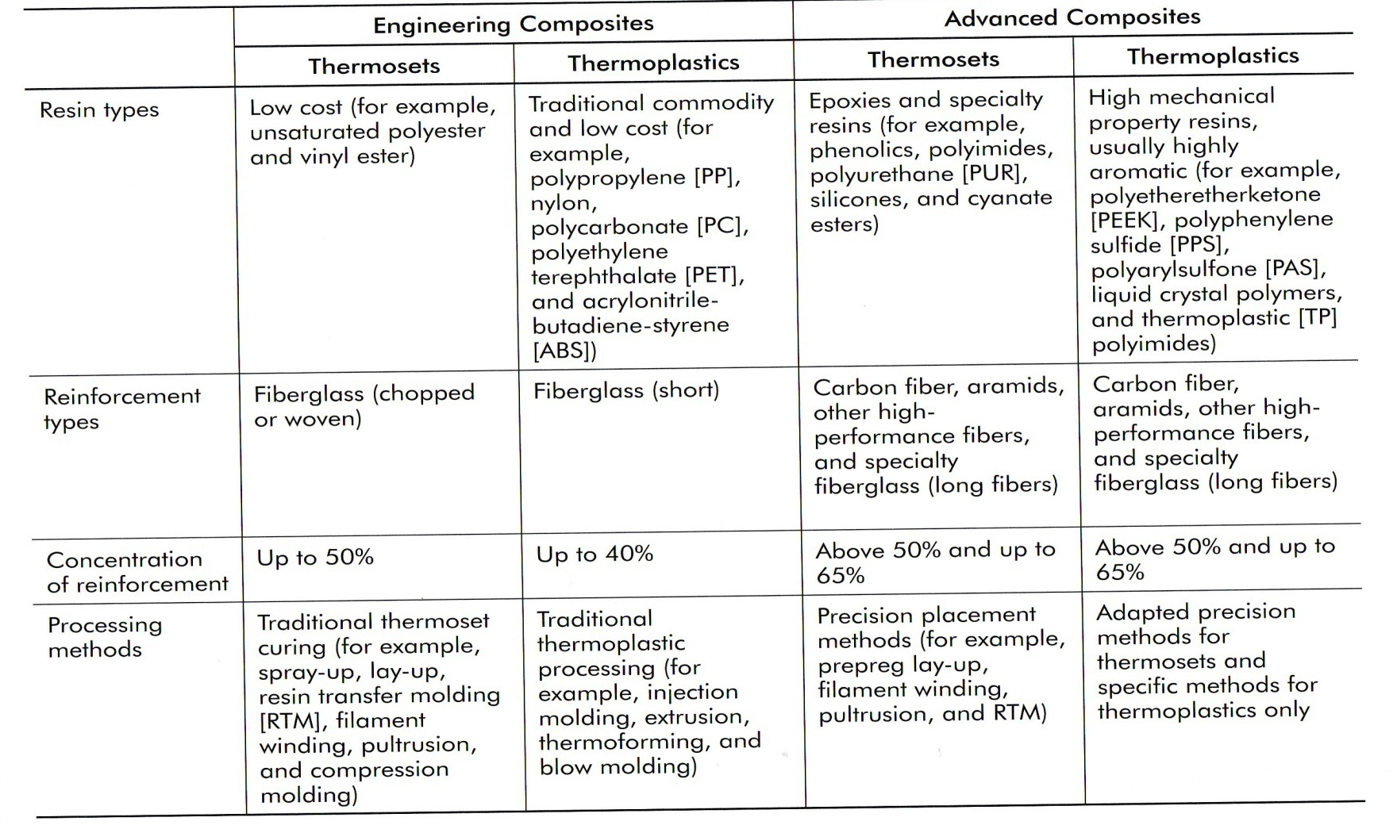
Review of Thermoset and Thermoplastic Composites
Differences between engineering and high performance composites
Table 6-1 Characteristics of engineering and advanced, high performance thermoset and thermoplastic composites.

Slide 5
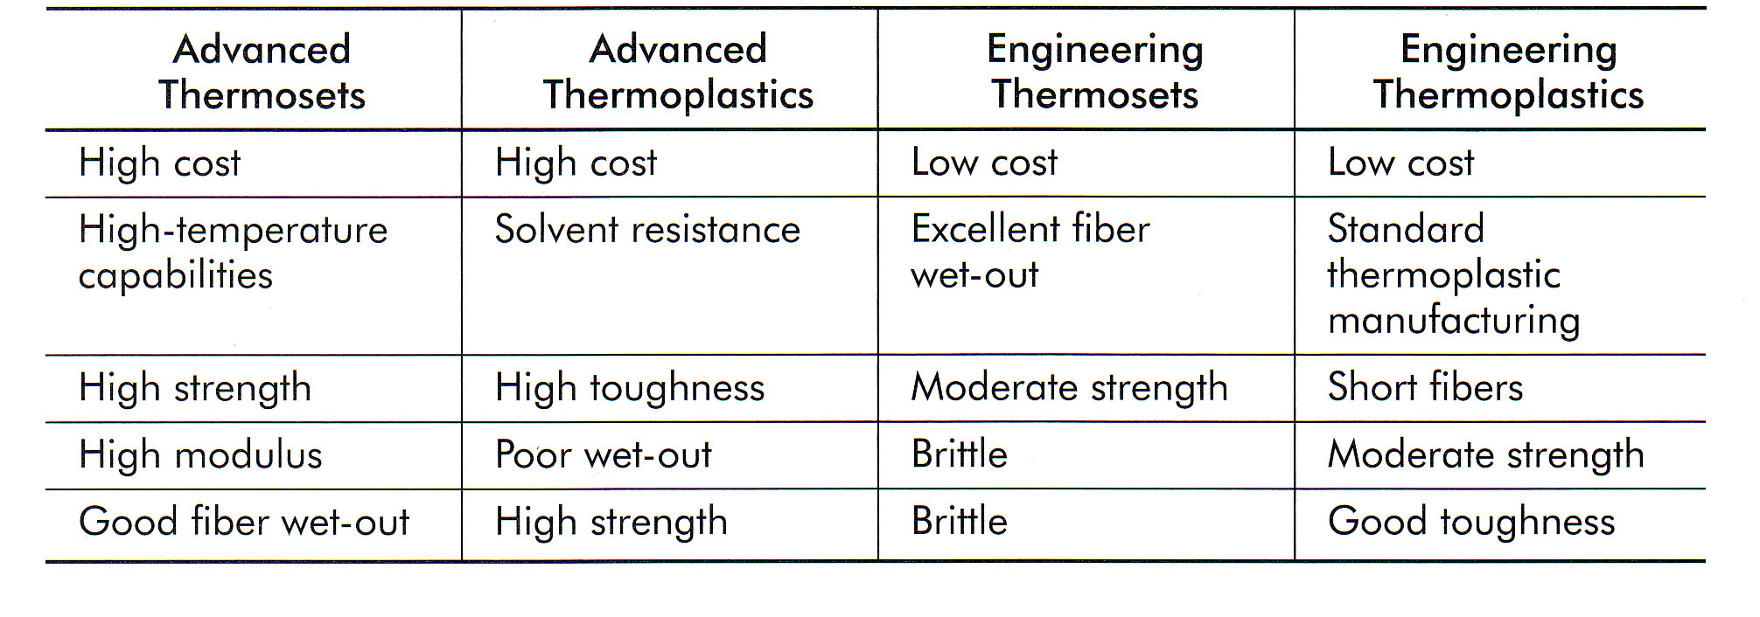
Review of Thermoset and Thermoplastic Composites
Table 6-2 Comparison of advanced and engineering thermoplastics and thermosets

Slide 6
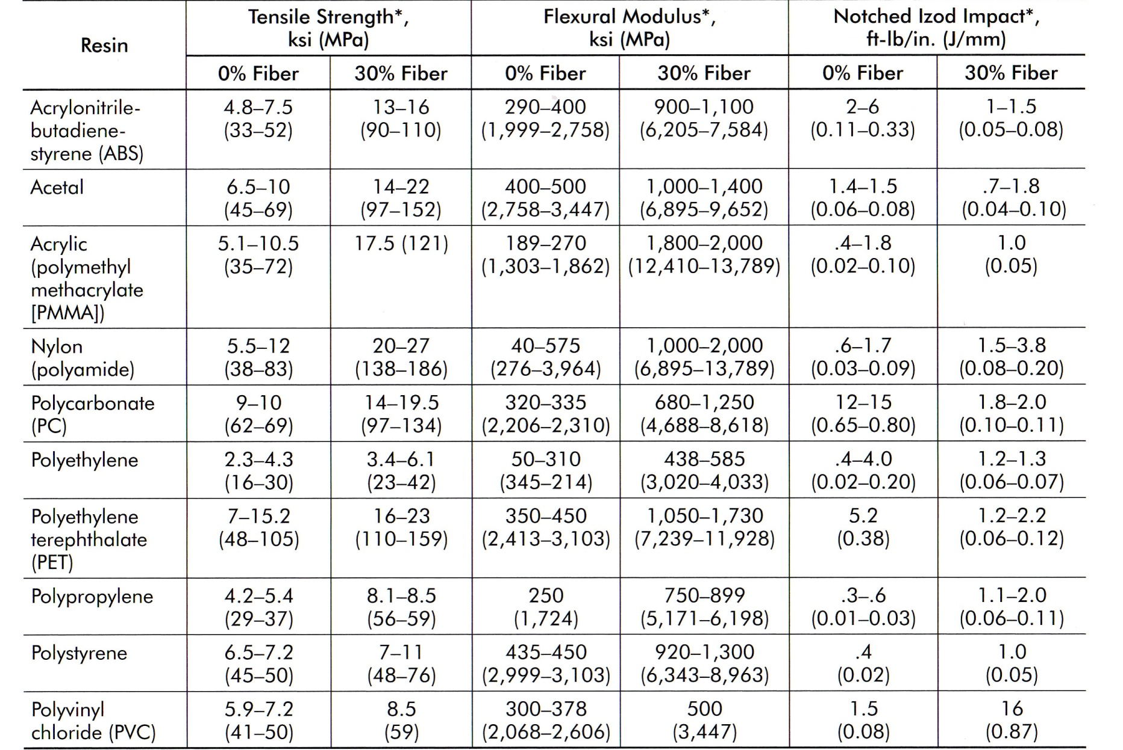
Engineering Thermoplastic Composites
Table 6-3 Effects of fiberglass content on mechanical properties of various engineering thermoplastic resins

Slide 7
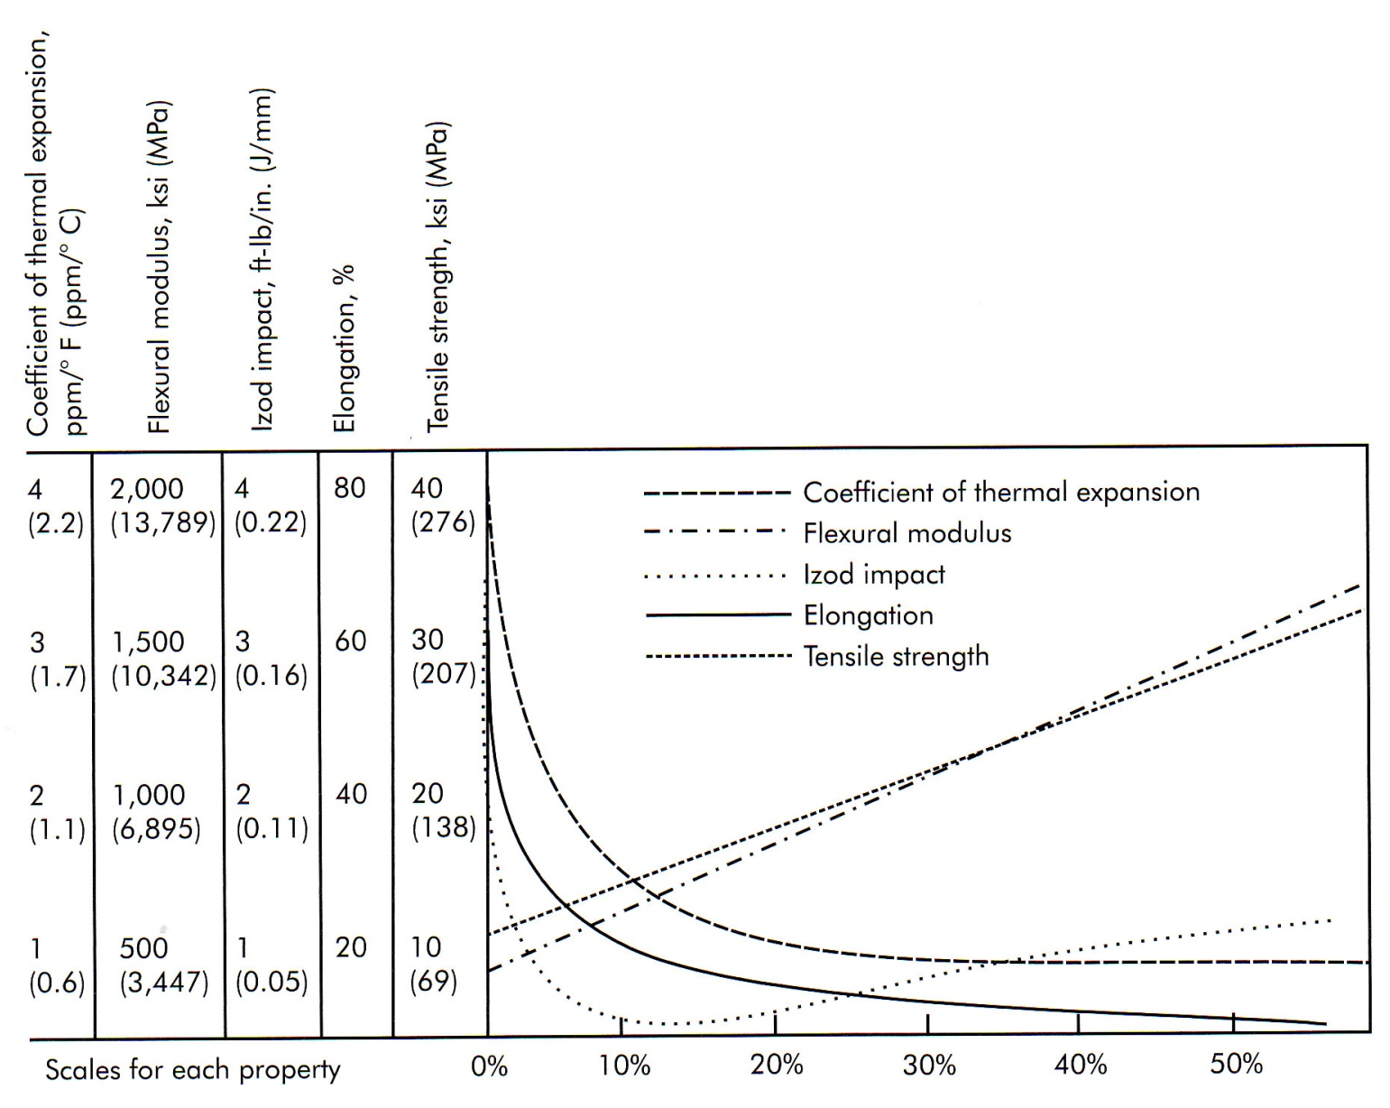
Engineering Thermoplastic Composites
Figure 6-1 Effects of fiber content on the properties of nylon

Slide 8
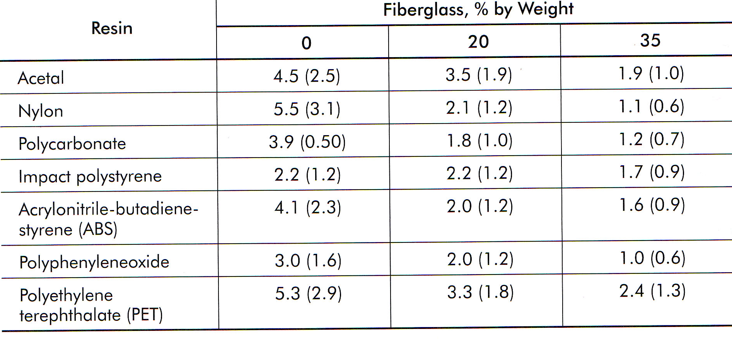
Engineering Thermoplastic Composites
Table 6-4 Coefficient of thermal expansion (CTE), ppm/degreeF (ppm/degreeC) for various thermoplastic composites at different fiber content levels

Slide 9
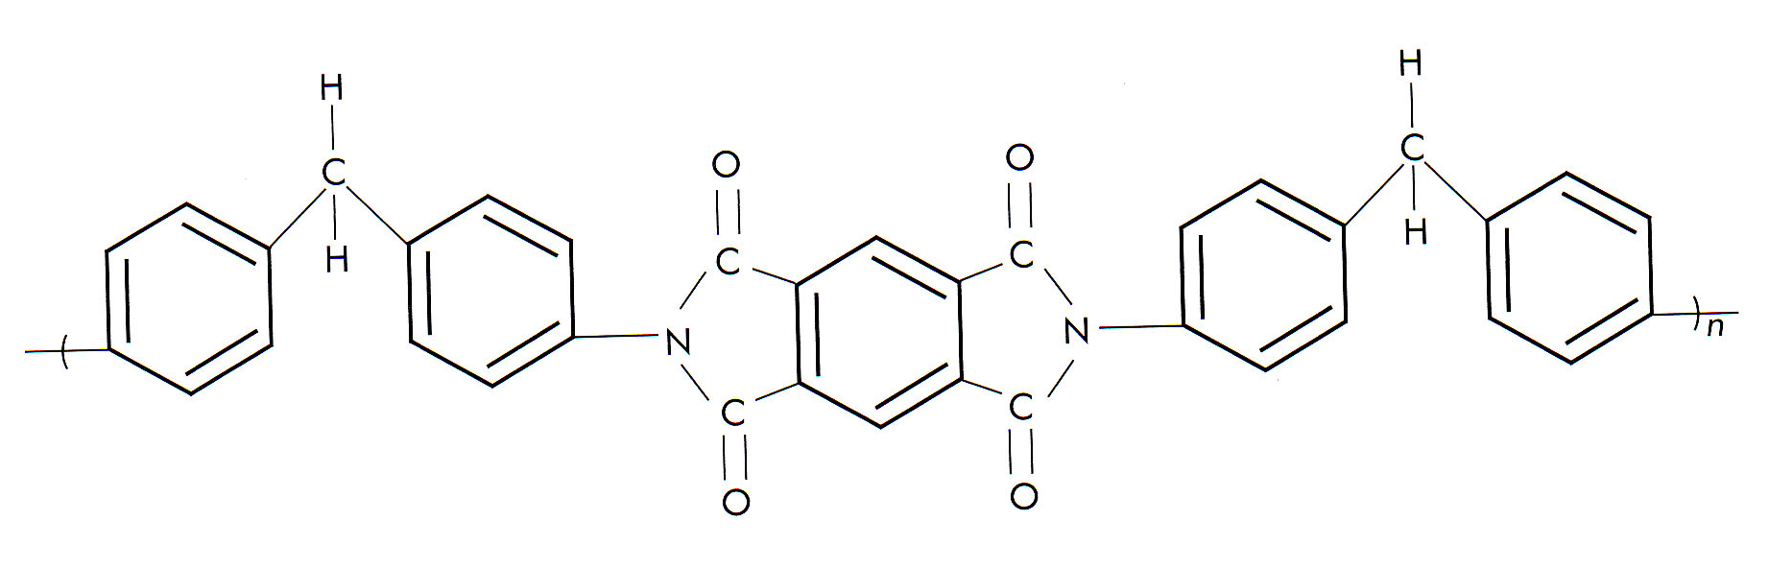
High Performance Thermoplastic Composites
Figure 6-2 Thermoplastic polyimide

Slide 10
High Performance Thermoplastic Composites
Thermoplastic polyimides and related polymers
Sintering
Polyamide-imide
Melt-processible resins
Polytherimide
Polybenzimidazole

Slide 11
High Performance Thermoplastic Composites
Figure 6-3 Polyetheretherketone (PEEK)

Slide 12
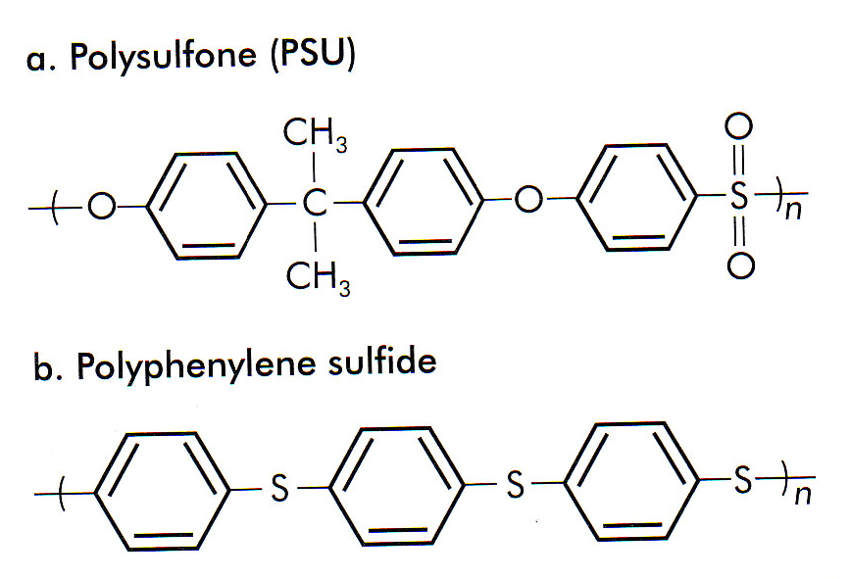
High Performance Thermoplastic Composites
Figure 6-4 Sulphur-containing advanced thermoplastics

Slide 13
High Performance Thermoplastic Composites
Liquid Crystal Polymers

Slide 14
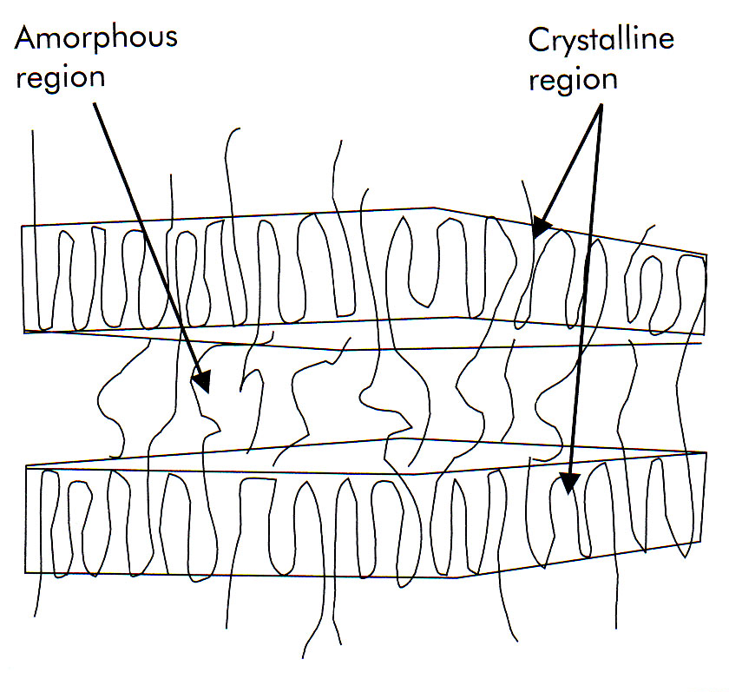
High Performance Thermoplastic Composites
Figure 6-5 Three-dimensional representation of a liquid crystalline polymer

