Slide 1
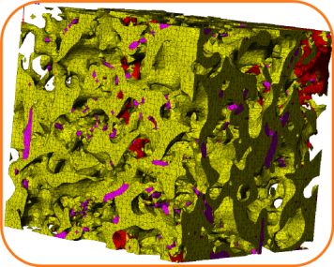
Fundamentals of Composites Manufacturing Materials, Methods, & Applications
Chapter 7 Ceramic and Metal Matrix Composites

Slide 2
Chapter 7 Ceramic and Metal Matrix Composites - Overview
Non-polymeric matrix materials
Properties and uses of ceramic matrix composites
Manufacturing of ceramic matrix composites
Properties and uses of metal matrix composites
Manufacturing of metal matrix composites

Slide 3
Non-Polymeric Matrix Materials
Ionic Bond - Metal Atom with Non-Metal Atom
Metallic Bond - Metal Atom with Another Metal Atom
Sea of Electrons
Covalent Bond - Non-metal Atom with Another Non-metal Atom

Slide 4
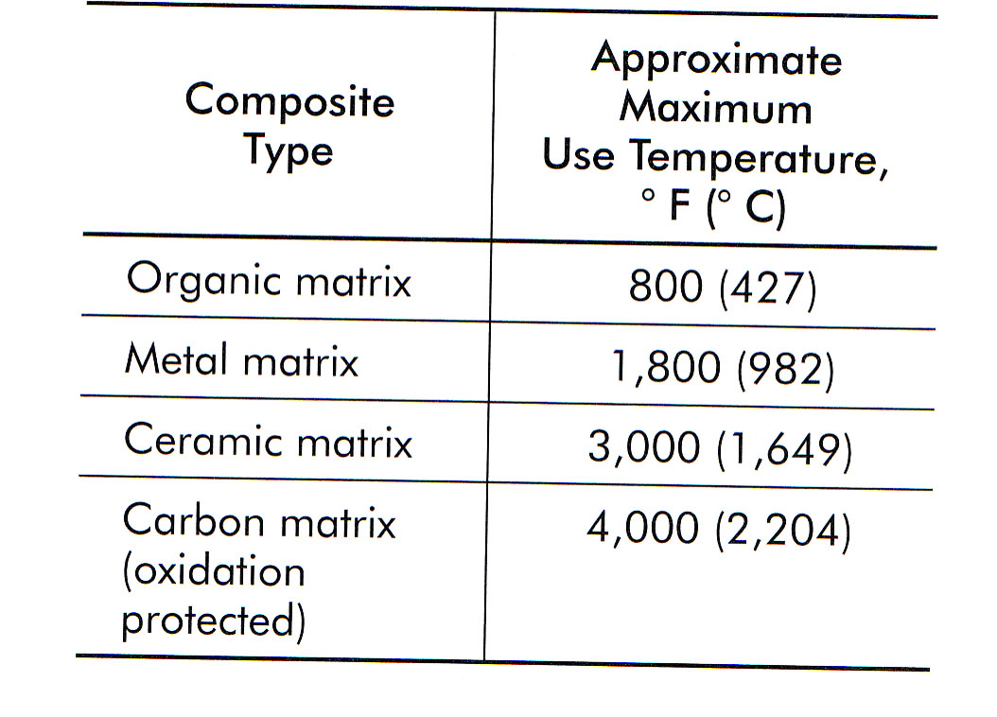
Properties and Uses of Ceramic Matrix Composites
Table 7-1 Temperature limits for composites with various matrices

Slide 5
Properties and Uses of Ceramic Matrix Composites
General Laws of problems associated with high temperatures
Everything reacts with everything at high temperatures
Everything reacts faster at high temperatures
The reaction products may be anything

Slide 6
Properties and Uses of Ceramic Matrix Composites
Toughening Mechanisms
Crack Pinning or Crack Deflection
Load Transfer to the Reinforcement
Transformation Toughening
Microcracks

Slide 7
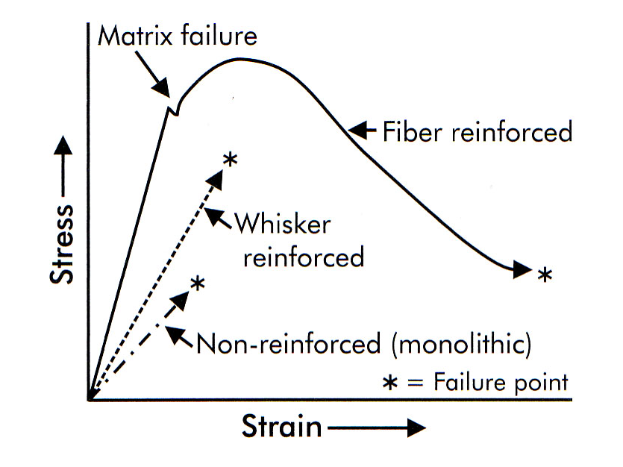
Properties and Uses of Ceramic Matrix Composites
Figure 7-1 Stress/strain characteristics of various reinforcements for ceramic matrix composites.

Slide 8
Properties and Uses of Ceramic Matrix Composites
Applications
Apps requiring good thermal and wear properties
Aerospace engine parts
Heat shields, re-entry vehicles, nose cones, rocket nozzles, general space structures (thermal exposure is a critical issue)

Slide 9
Manufacturing of Ceramic Matrix Composites
Sintering
In-situ Reaction Sintering

Slide 10
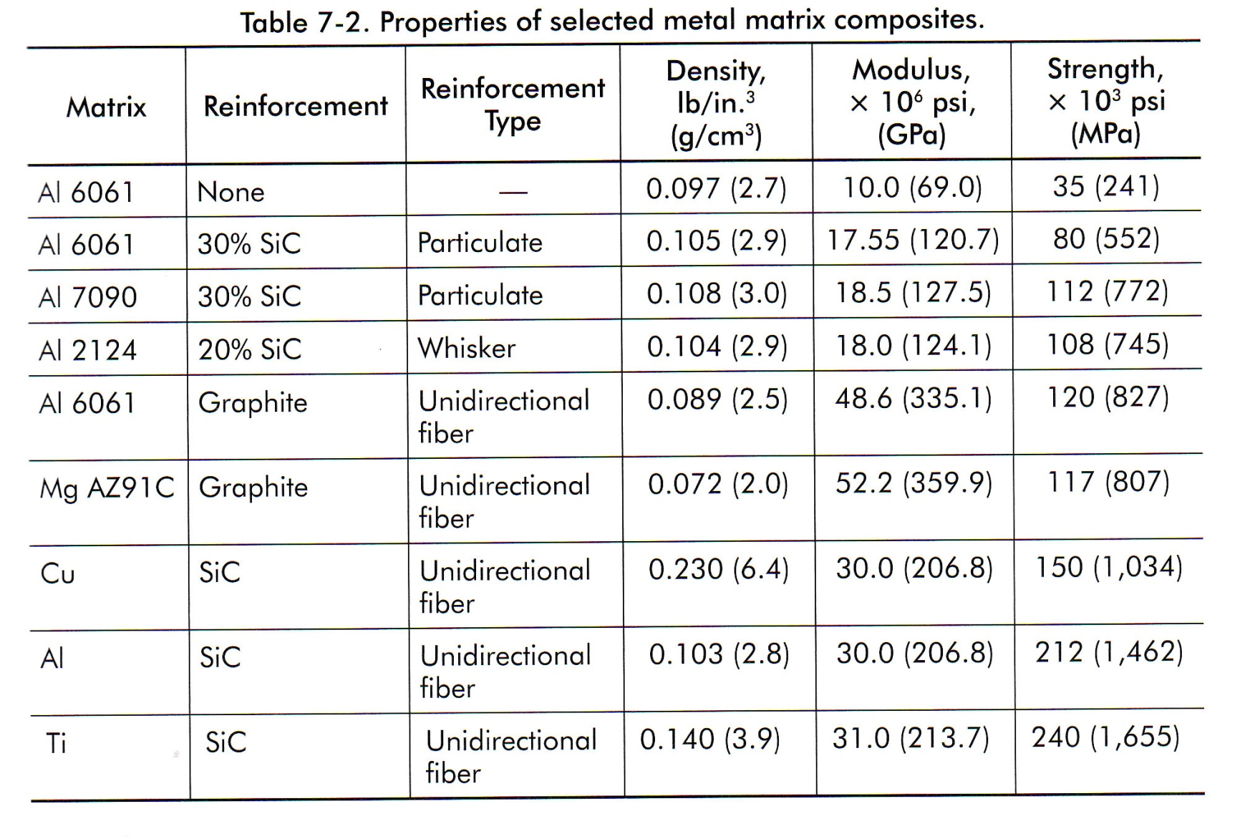
Properties and Uses of Metal Matrix Composites
Table 7-2 Properties of selected metal matrix composites

Slide 11
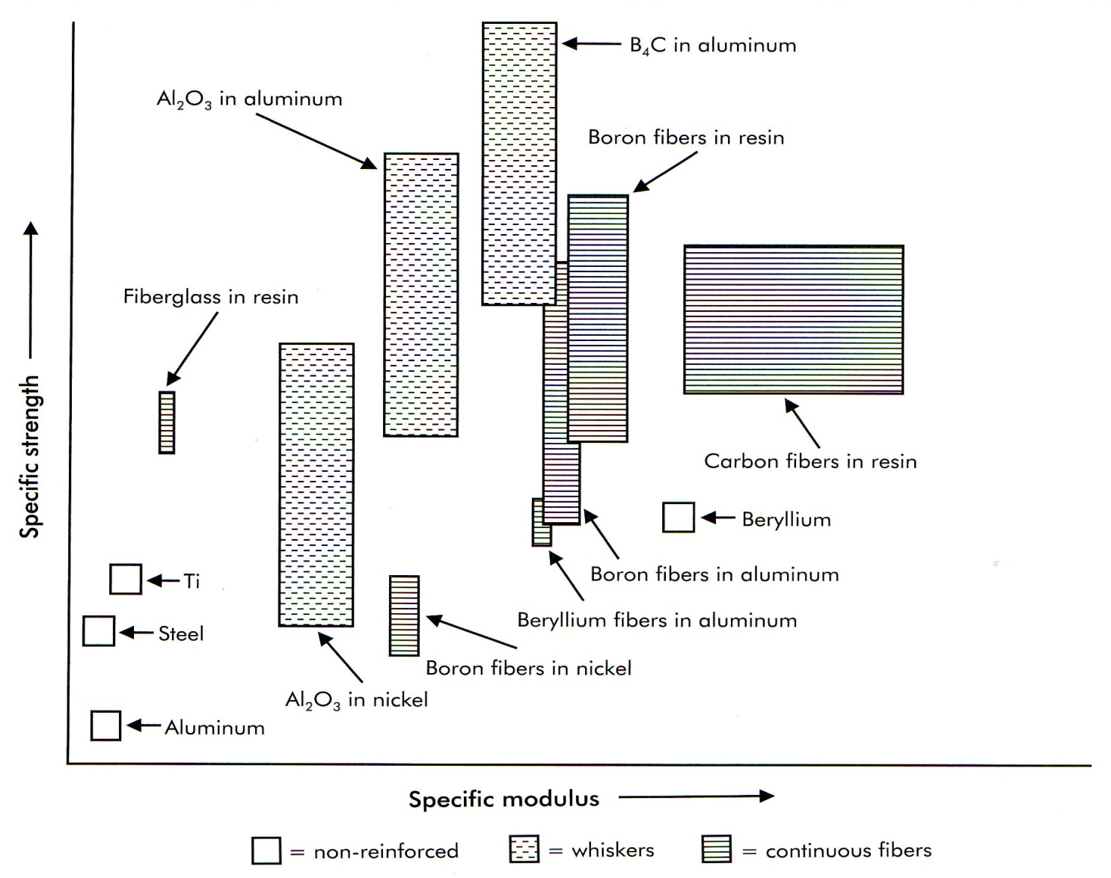
Properties and Uses of Metal Matrix Composites
Figure 7-2 Specific strengths versus specific stiffnesses of various composites

Slide 12
Properties and Uses of Metal Matrix Composites
Applications
Automotive Apps which include piston ring inserts, pistons, connecting rods, impellers, brake calipers.
Aerospace Apps include structural rods for space platforms, antenna masts for satellites, aircraft stiffeners, actuator rods.

Slide 13
Manufacturing of Metal Matrix Composites
Reinforcement material orientation important?
Reinforcement material size.

Slide 14
Case Study 7-1 Diamond Reinforced Abrasive Pads

