Slide 1
Fundamentals of Composites Manufacturing Materials, Methods, & Applications
Chapter 9 Summary

Slide 2
Chapter 9: Reinforcement Forms - Overview
Filaments, strands, tows, rovings, and yarns
Woven and knitted fabrics (cloth)
Non-woven fabrics (mat)
Prepregs
Braided, stitched, and three-dimensional laminates
Preforms
Hybrids
Whiskers

Slide 3
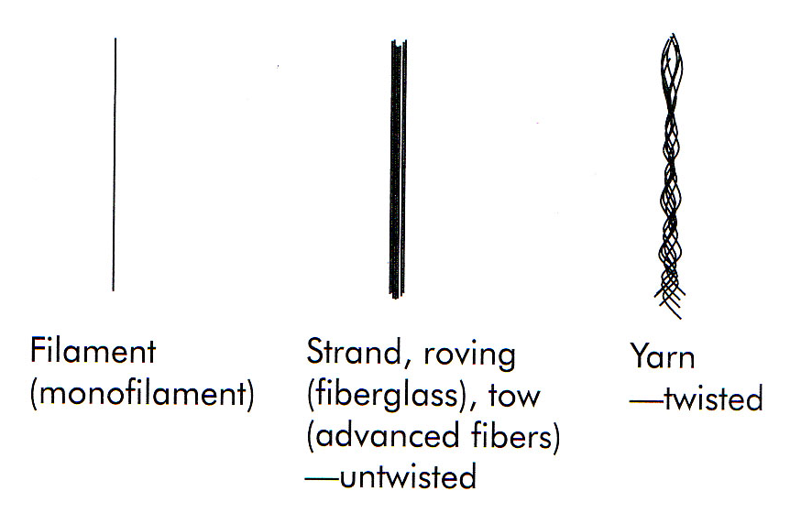
Filaments, Strands, Tows, Rovings, and Yarns
Figure 9-1 Various continuous fiber forms

Slide 4
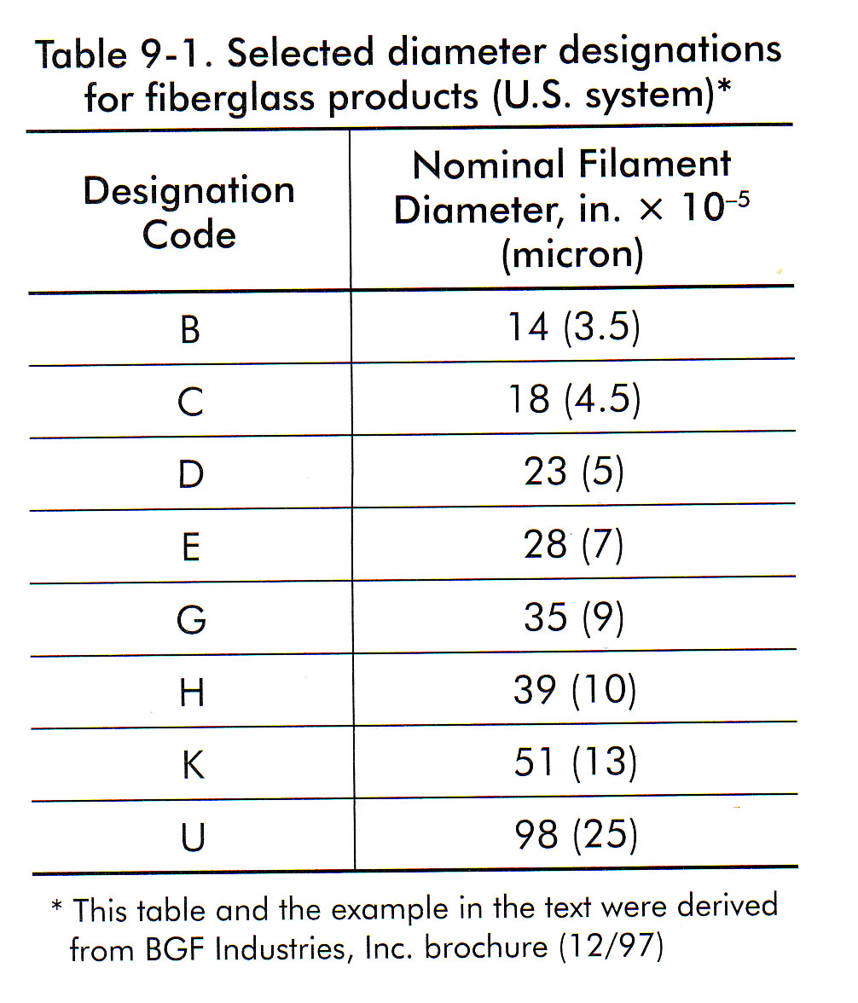
Filaments, Strands, Tows, Rovings, and Yarns
Table 9-1 Selected diameter designations for fiberglass products (U.S. System)

Slide 5
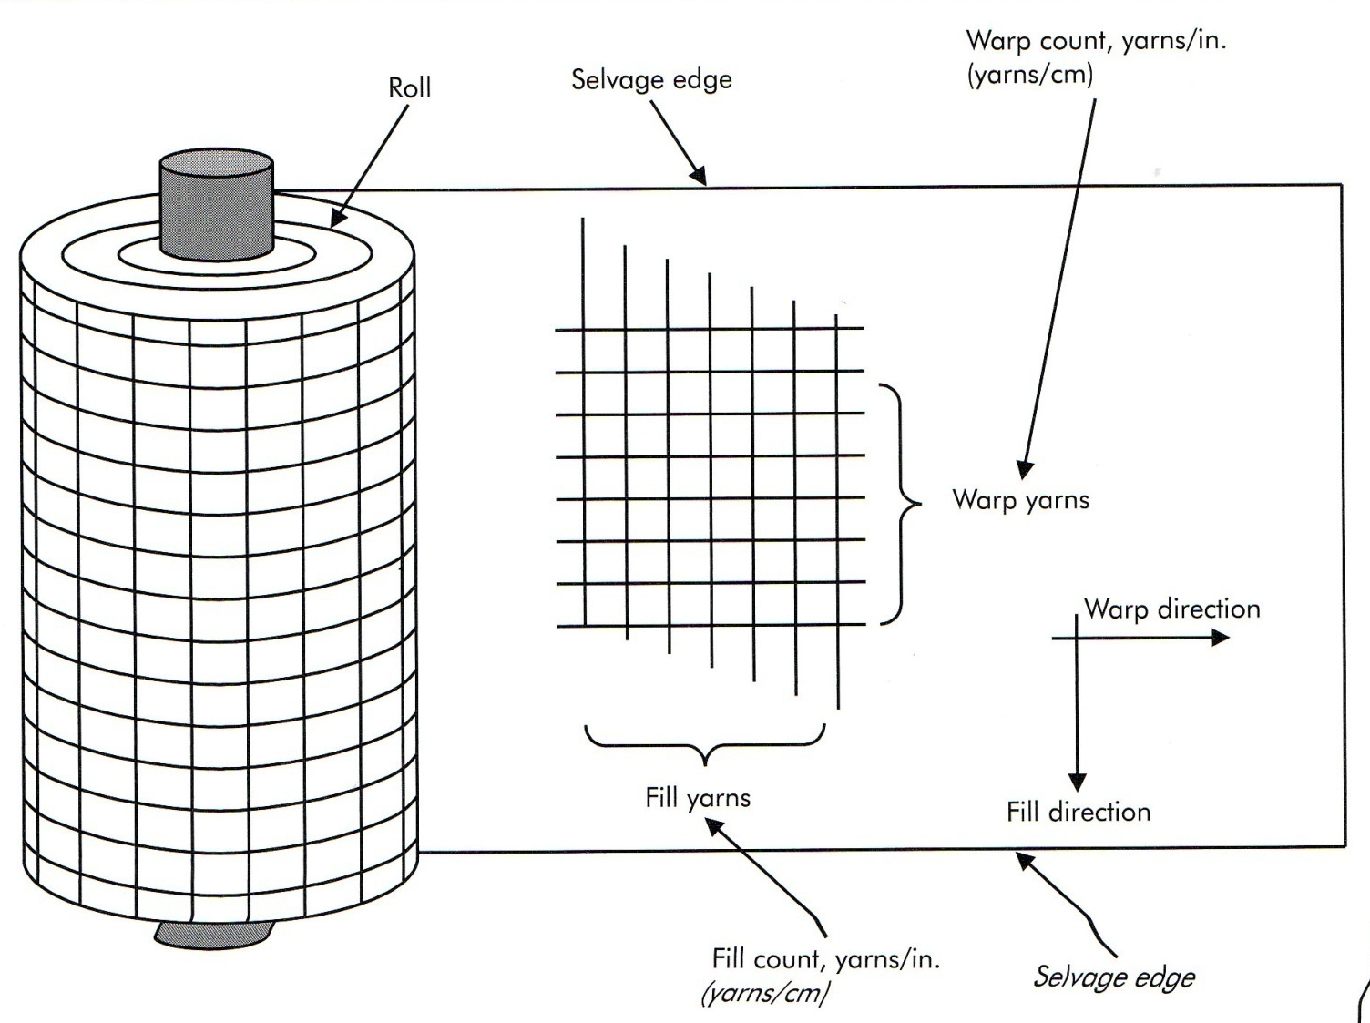
Woven and Knitted Fabrics (Cloth)
Figure 9-2 Roll terminology

Slide 6
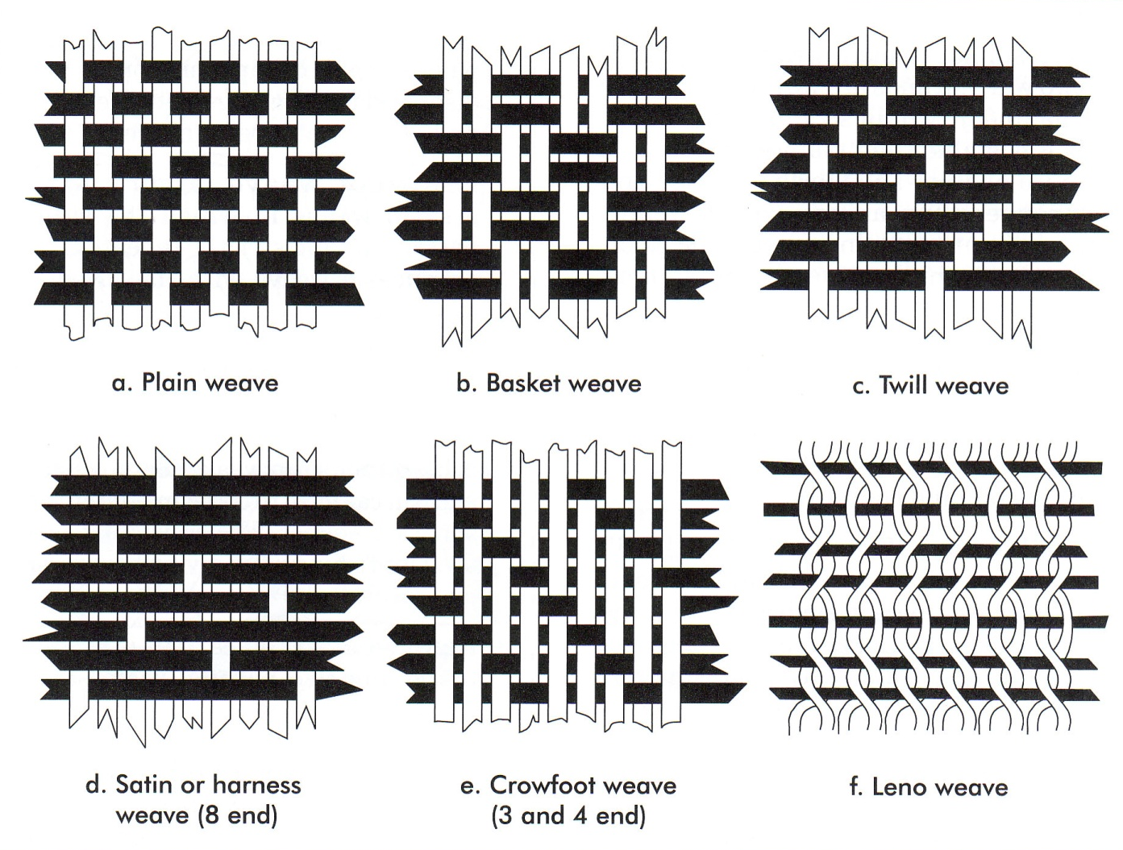
Woven and Knitted Fabrics (Cloth)
Types of weaves
Figure 9-3 Fabric construction forms

Slide 7
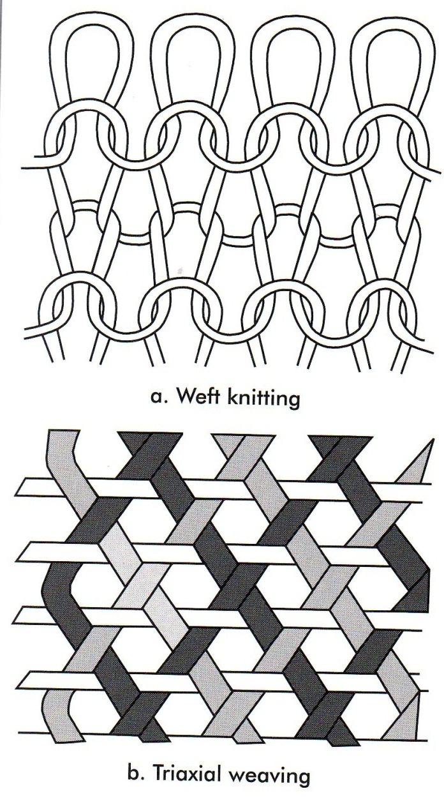
Woven and Knitted Fabrics (Cloth)
Types of Weaves
Figure 9-4 Knitted fabrics

Slide 8
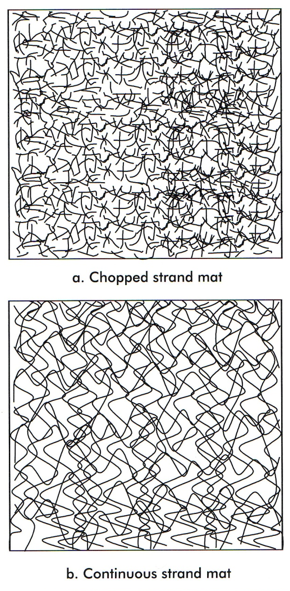
Non-Woven Fabrics (MAT)
Figure 9-5 Types of mat

Slide 9
Prepregs
Fibers which are pre-impregnated with the matrix resin
“Out-time”

Slide 10
Prepregs
Properties
“Drape”
The degree of flexibility of the prepreg
“Tack”
The stickyness of the prepreg surface

Slide 11
Braided, Stitched, and Three-Dimensional Laminates
Braided Reinforcements
Stitched Laminates
Trans-laminar reinforced composite
Z-fiber construction
Comprehensive stitching
Selective Stitching
Three-dimensional Laminates

Slide 12
Preforms
The Concept
“Net Shapt”
Make the reinforcement package in the shape of the final product (or nearly so)
“Kitting”
Precutting and assembling stacks of material so that the molding station operator does not have to worry about getting the materials in the proper lay-up.

Slide 13
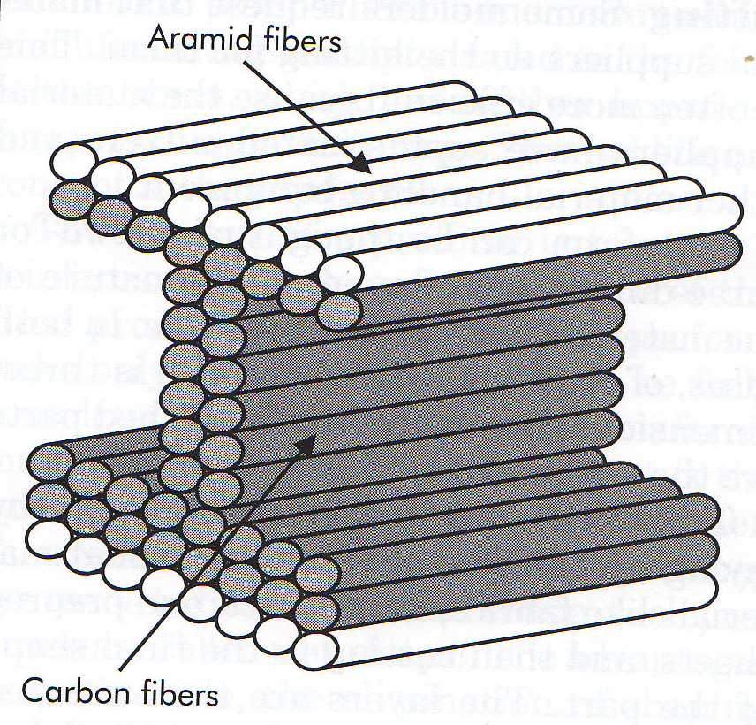
Hybrids
Figure 9-6 Selective placement of fibers within hybrid composites

Slide 14
Whiskers
Comparison to Fibers
Whiskers are shorter
< 5mm
Maintains a high length to radius ratio
< 5mm w/ a low aspect ration is called a “particle”

Slide 15
Case Study 9-1: Braided Preform Use in Hockey Sticks

