Slide 1
COMPOSITES
Lighter / Stronger / Better
Notes:
I am happy that you were here today, and I hope to see you for the next video in this series on composites.

Slide 2
Project Produced
with the Generous Support
of the Following
Notes:
I am happy that you were here today, and I hope to see you for the next video in this series on composites.

Slide 3
Los Angeles Chapter
William Dahlgren Family
Ernest Solvay Fund Managed
by The King Baudouin Foundation
St. Margaret’s
Episcopal School
Notes:
Hello. I’m glad you have joined me today. We are going to explore how composite materials are helping to make the world better. This is the first of four videos that will discuss composites. In this first video, we will discuss the benefits of composites in today’s world and discuss what composites are. In the other videos we will explore the materials that make up composites, the way composites are designed in order to make things lighter, stronger, and better, and then the ways that composite parts are made.

Slide 4
Presents
Notes:
I am happy that you were here today, and I hope to see you for the next video in this series on composites.

Slide 5
COMPOSITES Lighter / Stronger / Better
Part 1:
Making The World Better
with Composites
Notes:
I am happy that you were here today, and I hope to see you for the next video in this series on composites.

Slide 6
OUR RESPONSIBILITIES AS HUMANS
Earth Stewardship
People Awareness
Notes:
I want to talk with you about some very important subjects that are our responsibilities as humans and to discuss how composite materials are important in meeting those responsibilities. I have summarized our human responsibilities as Earth Stewardship and People Awareness. We should take care of both the planet we live on and try to help the people on the planet live better lives. These are complex subjects with many different aspects. I think you will see how composite materials are important in several key ways to allow us to take care of the earth and to ensure that people have opportunities for good lives.

Slide 7
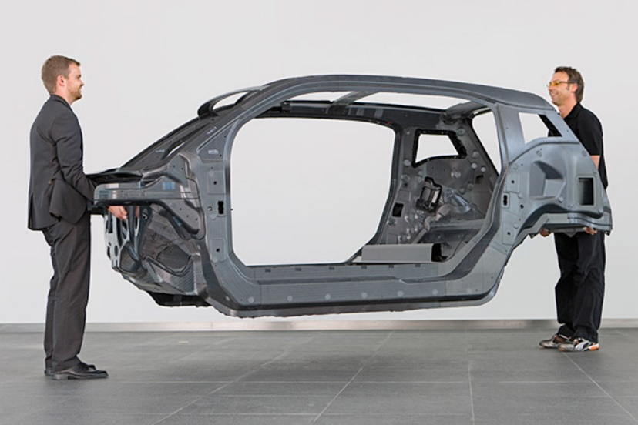
IMPROVED ENERGY
MANAGEMENT
Lighter Weight Autos
Notes:
Energy is important to support our modern lives and we hear a lot about how to reduce the amount of energy that we use so that we can use the energy we have more effectively. One of the most important ways to save energy is to reduce the weight of things that move, such as our cars, bicycles, boats, and airplanes. We have found that by using composites these products can all be made lighter and that means less energy is required to move them. There are now car models and some airplanes, boats, and bicycles that have all composite frames.
Another way to use energy more effectively is to change from burning carbon-based fuels to other energy sources such as wind turbines. Today, one of the largest uses of composites is in wind turbine blades and the demand is growing rapidly.
Making more energy available helps people live better lives. As people get better access to energy, they can do more things and their standard of living increases. For example, instead of walking an hour to get water from a stream, with electricity the people can have the water pumped into their homes. The time saved allows the people to work in their garden and raise more food, both to consume themselves and to sell. Similarly, electricity allows school kids to do homework after dark and parents to use cell phones to get better information and, perhaps, to work from their homes. Composites are helping to make it happen.

Slide 8
IMPROVED ENERGY
MANAGEMENT
Wind Energy
Notes:
Energy is important to support our modern lives and we hear a lot about how to reduce the amount of energy that we use so that we can use the energy we have more effectively. One of the most important ways to save energy is to reduce the weight of things that move, such as our cars, bicycles, boats, and airplanes. We have found that by using composites these products can all be made lighter and that means less energy is required to move them. There are now car models and some airplanes, boats, and bicycles that have all composite frames.
Another way to use energy more effectively is to change from burning carbon-based fuels to other energy sources such as wind turbines. Today, one of the largest uses of composites is in wind turbine blades and the demand is growing rapidly.
Making more energy available helps people live better lives. As people get better access to energy, they can do more things and their standard of living increases. For example, instead of walking an hour to get water from a stream, with electricity the people can have the water pumped into their homes. The time saved allows the people to work in their garden and raise more food, both to consume themselves and to sell. Similarly, electricity allows school kids to do homework after dark and parents to use cell phones to get better information and, perhaps, to work from their homes. Composites are helping to make it happen.

Slide 9
REDUCED POLLUTION
Reducing Vehicle Weight 50 To 70%
…will Reduce Emissions By 40%
Notes:
To meet the pollution requirements mandated for the United States and many other countries, car companies have streamlined the design of cars, improved mechanical efficiency of the engine and other moving parts, reduced the thickness of the steel, and numerous other changes. However, the cars are still not able to meet the mandates. Simply, the most effective way to reduce pollution now and to meet the standards is to reduce the weight of the car. Composites are the enabler for the weight reduction.

Slide 10
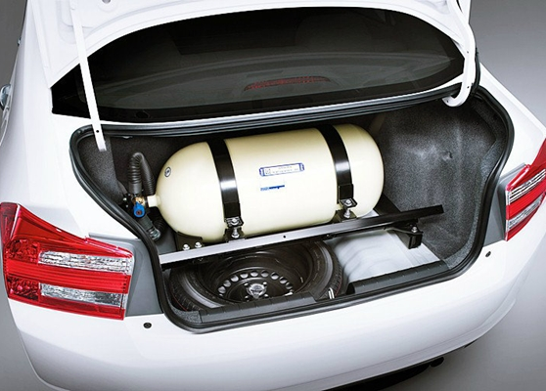
REDUCED POLLUTION
Changing to non-polluting fuels
Hydrogen-powered cars
have more range than
electric-powered cars
Hydrogen tanks
are made of
composites
Notes:
To meet the pollution requirements mandated for the United States and many other countries, car companies have streamlined the design of cars, improved mechanical efficiency of the engine and other moving parts, reduced the thickness of the steel, and numerous other changes. However, the cars are still not able to meet the mandates. Simply, the most effective way to reduce pollution now and to meet the standards is to reduce the weight of the car. Composites are the enabler for the weight reduction.

Slide 11
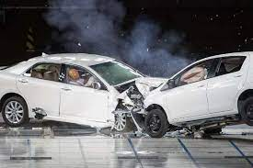
IMPROVED SAFETY
Energy Absorption In Automobile Crashes For Various MaterialsLon
Composites | 100 J/g
Steel | 20-25 J/g
Aluminum | 35 J/g
Best
Notes:
If composites are used as the frames and bodies of automobiles, you might wonder whether the cars would be as safe as the current steel cars. Tests have been conducted to compare the energy absorbed in collisions of steel cars and composite cars. The tests showed that composite cars absorb much more energy during the crashes compared to both steel and aluminum, thus capturing that energy within the frame and preventing it from entering the passenger compartment and causing injuries to the passengers. Hence, composite cars are safer than steel cars.

Slide 12
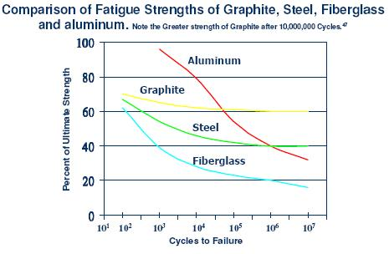
LONGER-LIVED PRODUCTS
Best
Notes:
An important way to use less material and less energy to make products that last longer. All products wear out eventually, most because of use. Therefore, it is important to look at how many use cycles a product can withstand before breaking. A nice way to test that is to make samples using different materials and then flex them until they break. We can see that after one million cycles (10⁶), the graphite composite performs better than all the other materials and that its decline is nearly flat, suggesting that the longevity of use will be even longer beyond 10 million cycles.

Slide 13
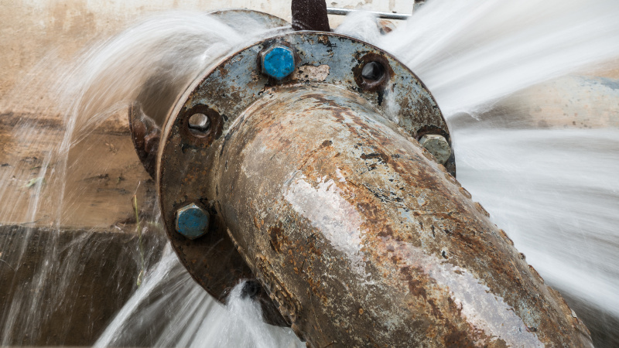
REDUCED CORROSION
Metal Pipes
Ship Hulls
Notes:
Composites don’t corrode in water like steel. Therefore, for products like pipes, ship hulls, and wind turbine towers, composites are much better and will last much longer than steel products. Composite pipes are common in many industries and applications, including hard to transport materials like crude oil. Most pleasure boats are made of composites and many war ships and some cruise ships and freight ships are also being made with composites.

Slide 14
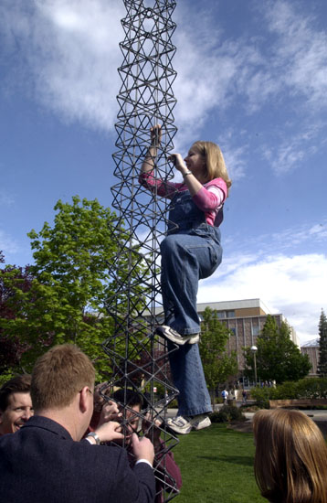
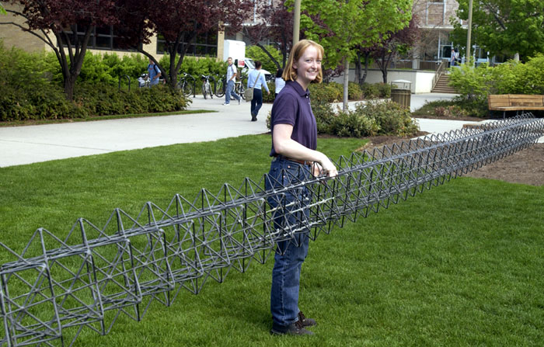
REDUCED CORROSION
Open Structure Towers
Cell Phone Towers
Wind Turbine Towers
Notes:
Composites don’t corrode in water like steel. Therefore, for products like pipes, ship hulls, and wind turbine towers, composites are much better and will last much longer than steel products. Composite pipes are common in many industries and applications, including hard to transport materials like crude oil. Most pleasure boats are made of composites and many war ships and some cruise ships and freight ships are also being made with composites.

Slide 15
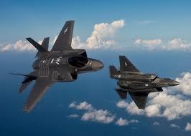
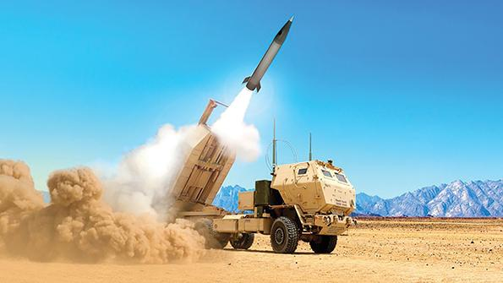
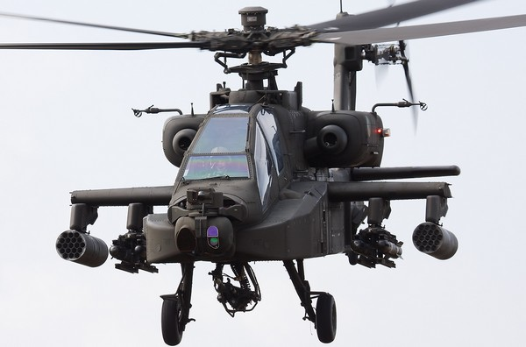
NATIONAL DEFENSE
Notes:
Having a strong national defense is an important component in preserving our way of life. Therefore, if we are to ensure good awareness of people, we need to maintain a strong defense. Composites are critical to that task. Every branch of the military uses composites extensively. The Air Force has built all composite planes for many years, and they have become the standard for fighters, bombers, and cargo planes. Missiles have been made of composites for decades and most helicopters are made from composites to give them maneuverability and range.

Slide 16
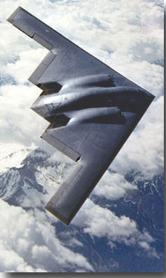
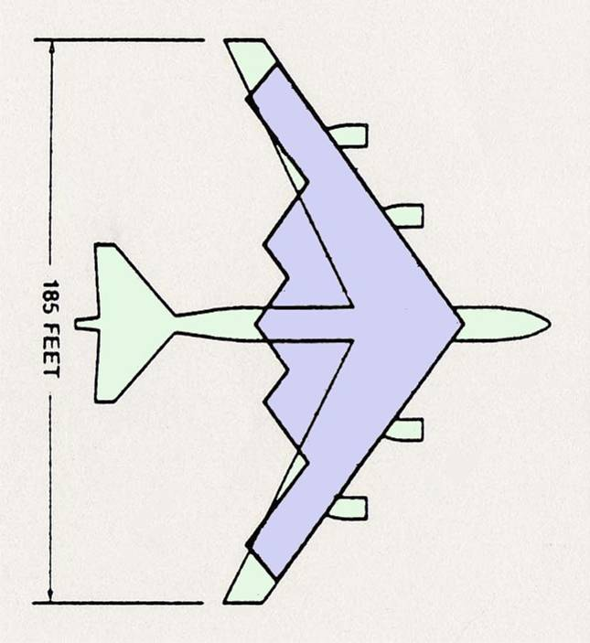
STEALTH
B-52/B-2 SIZE COMPARISON
Notes:
Stealth is important in national defense. It depends, to a large extent, on composites and one of the best examples is the B-2. Some amazing facts can tell us how effective stealth properties have become. Comparing the size of the B-2 and the B-52 shows that they are about the same size, but the stealth properties are vastly different.

Slide 17
STEALTH RADAR CROSS SECTION OF TYPICAL AIRBORNE OBJECTS
Object
Person
747 (Jumbo Jet)
B-17 (WWII)
B-47 (Korean War)
B-52 (Cold War)
B-1B (First stealth)
Small single engine plane
Small bird
B-2 (Stealth Bomber)
F-35 (Stealth Fighter)
Radar Cross Section (m²)
1.0
100
80
40
10
1.0
1.0
0.01
0.01
0.005
Notes:
Stealth is measured by determining the size that an object appears on a radar screen. That measurement is called the radar cross section. For example, a person appears to be about 1 square meter cross section, that is, the width times the height of a person is about 1 square meter. The radar cross sections of other objects are shown with the B-52 at about 10 square meters. Note that a small bird is only about .01 square meter—hardly detectable on most radars. The B-2 is only 0.01—one thousand times less than the B-52. Now we have the F-35, and it is about half the radar cross section as the B-2.

Slide 18
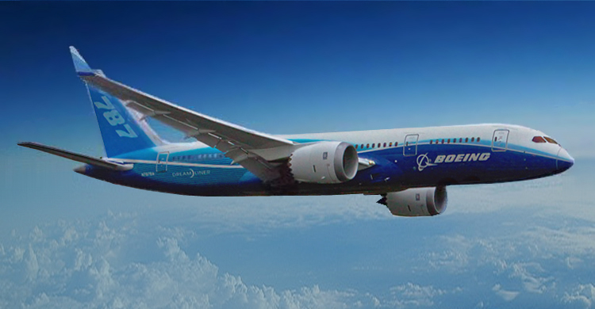
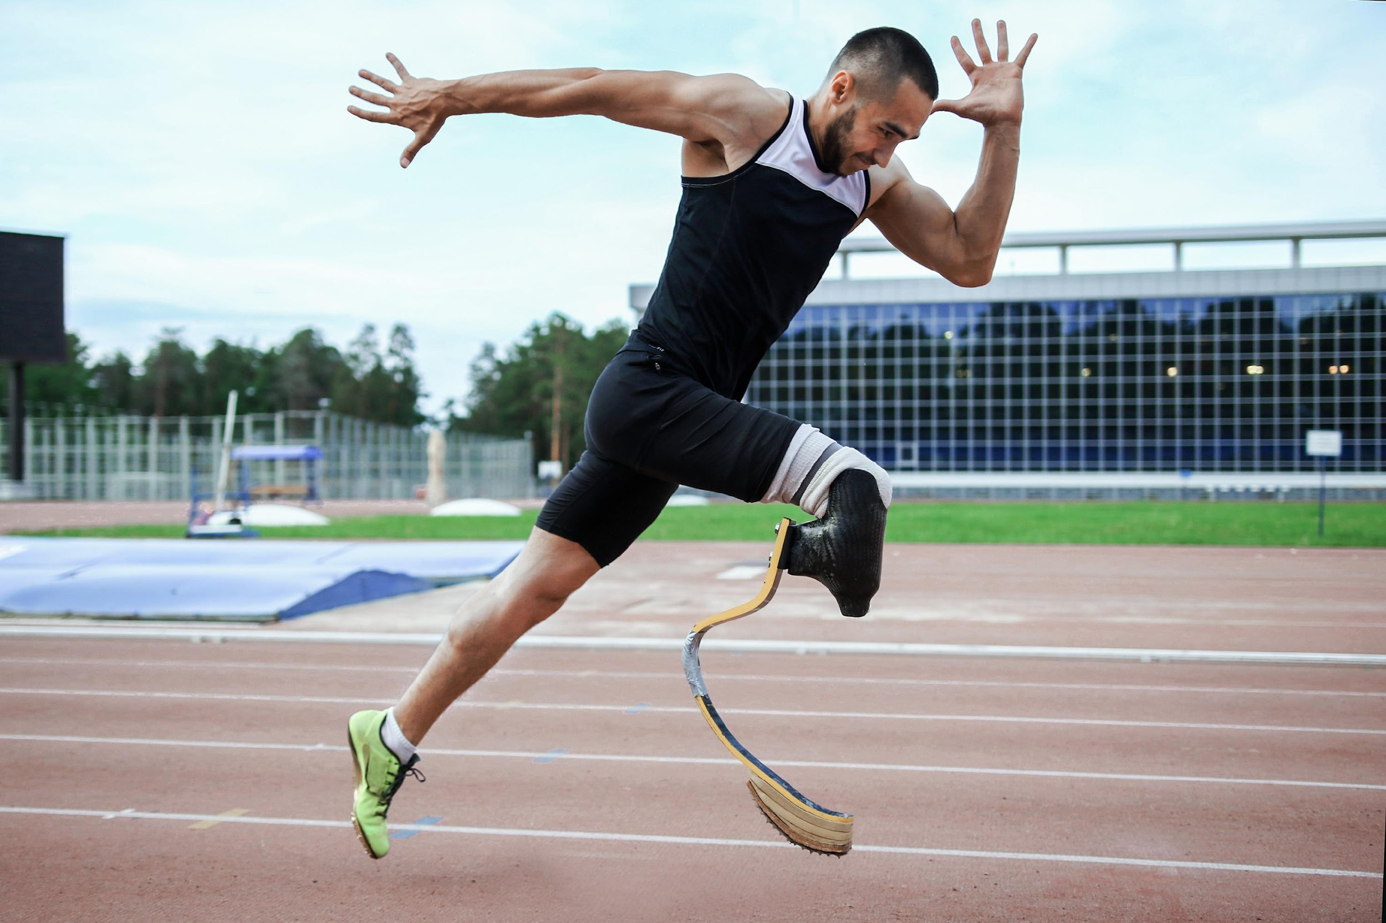
TECHNICAL SUPERIORITY
Taking Airplane Technology
and Putting it Into Sports and Recreation
Notes:
The preservation and improvement of our lifestyle also depends on the ability of our industry to sell products, both at home and abroad. Composites are helping us take the most advanced technologies developed for defense and to migrate them into products for consumers. Some of the fields that have benefited the most are airlines, sports, and recreations. Bicycles and artificial limbs are good examples of composites taken from military and are now are used in the best products for consumers.

Slide 19
IMPROVED JOBS COMPOSITE ENGINEERS AND TECHNICIANS EARN 20% MORE THAN OTHERS
Average Engineer Salary
Aerospace $86,034
vs.
All Other $72,000
Average Technician Salary
Aerospace $42,000
vs.
All Other $33,700
Notes:
Of course, having a well-paying job can be important in the having a good life. Comparing the salaries of aerospace engineers, the category that best fits for composite engineers, with salaries of all other engineers, shows that composite engineers earn about 20% more. The premium for composite technicians is similar or a bit more. As the composite market continues to grow, the demand for composite engineers will be even higher and the pay differential will likely increase.

Slide 20
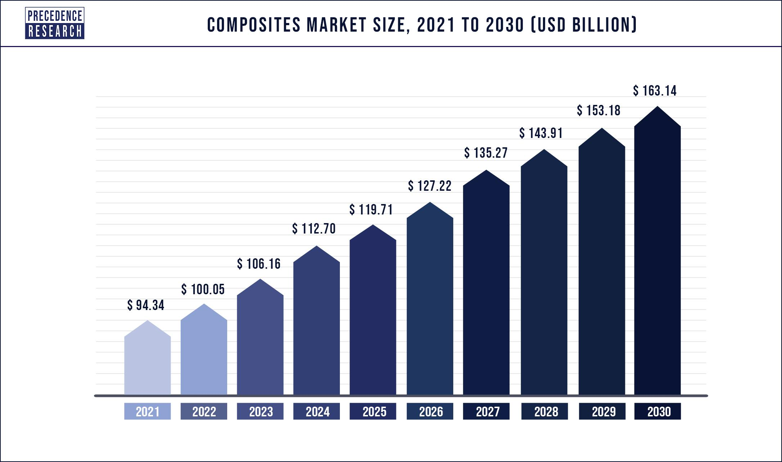
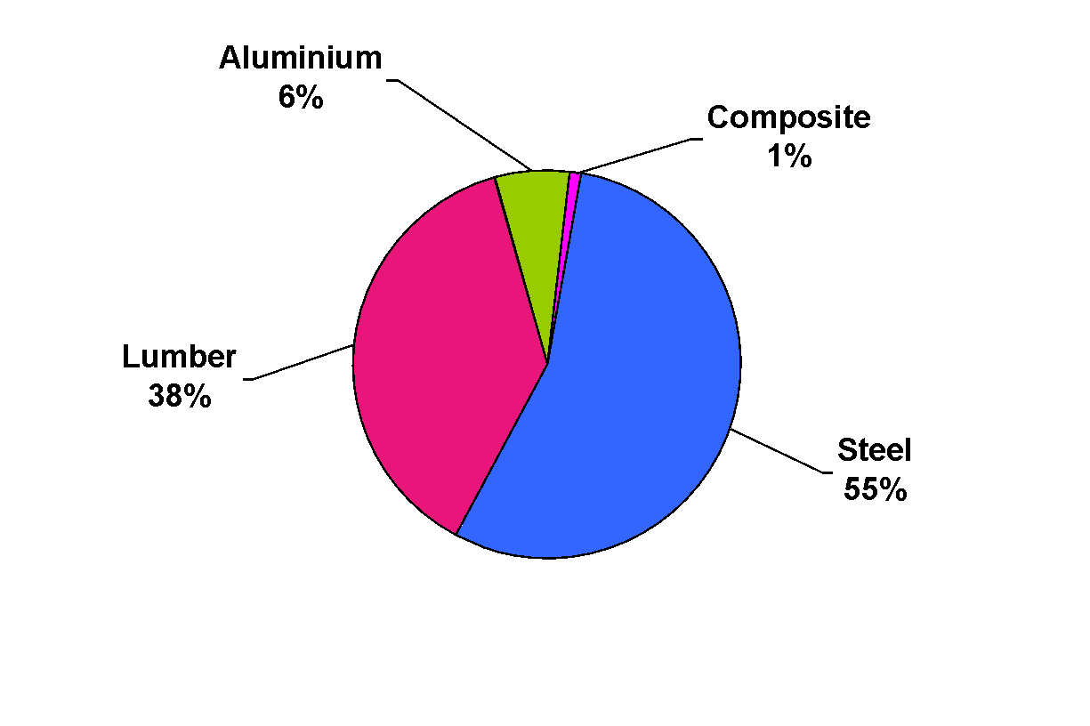
COMPOSITES INDUSTRY THERE IS PLENTY OF ROOM FOR GROWTH
Total Material Use in The United States
Composites is a Field Where
the Future is Very Positive.
Notes:
Looking at the total of structural materials use in the United States, shows that steel is by far the most commonly used material followed by lumber and aluminum. Composites are still a very small part of the market but, as we have seen, will continue to grow. The growth in the composites market reflects the many new uses being found for composites. There is a lot of future growth in composites.

Slide 21
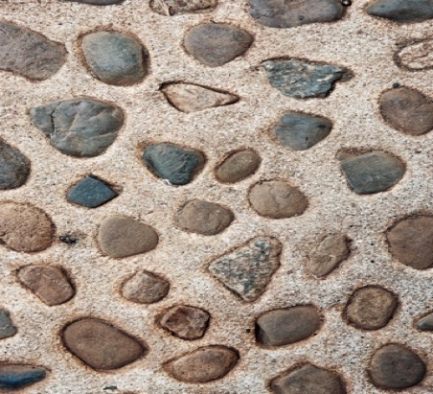
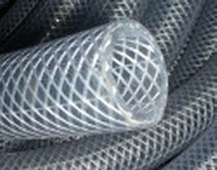
WHAT ARE COMPOSITES?
BROAD DEFINITION: Solid materials composed of more than one component wherein those components are separate phases (physically distinct)
Many types of composites under this definition
Aggregate floor terrazzo
Concrete with rebar
Fiberglass reinforced plastics
Notes:
There are two ways to define composites—one very broad and the other much narrower and, for us, more appropriate. The broad definition is that composites are solid materials composed of more than one component in which the components are physically separate. In theory, you could pick one material out of the other just by looking at them and extracting the one you want. Some examples that fit this definition are aggregate like floor terrazzo, concrete with rebar, and fiberglass reinforced plastics.

Slide 22
WHAT ARE COMPOSITES?
NARROW DEFINITION: Solid materials made from fibers surrounded by a matrix
The matrix is a continuous phase that surrounds each of the fibers
Like the ocean surrounding islands
Notes:
The narrow definition is simpler. Composites are solid materials containing a fiber reinforcement in a matrix. The matrix can be polymeric, ceramic, or metallic and polymeric is the most common. An analogy is the ocean with islands in it. The ocean is the matrix, and it surrounds all the islands. The islands are like the fibers.

Slide 23
SOME COMPOSITES HAVE “MAGIC”
A mixture of two materials
The mixture can be synergistic
Combined properties are greater than separate properties
These synergistic composites are the composites we will discuss
All will be fiber reinforced
Notes:
Sometimes something almost impossible can happen in materials. Consider a simple mixture of two materials. We would expect the properties to be the sum of the individual parts. But sometimes, synergy occurs, and it seems like magic. The sum of the properties is greater than either of the properties by itself. This has happened with composites.

Slide 24
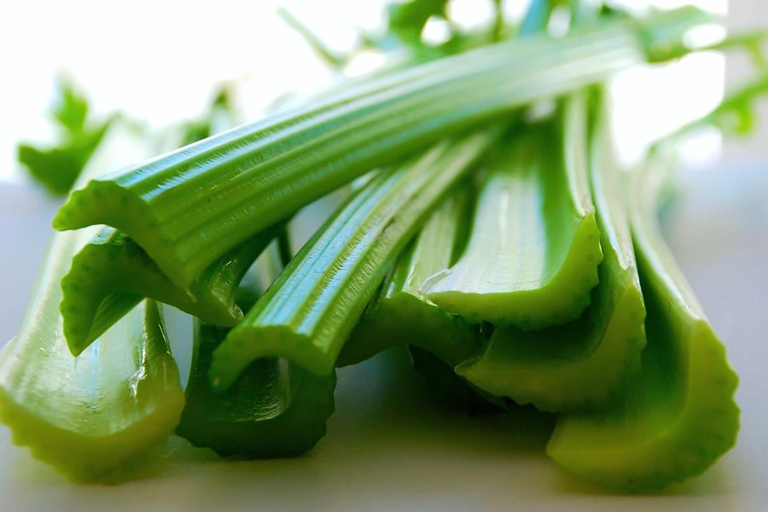
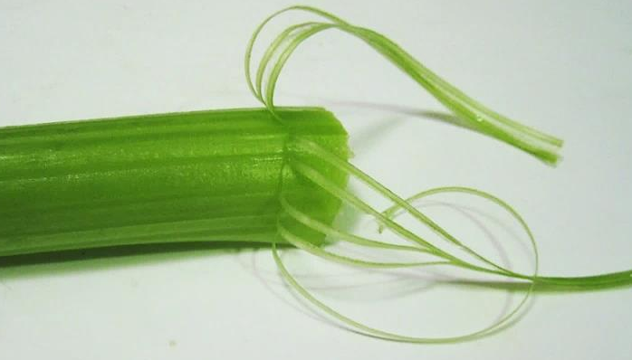
NATURAL COMPOSITES CELERY
Reinforcement = fibrils
Matrix = cellulose
Notes:
Nature understood composites and made some plants as composites. Celery is a good example, but so are trees and many other natural objects.

Slide 25
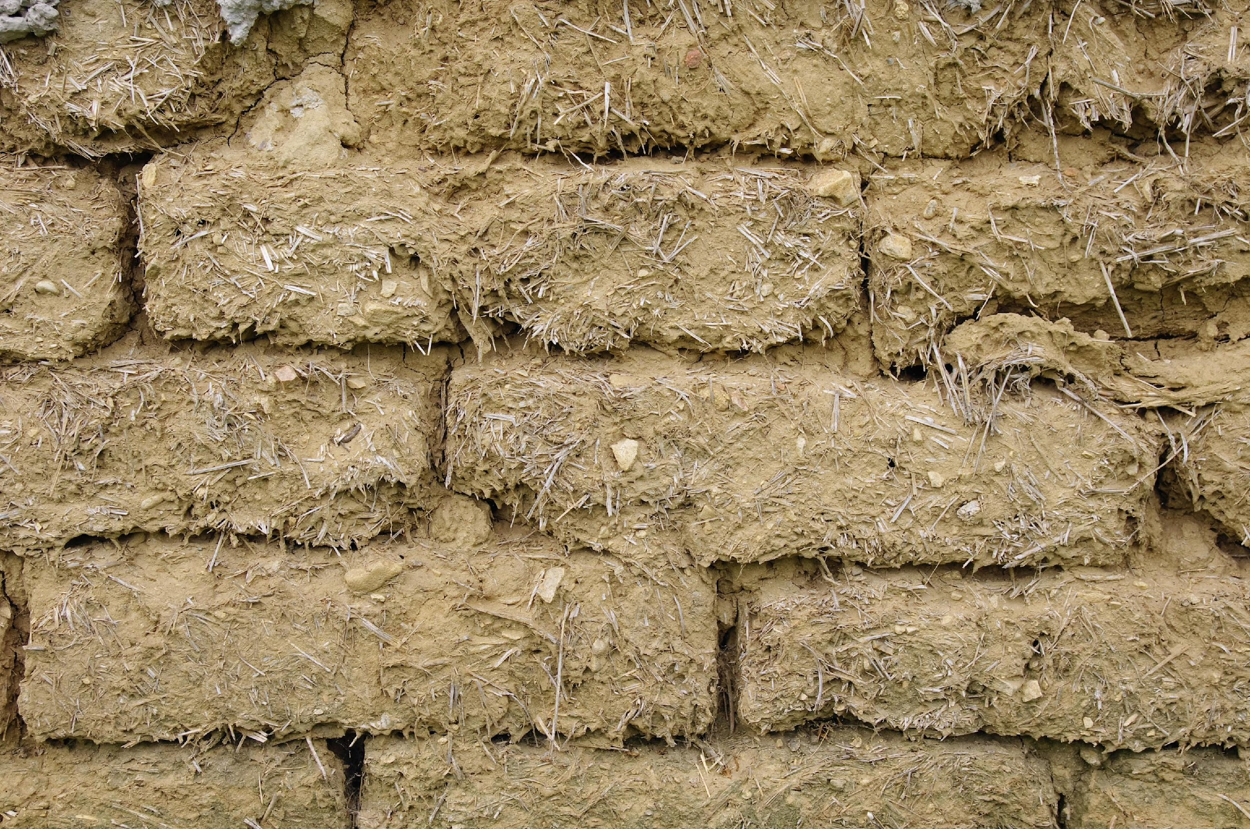
MAN-MADE COMPOSITES
Egyptians Combined Mud with Straw to Achieve Strengthened
Bricks
Notes:
The ancient Egyptians recognized the value of putting straw into mud bricks to make stronger bricks. They even described it in a tomb painting, and it is mentioned in the Bible.

Slide 26
RESINS (MATRIX)
Matrix Families
Organics (PMC)
Thermoset resins
Thermoplastic resins
Metals (MMC)
Aluminum
Titanium
Ceramics (CMC)
Pyrex
Silica
Alumina
Boron Nitride
Carbon (CC)
Amorphous Carbon
Notes:
To repeat, in the narrow definition of composites fibers are surrounded by a matrix. There are four general categories of matrix materials. These are organics (also called polymer) matrix composites, metals, ceramics and carbon-carbon. For most of our discussions, we will focus only on the organics/polymerics. Note that there are two different types of organic matrix materials—thermosets and thermoplastics. The metal matrix, ceramic matrix, and carbon matrix materials are used for special applications.

Slide 27
FIBERS FOR COMPOSITES
Fiber Families
Advanced
Carbon / Graphite
Aramid (Kevlar)
Engineering
Fiberglass
Natural
Notes:
To repeat, in the narrow definition of composites fibers are surrounded by a matrix. There are four general categories of matrix materials. These are organics (also called polymer) matrix composites, metals, ceramics and carbon-carbon. For most of our discussions, we will focus only on the organics/polymerics. Note that there are two different types of organic matrix materials—thermosets and thermoplastics. The metal matrix, ceramic matrix, and carbon matrix materials are used for special applications.

Slide 28
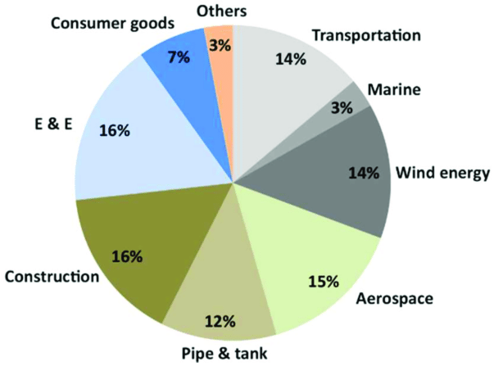
COMPOSITES SHIPMENTS BY INDUSTRY
Est. 3.9 Billion Pounds of Shipments
Notes:
In what types of products are composites being used today. The largest are electrical and electronics, construction, aerospace, wind energy, and transportation. Each of these will continue to grow and, surely, the other markets will grow also.

Slide 29
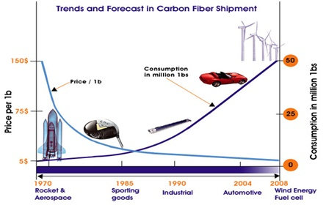
COSTS OF FIBERS and RESINS
Carbon Fibers Cost From $15/Pound
Some Carbon Fiber Is Over $100/Pound
Fiberglass Costs About $2.00/Pound
Most Resins Cost $3.00/Pound To $8.00/Pound
Notes:
The fibers are much more expensive than the matrix. The prices have dropped over time, but the consumption has continued to grow and major changes in the prices of fibers and matrix have slowed greatly

Slide 30
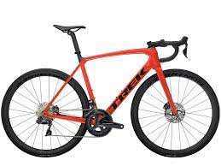
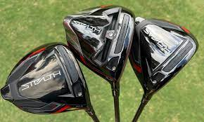
RECYCLING (REUSE)
Reuse Composite Parts with Little or No Modification
Notes:
How can composites be recycled? If possible, composites should be reused without modifications. This is possible because some applications, such as bicycles and golf clubs, see people change to a new product long before the old product wears out.

Slide 31
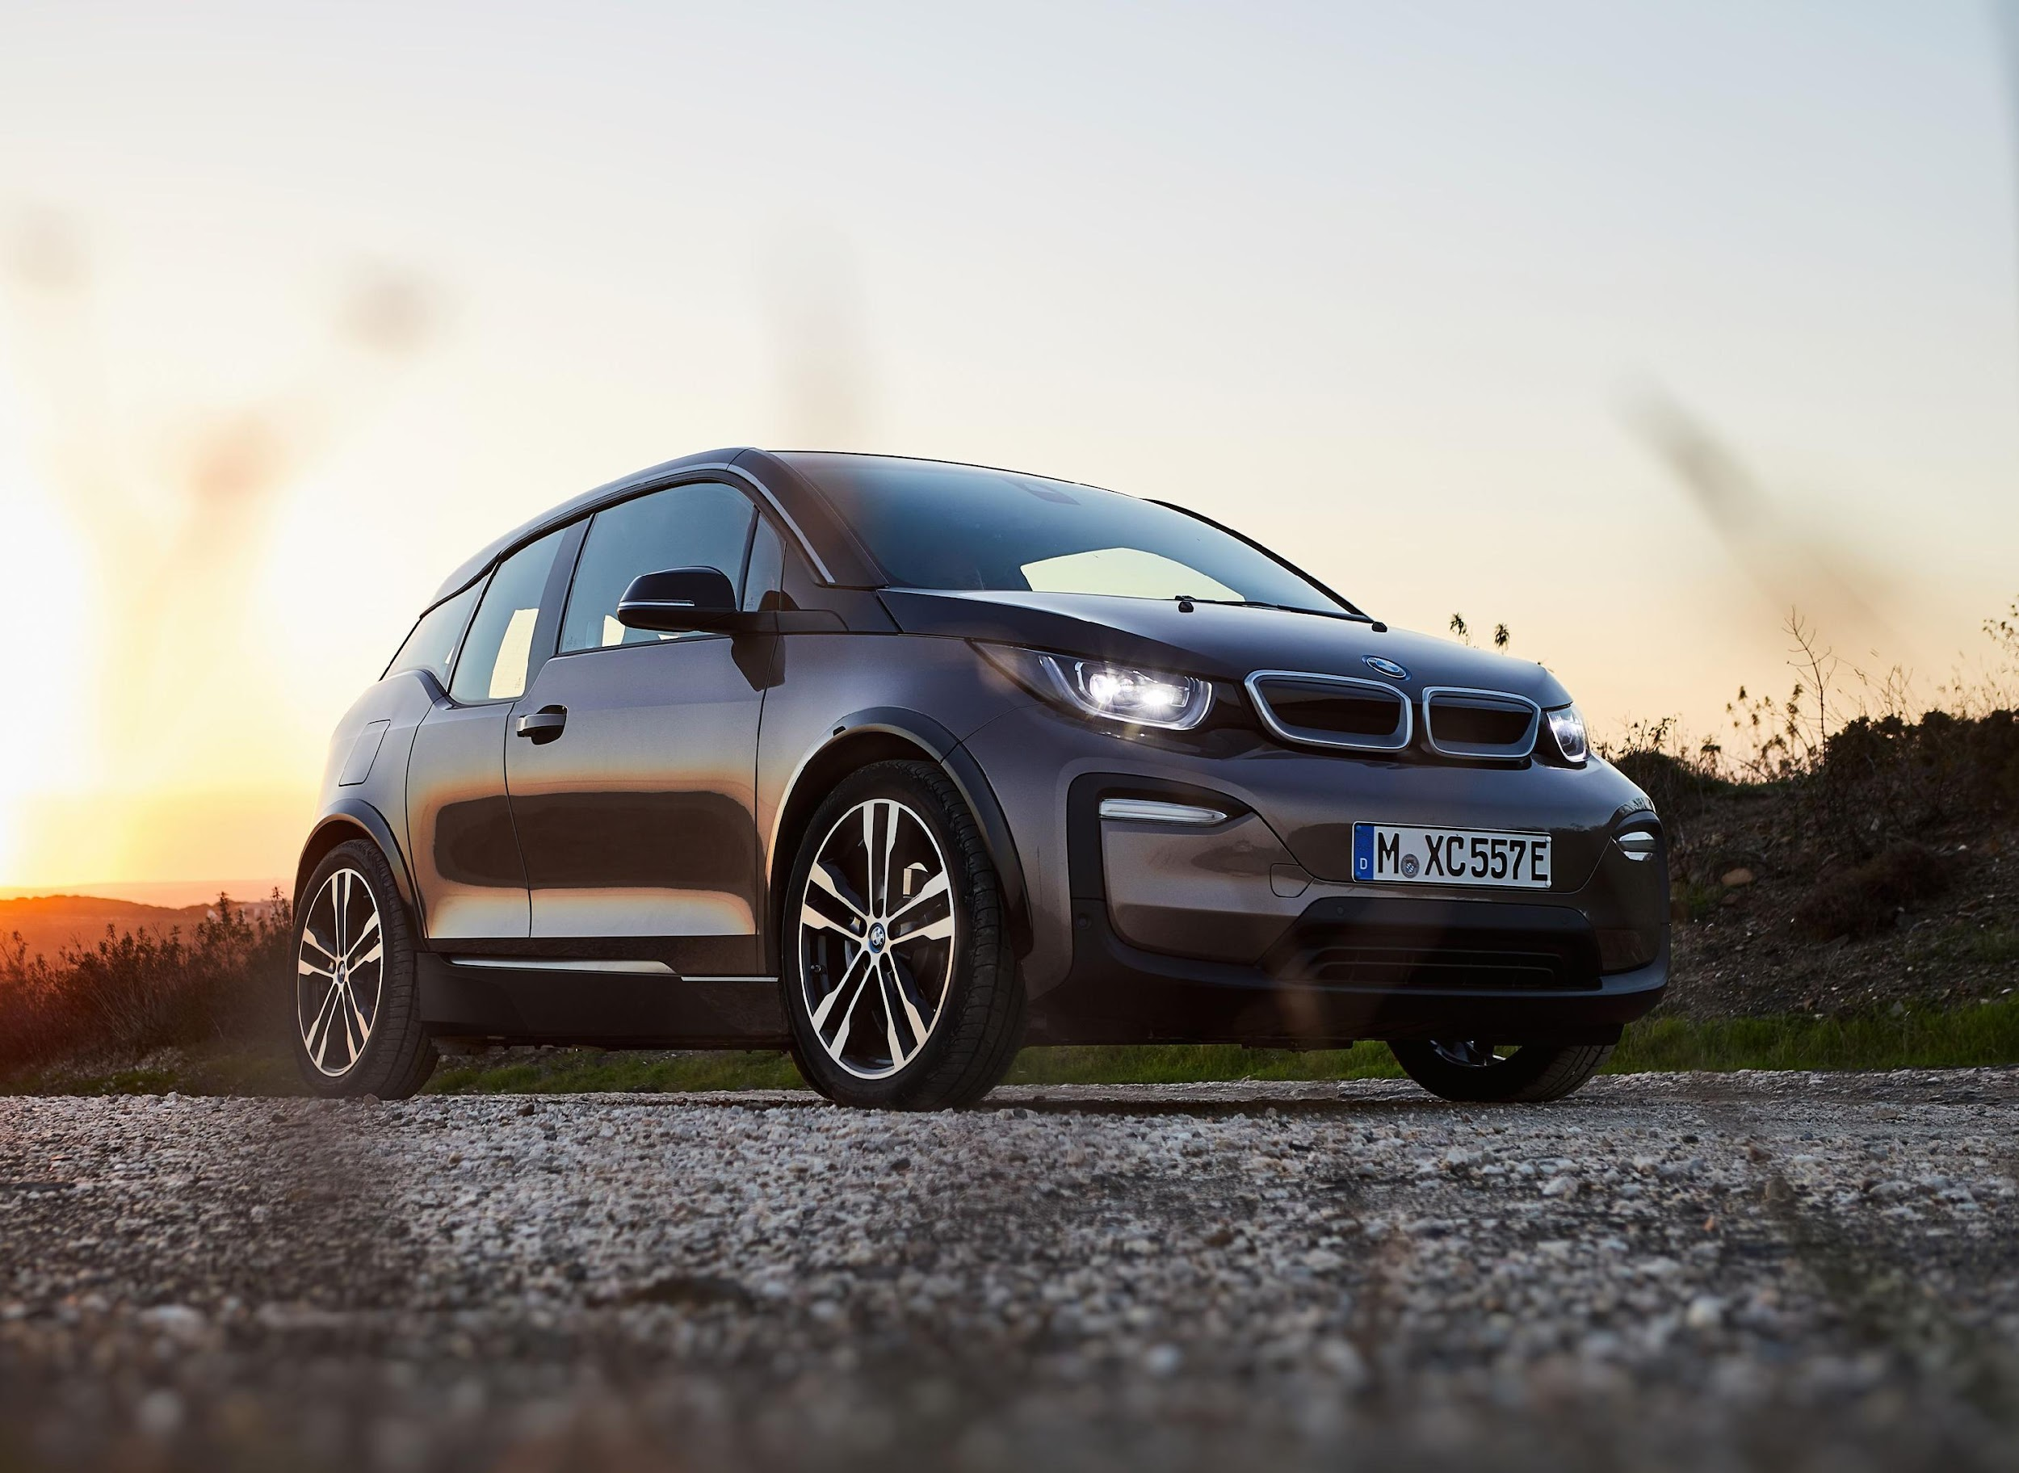
RECYCLING METHOD SOLVOLYSIS
Dissolve the matrix in a solvent and recover the fibers
Resin can be recovered by evaporation of the solvent
Properties can be maintained
>90%
Automotive is a good application
Notes:
Next best is to recover the fibers and matrix and to maintain their properties. This is best done by solvolysis—dissolving the matrix away from the fibers and then evaporating the solvent to recover the matrix.

Slide 32
RECYCLING METHOD PYROLYSIS
Heating Without Oxygen (No Burning)
Fiber Properties Retained Quite Well (>80%)
Computer Cases Are Made With Recovered Fibers
Notes:
After that is to recover the most expensive component, the fibers. When it is difficult to dissolve the matrix, pyrolysis is used. This is heating without oxygen. It decomposes the matrix and leaves the fibers with near original properties. Computer cases use recycled fibers. .

Slide 33
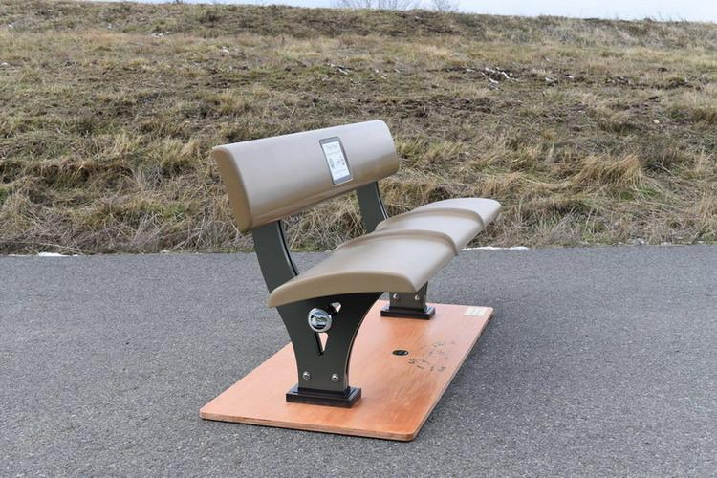
RECYCLING METHOD CHOPPING and MOLDING
Chopped Into Pieces That Move In The Mold
Re-Molded
Used In Products Where High Mechanical Properties Are Not Critical
Notes:
Some composites are difficult to recycle and must be chopped so that additional matrix can be added, and the mixture remolded. Sometimes the fiber and resin can be reused in new, generally less valuable, applications without separation but with additional processing. Park benches are a typical application.

Slide 34
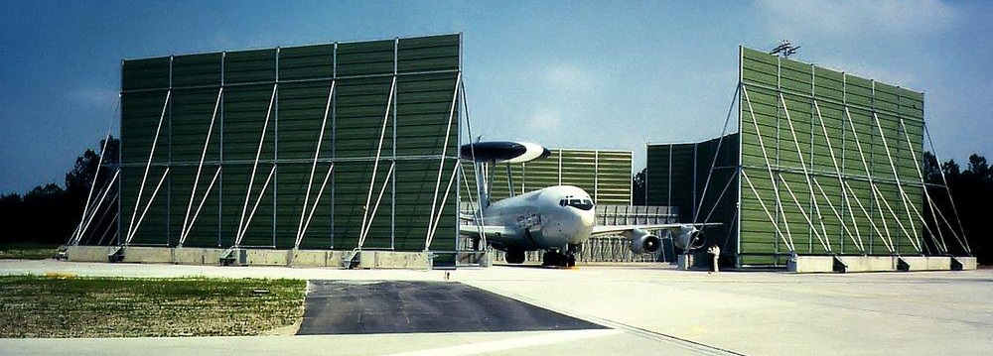
RECYCLING METHOD DIRECT MOLDING
Placing Prepreg Pieces Into The Mold
Compression Molding
Used Where Thickness Uniformity And Weight Are Not Critical
Notes:
Sometimes prepreg materials can simply be remolded without chopping. This usually works only for applications in which strength and stiffness are not critical or in which adding thickness uniformity will not be a strict requirement. Dimensions are often uneven with these products. A good application is sound barriers in airports, especially where the light weight of composites allows the sound barriers to be moved.

Slide 35
PLANNING YOUR FUTURE
Three Types Of Decisions
Immediate Living
Day-to-day to Just Live Life
Structural
Affecting Structure Of Life (Family, Place To Live, Friends)
Strategic
Made Infrequently
Concern Basic Values
Strong Consequences
Notes:
I hope that some of you will have an interest in composites. That generally requires making a decision to become involved in a work or school program involving composites. To help you make that decision, let’s discuss decision-making for a minute.
There are three general types of decisions—immediate, structural, and strategic. We make immediate living decisions every day. They are things like when to get up, what to eat, what to wear, how to get to school, and so on. These decisions are usually easy to make and have only minor consequences if we choose poorly.
Structural decisions require more thought and have greater consequences in how our lives are led. These are decisions that affect where you live, the school you will go to, the type of company you work for, and the specific nature of your job. This might be a decision you make when you graduate from high school or from college.
Finally, you might want to take more time and think strategically. These decisions are made infrequently and have longer-lasting consequences. Your basic values in living and choices affecting your career and family are examples of strategic decisions. You might want to consider, for example, whether you want to enter the composites field. To help you with that strategic decision, here are some questions you can ask yourself.

Slide 36
STRATEGIC QUESTIONS
What Do You Want To Be Doing In 10 Years?
How Should You Get To The Pathway That Will Lead To Your Objective?
Notes:
What do you want to be doing in 10 years? I have interviewed many students over my 27-year career as a professor and this is the question that I have found is most effective is getting the student to think strategically. You should consider the future in terms of growth, likelihood for innovation, salary, and, of course, interest. There are many types of jobs within the composites field as will be more obvious after you have seen the other videos in this series.
After asking yourself the future question, think about how to position yourself now to ensure that you will be on a path to accomplish your objective. That might be additional schooling but could also be just making a decision to continue to learn about your chosen field now. I hope you will at least consider composites as a potential career.

Slide 37
FACTORS TO CONSIDER IN CHOOSING A CAREER OR COMPANY OR JOB
Skills
What Do You Have In Your “Toolbox” From School And Life?
Abilities
What Innate Strengths Do You Have?
Values
What Is Important To You?
Interests
What Do You Do When You Aren’t Working?
Notes:
Four factors are critical in deciding what career you should pursue or what company or job you should accept. These factors concern you personally. They are: Skills (that is, what do you have in your toolbox from school and life), Abilities (what innate strengths do you have), Values (what is important to you), and Interests (what do you do when you aren’t working). You might want to make a written list of each of these factors because often writing will help you focus better.

Slide 38
PUTTING THE FACTORS TOGETHER
SKILLS
ABILITIES
The Perfect
Career!
VALUES
INTEREST
Notes:
After careful consideration of each factor, put them together in a Venn Diagram where you list each of the factors in a circle and overlap the circles. Consider what overlaps there are between each pair of factors. And then, seek to find careers or jobs that might overlap with all the factors. Write down a diagram for each possible career choice and identify where it fits. Hopefully, one or more will lie in the convergence area and be a perfect career choice.

Slide 39
Thank You
Part 1:
Making The World Better With Composites
Notes:
Thank you for being here. See you next time in part 4

Slide 40
Notes:
I am happy that you were here today, and I hope to see you for the next video in this series on composites.

