Slide 1
COMPOSITES
Lighter / Stronger / Better
Notes:
I am happy that you were here today, and I hope to see you for the next video in this series on composites.

Slide 2
Project Produced
with the Generous Support
of the Following
Notes:
I am happy that you were here today, and I hope to see you for the next video in this series on composites.

Slide 3
Los Angeles Chapter
William Dahlgren Family
Ernest Solvay Fund Managed
by The King Baudouin Foundation
St. Margaret’s
Episcopal School
Notes:
Hello. I’m glad you have joined me today. We are going to explore how composite materials are helping to make the world better. This is the first of four videos that will discuss composites. In this first video, we will discuss the benefits of composites in today’s world and discuss what composites are. In the other videos we will explore the materials that make up composites, the way composites are designed in order to make things lighter, stronger, and better, and then the ways that composite parts are made.

Slide 4
Presents
Notes:
I am happy that you were here today, and I hope to see you for the next video in this series on composites.

Slide 5
COMPOSITES Lighter / Stronger / Better
Part 3:
Composites Design:
Forces and How to Withstand Them
Notes:
I am happy that you were here today, and I hope to see you for the next video in this series on composites.

Slide 6
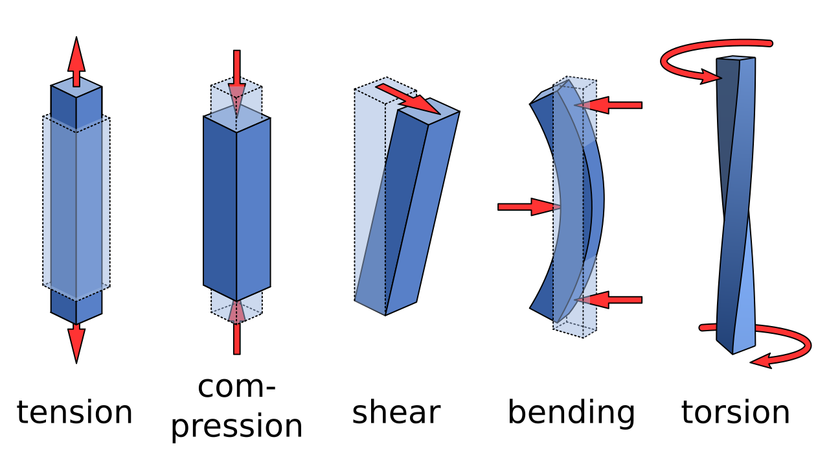
TYPES OF LOADS (FORCES)
Notes:
The terms loads and forces are used interchangeably in this discussion, and both have to do with how stress is placed on a part. There are five major types of forces. The most common is tension (pulling on the part). Others are compression (pushing on the top and bottom), shear (holding one end in place and pressing sideways on the other end), bending (where the force is applied to flex the part), and torsion (where the part is twisted).

Slide 7
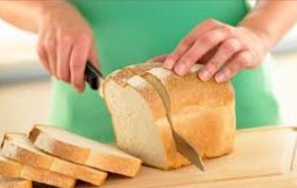
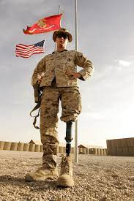
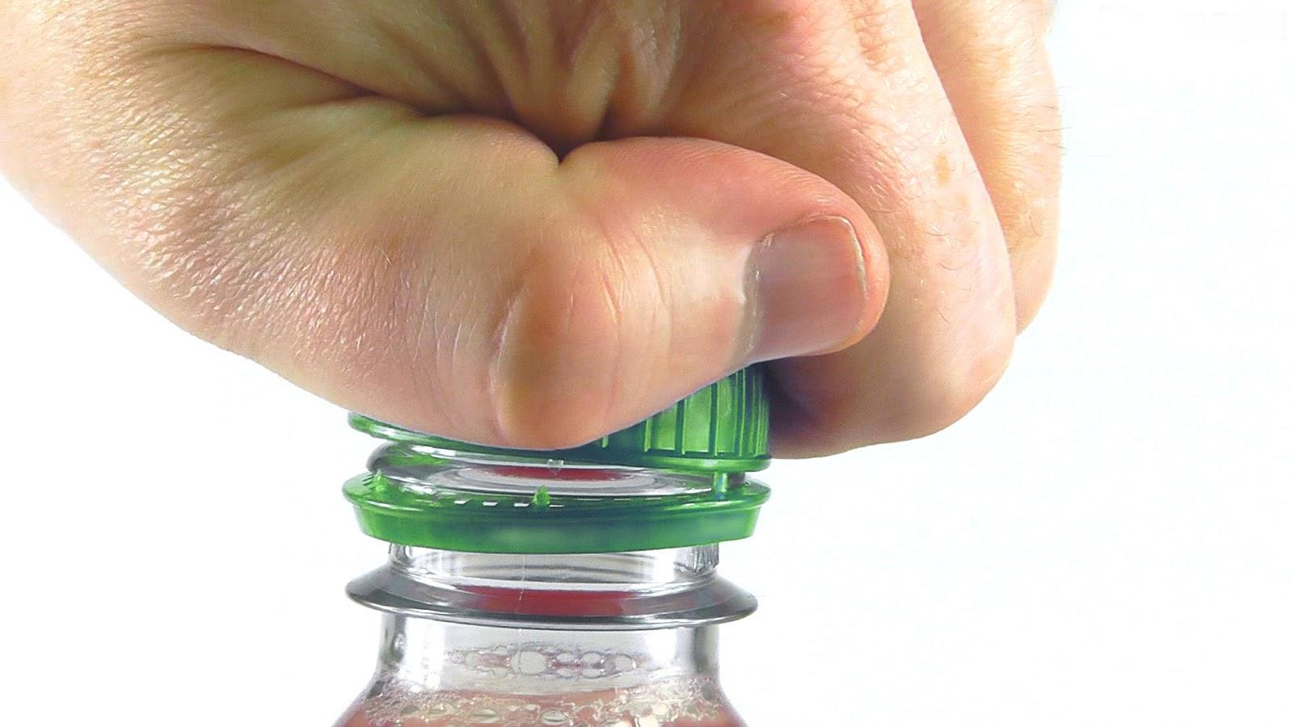
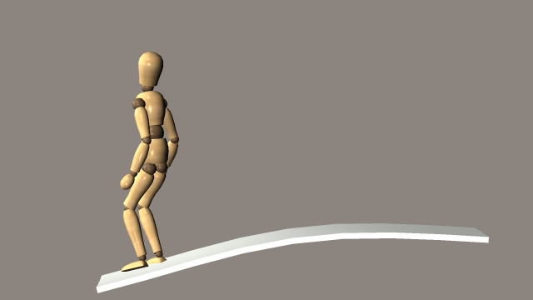
TYPES OF LOADS (FORCES)
Tension
Shear
Compression
Torsion
Bending
Notes:
It might help to understand these forces by seeing them in real life situations. Tension is like two teams pulling on a rope in a tug-of-war. Compression is like the soldier standing on his artificial leg. The composite leg is being pressed on the top and straight down to the bottom. Shear is the force caused when a knife cuts through something. It is how shears got their name. Bending can occur either in the middle of a part that is anchored on the ends or on the end of a part that is anchored on one end like a diving board. Torsion is twisting to create the forces that break the cap from the small ring below it.

Slide 8
CARRYING THE LOADS (FORCES)
The fibers carry most of the load
High ratio of (Load_{fibers}/Load_{composite})
When
Fibers are much stiffer than the matrix (high E_{f}/E_{m})
Volume fraction of fibers (V_{f}) is above 0.6 (60%)
Advanced fibers
100
0.9
0.7
0.6
0.5
50
0.3
0.1 = V_{f} (Fiber volume fraction)
Load_{fibers}/Load_{composites} (P_{f}/P_{c})
5
1
I
I
I
I
I
0.1
0.5
1.0
5
10
50
100
Stiffness Ratio: E_{f}/E_{m}
Notes:
This chart is important because it tells engineers what fraction of the load is carried by the fibers and what fraction is carried by the matrix, what properties of the resin and the fiber are important in carrying the load, and how much of each component should be used in a part.
The fraction of the load carried by the fibers is the vertical (y) axis of the chart. It is the load carried by the fibers divided by the total load on the composite. The horizontal (x) axis is the ratio of the stiffness of the fibers divided by the stiffness of the matrix. Engineers have found that the stiffness, symbolized here by E, is very important in determining the share of the load carried by each component. Typically, the fibers are much stiffer than the matrix. It is not unusual to see the ratio of stiffness of fiber to matrix to be 4 or higher.
The curves in the chart are lines of fiber volume fraction, that is, what fraction of the total volume of the composite is taken by the fibers.
Let’s do a typical case. Assume the stiffness ratio (x-axis) is 5 and the fiber fraction (curve) is 0.6 (60% of the volume is fibers). Going up from 5 to meet the 0.6 line is shown as being within the red circle. That circle is typical of advanced composites. If we then move straight across horizontally to the y-axis, we see that the fraction of the load carried by the fibers is above 90. That means that the fibers are carrying over 90% of the load.
Of course, if the volume of fibers is reduced or the fibers are not 5 times stiffer than the matrix, the fraction of the load carried by the fibers will be less. However, the most efficient composites are those in which the fibers carry as much of the load as possible. Hence, the advanced composites typically use over 60% fiber volume and use carbon fiber, the stiffest fiber we know for its weight.

Slide 9
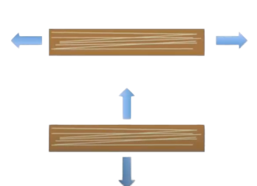
REINFORCEMENT DIRECTION
Strong
Weak
Notes:
I think it is obvious, but in composites the fibers only carry loads in the fiber direction. Pulling on the ends of a rope gives strength but pulling sideways on a rope gives little strength. Hence, always remember that the fibers only carry loads in the fiber direction.

Slide 10
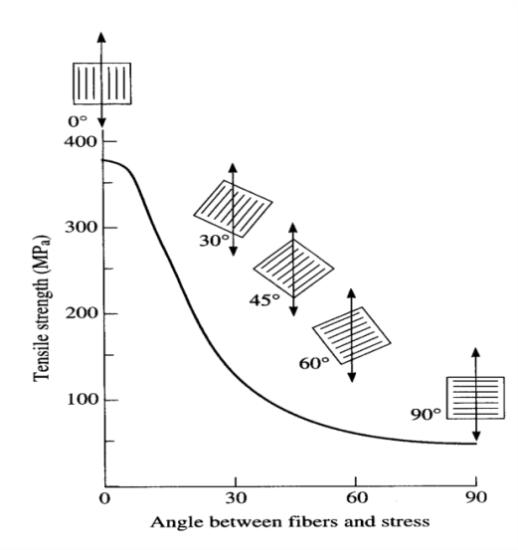
REINFORCEMENT DIRECTION
Stress Direction
Strong In The Direction Of The Fibers
Strength Decreases As The Angle Departs From The 0° Direction
Notes:
The directionality of fibers has been proven by experiment. Some composite sheets were made where all the fibers were in one direction. Then, loads were placed on the composite sheets in various directions with respect to the direction of the fibers. The strength of the composite was strongest when the loads were exactly in the direction of the fibers. This direction was called the 0-degree direction. The strength diminished as the angle changed until the lowest strength was when the load was at 90-degrees from the fiber direction.

Slide 11
ANISOTROPIC and ISOTROPIC
Anisotropic or Non-isotropic
Fibers Are Directionally Oriented
Isotropic
Fibers Are Randomly Oriented
Notes:
Knowing that the fibers are only strong in the fiber direction is important in aligning the fibers with the expected load. However, what if the composite receives loads in different directions. The fibers might have to be oriented in multiple ways. Two terms are used to describe how the fibers are oriented. If all the fibers are in the same direction, the arrangement is called anisotropic. If the fibers are oriented in all directions, the term is isotropic.

Slide 12
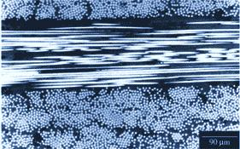
LAYERING
Composites Are Often Laminar
* Microscopic Side View of Composite Laminate
Notes:
Because the fibers are often in a sheet, composites are usually laminar. In most advanced composites that have the highest performance, the layers are unidirectional fibers that are put in place with the fibers in the direction of the loads. When a stack of layers has the fibers in many directions, the arrangement is called pseudoisotropic. This means it is like an isotropic material where the forces applied in all directions are the same. Note that one of the directions is called the x and in the same plane is called y and vertical is called z.

Slide 13
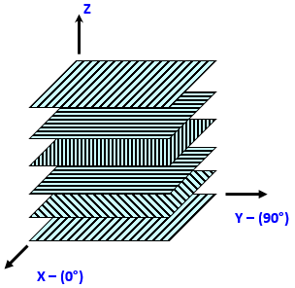
LAYERING
The Layers Are Oriented In The Direction Of Expected Stress
Layers Can Be Crossed To Give Strength In Multiple Directions
Pseudoisotropic
Notes:
Because the fibers are often in a sheet, composites are usually laminar. In most advanced composites that have the highest performance, the layers are unidirectional fibers that are put in place with the fibers in the direction of the loads. When a stack of layers has the fibers in many directions, the arrangement is called pseudoisotropic. This means it is like an isotropic material where the forces applied in all directions are the same. Note that one of the directions is called the x and in the same plane is called y and vertical is called z.

Slide 14
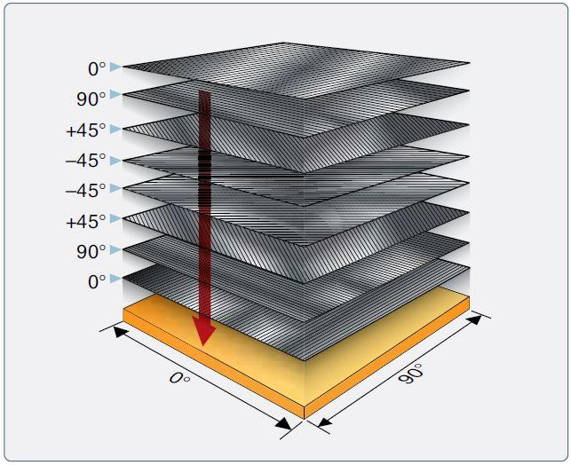
FIBER ORIENTATION
Layers Are Stacked In Specific Orders and Direction
Symmetric - the Layers Are Mirror Images From The Mid-point Of The Stack
Balanced - the Number In Each Direction (+ And -) Is The Same
All Stacks Should Be Both Symmetric And Balanced
MIRRORED
Notes:
Laying up the sheets of unidirectional prepreg is the essence of making advanced composite parts. Much care and technology is needed to anticipate what the forces will be on a part, the direction of the forces, the magnitude of the forces, and the number and direction of the fiber sheets to withstand those forces (and have a small safety factor).
Not only is it important to know the number of sheets needed in a particular directions, but it is also important to lay the sheets up in certain orders. Especially important are ensuring that the stack is both symmetric and balanced. Symmetric means that the directions and number of sheets are mirrored above and below the mid-point of the stack. Balance means that the number of sheets rotated to the positive direction (to the left) is the same as the number rotated in the negative direction (to the right). If both symmetry and balance are not observed, the part will be warped after it is cured.

Slide 15
FIBER LENGTH CONSIDERATIONS
Longer Fibers Have Higher Strength
Up To 25% More With Twice The Length
Continuous Fibers Are Preferred For Advanced Composites
Discontinuities Are Crack Initiation Points
Tapering Is Used To Help Reduce The Stresses
Notes:
Long fibers are stronger than short fibers because any discontinuity in the composite, like the end of a fiber, is a potential point of crack initiation when the composite is put under load. The best strength comes when the composite layers are continuous. Therefore, any break or end of a part is to be avoided.
However, sometimes weight can be saved by reducing the thickness of the part, that is, reducing the number of plies, wherever the loads are reduced. An example of this is the tips of airplane wings. The weight of the composite is reduced by decreasing the number of layers. This means that somewhere along the length of the part the number of plies decreases and, of course, that means that some plies end. Rather than reducing the thickness all at once, it is better to reduce it one layer at a time with some distance between the reductions. This is called tapering.
Therefore, the value of saving weight by reducing the thickness needs to be weighed against the decrease in strength caused when fibers are terminated. A compromise is usually the answer.

Slide 16
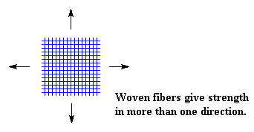
WOVEN MATERIALS
Reinforcement In Two Directions Using A Woven Fabric Can Save Manufacturing Time
This Works Best With Plain Weave Fabric, Where The Long Continuous Strands Are Oriented At 90°to One Another
However, Each Cross-over Point (Node) Is A Weaker Point, And Some Strength Is Lost When Woven Materials Are Used
Notes:
Layups can often be done faster if woven materials are used rather than unidirectional sheets. However, each time a fiber crosses over another in the same layer, the fibers are compressed and a weak point is created. Therefore, if the part is to be optimized, unidirectional sheets are best.

Slide 17
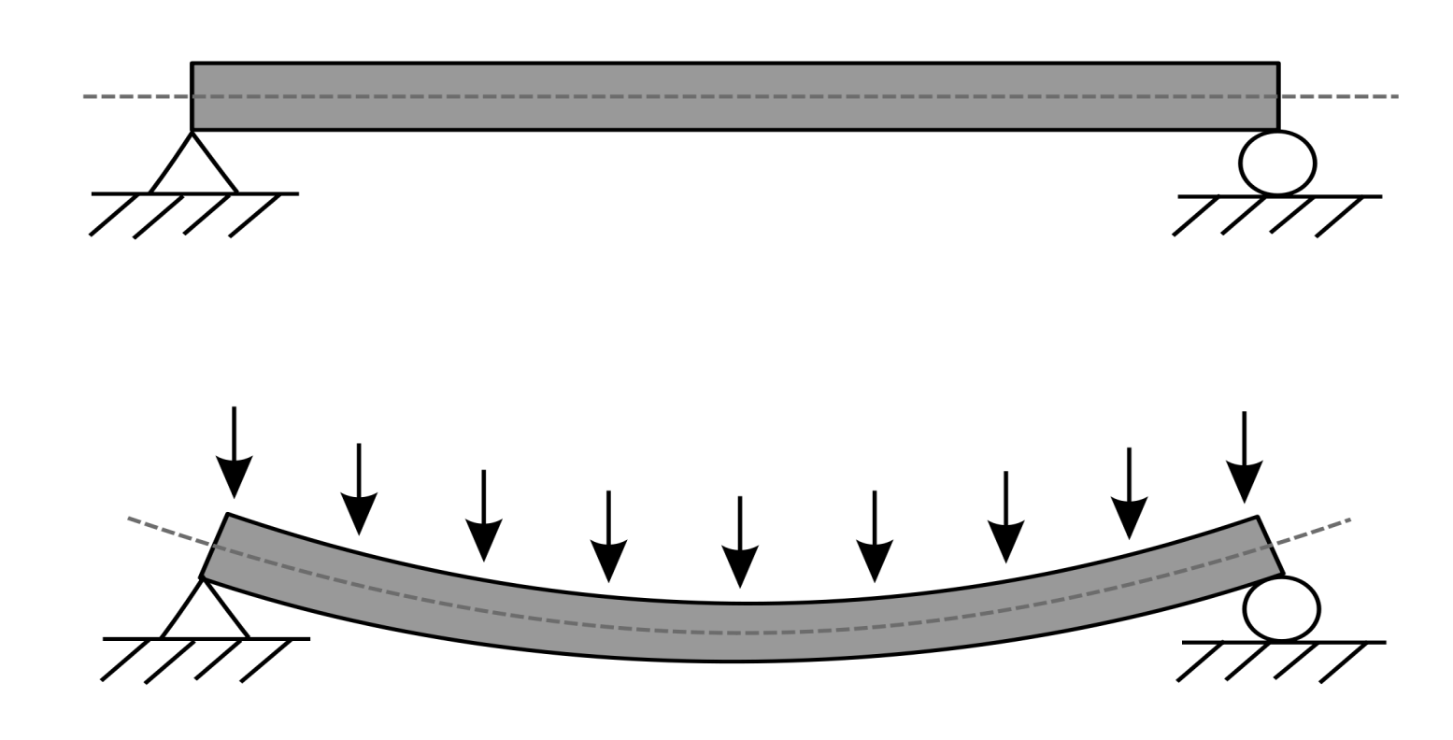
LOADING A COMPOSITE
Z-direction Loads
NO LOAD
LOADED
Compression Side
Tension side
Notes:
As we have seen, most composites are laminar with the fibers only in the x and y directions. But what do we do if some of the load is also in the z direction? This case results in the top of the composite begin placed in compression (pushing force) and the bottom being in tension (pulling force).

Slide 18
LOADING A COMPOSITE
LOAD
Additional
Plies
By Placing Additional Fiber Plies Across the Load Bearing Surface, the Structure is Better Able to Resist/Support the Applied Loads.
The Load is Spread Across a Greater Thickness (More Plies) Which Resists the Applied Load
Notes:
One method of increasing the ability of the composite to withstand a z-direction force is to simply add more layers. The load is spread across a greater thickness and that helps resist the load. However, adding thickness also adds weight and in some applications, like an airplane wing, adding weight is not good.

Slide 19
COMPOSITE LOAD SANDWICH
How to increase
the stiffness and
strength in the
vertical (z) direction
Solid Sheet
Sandwich Construction
Thicker Sandwich
3t
t
2t
Relative Stiffness
700
7 times more rigid
3700
37 times more rigid
100
Relative Strength
350
3.5 times as strong
925
9.25 times as strong
100
Relative Weight
1.03
3% increase in weight
1.06
6% increase in weight
1.00
Notes:
Another way to add strength and, especially, stiffness in the z-direction, is to use core materials to make sandwich structures. The sandwich structure is made by placing a core material between two composite laminates and then adhesively bonding them all together. This is like a peanut butter and jelly sandwich where the bread is the composite laminates, the peanut butter is the adhesive, and the jelly is the core.
If the thickness of the core material is twice the thickness of the original laminate, the stiffness goes up 7 times and the strength is 3.5 times more while the weight only increases 3%. If the thickness of the core is 3 times the original, the stiffness is 37 times greater, and the strength is over 9 times greater with only a 6% increase in weight. Clearly making sandwich structures has some major advantages. However, there are some disadvantages in time to manufacture and the possibility of picking u p water through microcracks in the structure and, therefore, adding weight. This has been found to be important for planes on aircraft carriers.

Slide 20
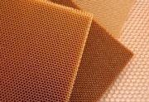
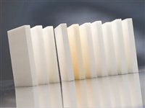
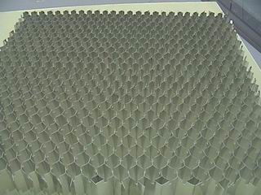
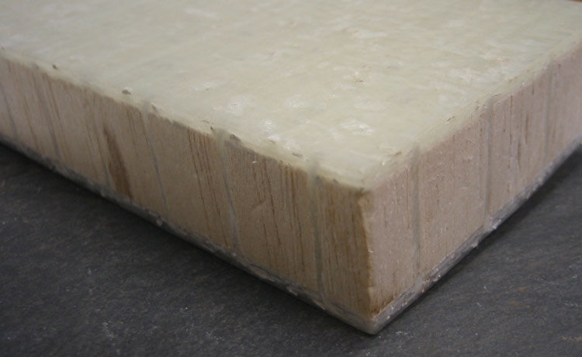
CORE MATERIALS
Common Core Materials
Aramid Honeycomb
Foam
Aluminum Honeycomb
Balsa Wood (end cut)
Notes:
. The most common core materials are very light weight and stiff materials like honeycombs, foams, and light wood.

Slide 21
SHAPE STIFFENERS
T & J Stiffeners
Hats
Compound Curves
Notes:
Yet another way to get strength and stiffness in the z-direction is to orient some fibers vertically or nearly vertical. Some shaped pieces have been developed that have proven to be very effective in giving z-directional strength and stiffness. These pieces are usually named after their shape. Examples are hats, T stiffeners, and J stiffeners. Sometimes compound curves where some of the fibers are curved into a general upward direction will also give some strength and stiffness. These shapes are used extensively by Boeing.

Slide 22
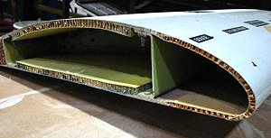
COMPOSITE STRUCTURES
Notes:
Here is an example of the use of sandwich material and C-stiffeners in a wing structure.

Slide 23
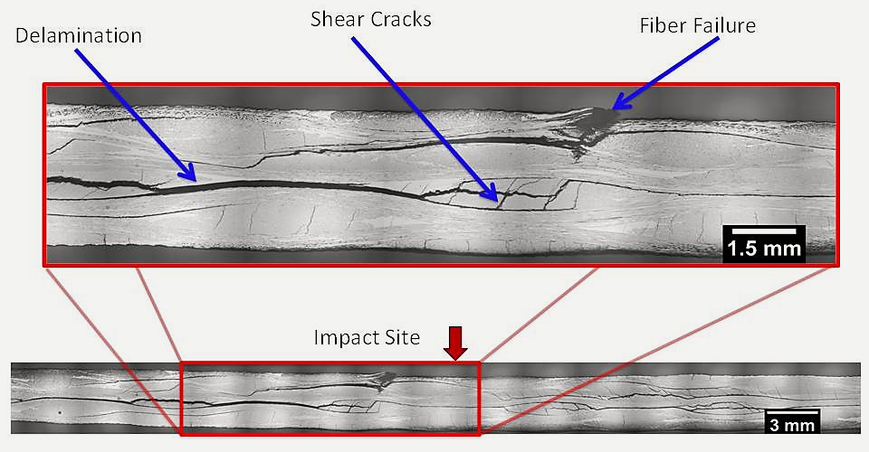
COMPOSITE FAILURE
Impacts
Over Stress
Over Twisting
Over Bending
Delamination's
Voids
FOD (foreign object debris)
Notes:
Failures of composites occur when the fibers break, cracks appear in the matrix, the matrix bond to the fibers is broken, and foreign objects are present in the layup. These defects can occur because of many reasons including impacts, too much force, delaminations from improper manufacturing, insufficient pressure during cure, and accidental inclusion of debris.

Slide 24
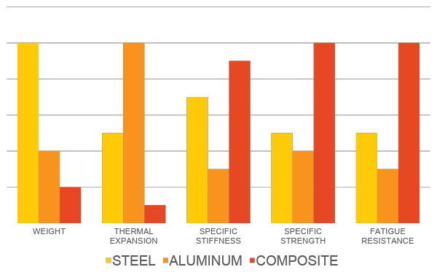
PROPERTIES COMPARISONS OF
METAL AND COMPOSITES
Al
Notes:
We have looked at how composites are designed. The process is obviously quite complex and, in truth, is more difficult than designing a part using metals. Therefore, there must be a good reason why composites are growing so rapidly and taking the place of metals in so many applications. The reasons are simply the superior properties of composites compared to metals. Remember that each of these properties is adjusted by the weight of the part.
Composites are about 9 times lighter than steel and about a third the weight of aluminum. The thermal expansion of composites is almost zero and that is, of course, much less than the metals. The stiffness of composites is much more than either steel or aluminum and the strength is also greater. Fatigue resistance is the ability of a material to withstand continued use and composites are much better than either steel or aluminum.
This demonstration unit has strips of composites and metals. It is intended to compare the stiffness of these materials when placed under a bending force. I will add a 100 gram weight to the end of each of the strips. You will be able to see which material is stiffest.

Slide 25
Thank You
Part 3:
Composites Design: Forces and How to Withstand Them
Notes:
Thank you for being here. See you next time in part 4

Slide 26
Notes:
I am happy that you were here today, and I hope to see you for the next video in this series on composites.

