Slide 1
COMPOSITES
Lighter / Stronger / Better
Notes:
I am happy that you were here today, and I hope to see you for the next video in this series on composites.

Slide 2
Project Produced
with the Generous Support
of the Following
Notes:
I am happy that you were here today, and I hope to see you for the next video in this series on composites.

Slide 3
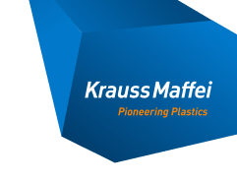
Los Angeles Chapter
William Dahlgren Family
Ernest Solvay Fund Managed
by The King Baudouin Foundation
St. Margaret’s
Episcopal School
Notes:
Hello. I’m glad you have joined me today. We are going to explore how composite materials are helping to make the world better. This is the first of four videos that will discuss composites. In this first video, we will discuss the benefits of composites in today’s world and discuss what composites are. In the other videos we will explore the materials that make up composites, the way composites are designed in order to make things lighter, stronger, and better, and then the ways that composite parts are made.

Slide 4
Presents
Notes:
I am happy that you were here today, and I hope to see you for the next video in this series on composites.

Slide 5
COMPOSITES Lighter / Stronger / Better
Part 4:
Composites Manufacturing:
Making Actual Composite Parts
Notes:
I am happy that you were here today, and I hope to see you for the next video in this series on composites.

Slide 6
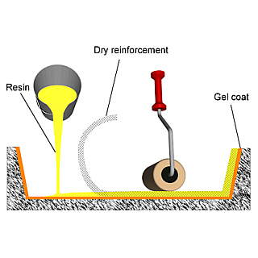
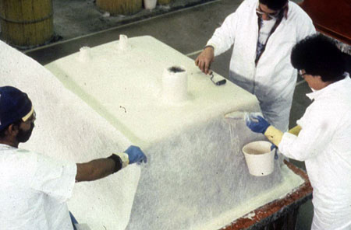
HAND LAYUP
Concave Mold
Convex Mold
Notes:
The simplest way to manufacture a composite is by hand. Normally the dry reinforcement, often fiberglass mat, is laid into the mold and covered with resin. The wet reinforcement is rolled to ensure that the fibers are fully coated (wetted) with resin. Other layers are added as required to get the thickness specified in the design. Each layer is rolled to ensure good wetting.
Often, the part will have a thin layer of high-quality resin that is applied first or last to the mold (depending on whether the mold is concave or convex) to give the part an outer layer that has good weatherability and damage protection. This outer layer is called a gel coat. For best adhesion of the composite layers to the gel coat, the composite layers should be applied when the gel coat is only partially cured (while still in the gel phase).
The advantages of this manufacturing method are simplicity, low cost, and low investment in machinery.

Slide 7
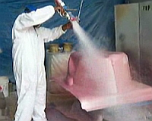
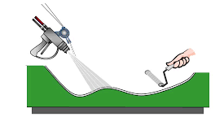
SPRAYUP
Notes:
Sprayup is similar to hand layup except that the placement of the fibers and the resin is done in a semi-automated way. The fibers and resin are sprayed into or onto the mold. The fibers are fed into a spray gun that has a chopper attached. The fibers are chopped and then entrained in the spray of the resin. The length of the chopped fibers and the amount of resin are adjusted to meet the design criteria. The thickness of the fiber layers is checked using a thickness gauge to ensure that the right amount of fiber/resin is placed on the mold. Usually, the complete wetting of the fibers is ensured by rolling the fibers and resin.
The advantages of this system are relatively low cost and increased production speed compared to hand layup.

Slide 8
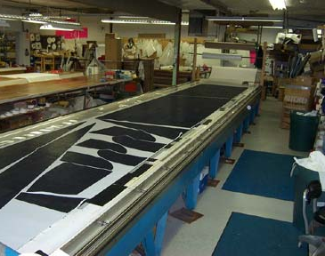
AUTOMATED PLY CUTTING
OF PREPREG
Notes:
Advanced composites (using carbon fiber) are often made using prepreg. The prepreg is made on machines that ensure uniform directionality of the fibers and the correct amount of resin. These prepregs are sheets that are stored in freezers until ready to be molded. They are removed, warmed to room temperature, and then cut to the proper shape. Each layer is carefully cut to ensure that when they are laid into a stack, the design is followed exactly. Often, because of part shape and tapering, each layer could be a different shape and have fibers in different directions from other layers.
Some companies cut each of the layers in the stack by hand but that is both tedious and normally wastes prepreg because of the varying shapes of the layers. It is better to automatically cut the layers by using a ply cutter that has an optimization program that minimizes the amount of prepreg used and does all the cutting automatically. Some machines are linked to a robot that will pick up the cut layers and stack them automatically in the correct order. Some companies do the cutting and stacking as a service for others. This service process is called kitting.

Slide 9
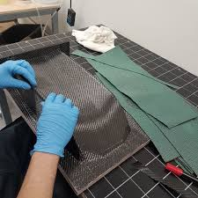
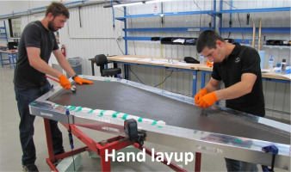
PREPREG LAYUP
Notes:
The most common method of placing the cut prepreg layers into the mold is by hand, especially for small parts or parts with complex curves. As each layer is put in place, it is often rolled or pressed to ensure that it adheres to the layer beneath.
The advantages of this manufacturing method are the ability to make parts that are complex and getting the optimal performance from the materials.

Slide 10
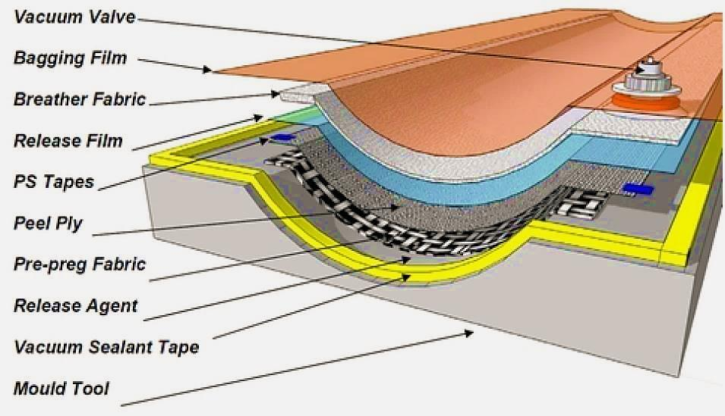
BAGGING ASSEMBLY
To Consolidate The Plies,
Remove Excess Resin & Encourage Air To Escape
Notes:
When all the layers in the stack have been placed, a bagging assembly is put over the stack to help consolidate the stack and to ensure that the optimal amount of resin is in the cured part. The bagging assembly consists of several layers, most of which are there to allow excess resin to flow into the bagging material layers. The bagging assembly is covered with a film bag, much like a cooking bag for turkey, and a vacuum port is added. The vacuum bag is airtight sealed onto the mold.

Slide 11
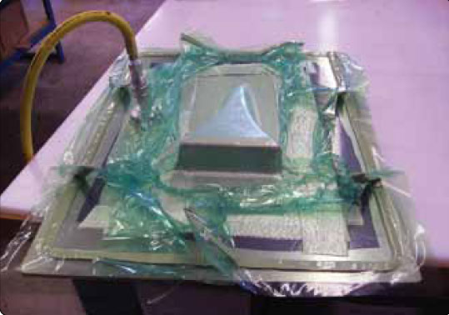
BAGGING
Put Under Vacuum
Eliminates Excess Resin
Consolidates The Prepreg Layers
Cured & Bag Assembly Removed
Notes:
A vacuum is applied to squeeze the entire assembly while it is being heated. This causes excess resin to flow into absorbent layers and sweeps air out of the stack so that all the layers are completely consolidated with no gaps or spaces. After curing, the bagging assembly is removed and discarded.

Slide 12
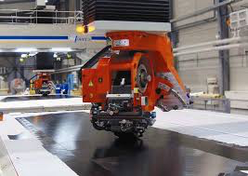
AUTOMATED TAPE LAYING
Notes:
When large parts, like wings or airplane body parts are made, the parts are too big to lay up the prepreg by hand. Machines have been developed to lay up the prepreg automatically. These machines have the ability to lay up flat parts and also parts with moderate curves and complexities. As robots become more commonly used in composites, the machines are able to automatically lay up ever more complex parts.

Slide 13
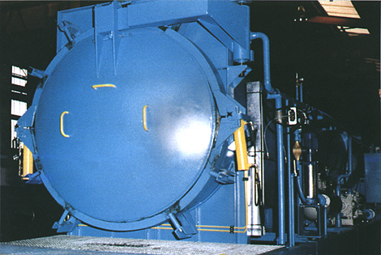
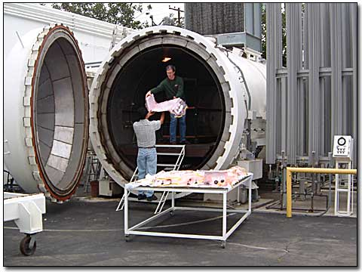
AUTOCLAVES
Notes:
After layup is completed, the bagged assembly is placed into an autoclave where it is heated, and pressure is added. This is done to ensure that the layers are fully consolidated and to cure the resin. The autoclave is like a giant pressure cooker.

Slide 14
CURING PROFILE
400
355±10
120 minutes
300
200
130
Temperature (°F)
100
1-5°F/minute
Begin heat after full pressurization of autoclave
Time
Vacuum
Autoclave
Notes:
A typical curing cycle has several different steps. It begins with the application of a vacuum to consolidate the stack within the vacuum bag assembly. The assembly is then heated at a moderate rate to allow the resin and gases in the stack to be removed. Then, heat is increased and pressure from the autoclave is added. The temperature and pressure are continued until the resin is fully cured. The pressure and temperature are then gradually reduced, and the part is removed from the autoclave. The total time for this cycle can be several hours.
Autoclaves can be quite dangerous. They are, therefore, covered by safety rules that mandate routine inspections by independent and certified experts. Also, the autoclaves are quite expensive and the times for curing are quite long. Therefore, several methods have been developed to eliminate the need for using autoclaves.

Slide 15
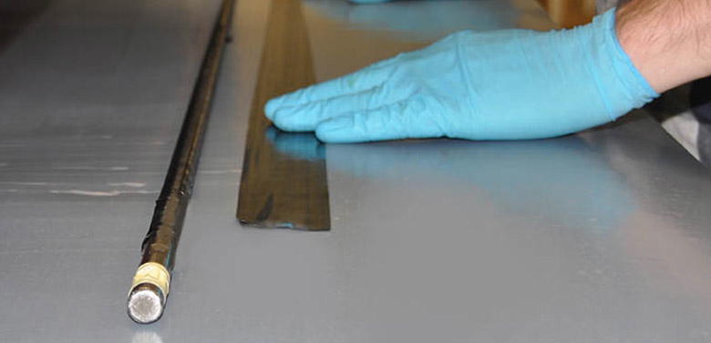
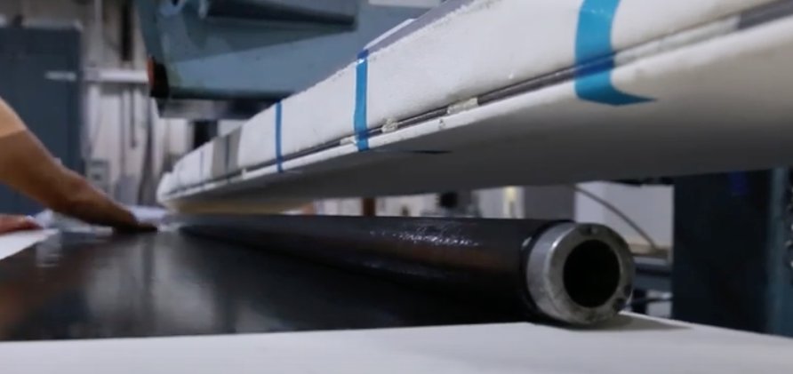
ROLL WRAPPING
Notes:
If the composite part is small and generally cylindrical, a simple and semi-automated system to apply prepreg is roll wrapping. A hard rod (usually steel), the size of the interior of the part, is used as the mold around which the prepreg is formed. The prepreg is cut into strips the length of the finished part and about 3 times wider than the diameter of the part. One edge of the prepreg is stuck to the rod (called a mandrel) and then the top of the machine is lowered onto the mandrel and moved back relative to the bottom part of the machine. This causes the mandrel to roll and wraps the prepreg around the mandrel. The process is repeated until the desired thickness is reached.
The part is then wrapped with plastic film that shrinks when heated. The part is put into an oven and is heated. The plastic squeezes the prepreg layers and eliminates the need for an autoclave. When fully cured, the part is removed, the plastic film is removed, and the mandrel is extracted from the part. If needed, the outside of the part can be sanded or ground to remove the ridges caused by the plastic film.
The advantages of this method are simplicity and relatively low cost for the machine and mandrels. However, only generally round parts like tubes and golf club shafts can be made.

Slide 16
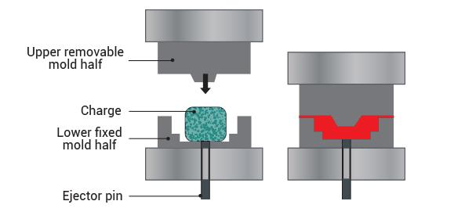
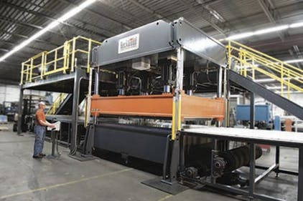
COMPRESSION MOLDING
Notes:
Compression molding has been used to mold non-reinforced plastic parts for decades and has been successfully used to make composite parts since the early 1950s. In this method, the mold is divided into two parts. One part is mounted to the machine and the other part is attached to a pressure plate that moves up and down. The machine opens and a charge of uncured resin, reinforcement, and often other additives, is placed on the lower mold half. The machine closes, the material is squeezed to fill the mold, and heat is added to cure the part. When fully cured, the mold opens, and a metal rod (called an ejector pin) is pressed upwards against the bottom of the part. The part is ejected from the mold.
The advantages of this system are many. The parts generally come out of the mold fully formed and finished. Both sides of the part are against molds and are therefore of high surface quality and with good definition. If inserts need to be added to the part, like a clamp or hinge, these can be added in the mold and cured into the part. However, as the parts get larger, the size of the machine needed to exert the required pressure goes up dramatically and becomes very expensive.

Slide 17
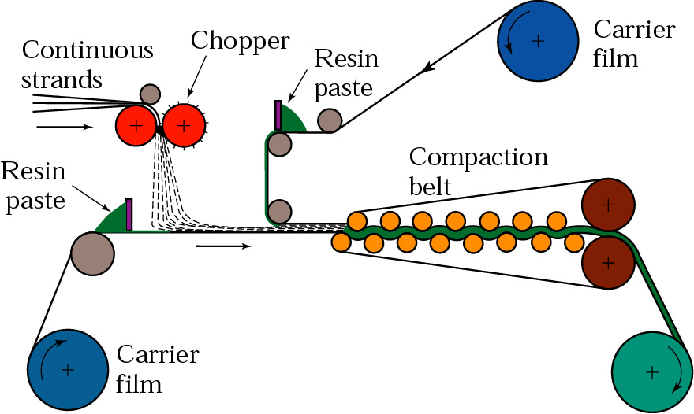
MOLDING COMPOUNDS
Sheet Molding Compound (SMC)
Notes:
The most commonly used materials in compression molding of composites are called molding compounds. They are made from resin, fibers, and often a ground up rock filler to reduce the cost. This type of material is used extensively in automobiles, but the filler would not be used in aerospace parts because of the weight. The relative proportions of the components must be adjusted to give the desired properties and to move properly to fill the mold when the mold closes. To help make molding compounds for use in parts that are quite large, like the hood of a Corvette, the molding compound is made in a sheet form. This is done by chopping the fiberglass onto a sheet of carrier film, adding the resin and filler, and then compacting the mixture between another sheet of carrier film. The resulting material is called sheet molding compound.

Slide 18
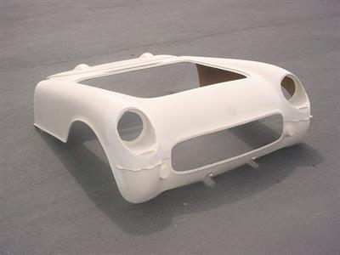
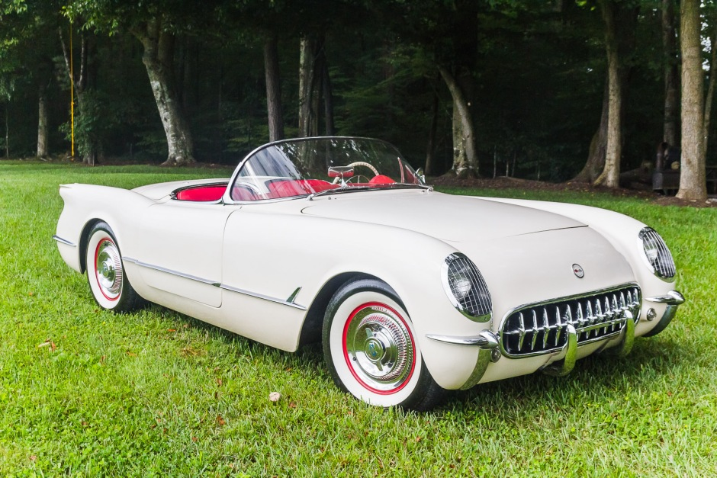
MOLDING COMPOUNDS
Making The Parts (1953 Corvette)
Notes:
The sheet molding system was originally invented to make the body parts for the 1953 Corvette.

Slide 19
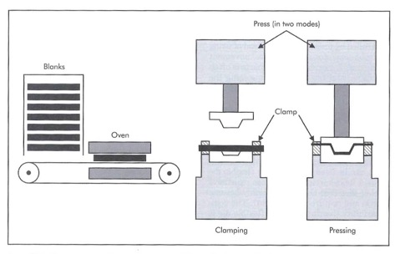
COMPRESSION MOLDING THERMOPLASTICS
Thermoplastic Layups Can Be Preheated & Shaped Very Quickly
Notes:
Compression molding can be used to mold thermoplastics as well as thermosets. When using thermoplastics, the input is a stack of prepreg sheets that have been lightly tacked together to keep them in position. These stacks are called blanks. The blanks are then heated in an oven to get them up to a temperature near the melting point of the thermoplastic. The blanks are then placed into the compression mold and pressed. Because they are near the melting point, little heating is required in the compression press. Instead, the parts are shaped and cooled to the point where they are solid enough to be removed. They are then further cooled outside the mold, perhaps on a tool that helps them maintain their shape.
The advantage of this system is very short cycle times and high productivity.

Slide 20
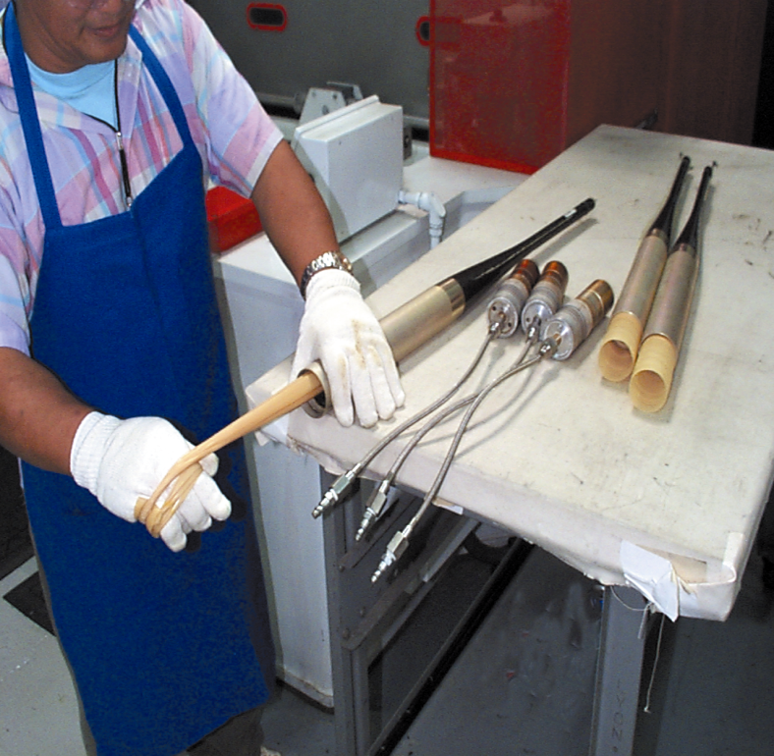
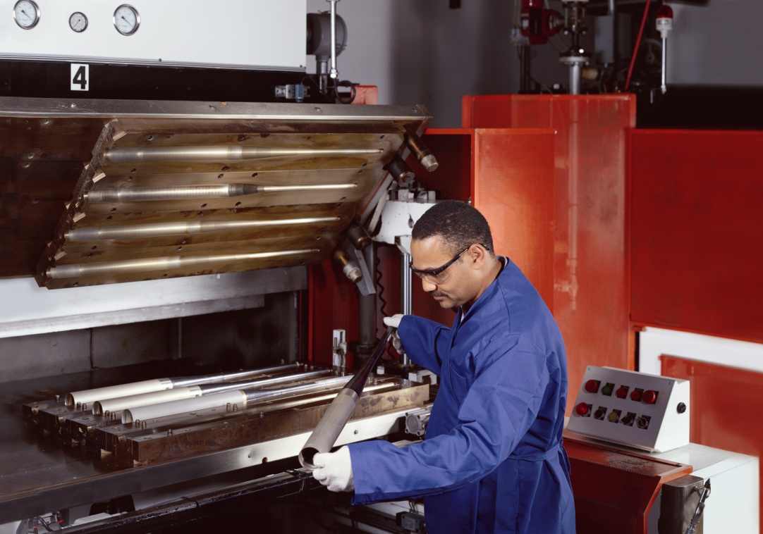
BLADDER MOLDING
Baseball Bats
Notes:
Making hollow parts can be done by using an internal bladder. The partially inflated bladder is wrapped with prepreg and then inserted into to metal mold. The mold is put into an oven and, while heat is applied, the bladder is further inflated to press the prepreg against the interior of the metal mold. This method is used to make parts like baseball bats, bike frames, and tennis racquets.

Slide 21
RTM PROCESSING STEPS
Notes:
Resin Transfer Molding or RTM is a method that avoids the need for an autoclave. In this method, a dry preform is made of the fibers that is the shape of the finished part. The preform is placed inside a mold and then resin is injected into the preform. Great care must be taken to ensure that the resin completely coats all the fibers in the preform. The part is then cured, and the mold is opened, and the part removed.
The advantages of this method are the elimination of an autoclave, the relatively rapid cures that are possible, and the high production rates that are possible. Further, this is a closed mold process and so the presence of vapors from some resins is avoided.

Slide 22
SCRIMP INFUSES
64ft YACHT HULL
TM
Notes:
The RTM process has been modified to permit very large parts to be made. This modified process is called SCRIMP and has been used to make parts as large as 64-foot yachts.

Slide 23
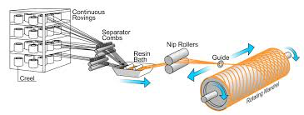
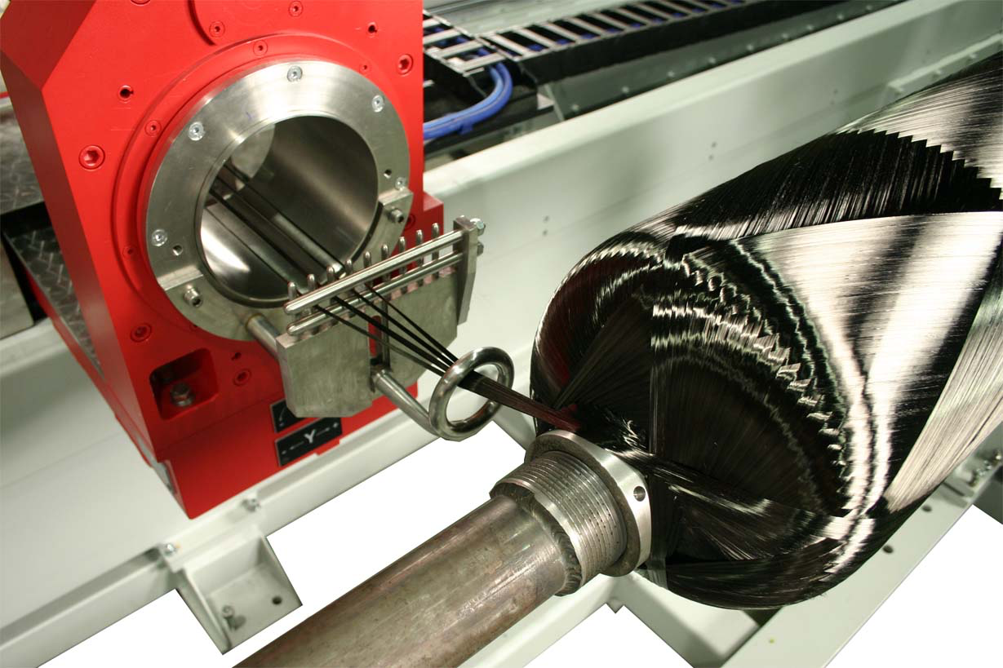
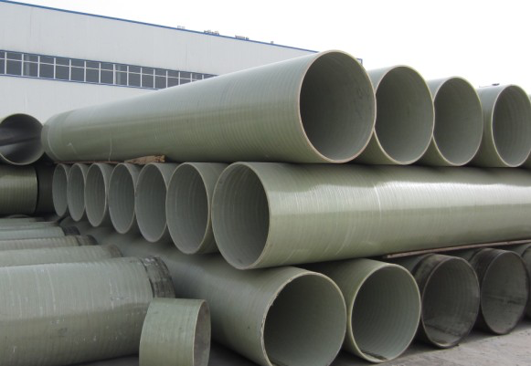
FILAMENT WINDING
Notes:
Filament winding is one of the oldest methods for making composite parts. It was used in the 1970s to make rocket motors for the flights into space. In this method the dry fibers are directed through a resin batch where they are coated with resin and then through nip rollers where the resin is pressed into the fibers and the excess resin is removed. The strand of wet fibers is then directed through a guide (a metal ring) that moves horizontally back and forth to apply fibers onto a rotating mandrel. When the design thickness is achieved, the wrapped mandrel is placed in an oven or autoclave and cured.
The advantage of this system is the speed of application of the fibers and the ability to make parts with either very small and very large diameters.

Slide 24
FILAMENT WINDING
Winding Patterns
Notes:
The pattern of laydown of the fibers is determined by the relative speeds of the motions of the guide and the mandrel. Some machines also allow the guide to move in other directions, thus increasing the complexity of the parts that can be made.

Slide 25
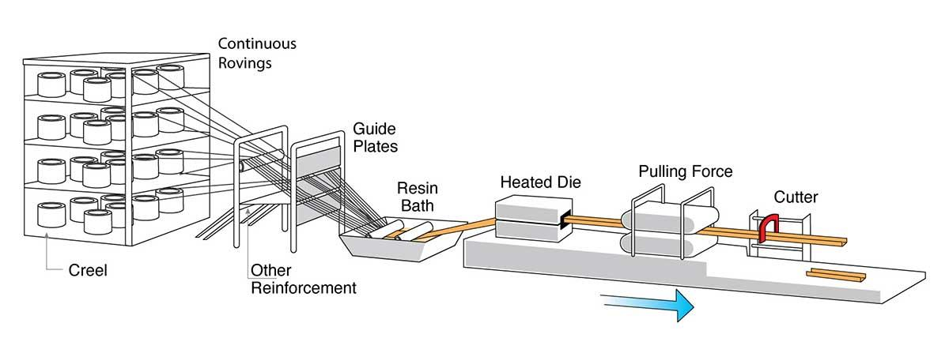
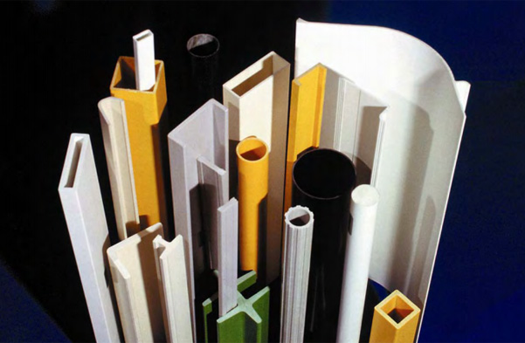
PULTRUSION
Notes:
If the part has a uniform and constant cross-section, like a tube or a rod, pultrusion is a very good manufacturing method. The fibers are drawn into a resin bath and then into a heated die where a metal die forces the fibers into the desired shape. The die is heated and is sufficient long that by the time the part leaves the die, it is solid and fully formed. The part then enters a pulling system that pulls the entire part through the machine.
This system has very high throughput and low cost.

Slide 26
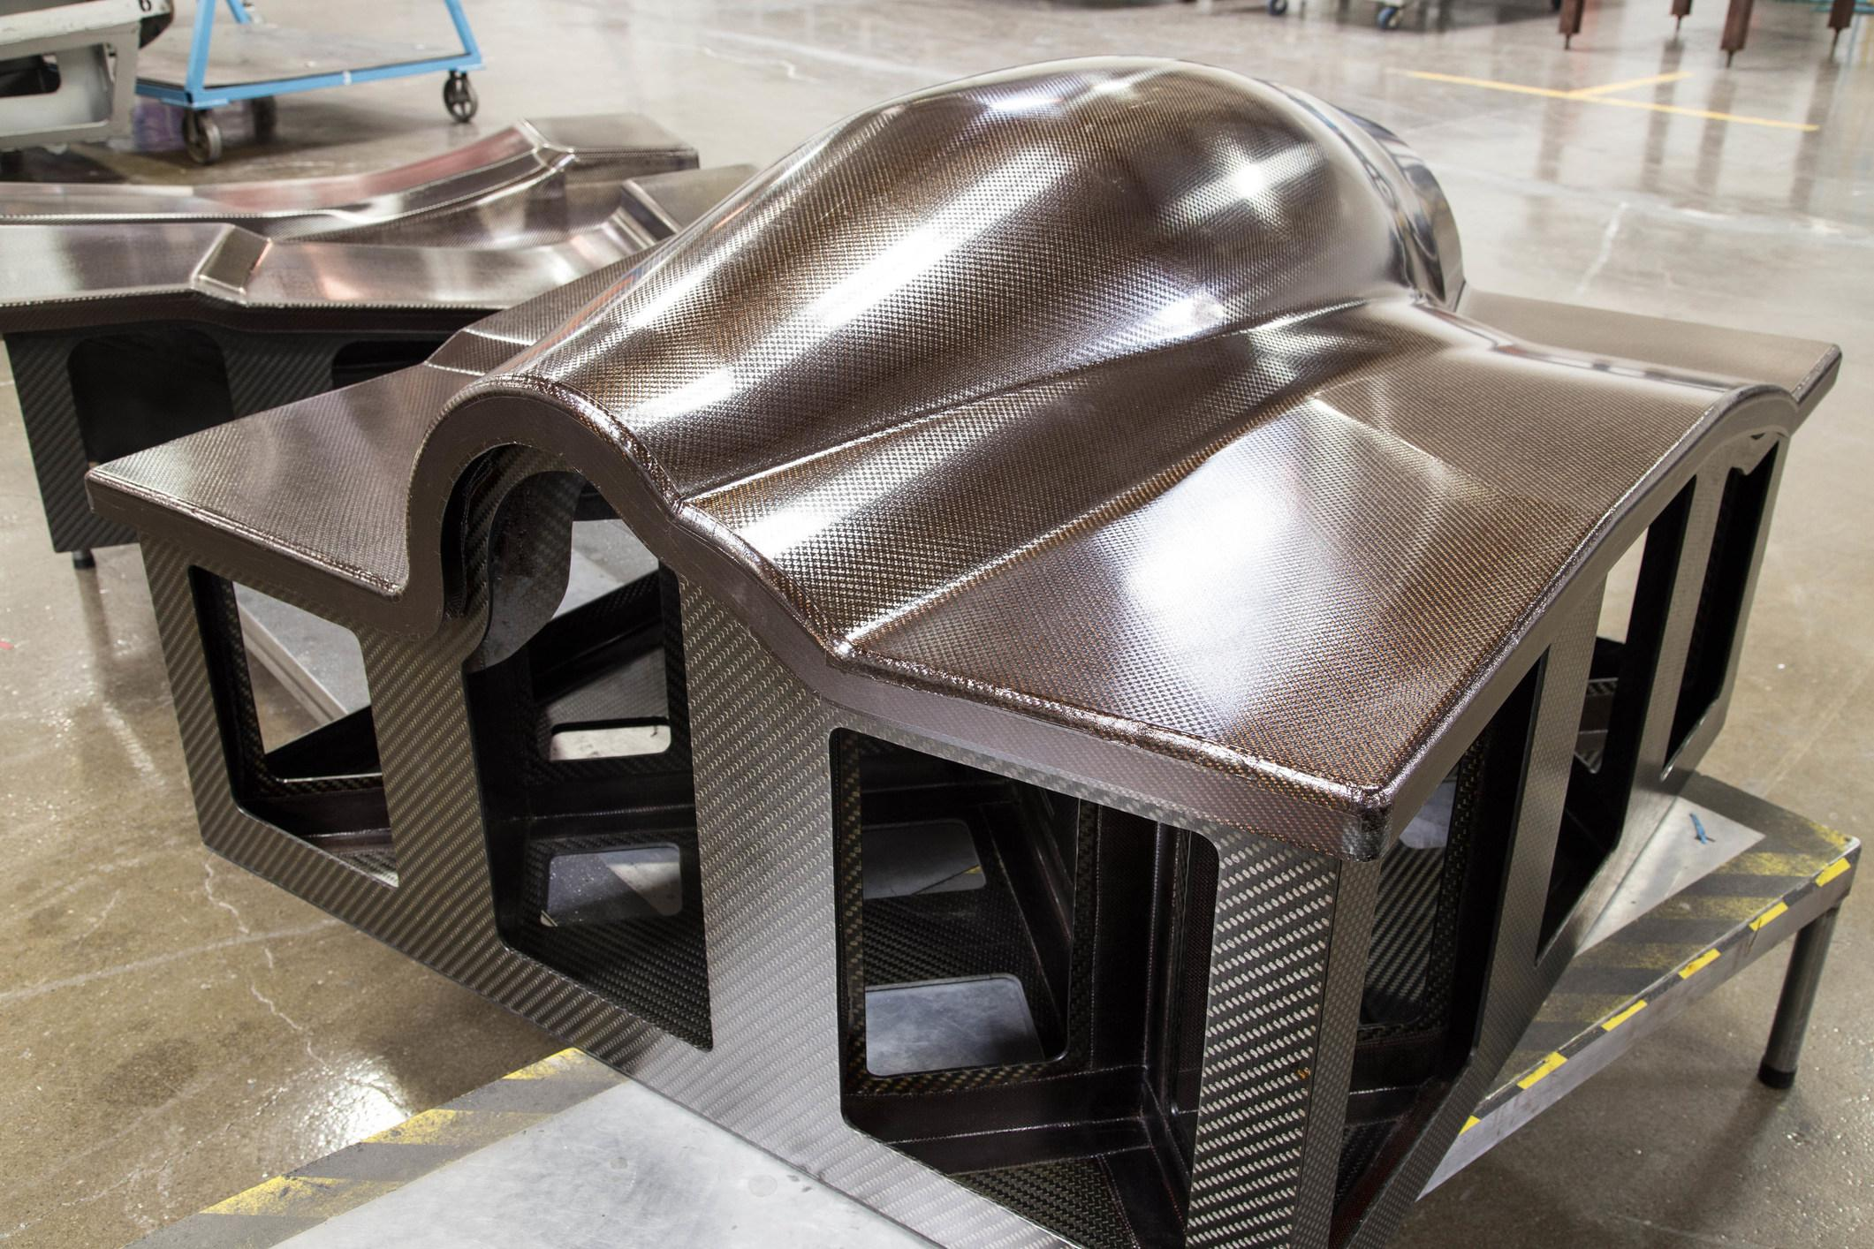
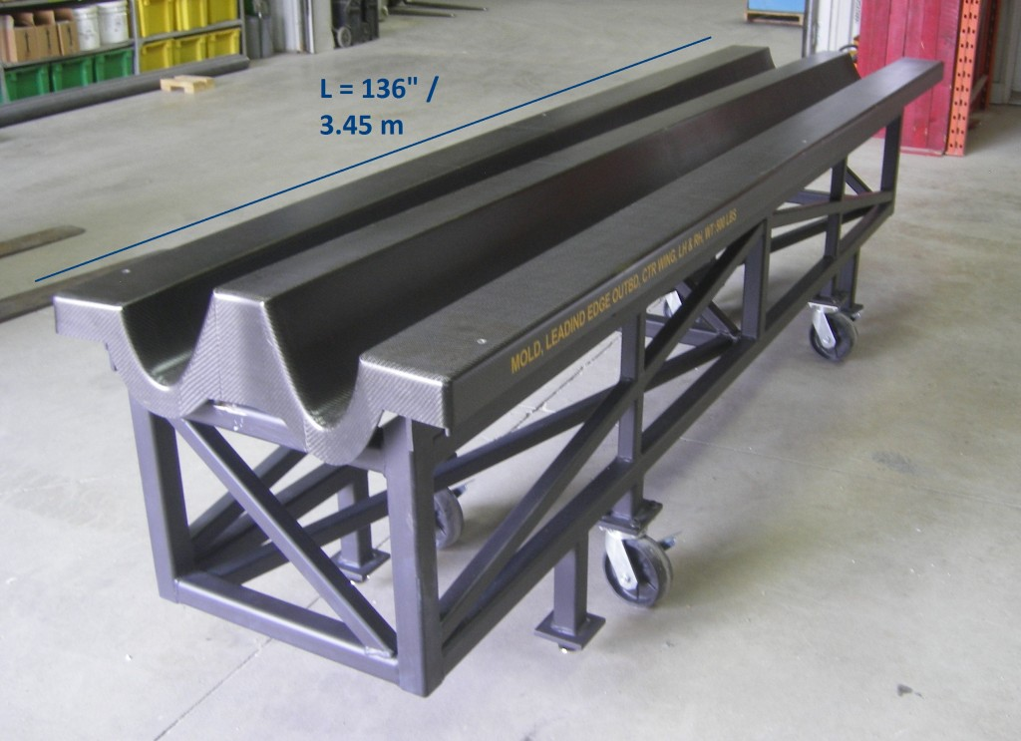
MOLD SHAPES
Convex Mold
Concave Mold
Notes:
Molds can be either convex or concave or combinations of both. When concave, the wetted fibers or prepreg must be pressed into the depths of the cavities to ensure that they are fully touching the mold.

Slide 27
TOOLING (MOLDS)
Need To Consider
CTE (Relative Shape Change)
Vacuum Integrity (Porosity Can Result In Leaks)
Thermal Mass
Cure Temp And Pressure
Number Of Parts
Cost (Can Be 5x Cost Of One Part)
Notes:
Other considerations in choosing a mold are:
The CTE or coefficient of thermal expansion. If the part cures and the mold is convex and continues to expand, the part could be cracked.
The mold needs to be airtight. Some molds are non-metals and porosity can be a problem.
The thermal mass affects the heating time for the cure to be completed.
The cure temperature and pressure can dictate the type of material used for the mold.
A high number of parts may dictate the mold material.
The cost of the mold is important. Some molds cost several hundreds of thousands of dollars.

Slide 28
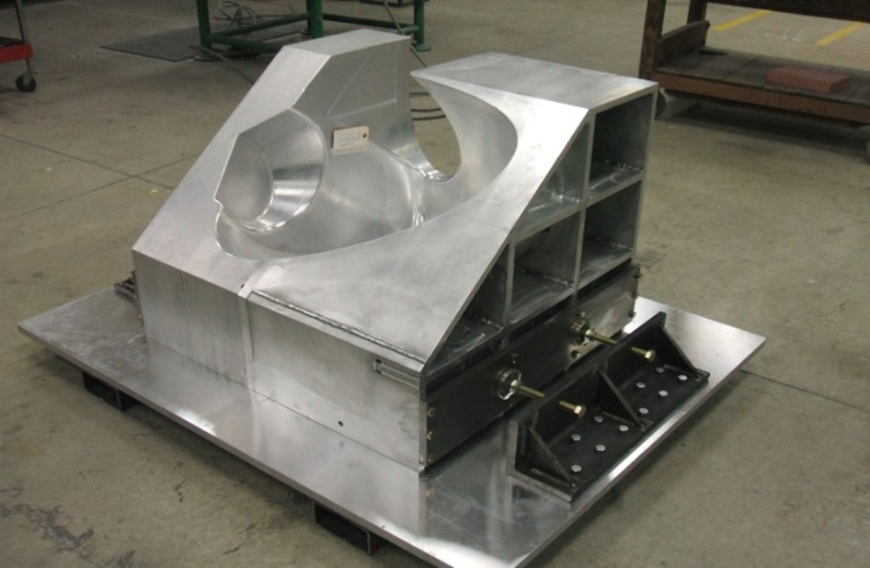
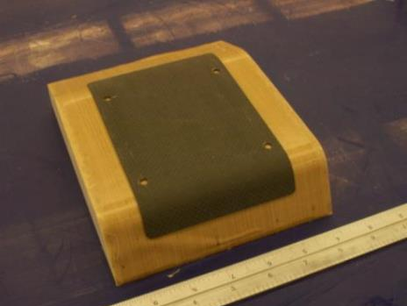
TOOLING MATERIALS
Steel
Invar
Composite
Aluminum
Tooling Board
Additive Manufactured
Notes:
The most commonly used mold materials are steel, Invar (an alloy of steel that has the same CTE as carbon fiber composite), composite materials (for moderate numbers of parts), aluminum (moderate number of parts), and tooling board (for prototypes). Tools can also be made by additive manufacturing. Additive is new but is proving to be a wonderful way to avoid the high costs of machining the tools. The additive tools can be made directly with metal or with composites.

Slide 29
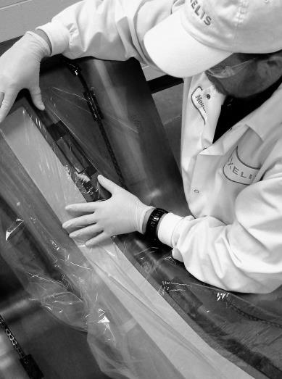
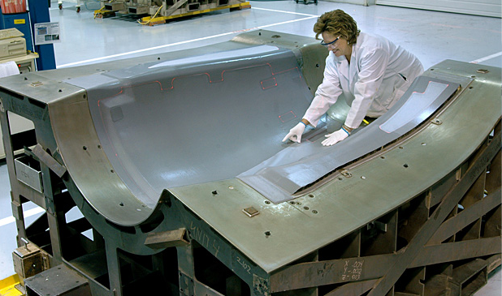
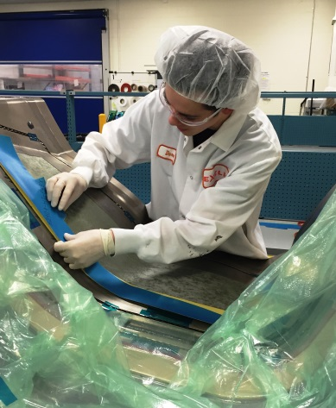
TOOLING
Prepping The Mold
Notes:
The molds need to have a mold release added to the surface of the mold to help the molded part be separated from the mold. Several types of mold release materials have been successful for composites. These can be waxes or liquids and most need to be cured in an oven to ensure that they fill the surface pores on the mold.

Slide 30
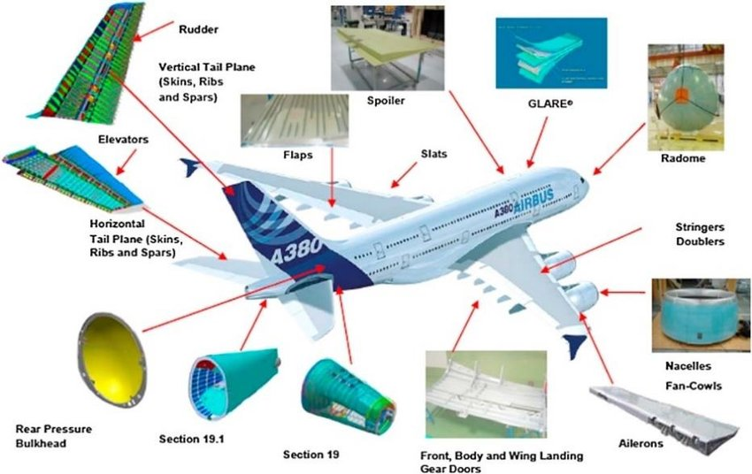
ADHESIVE BONDING
Adhesion Depends Upon Chemical Bonds Across The Interface
Surfaces Must Be Clean And Dry
Application Of Adhesive Should Be Uniform
Adhesive Sheets Often Used In Aerospace
Difficult To Inspect After Parts Are Joined
Adhesive Must Be Cured (Usually In An Oven)
Notes:
When putting the composite parts together to make a large assembly, like an airplane, many of the parts can be joined using adhesives. This is less expensive than mechanical fasteners like rivets or screws and is lighter weight. As of now, however, the government does not allow adhesives to be used to join structural parts of airplanes. Other airplane parts are often adhesively bonded. Sporting goods and most other applications of composites use adhesives.

Slide 31
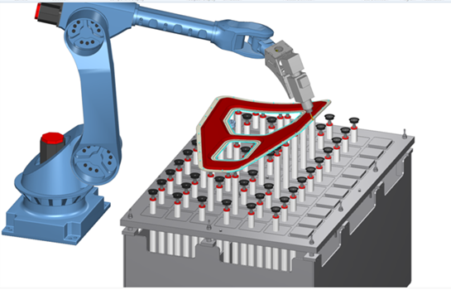
FINISHING
Mechanical
Air-driven Hand Tools, Wet Saws, CNC Router, Machining Center For Trimming Edges
Carbide Or Diamond Grit Burrs And Saw Blades
Special Drill Bits
Water Jet
60,000 Psi
Noisy, Water Collection/ﬁlter, Trailback
Notes:
After composites are molded, they often need to be finished to final shape or surface quality. The most common way to finish composites is with mechanical cutting, often with robots. However, because cured composites are very difficult to machine, water jets are also used, especially when long cuts need to be made.

Slide 32
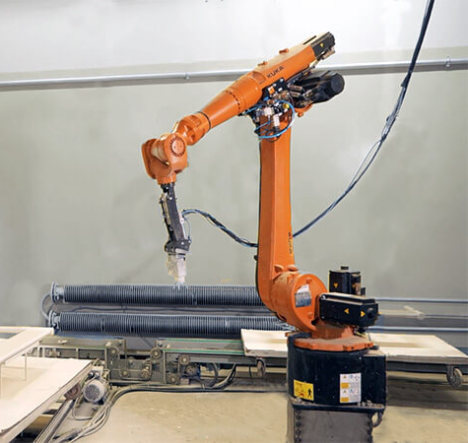
QUALITY CONTROL
Ultrasonic Testing
Notes:
Quality control of composite parts generally looks at both dimensional accuracy of the part and the integrity of the layered structure. The dimensional checks are similar to what would be done with metal or plastic parts. However, the integrity of the layered structure needs to be confirmed using some method that examines through the structure. The most widely used system uses ultrasound. In this system, an ultrasonic signal is sent into the part and the time for the signal to bounce off the opposite edge is measured. If the signal returns too quickly, then some defect is present in the composite and further inspection and perhaps repair must be done.

Slide 33
COST & PRODUCTIVITY OF
COMPOSITE MANUFACTURING METHODS
Labor
Equipment
Tooling
Material
Total time including, for example, preparation, compaction, cutting,
layup, machine operation, and curing
Cost/part
Cycle time
Wet layup
Pultrusion
Wet layup
Pultrusion
Robotic layup
Prepreg layup
Prepreg layup
Robotic layup
Filament winding
Filament winding
Notes:
Comparing all the major methods shows that the costs of labor, equipment, tooling, and materials vary widely among the methods. Similarly, the cycle time for each of the methods is quite different.
In general, if the part can be made by pultrusion, it is the least expensive method. As the part becomes more complex, the need to use a more expensive method becomes greater.

Slide 34
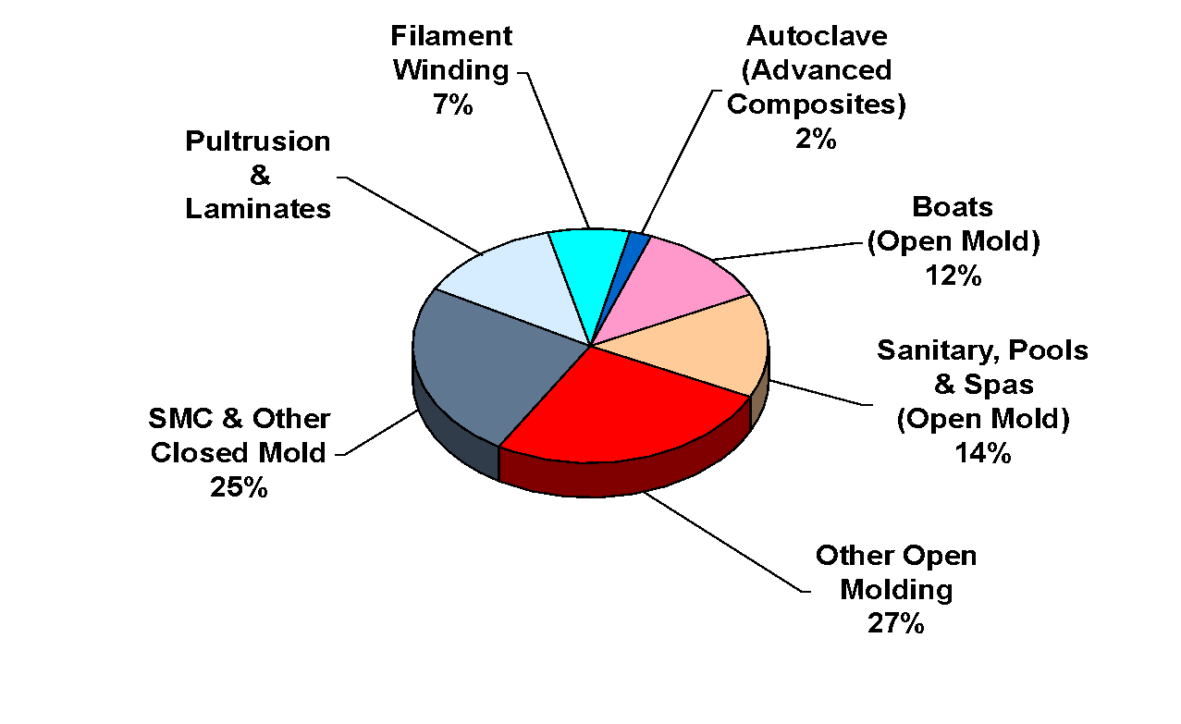
U.S. COMPOSITE MARKET
BY FABRICATION METHOD
13%
Notes:
It is clear that the high-speed manufacturing methods are the most common. These methods generally make fiberglass parts. The advanced manufacturing methods are still quite small percentages of the total. One of the major challenges for advanced composites is to find ways to use high speed manufacturing methods and thus lower the cost of the composites. This is a key to the adoption of advanced materials like carbon fiber into high volume markets.

Slide 35
Thank You
Part 4:
Composites Manufacturing: Making Actual Composite Parts
Notes:
Thank you for being here. See you next time in part 4

Slide 36
Notes:
I am happy that you were here today, and I hope to see you for the next video in this series on composites.

